Slide 1

Secure Programming – Final Project
Truong Quoc Thong (leader)
Luu Thao Vi

Slide 2
Software Architecture
Send data
Decryption
Encryption
Software

Slide 3
Encryption
Padding value
Key
DateTime
Input text
Send
Encrypted Text
HashMD5
Final Text

Slide 4
Send data
FinalText
Send
Receive

Slide 5
Decryption
MD5 Encrypted text
Receive
Hash MD5 Encrypted text
FinalText
Decrypted text
Encrypted text
Date time
Key
Padding value
MD5 Encrypted text
MD5 Encrypted text
Hash MD5 Encrypted text
Text changed

Slide 6
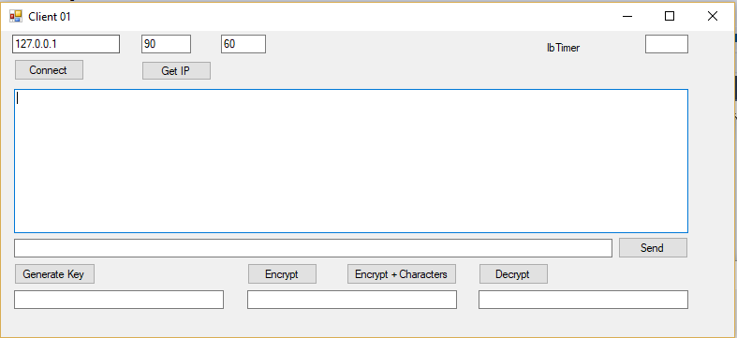
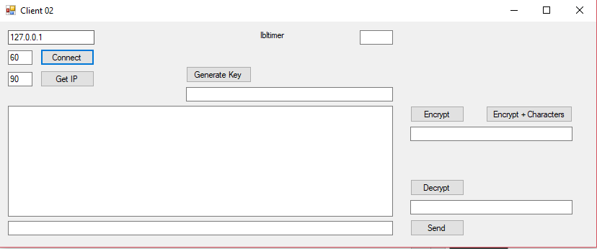
Instructions for use
Click Get IP → Connect

Slide 7
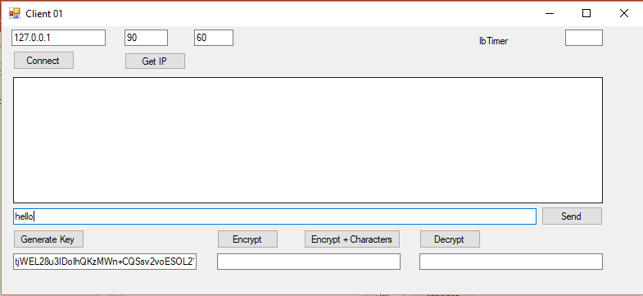
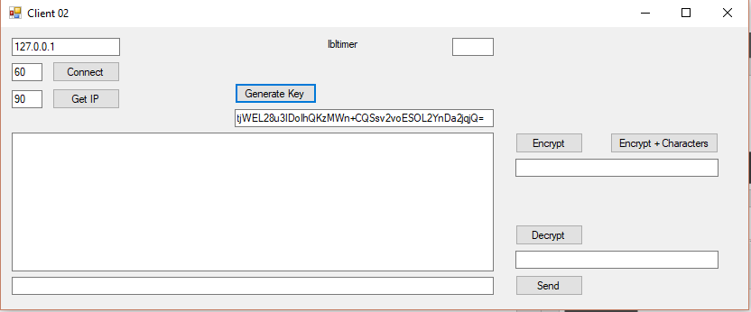
Instructions for use
Click Generate key → Type text

Slide 8
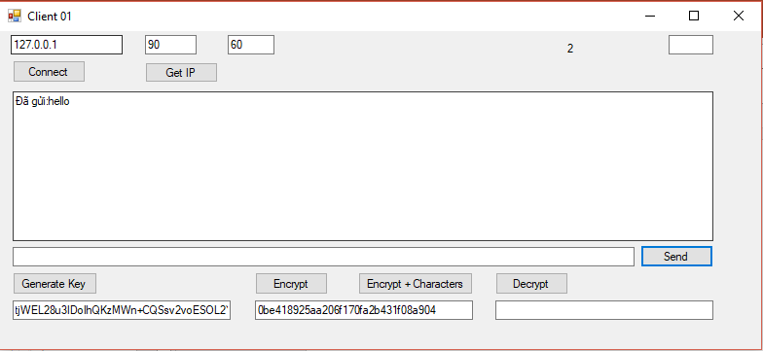
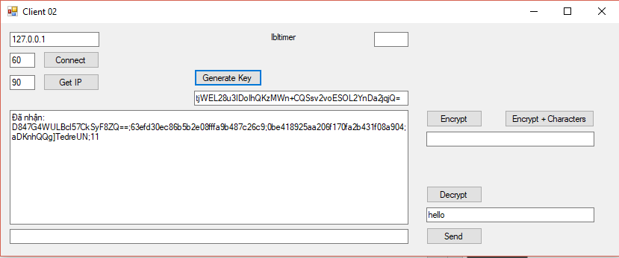
Instructions for use
Click Encrypt → Click Send

Slide 9
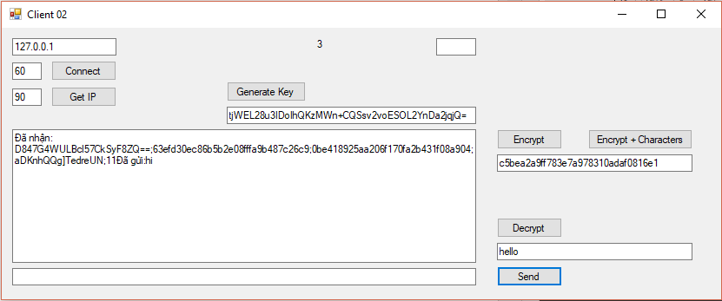
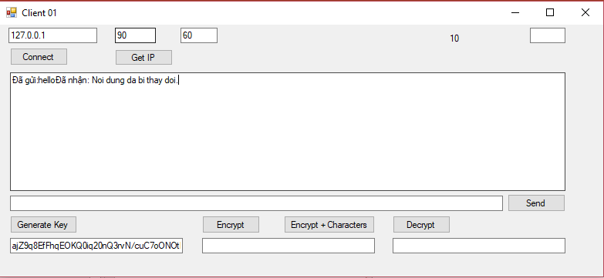
Instructions for use
Whether data has been modified since creation?
Type text → Click Encrypt + Characters → Click Send

