Slide 1
state machine AND ACTIViTY diagram
Lecture: nguyễn Huy Hùng
Group 4
Võ Huy thông
Hà trung kiên
Lâm quang Nhựt
Nguyễn đức nhật anh
Nguyễn hoàng khang

Slide 2
Content
State Machine diagram
Activity diagram
Code demo activity diagram

Slide 3
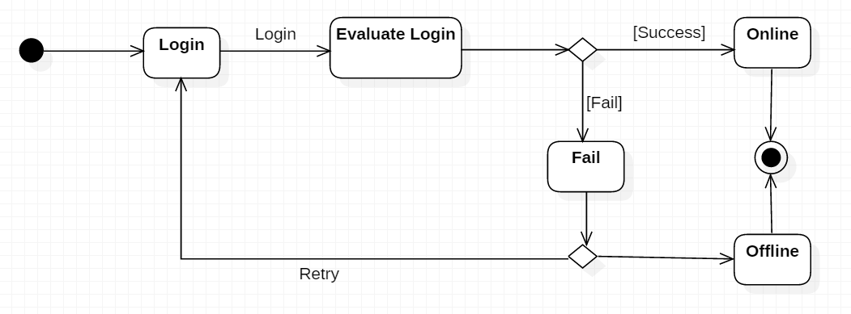
State machine diagram
State machine diagram is a behavior diagram which shows discrete behavior of a part of designed system through finite state transitions.
Notes:
State machine diagram is a behavior diagram which shows discrete behavior of a part of designed system through finite state transitions.

Slide 4



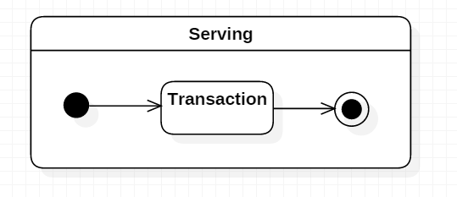
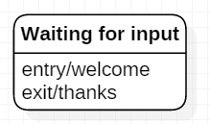
State machine diagram notations
Initial
Simple State
Composite State
Final State
Notes:
- The initial state of a state machine diagram, known as an initial pseudo-state, is indicated with a solid circle. A transition from this state will show the first real state
Firstly, I introduce to you guys some state in state machine diagram
- The final state of a state machine diagram is shown as concentric circles. An open loop state machine represents an object that may terminate before the system terminates, while a closed loop state machine diagram does not have a final state; if it is the case, then the object lives until the entire system terminates.
-A simple state is a state that does not have substates.
-Internal activities compartment holds a list of internal actions or state (do) activities (behaviors) that are performed while the element is in the state.
- Composite state is state that has substates (nested states). Composite state as the state which contains one or more regions. A state is not allowed to have both regions and a submachine

Slide 5
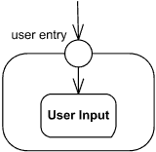
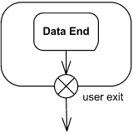
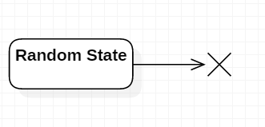
State machine diagram notations
Terminate
Entry Point
Exit Point
Notes:
- Terminate pseudostate implies that the execution of this state machine by means of its context object is terminated. The state machine does not exit any states nor does it perform any exit actions other than those associated with the transition leading to the terminate pseudostate. Entering a terminate pseudostate is equivalent to invoking a DestroyObjectAction
- Entry point pseudostate is an entry point of a state machine or composite state. In each region of the state machine or composite state it has at most a single transition to a vertex within the same region.
- Exit point pseudostate is an exit point of a state machine or composite state. Entering an exit point within any region of the composite state or state machine referenced by a submachine state implies the exit of this composite state or submachine state and the triggering of the transition that has this exit point as source in the state machine enclosing the submachine or composite state.

Slide 6
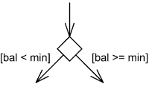
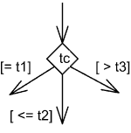
State machine diagram notations
Choice
Notes:
- Choice pseudostate realizes a dynamic conditional branch. It evaluates the guards of the triggers of its outgoing transitions to select only one outgoing transition.
- If more than one of the guards evaluates to true, an arbitrary one is selected. If none of the guards evaluates to true, then the model is considered ill-formed. To avoid this define one outgoing transition with the predefined "else" guard when appropriate.

Slide 7
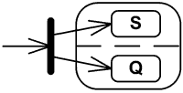


State machine diagram notations
Fork
Join
Junction
Notes:
- Fork pseudostate vertices serve to split an incoming transition into two or more transitions terminating on orthogonal target vertices (i.e., vertices in different regions of a composite state). The segments outgoing from a fork vertex must not have guards or triggers.
- Join pseudostate merges several transitions originating from source vertices in different orthogonal regions. The transitions entering a join vertex cannot have guards or triggers.
- Junction pseudostate vertices are vertices that are used to chain together multiple transitions. They are used to construct compound transition paths between states.

Slide 8
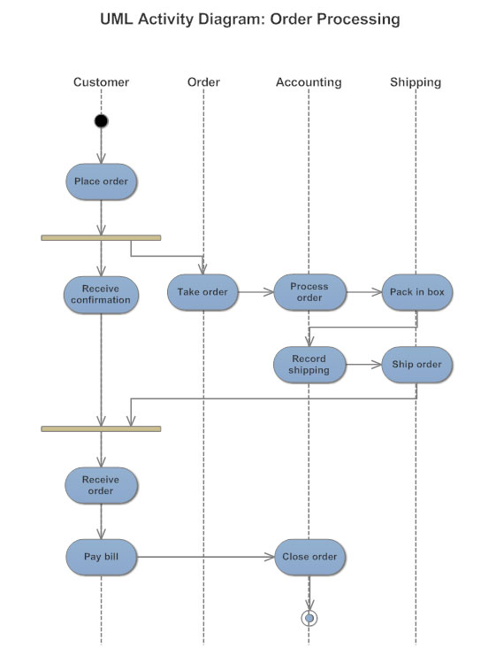
Activity diagram
An activity diagram visually presents a series of actions or flow of control in a system. Activity diagrams are often used in business process modeling.
Notes:
Activity Diagram is a logical model used to model activities in a business process.
An activity diagram visually presents a series of actions or flow of control in a system. Activity diagrams are often used in business process modeling.

Slide 9

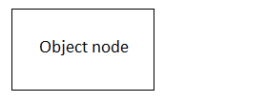
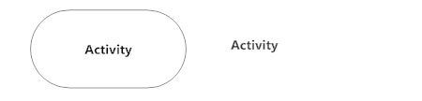



Activity diagram notations
Notes:
Initial State or Start Point
A small filled circle followed by an arrow represents the initial action state or the start point for any activity diagram.
Activity
An action state represents the non-interruptible action of objects
Action Flow
Action flows, also called edges and paths, illustrate the transitions from one action state to another. They are usually drawn with an arrowed line.
Action
A task to be performed
Object Node
Represent an object that is connected to a set of Object Flows
Decisions and Branching
A diamond represents a decision with alternate paths. When an activity requires a decision prior to moving on to the next activity, add a diamond between the two activities. The outgoing alternates should be labeled with a condition or guard expression. You can also label one of the paths "else."

Slide 10
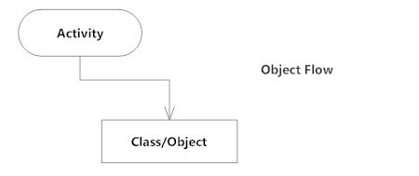
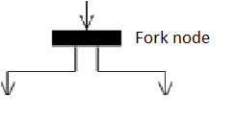
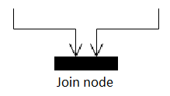
Activity diagram notations
Notes:
Object Flow
Object flow refers to the creation and modification of objects by activities. An object flow arrow from an action to an object means that the action creates or influences the object. An object flow arrow from an object to an action indicates that the action state uses the object.
Fork Node
Split behavior into a set of parallel or concurrent flows of activities (or actions)
Join Node
Bring back together a set of parallel or concurrent flows of activities (or actions).

Slide 11
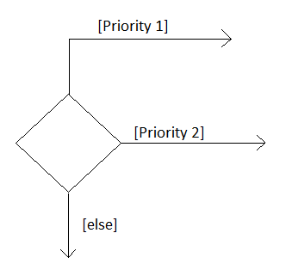
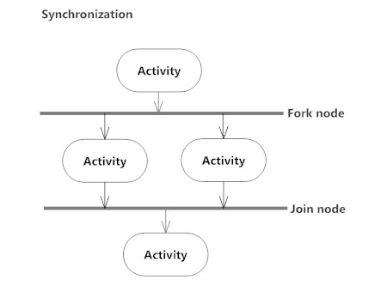
Activity diagram notations
Notes:
Guards
In UML, guards are a statement written next to a decision diamond that must be true before moving next to the next activity. These are not essential, but it is needed before moving forward.
Synchronization
A fork node is used to split a single incoming flow into multiple concurrent flows. It is represented as a straight, slightly thicker line in an activity diagram.
A join node joins multiple concurrent flows back into a single outgoing flow.
A fork and join mode used together are often referred to as synchronization.

Slide 12
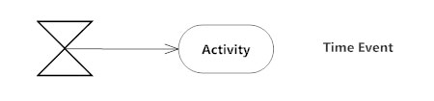
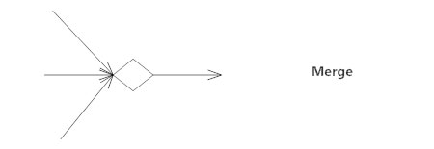
Activity diagram notations
Notes:
Time Event
This refers to an event that stops the flow for a time; an hourglass depicts it.
Merge Event
A merge event brings together multiple flows that are not concurrent.

Slide 13
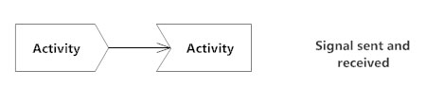
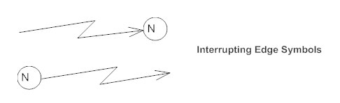

Activity diagram notations
Notes:
Sent and Received Signals
Signals represent how activities can be modified from outside the system. They usually appear in pairs of sent and received signals, because the state can't change until a response is received, much like synchronous messages in a sequence diagram. For example, an authorization of payment is needed before an order can be completed.
Interrupting Edge
An event, such as a cancellation, that interrupts the flow denoted with a lightning bolt.
Swimlanes
Swimlanes group related activities into one column.
Final State or End Point
An arrow pointing to a filled circle nested inside another circle represents the final action state.

Slide 14
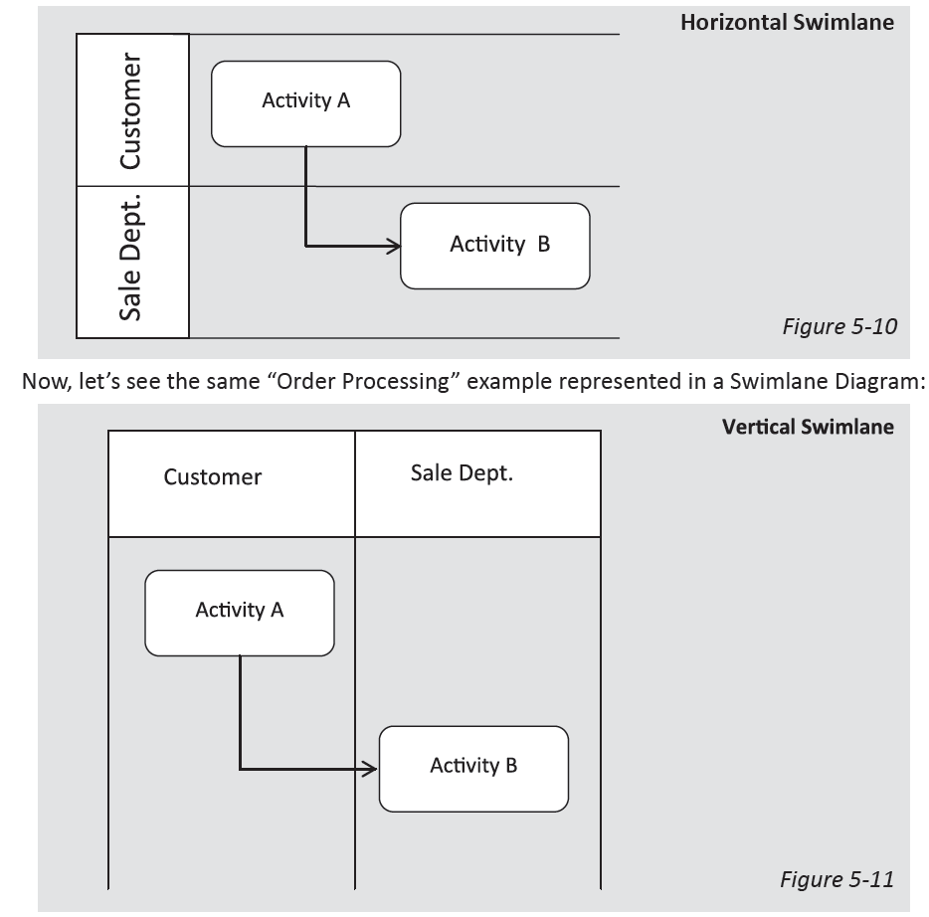
Activity diagram notations
Swimlane
Notes:
Swimlane
A swimlane is a way to group activities performed by the same actor on an activity diagram or activity diagram or to group activities in a single thread.

Slide 15
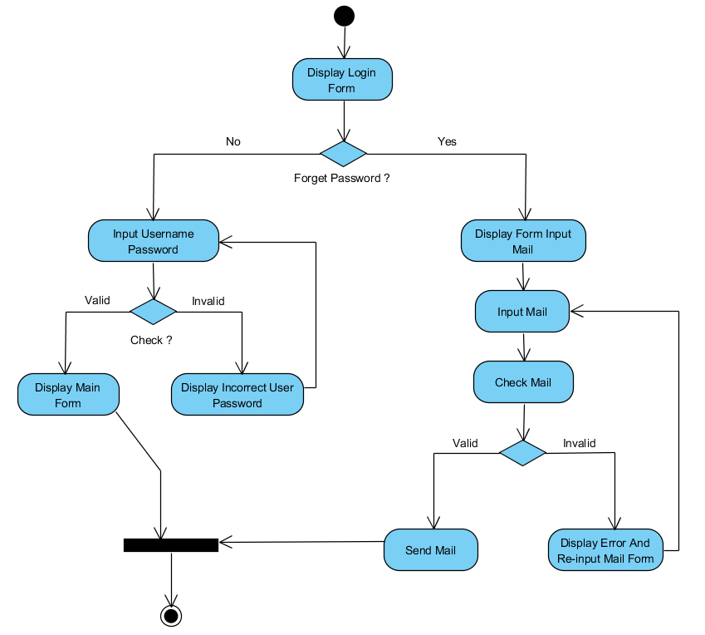
Demo

Slide 16
references
https://www.smartdraw.com/activity-diagram/#whatisActivityDiagram
https://www.visual-paradigm.com/guide/uml-unified-modeling-language/what-is-activity-diagram/
http://mohamedelgendy.com/blog/business-analysis/business-process-modeling.html

Slide 17


