Slide 1
LAB4
VIRTUOSO

Slide 2
Outline
Virtuoso setup
Create Library
Schematic
Run Spectre simulation

Slide 3
1. Virtuoso setup
Step 1: Create and change directory to “layout_env” folder. In this Lab 4, we will work at this place:
%> cd /home/vlsi_group??/vlsi/${Student_ID}/work/layout_env
Step 2: Copy Sample Environment Kit from Cadence to each of your synthesis working folder
%> cp –rf /home/share_file/cadence/pdk/ pdk

Slide 4
1. Virtuoso setup
Step 3: Get license and start virtuoso with a executable file:
Create a file called “go_vir” with the content as follows:
#!/bin/bash –f
cd pdk/gpdk045_v_6_0/
cd /home/share_file/cadence/
source add_path
source add_license
cd –
virtuoso &

Slide 5
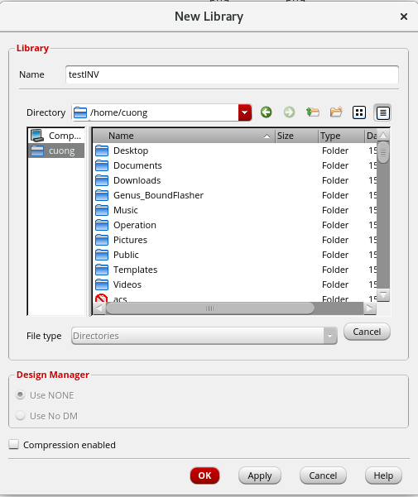
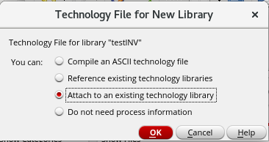
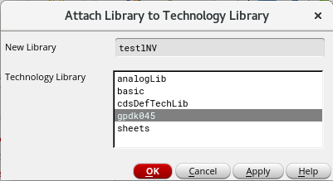
2. Create Library
Step 1: Open Tools → Library Manager
Step 2: Select File → New → Library and enter a name for the library

Slide 6
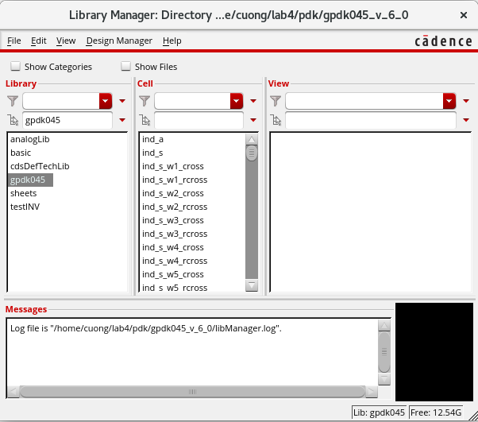
2. Create Library
Step 3: Tools → Library Manager…
Here you can find all your libraries as well as the built-in libraries and their contents.

Slide 7
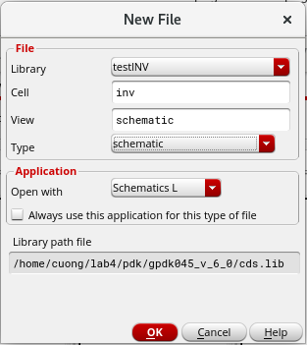
3. Schematic
Step 1: Create a cell view: Select File → New → Cell View
Name the cell “inv” and click OK.

Slide 8
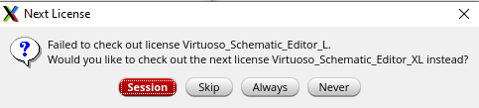
3. Schematic
Note: If this pop up appears, choose Always

Slide 9
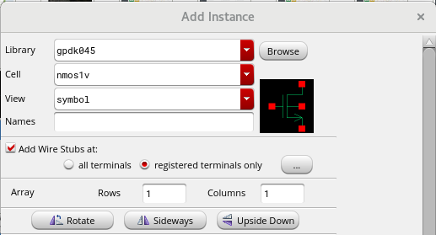
3. Schematic
Step 2: Draw a schematic:
1. select Create → Instance (I) and choose the NMOS transistor

Slide 10
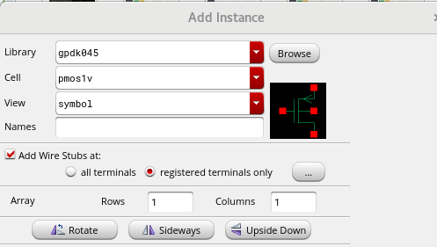
3. Schematic
Step 2: Draw a schematic:
2. select Create → Instance (I) and choose the PMOS transistor

Slide 11
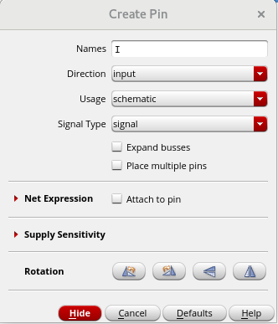

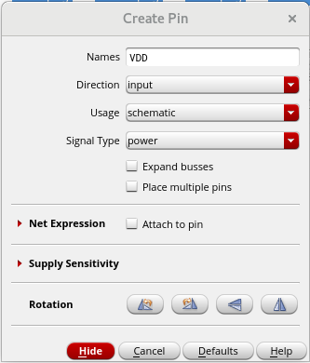

3. Schematic
Step 2: Draw a schematic:
3. To add pin, Select Create → Pin. (P), then add input, output, vdd and gnd

Slide 12
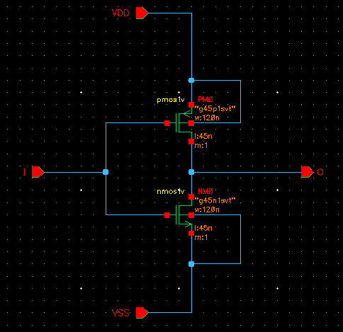
3. Schematic
Step 2: Draw a schematic:
4. Connect the components: Select Create → Wire. (W)
Complete the circuit

Slide 13
3. Schematic
Step 2: Draw a schematic:
5. Check and save: Select File → Check and Save.

Slide 14
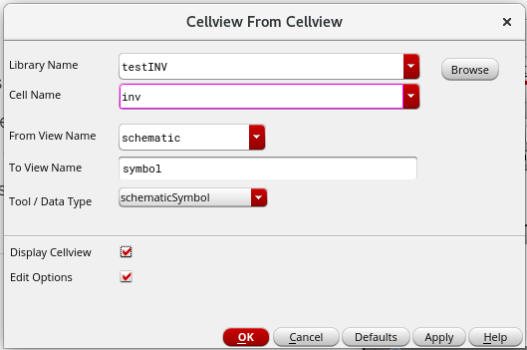
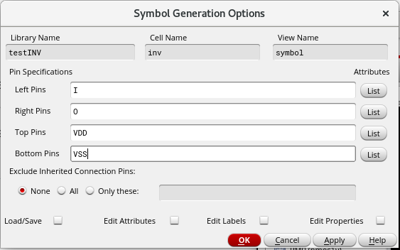
3. Schematic
Step 3: In order to use your cell in a test bench, you first need to create a symbol that represents it.
In order to do that, select Create → Cellview → From Cellview.

Slide 15
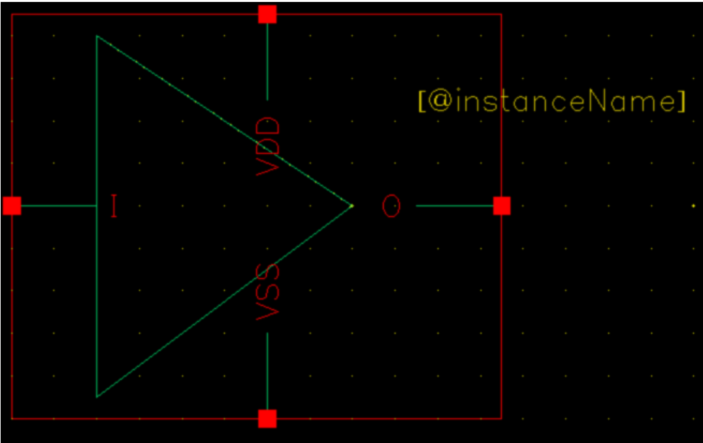
3. Schematic
Step 4: You can modify the symbol by simply delete things that you don’t want, and add the shape by: (from the Symbol Editor) Create → Shape → Line/Rectangle/Polygon/Circle/…

Slide 16
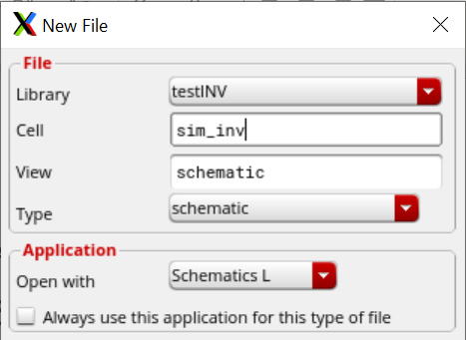
4. Run Spectre simulation
Step 1: To simulate the circuit, we create a new schematic: (from the Library Manager)
File →New → Cellview.
This time, we name it something like sim_inv:

Slide 17
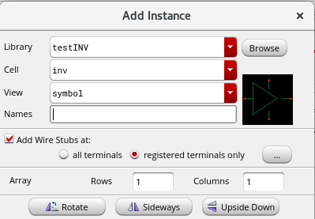
4. Run Spectre simulation
To add the cell inv: press I

Slide 18
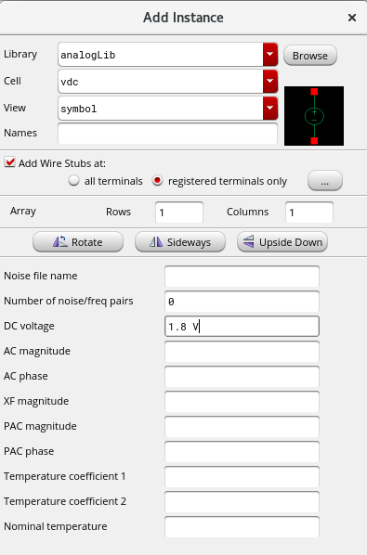
4. Run Spectre simulation
To add VDD and In voltages: press I then browse to vdc in the analogLib library, set DC voltage as 1.8:

Slide 19

4. Run Spectre simulation
To add VSS: press I then browse to gnd in the analogLib library:

Slide 20
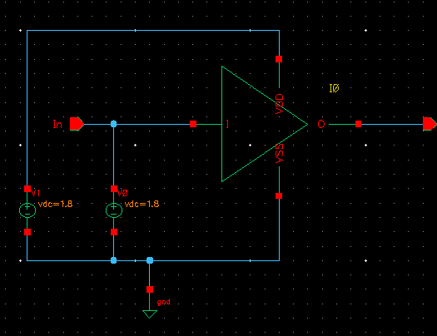
4. Run Spectre simulation
Complete the test circuit.

Slide 21
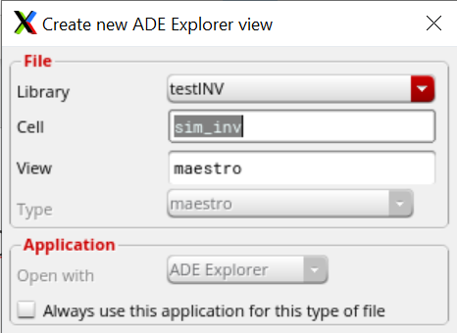
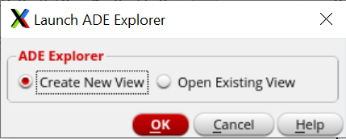
4. Run Spectre simulation
Step 2: Now we will use the tool ADE Explorer to run the analyses.
1. In Schematic Editor, select Launch → ADE Explorer.

Slide 22
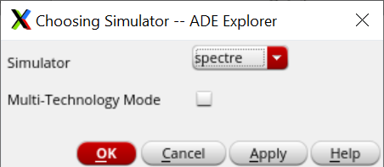
4. Run Spectre simulation
2. From the ADE Explorer,
Setup → Simulator,
then select spectre

Slide 23
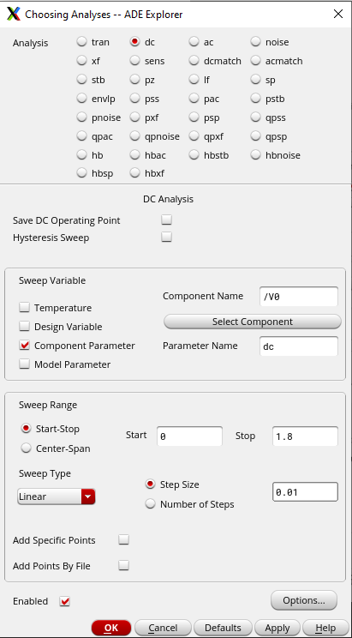
4. Run Spectre simulation
4. To run a simulation, we need to choose the type of analysis. Select Analyses → Choose…
Select as below
Select Select Component and click on V0 vdc on schematic.
The Start point should be 0, the Stop should be 1.8, the Step Size should be 0.01

Slide 24
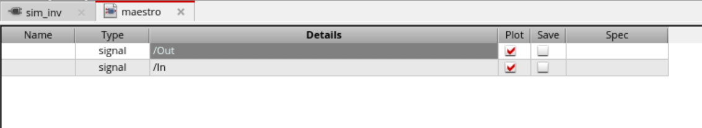
4. Run Spectre simulation
5. Return back to maestro view
Select Outputs → To Be Plotted → Select on Design.
Point to the In and Out pins on schematic

Slide 25
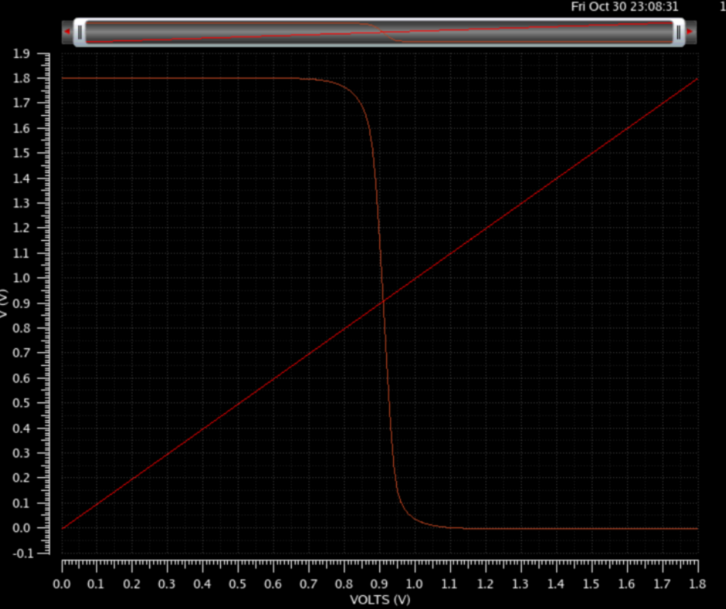
4. Run Spectre simulation
6. To run the simulation, select Simulation → Netlist and Run

Slide 26
5. Submission
This slide just showed an example of an Inverter
Your exercise is to do the same with an And gate (or Or/Nand/Nor gate)
Each individual submit a report with schematics and simulation of those gates.
There must be your comments showing your own understanding of the schematics and simulation result you submitted in your report

