Slide 1

European Union
Institutions and functions

Slide 2
EU institutions
EU in constant evolution
  exercise some sovereignty
  the treaties that have created it
EU institutions in constant evolution
  balance of power among institutions
  new institutions
EU institutions dense and complex
  a triangle of institutions plus the court

Slide 3
Triangle of institutions
European Parliament
  elected by the peoples of the Member States
Council of the European Union
  representing the governments of the Member States
European Commission
  driving force, agenda setter, and executive body

Slide 4
European Commission
Commission proposes EU legislation
Commission oversees and monitors implementation of EU policy
  transposition of EU law into national statute
Commission is
  the guardian of the treaties
  to agitate for the future of European integration

Slide 5
European Commission’s duties
administers EU competition policies
administers Common Agricultural Policy
administers structural funds
plays role in environmental policy
plays role in R&D strategies and programs
regulates workplace health and safety
draws up EU budget
represents EU and member states

Slide 6
European Commissioners (27)
Appointed by member states for 5-year term
President nominated by the European Council
President and entire commission approved by the European Parliament
President assigns each commissioner a portfolio of precise tasks

Slide 7
European Commissioners (27)
A college of equals
  broad participation in collective debate
  Commission votes only when there’s no consensus
are all required to swear
  “to be completely independent in the performance of their duties
  “neither seek nor take instructions from any government or from any other body

Slide 8
European Commission
Former president Santer claimed that the Commission would “do less and better”
  Commission did do less, but not better
conflict with European Parliament
  Parliament threatened to refuse discharge to the 1996 annual budget
  entire commission resigned collectively

Slide 9
Council of the EU
Co-decides with the European Parliament
  trade and economic matters
  justice and home affairs
  foreign and security policy
composed of ministers empowered by member states’ government
where member states express preferences

Slide 10
Council of the EU
Different councils in practice
  foreign ministers (General Affairs Council)
  economics and finance ministers
  agriculture ministers
  multiplicity of different councils
  90 council meetings per year on average

Slide 11
Council of the EU
Complex decision rules:
unanimity
simple majority
qualified majority voting (232/321)
  distributes voting power according to the relative size of different member states
  largest countries have 27-29 votes
  smallest countries have 3-4 votes

Slide 12
Council of the EU
Committee of Permanent Representatives
  member state ambassadors to the EU
  their deputies and top staff
secretariat (administrators, legal linguists, etc)
150 to 200 lower-level working committees
mysterious internal processes
  bilateral and multilateral discussions

Slide 13
Presidency of the Council
Presidency of the Council of the EU
  rotates among member states every 6 months
  oversees Council-Commission relationships
  coordinates Council-Parliament interactions
  presides over and prepares the European Council summits
  speaks for the EU externally on foreign policy matters (excepting trade)

Slide 14
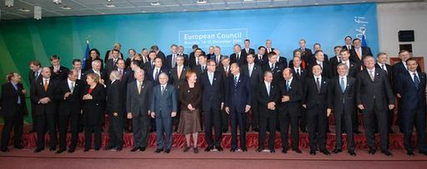
The European Council
Institutionalization of regular meetings of EU heads of state and government

Slide 15
The European Council
the EU’s “board of trustees”
  supplements the strategic capacities of the triangle of institutions
usually 2 summits during each 6-month presidency of the Council of Ministers
  presidents or prime ministers
  plus one other minister (usually the foreign minister)

Slide 16
Evolution of power balance
Council of the EU gains power
  at the expense of the European Commission
Council of the EU tends to pass decision-making tasks upward
  European Council summits
bilateral agreements between member states
  bypass EU institutions altogether

Slide 17
European Parliament
growing power and influence
Members of European Parliament
  have been directly elected since 1979
  5-year terms
  run on national party tickets
785 seats allocated among member states
  number of seats for each country ranges from 99 (Germany) to 5 (Malta)

Slide 18
European Parliament
codecision
  Council and Commission must consult the Parliament
The European Parliament has the right
  to approve all nominees to the Commission
  to remove the entire Commission if a vote of censure passes by a two-thirds margin
  to approve the budget

Slide 19
Members of European Parliam.
European-level party groups
  European Socialists
  Christian Democrats
general commitment to social market economies
  there can be no substitute for market
  welfare state programs and negotiated decisions

Slide 20
European Court of Justice
European Court of Justice
  created in ECSC treaty of 1957
  sits in Luxembourg
  establish the primacy of European law
  major institutional actor in the recognition that European law is superior to and supersedes member state law

Slide 21
European Court of Justice
plenary session when dealing with matters brought by EU institutions or member state
over 3,000 decisions since 1957
“European citizenship”
  right to move and to live in any member state
  right to vote and to be elected in elections
  right to petition the European Parliament
  entitled to full diplomatic protection

Slide 22
EU Decision Making
The Complexities of EU Decision Making
Policy making more complex and confusing because it has to reconcile interests of its 27 member states with those that transcend national boundaries
The institutions are greatly fragmented
Still being built

Slide 23
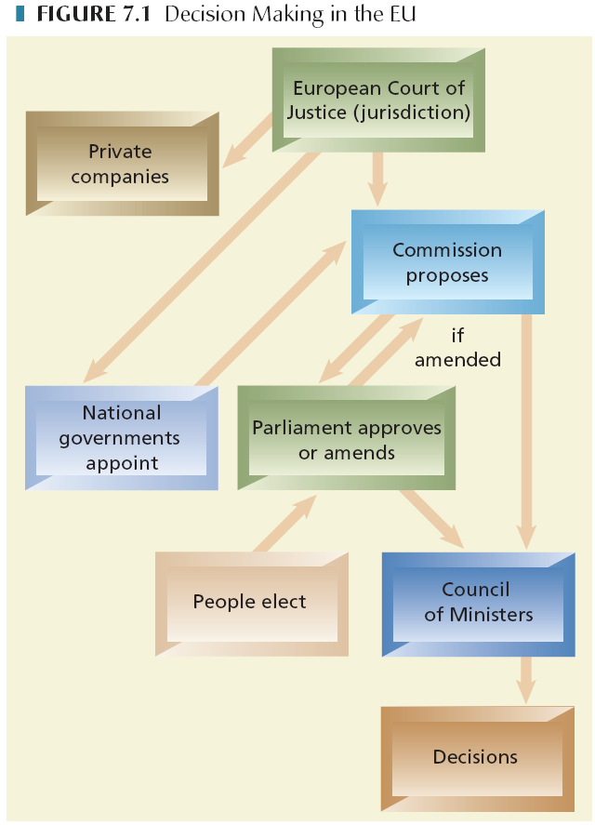

Slide 24
European Central Bank
European Central Bank
  sits atop a system of European central banks
  responsible for monetary policy
  manages the euro
complete autonomy in monetary sphere
  indirectly decides on economic policy

Slide 25
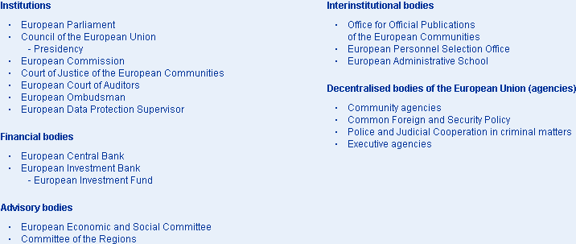
Other EU institutions

