Slide 1
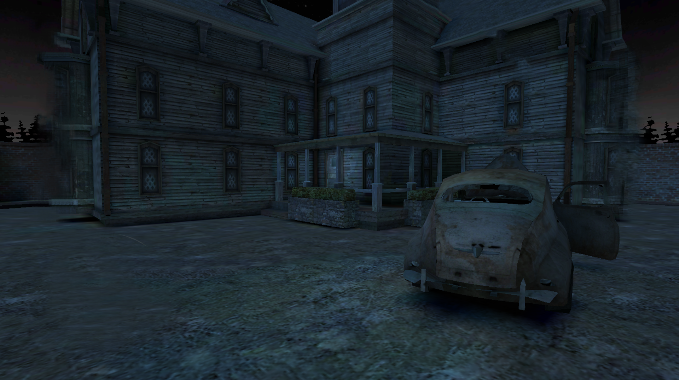

game
ESCAPE ROOM
START
QUIT
V.1.0

Slide 2
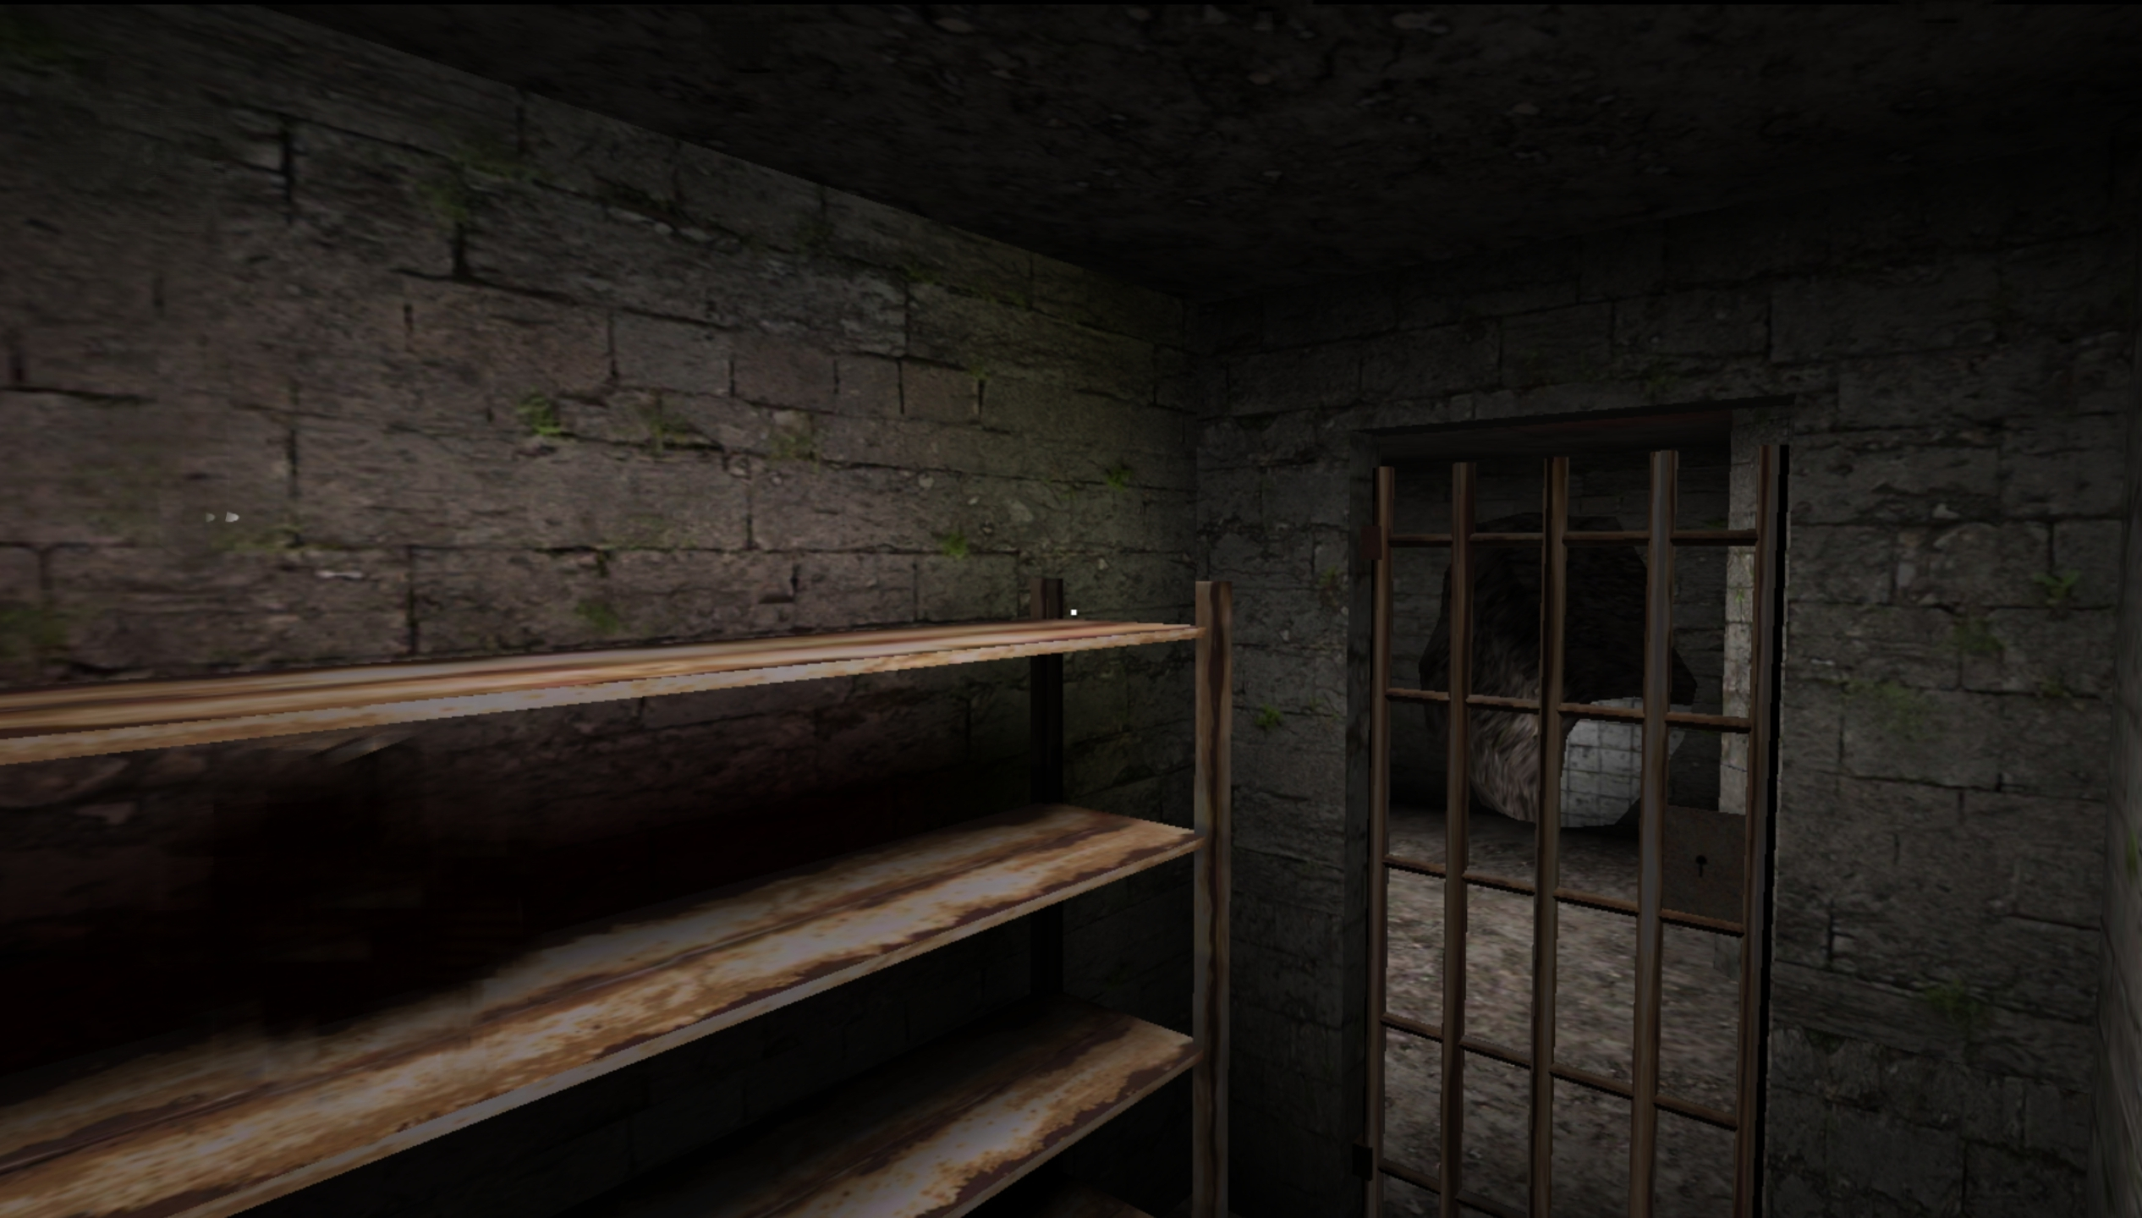

Slide 3
LEVEL I
SIMON GAME
I

Slide 4
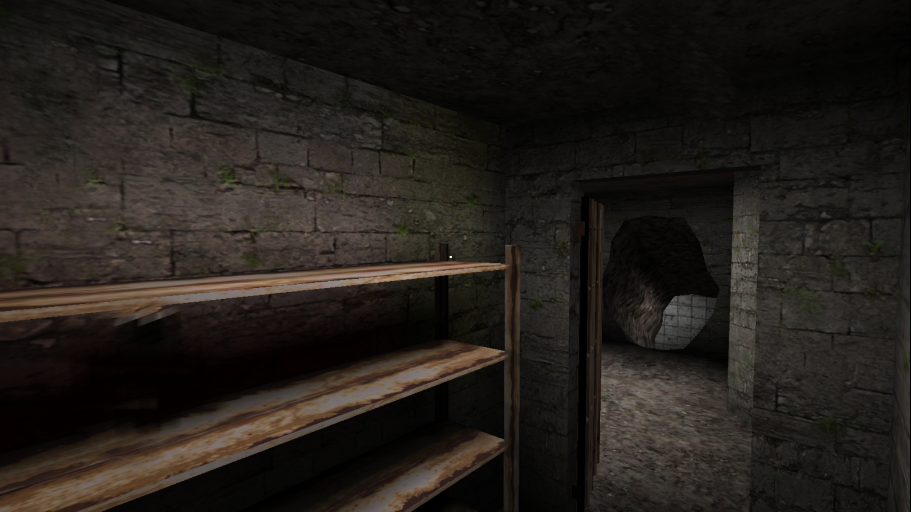

Slide 5
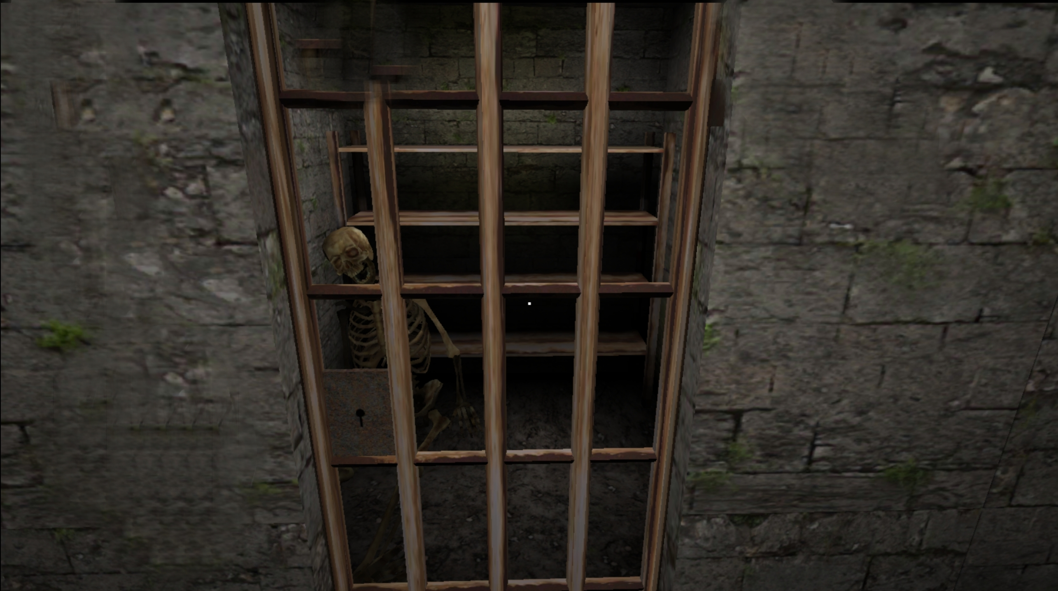

Slide 6

Timer : 00:00
LEVEL I I
MEMORY CARD

Slide 7
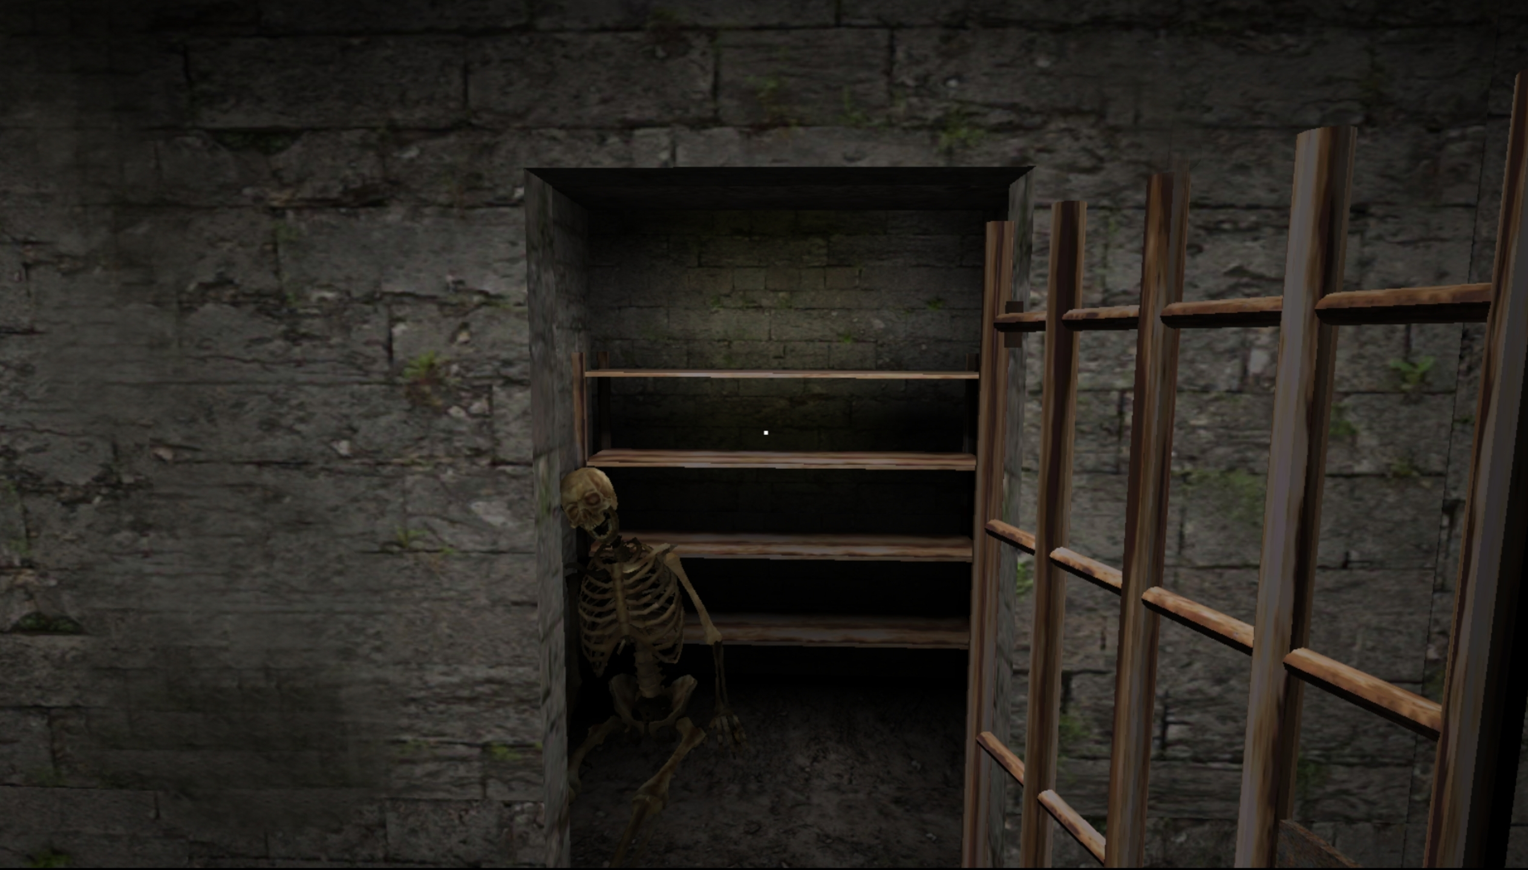


Slide 8
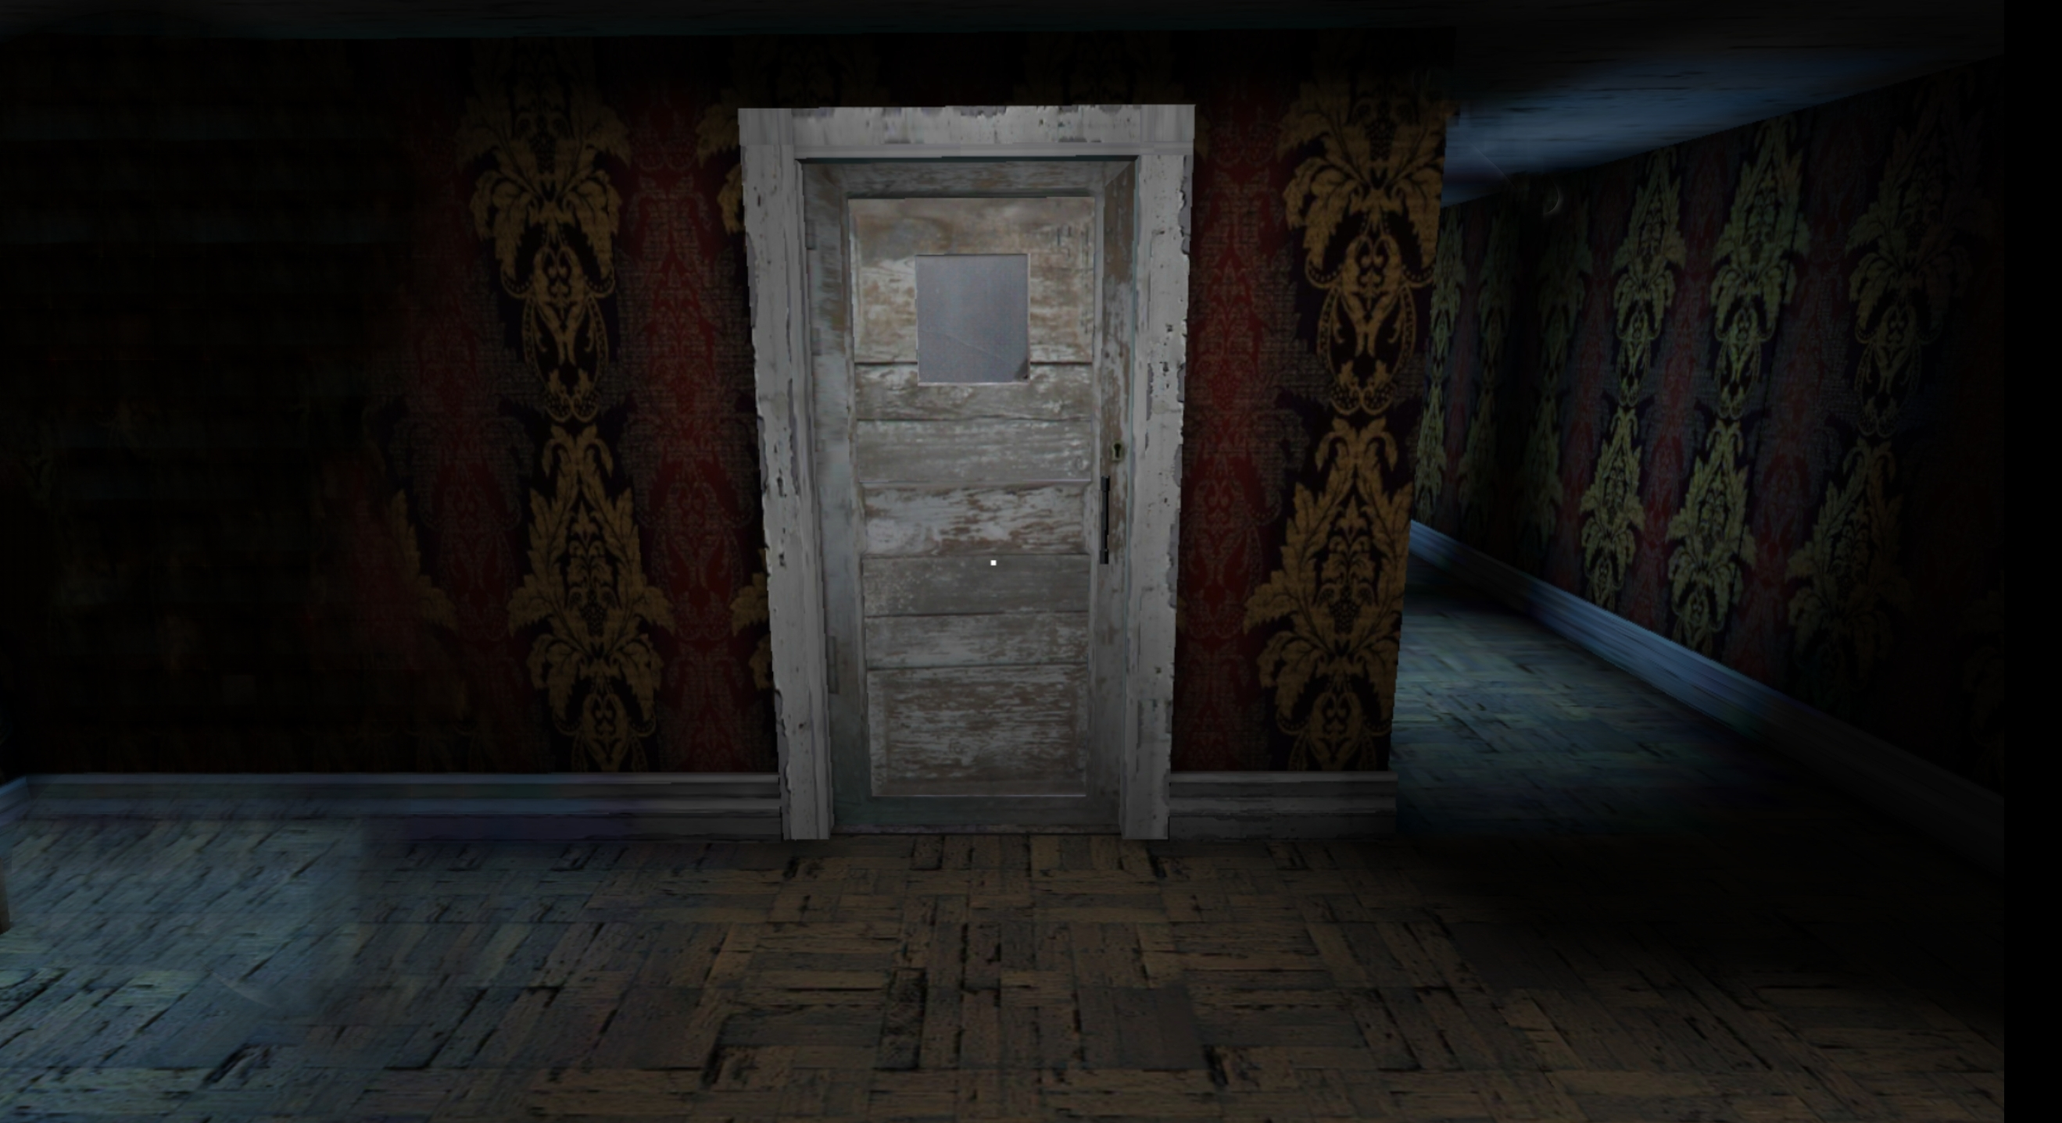

Slide 9

Timer : 00:00
LEVEL I I I
SLIDE PUZZLE

Slide 10
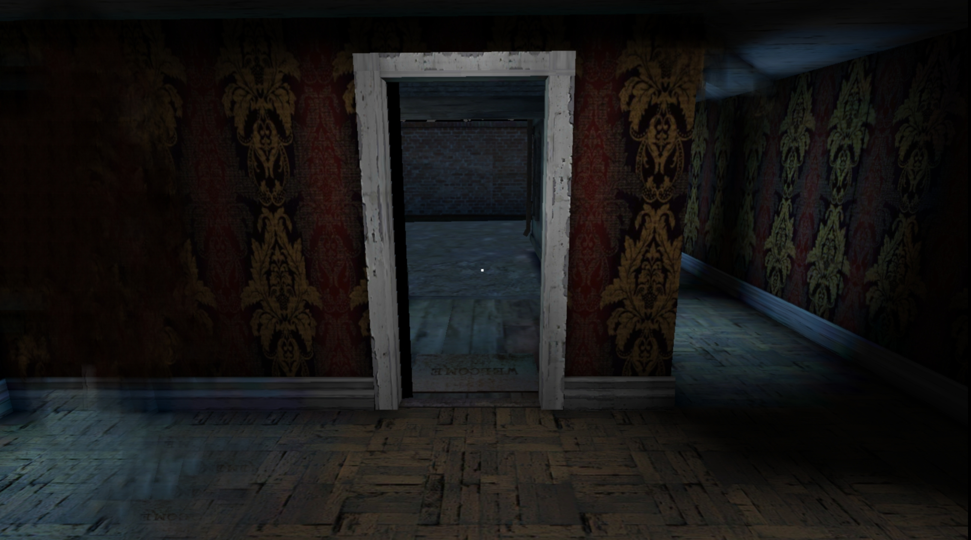
ESCAPE!!!!

Slide 11
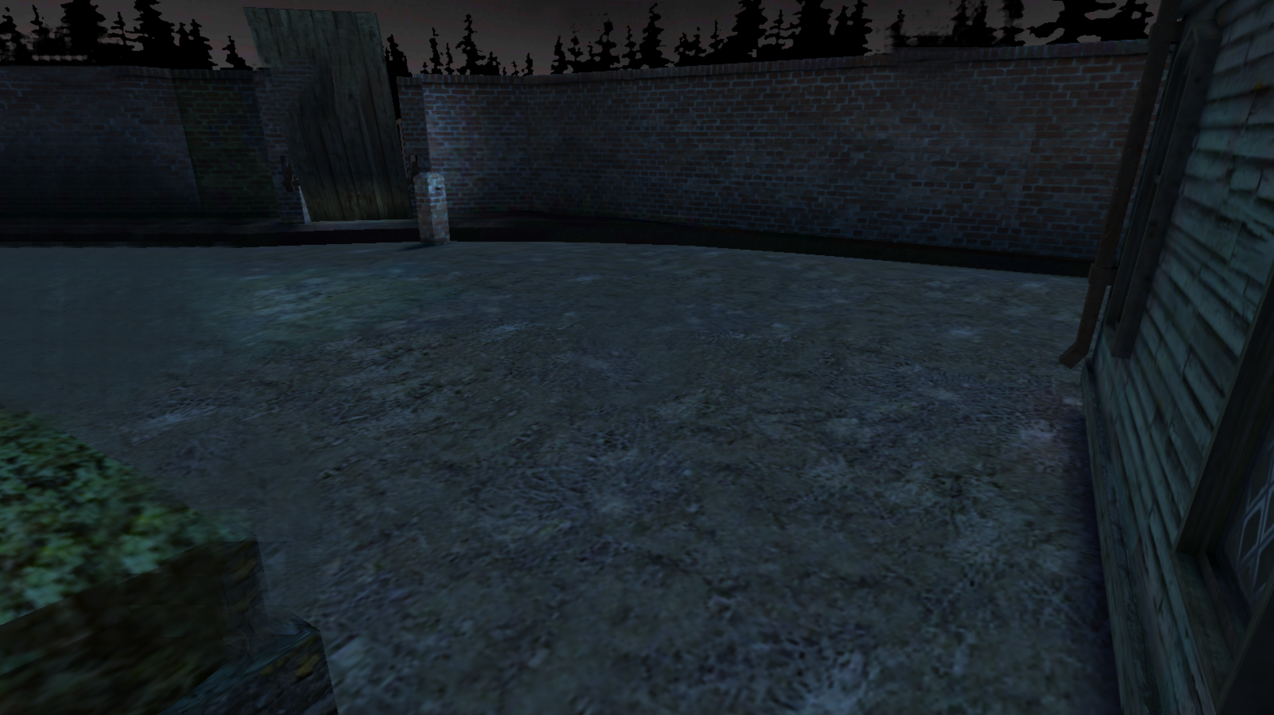
Escaped!!!
Try again
quit
V.1.0

