Slide 1
Semester Project Sudoku Solver
Tho Man

Slide 2
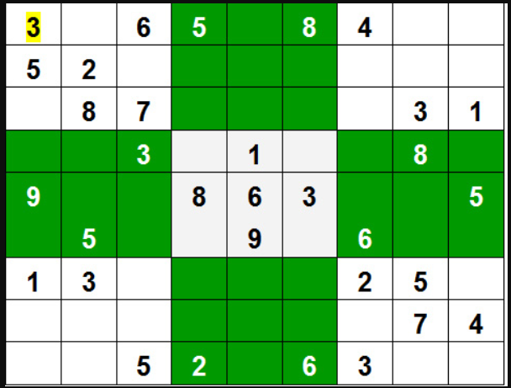
Rule
Given a partially filled 9×9 2D array ‘grid[9][9]’
The goal is:
- To assign digits (from 1 to 9) to the empty cells so that
every row
every column
every subgrid of size 3×3
- Contains exactly one instance of the digits from 1 to 9.

Slide 3
Solution
Backtracking Algorithm:
Find row, col of an unassigned cell
If there is none, return true
For digits from 1 to 9
a) If there is no conflict for digit at row, col
assign digit to row, col and recursively try fill in rest of grid
b) If recursion successful, return true
c) Else, remove digit and try another
If all digits have been tried and nothing worked, return false

Slide 4
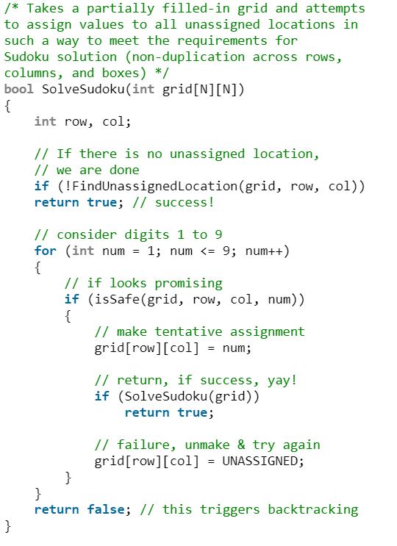
Code Example
Reference: https://www.geeksforgeeks.org/sudoku-backtracking-7/

Slide 5
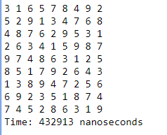
Result

Slide 6
Mission
Optimize Sudoku solver:
-Speed up solving ability to reduce elapsed time
Idea:
-Using multithreading to boost up performance
Technology:
-Programming Language: C++
-Testing on Hardware Configuration: Core i3 8th Gen, 8Gb DDR4 Memory
Goal:
-Elapsed time is improved after multithreading

Slide 7
Red Group (1 thread):
-Attack rows with 3 vectors (check row, column and sub-grid)
Yellow Group (1 thread):
-Attack columns with 3 vectors (check row, column and sub-grid)
Purple Group (9 threads):
-Attack sub-grid with 3 vectors (check row, column and sub-grid)

Slide 8
Red Group (1 thread):
-Attack rows with 3 vectors (check row, column and sub-grid)
Yellow Group (1 thread):
-Attack columns with 3 vectors (check row, column and sub-grid)
Purple Group (9 threads):
-Attack sub-grid with 3 vectors (check row, column and sub-grid)

Slide 9
Red Group (1 thread):
-Attack rows with 3 vectors (check row, column and sub-grid)
Yellow Group (1 thread):
-Attack columns with 3 vectors (check row, column and sub-grid)
Purple Group (9 threads):
-Attack sub-grid with 3 vectors (check row, column and sub-grid)

Slide 10
Red Group (1 thread):
-Attack rows with 3 vectors (check row, column and sub-grid)
Yellow Group (1 thread):
-Attack columns with 3 vectors (check row, column and sub-grid)
Purple Group (9 threads):
-Attack sub-grid with 3 vectors (check row, column and sub-grid)

Slide 11
Final Outcome
-Built successfully
-Code working, but:
+The multi-threaded version works 3 time longer than the original version
+Issue: each group of threads solves a new different board instead of the same board.
-Technical issue:
+Missing MSCVR100.dll in Visual Studio
-> not able to start

Slide 12
Future Features
-Decent user interface: background, sounds and options
-Checking valid boards
-Input valid boards
+By keyboard
+By drag/drop
-Auto generated/randomized board
-Speed statistic

Slide 13
END

