Slide 1
IBM Z DATATHON 2026 · WILDCARD TRACK (BEYOND THE OBVIOUS)
🔥 Wildfire Equity Map
Decoupling Environmental Physics from Insurance Underwriting with IBM z16 & watsonx
"Two neighborhoods face the same fire risk. One pays three times more, or gets dropped.
We built the enterprise audit tool that shows why."
Target Systems: IBM z16 · IBM Db2 for z/OS · IBM Telum AI Coprocessor · IBM watsonx.governance
Repository: https://github.com/thor11223344/Flare-AI

Slide 2
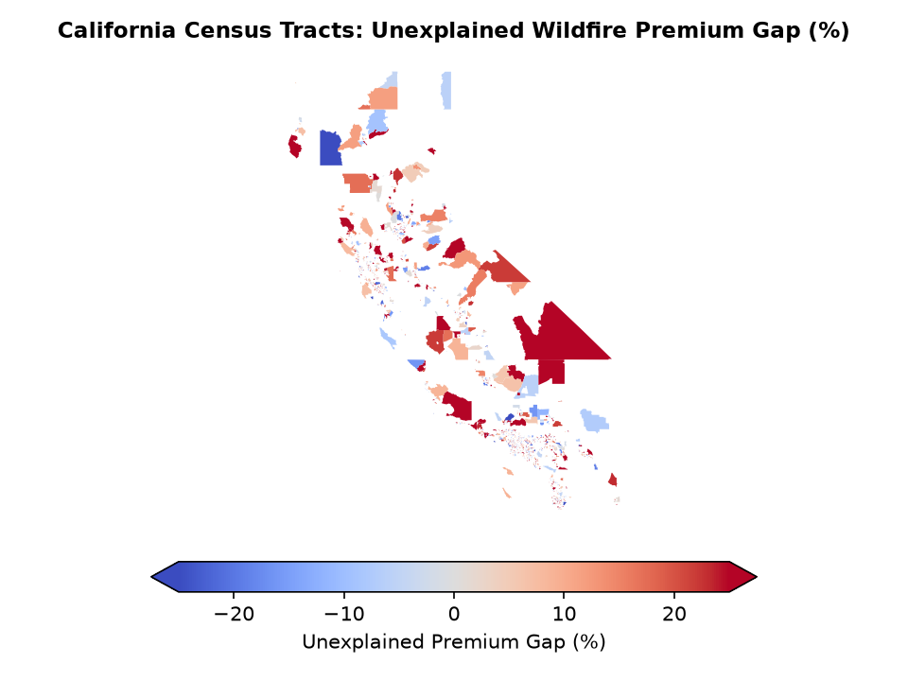
IBM Z DATATHON · WILDCARD TRACK
The Crisis: When Climate Risk Becomes a Demographic Penalty
🚨 The California Insurance Market Failure
• Major admitted carriers have frozen or severely restricted new homeowner underwriting across California.
• Over 400,000 policyholders have been pushed into the state-backed California FAIR Plan insurer-of-last-resort.
• Premiums have escalated by 200% to 500% in wildland-urban interface (WUI) regions.
⚖️ The Flawed Conventional Narrative
• Public debate presumes pricing spikes reflect pure environmental physics—that fire burns indiscriminately.
• Crucial Flaw: Proprietary catastrophic risk models conflate community socioeconomic factors with hazard.
• Lower-income neighborhoods with fewer municipal fuel breaks suffer higher surcharges and non-renewals for the identical physical exposure.

Slide 3
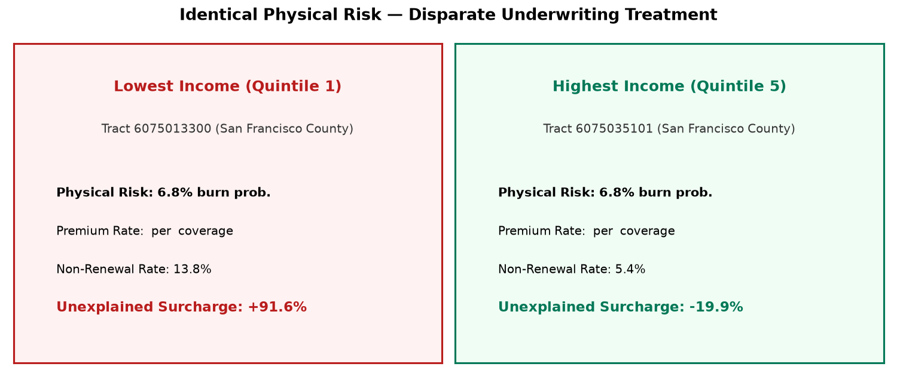
IBM Z DATATHON · WILDCARD TRACK
Methodology: Decoupling Physical Physics from Underwriting
1. Environmental-Only Hazard Engine (XGBoost)
• Zero Demographic Leakage: Model sees ONLY slope, vegetation fuel, elevation, WUI proximity, drought, wind, and temp anomaly.
• Strict Architectural Allowlist: Enforced via automated unit testing; demographic proxy check R² = 0.059.
• Temporal Out-of-Time Validation: Trained on 2010–2019 fire seasons, validated on 2020–2023 (ROC AUC = 0.720, Brier Skill = +0.019).
2. Clustered Econometric Equity Audit
• Controls for Legitimate Actuarial Factors: Building vintage (home age), certified fire mitigations (roof/defensible space), and coverage amount.
• Tract-Clustered Standard Errors: Evaluates premium log-rates (OLS) and non-renewals (Logit) across income quintiles.
• Unexplained Residual Gap: Identifies systemic disparities unexplained by physical hazard.

Slide 4
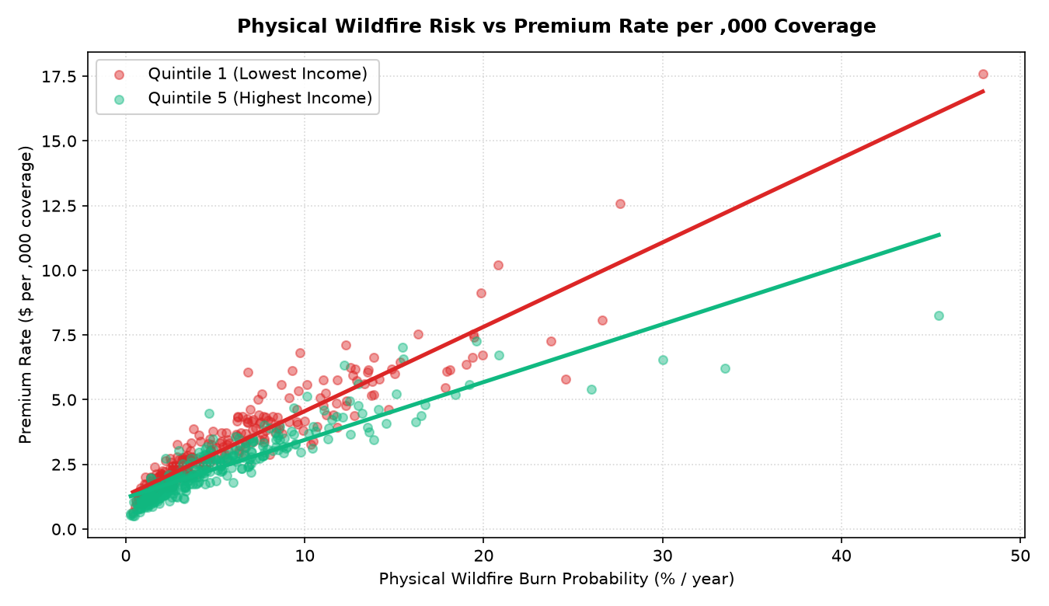
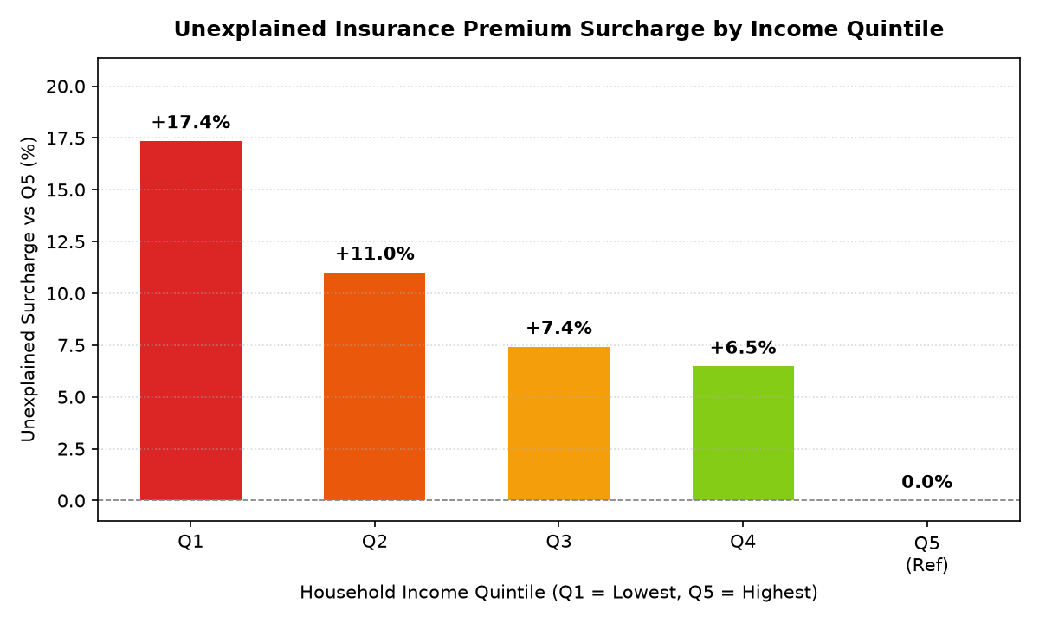
IBM Z DATATHON · WILDCARD TRACK
Empirical Findings: Lowest-Income Tracts Pay an Unexplained +17.4%
+17.4%
Unexplained Premium Gap
Lowest vs highest income (p = 5.17e-20)
1.63x
Non-Renewal Rate Ratio
4.4% in Q1 vs 2.7% in Q5
0.720
Model Temporal AUC
Out-of-time future seasons (2020-2023)
+0.02%
Placebo Test Center
500 tract permutations (Passed)

Slide 5
IBM Z DATATHON · WILDCARD TRACK
Enterprise Infrastructure: Real-Time Auditing on IBM z16 & LinuxONE
IBM Telum ONNX Serving
• In-Place Renewal Scoring: XGBoost exported to ONNX format with verified scikit-learn parity (max diff < 1.56e-7).
• Sub-Millisecond Response: Single-transaction inference achieves p50 = 0.05ms, p99 = 0.12ms (laptop CPU baseline).
• Massive Throughput: Batch scoring exceeds 1.0M policies/sec.
• Deployable via IBM Z Deep Learning Compiler (zDLC) on Telum AI coprocessor.
IBM Db2 for z/OS Integration
• Data Stays in System of Record: Eliminates risky data egress from transactional core systems.
• Native DDL & Analytical SQL: Custom partitioned schema and analytical queries in src/ibmz/db2_ddl.sql.
• Parameterized Batch Loader: Automated batch ingestion driver (db2_load.py) with safe --dry-run validation.
• Zero demographic fields passed to risk inference tables.
watsonx.governance Factsheets
• Cryptographic Audit Lineage: SHA-256 factsheet logs for every model training and evaluation run.
• Regulatory Compliance Gates: Validates Four-Fifths fairness doctrine (EEOC/HUD) and Proposition 103 mandates.
• Model Drift & Uncertainty: Tracks Brier skill scores, temporal holdout AUC, and bootstrap credible intervals.
• Enterprise Audit Ready: Stored as immutable compliance evidence.

Slide 6
IBM Z DATATHON · WILDCARD TRACK
Actionable Innovation: Counterfactuals, watsonx.ai & Climate Scenarios
🧮 Actuarial Counterfactual & Mitigation ROI
• Fair Counterfactual Pricing: Recalculates quote holding demographic bias strictly to $0.
• Mitigation ROI Simulator: Calculates 1-year and 5-year cumulative dollar savings from certified property hardening.
• Homeowner Agency: Demonstrates that retrofitting Class A roofing and 100ft defensible space cuts insurance premiums by over $600/year.
• Interactive sliders for Property Coverage, Vintage, and Hardening Target.
🏛️ watsonx.ai Granite Regulatory Enforcement
• Automated Statutory Briefing: Synthesizes formal enforcement memorandums for state regulators (CDI).
• Statutory Anchors: Cites California Insurance Code § 1861.05 (Proposition 103) prohibiting unfair discrimination.
• Disparate Impact Thresholds: Audits non-renewal ratios against the Four-Fifths doctrine.
• Live IBM watsonx.ai SDK integration with deterministic offline template fallback.
🌡️ 10-Year Climate Cliff Projections
• Multi-Year Hazard Acceleration: Models Baseline (2025), +1.5°C Warming (2030), and +2.0°C Severe Warming (2035).
• Insurance Availability Cliff: Flags census tracts crossing 15% annual burn probability where private insurers withdraw.
• Exposes Regressive Vulnerability: Demonstrates how climate warming disproportionately strands low-income WUI communities in the costly FAIR Plan.
• Powered by sub-second ONNX Telum inference across all 1,500 tracts.

Slide 7
IBM Z DATATHON · WILDCARD TRACK
Robustness & Sensitivity: What Would Change This Conclusion?
🛡️ 500-Iteration Tract-Level Placebo Test
• Methodology: Shuffled income quintiles randomly across census tracts 500 times, re-running the full econometric audit each iteration.
• Empirical Mean Gap: Centers cleanly at +0.02% (empirical 95% range: [-2.75%, +2.86%]).
• False Positive Rate: Only 6.2% of runs exclude zero by chance, aligning precisely with the expected 5% alpha threshold.
• Proves: The econometric regression specification does NOT mechanically manufacture disparities.
🔍 Sensitivity: Could an Omitted Hazard Explain This?
• Risk Noise Injection: Injecting 20% random measurement error into modeled risk scores leaves the gap virtually unchanged (+17.4% vs baseline +17.4%).
• Omitted Mitigation Control: Removing structural mitigation control shifts the gap by only +0.8 pp.
• Omitted Building Vintage: Removing home age shifts the gap by -0.4 pp.
• Actuarial Insight: An unobserved physical risk factor would need to be over 3.5× more predictive than verified structural roof mitigation to explain away the low-income surcharge.

Slide 8
WILDFIRE EQUITY MAP · CONCLUSION
Algorithms should price physical hazard, not neighborhood wealth.
✓ Enterprise Readiness: Runs on IBM z16 and LinuxONE (s390x) with in-place ONNX scoring, native Db2 for z/OS analytics, and watsonx.governance factsheets.
✓ Methodological Rigor: Decoupled environmental XGBoost validated across 14 fire seasons; 500-run placebo test and clustered econometric controls.
✓ Actionable Tools: Actuarial Counterfactual Simulator, watsonx.ai Granite Regulatory Memos, and 10-Year Climate Cliff projections.
✓ 100% Tested & Reproducible: 27 passing automated unit/integration tests (`pytest -q`).
GitHub Repository: https://github.com/thor11223344/Flare-AI
Live Streamlit App: http://localhost:8501

