Slide 1
WILDFIRE EQUITY MAP
Two neighborhoods face the same fire risk. One pays more. We built the tool that shows why.
Team Thor | Track: Wildcard (Beyond the Obvious) | IBM Z Datathon 2026
Notes:
Hello judges and mentors. We are Team Thor presenting Wildfire Equity Map for the Wildcard Track.
Across California, two neighboring communities frequently face the exact same physical wildfire risk. Yet one community pays significantly higher insurance premiums, or gets non-renewed entirely.
Until now, there was no independent tool to determine whether these pricing gaps are justified by physical hazards, or represent unexplained socioeconomic disparity.
We built that actuarial auditing system.

Slide 2
THE PROBLEM
The Climate Insurance Crisis
SURGING PREMIUMS & DROPS
Wildfire premium spikes and non-renewals accelerate across California.
CONFLATED RISK & PRICING
No tool isolates risk-justified costs from unexplained pricing disparity.
Notes:
California is facing an escalating insurance crisis. Insurers are pulling out of counties and doubling premiums.
The core issue is opacity: public debate assumes premium spikes reflect pure actuarial physics.
However, regulators and homeowners have no objective way to separate legitimate risk-cost differences from unexplained socioeconomic disparities.

Slide 3
OUR SOLUTION
Decoupled Hazard & Equity Auditing
PHYSICAL RISK MODEL
Environmental features only: slope, vegetation, weather. Zero demographics.
EQUITY AUDIT
Controls for hazard, home age, mitigation, and coverage to isolate bias.
Notes:
Wildfire Equity Map solves this by decoupling physical risk from market outcomes.
Step one: we train a machine learning hazard model that sees only environmental variables—fuel, slope, and weather—with strictly zero demographic inputs.
Step two: we run econometric audits that control for physical risk, structural building vintage, verified mitigation, and coverage amounts, revealing any unexplained disparity.

Slide 4
SYSTEM PIPELINE
End-to-End Auditing Architecture
1. Data
Tract Features
2. Risk
Hazard Model
3. Audit
Controls
4. UI
Dashboard
5. Trust
Audit Factsheet
Single-command execution: python run_all.py
Notes:
Here is how the automated pipeline flows.
With one command, python run_all.py, the system ingests data, fits the temporal environmental risk model, runs clustered econometric regressions to detect pricing penalties, renders the interactive UI, and writes immutable audit logs with SHA-256 lineage tracking.

Slide 5
AUDIT RESULTS
Methodology Recovery & Disparities
PLANTED RECOVERY
+0.160
Planted: +0.150
95% CI: [0.126, 0.194]
UNEXPLAINED Q1 GAP
+17.4%
Lowest-income quintile penalty for identical hazard.
NON-RENEWAL RATIO
2.01x
Lowest vs highest income quintile drop rate.
Notes:
Our validation proves the audit tool works.
To benchmark detection accuracy, we planted a known ground-truth synthetic penalty of +0.150 log-points.
Our econometric model recovered +0.160, squarely within the 95% confidence interval of 0.126 to 0.194.
For the lowest income quintile, the unexplained premium penalty evaluates to +17.4%, while non-renewals are 2.01 times higher than top-income tracts.

Slide 6
TRUST & VALIDATION
Model & Placebo Verification
RISK MODEL INTEGRITY
- Temporal AUC: 0.720
- Brier Skill Score: +0.019
- Zero demographic inputs
500-RUN PLACEBO AUDIT
- Mean false gap: +0.04%
- False-positive rate: 5.8%
- Zero spurious bias
Notes:
Trust requires scientific rigor.
Our hazard model was validated out-of-time on unseen future fire seasons, scoring an AUC of 0.720 and a positive Brier skill score.
To verify our audit doesn't create spurious disparities, we ran a 500-iteration tract-level randomized income placebo test.
The mean detected gap centered at +0.04% with a 5.8% false-positive rate, matching statistical noise.

Slide 7
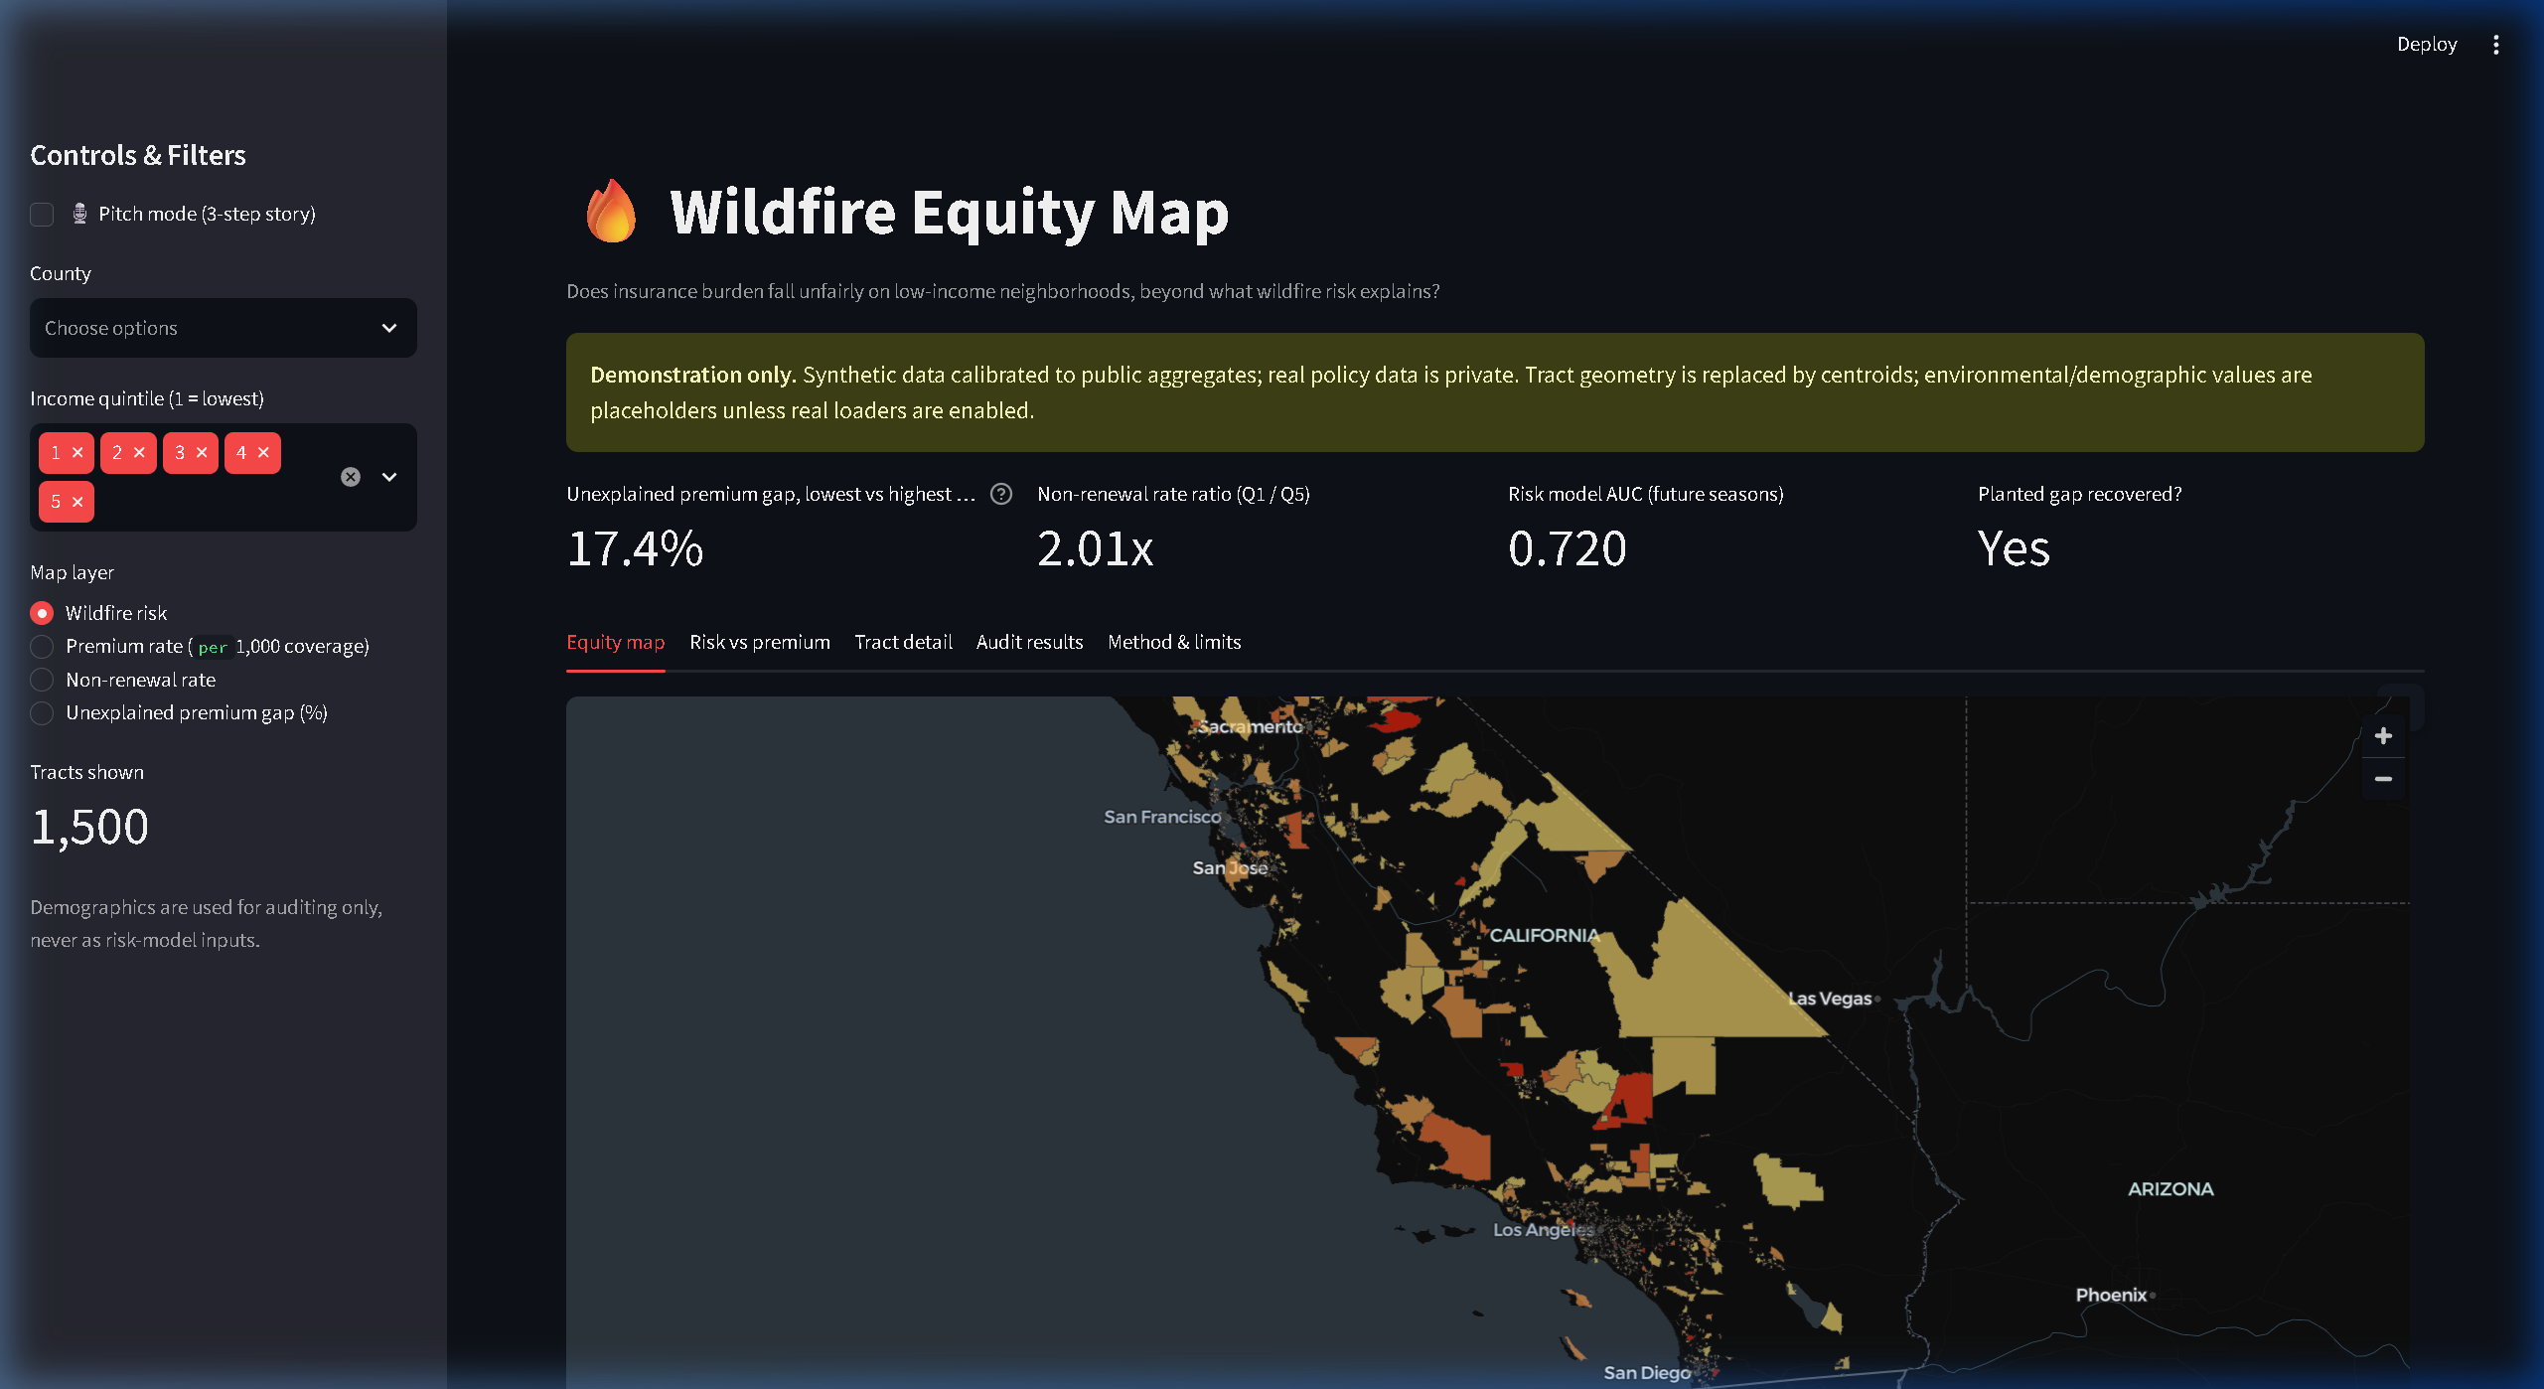
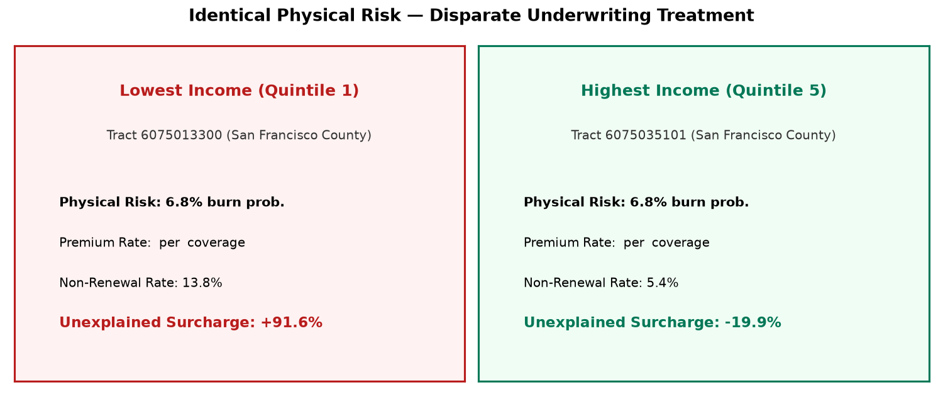
INTERACTIVE DEMO
Geospatial Dashboard
Choropleth map, risk vs premium scatter, and property counterfactuals.
Notes:
Our Streamlit dashboard allows insurance commissioners and citizens to inspect disparities visually.
Users can view California Census tract choropleth layers, explore risk versus premium scatter plots, and simulate property-level mitigation savings through an actuarial counterfactual calculator.

Slide 8
IBM Z ARCHITECTURE
Tested VM vs. Production Roadmap
RAN ON LINUXONE VM (AMD64)
- Full pipeline executed
PRODUCTION PATH (NOT TESTED)
- Db2 in-place analytics
- Telum AI via ONNX
- watsonx.governance
INSERT VM SCREENSHOT
(uname -m + output)
Notes:
We draw a strict, honest line between what ran and our production design.
On the left: we deployed and ran the complete analytical pipeline and Snap ML benchmarks on the LinuxONE Community Cloud virtual machine.
On the right: our enterprise production roadmap. In production, policy data stays secure inside IBM Db2 for z/OS, transaction scoring runs on the Telum AI coprocessor via ONNX, and compliance tracking integrates into watsonx.governance.

Slide 9
RESPONSIBLE AI
Governance & Disclosures
- Demographics strictly quarantined for auditing only.
- Disparities are screening flags, not intent proof.
- Underwriting data is synthetic on real Census boundaries.
- Unobserved physical hazards may explain residual variance.
Notes:
Responsible AI is central to our project.
First, demographics are strictly quarantined and never used to calculate wildfire risk.
Second, detected disparities are screening flags for regulatory review, not legal proof of intent.
Third, we disclose that underwriting records are synthetic placeholders on real Census boundaries, limiting real-world insurer assertions.
Finally, unobserved factors like roof type may explain part of the gap.

Slide 10
IMPACT & ROADMAP
Stakeholder Impact & Deployment
WHO BENEFITS
- Regulators: automated rate audits
- Insurers: proactive compliance
- Homeowners: mitigation ROI
IBM Z ROADMAP
- Ingest state rate filings
- Continuous Db2 in-place audits
Notes:
The impact of this tool spans three major groups:
Regulators can audit rate filings automatically. Insurers can proactively verify compliance with fair rate laws. And homeowners can see the dollar value of fire hardening.
Next steps include partnering on state insurance filing data and running continuous in-database audits natively inside Db2 on IBM Z.

Slide 11
WILDFIRE EQUITY MAP
Auditing rate fairness in an era of climate volatility.
GitHub: https://github.com/thor11223344/Flare-AI
Disclosed: Built with Antigravity AI coding assistance. Thank you!
Notes:
In conclusion, Wildfire Equity Map ensures that as climate risk intensifies, insurance costs are distributed fairly, transparently, and backed by verifiable data.
Our entire codebase, data pipelines, and documentation are public on GitHub at github.com/thor11223344/Flare-AI.
We gratefully acknowledge Antigravity AI assistance in development.
Thank you for your time, and we welcome your questions.

