Slide 1
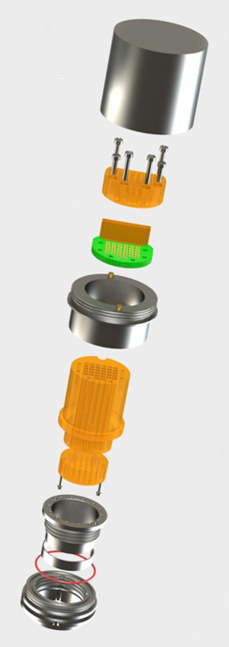
This is the 32 channel microdrive. We used 2 of these on Betty.
See the Gray et al., 2007 paper for the method used for Clark.

