Slide 1
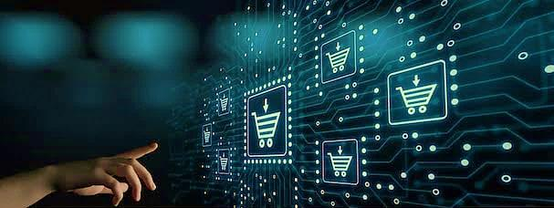
ONLINE SHOPPING PREDICTION USING SVM
Prepared by:-
Kirti Chiplunkar 15
Sonal Dimbar 19
Stuti Thorat 74

Slide 2
Problem Statement
Predicting the needs and behavior of the customers in online shopping using Support Vector Machine
Area: Machine learning

Slide 3
Introduction
Predicting customer behavior in the context of e-commerce is becoming more important nowadays. Customers are increasingly demanding and expect the highest quality service at any time.
On the other hand, online retailers need to be know their customers and to predict their needs.
So a Support Vector Machine(SVM) classiﬁer is applied to predict the probability of making an online purchase.

Slide 4
Objective
To effectively predict whether purchase will be made or not during next visit.
To successfully implement the test model based on training set as supervised learning approach.
To generate accurate results based on the given inputs.

Slide 5
Support Vector Machine
Support Vector Machine (SVM) is a supervised machine learning algorithm which can be used for both classification or regression challenges.
An SVM model is basically a representation of different classes in a hyperplane in multidimensional space.

Slide 6
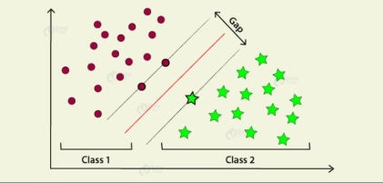
Example Of SVM

Slide 7
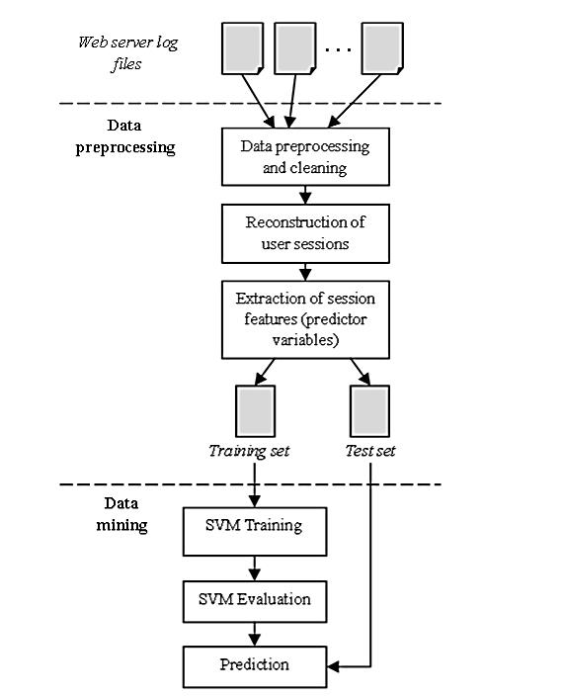
Architecture

Slide 8
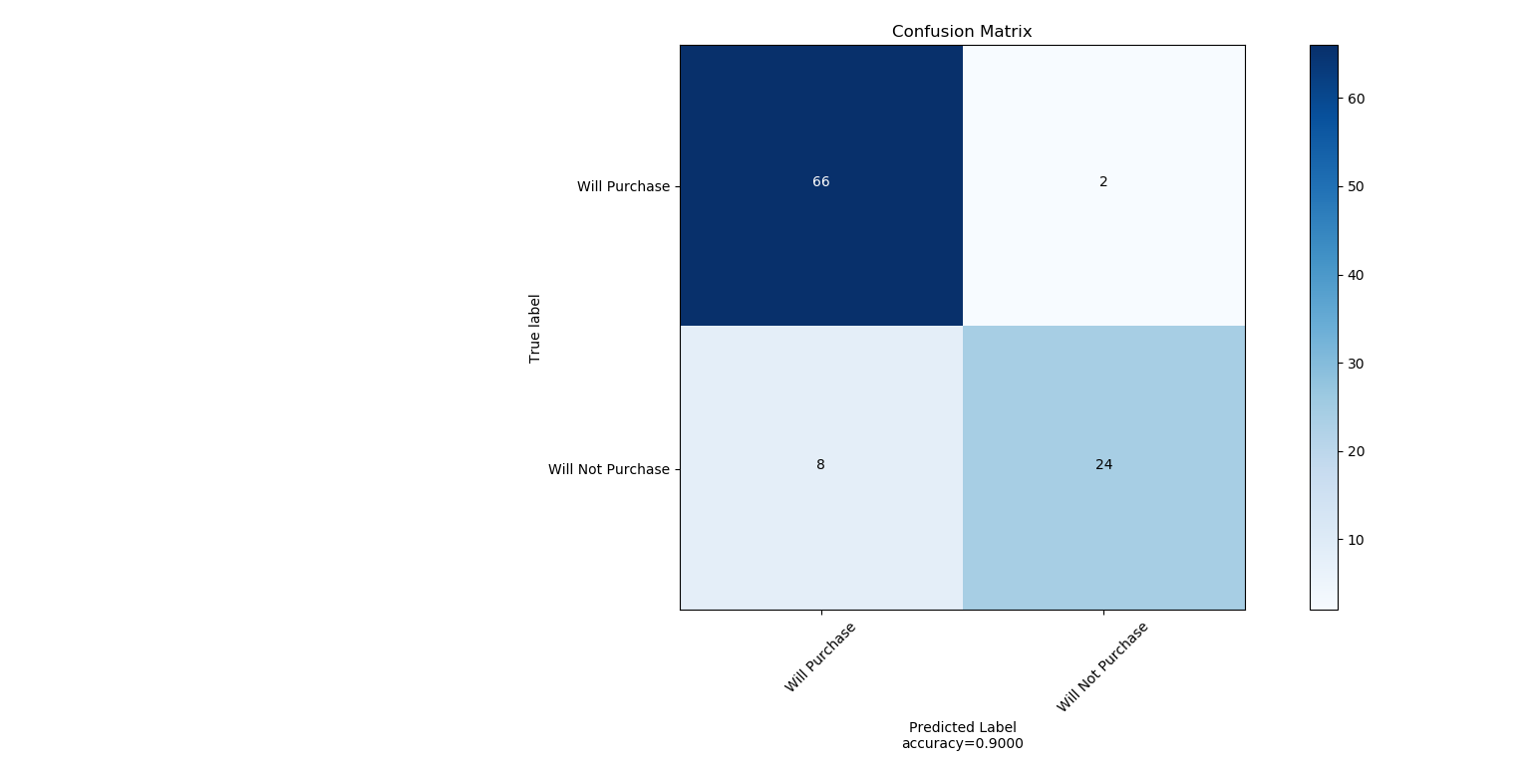
Results and Analysis
The best SVM classiﬁer proved to be very effective, with a predictive accuracy of over 99% and the probability of predicting a buying session of almost 95%.
Accuracy obtained : 90%
Confusion matrix diagram

Slide 9
Conclusion
We concluded that visualizing data in this way can help the management to create an understanding of which website visitors actually purchase and can already prompt decisions on targeting a specific customer segment with personalized ads or special offers.

