Slide 1
HIPERLAN:
HIgh PErformance Radio
Local Area Networks
By
Lei Fang (lfang@nd.edu),
Wenyi Zhang (wzhang1@nd.edu)
5th November 2001

Slide 2
I. Introduction
Roughly speaking there are two types of wireless networks:
  Local Area Networks (LAN)
    Bluetooth, 802.11 Family, HiperLAN Family, HomeRF...
  Wide Area Networks (WAN)
    GSM, 3G, 4G, Iridium...

Slide 3
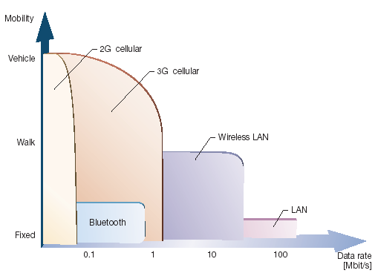
Mobility and data rates for communications standards

Slide 4
Two main standards families for Wireless Lan:
  IEEE 802.11 (802.11b, 802.11a, 802.11g...)
  ETSI Hiperlan (Hiperlan Type 1, Type 2, HiperAccess, HiperLink...)
HiperLAN Family
 | Hiperlan 1 | Hiperlan2 | HiperAccess | HiperLink
Description | Wireless Ethernet | Wireless ATM | Wireless Local Loop | Wireless Point-to-Point
Freq. Range | 5GHz | 5GHz | 5GHz | 17GHz
PHY Bit Rate | 23.5Mbps | 6~54Mbps | ~25Mbps (data rate) | ~155Mbps (data rate)

Slide 5
Motivation of HiperLAN
  Massive Growth in wireless and mobile communications
  Emergence of multimedia applications
  Demands for high-speed Internet access
  Deregulation of the telecommunications industry

Slide 6
The History, Present and Future
  HiperLAN Type 1
    Developed by ETSI during 1991 to 1996
    Goal: to achieve higher data rate than IEEE 802.11 data rates: 1~2 Mbps, and to be used in ad hoc networking of portable devices
    Support asynchronous data transfer, carrier-sense multiple access multiple access with collision avoidance (CSMA/CA), no QoS guaranteed.
    Products
      Proxim's High Speed RangeLAN5 product family (24Mbps; 5GHz; QoS guaranteed)
      RadioLAN’s products for indoor wireless communication (10Mbps; 5GHz; Peer-to-Peer Topology)

Slide 7
  HiperLAN Type 2
    Next generation of HiperLAN family: Proposed by ETSI BRAN (Broadband Radio Access Networks) in 1999, and is still under development.
    Goal: Providing high-speed (raw bit rate ~54Mbps) communications access to different broadband core networks and moving terminals
    Features: connection-oriented, QoS guaranteed, security mechanism, highly flexibility
    Product: Prototypes are available now, and commercial products are expected at the end of 2001 (Ericsson).
  HiperAccess and HiperLink
    In parallel to developing the HIPERLAN Type 2 standards, ETSI BRAN has started work on standards complementary to HIPERLAN Type 2

Slide 8
Relevant Organizations
  Standards body: ETSI (European Telecommunications Standards Institute, www.etsi.org)
  Technology alliance:
    HiperLAN2 Global Forum (H2GF, www.hiperlan2.com): promote HiperLAN Type 2 as a standard, in order to accelerate its use in business and consumer industries.
    OFDM Forum (www.ofdm-forum.com): OFDM is the cornerstone technology for high-speed wireless LAN such as HiperLAN.
  Industry backers: Texas Instruments, Dell, Bosch, Ericsson, Nokia,Telia, Xircom…

Slide 9
H2GF Membership Status - Commercial Support
ADC Communications
Alcatel
Adaptive Broadband
Axis
Bosch
Cambridge Silicon Radio
Canon
Dell
Elisa
Emtac
Ericsson
Eumitcom
Grundig
HLAN
Intersil
KDI
Lucent
Matsushita Communications
Mediascape
Mitsubishi
Motorola
National Semiconductors
Nokia
NTT
Philips
Samsung
Siemens
Silicon Wave
Sony International
Systemonic AG
TDK
Telia
Texas Instruments
Thomson
3Com
T-Span
Wireless Communication
Xircom

Slide 10
Typical application scenarios
  HiperLAN: A complement to present-day wireless access systems, giving high data rates to end-users in hot-spot areas.
  Typical app. Environment: Offices, homes, exhibition halls, airports, train stations, etc.
  Different with Bluetooth, which is mainly used for linking individual communication devices within the personal area network

Slide 11
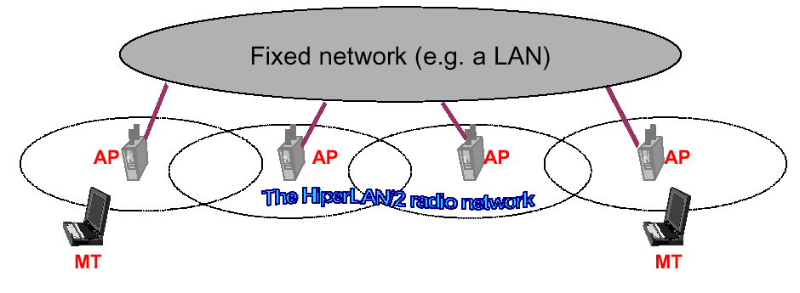
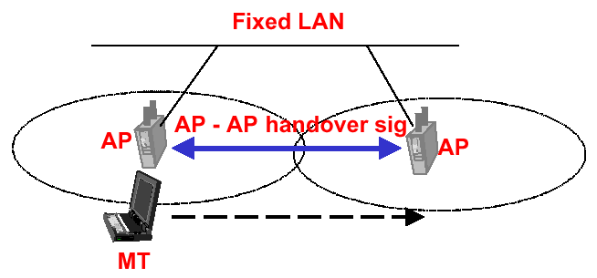
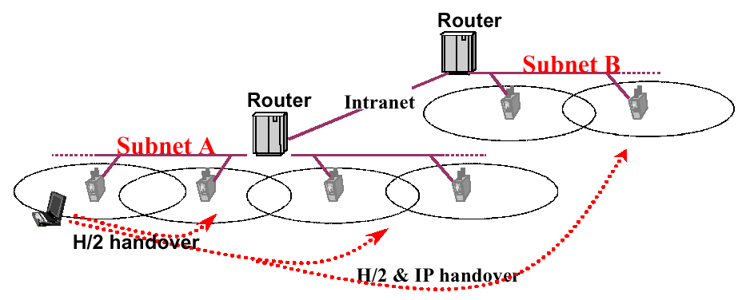

Slide 12
II. Hiperlan2 System Overview
Features
  5 GHz technology, up to 54 Mbit/s
  Generic architecture supporting:
  Ethernet, IEEE 1394, ATM, 3G etc
  Connection-oriented with QoS per conn.
  Security - authentication & encryption
  Plug-and-play radio network using DFS
  Optimal throughput scheme

Slide 13
Architecture
Control Plane
User Plane
CL
MAC
RRC
ACF
DCC
EC
CAC
RLC
PHY
MAC
DLC
HiperLAN Type 1 Reference Model
PHY
HiperLAN Type 2 Reference Model
MAC: Medium Access Sublayer EC: Error Control
CAC: Channel Access Control Sublayer RLC: Radio Link Control
PHY: Physical Layer RRC: Radio Resource Control
DLC: Data Link Control Layer ACF: Association Control Function
CL: Convergence Layer DCC: DLC Connection Control

Slide 14
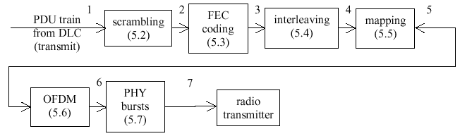
Physical Layer
Data units on physical layer: Burst of variable length, consist of a preamble and a data field
Reference configuration
1: information bits
2: scrambled bits
3: encoded bits
4: interleaved bits
5: sub-carrier symbols
6: complex baseband OFDM symbols
7: PHY bursts

Slide 15
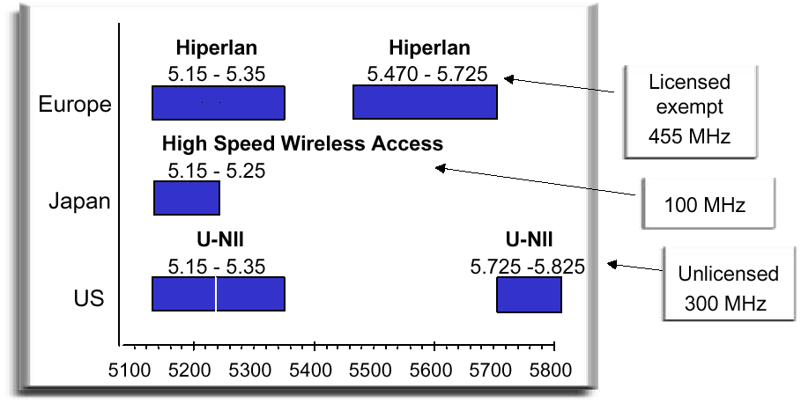
Spectrum plays a crucial role in the deployment of WLAN
Currently, most WLAN products operate in the unlicensed 2.4GHz band, which has several limitations: 80MHz bandwidth; spread spectrum technology; interference
Spectrum allocation for Hiperlan2

Slide 16
Modulation scheme: Orthogonal frequency-division multiplexing (OFDM)
  Robustness on highly dispersive channels of multipath fading and intersymbol interference
  Spectrally efficient
  Admits great flexibility for different modulation alternatives
  Facilitated by the efficiency of FFT and IFFT algorithms and DSP chips
Hiperlan2: 19 channels (20MHz apart). Each channel divided into 52 subcarriers

Slide 17
Encoding: Involves the serial sequencing of data, as well as FEC
Key feature: Flexible transmission modes
  With different coding rates and modulation schemes
  Modes are selected by link adaptation
  BPSK, QPSK as well as 16QAM (64QAM) supported
Mode | Modulation | Code rate | Physical layer bit rate (Mbps)
1 | BPSK | ½ | 6
2 | BPSK | ¾ | 9
3 | QPSK | ½ | 12
4 | QPSK | ¾ | 18
5 | 16QAM | 9/16 | 27
6 | 16QAM | ¾ | 36
7(optional) | 64QAM | ¾ | 54

Slide 18
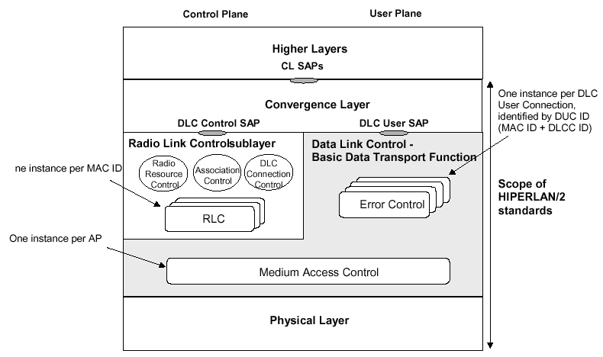
Data Link Control Layer

Slide 19
Three main control functions
  Association control function (ACF): authentication, key management, association, disassociation, encryption
  Radio resource control function (RRC): handover, dynamic frequency selection, mobile terminal alive/absent, power saving, power control
  DLC user connection control function (DCC): setup and release of user connections, multicast and broadcast
Connection-oriented
  After completing association, a mobile terminal may request one or several DLC connections, with one unique DLC address corresponding to each DLC connection, thus providing different QoS for each connection

Slide 20
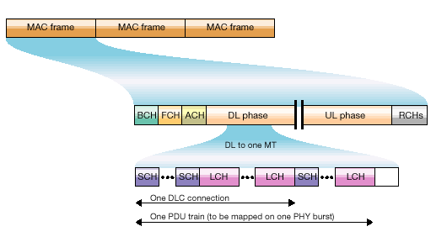
DLC: MAC Sublayer
  Basic frame structure (one-sector antenna)

Slide 21
BCH (broadcast channel): enables control of radio resources
FCH (frequency channel): exact description of the allocation of resources within the current MAC frame
ACH (access feedback channel): conveys information on previous attempts at random access
Multibeam antennas (sectors) up to 8 beams supported
A connection-oriented approach, QoS guaranteed

Slide 22
Hiperlan implements QoS through time slots
  QoS parameters: bandwidth, bit error rate, latency, and jitter
  The original request by a MT to send data uses specific time slots that are allocated for random access.
  AP grants access by allocating specific time slots for a specific duration in transport channels. The MT then sends data without interruption from other MT operating on that frequency.
  A control channel provides feedback to the sender.

Slide 23
DLC: Error Control
  Acknowledged mode: selective-repeat ARQ
  Repetition mode: typically used for broadcast
  Unacknowledged mode: unreliable, low latency
DLC: other features
  Radio network functions: Dynamic frequency selection; handover; link adaptation; multibeam antennas; power control
  QoS support: Appropriate error control mode selected; Scheduling performed at MAC level; link adaptation; internal functions (admission, congestion control, and dropping mechanisms) for avoiding overload

Slide 24
III. Comparison with Peers
Main competitor: IEEE 802.11 Family
  802.11b vs. HiperLAN Type 1
  802.11a vs. HiperLAN Type 2
Pros
  High rate with QoS support: Suitable for data and multimedia app.
  Security mechanism
  Flexibility: different fixed network support, link adaptation, dynamic frequency selection…

Slide 25
Cons
  High cost
  Tedious protocol specification
  Limited outdoor mobility
  No commercial products in market till now
 | 802.11 | 802.11b | 802.11a | HiperLAN2
Spectrum (GHz) | 2.4 | 2.4 | 5 | 5
Max PHY rate (Mbps) | 2 | 11 | 54 | 54
Max data rate, layer 3 (Mbps) | 1.2 | 5 | 32 | 32
MAC | CS | CSMA/CA |  | Central resource control/TDMA/TDD
Connectivity | Conn.-less | Conn.-less | Conn.-less | Conn.-oriented
Multicast | Yes | Yes | Yes | Yes
QoS | PCF (Point Control Function) | PCF | PCF | ATM/802.1p/RSVP/DiffServ (full control)
Frequency selection | Frequency-hopping or DSSS | DSSS | Single carrier | Single carrier with Dynamic Frequency Selection
Authentication | No | No | No | NAI/IEEE address/X.509

Slide 26
 | 802.11 | 802.11b | 802.11a | HiperLAN2
Encryption | 40-bit RC4 | 40-bit RC4 | 40-bit RC4 | DES, 3DES
Handover support | No | No | No | To be specified by H2GF
Fixed Network Support | Ethernet | Ethernet | Ethernet | Ethernet, IP, ATM, UMTS, FireWire (IEEE 1394), PPP
Management | 802.11 MIB | 802.11 MIB | 802.11 MIB | HiperLAN/2 MIB
Radio link quality control | No | No | No | Link adaptation

Slide 27
IV. Conclusion
Will Hiperlan standards replace 802.11?
  There will be a fight between connection and connectionless camps Hiperlan2/802.11a
Current products under development and becoming available only offer 25Mbps
Hiperlink 155Mbps data rates still some way off
Wireless: Useful as an adjunct to the wired world

