Slide 1
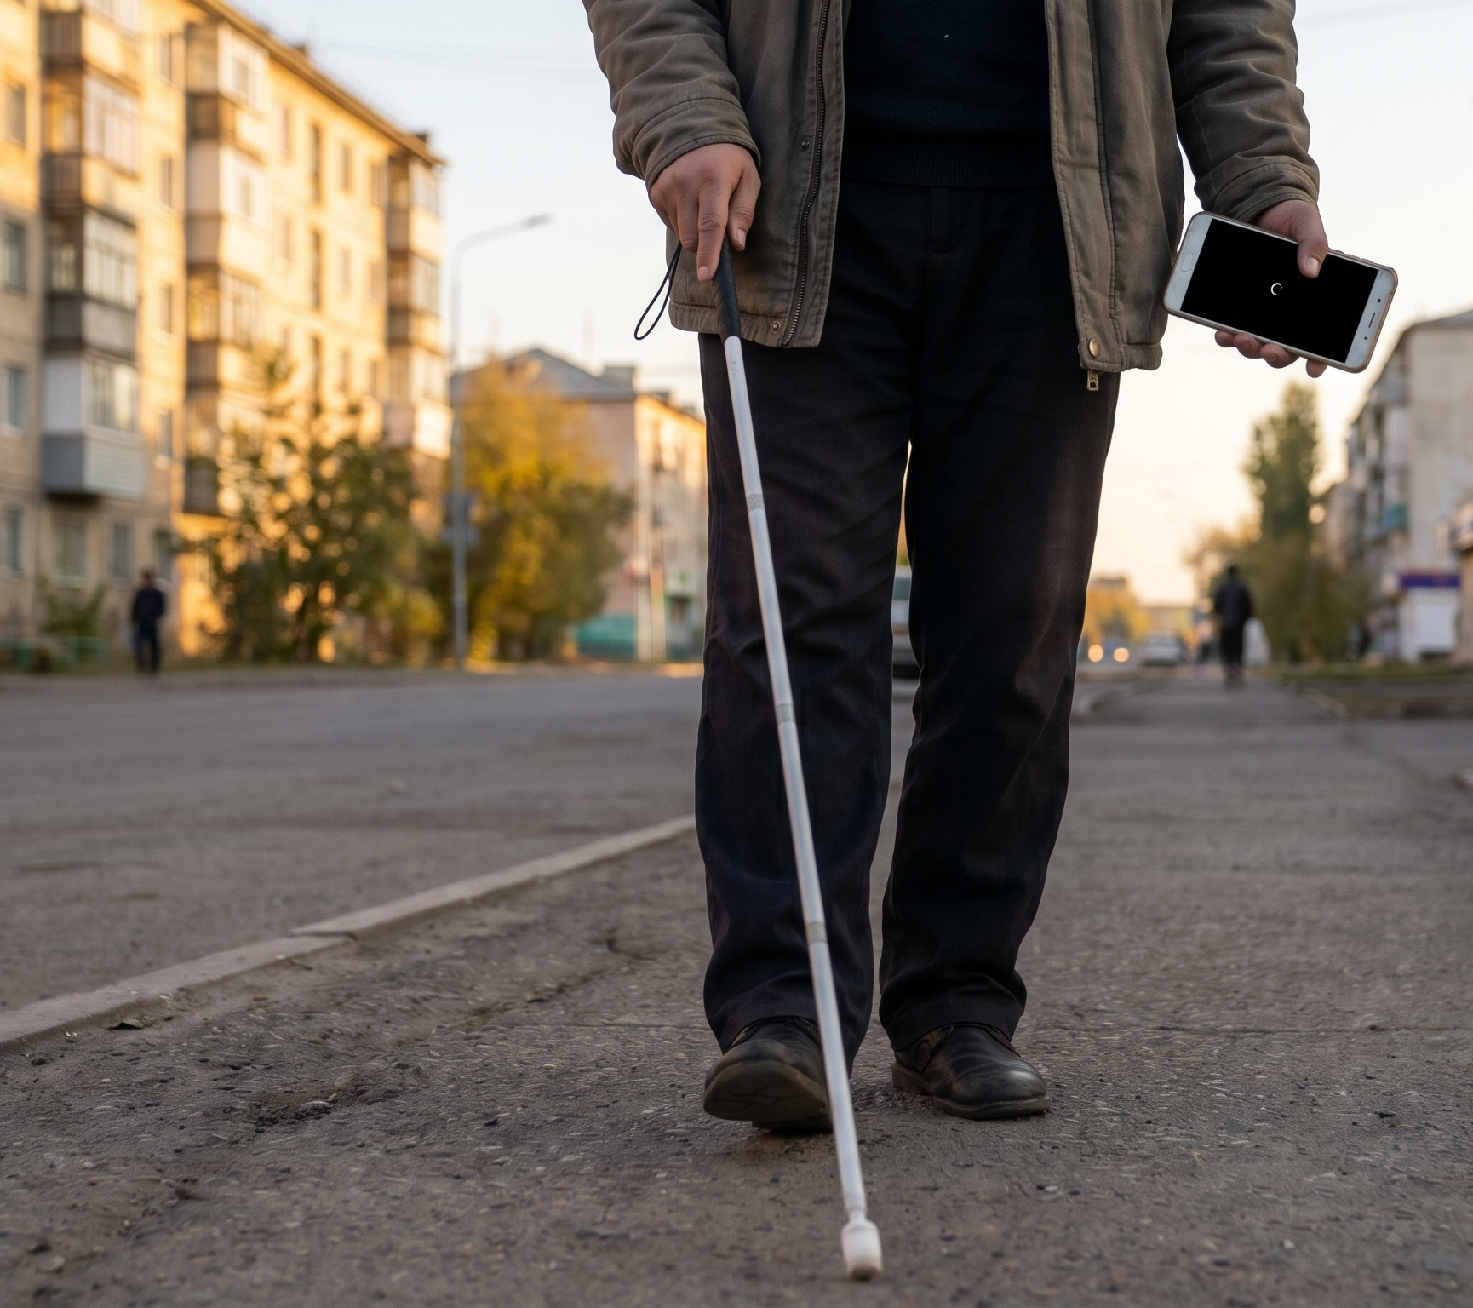
BAGDAR · AI MOBILITY ASSISTANT
BAGDAR
Bagdar AI.
Көру қабілеті нашар адамдарға арналған
оффлайн AI көмекші.
Нақты уақытта қауіп анықтау, навигация және қауіпсіздік – бәрі 50 000 ₸ Android телефонында.
Команда
Категория
Статус
Nurmukhamed Sabit · Nurbakyt Sultan
Әлеуметтік
Жұмыс істейтін Android MVP
Қарағанды Назарбаев Зияткерлік мектебі
Q-IDEA жобалар байқауы
100% оффлайн · KK / RU / EN
01 / 12

Slide 2
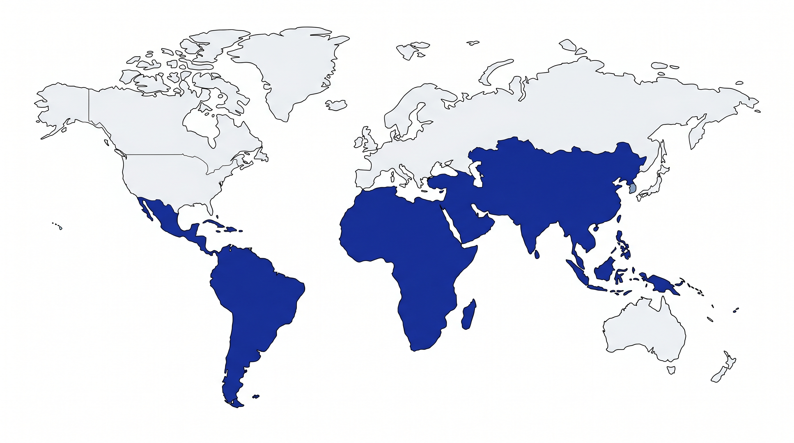
BAGDAR · AI MOBILITY ASSISTANT
Samsung Solve for Tomorrow · Community / Social Impact
2.2 billion people. One missing assumption.
2.2B
адам дүниежүзі бойынша көру қабілетінің бұзылуымен өмір сүреді.
ДДСҰ, 2023
~90%
дамушы және орташа табысы бар елдерде тұрады.
Дүниежүзілік Банк жіктеуі
~100%
көмекші AI жетекші қосымшалары тұрақты интернет пен 200 000+ ₸ телефонды талап етеді.
Be My Eyes · Seeing AI · Envision
low- and middle-income countries
THE EXCLUSION PARADOX
Existing assistive technology is built for users who already have the infrastructure to be independent.
The users who need it most are the ones it was never designed for.
02 / 12

Slide 3
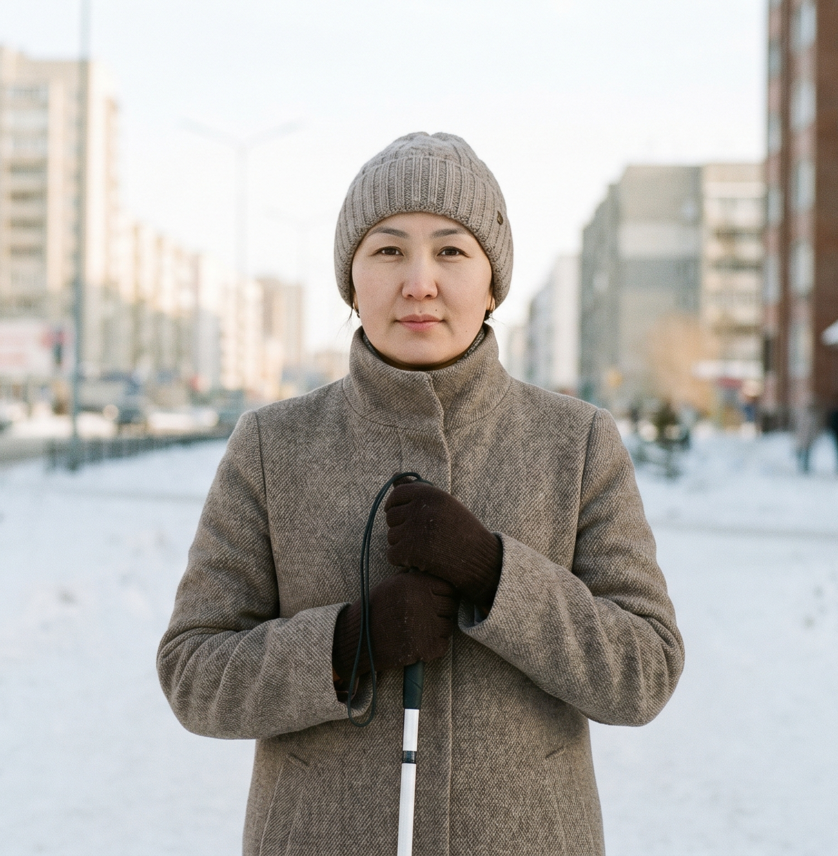
BAGDAR · AI MOBILITY ASSISTANT
Samsung Solve for Tomorrow · Community / Social Impact
Meet Aigerim.
PERSONA
Aigerim, 34
Astana, Kazakhstan
Lost her vision at 19 after illness.
Earns ~90,000 ₸ / month as a call-center operator.
Owns a Redmi 9A – the phone she could afford.
Walks ~4 km daily – unmaintained sidewalks, construction, traffic.
PAIN POINTS SHE FACES TODAY
Cloud apps fail when she needs them most
underground, metro, low-data days
Premium devices cost 6-18 months of her salary
OrCam, Envision Glasses – out of reach
No general-purpose assistive AI speaks Kazakh
her first language
03 / 12

Slide 4



BAGDAR · AI MOBILITY ASSISTANT
Samsung Solve for Tomorrow · Community / Social Impact
Three pillars. Zero cloud.
Bagdar turns any low-end Android into a real-time AI guide – with no internet, no subscription, no cloud.
SEE
NAVIGATE
PROTECT
· Object detection – YOLOv8n INT8
· Monocular depth – MiDaS via NCNN
· Ground-plane hazards – RANSAC fitting
· Traffic lights · peripheral motion
· Offline pedestrian routing on OSM data
· Public transit – local GTFS database
· Voice commands in KK / RU / EN
· Offline POI search with fuzzy match
· IMU fall detection – 3-phase FSM
· Auto-SOS – GPS + SMS fallback
· Thermal and battery-aware throttling
· Indoor / outdoor auto-classification
Android 5.0+ · 100% offline · KK / RU / EN · Free & open-source
04 / 12

Slide 5
BAGDAR · AI MOBILITY ASSISTANT
Samsung Solve for Tomorrow · Community / Social Impact
One pipeline. Entirely on-device.
DEVICE BOUNDARY
INPUTS
ML
PERCEPTION
DECISION
OUTPUT
Camera · IMU
GPS · Mic
YOLOv8n INT8
MiDaS via NCNN
(Vulkan / CPU)
Kalman + Hungarian
RANSAC plane
Motion · Lights
Adaptive throttler
Decision engine
Priority TTS
Haptics · Earcons
ADAPTIVE GOVERNOR
retunes detection cadence in real time
inputs: inference latency · thermal · battery · memory · motion
05 / 12

Slide 6
BAGDAR · AI MOBILITY ASSISTANT
Samsung Solve for Tomorrow · Community / Social Impact
Two neural networks. 10+ FPS. $120 phone.
Three engineering decisions that make on-device AI possible on budget hardware.
QUANTIZATION
DEPTH FALLBACK
THROTTLER
Format choice
Auto-selected at first launch
Adaptive multi-signal governor
YOLOv8n – INT8 quantized, 3.2 MB, runs through flutter_vision (TFLite).
MiDaS Small – ported to NCNN for Vulkan GPU acceleration; CPU fallback otherwise.
1. Hardware depth (ARCore ToF / structured light)
2. NCNN MiDaS + Vulkan GPU
3. NCNN MiDaS + CPU
4. Focal-length heuristic
Cached across launches.
Reads latency · thermal · battery · memory · motion.
Continuously retunes detection interval, MiDaS cadence, OCR cadence, and UI refresh.
Snapdragon 680
≈ 45 ms
≈ 180 ms
8 – 12 FPS
YOLOv8n
MiDaS
End-to-end
06 / 12

Slide 7
BAGDAR · AI MOBILITY ASSISTANT
Samsung Solve for Tomorrow · Community / Social Impact
Object detection alone misses what actually injures people.
Four hazard categories Bagdar handles that most assistive AI products do not.
Ground-level hazards
potholes · curbs · steps · slopes · low curbs
RANSAC plane fitting (40 iter, 0.15 inlier threshold), 5-zone deviation analysis, temporal confirmation.
Glass doors & transparent walls
false-positive trap for depth models
Luma-variance analysis identifies surfaces depth incorrectly reads as open space.
Pothole / curb
Glass door
Traffic lights
no extra model required
Direct YUV colorimetry on the camera stream – 3-zone brightness analysis with temporal stability.
Peripheral motion
fast-approaching cars and cyclists
Traffic light
Peripheral motion
Luma-grid differencing across left / center / right sectors – fires before the detector locks on.
07 / 12

Slide 8
BAGDAR · AI MOBILITY ASSISTANT
Samsung Solve for Tomorrow · Community / Social Impact
The phone becomes the last line of defense.
SAFETY
ACCESSIBILITY
Fall detector – 3-phase FSM
Priority TTS queue
freefall < 3.5 m/s² → impact > 30 m/s² → 40-frame stillness
3 tiers – critical preempts all queued speech
Gyro rotational confirmation
Haptic direction encoding
peak ≥ 2.50 rad/s – kills phone-drop false positives
left / right / center + urgency level
Auto-SOS countdown
Pitch-black UI
voice cancellation
fully black, vision pipeline still running, zero display power
SMS dispatch
Guide-dog mode
GPS link + fallback to 112
suppresses alerts that conflict with trained dog behavior
60-second cooldown
Audio-session management
prevents re-triggers
ducking, interruption recovery, route-change handling
FALL DETECTION FSM
FREEFALL
IMPACT
STILLNESS
SOS
Native voice control in Kazakh, Russian, English – 32 commands per language
08 / 12

Slide 9
BAGDAR · AI MOBILITY ASSISTANT
Samsung Solve for Tomorrow · Community / Social Impact
Working Android MVP. Not a slide deck.
Every claim in this deck is backed by code that runs today.
DELIVERED
✓
Functional Android build
Flutter 3.11+ · 83 Dart files · ~742 KB of code
✓
39 service modules
vision · navigation · safety · accessibility · offline data
✓
Trilingual UI & voice
KK / RU / EN · ~96 KB string table · 32 voice commands
✓
Offline data stack
OpenStreetMap routing · GTFS transit DB · FTS5 POI search
✓
Field telemetry
FieldLogger writes per-session JSONL · Python analyzer
PLANNED
○
Multi-device benchmarking suite
10+ Android models – design ready
○
iOS port
scoped – see roadmap
App UI · KK / RU / EN
○
Pilot study with partner organization
see roadmap slide
09 / 12

Slide 10
BAGDAR · AI MOBILITY ASSISTANT
Samsung Solve for Tomorrow · Community / Social Impact
Built where infrastructure isn't.
REACH
LANGUAGE EQUITY
INDEPENDENCE
Runs on phones our users already own. No upgrade. No fee.
First general-purpose assistive AI with native Kazakh.
Every confident kilometer = a job, an errand, a relationship.
Capability
Bagdar
Be My Eyes
Seeing AI
Envision
Works fully offline
✓
—
—
partial
Free
✓
✓
✓
—
Native Kazakh support
✓
—
—
—
Real-time hazard detection
✓
—
partial
partial
Fall detection + auto-SOS
✓
—
—
—
Offline pedestrian + transit nav
✓
—
—
—
Runs on $100–150 Android
✓
partial
partial
—
Comparison based on publicly available product information at submission time.
10 / 12

Slide 11
BAGDAR · AI MOBILITY ASSISTANT
Samsung Solve for Tomorrow · Community / Social Impact
Where Bagdar goes next.
0 – 3 months
3 – 9 months
9 – 18 months
VALIDATE
EXPAND
SCALE
· Formal benchmarking suite – 10+ Android models
· Pilot study with planned partner – Kazakh Society of the Blind (in discussion)
· Internal-test Play Store release
· iOS port
· Hazard taxonomy: construction zones, uneven terrain, dynamic obstacles
· Crowd-sourced hazard layer (opt-in, anonymous)
· Language packs: Turkish, Arabic, Hindi
· Integration with municipal accessibility data feeds
· Partnerships with national associations of the blind
Every milestone connects to either more users served or more places served – not technology for its own sake.
11 / 12

Slide 12
BAGDAR · AI MOBILITY ASSISTANT
Samsung Solve for Tomorrow · Community / Social Impact
Built by Bagdar Labs. Made for everyone walking without sight.
TEAM
NS
Nurmukhamed Sabit
NS
Nurbakyt Sultan
KN
Adekenova Aigul
Project Lead · Engineering & Research
Field Tester & User Research
Mentor
Nazarbayev Intellectual School in Karagandy
Nazarbayev Intellectual School in Karagandy
Nazarbayev Intellectual School in Karagandy
WHAT WE ASK FROM SAMSUNG SOLVE FOR TOMORROW
MENTORSHIP
DEVICE GRANTS
A PLATFORM
to formalize a clinical-feasibility study with a partner organization for the visually impaired
to expand our benchmarking lab beyond two phones to a representative cross-section of the Android market
to put Bagdar into the hands of the users it was built for
Built to work where infrastructure doesn't.
Contact: nurik07070990@gmail.com · GitHub: https://github.com/thorfinn071/Bagdar-AI
12 / 12

