Slide 1

System Call in Unix/Linux

Slide 2
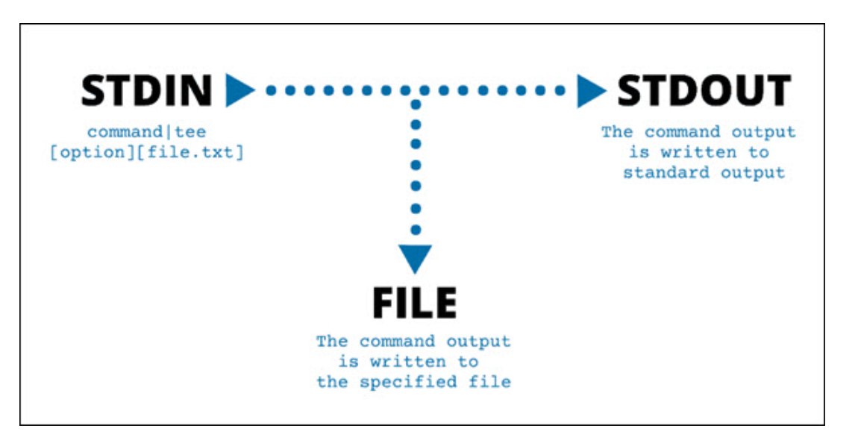

Slide 3
System Call in Unix/Linux
A system call in Unix is a mechanism that allows user-space programs to request services from the operating system's kernel. These services include tasks like file manipulation, process control, communication, and memory management.
when a program executes read(fd, buffer, size), it calls the kernel to read data from a file descriptor (fd) into a buffer. The kernel performs the operation and returns the result to the program.

Slide 4
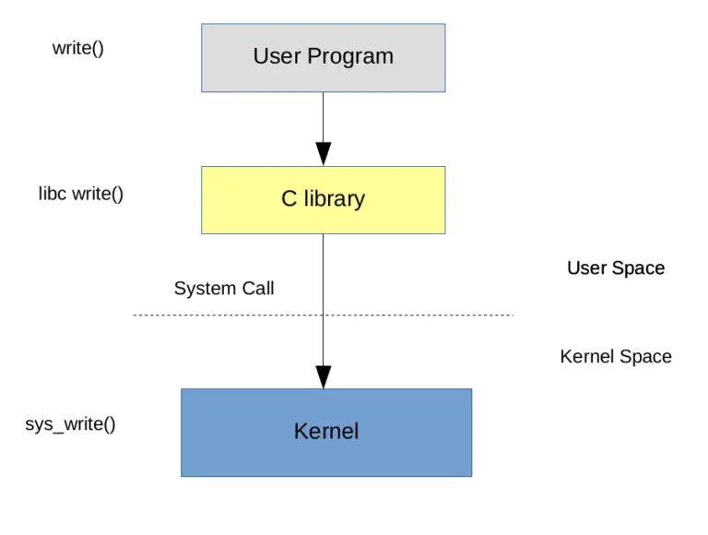

Slide 5
Why System Calls?
User programs run in user mode, which has restricted access to system resources for security and stability. The kernel, running in kernel mode, has full control over the hardware. Since user programs cannot directly access hardware or critical system resources, they use system calls to interact with the kernel safely.

Slide 6
Linux command and program makes several types of system calls. You can easily see them with the strace command. strace linux_command

Slide 7
System Calls in Unix:
Examples of System Calls in Unix:
1. Process Control: fork(), exec(), exit(), wait()
2. File Management: open(), read(), write(), close()
3. Device Management: ioctl(), read(), write()
4. Information Management: getpid(), gettimeofday()
5. Communication: pipe(), shmget(), socket()

Slide 8
Types of system calls in Unix/Linux
Process management system calls
File management system calls
Device management system calls
Network management system calls
System information system calls

Slide 9
Process management system calls
The process management system calls provide a way to create, manage and control the processes. In simple words, process management is a way to handle multiple processes and plays a crucial role in multitasking. Process control system calls manage processes, including their creation, execution, termination, and synchronization
Some common process management system calls
fork(): As the name suggests, this creates a child process from the parent process which results in the exact same process except for some values like PID and parent PID.
exec(): This system call replaces the current process image with the new image and it is used when you want to run a different program from the current process.
wait(): This system call waits to will the child process gets terminated and then gives some information about the child process. The prime example of this would be the exit status.
exit(): This system call terminates the current process and returns the resources acquired by that process (which was terminated recently) to the system.

Slide 10
Process Control System Calls
Problem: A parent process creates a child process that runs another program (e.g., /bin/ls).
#include <stdio.h>
#include <stdlib.h>
#include <unistd.h>
#include <sys/wait.h>
int main() {
pid _t pid = fork(); // Create a child process
if (pid < 0)
{
perror("fork failed");
return 1;
}
else if (pid == 0)
{ // Child process
execl("/bin/ls", "ls", NULL); // Execute the "ls" command
perror("execl failed");
exit(1);
}
else
{ // Parent process
wait(NULL); // Wait for the child to finish
printf("Child process completed.\n");
}
return 0;
}

Slide 11

File system calls
The filesystem calls in Linux facilities other programs to interact with the filesystem. File management system calls handle file operations like opening, reading, writing, and closing files.
open(): As the name suggests, it is used to open the file.
1
read(): This system call can be used to read data from a wide range of data types including regular files, and special files like pipes and sockets, and it can also read from device files like /dev directory.
2
write(): It is used to modify files, generate log files, reports, etc.
3
close(): This will close the file and save the changes to the disk(if any).
4

Slide 12
File Management System Calls
#include <stdio.h>
#include <stdlib.h>
#include <fcntl.h>
#include <unistd.h>
int main() {
int fd;
char buffer[50];
// Open a file (or create it if it doesn't exist)
fd = open("example.txt", O_CREAT | O_WRONLY, 0644);
if (fd < 0)
{
perror("open failed");
return 1;
}
// Write to the file
write(fd, "Hello, Unix system calls!", 25);
close(fd);
// Reopen file for reading
fd = open("example.txt", O_RDONLY);
if (fd < 0)
{
perror("open failed");
return 1;
}
// Read from file
read(fd, buffer, 25);
buffer[25] = '\0';
// Null-terminate string
printf("File content: %s\n", buffer);
close(fd);
return 0;
}
When to Use These Calls?
Use process control calls (fork(), exec(), wait()) when you need to create new processes, run different programs, or manage multiple processes.
Use file management calls (open(), read(), write(), close()) when you need to create, read, or write files programmatically.

Slide 13
Network system calls
The network system calls are used to manage networks, send/receive data, resolve network addresses, etc.
socket(): This system call is used to create sockets which are endpoints for communication.
bind(): It is used to bind a socket to the specific address and port on the local network.
listen(): It is used to mark the socket as a passive listener so it can accept incoming requests from the other hosts.
accept(): This system call is used to accept the new incoming connection request.
connect(): It establishes the connection to the external network endpoint.
send(): As the name suggests, it is used to send data over the socket.
recv(): It is used to receive data over the socket.

Slide 14
Communication System Calls
Example Scenario: Using pipe() for Communication Between Parent and Child Process
#include <stdio.h>#include <unistd.h>
int main()
{
int fd[2];
char buffer[100];
pipe(fd); // Create a pipe
if (fork() == 0)
{
// Child process
close(fd[1]); // Close write end
read(fd[0], buffer, sizeof(buffer));
printf("Child received: %s\n", buffer);
}
else {
// Parent process
close(fd[0]);
// Close read end
write(fd[1], "Hello from Parent", 18);
}
return 0;
}
Inter-process communication (IPC) system calls allow processes to communicate with each other. Methods include pipes, message queues, shared memory, and sockets.
Where to Use?
Parent-child process communication
Message passing between unrelated processes
Network communication
Why Needed in Real-Time?
Used in chat applications
Essential for client-server models
Helps in multi-process programming

Slide 15
Device management system calls
The device management system calls are used to manage devices that are connected to your system. In simple terms, the device management system calls provides a way to read/write data, and control and configure those devices.
Device management system calls are used to interact with hardware devices like hard drives, printers, USB devices, etc. The kernel provides a uniform interface to access these devices via device files (found in /dev/).
ioctl(): It is used to send control commands to the connected devices. Think of you controlling a robotic arm using a computer! Yep, that's how it is used.
mmap(): It is used to map the partition of a file into the memory of the own process. This results in direct access to the memory-mapped data as if it was a part of the process's own memory.

Slide 16
Device Management System Calls in Unix/Linux
Example Scenario: Getting Terminal Window Size using ioctl()
#include <stdio.h>
#include <sys/ioctl.h>
#include <unistd.h>
int main()
{
struct winsize w;
ioctl(STDOUT_FILENO, TIOCGWINSZ, &w);
// Get terminal size
printf("Terminal size: %d rows × %d cols\n", w.ws_row, w.ws_col);
return 0;
}S
Why Needed in Real-Time?
i) Used in disk partitioning tools (fdisk, parted)
ii) Helps in printer communication
iii) Essential for managing input/output devices (mouse, keyboard, etc.)
Where to Use?
i) Getting terminal screen size dynamically
ii) Managing device drivers
iii) Controlling disk operations

Slide 17
System information system calls
Information management system calls retrieve system and process-related information, such as process ID, system time, user details, system configuration and system resources
Common Information Management System Calls
getpid(): Gets the PID (process ID) of the current process.
getppid(): Gets the parent PID of the current process.
getuid(): It will get the UID (used ID) of the current process.
getgid(): It will get the GID (group ID) of the current process.
uname(): This system call gets the information about the system name, version, release info, and other system-related info.
sysinfo(): It gets general information about the system which includes free memory, total memory, number of current processes, etc.
time(): It gets the current system time in seconds since 1t January 1970.

Slide 18
Information Management System Calls in Unix/Linux
Example Scenario: Getting System Information Using uname()
#include <stdio.h>
#include <sys/utsname.h>
int main()
{
struct utsname sysinfo;
uname(&sysinfo);
printf("System Name: %s\n", sysinfo.sysname);
printf("Node Name: %s\n", sysinfo.nodename);
printf("Release: %s\n", sysinfo.release);
return 0;
}
Where to Use?
Checking system details (uname -a command)
Identifying process ownership (ps -ef)
Getting user authentication information
Why Needed in Real-Time?
Used in system monitoring tools (top, htop)
Helps in debugging and security auditing
Essential for multi-user systems

Slide 19
Error Handling and Logging
Error handling in Unix/Linux shell scripting involves using exit statuses to check the success or failure of a command. Every command executed in the shell returns an exit status, which is a numerical value. The convention is:
Exit status 0: Command executed successfully.
Non-zero exit status: Command failed. The specific number often indicates the type of error.
The exit status of the last executed command is stored in the special variable $?. You can use this variable in your script to implement error handling by checking whether a command succeeded or failed, and then taking appropriate action based on the result.

Slide 20
#!/bin/bash
# Example: Copy a file
SOURCE_FILE="source.txt"
DESTINATION_FILE="destination.txt"
# Check if the source file exists
if [ ! -f "$SOURCE_FILE" ]; then
echo "Error: Source file does not exist!"
exit 1 # Exit with an error status
fi
# Try to copy the file
cp "$SOURCE_FILE" "$DESTINATION_FILE"
# Check the exit status of the 'cp' command
if [ $? -eq 0 ]; then
echo "File copied successfully."
else
echo "Error: Failed to copy the file."
exit 1 # Exit with an error status
fi
echo "Script completed."

Slide 21
Debugging Tools in Unix Shell Scripts
Common tools and techniques for debugging shell scripts:
set -x (or set +x):
Enables a mode where each command and its arguments are printed as they are executed. This is helpful for tracing the execution flow.
Runs the script with debugging output, equivalent to using set –x
bash -x script.sh
trap Command:
Detects errors or signals and can help identify where a script fails
trap 'echo "Error occurred at line $LINENO"; exit 1' ERR
ShellCheck:
A popular static analysis tool that checks shell scripts for syntax errors, style issues, and potential bugs. It provides actionable feedback.
shellcheck your_script.sh
Logging and echo Statements:
Adding echo statements for logging key variable values and flow control can help you debug logically.
shfmt:
A shell script formatter that helps you maintain consistent coding style.
Install it using sudo apt-get install shfmt or brew install shfmt.

Slide 22
Testing Unix Shell Scripts
Systematic testing ensures that your shell script functions as intended. Here’s how you can test
Unit Testing for Functions: Isolate and test functions in your script independently to ensure accuracy.
Input Testing: Check your script with various input combinations, including edge cases, to test for robustness.
Mock Commands: Replace actual commands with mocks or dry runs (--dry-run option for some commands) to see the script's behavior without causing real changes.
Test Environments:
Use virtual machines, containers, or sandboxes to safely test scripts.
Create test files or directories that the script operates on.
Error Simulation: Intentionally induce errors (e.g., missing files, incorrect permissions) to validate how well the script handles failures.
Unit Testing with bats:
bats (Bash Automated Testing System) is a testing framework for Bash scripts.
Install it using sudo apt-get install bats or brew install bats.

Slide 23
Validation Practices -Unix Shell Scripts
Validation ensures the correctness and stability of your script:
Validate User Input: Always check for valid input using if statements or regular expressions.
Test Exit Codes: Check the exit status of critical commands using $? or a custom error-handling function.
Code Reviews: Peer reviews can help catch logic errors and ensure compliance with best practices.
Automated Validation Tools: Use CI/CD pipelines to automate script validation, where possible.
if [[ "$USER_INPUT" =~ ^[a-zA-Z]+$ ]]; then
echo "Valid input"
else
echo "Invalid input"
exit 1
fi

Slide 24
Script Debugging and Testing
Manual Testing:
Run your script with different inputs and edge cases to ensure it behaves as expected.
Validation:
Validate your script's output using tools like diff to compare expected and actual outputs.
Tips for Beginners
Start Small: Begin with simple scripts and gradually add complexity.
Use Comments:
Comment your code to explain what each part does.
Read Error Messages:
Pay attention to error messages; they often provide clues about what's wrong.
Practice:
The more you practice, the more comfortable you'll become with debugging and testing.

