Slide 1

Global Partners – Weather Data Microservice
Gaurav Thorat
July 2025

Slide 2
Executive Summary
Business Problem
Need for real-time weather data processing
Geographic-specific weather insights
Scalable weather analytics platform
Solution Overview
FastAPI-based microservice for weather data processing
NWS API integration for reliable data
Advanced data enrichment with geospatial analysis
PostgreSQL persistence with relationship modelling`
Key Benefits
Real-time processing of weather data
Enhanced analytics with temperature ratios and wind patterns
Geographic precision with distance calculations
Production-ready containerized deployment

Slide 3
Technical Stack
Core Technologies
Component | Technology | Purpose
API Framework | FastAPI + Uvicorn | High-performance REST API
Database | PostgreSQL 15 | Relational data storage
Caching | - | Performance optimization
ORM | SQLAlchemy | Database abstraction
Containerization | Docker + Docker Compose | Deployment & scaling
Testing | PyTest | Quality assurance
External Integrations
NWS API
Geopy library for geospatial calculations
HTTpie for API testing

Slide 4
System Architecture
Layered Architecture Design
Presentation Layer
REST API endpoints(/weather, /healthz)
Input validation and error handling
2. Business Logic Layer
Weather data processing engine
Data enrichment algorithms
External API integration
3. Data Access Layer
SQLAlchemy ORM models
Connection pooling & caching
Transaction management
4. Data Storage Layer
Normalized PostgreSQL schema
JSON raw data preservation
Relationship modeling

Slide 5
Data Flow Architecture
End-to-End Processing Pipeline
Client Request → FastAPI → NWS API → Data Enrichment → PostgreSQL → Response
Step-by-Step Process:
Input Validation - Validate coordinates and user data
Gridpoint Lookup - Get NWS forecast URLs from coordinates
Forecast Retrieval - Fetch current and hourly weather data
Grid Center Calculation - Parse polygon geometry for precise location
Data Enrichment - Calculate temperature ratios, wind analysis, distances
Database Persistence - Store normalized data with relationships
Response Generation - Return processed results to client

Slide 6
Data Flow Architecture
End-to-End Processing Pipeline
Client Request → FastAPI → NWS API → Data Enrichment → PostgreSQL → Response
Step-by-Step Process:
Input Validation - Validate coordinates and user data
Gridpoint Lookup - Get NWS forecast URLs from coordinates
Forecast Retrieval - Fetch current and hourly weather data
Grid Center Calculation - Parse polygon geometry for precise location
Data Enrichment - Calculate temperature ratios, wind analysis, distances
Database Persistence - Store normalized data with relationships
Response Generation - Return processed results to client

Slide 7
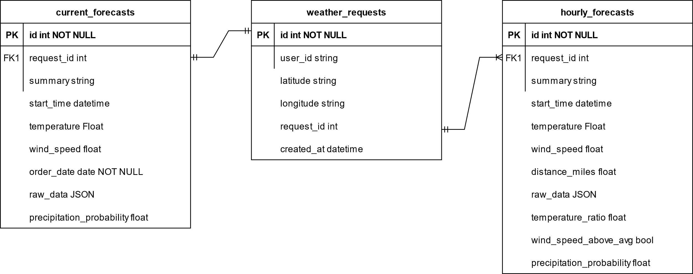
Database Schema Design
Key Principles:
3NF Normalization for data integrity
Foreign key constraints for referential integrity
JSON storage for raw data preservation
Strategic indexing for query performance
Normalized Relational Model

Slide 8
Data Enrichment
Advanced Analytics Feature Calculations
Temperature Analysis
temperature_ratio = hourly_temp / daily_average_temp
## Values above 1.0 would indicate above average temperature
2. Wind Pattern Detection
wind_above_avg = current_wind > daily_average_wind
## Boolean indicator for wind conditions
3. Geospatial Calculation
wind_above_avg = current_wind > daily_average_wind
## Boolean indicator for wind conditions
4. Precipitation Trends
Raw precipitation probabilities are preserved in JSON

Slide 9
Infrastructure & Deployment
Container-First Architecture
Docker Containeriztion
Application container with FastAPI
PostgreSQL container with persistence
Docker Compose orchestration
Configuration Management
Environment-based configuration (.env)
Multi-environment support (dev/staging/prod)
Monitoring & Observability
Structured JSON logging
Health check endpoints

Slide 10
Quality Assurance
Comprehensive Testing Strategy
Test Coverage
Unit Tests - Data enrichment algorithms
Integration Tests - Full API workflow
Service Tests - External API mocking
Development Workflow
docker-compose up –build
docker-compose run --rm app pytest

Slide 11
Design Choices & Justification - Architecture
Microservice Architecture
Choice: Single-responsibility weather service
Rationale: Easier to scale, deploy, and maintain independently
Alternative: Monolithic application
Trade-off: Slightly more complex deployment vs. better scalability
2. FastAPI Framework
Choice: FastAPI over Flask/Django
Rationale:
Built-in async support for better performance
Type hints and Pydantic validation
Modern Python 3.6+ features
Trade-off: Newer ecosystem vs. proven performance
3. PostgreSQL Database
Choice: PostgreSQL over NoSQL
Rationale:
ACID compliant
Stong JSON support for raw data storage
Excellent geospatial capabilities (PostGIS ready)
Trade-off: Structure schema vs document flexibilities

Slide 12
Design Choices & Justification – Data Design
Normalized Schema Design
Choice: 3 NF with separate tables
Rationale:
Eliminates data redundancy and ensures referential integrity
Enables complex queries and analytics
Alternative: Denormalized/flat structure
Trade-off: Query complexity vs. data consistency
2. Hybrid Storage Approach
Choice: Structured fields + JSON raw data storage
Rationale:
Fast queries on structured data
Preserves complete original data for future analysis
Flexibility for schema evolution
Trade-off: Storage overhead vs. data preservation

Slide 13
Optimization Strategies – Future Improvements
Performance Features
Connection pooling for db efficiency
Redis caching for frequently accessed data
Async processing with FastAPIOptimized SQL queries with proper indexing
2. Scalability Approach
Horizontal scaling with load balancers
Database read replicas for query distribution
Microservice architecture for independent scaling
Container orchestration for auto-scaling

Slide 14
Future Improvements - General
OAuth2 / API key-based authentication
CI/CD setup for automated testing & deploy
Metrics via Prometheus + Grafana
Scheduled batch ingestion from NWS

