Slide 1
TITLE
START SLIDE
...
Data Science SS19 (Text Mining) – Group B (Salous, R. / Brechmann, L. / Petersen, T.)

Slide 2
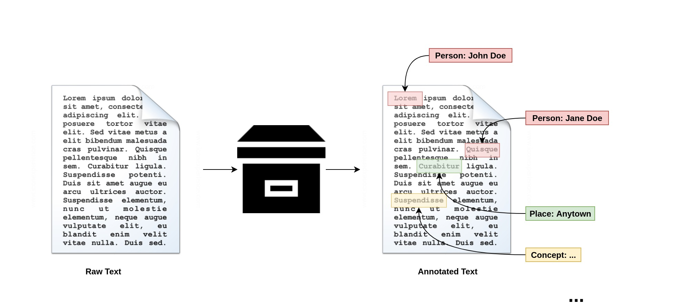
THE IDEA
(1) Concept Mining
→ Extract concepts from text (in our case: person names)
Data Science SS19 (Text Mining) – Group B (Salous, R. / Brechmann, L. / Petersen, T.)

Slide 3
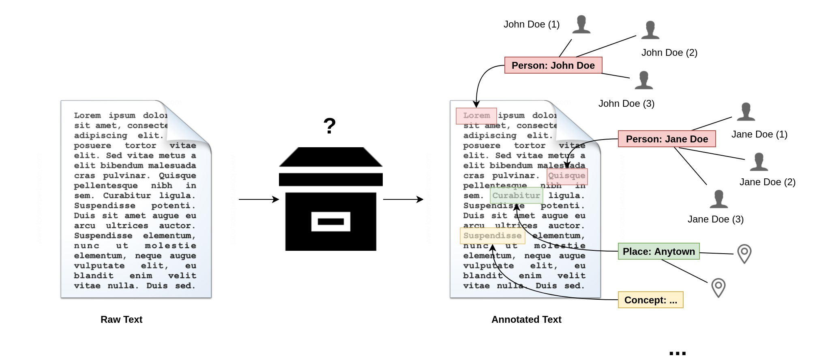
THE IDEA
(2) Find concept candidates
→ Query Knowledge Base (e.g. Wikidata, DBpedia)
Data Science SS19 (Text Mining) – Group B (Salous, R. / Brechmann, L. / Petersen, T.)

Slide 4

THE IDEA
(3) Disambiguation
→ Rank candidates by context data
Data Science SS19 (Text Mining) – Group B (Salous, R. / Brechmann, L. / Petersen, T.)

