Slide 1
Concept ranking by context comparison
with blended open data for personal names
Ludger Brechmann, Thorge Petersen, Reem Salous
Department of computer Science
CAU University
Data Science Seminar SS2019

Slide 2
Outline
Related Paper
The Idea of the project
The Use
Our approach
Named Entity Recognition
Query Knowledge base
Context comparison
Ranking
Data Science SS19 (Text Mining) – Group B (Salous, R. / Brechmann, L. / Petersen, T.)

Slide 3
Related Paper
TextTruth: An Unsupervised Approach to Discover Trustworthy Information from Multi-Sourced Text Data
it’s about a novel truth discovery method for unstructured data (raw text data), which aims to ranking the answers for each question based on estimated trustworthiness of factors
Estimate trustworthiness of factors done by groups the keywords extracted from the answers of a specific question into multiple interpretable factors then infer the trustworthiness of answer factors and answer providers
Using unsupervised learning
source:
TextTruth _-_ An_Unsupervised_Approach_to_Discover_TrustworthyInformation_from_Multi-Sourced_Text_Data
Data Science SS19 (Text Mining) – Group B (Salous, R. / Brechmann, L. / Petersen, T.)

Slide 4
THE IDEA
The first idea:
Discover Trustworthy Concepts from Text by Context Information and Multi-Sourced Linked Open Data (Blended Data)
Or what we did:
Concept ranking by context comparison with blended open data for personal names
Data Science SS19 (Text Mining) – Group B (Salous, R. / Brechmann, L. / Petersen, T.)

Slide 5
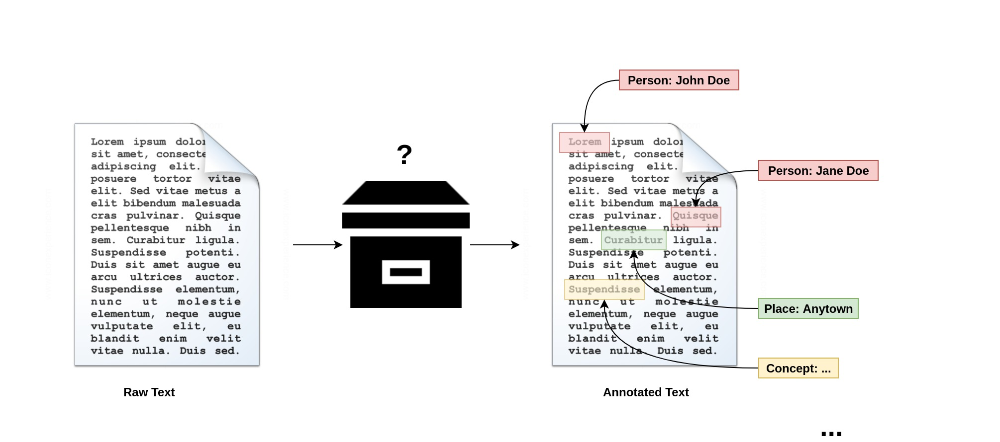
THE IDEA
(1) Concept Mining
→ Extract concept candidates from text
* To keep things simple, we focused on named entity recognition algorithms to
find person names instead of extracting all possible concept candidates.
Data Science SS19 (Text Mining) – Group B (Salous, R. / Brechmann, L. / Petersen, T.)

Slide 6
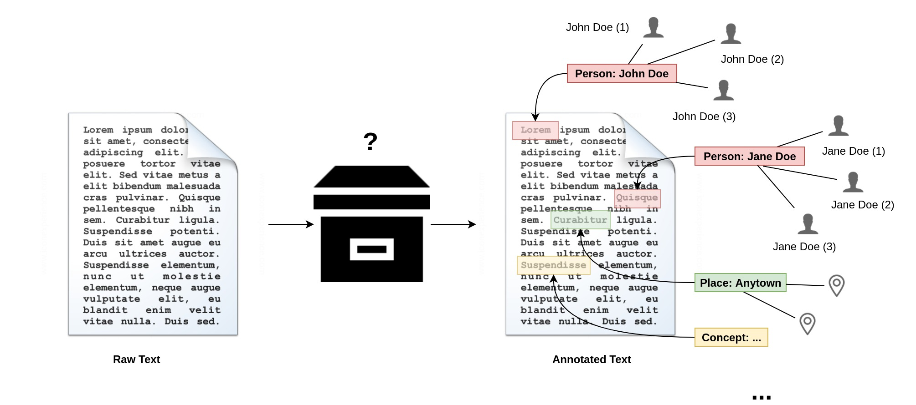
THE IDEA
(2) Find concept candidates
→ Query Knowledge Base (e.g. Wikidata, DBpedia)
Data Science SS19 (Text Mining) – Group B (Salous, R. / Brechmann, L. / Petersen, T.)

Slide 7

THE IDEA
(3) Disambiguation
→ Rank candidates by context data
Data Science SS19 (Text Mining) – Group B (Salous, R. / Brechmann, L. / Petersen, T.)

Slide 8
THE USE
What is it good for?
Structured data (!)
→ data interlinkage
→ machine-readability
What can we do with it?
Improve data access, discovery, and re-use
automatically annotate text (→ generate TEI attributes)
cluster documents by found concepts
<particDesc>
<listPerson>
<person>
<persName>
<forename>Max</forename>
<surname>Planck</surname>
</persName>
<idno type="URI">http://www.wikidata.org/entity/Q9021</idno>
</person>
</listPerson>
</particDesc>
…
<name type="pname" corresp="#planck">Max Planck</name>
Data Science SS19 (Text Mining) – Group B (Salous, R. / Brechmann, L. / Petersen, T.)

Slide 9
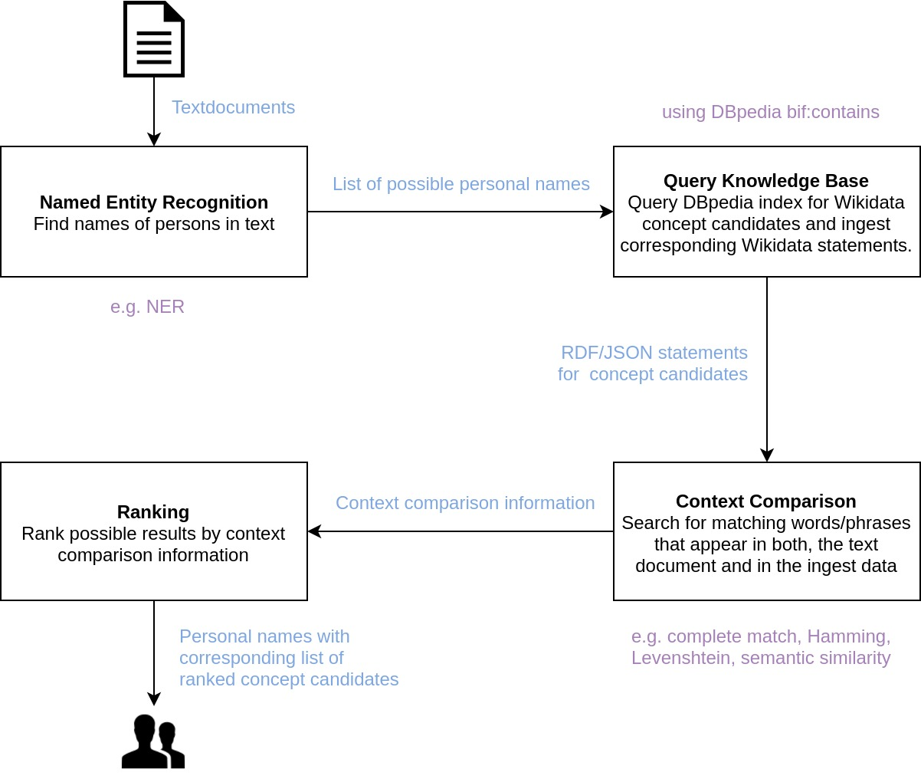
Our approach
Our simplified approach
Only extract personal names
Simple AND query for personal names using DBpedia‘s property bif:contains
Focus on specific topics (e.g. scientific texts, news, …)
Ingest predefined selection of Wikidata properties
...
Data Science SS19 (Text Mining) – Group B (Salous, R. / Brechmann, L. / Petersen, T.)

Slide 10
NAMED ENTITY RECOGNITION
The goal of this part is to extract personal names from a document.
There are many software libraries and algorithms to extract entities from a document, such as SpaCy, NLTK and Stanford NER. in our project we will use SpaCy Library
SpaCy
it's a free open-source library for NLP in Python.
SpaCy can recognize various types of named entities in a document like person, nationality, location and companies.
it has trained models and they are statistical and strongly depend on the examples were trained on. so it will give prediction based on the examples that the models have seen during training
Training the model by adding more examples of text and the labels we want the model to predict,
we can check the accuracy of the prediction from error gradient of the loss function.
Data Science SS19 (Text Mining) – Group B (Salous, R. / Brechmann, L. / Petersen, T.)

Slide 11
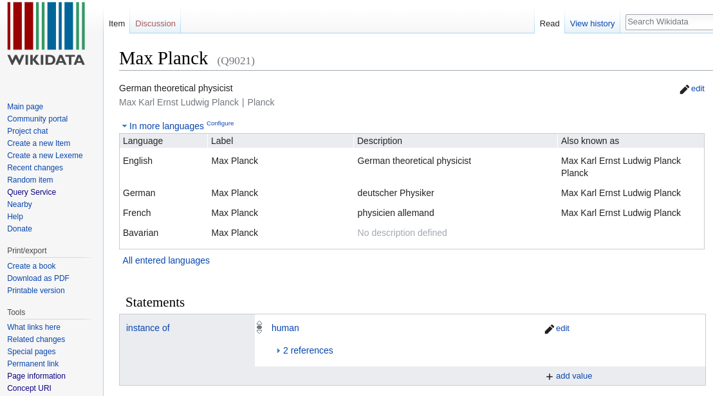
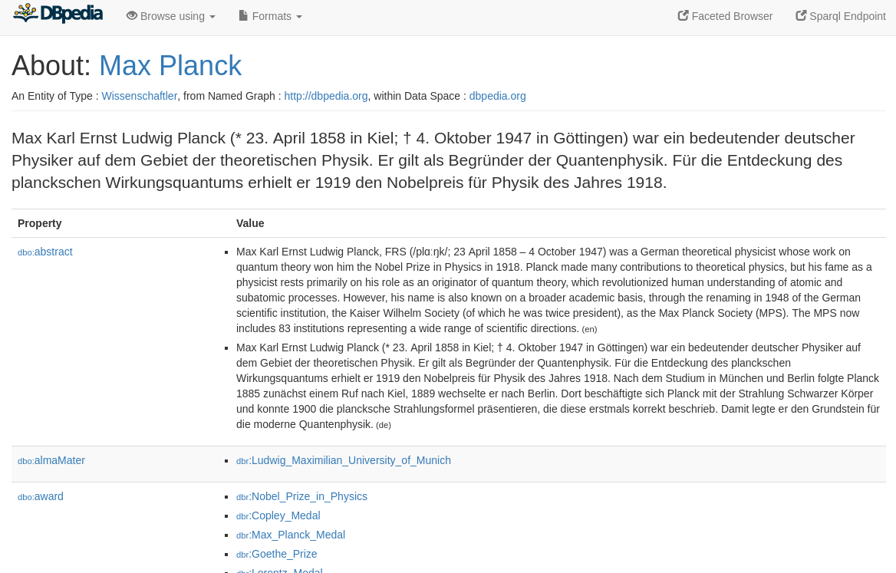
QUERY KNOWLEDGE BASE
Wikidata
project of the Wikimedia Foundation
provides data to Wikipedia
will allow infoboxes to be created
community curated vocabulary as part of data maintained on site
CC-0
DBpedia
extracts structured data from Wikipedia’s infoboxes
more static vocabulary
full-text search through Virtuoso’s
indexing of RDF object values
CC-BY-SA
Both publish RDF data (LOD) and operate SPARQL query service endpoints.
→ Build federated query over useful service endpoints and retrieve useful data
Data Science SS19 (Text Mining) – Group B (Salous, R. / Brechmann, L. / Petersen, T.)

Slide 12
CONTEXT COMPARISON
Parsing, filtering and converting the JSON-Data from the name-query into reduced,weighted differently structured data
→ different properties mean different ranking-values
(e.g. place of birth vs. favourite food)
Convert the converted paper into a suiting data type and data structure which is efficient searchable
Necessary because of many comparisons between context data and phrases/words within the converted paper
→ Key-Value-Store based on balanced binary trees (O(log n))
→ Haskell’s Bytestring-library:
Can often match or exceed the performance and memory footprint of C, while maintaining Haskell's expressivity and conciseness.
Data Science SS19 (Text Mining) – Group B (Salous, R. / Brechmann, L. / Petersen, T.)

Slide 13
RANKING
general idea
→ distance between names and context data provide information about a possible content connection
Factors, which influence the probability of connection between context data and names
→ context data which can be linked locally to more than one name
→ different weighting of properties of the context data
→ amount of linked context data and names
→ negligibility of links between context data and names, where the context data is most likely already linked to another name
Data Science SS19 (Text Mining) – Group B (Salous, R. / Brechmann, L. / Petersen, T.)

