Slide 1
Finding a Good Location for Gourmet Pizza Places in Cuyahoga County
IBM Data Science Professional Capstone Project
April 2019

Slide 2
Objective
Basilico Pizzeria, a local gourmet pizza chain in the Cleveland, Ohio area, wants to open 2 new restaurants.
Need to choose cities without a lot of competition and where the population and median income are high enough to support the business.
The restaurant business is very competitive, so the owners want to base their 2 new ventures on some solid data.

Slide 3
Data acquisition and cleaning
Data for latitude and longitude for all US cities was downloaded from: https://simplemaps.com/data/us-cities. Removed the non-Ohio locations and uploaded the CSV. See header below.
city | county | lat | lng | population
Dunkinsville | Adams | 38.8559 | -83.4713 | NaN
Cherry Fork | Adams | 38.8862 | -83.6146 | 155
Peebles | Adams | 38.9463 | -83.4094 | 1753
West Union | Adams | 38.7917 | -83.5441 | 3074
Manchester | Adams | 38.6902 | -83.6053 | 1978
Obtained Ohio median income data from https://www.cleveland.com/datacentral/2016/12/median_family_income_household.html and converted it to a CSV and uploaded it. See header below.
city | median_income
New Albany | $214,850
Indian Hill | $211,795
Pepper Pike | $186,765
Powell | $146,442
Dublin | $144,005

Slide 4
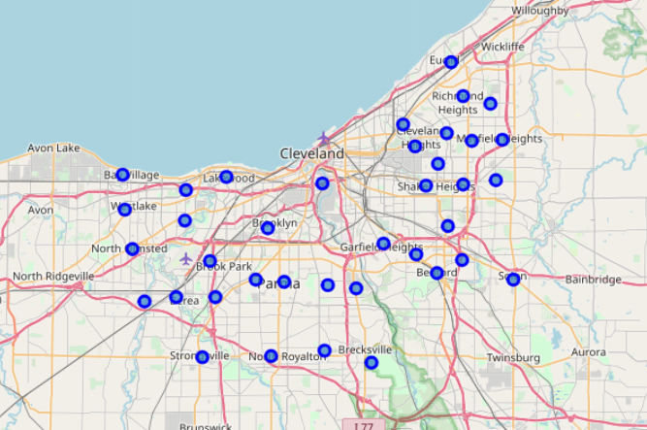
Data acquisition and cleaning (con’t)
Next, merge the dataframes and filter dataframe to include only cities in Cuyahoga County. See header below.
city | lat | lng | population | median_income
University Heights | 41.4948 | -81.5348 | 13126.0 | 84594.0
Lakewood | 41.4824 | -81.8008 | 50279.0 | 70448.0
Richmond Heights | 41.5589 | -81.5029 | 10421.0 | 63029.0
Shaker Heights | 41.4744 | -81.5496 | 27448.0 | 107938.0
Brecksville | 41.3079 | -81.6193 | 13425.0 | 121974.0
To the right is a map of our dataset.

Slide 5
Data Analysis
Let’s begin by looking at the summary statistics.
 | lat | lng | population | median_income
count | 38.0000 | 38.0000 | 38 | 38
mean | 41.4375 | -81.6611 | 67026 | 80272
std | 0.0731 | 0.1576 | 277729 | 30601
min | 41.3079 | -81.9315 | 6198 | 30466
25% | 41.3848 | -81.8115 | 12780 | 58253
50% | 41.4356 | -81.6289 | 18711 | 76733
75% | 41.4844 | -81.5228 | 27791 | 102063
max | 41.5904 | -81.4401 | 1731637 | 186765
We will use the population and median income statistics as a factor in our decision making.
Particularly we will be looking for population and median income near the 75 percentile.

Slide 6
Data Analysis (con’t)
Remove population and median income before clustering.
Below is the header of the dataset we will use for clustering
city | county | lat | lng
University Heights | Cuyahoga | 41.4948 | -81.5348
Lakewood | Cuyahoga | 41.4824 | -81.8008
Richmond Heights | Cuyahoga | 41.5589 | -81.5029
Shaker Heights | Cuyahoga | 41.4744 | -81.5496
Brecksville | Cuyahoga | 41.3079 | -81.6193

Slide 7
Data Analysis (con’t)
Next we need to look at the competition.
We’ll use Foursquare to get venues in our cities.
Our query returned 417 venues and 129 unique categories. Below is the header.
city | Venue | Venue Latitude | Venue Longitude | Venue Category
University Heights | Bialy's Bagels | 41.4979 | -81.5360 | Bagel Shop
University Heights | Geraci's Restaurant | 41.4982 | -81.5368 | Restaurant
University Heights | HomeGoods | 41.4985 | -81.5363 | Furniture / Home Store
University Heights | Peter's Tailor Shop | 41.4983 | -81.5361 | Tailor Shop
University Heights | Quagmire's | 41.4934 | -81.5402 | Bar

Slide 8
Data Analysis (con’t)
Next let’s filter the data frame to look at only pizza places. Below is the result.
city | Venue | Venue Latitude | Venue Longitude | Venue Category
Strongsville | Pizza Hut | 41.3121 | -81.8346 | Pizza Place
Lyndhurst | Tasty Pizza | 41.5199 | -81.4956 | Pizza Place
Lyndhurst | Vicinato Pizzeria | 41.5194 | -81.4969 | Pizza Place
Garfield Heights | Papa John's Pizza | 41.4164 | -81.6059 | Pizza Place
Garfield Heights | Pizza Pan | 41.4214 | -81.6091 | Pizza Place
North Olmsted | Little Caesars Pizza | 41.4180 | -81.9192 | Pizza Place
Berea | Marco's Pizza | 41.3716 | -81.8689 | Pizza Place
Berea | Romeo's Pizza | 41.3725 | -81.8680 | Pizza Place
Parma Heights | Pizza Hut | 41.3867 | -81.7690 | Pizza Place
Parma Heights | Godmother's Pizza & Subs | 41.3856 | -81.7611 | Pizza Place
East Cleveland | Happy's Pizza | 41.5292 | -81.5826 | Pizza Place
North Royalton | Marco's Pizza | 41.3135 | -81.7492 | Pizza Place
Solon | Domino's | 41.3846 | -81.4394 | Pizza Place
Solon | Papa John's Pizza | 41.3871 | -81.4415 | Pizza Place
Solon | Pizza Hut | 41.3854 | -81.4364 | Pizza Place
Solon | Antonio's Pizza Solon | 41.3840 | -81.4362 | Pizza Place
Fairview Park | Domino's | 41.4460 | -81.8550 | Pizza Place

Slide 9
Data Analysis (con’t)
Next, let’s get the counts by city with the groupby function. Below is the result.
city | counts
Berea | 2
East Cleveland | 1
Fairview Park | 1
Garfield Heights | 2
Lyndhurst | 2
North Olmsted | 1
North Royalton | 1
Parma Heights | 2
Solon | 4
Strongsville | 1
I'm surprised there aren't more pizza places listed.
I'm sure they have a lot of chain and carryout pizza places that aren't reported as much on Foursquare, but that's not our market anyway.
This does tell us we don't want to open up our pizza place in Solon!

Slide 10
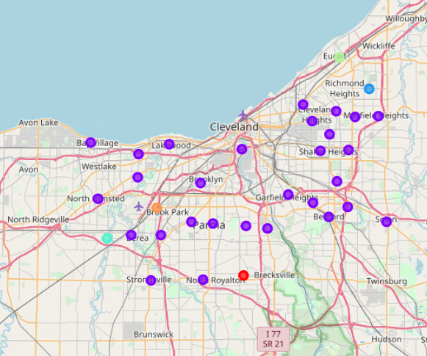
Data Analysis (con’t)
Below are the resulting dataframe and map.
city | Cluster | 1st Most Common Venue | 2nd Most Common Venue | 3rd Most Common Venue
University Heights | 0 | Restaurant | Bar | Furniture / Home Store
Lakewood | 0 | Sandwich Place | Salon / Barbershop | Mobile Phone Shop
Shaker Heights | 4 | Light Rail Station | Women's Store | Football Stadium
Bedford Heights | 8 | Home Service | Rest Area | Intersection
Strongsville | 0 | American Restaurant | Shoe Store | Bank
Cleveland | 0 | Pub | Molecular Gastronomy Restaurant | Bus Station
Lyndhurst | 0 | American Restaurant | Pizza Place | Shipping Store
Cleveland Heights | 0 | ATM | Pool | Park
Parma | 0 | Convenience Store | Sandwich Place | Golf Course
Seven Hills | 7 | Baseball Field | Pool | Women's Store
Middleburg Heights | 0 | Automotive Shop | American Restaurant | Community Center
Mayfield Heights | 0 | Sandwich Place | Women's Store | Men's Store
South Euclid | 0 | Ice Cream Shop | Bar | Flower Shop
Euclid | 6 | Pet Store | Women's Store | Convenience Store
Maple Heights | 0 | Sandwich Place | Convenience Store | Deli / Bodega
Garfield Heights | 0 | Pharmacy | Fast Food Restaurant | Pizza Place
North Olmsted | 0 | American Restaurant | Sandwich Place | Fast Food Restaurant
Olmsted Falls | 2 | Flower Shop | Women's Store | Hot Dog Joint
Bay Village | 10 | Soccer Field | Gym / Fitness Center | Italian Restaurant
Brooklyn | 10 | Park | Football Stadium | Soccer Field
Berea | 0 | Pizza Place | Ice Cream Shop | Sandwich Place
Brook Park | 1 | Beach | Convenience Store | Deli / Bodega
Broadview Heights | 5 | Gym | Women's Store | Food Truck
Bedford | 0 | Bar | Hot Dog Joint | CafÃ©
Beachwood | 12 | Intersection | Bakery | Women's Store
Parma Heights | 0 | Pizza Place | Bar | Chinese Restaurant
East Cleveland | 0 | Mobile Phone Shop | Mattress Store | American Restaurant
Warrensville Heights | 0 | Gym / Fitness Center | Discount Store | Fast Food Restaurant
North Royalton | 9 | Pool | Gym / Fitness Center | Pizza Place
Rocky River | 10 | Gym / Fitness Center | Pub | Playground
Highland Heights | 3 | Concert Hall | Hot Dog Joint | Cosmetics Shop
Independence | 11 | Theater | Sandwich Place | Art Gallery
Solon | 0 | Pizza Place | Grocery Store | Sandwich Place
Fairview Park | 0 | Ice Cream Shop | Italian Restaurant | Donut Shop

Slide 11
Data Analysis (con’t)
We have an interesting finding.
Category 0 has the most members it's members appear to have more pizza places and other restaurants.
Remove category 0 and merge with median income data.
This is the dataset from which we will pick the 2 new locations.
city | population | median_income | Cluster | 1st | 2nd | 3rd
Brook Park | 18691 | 60571 | 1 | Beach | Convenience Store | Deli / Bodega
Olmsted Falls | 8890 | 79699 | 2 | Flower Shop | Women's Store | Hot Dog Joint
Highland Heights | 8397 | 114792 | 3 | Concert Hall | Hot Dog Joint | Cosmetics Shop
Shaker Heights | 27448 | 107938 | 4 | Light Rail Station | Women's Store | Football Stadium
Broadview Heights | 19197 | 99286 | 5 | Gym | Women's Store | Food Truck
Euclid | 47360 | 49668 | 6 | Pet Store | Women's Store | Convenience Store
Seven Hills | 11655 | 92235 | 7 | Baseball Field | Pool | Women's Store
Bedford Heights | 10555 | 51591 | 8 | Home Service | Rest Area | Intersection
North Royalton | 30247 | 90771 | 9 | Pool | Gym / Fitness Center | Pizza Place
Bay Village | 15328 | 109673 | 10 | Soccer Field | Gym / Fitness Center | Italian Restaurant
Brooklyn | 10828 | 54293 | 10 | Park | Football Stadium | Soccer Field
Rocky River | 20264 | 100334 | 10 | Gym / Fitness Center | Pub | Playground
Independence | 7114 | 105600 | 11 | Theater | Sandwich Place | Art Gallery
Beachwood | 11707 | 115536 | 12 | Intersection | Bakery | Women's Store

Slide 12
conclusion
Based on population, median income, and the amount of competition, it looks like Rocky River and Shaker Heights are good locations for our 2 gourmet pizza places.
This is based on selecting the 2 cities with over $100k median income and then the highest population among those.
Both population and median incomes are well above the mean for Cuyahoga county and close to the 75 percentile.
 | lat | lng | population | median_income
count | 38.0000 | 38.0000 | 38 | 38
mean | 41.4375 | -81.6611 | 67026 | 80272
std | 0.0731 | 0.1576 | 277729 | 30601
min | 41.3079 | -81.9315 | 6198 | 30466
25% | 41.3848 | -81.8115 | 12780 | 58253
50% | 41.4356 | -81.6289 | 18711 | 76733
75% | 41.4844 | -81.5228 | 27791 | 102063
max | 41.5904 | -81.4401 | 1731637 | 186765

