Slide 1
Assignment Project Traffic Light using STM32F103RB

Slide 2
Introduction
In this project, the STM32F103RB is used to simulate the 2-way traffic light system, having some main features:
Automatic mode: The system operates as normal. The light colors are red, yellow, and green.
Manual mode: A button is used to switch the light colors in this mode
Tuning mode: This mode is used to modify the light timing length
Pedestrian scramble: when the button for pedestrian is pressed, its light is turned on and operates reversely to the light of vehicles

Slide 3

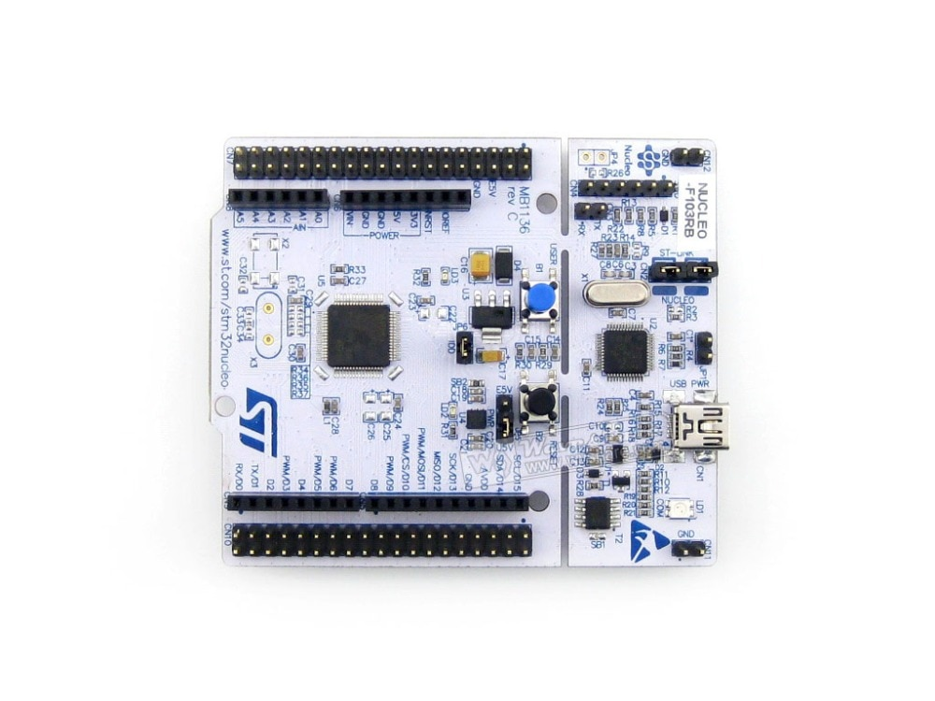
Block Diagram
Pedestrian Light
(D6 – PB10
D7 – PA8)
Traffic Light 1
(D2 – PA10
D3 – PB3)
Traffic Light 2
(D4 – PB5
D5 – PB4)
Pedestrian Buzzer
(D12 – PA6
TIM3-CH1)
USART2
Pedestrian Button
(A0 – PA0)
SELECT
Button
(A1 – PA1)
MODIFY
Button
(A2 – PA4)
SET
Button
(A3 – PB0)

Slide 4
Configuration
Clock: 64MHz
TIM2: PSC = 7999, ARR = 79 => 100Hz clock
TIM3 - PWM: PSC = 63, ARR = 999 => 1kHz clock
USART2, baud rate: 9600

Slide 5
Function
AUTO MODE
We use FSM with 5 state:
Init, red_green1, red_yellow1, red_green2, red_yellow2
Function put in main.c
trafficLight_automatic()
trafficLight_change()
trafficLight_manual()
trafficLight_pedestrian()

Slide 6
Function
MANUAL MODE
Press ’’SELECT’’ => MANUAL MODE
=> Force change traffic light (For policeman use)
Press ’’MODIFY’’, change the traffic light manually
Press ’’SET’’, return to AUTO MODE

Slide 7
Function
MODIFY TIME MODE

