Slide 1

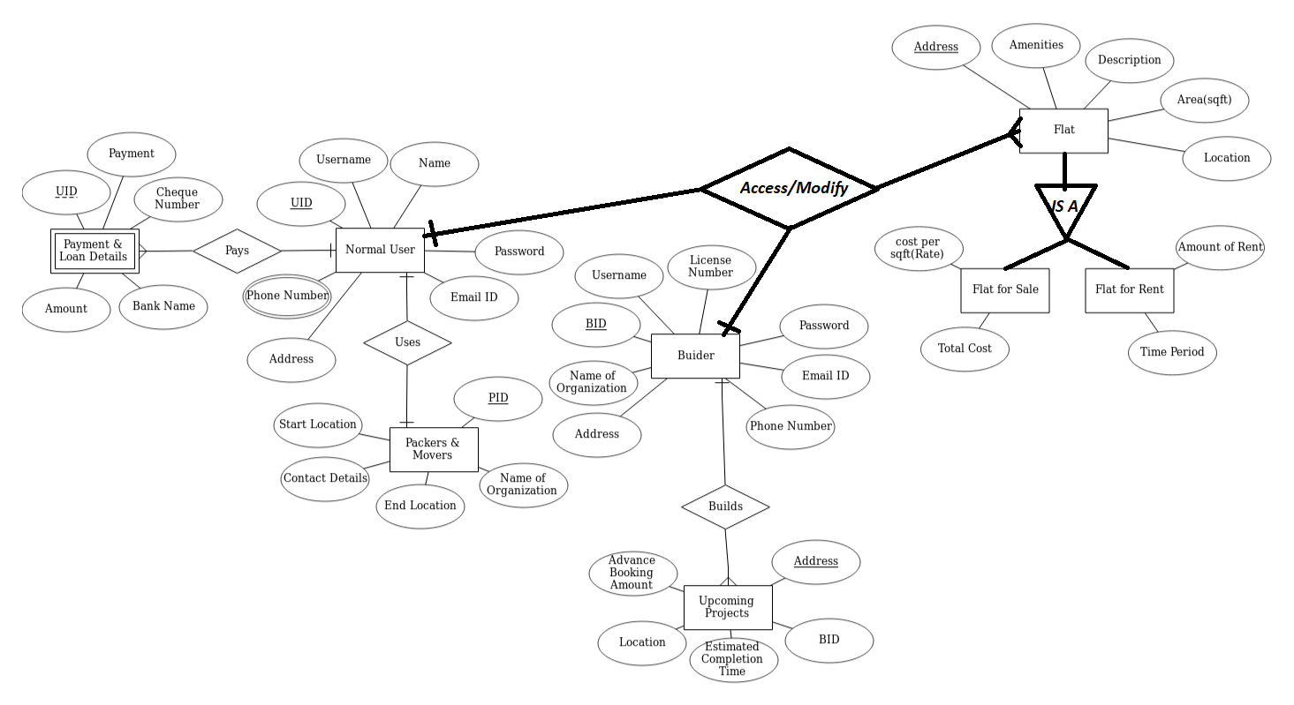
Real Estate (Property Buying And Selling)
Manas Sinkar 57
Parth Thosani 60
Jaydeep Vaghasiya 61
ABSTRACT
OBJECTIVES
OUTCOMES
TECHNOLOGY USED
FUTURE SCOPE
The proposed system applies to the normal citizens of the world.
The basic idea is to provide easy access to data of real estate sale and rent and to have direct communication between client and organization
To eradicate the brokerage/mid-man cost for the clients and seller/leaser
To provide platform to normal user for listing their flats on our website for selling as well as well as renting.
Builders can sell their flats effectively and it Provides advanced booking facility for upcoming projects of builders.
User can find flats for rent easily in near by location
Normal user would be able to upload their flats or property to our website for selling or renting
Normal user can also buy or rent the flat from our website
Builders can list their buildings for selling and they can also upload their upcoming project.
Front end: HTML , CSS , BOOTSTRAP , JAVA SCRIPT
Middle-tier: PHP
Back-end: MySQL
The Service provided by our website housing-co will be very useful for the user who is searching for a new flat for rent or sale because our website has various options with the best facilities in the flats and user can search for a flat in entire city by using our website
Builders can list their upcoming projects on our website so selling of flats would be faster as compare to normal selling and it will maximize the profit for builders.
MOTIVATION
The current real estate property buying and selling method is too time consuming and there are very few choices for client to buy or sell or rent their property. And also client have to visit the property site(location) which is time consuming . They are not getting best houses with best price since there are very few options available for the client The motivation behind this project is to provide several options for buying the property with the details of the property and with images so that client can see the property without visiting the location . So our project will make sure that client will get best choice with best price and various options for the property buying , selling and renting.
METHODOLOGY
CONCLUSION
We have designed our website for two types of user Normal user and Builders service provided to the Normal user is they can sell the flat or rent the flat and also they can buy the flat through our website for Builders they can upload their upcoming projects and buildings on our website for selling purpose so basically it provides better platform for buying and selling of property.
We can conclude that with the help of database management system we can keep the record of all the properties which are listed on the website or selling or renting purpose and we can provide various options for buying a flats to the client who is searching for a flats and builders can also sell their flats effectively so it will make property buying and selling process very easy efficient and consistent.
PROBLEM STATEMENT
To make the process of selling and buying the property easy there is requirement of database system which keeps the track of all the flats and properties in the city . In real estate world there are various builders who builds the building and they want to sell their flats with maximum profit but they are not able to get maximum profit due to fierce competition and lack of marketing strategy. So database of real estate will make this process easy for both normal user as well as builders.
REFERENCES
!) www.w3schools.com
2) www.stackoverflow.com
3) www.geeksforgeeks.com

