Slide 1
Tanvir Hossain GEOG 4057 CLASS Project 1 Report

Slide 2
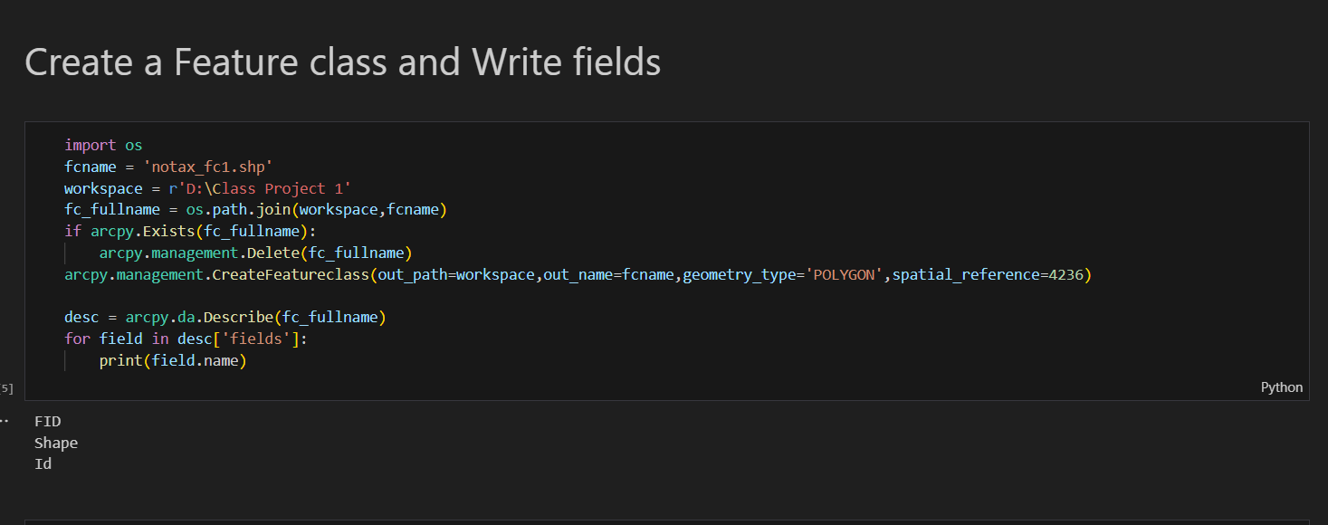
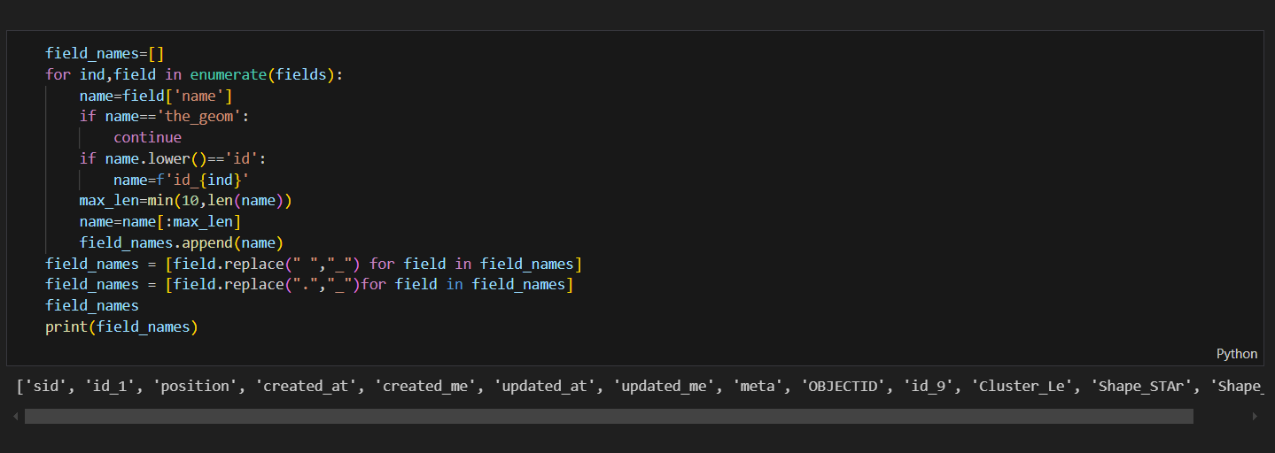
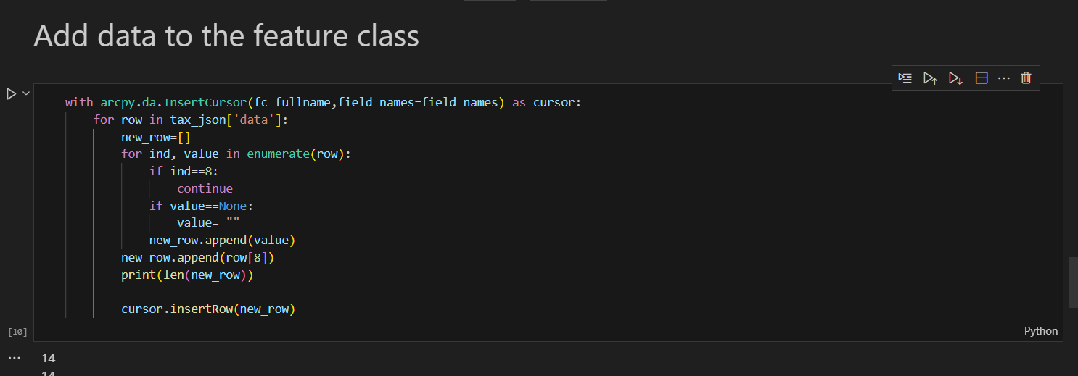
Code of ipynb file

Slide 3
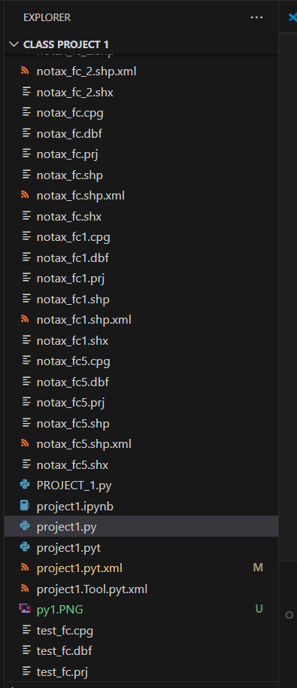
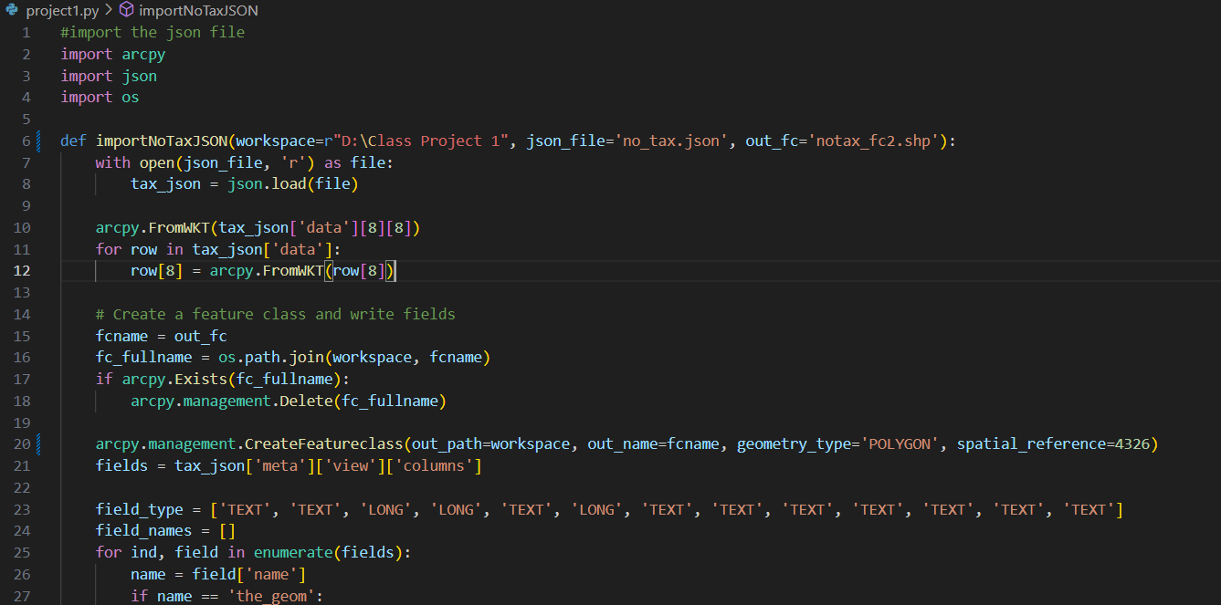
Screenshot of code and generated file in vs code

Slide 4
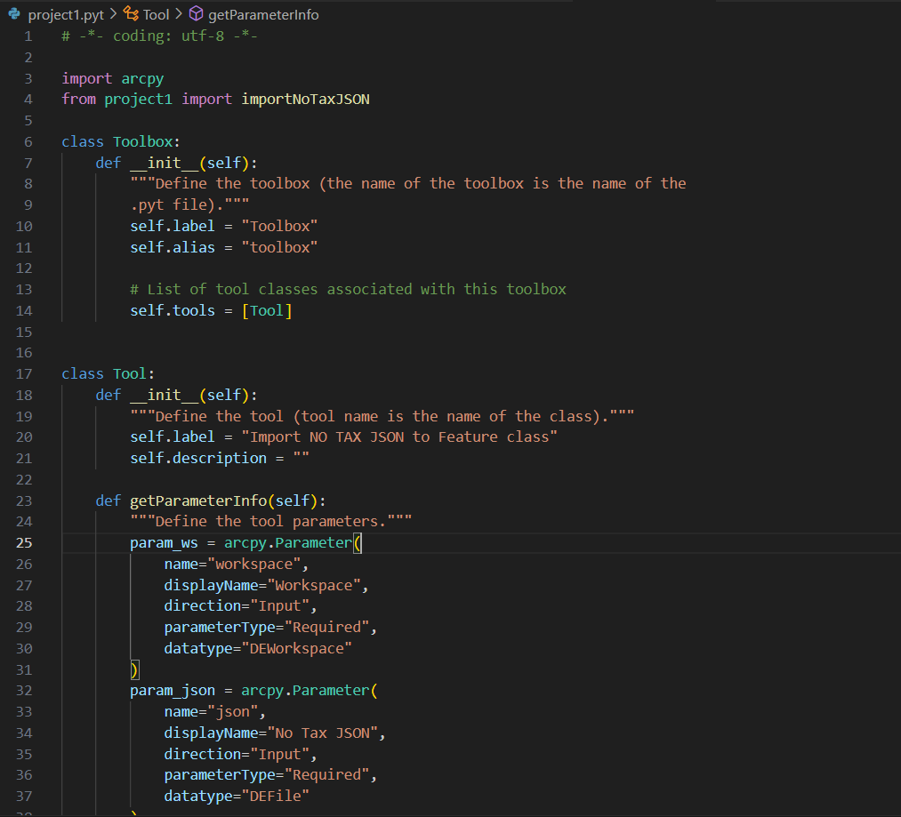
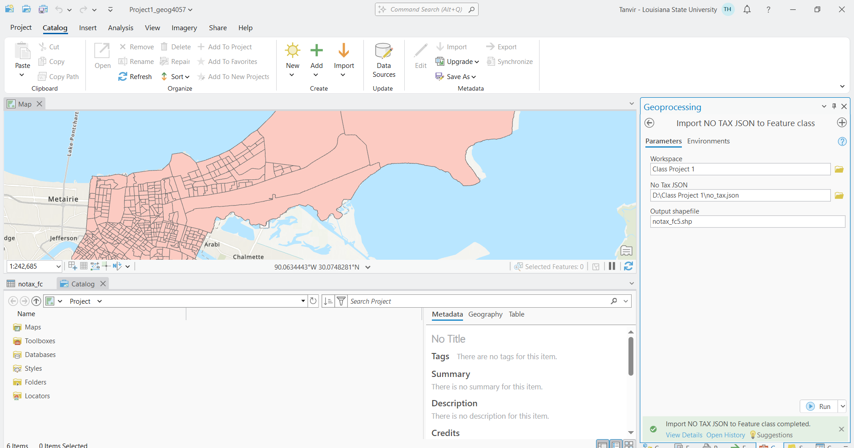
Successfully run the toolbox in ArcGIS pro
Code of Toolbox in VS code

Slide 5
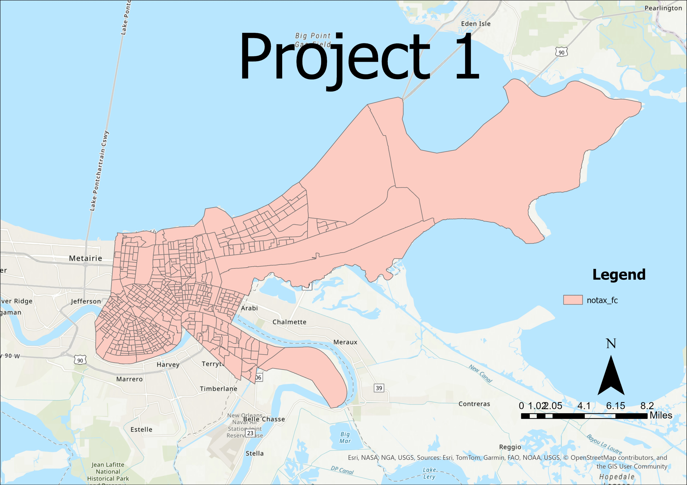
Final Map

