Slide 1
Semantic Data Processing and Representation
Capstone Project – MigrantNav
Lecturer : Prof. Dr. Ivan Yamshchikov
Project Team:
Bhuvana Chandra Thota
Shehariyar Firdous Shaikh
Rachitha Chandra Bhanu
Sai Surya Mada

Slide 2
Problem Statement & Solution
Refugees and asylum seekers coming to Germany and the EU face language barriers, complex asylum procedures, and lack of reliable information.
Official information is scattered across multiple websites, often outdated or hard to understand.
Many depend on unverified sources, leading to confusion, misinformation, and missed deadlines.
A Retrieval-Augmented Generation (RAG) chatbot that provides accurate, up-to-date, and verified asylum information that Supports multi languages.

Slide 3
What is RAG (Retrieval-Augmented Generation)?
RAG combines information retrieval with LLM generation
The model retrieves verified documents first, then generates answers grounded in those sources
Prevents hallucinations by forcing the LLM to answer only from retrieved facts
Ideal for domain critical systems (law, healthcare, finance).
Why RAG in MigrantNav?
Legal accuracy is mandatory → EU & German asylum laws must not be hallucinated
Enables a privacy preserving, explainable, and trustworthy legal agent.
RAG allows MigrantNav to be helpful like a human caseworker, but accurate like a law book.

Slide 4
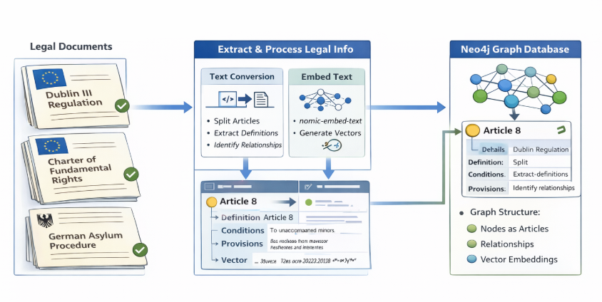
Building The MigrantNAV Legal Knowledge Database

Slide 5
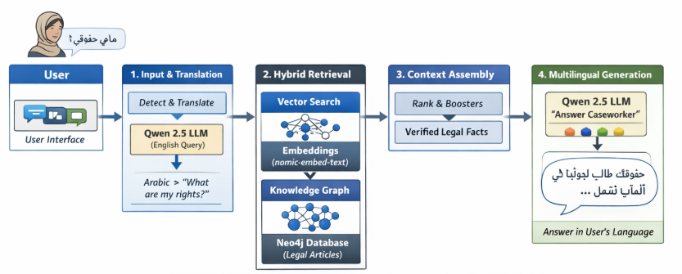
WorkFlow: Rag Chatbot MigrantNav

Slide 6
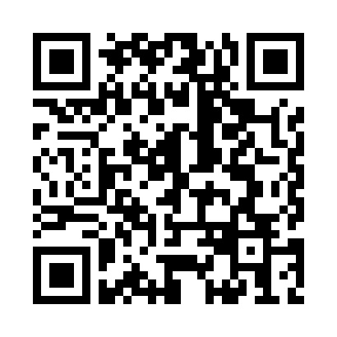
Scan QR Test Our MigrantNav
THANK YOU

