Slide 1
Interactive Dashboard Design for Business Stakeholders
NAME : THOTA BHARATH DATE :27/04/2025
Notes:
NAME : THOTA BHARATH DATE :27/04/2025

Slide 2
Objective
Goal: Design an interactive dashboard that helps stakeholders.
Tools Used: Power BI / Tableau
Dataset: Sales/Financial dataset from Kaggle

Slide 3
Key KPIs Chosen
Sales (Total Revenue)
Profit (Net Profit)
Growth Rate (Sales Growth %)
Additional Metrics: Customer Count, Average Order Value

Slide 4
Dashboard Design Features
Use of slicers and filters for interactivity
Time-series analysis for trends
Cards displaying key totals and summaries
Consistent color theme for appearance
Navigation menu for easier exploration (if possible)

Slide 5
Dashboard Components
Cards: Total Sales, Total Profit, Year-over-Year Growth
Line Charts: Monthly Sales and Profit Trends
Bar Charts: Sales by Region/Product
Filters/Slicers: Time Period, Region, Product Category

Slide 6
Color Theme and Design Choices
Blue and white theme for a clean look
Consistent fonts and sizes
Key figures highlighted with contrasting colors
Dashboard made mobile-friendly

Slide 7
Outcome
Built professional dashboards
Designed with stakeholder needs in mind
Practiced using interactive elements
Improved skills in Power BI/Tableau

Slide 8
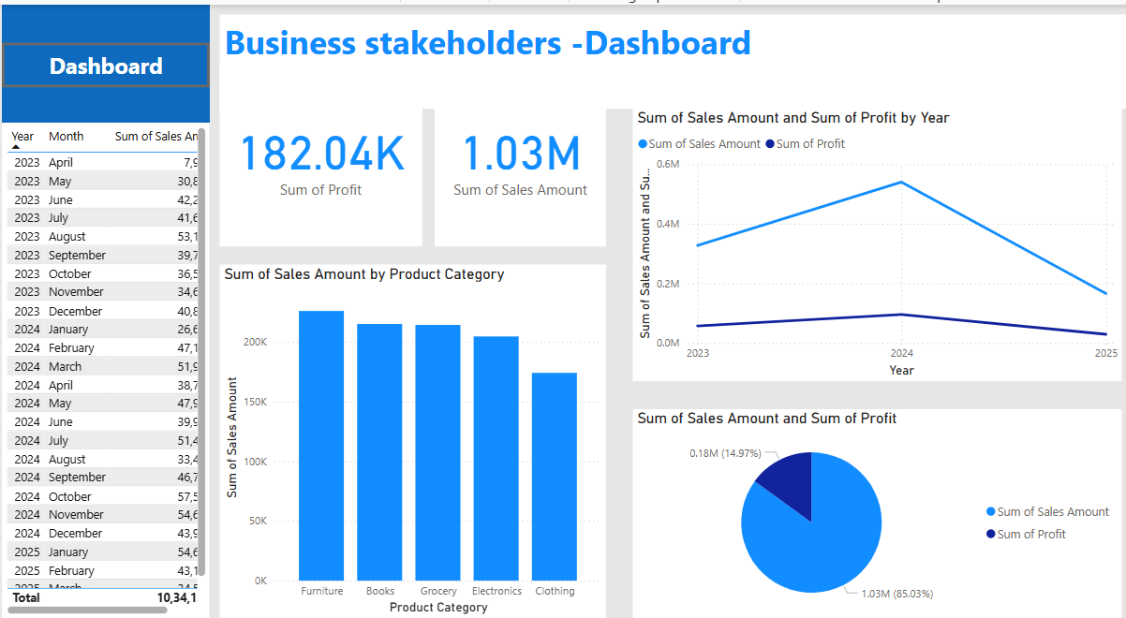

Slide 9


