Slide 1
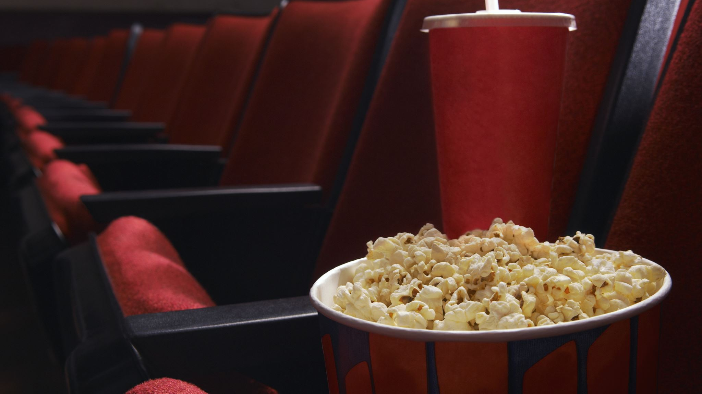
Generating Realistic and Diverse Textual Movie Reviews with IMDb Dataset leveraging Deep Learning
by
Sreecharan Vanam
Krishna Varma Ayinampudi
SaiKrishna Meduri
At
University of North Texas

Slide 2
Introduction
The project leverages advanced Natural Language Processing (NLP) to automate the creation of movie reviews that are realistic and diverse.
Using the collected IMDb dataset, we developed a model that produce reviews that try to mimic human-written content.
Our goal is to enhance the efficiency and quality of content generation in media and entertainment industries exploring new deep learning architectures capabilities.

Slide 3
Motivation
Increasing demand for automated content creation across digital platforms requires innovative solutions.
High-quality, automated text generation aids in managing large volumes of content, ensuring consistency and diversity.
Our project addresses the need for advanced tools in the growing field of AI-driven content creation.

Slide 4
Advantages
Enhanced Realism: Generates text that mirrors human tone and style, making it relatable and engaging capturing different emotions of movie reviewers.
Scalability: Capable of producing large quantities of content rapidly, suitable for platforms with extensive content needs.
Customization: Offers flexibility in generating text according to specific style guides or thematic requirements.

Slide 5
Previous Works
Early models like RNNs and LSTMs laid the groundwork but struggled with long-text coherence and memory limitations.
The introduction of transformers revolutionized text generation, enabling better handling of context and dependencies.
Our work builds on these innovations, employing the latest GPT-2 model to push the boundaries further in text realism.

Slide 6
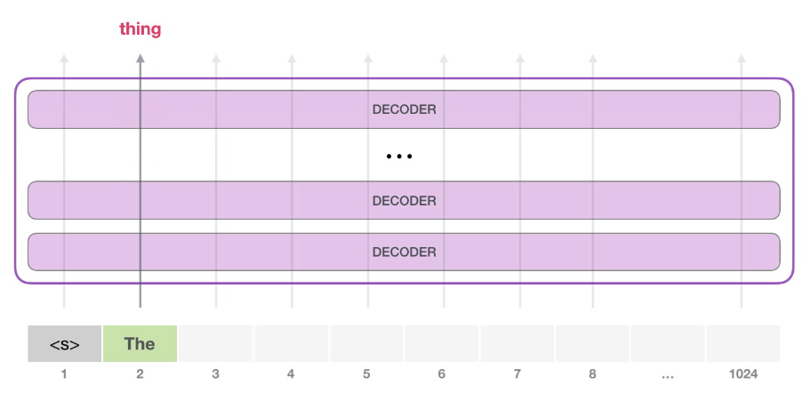
Model Architecture
GPT-2 Architecture: Employs a multi-layer transformer network capable of understanding and generating complex text structures.
Self-Attention Mechanisms: Enable the model to focus on different words in the input sequence, improving relevance and accuracy.
Layered Decoding: Each layer of the model refines the output, enhancing the fluency and grammatical correctness of the text.

Slide 7
Approach
We employ GPT-2, a transformer-based model known for its effectiveness in generating coherent and contextually aware text.
Our approach involves extensive data preprocessing to optimize the quality of input for training.
We focus on continuous improvement and optimization of the model to adapt to new data and feedback

Slide 8
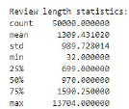
Dataset
The analysis revealed the following statistics regarding the statistics of the IMDB movie reviews dataset:
• Count: The dataset contains 50,000 movie reviews.
• Mean Length: The average length of the movie reviews is approximately 1309 words.
• Standard Deviation: The variety in the lengths of the reviews is indicated by the standard deviation of the review lengths, which is around 989.73 words.
• Minimum Length: The shortest movie review in the dataset contains 32 words.
• 25th Percentile (Q1): 25% of the movie reviews have a length of 699 words or less.
• Median (50th Percentile): The median length of the movie reviews is 970 words, indicating that half of the reviews have a length of 970 words or less.
• 75th Percentile (Q3): 75% of the movie reviews have a length of 1590 words or less.
• Maximum Length: The longest movie review in the dataset contains 13,704 words.

Slide 9
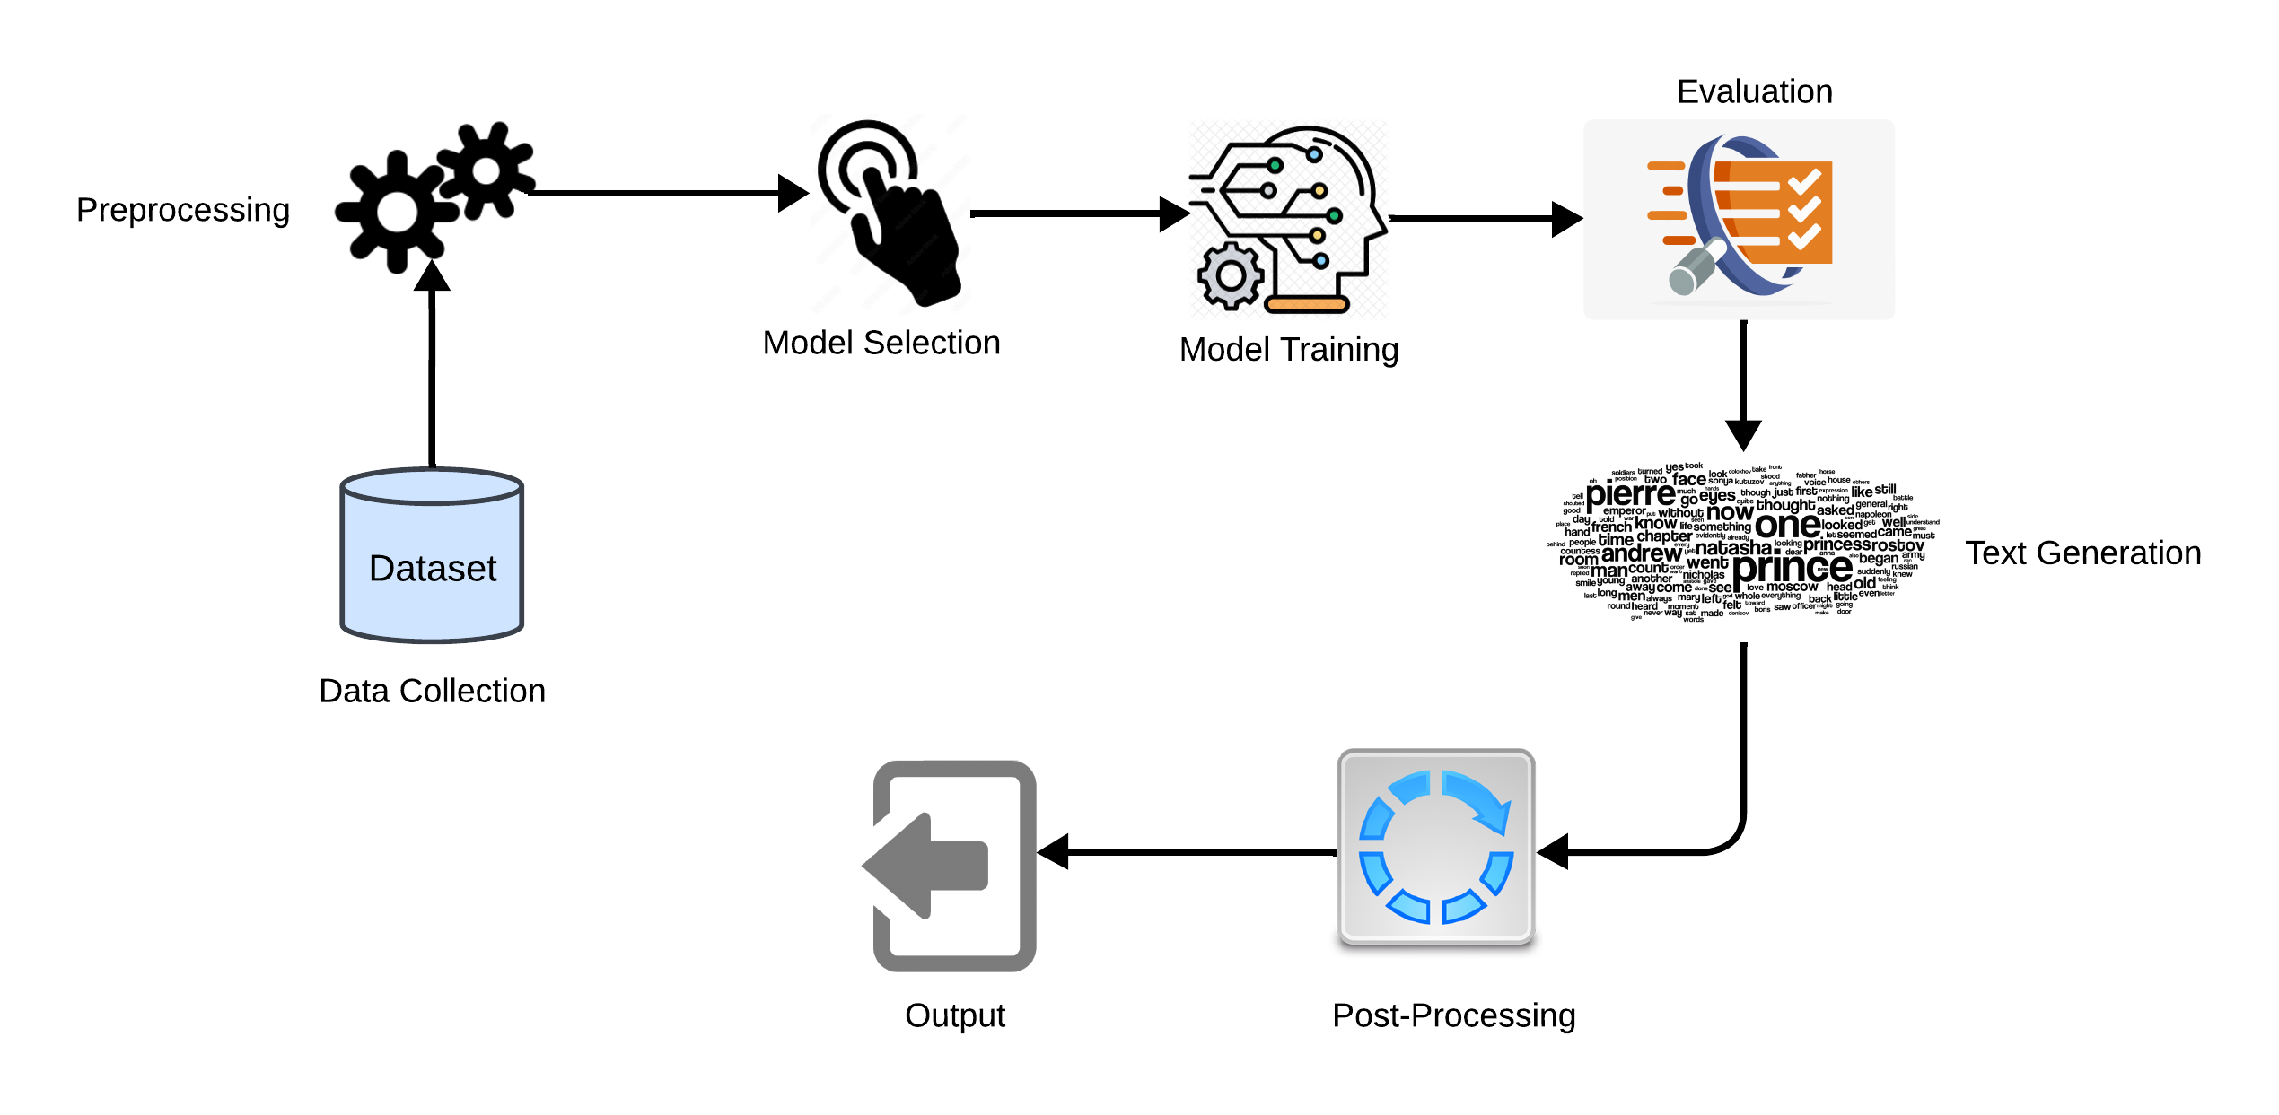
Workflow
Data collection
Data Preprocessing
Model Selection
Model Training
Evaluation
Text Generation
Post-Processing
Output

Slide 10
Methodology
Preprocessing includes tokenization, normalization, and removal of non-informative text elements.
Adopts advanced optimization algorithms like Adam for better convergence during training.
Utilizes both automated metrics (BLEU, ROUGE) and human evaluation to ensure the generated text meets quality standards.

Slide 11
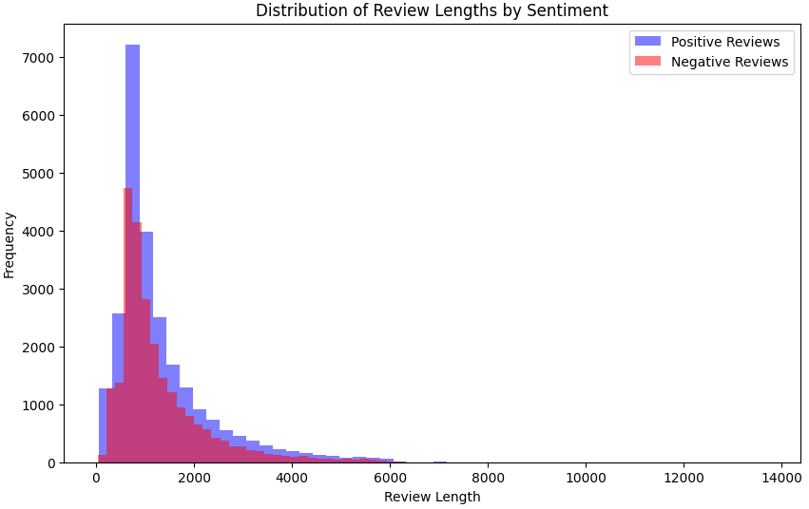
Review sentiment Distribution
The sentiment-based review length analysis showed that positive reviews were generally shorter than negative ones. Due to more positive reviews in the dataset, the model is biased towards generating more positive reviews.

Slide 12

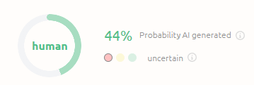
Model Performance
Standard metrics like BLEU and ROUGE are complemented by human evaluations to capture the full nuance of text generation, demonstrating the model's ability to produce rich and emotionally resonant content. This approach highlights the effectiveness of using advanced models for specialized text generation. Continued improvements and targeted training can further enhance the model’s performance.
The probability of just 44% Ai detection from the generated reviews showcases how realistic the nuances are structured in the generated reviews by our model.

Slide 13
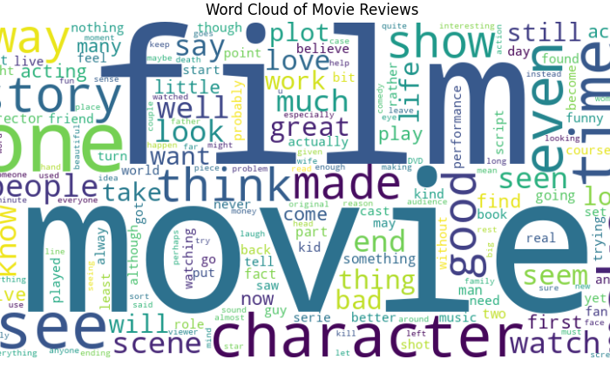
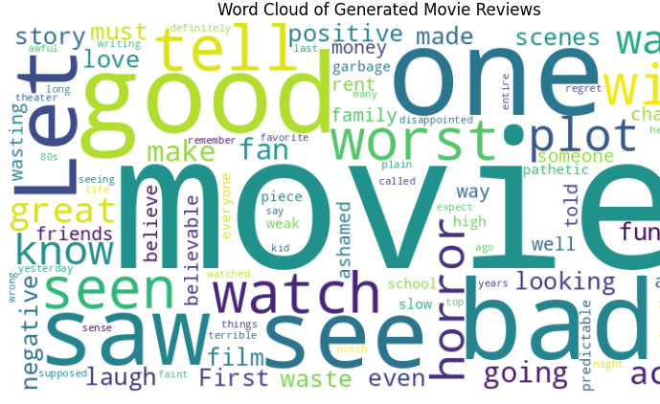
Wordclouds
Word clouds from the dataset and generated reviews provided a broad view of the vocabulary and themes, indicating that the model effectively preserved key thematic words. This suggests that the model can successfully mimic relevant content from the dataset.

Slide 14
Limitations
Data Bias: The model's output quality is heavily dependent on the diversity and balance of the training dataset.
Complex Language Handling: Challenges remain in capturing the subtleties of human sarcasm and humor effectively.
Generalization: While effective in movie reviews, extending the model to other domains requires additional tuning and data.

Slide 15
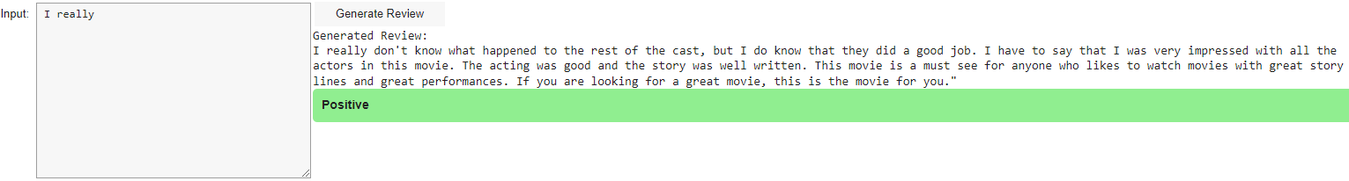
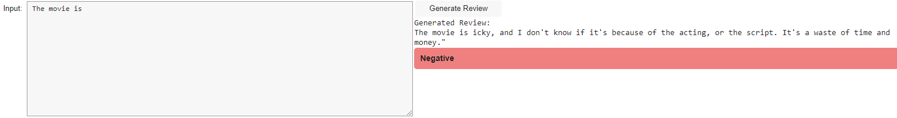
Examples

Slide 16
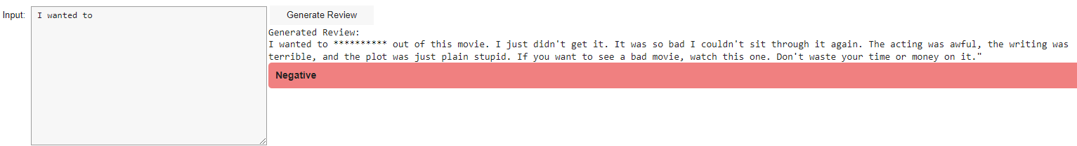
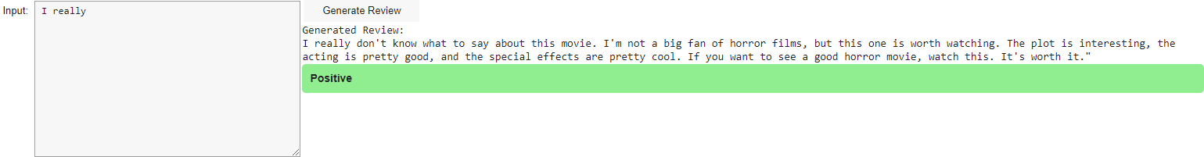

Slide 17
Conclusion
Our model demonstrates significant potential in transforming content generation through deep learning adapted on a specific dataset.
Future work will focus on expanding the model's capabilities to other domains and enhancing its sensitivity to nuanced language.
Ongoing improvements will aim at integrating real-time feedback mechanisms to adapt content dynamically based on user interactions.

Slide 18

Questions and Answers
We welcome any questions or feedback. Thank you for your attention!

