Slide 1
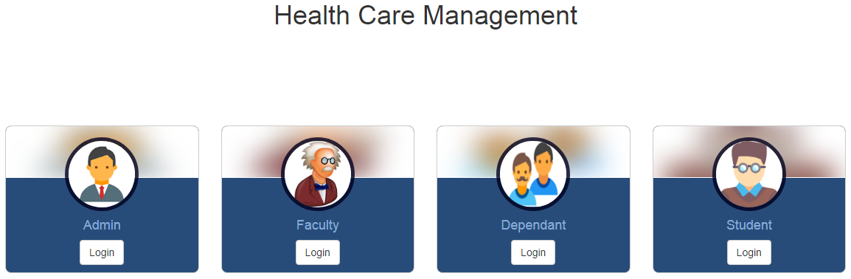
THOTAKURA BALA KRISHNA
17MTCYSC04
M.TECH(CBS)

Slide 2
INTRODUCTION
We are formulating the health record management system which will facilitate effective way of storing medical information of Students, Faculty and their Dependents also.
Admin(Doctor) will be able to insert new medication details. The rest can only view their medical records. Faculty can also add their dependents.

Slide 3
COMPARING TO EXISTING SYSTEM
Existing system is a traditional system, where we use paper records to store data
I think we don’t have to discuss the benefits of E-Records.

Slide 4
BACKEND AND FRONTEND TECHNOLOGIES
HTML
CSS
JavaScript
PHP
MYSql

Slide 5
ANALYSIS AND DESCRIPTION OF PROJECT
Doctor Module: In this module, the Doctor can search for medical records and update the treatment details of patient.
Faculty Module: This module will facilitate faculty for adding new dependents and they can also view their previous medication.
Dependent and Student Module: These users will have no control over data flow they can only view their medical records.

Slide 6
UNIT TESTING
In every module we have done testing of individual pages while building the pages itself.
FUNCTIONAL TESTING
I have tested our web application on the server by integrating all the units of our project. In this testing we focus on the output is as per requirement or not.

Slide 7
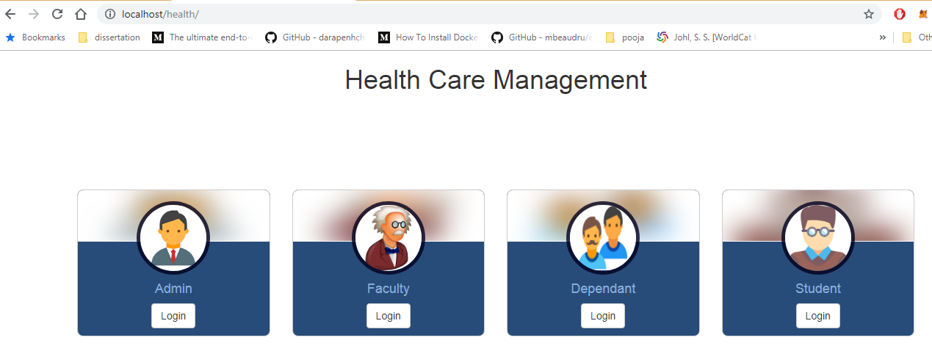
Index page of project

Slide 8
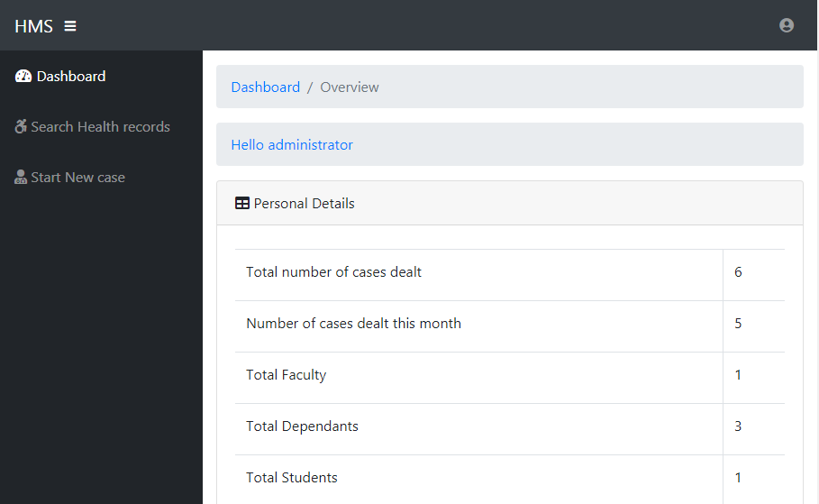
Admin Dashboard

Slide 9
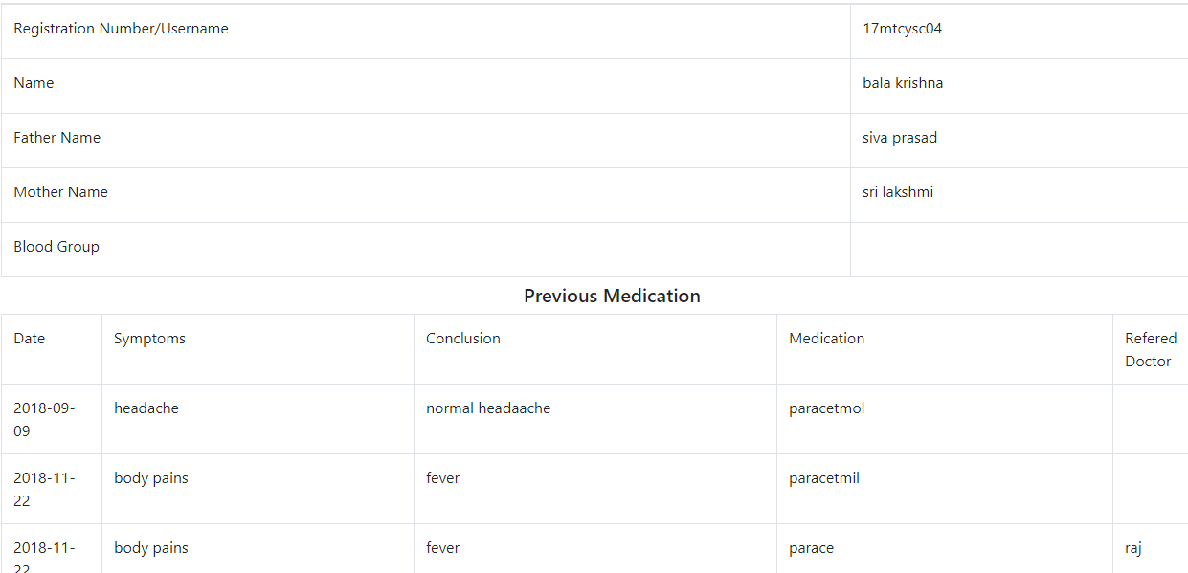
Admin – Start new case

Slide 10
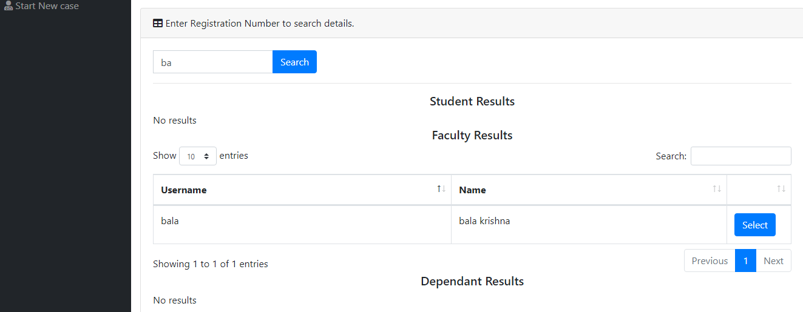
Admin - Search of medical records

Slide 11
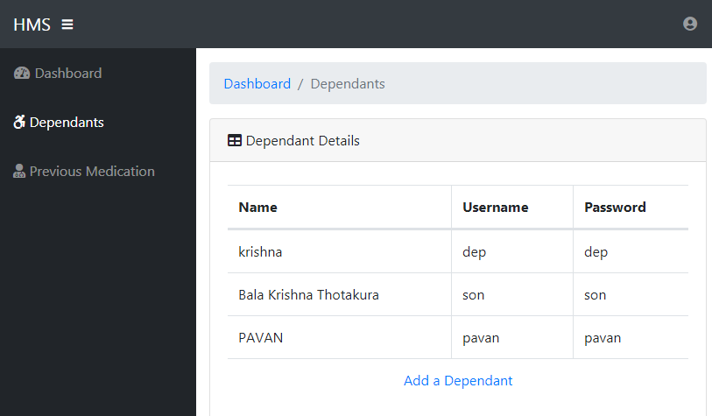
Faculty – Dependent details

Slide 12
CONCLUSION
Health record management system for any University is very important. It will help in maintaining the records easily. We can also view records at any time with a click. While treating a patient we can view his previous treatment and suggest new medication.

Slide 13

THANKYOU

