Slide 1

Blockchain
Connecting Gaps…
Day 3
→By Narendranath Reddy

Slide 2
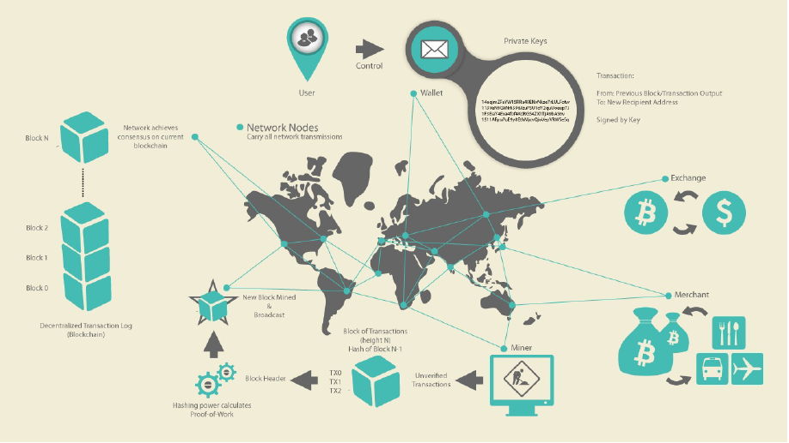

Slide 3
Proof Of Work
Proof Of Stake
Proof Of Existence

Slide 4
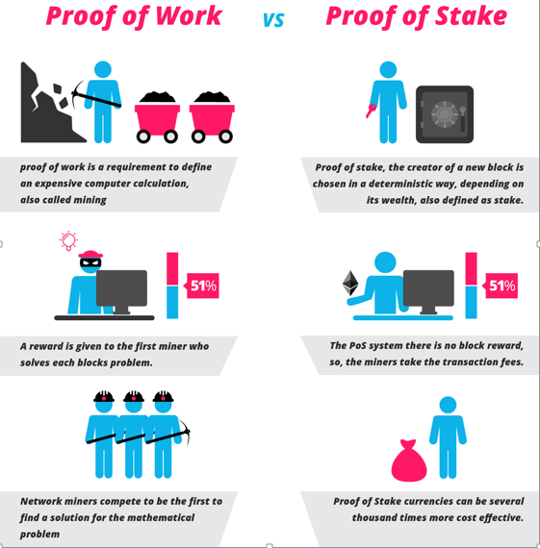

Slide 5

POE
https://proofofexistence.com/

Slide 6
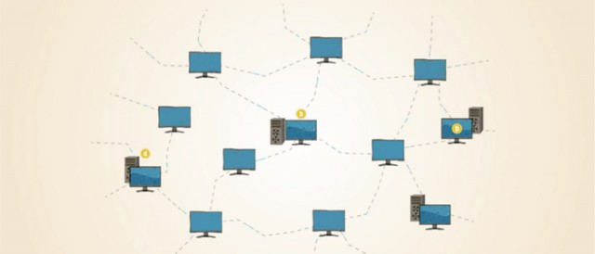
The Bitcoin Network

Slide 7
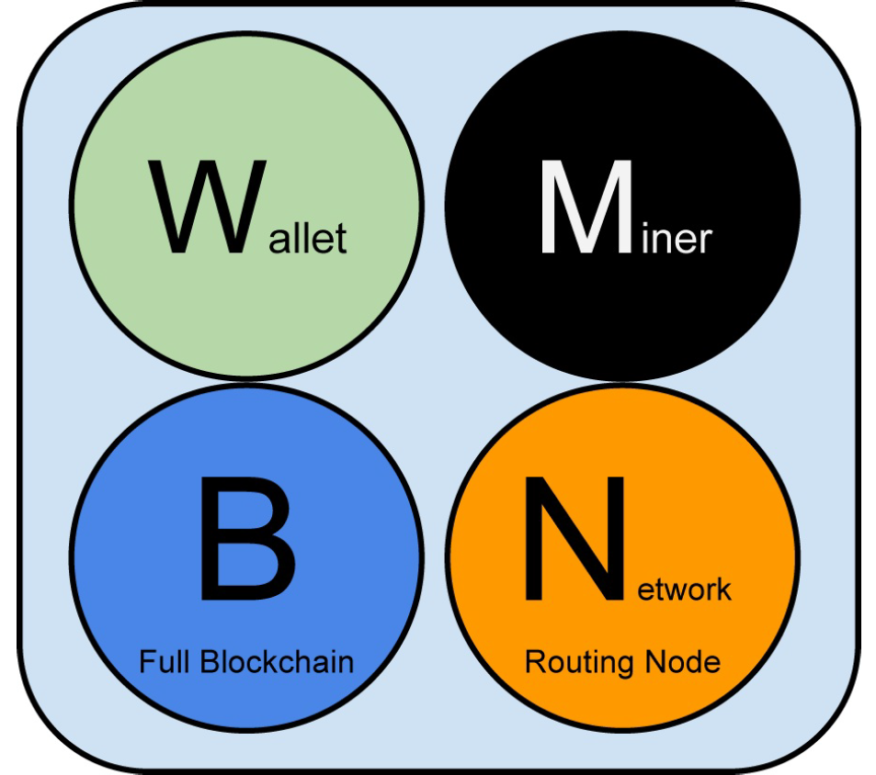
Node Types and Roles
Although nodes in the bitcoin P2P network are equal, they may take on different
roles depending on the functionality they are supporting.
A bitcoin node is a
collection of functions: routing, the Blockchain database, mining, and wallet
services.

Slide 8
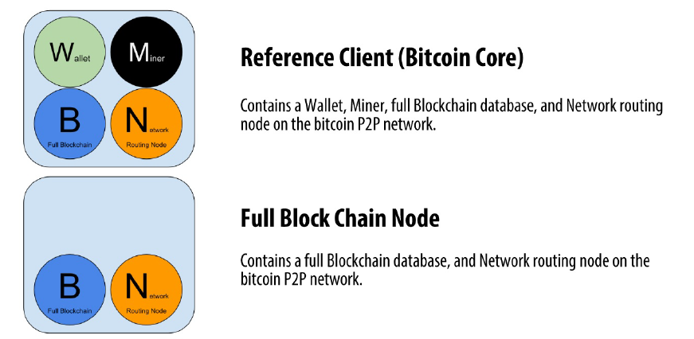
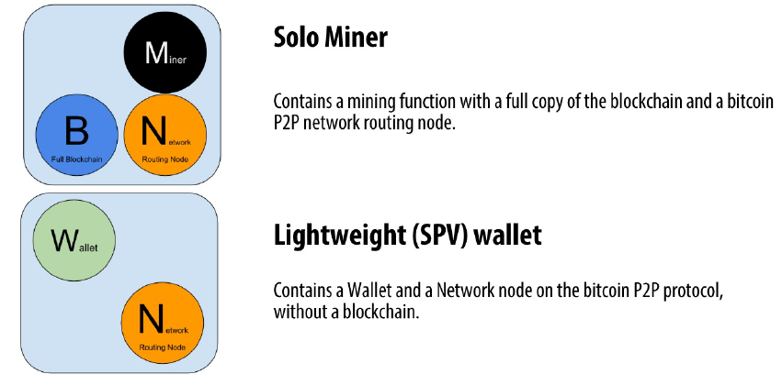
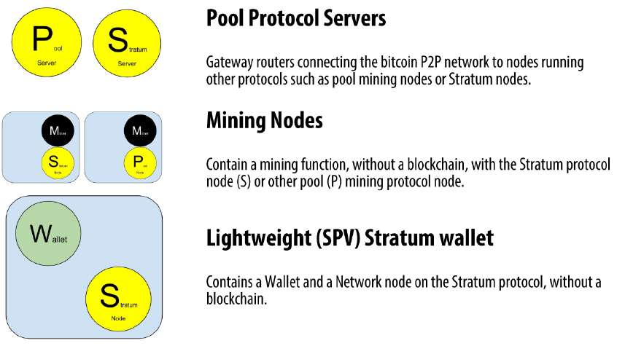

Slide 9
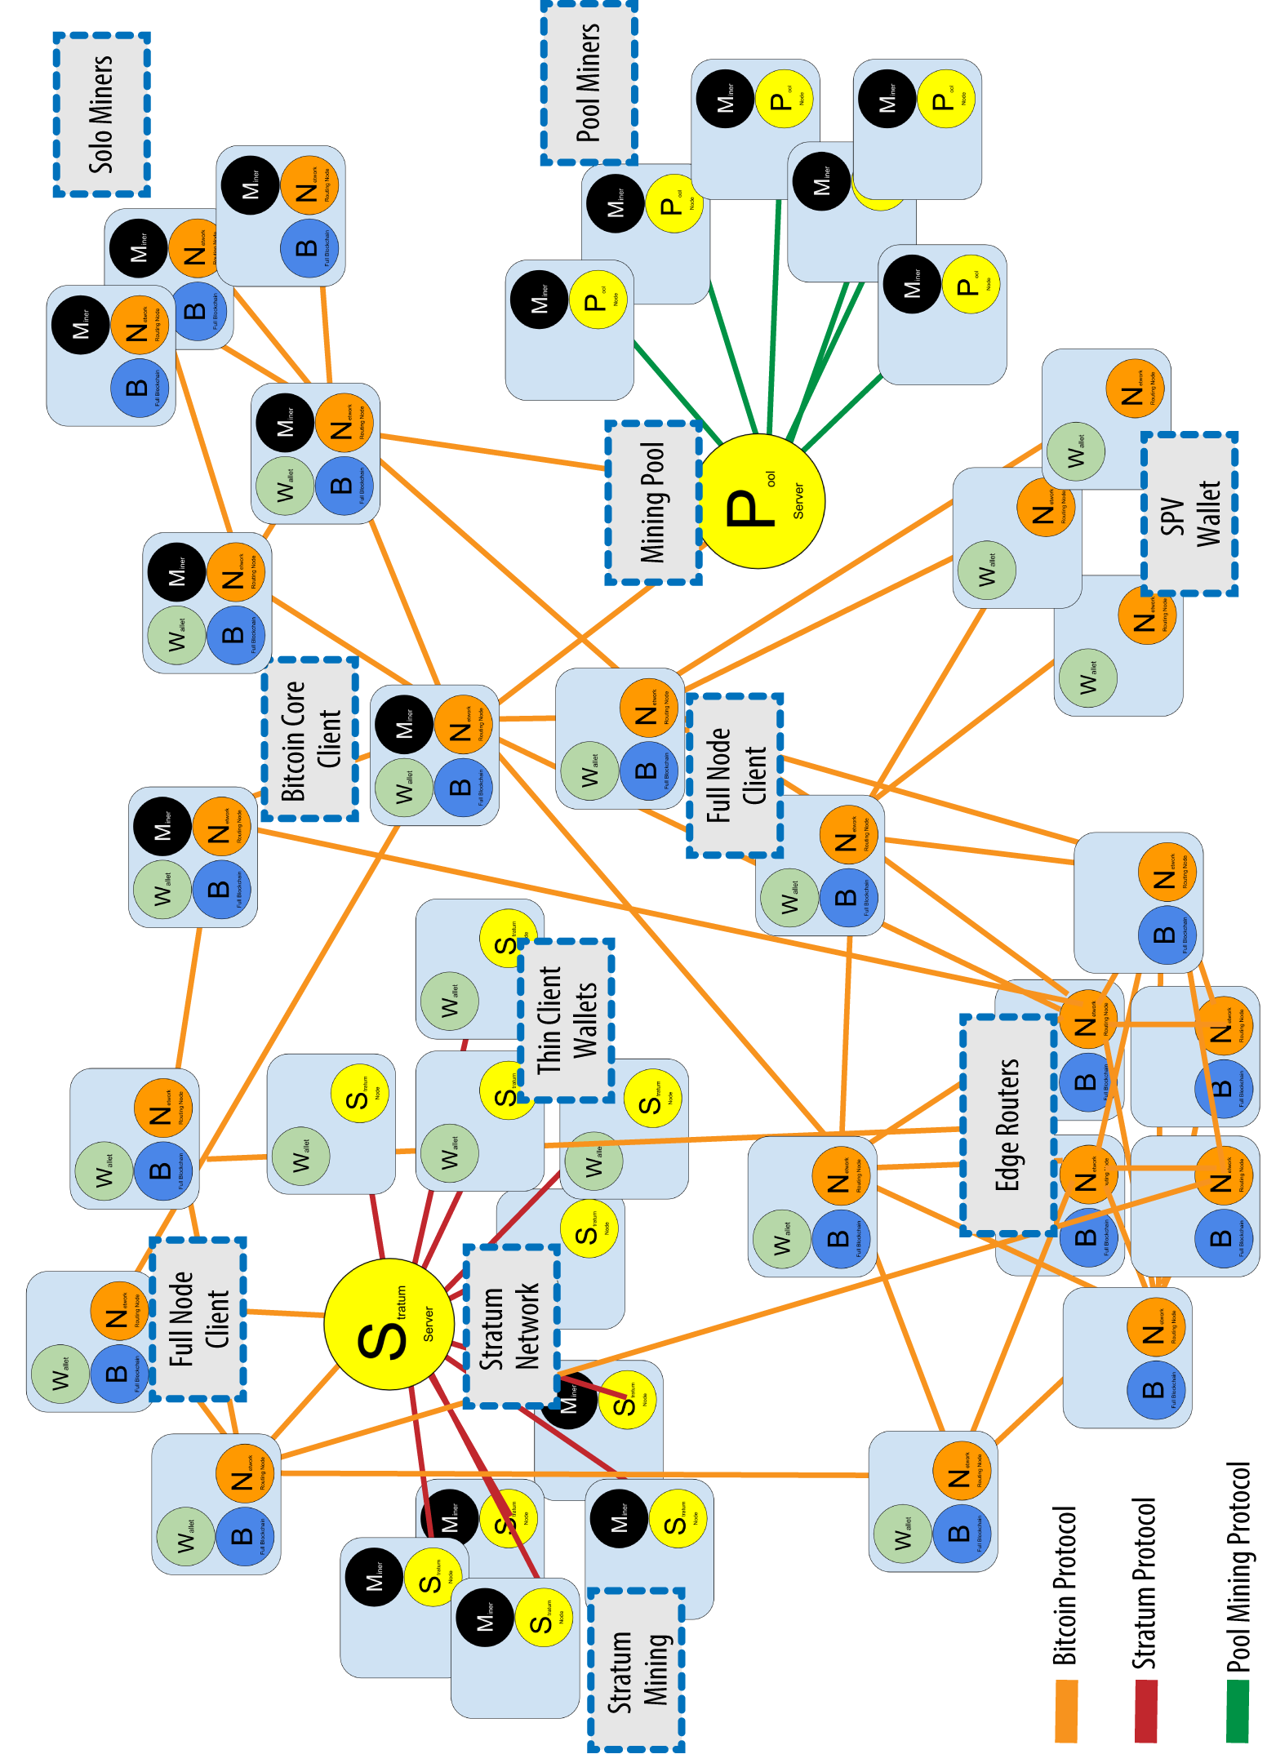

Slide 10
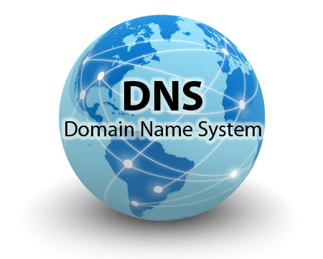
How does a new node find peers?
DNS – List of IP Address
DNS seeds are implementation of BIND (Berkeley Internet Name Daemon)
BIND get a list of bitcoin network details by crawlers

Slide 11

SPV Node
A lightweight client, also known as a simple-payment-verification (SPV)client, connects to bitcoin full nodes (mentioned previously) for access to the bitcoin transaction information, but stores the user wallet locally and independently creates, validates, and transmits transactions. Lightweight clients interact directly with the bitcoin network, without an intermediary.

Slide 12
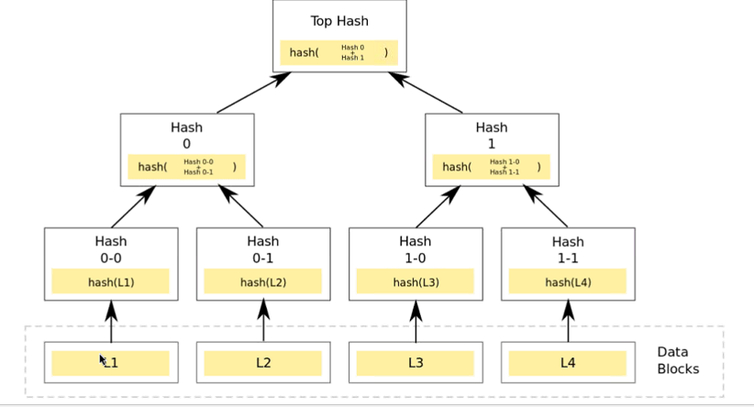

Slide 13
Live Demo
http://localhost:3000/

Slide 14
Private Blockchain from Scratch

Slide 15
Important Links
http://Bitcoin.org
https://bitnodes.21.co
https://insight.is
https://Blockchain.info
https://coinmarketcap.com/currencies/views/all/
http://Btcrates.in

Slide 16

Thank you.

