Slide 1


SMART INDIA HACKATHON 2026
TITLE PAGE
Problem Statement ID – SIH26181
Problem Statement Title – A secure, AI-powered Personal Health Companion that delivers real-time, privacy-preserving health monitoring and early warning capabilities, helping individuals recognize health risks before they become emergencies. The solution should improve resilience during heat waves, floods, pollution events, and other disasters common in India while enabling continuous health support through on-device intelligence.
Theme – MedTech / BioTech / HealthTech
PS Category – Hardware
Team ID – —
Team Name (Registered on portal) – ArogyaAegis

Slide 2

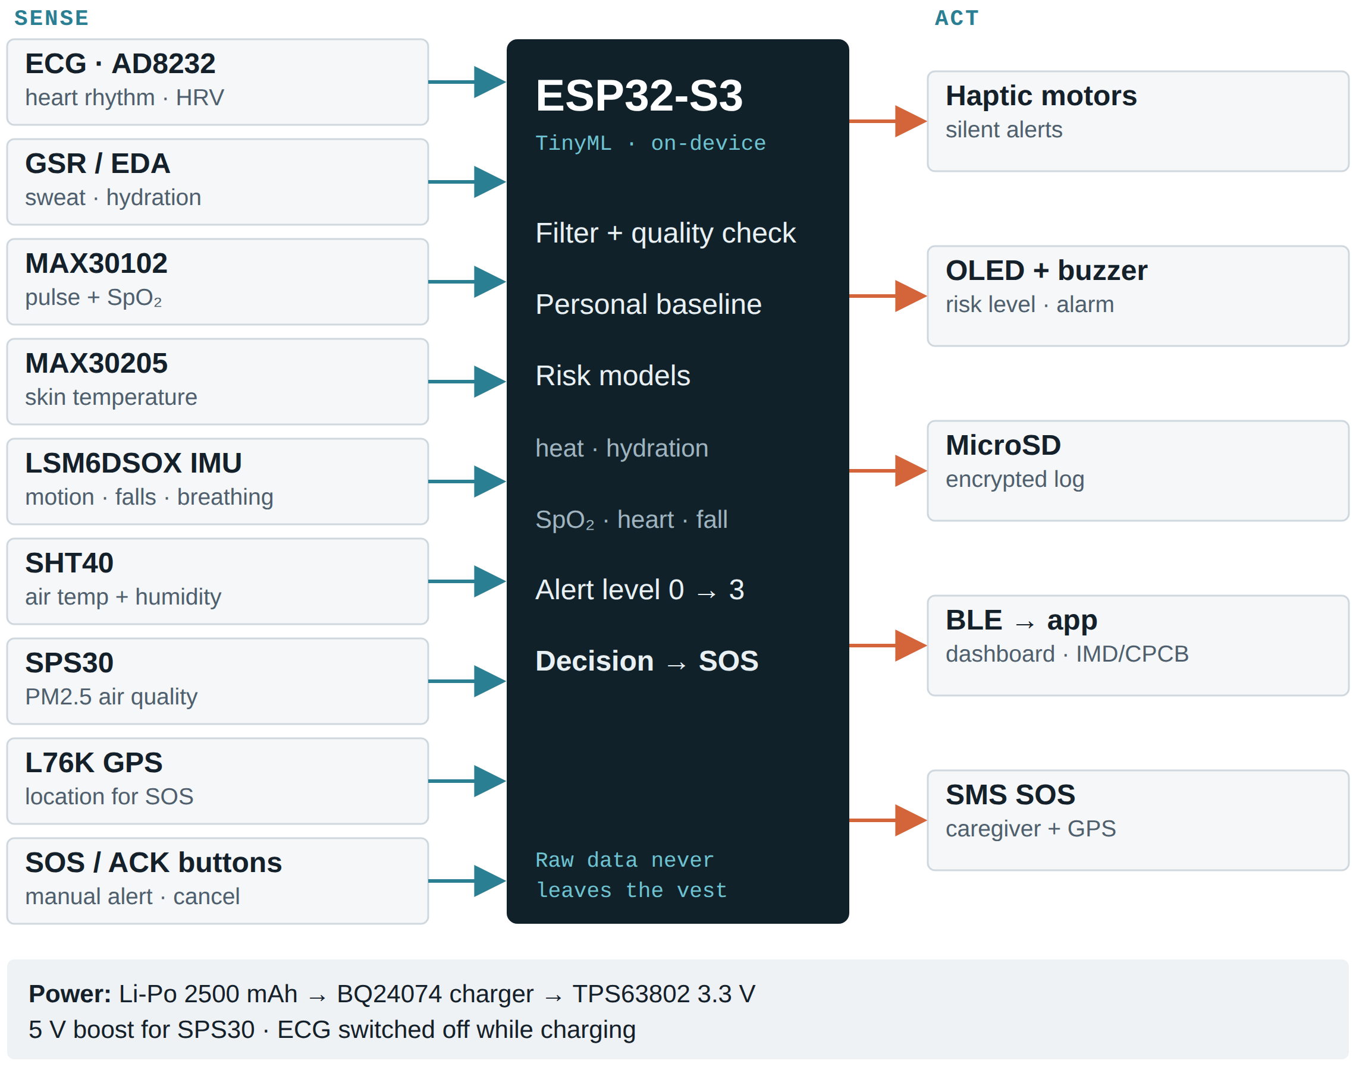
ArogyaAegis
ArogyaAegis — Privacy-First AI Health Companion Vest
for Heat, Pollution & Disaster Resilience
Problem:
Our Idea:
People do not notice heat stress, dehydration or breathing trouble until it becomes an emergency — and during heat waves, floods and smog, help is hardest to reach. In 2024 India logged 40,000+ suspected heatstroke cases (MoHFW); news reports counted 733 heat deaths vs 360 official (HeatWatch). One 5-day heatwave can cause ~30,000 excess deaths (Frontiers, 2026), and air pollution caused 1.67 M deaths in 2019 (Lancet Planetary Health).
ArogyaAegis is a smart vest (SereniSuit v2) with 9 body and environment sensors and an ESP32-S3 running TinyML on-device. It combines the wearer’s own vitals with local heat, humidity and PM2.5 to give graded early warnings and auto-SOS — working offline, with raw health data never leaving the vest.
Proposed Solution:
System Architecture
Innovation / Uniqueness:
• Senses continuously: ECG, PPG/SpO₂, skin temperature, sweat (GSR), motion and breathing, plus air heat, humidity and PM2.5.
• On-device TinyML learns each wearer’s baseline and scores heat-stress, dehydration, respiratory, cardiac and fall risk every second.
• Graded alerts (Normal → Pre-warning → Level 1–3) through silent vibration, OLED status and buzzer — no phone needed.
• Auto-SOS: a fall or an unanswered alert starts a 30-s countdown, then SMS with GPS to caregivers / ASHA workers — no mobile data required.
• BLE companion app shows daily summaries and caches IMD heat and CPCB air-quality alerts for offline use.
• Private by design: only alerts and user-approved summaries leave the vest; logs are encrypted on microSD.
• Body + environment in one risk score — 17 of 18 climate-health ML studies used weather data only, and none modelled flood-health outcomes (Ayaz, 2026).
• Chest-worn, not a wristband — true ECG for AF detection, breathing from chest motion, and armpit skin temperature as a core-temperature proxy.
• Graded, explainable heat alerts modelled on the HHSEW warning system (Lancet RH-WP, 2025) and the Physiological Strain Index.
• Offline-first edge AI — no raw-data upload, SMS fallback, battery power: built for network and power outages during disasters.
• Silent haptic alerts (chest + back) usable by the elderly, on noisy worksites and by low-literacy users; app in regional languages.
2

Slide 3
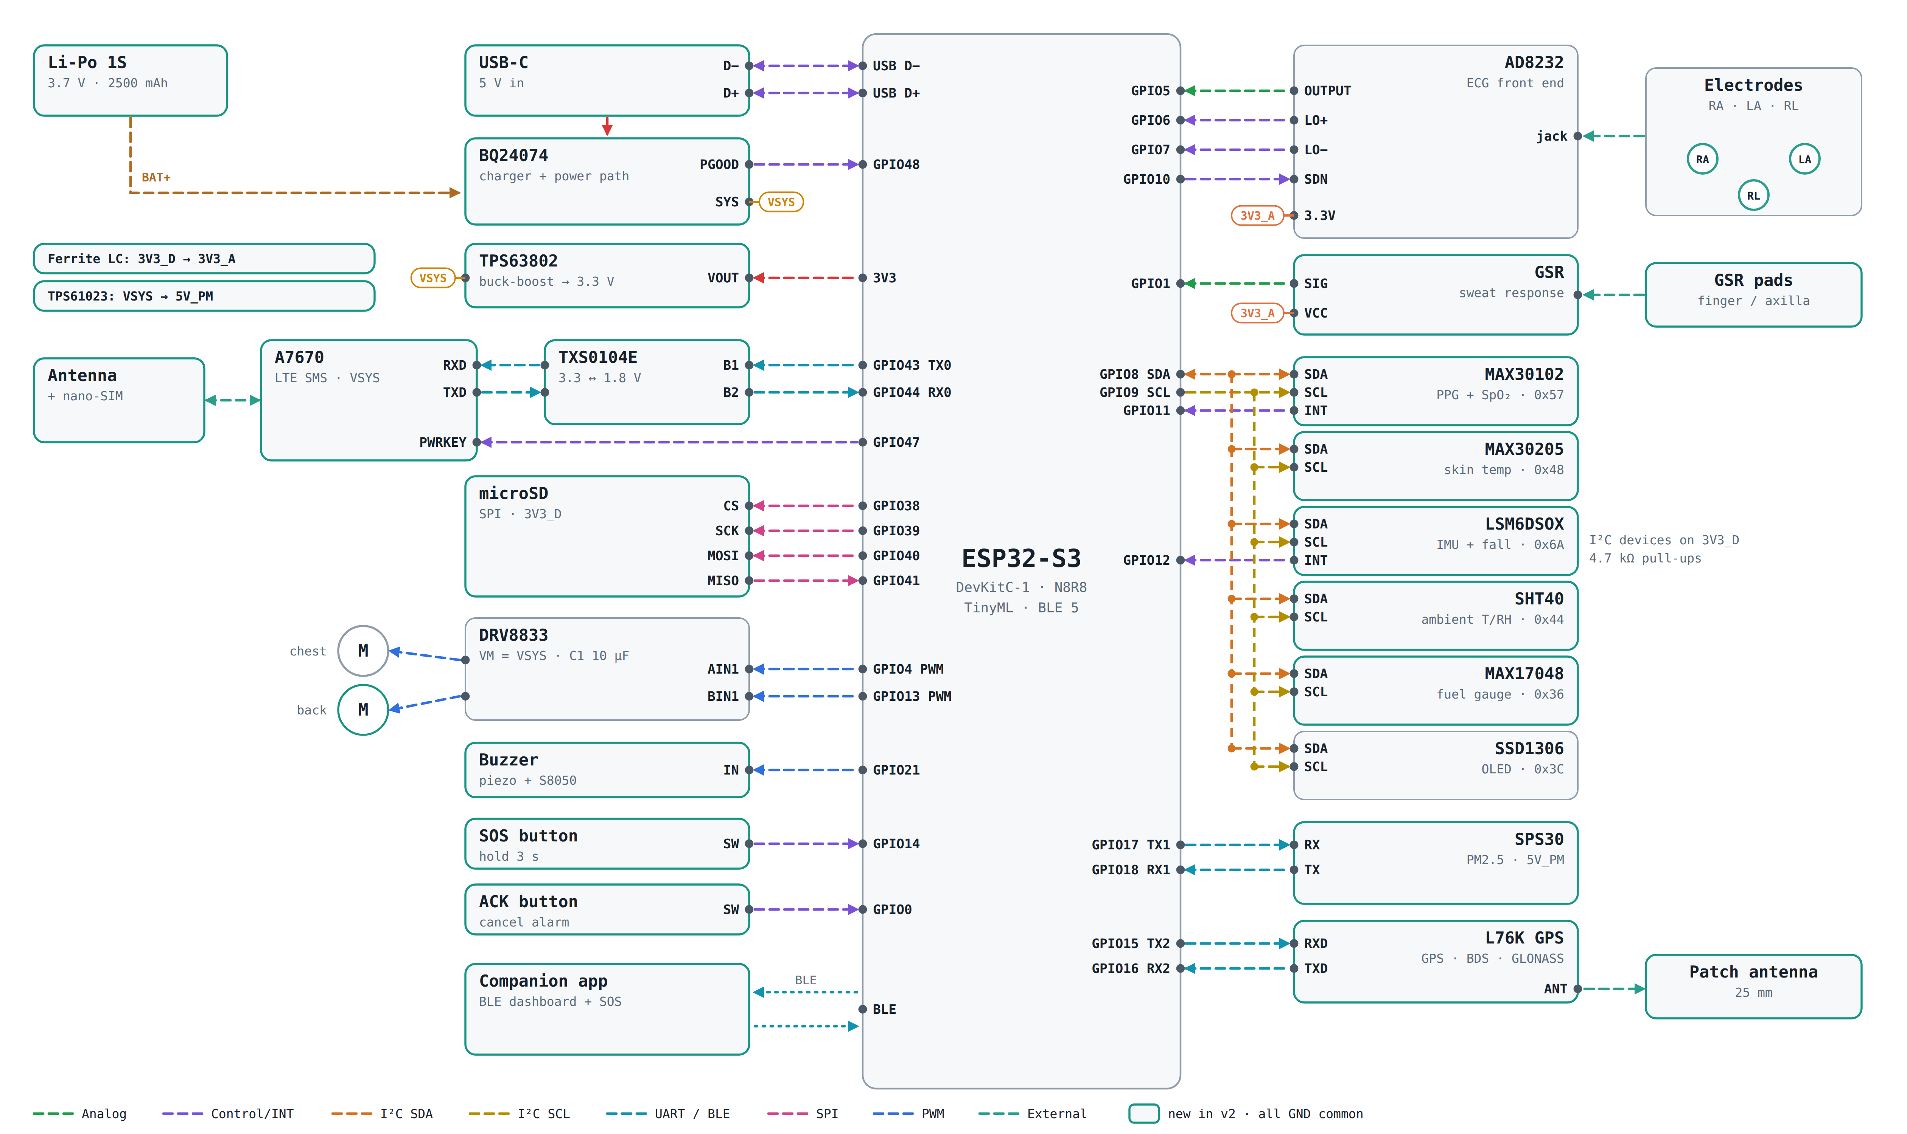
ArogyaAegis
TECHNICAL APPROACH
Key Technologies
CIRCUIT DIAGRAM
On-device ML Models
SENSING LAYER
AD8232 ECG front end: single-lead heart rhythm, HRV and ECG-derived breathing rate.
MAX30102 PPG: heart rate and SpO₂ from red + IR light.
MAX30205 skin temperature (±0.1 °C): armpit reading used as a core-temperature proxy for heat stress.
GSR / EDA sensor: sweat response for stress and hydration trend.
LSM6DSOX IMU (on-sensor ML core): activity, fall detection and chest-motion breathing.
SHT40 + SPS30: air temperature/humidity (heat index) and PM2.5.
EDGE COMPUTE & AI
ESP32-S3 N8R8: dual-core 240 MHz with 8 MB PSRAM for TinyML models.
TensorFlow Lite Micro + ESP-NN: int8 models run fully on the vest.
Rule engine: Physiological Strain Index + heat index give explainable heat alerts.
CONNECTIVITY & ALERTS
BLE 5: vest ↔ companion app with no internet.
L76K multi-GNSS (GPS, BeiDou, GLONASS): location shared only during SOS.
A7670 LTE Cat-1 (optional): SMS SOS even without the phone.
DRV8833 + vibration motors, SSD1306 OLED, buzzer: silent and visible alerts.
POWER & DATA
Li-Po 2500 mAh + BQ24074 + TPS63802: ~26–45 h estimated runtime; ECG off while charging.
microSD (AES-encrypted): offline history for the personal baseline.
APP & EXTERNAL DATA
Android companion app: dashboard, trends, SOS contacts, regional languages.
IMD heat-wave warnings + CPCB AQI: cached when online, used offline.
• Heat stress: PSI + heat-index rules, then a small MLP grading risk into 5 levels.
• Dehydration: HR drift at the same activity + GSR + skin-temperature trend (logistic model).
• Arrhythmia / AF: 1D-CNN on single-lead ECG (~50 KB int8).
• Stress: 1D-CNN on GSR + PPG + IMU windows (existing SereniSuit model).
• Falls: decision tree on the IMU’s ML core, confirmed on the MCU.
• Respiratory: breathing rate (ECG + chest IMU) + SpO₂ + PM2.5 rules.
• Personal baseline: autoencoder trained on the wearer’s first 7 days flags deviations.
• Explainable output: every alert states its reason, e.g. “skin 38.4 °C + HR 132 → rest and drink water”.
Open Datasets for Training & Validation
Dataset | What it contains | Used for
WESAD (UCI / Kaggle) | 15 subjects; chest ECG, EDA, temperature, respiration, ACC at 700 Hz | Stress model, sensor fusion
PhysioNet/CinC Challenge 2017 | 8,528 single-lead ECGs (9–61 s, 300 Hz); normal, AF, other, noisy | AF / arrhythmia 1D-CNN
BIDMC PPG & Respiration (PhysioNet) | 53 × 8-min PPG, ECG, respiration with HR, RR, SpO₂ | Breathing rate, SpO₂ checks
SisFall | 38 people (15 aged 60–75); 4,504 trials; 15 fall and 19 daily-activity types | Fall detection
Wearable Stress & Exercise (PhysioNet / Kaggle) | 36 people; EDA, skin temp, BVP, ACC during stress and exercise | Exertion / heat-strain, dehydration
Air Quality Data in India (Kaggle, CPCB) | Daily and hourly AQI, PM2.5, PM10 for Indian cities, 2015–2020 | PM2.5 risk thresholds
GitHub Repository: https://github.com/thotapremkumar-tpk/ArogyaAegis-SIH.git
3

Slide 4
ArogyaAegis
FEASIBILITY AND VIABILITY
Feasibility
Commercial Feasibility
• Builds on a working v1 prototype (ESP32-S3 + AD8232 ECG + OLED + DRV8833 haptics); v2 adds off-the-shelf I²C/UART modules — no custom chips.
• Edge AI is proven on wearables: 94.8% anomaly-detection accuracy with ECG + PPG + accelerometer + temperature (Kim, 2026) and 47 ms on-device stress inference with 8-bit models (Jaber, 2026).
• Fits the hardware: int8 models of ~50 KB each fit in the ESP32-S3’s 8 MB PSRAM; average draw ≈ 80 mA gives ~26 h, or ~45 h with light sleep (estimated).
• All training data is open — WESAD, PhysioNet CinC 2017, BIDMC, SisFall, CPCB air quality.
• Commodity parts, no licence fees — every module is available from Indian electronics distributors.
• Plugs into existing public-health rails — IMD heat-wave warnings, CPCB AQI, the NPCCHH heat-health programme and ASHA referral — not a parallel system.
• Three buyers: families of elderly users; employers of outdoor workers (construction, delivery, farms); state health departments and disaster agencies (NDMA/SDMA) for high-risk groups.
• Scales beyond the vest: the same models run in the phone app on smartwatch and fitness-band data.
Challenges
Strategy
• No open dataset of real heatstroke events — heat models start from physiology rules (PSI) and exercise data; PSI alone can miss at-risk people (Eur J Appl Physiol, 2021), so field validation is essential.
• Motion and sweat degrade ECG, PPG and GSR signals during outdoor work.
• Comfort and battery of a chest-worn vest in 45 °C heat.
• False alarms erode trust and daily use (Oloko-Oba, 2026).
• Sensitive health data needs consent and compliance with the DPDP Act 2023.
• Pilot with 30–50 outdoor workers and elderly users in a heat-prone district to collect labelled field data; later improve models by federated learning without collecting raw data (Shokri, 2024).
• Signal-quality checks + multi-sensor agreement: alert only when 2+ signals agree; the ACK button cancels false alarms.
• Breathable mesh vest, duty-cycled sensors and light sleep; power-bank or solar top-up.
• Explainable alerts (“skin 38.4 °C + HR 132 → rest”) build trust.
• Privacy by design: on-device processing, encrypted logs, location only at SOS, clear consent screens.
4

Slide 5
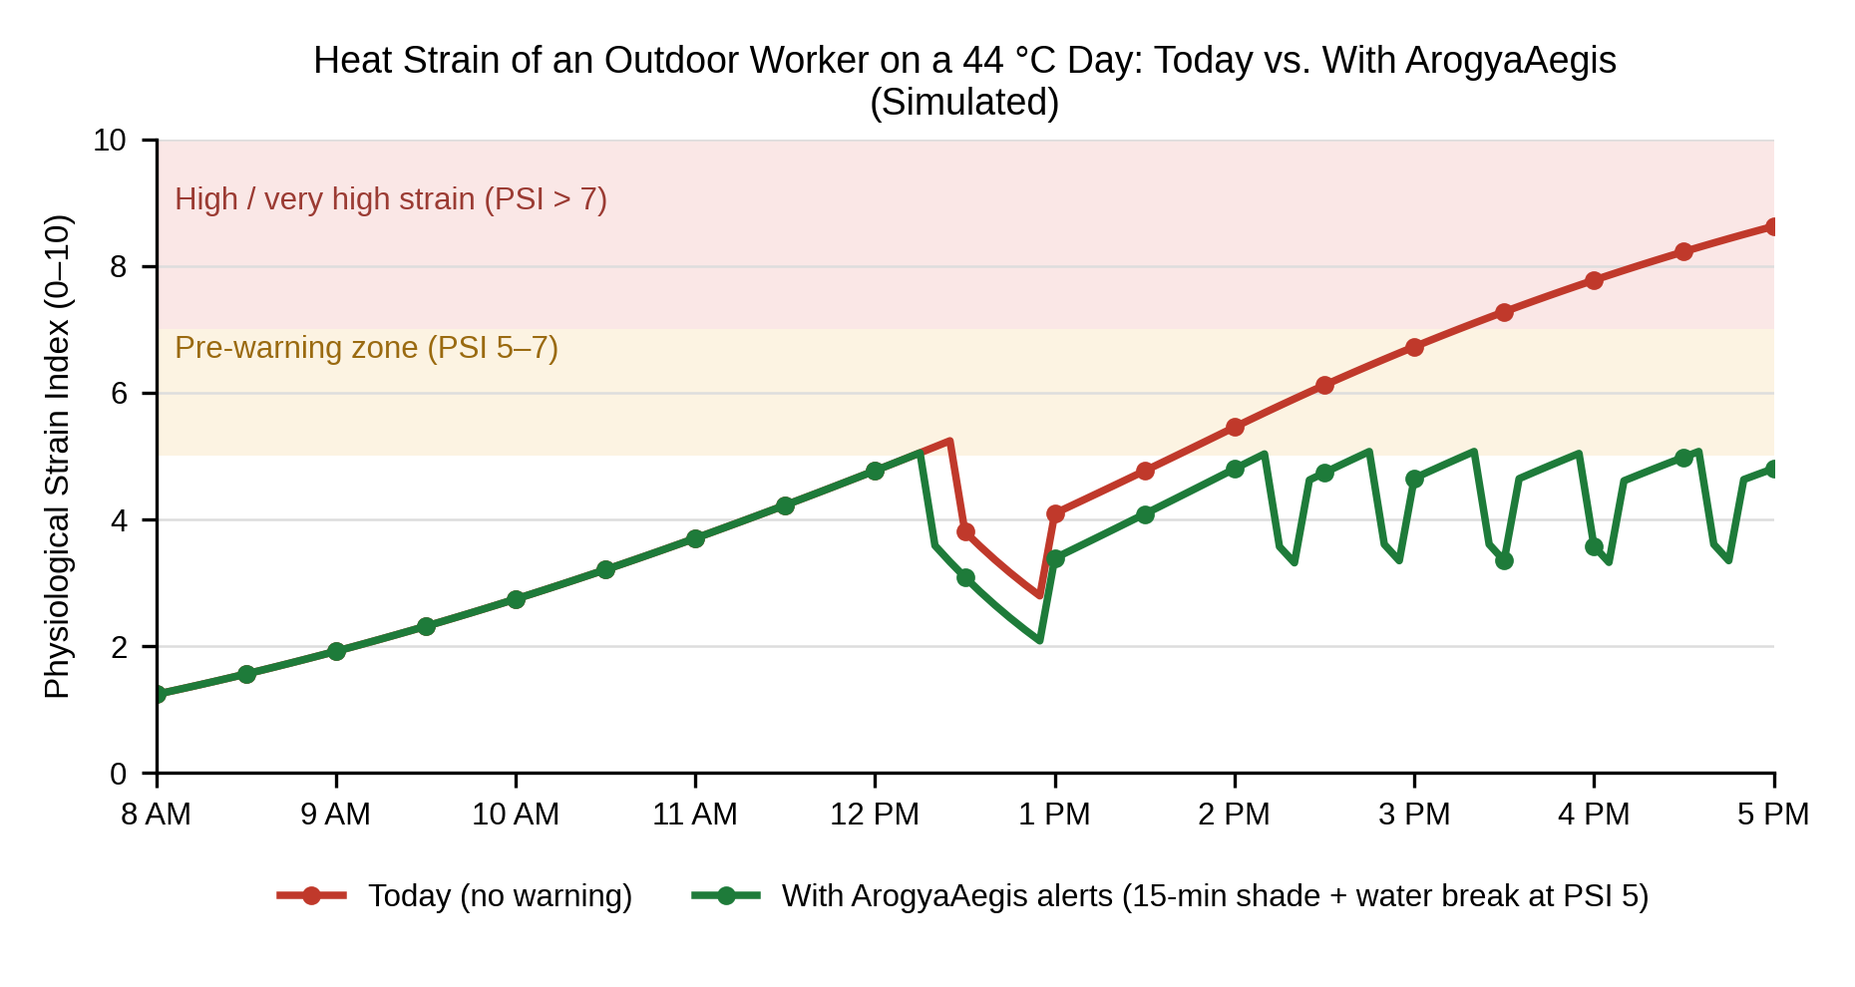
ArogyaAegis
IMPACT AND BENEFITS
Direct Impact on Target Users
Economic & Strategic Benefits
• Outdoor and informal workers: warnings before heat strain turns into heatstroke — the group HeatWatch found most affected among 733 news-reported heat deaths in 2024.
• Elderly and people with heart or lung conditions: continuous vitals with auto-SOS on falls or abnormal heart rhythm; caregivers get an SMS with location.
• Rural and low-connectivity users: works fully offline; alerts by vibration and display, so no smartphone skills are needed.
• ASHA workers and PHCs: receive only escalated cases with vitals attached, for faster triage.
• Early warning pays off: a graded heat-health warning system was estimated to avoid 220 billion CNY in health costs in China (Wang, 2025).
• Air pollution cost India US$36.8 B (1.36% of GDP) in 2019 — personal PM2.5 + SpO₂ alerts help vulnerable people limit exposure.
• Fewer lost workdays and hospital visits for employers, insurers and public hospitals during heat seasons.
• Made-in-India, data stays on the device — commodity hardware, no cloud lock-in.
Strategic Impact
• Adds individual early warning to India’s city Heat Action Plans and NCDC heat-illness surveillance.
• Closes the data gap: official counts are 500–1,500 heat deaths a year, while one 5-day heatwave may cause ~30,000 excess deaths (Narang & Gadgil, 2026); consented, anonymised alerts give districts real-time data.
• Seeds new research: no ML model yet predicts flood-related health outcomes (Ayaz, 2026); vest data can help build one.
• Helps responders (NDMA/SDMA, NDRF) locate high-risk people during floods and cyclones.
Peak strain: 8.6 → 5.1 | Time in high strain: 1.8 h → 0 h
Model: outdoor worker, air temperature 33–44 °C, 30-min lunch break. PSI from core temperature and heart rate (Moran, 1998). With ArogyaAegis, a pre-warning at PSI 5 triggers a 15-min shade + water break (6 breaks over the day).
5

Slide 6
ArogyaAegis
RESEARCH AND REFERENCES
Problem Evidence — News & Official Data
Health Burden & Heat-Health Warning
• Tribune India (20 Jun 2024) — MoHFW: 110 heat deaths and 40,000+ suspected heatstroke cases, 1 Mar–18 Jun 2024. [Open]
• HeatWatch (27 Jul 2024) — 733 heat deaths in news reports vs 360 official across 17 states; outdoor workers and 33 polling officers among the dead. [Open]
• Euronews (10 Jun 2026) — official counts of 500–1,500 heat deaths a year vs research estimates of tens of thousands. [Open]
• ETV Bharat (Jun 2026) — MHA: about 5,000 flood and landslide deaths in the last three years. [Open]
• Narang & Gadgil (2026), Frontiers in Environmental Health — ~3,400 excess deaths per extreme-heat day, ~30,000 per 5-day heatwave. [Open]
• India State-Level Disease Burden Initiative (2021), Lancet Planetary Health — air pollution: 1.67 M deaths (17.8%) in 2019; US$36.8 B loss. [Open]
• Wang et al. (2025), Lancet Regional Health – Western Pacific — graded heat-health warning (HHSEW) model. [Open]
• Li et al. (2022), The Lancet — the global need for smart heat-health warning systems. [Open]
Edge AI on Wearables — Technology Validation
Climate-Health AI & Research Gaps
• Oloko-Oba et al. (2026), Bioengineering — review of real-time edge ML for wearable biosignals. [Open]
• Kim et al. (2026), IEEE Trans. Consumer Electronics — 94.8% on-device anomaly detection (ECG/PPG/accel/temp). [Open]
• Jaber (2026), IJRIAS — 47 ms on-wearable stress inference; F1 89.7% on WESAD. [Open]
• Jayathilake et al. (2025), IEEE Sensors Journal — edge PPG: HR error 2.21 bpm, RR ±1.35 breaths/min. [Open]
• Ayaz et al. (2026), Frontiers in Climate — 17 of 18 ML studies on heat, none on flood-health outcomes. [Open]
• Ssebyala et al. (2024), PLOS Climate — ML to predict health risks from extreme weather. [Open]
• Subramaniam et al. (2022), Sustainability — hybrid AI for PM2.5 and air-quality forecasting. [Open]
• Moran et al. (1998), Am. J. Physiology — the Physiological Strain Index (PSI). [Open]
Privacy & India Deployment
Open Datasets
• Shokri (2024), Future Generation Computer Systems — privacy-preserving edge federated learning for mHealth. [Open]
• Alammar et al. (2026), IEEE TCE — federated explainable AI for cardiac alerts on wearables. [Open]
• Nedungadi et al. (2017), J. Medical Systems — rural India monitoring with local languages, health workers, intermittent internet. [Open]
• WESAD (UCI, 2018) — chest-worn ECG, EDA, temperature, respiration; stress labels. [Open]
• PhysioNet/CinC Challenge 2017 — 8,528 single-lead ECGs for AF classification. [Open]
• BIDMC PPG & Respiration (PhysioNet) — PPG with reference breathing rate and SpO₂. [Open]
• SisFall (Sensors, 2017) — 4,504 fall and daily-activity trials incl. elderly. [Open]
• Air Quality Data in India (Kaggle) — CPCB city-level AQI and PM2.5, 2015–2020. [Open]
6

