Slide 1
Sort or Stay
GDIT · GAME PROJECT PRESENTATION
SMALLEST
LARGEST
5
2
4
1
3
6
A 3D escape-room game where you learn sorting algorithms by sorting real objects — or stay locked in
swap neighbours
1
2
3
4
5
6
Group 3 · Course: GDIT — Game project, IIIT Sri City · October 2026
door unlocks
Team member | Roll No. | Contribution (levels)
Premkumar Thota | S20240010243 | Floor 1 · Locked Room — bubble sort (built) Floor 4 · Control Room — merge sort (next) · player avatars & controls
Vijaya Teja Kameswar | S20240010048 | Floor 2 · Storage Room — selection sort (built) Floor 5 · Vault — quick sort (planned)
Uday Banu Prakash | S20240010009 | Floor 3 · Library — insertion sort (built) Debrief cards & scoreboard · pilot study (planned)
Notes:
Title slide. Project: Sort or Stay — a 3D escape-room game built in Unity 6 that teaches sorting algorithms. Group 3, course GDIT, IIIT Sri City. Team and contributions: Premkumar Thota (S20240010243) — Floor 1, the Locked Room (bubble sort), and Floor 4, the Control Room (merge sort), plus the shared player (realistic avatars and point-and-click controls). Vijaya Teja Kameswar (S20240010048) — Floor 2, the Storage Room (selection sort), and Floor 5, the Vault (quick sort). Uday Banu Prakash (S20240010009) — Floor 3, the Library (insertion sort), plus the debrief cards, the scoreboard and the pilot study. The six tags on the right are the idea of the game in one picture: the keys start out of order (5 2 4 1 3 6); on Floor 1 you may only swap two neighbours, which is exactly bubble sort; when the row reads 1 to 6 the door unlocks.

Slide 2




Sorting is taught everywhere, but rarely understood
MOTIVATION
Why this problem
Who faces it
Why it matters
Why a game
Sorting is the first real algorithm topic in every CS course. Learners memorise the steps, then mix up the algorithms and what each one costs.
First- and second-year Data Structures & Algorithms students, school students starting programming, self-learners and their teachers.
Sorting is where students first meet comparisons, swaps and O(n²) vs O(n log n). Gaps here carry into searching, databases and later courses.
A game makes the learner do every comparison and swap under the algorithm's rule, with instant feedback, instead of watching an animation.
WHAT THE THREE STUDIES FOUND
76.9% vs 48.7%
4.34 vs 3.72
Watch ≠ learn
reached the top understanding level on Task 1 after sorting cubes by hand in VR, vs. slides and flowcharts (Mukasheva et al., 2023)
satisfaction (out of 5) with a gamified sorting module vs. text + GIF animation (Sidorov & Cherkasova, 2026)
tools that only show an animation leave the learner out of the decision-making (Schöller, 2025)
Notes:
Why I picked this problem: sorting algorithms are taught in every programming course, but students usually learn them by reading pseudocode or watching an animation. They can repeat the steps, but they confuse the algorithms and cannot say why a step happens or what it costs (Sidorov & Cherkasova 2026 describe exactly this: rote memorisation and confused logic). Who experiences it: first- and second-year B.Tech students in DSA, senior school students in informatics, self-learners, and teachers who only have slides and GIFs. Why it is important: sorting is the first place students meet comparisons, swaps and time complexity; it is the base for searching, databases and scheduling. Why a game: in a game the player has to perform each operation under the rule of the algorithm and gets feedback immediately. The evidence row shows this: in Mukasheva et al. (2023) 76.9% of the VR hands-on group reached the high level on Task 1 against 48.7% of the slides group; in Sidorov & Cherkasova (2026) satisfaction was 4.34 vs 3.72 out of 5; and Schöller (2025) argues passive demonstrations do not involve the learner in the decisions.

Slide 3




Learners watch sorting but rarely do it themselves
PROBLEM STATEMENT
Problem: beginners learn the steps of sorting algorithms but not the rule behind each step or its cost, because today's tools are passive, abstract, or need costly hardware. We need an affordable, hands-on game that checks every move and explains every mistake.
Current limitations
Target users
Scope
Animations and bar visualisers are passive: the learner watches, never decides
2D card apps check moves but stay abstract and rarely explain why a move is wrong
VR helps more, but needs a headset for every learner
Costs (comparisons, swaps) are seldom compared across algorithms
1st–2nd year undergraduates in Data Structures & Algorithms (about 17–21)
Senior school students starting programming
Teachers: a class demo, then practice at home
In: 5 comparison sorts (bubble, selection, insertion, merge, quick) as 5 floors
In: single-player 3D desktop game (Windows / Mac) with move checking, hints, debriefs, scoreboard; a small pilot study
Out: VR/AR, multiplayer, writing code, non-comparison sorts
Notes:
Specific problem: learners can list the steps of bubble, selection or insertion sort, but they do not understand the rule that forces each step (only neighbours swap, the minimum must be found among all remaining items, an item is inserted into an already sorted part) or what each algorithm costs. Current limitation of existing tools: bar animations and visualisers are passive; card-based apps such as Schöller's check moves but remain abstract and only list the allowed moves; VR such as Mukasheva et al. works better but needs a headset per student; and cost is rarely compared across algorithms. Target users: first- and second-year undergraduates taking DSA, senior school students, and teachers who can demo it in class. Scope: five comparison sorts as five floors of one building, a single-player 3D desktop game for Windows and Mac, move checking, hints, debriefs and a scoreboard, and a small pilot study. Out of scope: VR/AR, multiplayer, teaching code syntax and non-comparison sorts such as counting or radix sort.

Slide 4


Schöller (2025): a card game that checks every move
STATE OF THE ART · PAPER 1 OF 3
Bachelor's thesis, Johannes Kepler University Linz (Austria), March 2025 · Ionic + Angular + Capacitor app for phone and web
Problem
Approach
CARD STATES
5
2
JKU's sorting workshops for kids used a ~20-year-old Java desktop tool: it froze, needed Java + a .jar, desktop only
Text and pseudocode leave learners passive
Face-down cards; at most two open (like two variables)
Actions: open, swap, pin (current minimum), finalize
Algorithm mode checks each action against a pre-built action queue; Free Play has no rules
closed
open
pinned
finalized
ACTION QUEUE · SELECTION SORT [3, 2, 1, 5, 4]
open([0,1])
next expected move; any other move = mistake + alert
Key contribution
Limitations
pin(1)
open([2])
Step-level checking: mistake +1 and an alert listing the allowed moves
Live counters: comparisons, swaps, mistakes
Workshop mode: teacher collects each student's stats
No study of learning with users
Abstract 2D cards, no story or world
Feedback says what is allowed, not why
Only bubble, selection, insertion
pin(2)
open([3]) · open([4])
open([0]) → swap(0,2)
finalize(0)
Redrawn from Schöller (2025), Figs. 7, 14 and §3.4
Notes:
Paper 1: Michael Schöller, 'An Educational Mobile Game about Sorting Algorithms', Bachelor's thesis, JKU Linz, March 2025 (supervisor Markus Weninger). Problem: JKU's Institute for System Software runs sorting workshops for children with an old Java desktop application that freezes when settings change, needs Java installed and a .jar downloaded, and does not run on phones. Approach: a cross-platform app (Ionic, Angular, Capacitor; Android and web). Cards are face-down and at most two can be open at once, imitating an algorithm that holds two variables. The player can open, swap, pin (to remember the current minimum, used in selection sort) and finalize a card. In Algorithm-Specific Mode the app builds an action list (a queue) for bubble, selection or insertion sort and every input is mapped to an action and compared with the head of the queue. Free Play Mode has no rules. Settings: 6–20 cards, numbers or letters, consecutive or random values. A red dot marks where to continue in insertion sort. Confetti on completion (three times with zero mistakes). Key contribution: operation-level checking with a mistake counter and an alert listing the allowed moves, live counters for comparisons, swaps and mistakes, and a lightweight workshop backend where a teacher starts a session with a key and sees every student's results in an HTML table. Limitations: no user study, so learning gains are not measured; the cards are abstract with no story or world; the alert lists allowed moves but does not explain why; only three O(n²) algorithms; iOS was not attempted and the Play Store release was postponed. The author lists efficiency feedback (comparing the player's own strategy with the known algorithms, possibly with AI) and quick/merge sort as future work.

Slide 5
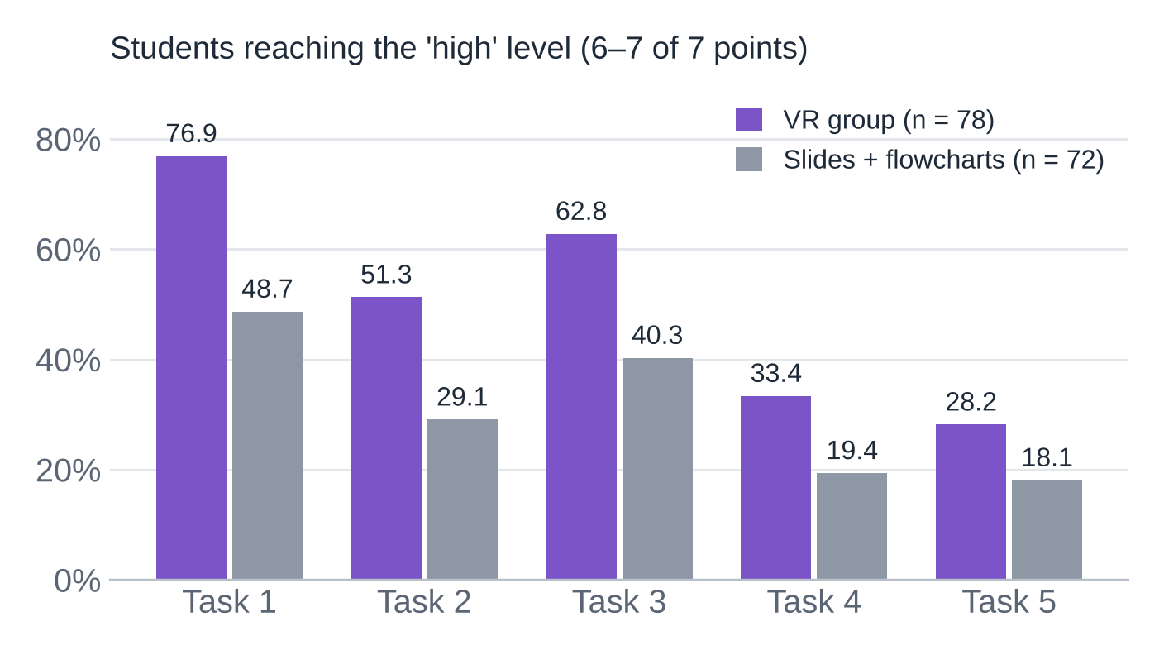
Mukasheva et al. (2023): sorting cubes by hand in VR
STATE OF THE ART · PAPER 2 OF 3
Frontiers in Education 8:1195200 · Unity + Oculus Quest 2 · 150 undergraduates, Kazakhstan
Problem
Approach
Abstract steps and several actions on unordered data at once make bubble and selection sort hard
Teaching relies on paper traces, slides, videos
'VR sorting': grab numbered cubes with virtual hands and swap them (10-element array)
Each step shown on a VR board; an error restarts the sort
78 VR vs 72 slides + flowcharts; 5 tasks, 7-point scoring
Key contribution
Limitations
+28.2 pts
α = 0.816
Every task favoured the VR group (χ², p ≤ 0.024)
Frames VR as 'constructive visualisation': static → dynamic → constructive
Extended taxonomy: implementation, adaptability, integrity
One university; no delayed test
Needs a headset per learner
Only 2 algorithms; no story, score or rewards
Transfer tasks 4–5 stayed low (≤ 33% high)
gap on Task 1 (76.9% vs 48.7%)
reliability of the 5 tasks (Cronbach)
Mean scores were higher for VR on all five tasks — e.g. Task 2: 5.12 vs 3.35 out of 7.
Chart redrawn from Mukasheva et al. (2023), Table 5
Notes:
Paper 2: Mukasheva, Kalkabayeva and Pussyrmanov, 'Visualization of sorting algorithms in the virtual reality environment', Frontiers in Education 8:1195200, 2023. Problem: the abstract nature of sorting and the many simultaneous actions on unordered data make bubble and selection sort hard; teachers use paper, presentations, flowcharts, dance videos and animations. Approach: they built 'VR sorting' in Unity with the Oculus Integration package for the Oculus Quest 2. Students choose bubble or selection sort on a VR board, then pick up cubes with numbers using one or two virtual hands and swap them; each step is shown on the board, and if an error occurs the sorting restarts. They place it in a 'constructive visualisation' paradigm (static, then dynamic 2D/3D, then constructive VR) and extend Myller's engagement taxonomy and Ihantola's taxonomy with implementation, adaptability and integrity levels. Study: 150 first- and second-year students aged 17–20; experimental group of 78 used VR, control group of 72 used presentations and flowcharts. Five practical tasks scored on a 7-point scale; Cronbach's alpha 0.816. Means were higher for VR on every task (Task 1: 6.05 vs 4.88; Task 2: 5.12 vs 3.35). The chart shows the share at the 'high' level (6–7 points): Task 1 76.9% vs 48.7%, Task 2 51.3% vs 29.1%, Task 3 62.8% vs 40.3%, Task 4 33.4% vs 19.4%, Task 5 28.2% vs 18.1%. Chi-square was significant for all five tasks (p from 0.000 to 0.024). Limitations: a case study at one regional university; needs a headset per learner; only two algorithms; no game layer — no story, score or rewards, and the only consequence of an error is a restart; tasks 4–5, which apply sorting to new problems (lakes by area), stayed low in both groups; participants received extra course points; no delayed test.

Slide 6
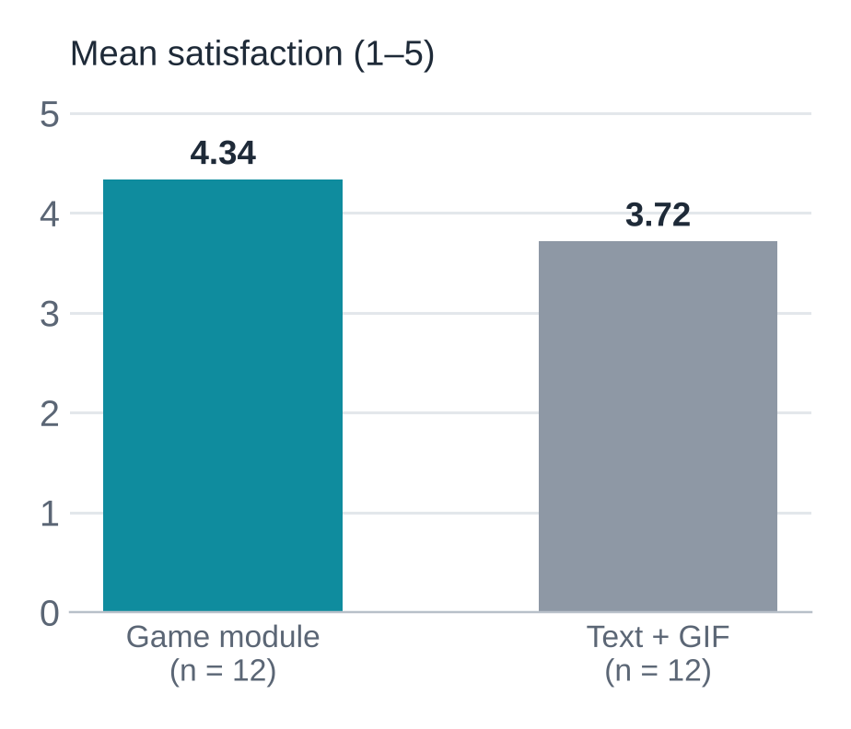
Sidorov & Cherkasova (2026): story levels from theory
STATE OF THE ART · PAPER 3 OF 3
Bulletin of Perm University. Math. Mech. Comp. Sci. 1(72): 118–130 · HTML5 / JavaScript web app · pilot with 24 students
Problem
Approach
ONE METAPHOR PER ALGORITHM
Learners memorise steps and confuse the logic of different algorithms
Passive animation is not enough; gamification, AI and learning theory are rarely combined
Galperin's stage-by-stage theory: each operation is acted out on objects
4 story levels; a mentor character sets each task
Wrong operations are blocked step by step
Bubble
frogs on lily pads
Selection
bridge of magic blocks
Insertion
crystals on an altar
Quick
warriors through gates
Key contribution
Limitations
A model that ties a classical learning theory to game mechanics and narrative
Satisfaction 4.34 vs 3.72 (Mann–Whitney U = 143.5, p < 0.001, r = 0.84)
Only 24 students; only satisfaction measured
No test score, no delayed test; medians equal (4.0)
2D web, no adaptivity yet
Bridge of Selection: pick the smallest unsorted block and place it on the bridge; a wrong pick lowers the bridge's stability.
Chart from the paper's group statistics (EG vs CG)
Notes:
Paper 3: Sidorov and Cherkasova, 'A Model for Integrating a Gamified Learning Module into the Study of Sorting Algorithms', Bulletin of Perm University, Mathematics, Mechanics, Computer Science, 2026, No. 1(72), pp. 118–130 (we used the English translation). Problem: sorting is abstract, learners memorise steps without understanding and confuse algorithms; passive animation is insufficient; few works combine gamification, AI and a classical theory of learning in one model. Approach: the web app 'The Path of the Master of Algorithmic Arts' follows P. Ya. Galperin's theory of the stage-by-stage formation of mental actions: an action is first done in an expanded, materialised form, so the array becomes frogs on lily pads (bubble sort), magic blocks for a bridge (selection sort; a wrong choice reduces the bridge's stability), crystals carried to an altar (insertion sort) and warriors sent through gates around a pivot (quick sort). Archmage Alaktik explains each task; Professor Sortius gives the theory. Every operation is controlled: if the learner tries a wrong one, the marker does not activate. Built in HTML5, CSS3 and ES6 classes with promise-based animation, hosted on GitHub Pages, developed with help from generative AI. Study: pilot with 24 fourth-year pedagogical-education students, 12 used the app and 12 used text with GIF animation. A 13-item Kirkpatrick-style satisfaction questionnaire (5-point scale): mean 4.34 vs 3.72; Mann–Whitney U = 143.5, p < 0.001, effect size r = 0.84. Limitations, stated by the authors: tiny sample, only subjective satisfaction (no objective performance and no delayed knowledge test), both medians equal 4.0; no adaptivity yet (AI-generated input variants are proposed). Also, the standard deviations in the text (0.12, 0.23) differ from those in the table (0.69, 1.13). Future work they list: merge and heap sort, comparing algorithms on the same input, LMS integration, and a study with at least 100 respondents.

Slide 7
Where each approach is strong, and where ours fits
SOTA COMPARISON
 | Schöller 2025 | Mukasheva et al. 2023 | Sidorov & Cherkasova 2026 | Sort or Stay (ours)
Technology | Ionic / Angular app, phone + web | Unity VR, Oculus Quest 2 | HTML5 / JavaScript web | Unity 6 3D, desktop (Mac / Win)
Interaction | Tap cards: open, pin, swap, finalize | Grab and swap cubes with VR hands | Click themed objects | Realistic avatar; point-and-click, walks to objects
Game mechanics | Hidden cards, max 2 open; free / algorithm modes | Swap cubes; an error restarts the sort | 4 themed levels; bridge 'stability' | Escape rooms: neighbour-only keys, hidden weights, carry-and-insert books
Narrative & immersion | None; flat 2D | High immersion, no story | Mentor + fantasy story; 2D | Locked building, floor by floor; bright 3D rooms
Feedback | Alert lists allowed moves; counters | Restart on error; steps on a board | Wrong move blocked; theory text | Says why a move is wrong; hints; debrief vs. optimum
Adaptivity & AI | None (AI feedback = future) | None | AI used to build it; AI inputs = future | None yet; adaptive hints planned
Evaluation | None reported | 150 students, 5 tasks, χ² | 24 students, satisfaction only | Pilot planned: pre / post + delayed test
Cost to learner | Free (phone / browser) | Headset per learner | Free (browser) | Free; any laptop
Takeaway: VR gave the clearest learning gain but costs a headset; the free 2D tools add rules or story but stay flat and give little 'why'. No tool combines all three.
Notes:
This table compares the three papers and our game on the dimensions from the template: technology, interaction, game mechanics, narrative and immersion, feedback, adaptivity and AI, evaluation, and cost. Algorithms covered (not in the table): Schöller — bubble, selection, insertion; Mukasheva — bubble and selection; Sidorov — bubble, selection, insertion and quick sort; Sort or Stay — bubble, selection and insertion are built, merge and quick are planned. Reading across: Mukasheva's VR is the only one with measured learning gains, but it needs a headset for each learner and has no game layer. Schöller's and Sidorov's tools are free and check each move, but they are 2D, and their feedback either lists the allowed moves or blocks the wrong one without explaining why. Sort or Stay sits in between: hands-on in a 3D world on an ordinary laptop, with a story and explanations. Its weak cells are honest: no adaptivity and no evaluation yet — both are in the plan on the last slides.

Slide 8
Missing: hands-on, explained and affordable at once
RESEARCH / DESIGN GAP
Schöller
Mukasheva
Sidorov
Ours
WHAT THE PAPERS SAY IS STILL MISSING
Learner performs every operation
Yes
Yes
Yes
Yes
Schöller 2025, §7
Feedback on how efficient the player's own sorting was, compared with the known algorithms; quick and merge sort as next levels.
3D world without special hardware
No
No
No
Yes
Story that gives the sort a purpose
No
No
Yes
Yes
Mukasheva et al. 2023, §5
Tasks applying sorting to new problems stayed low; a wider range of tasks is needed. One university only.
Algorithm's limits felt (hidden values)
Yes
No
No
Yes
Explains why a move is wrong
Partly
No
Partly
Yes
Sidorov & Cherkasova 2026
Objective scores and delayed tests with 100+ learners; merge sort; comparing algorithms on the same input.
Cost vs. optimum, across algorithms
Partly
No
No
Yes
Gap: a free, hands-on 3D game that makes each rule physical, explains mistakes, compares costs — and is tested on learning, not only liking.
Learning measured, incl. delayed test
No
Partly
No
Planned
Notes:
Left: seven things a learner needs, checked against each paper. Yes / Partly / No is our reading of each paper. 1) All three let the learner perform the operations. 2) None offers a 3D world without special hardware: two are 2D and the 3D one needs a VR headset. 3) Only Sidorov gives the sort a story. 4) Only Schöller makes the algorithm's limits felt — face-down cards mean you only see two values at a time. In our Floor 2 the crate weights are hidden until weighed, which plays the same role. 5) None explains why a move is wrong: Schöller lists the allowed moves, Sidorov blocks the move, Mukasheva restarts. 6) Schöller counts comparisons and swaps, but nobody compares the player's cost with the optimum or across algorithms. 7) Only Mukasheva measured learning with tasks, and nobody ran a delayed test; ours is planned, not done. Right: the papers point at this gap themselves. Schöller's future work asks for efficiency feedback and quick/merge sort; Mukasheva found transfer tasks 4 and 5 low in both groups and studied one university; Sidorov and Cherkasova call for objective performance indicators, delayed knowledge tests with at least one hundred respondents, merge sort, and comparing algorithms on the same input.

Slide 9
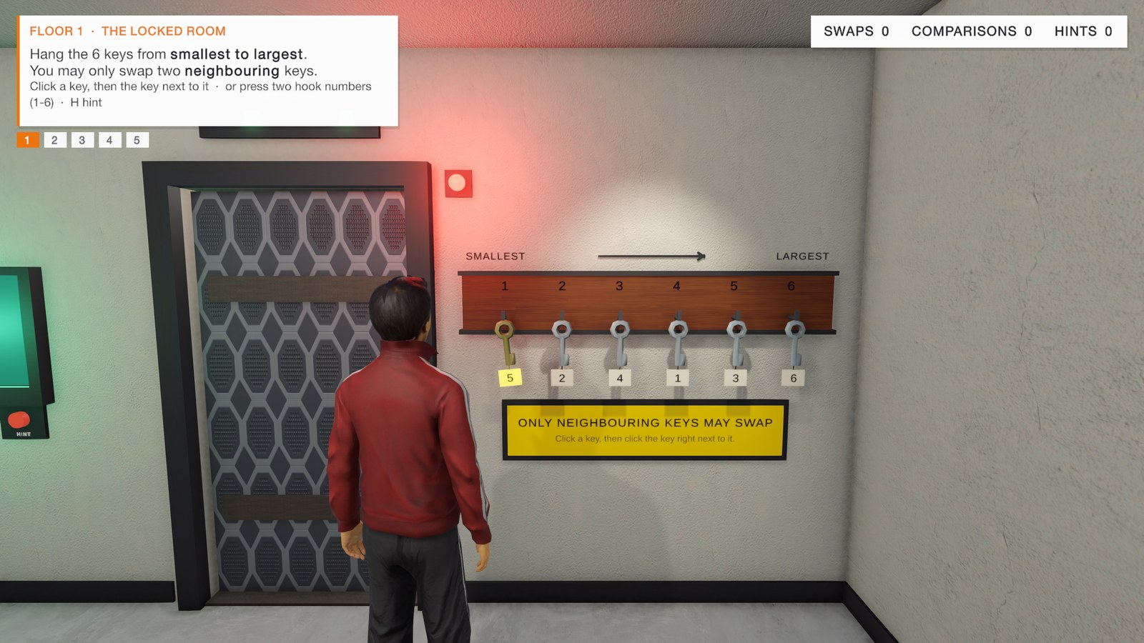
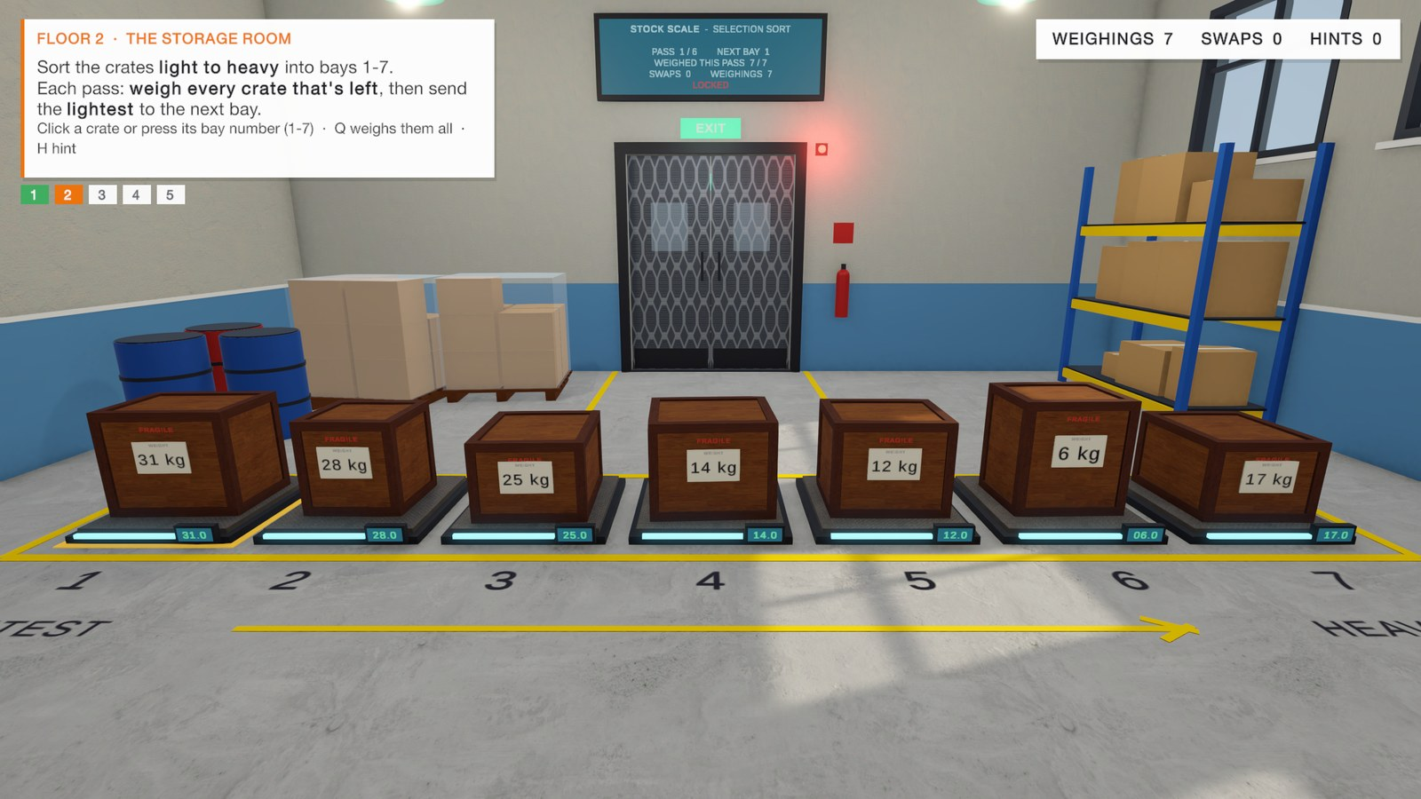
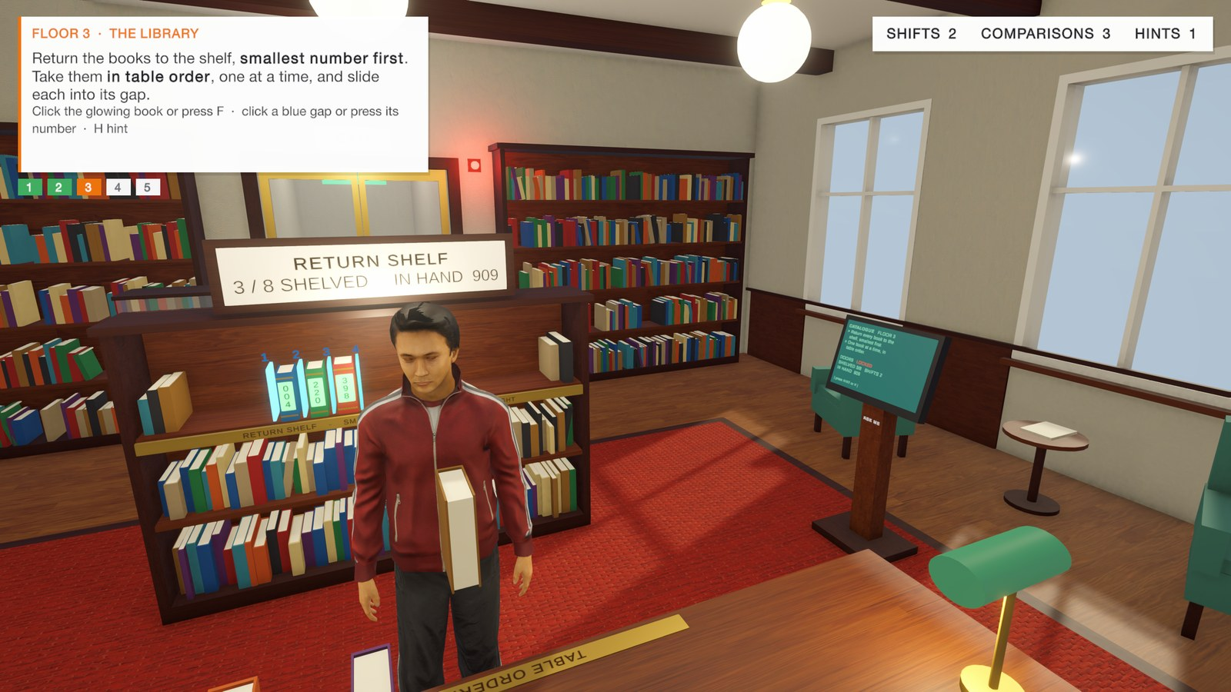






Sort or Stay: sort the room, or stay locked in
PROPOSED SOLUTION
A single-player 3D escape game in Unity 6. You play a realistic human locked in a five-floor building; each floor's exit opens only when its objects are sorted with that floor's algorithm.
Built
Premkumar
Built
Vijaya Teja
Built
Uday
Next
Premkumar
Planned
Vijaya Teja
Floor 1 · Locked Room
Floor 2 · Storage Room
Floor 3 · Library
Floor 4 · Control Room
Floor 5 · Vault
Bubble sort
Selection sort
Insertion sort
Merge sort
Quick sort
6 keys on hooks; only neighbours may swap
7 crates with hidden weights; a crane moves the lightest
8 books taken in order and slid into shelf gaps
Split, sort halves, merge two queues
Choose a pivot, partition left / right
MAJOR COMPONENTS
HOW IT ADDRESSES THE PROBLEM AND GAP
Player & controls
realistic avatars, click-to-walk, 1st/3rd person
Rule checker
one puzzle script per algorithm validates each move
Passive learning → you perform every swap, weigh and insert yourself
Abstract or costly → a 3D world on an ordinary laptop, no headset
Feedback layer
why-messages, hints, gestures, debrief cards
Progress
level manager, game state, cross-floor scoreboard
No 'why' → each wrong move gets a reason; hints explain the next step
Cost unseen → debrief compares your moves with the fewest possible
Notes:
Sort or Stay is a single-player 3D escape game made in Unity 6 (URP). The player is a realistic human (Microsoft Rocketbox avatars Alex and Maya, MIT licence) who wakes up locked in a building. Each floor is one room and one algorithm; the exit only opens when the objects are in order, and the room's rule forces the algorithm. Floor 1, the Locked Room: six keys on numbered hooks; you may only swap neighbours — that is bubble sort, and the minimum number of swaps equals the number of out-of-order pairs. Floor 2, the Storage Room: seven crates whose weights are hidden until weighed on the scales; each pass you must weigh every crate that is left and send the lightest to the next bay with an overhead crane — selection sort, and the readings reset every pass because selection sort keeps no memory. Floor 3, the Library: eight books with call numbers, taken from the table in order and slid into numbered gaps; bigger books shift right — insertion sort. Floors 4 (merge sort) and 5 (quick sort) are next. The pill on each floor names its owner in Group 3: Premkumar — Floors 1 and 4; Vijaya Teja — Floors 2 and 5; Uday — Floor 3. Components: the player and controls; one rule-checking puzzle script per algorithm that validates every move; the feedback layer with explanation messages, hints, gestures and debrief cards; and the level manager, game state and scoreboard that carry results across floors. How it addresses the problem and gap: the learner acts instead of watching; the world is 3D but needs no headset; every wrong move gets a reason; and after each floor the debrief compares the player's moves with the fewest possible and with the previous floors.

Slide 10







Each room's rule is the algorithm
GAME DESIGN
Mechanics
Dynamics
Aesthetics
Narrative
Pick, swap neighbours, weigh (Q), crane move, fetch (F), insert into a gap, hint (H). Every move is checked.
Players plan passes, re-weigh every crate because selection sort forgets, and watch books shift right.
Bright, realistic rooms, a realistic human avatar, sound for every thud, scan and page.
You wake up locked in. Each floor's door opens only when its objects are in order: sort, or stay.
Interaction
Challenges
Rewards
Progression
Point and click — the avatar walks over. Number keys, 1st/3rd-person camera, two characters.
Only neighbours swap; weights stay hidden until weighed; books come in table order. Wrong moves are slips.
Items glow green, the door unlocks, the avatar cheers; a debrief shows your moves vs. the fewest possible.
6 keys → 7 crates → 8 books → merge → quick: simple O(n²) first, then divide and conquer.
Notes:
Mechanics (the rules and actions): select a key, swap neighbours; weigh one crate or press Q to weigh all, choose the lightest and the crane moves it; press F to fetch the next book, choose a gap; H gives a hint. Each puzzle script checks every move against the algorithm. Dynamics (what play turns into): players plan passes; on Floor 2 they learn that every pass needs all remaining crates weighed again because selection sort keeps no memory; on Floor 3 they see that inserting a small book shifts all bigger ones. Aesthetics: a bright look (LED-lit lock-up room, warehouse, wooden library), realistic avatars rather than cartoons, procedural sounds; the intended feelings are challenge and discovery. Narrative: you wake up locked in a building; every floor is a locked room — sort, or stay. Interaction: point and click is the default — hover shows a marker and a label, a click makes the avatar walk over and use the object. Number keys pick hooks, bays and gaps; Tab switches to mouse-look; V toggles first/third person; C switches between Alex and Maya; Esc opens the pause menu. Challenges: each floor's constraint; wrong moves count as slips. Rewards: green glow, door, cheer gesture, a debrief card comparing your moves with the minimum, and a scoreboard across floors. Progression: more items each floor (6, 7, 8) and from O(n²) algorithms to divide and conquer.

Slide 11

Act, see the result, learn why, face the next pass
GAMEPLAY LOOP
EXAMPLE · FLOOR 2, THE STORAGE ROOM (SELECTION SORT)
1
Player action
Press Q to weigh every crate left, then click the lightest one (12 kg).
1. Player action
2. Game response
3. Feedback
2
Game response
Scales show readings; the crane lifts the crate into the next bay; weighings and swaps go up.
3
Feedback
A wrong pick: "17 kg is not the lightest crate left" — the avatar scratches his head. H explains the next step.
next pass, then next floor
4
Reward / consequence
Right: the bay glows green and stays locked in. Wrong: a slip is counted and nothing moves.
5. New challenge
4. Reward / consequence
5
New challenge
Readings reset — the next pass has one crate fewer. After the last pass the doors open to Floor 3.
Notes:
The core loop has five beats. 1) Player action: the player does one operation of the algorithm — swap two neighbouring keys, weigh crates and choose one, or insert a book into a gap. 2) Game response: the puzzle script checks the move against the algorithm, animates it (keys swap on an arc, the crane lifts a crate, books slide) and updates the counters. 3) Feedback: a wrong move gets a sentence that says why it is wrong, plus a gesture; H gives a hint that explains the next correct step. 4) Reward or consequence: a correct move locks items in with a green glow and finally opens the door; a wrong move counts as a slip and changes nothing. 5) New challenge: the next pass has one item fewer; after the floor, the debrief card compares your moves with the minimum and the next floor brings a new algorithm and one more item. The example on the right is Floor 2 as played in the test run on 23 October: after weighing all seven crates, picking the 17 kg crate produced '17 kg is not the lightest crate left. Compare the readings again', and picking the 12 kg crate moved it to bay 2.

Slide 12
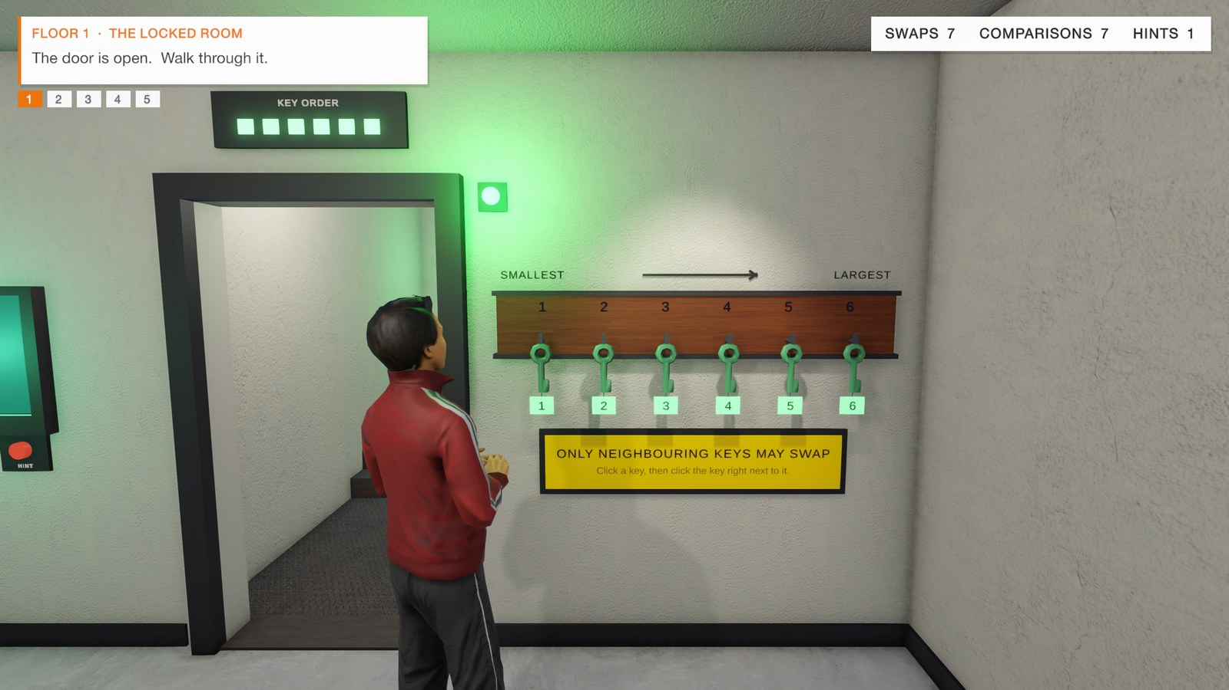
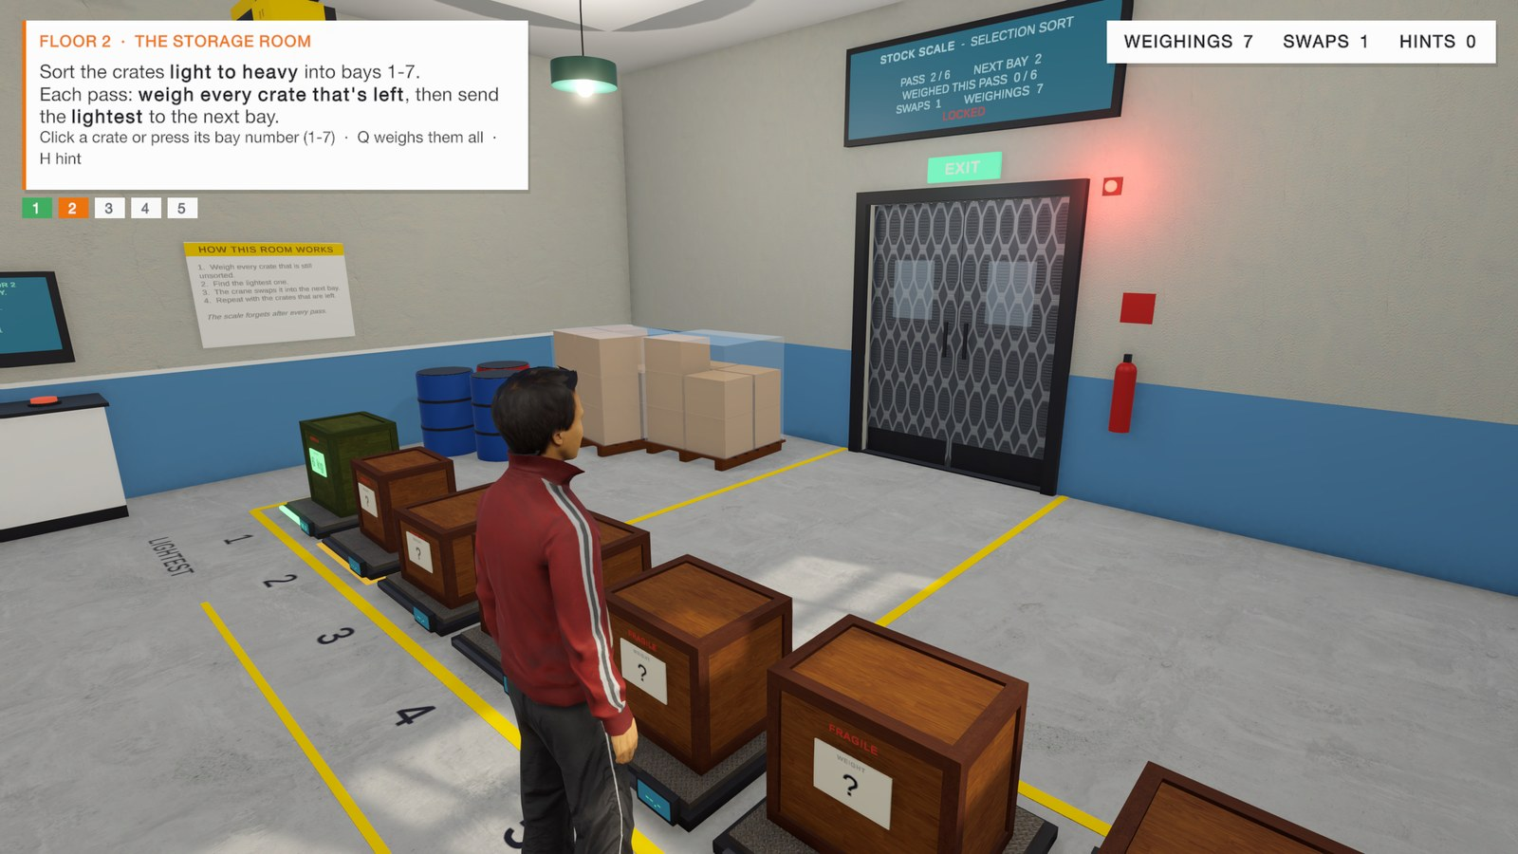
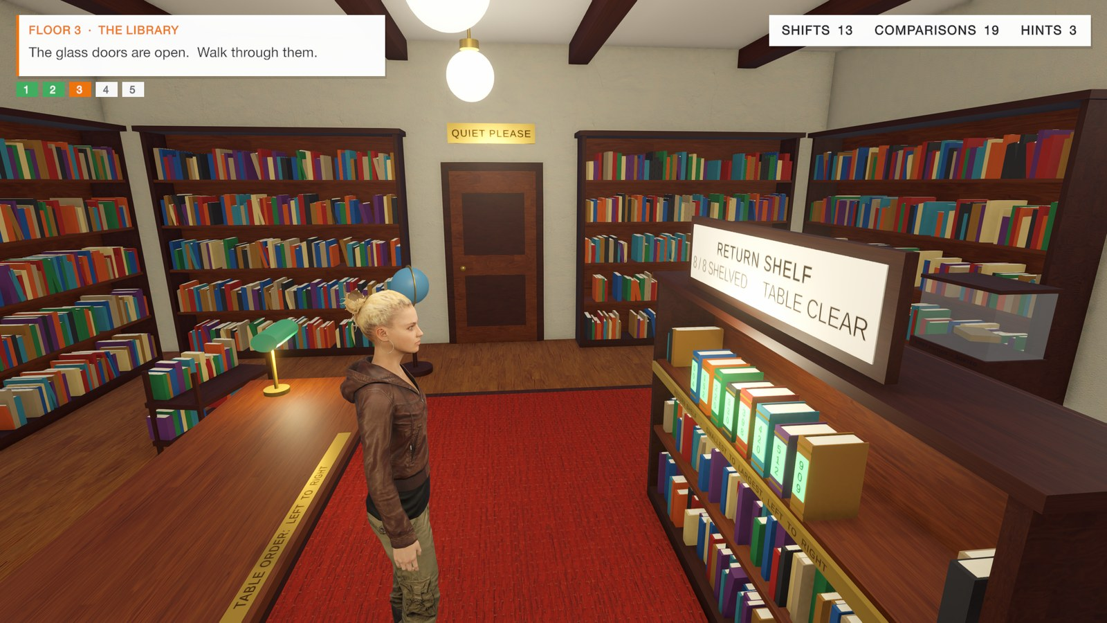
Floors 1–3 are built and playable end to end
CURRENT PROGRESS · COMPLETED
Done
Built by Premkumar
Done
Built by Vijaya Teja
Done
Built by Uday
Floor 1 · Locked Room
Floor 2 · Storage Room
Floor 3 · Library
Bubble sort: all six keys sorted, keys glow green, door open
Selection sort: bay 1 locked in green; readings reset for pass 2
Insertion sort: 8 / 8 books shelved, 'table clear'
TEST RUN · 23 OCT 2026 · SCOREBOARD 'FLOORS 1–3 ESCAPED'
7 = 7
6 & 21
13 = 13
Floor 1: swaps = out-of-order pairs, the fewest possible
Floor 2: 6 swaps (at most n − 1) and 21 = n(n−1)/2 comparisons
Floor 3: shifts = out-of-order pairs in the table order
Also done: realistic avatars Alex & Maya · point-and-click with auto-walk · number-key shortcuts · hints · slips · debrief cards · pause menu · editor scene builders
Notes:
Completed implementation, shown with in-game screenshots captured from the Unity Game view (Full HD) on 23 October 2026. Floor 1 was built by Premkumar Thota, Floor 2 by Vijaya Teja Kameswar and Floor 3 by Uday Banu Prakash. Floor 1, the Locked Room (bubble sort): six keys, neighbour-only swaps, hint, door and debrief card. Floor 2, the Storage Room (selection sort): seven crates with hidden weights, scales, the overhead crane, readings that reset each pass, and loading doors to the stairwell. Floor 3, the Library (insertion sort): eight books with call numbers, fetch in table order, numbered gaps, shifting, glass doors. Test-run numbers from the end scoreboard: Floor 1 — 7 swaps, the fewest possible (7 out-of-order pairs), 7 comparisons, 1 hint, 0 slips, 1:52. Floor 2 — 6 swaps (never more than n − 1 = 6), 27 weighings, 21 comparisons (6+5+4+3+2+1 = n(n−1)/2), 1 slip (deliberate, to test the feedback), 3:27. Floor 3 — 13 shifts equal to the 13 out-of-order pairs, 19 comparisons, 3 hints, 0 slips, 4:28. Total 9:49. Other completed work: Rocketbox avatars with an animation controller, gestures (cheer, scratch head, try the door), point-and-click with a runtime NavMesh for auto-walking, hover marker and labels, number keys, first/third-person camera, pause menu, and editor menus that rebuild each floor's scene.

Slide 13
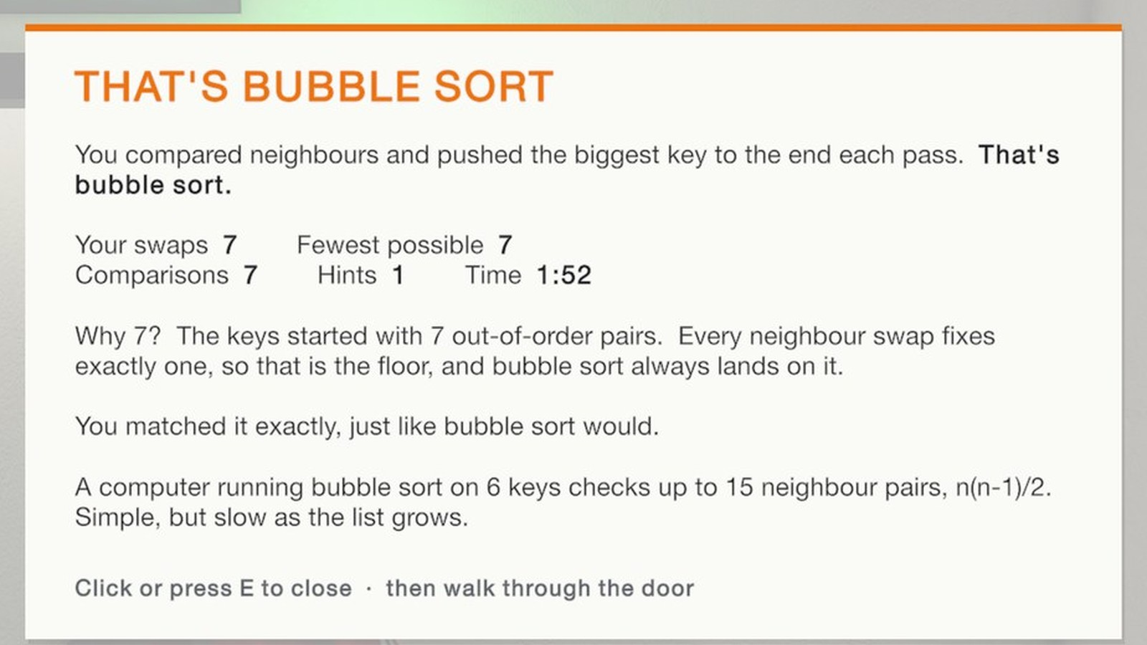
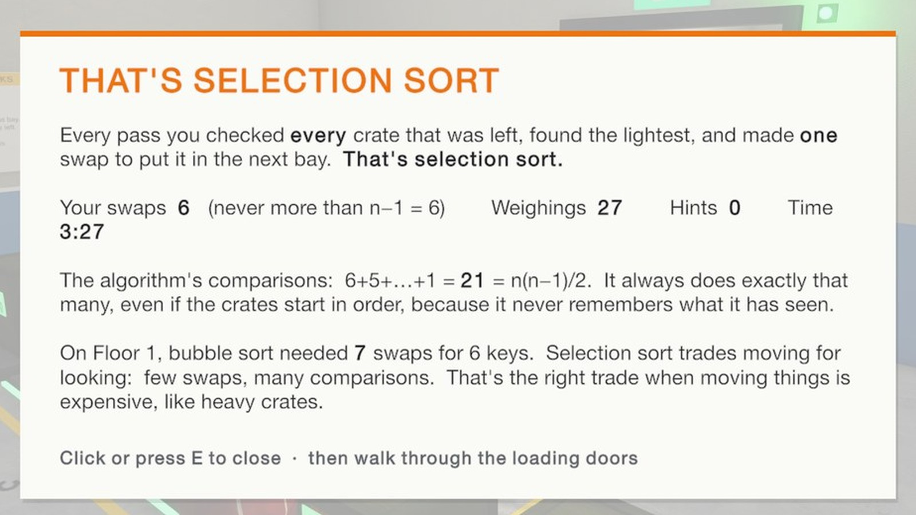
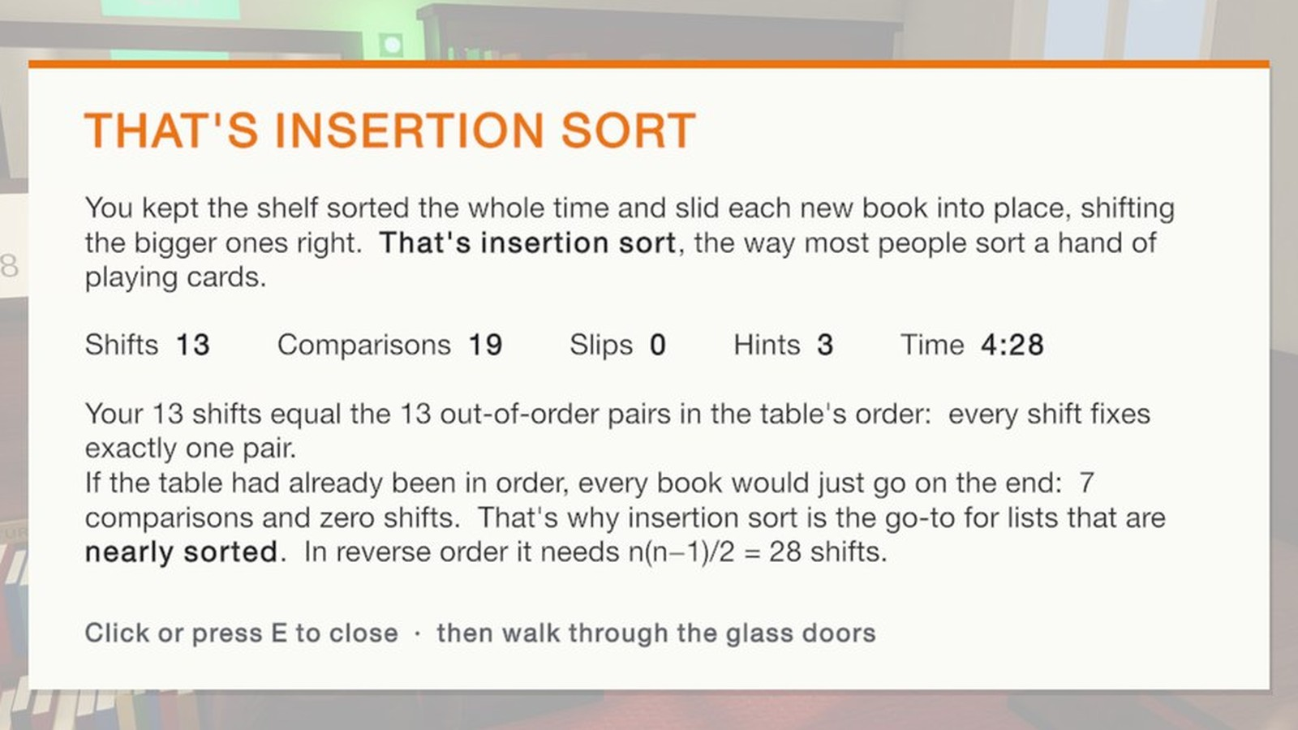

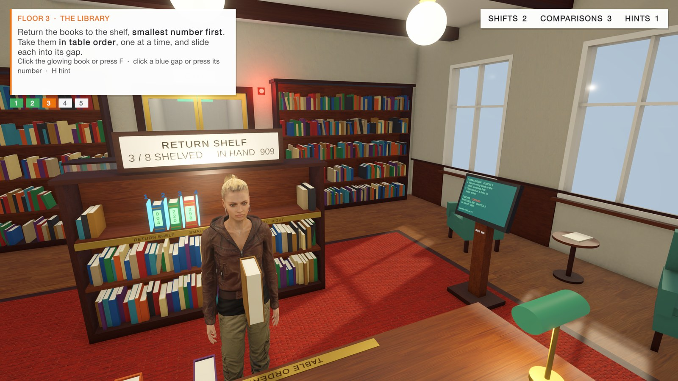
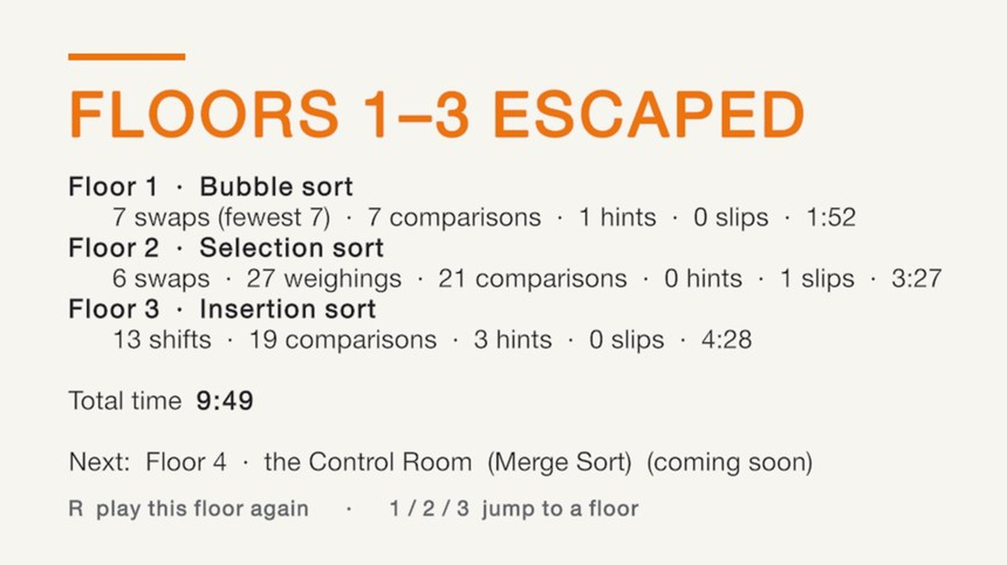
Feedback that explains, not just a score
CURRENT PROGRESS · DEMO EVIDENCE
Debrief after Floor 1: "Why 7?" — 7 out-of-order pairs, each swap fixes one
Debrief after Floor 2: 21 = n(n−1)/2 comparisons; compared with Floor 1
Debrief after Floor 3: shifts = out-of-order pairs; why insertion suits nearly sorted lists
Point and click: hover marker + label, the avatar walks over by himself
Second realistic character (Maya); press C to switch
End scoreboard: all three floors, total time 9:49
Notes:
Demo evidence. Top row: the debrief card after each floor. These cards are the main learning feature: they explain the count, not just show it. Floor 1 explains that the keys started with 7 out-of-order pairs and every neighbour swap fixes exactly one, so 7 is the floor. Floor 2 shows that selection sort always makes 6+5+4+3+2+1 = 21 comparisons and never more than n − 1 swaps, and contrasts it with bubble sort's 7 swaps on Floor 1: few swaps, many comparisons — right when moving things is expensive. Floor 3 shows that 13 shifts equal the 13 out-of-order pairs and that an already-sorted table would need only 7 comparisons and 0 shifts, which is why insertion sort is used for nearly sorted lists. Bottom row: the point-and-click control with the bouncing marker and the label 'Click · Send the 12 kg crate to bay 2 [5]'; the second character Maya; and the end scoreboard 'Floors 1–3 escaped'. The 'not the lightest' message and the hint text appear on screen during play (see the gameplay-loop example); they are not in these captures.

Slide 14


Two floors and a pilot study to go
NEXT STEPS
COMPLETION PLAN (PROPOSED)
Work in progress
Remaining work
Week 1 27 Oct – 2 Nov
Floor 4 · Control Room — merge sort: level design and rule checker (Premkumar)
Control polish: editor focus click counted as a move; Floor 1 marker overlaps hook numbers (Premkumar)
Pilot test questions for each floor (Uday)
Floor 5 · Vault — quick sort, pivot and partition (Vijaya Teja)
Adaptive hints after repeated slips (Uday)
Start menu, settings, Windows / Mac builds (all)
Pilot study: pre / post test, delayed test after a week, questionnaire (Uday leads)
Final report and demo video (all)
Floors 4 and 5: layout + rule checker
Premkumar (F4) · Vijaya Teja (F5) · Uday: tests
Week 2 3 – 9 Nov
Floors 4 and 5 playable; adaptive hints
Premkumar · Vijaya Teja · Uday (hints)
Week 3 10 – 16 Nov
Menus, builds, bug fixes
All three
Week 4 17 – 23 Nov
Pilot study with classmates
DONE MEANS
Uday leads · all three
All 5 floors playable
Pilot study results
Report + demo video
Week 5 24 – 30 Nov
Analysis, report, final demo
All three
Notes:
Work in progress: Floor 4, the Control Room, for merge sort — level design and its rule checker, reusing the shared kit (scene builder, player, interactor, level intro, HUD). Small control fixes found in play-testing: in the Unity editor the click that focuses the Game view also counts as a game click; on Floor 1 the hover chevron sits over the hook number; Maya's hair bun shows a patch from the hair texture. Remaining: Floor 5, the Vault, for quick sort; adaptive hints that give more detail after repeated slips (the adaptivity gap from the comparison slide); a start menu, settings and stand-alone builds; a pilot study — pre-test, play, post-test, and a delayed test after one week, plus a short questionnaire, which answers the evaluation gap; then the report and a demo video. Owners: Premkumar Thota builds Floor 4 (merge sort) and fixes the controls; Vijaya Teja Kameswar builds Floor 5 (quick sort); Uday Banu Prakash writes the pilot tests, adds adaptive hints and leads the pilot study. Floors 4 and 5 are built in parallel in Weeks 1–2; builds, the study and the report are shared. The week-by-week plan is a proposal counted from 27 October and can be shifted to match the course deadline.

Slide 15
Sources
REFERENCES
Schöller, M. (2025). An Educational Mobile Game about Sorting Algorithms. Bachelor's thesis, Institute for System Software, Johannes Kepler University Linz, Austria.
Mukasheva, M., Kalkabayeva, Z., & Pussyrmanov, N. (2023). Visualization of sorting algorithms in the virtual reality environment. Frontiers in Education, 8, 1195200. https://doi.org/10.3389/feduc.2023.1195200
Sidorov, S. V., & Cherkasova, V. A. (2026). A model for integrating a gamified learning module into the study of sorting algorithms. Bulletin of Perm University. Mathematics. Mechanics. Computer Science, 1(72), 118–130. https://doi.org/10.17072/1993-0550-2026-1-118-130
ASSETS AND TOOLS
Unity 6 (URP) · Microsoft Rocketbox avatar library (MIT licence) · all screenshots captured from the Sort or Stay Unity project, 23 Oct 2026 · charts redrawn from the papers' reported data
Notes:
Full references for the three state-of-the-art papers, plus the main tools and assets used in the game.

