Slide 1
TITLE PAGE
Problem Statement ID – SIH26250
Problem Statement Title – Air Power - Dynamic Air Operations & Resource Optimisation.
Theme – Transportation & Logistics
PS Category – Software
Team ID – [to be added]
Team Name (Registered on portal) – VayuVyuha
Notes:
Title page in the SIH template. Fill in the Team ID from the portal. VayuVyuha (vayu = air, vyuha = battle formation) is the suggested team name.

Slide 2

























VayuVyuha — AI Decision Support for Dynamic Air Operations & Resource Optimisation
THE PROBLEM TODAY
Aircraft, crew, weapon, weather and threat data sit in separate systems
OUR IDEA
One live operating picture from every feed
72–96 h
< 1 s
Re-tasking after a change is manual and slow
Ranked options, with a reason for each change
to build an air plan (US Army CALL, 2023)
Scarce aircraft are under-used
to re-plan after any change, in the prototype
A commander approves; launched sorties never change
SYSTEM ARCHITECTURE
LIVE FEEDS
VAYUVYUHA ENGINE
WHAT THE COMMANDER SEES
Aircraft status
Ranked options
recommended, cautious, max coverage
Crew duty hours
Change list
what moves, and why
Weapon stock
1 Fuse
2 Predict
3 Optimise
4 Validate
5 Explain
all feeds into one state
aircraft no-go risk, threat exposure
aircraft, crews, weapons, launch slots
nine rule families, from scratch
rank options, give reasons
Why not tasked
the limit that blocks a mission
Airspace and runways
Weather
Plan confidence
1,000 simulated days
Exact engine OR-Tools CP-SAT on a server. Proves the best plan.
Built-in engine Adaptive search in the browser. 98.9% of exact in 0.3 s.
Threats
Mission priorities
Same rules and the same objective in both engines. Sorties already launched are locked.
Commander approves
the plan becomes the new baseline
WHAT IS NEW
Changes only what must change
Readiness-aware tasking
Says why
Plan confidence
Runs anywhere
4.0 plan changes per event, not 14.0
unreliable jets stay off top-priority missions
names the limit that blocks a mission
tested against 1,000 simulated days
one file, any browser, no install
Notes:
The problem, the idea, the architecture and what is new. The 72 to 96 hour figure is from the US Army Center for Army Lessons Learned handbook on the air tasking cycle (2023); RAND (Lingel et al., 2020) calls that cycle out of step with digital-speed operations. In the architecture, seven feeds enter the engine, five stages run inside it, and four kinds of output reach the commander, who approves before anything is published. Both engines apply the same rules and objective.

Slide 3
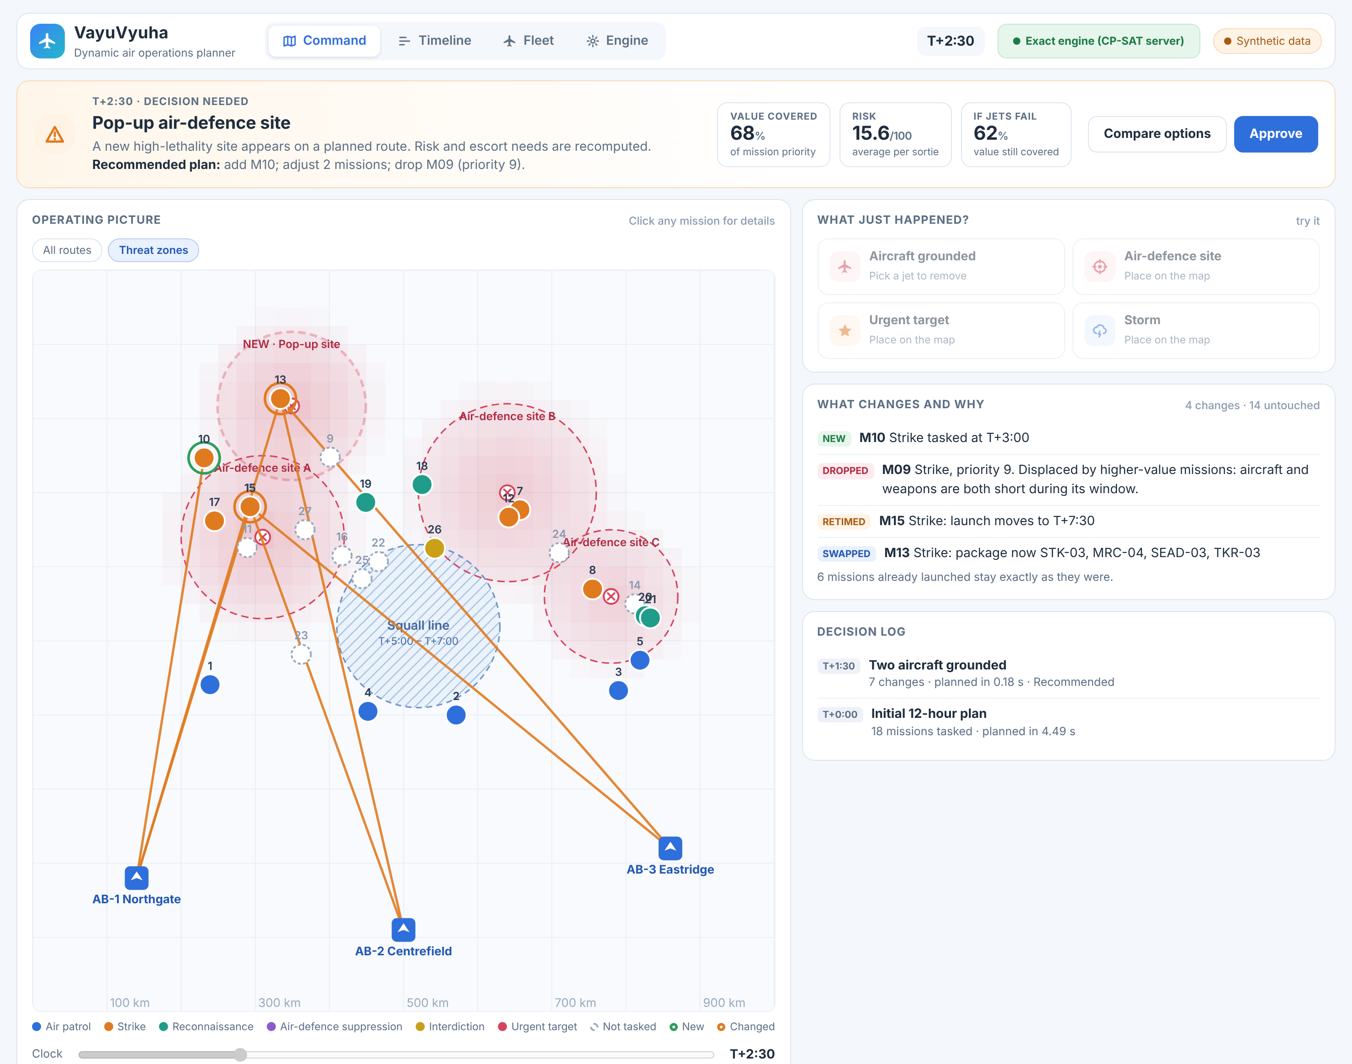



TECHNICAL APPROACH
HOW A RE-PLAN HAPPENS
WORKING PROTOTYPE: THE COMMAND VIEW AFTER AN EVENT
Event arrives
A jet is grounded, an air-defence site pops up, an urgent target appears, or a storm closes a corridor.
Lock launched sorties
Anything already airborne is fixed. Only the future is re-planned.
Re-plan
Exact CP-SAT on the server, or adaptive search in the browser, starting from the current plan.
Validate
Nine rule families are re-checked from scratch.
Rank and explain
Three options, a reason for each change, and why any mission is left out.
Commander approves
The chosen plan becomes the new baseline, and the loop waits for the next event.
ENGINE STACK
THE OPTIMISATION MODEL
TRY IT
Python
OR-Tools CP-SAT
scikit-learn
Decide which missions fly, when, with which aircraft, crew and weapons.
Rules roles, range, serviceability, turnaround, crew duty, weapon stock, runway cap, weather, escort.
Maximise mission value minus risk, unreliability, flight time, delay and plan change.
GitHub repository
github.com/thotapremkumar-tpk/VayuVyuha
Live prototype, opens in any browser
thotapremkumar-tpk.github.io/VayuVyuha
JavaScript search
REST API
HTML + SVG app
Notes:
Left: the loop that runs on every event. Right: the working prototype. Bottom: the stack, the optimisation model in three lines, and where to try it. The exact engine is Google OR-Tools CP-SAT; the built-in engine is an adaptive large-neighbourhood search written in JavaScript, so the app also runs with no server.

Slide 4
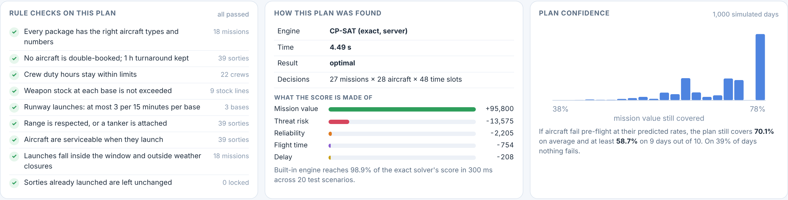




FEASIBILITY AND VIABILITY
IT WORKS TODAY: EVERY PLAN IS CHECKED AND STRESS-TESTED
IT SCALES: SCORE GAIN OVER MANUAL-STYLE PLANNING (%)
The Engine view of the prototype: nine rule checks, how the plan was found, and how much mission value survives when aircraft fail.
142
plans checked, 0 rule violations
0.06–0.18 s
exact re-plan after an event
98.9%
of the exact score, in a browser
The gain holds as the force grows: +6.6% at 112 aircraft in 2 s. Three synthetic instances per size.
CHALLENGES AND HOW WE HANDLE THEM
Real data is classified and scattered
Commanders will not act on a black box
The problem grows fast with force size
Links to a central planner can be jammed
Open state schema with adapters. Built on synthetic data, deployed on-premise.
Ranked options, a reason for every change, human approval, independent validator.
Search engines hold the gain at 112 aircraft. Rolling-horizon planning is next.
The built-in engine runs offline on any device. Decentralised auctions as fallback.
ROADMAP
Phase 1 Prototype solver, validator, app: done
Phase 2 Simulator pilot wargame feeds, planner trials
Phase 3 Integrate and scale C2 interfaces, larger forces
Notes:
Feasibility: the prototype runs today and every plan passes an independent validator. The scale chart shows the percentage by which each engine's plan score exceeds a sequential priority-first planner on the same synthetic instances; the exact solver was capped at 10 seconds on two CPU cores and proves the optimum only at the smallest size. Viability: each challenge is paired with how it is handled, and the roadmap moves from prototype to a simulator pilot to integration.

Slide 5




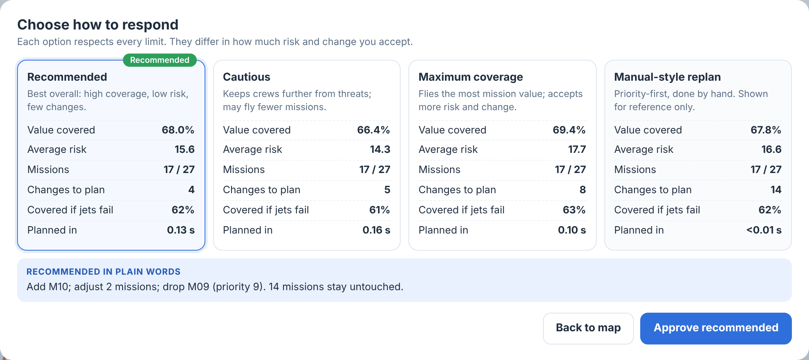
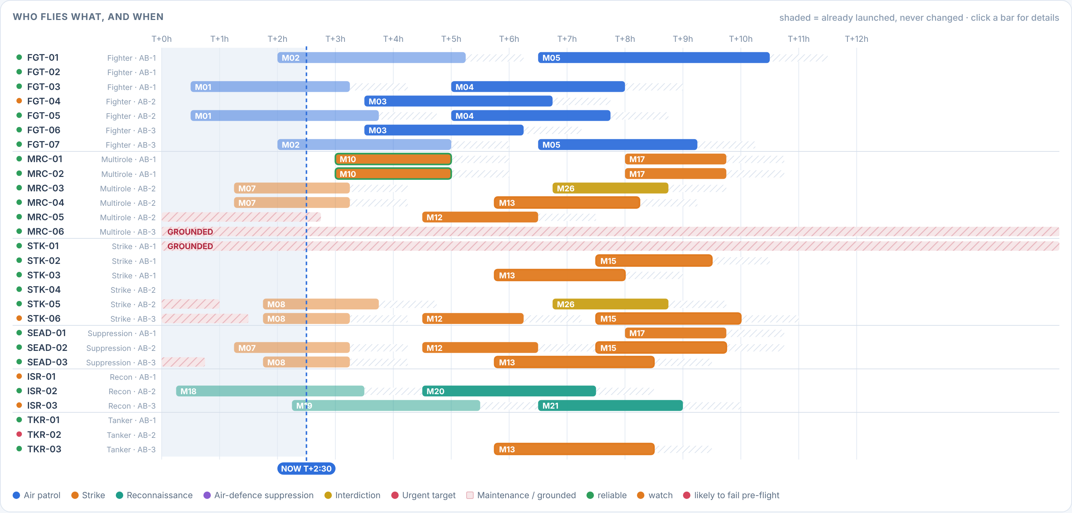



IMPACT AND BENEFITS
MEASURED IN THE PROTOTYPE
0.06–0.18 s
−26%
3.5× fewer
+11.8%
to re-plan after an event
average risk per sortie
plan changes per event
plan score, better in 20 of 20 scenarios
MISSION VALUE STILL COVERED AFTER EACH EVENT (%)
PLANNED MISSIONS CHANGED PER EVENT
THE DECISION SCREEN
Three valid options side by side. The commander picks how much risk and change to accept.
WHO BENEFITS
STRATEGIC IMPACT
Air operations planners
Re-planning becomes a sub-second computation plus one decision.
Commanders
Complete options with coverage, risk and change counts.
Fits a stated need: the IAF plans AI decision support for air battle managers on IACCS (IDRW, 2025).
Indigenous and open: no foreign licence; runs on-premise or offline.
Reusable: the same engine plans airlift, tanker and relief sorties.
Maintenance and logistics
Sorties matched to aircraft health and weapon stock per base.
Aircrew
26% lower average threat exposure per sortie in tests.
Prototype results on synthetic scenarios (20 scenarios; 4-event chain, exact engine). Baseline: a priority-first sequential planner standing in for manual planning.
Notes:
Four headline results, two charts, the decision screen, who benefits and the strategic impact. The line chart shows the share of mission priority value still covered after each of four events; the bars show how many planned missions each approach had to change. These are prototype results on synthetic data, not operational claims.

Slide 6




RESEARCH AND REFERENCES
HOW THE RESEARCH SHAPED THE DESIGN
Problem
A 72–96 hour cycle, manual steps, a stated IAF need
CALL · RAND · USAF · IDRW
Predict
Plan maintenance and missions together
O'Neil 2025
Optimise
Exact model plus adaptive search; runway limits
Li 2024 · Ropke 2006 · Meng 2022
Re-plan
Plan first, then re-assign when events hit
Wang 2025 · Sorton 2019
Approve
Keep a human in the loop; test for trust
Zhang L.A. 2020 · Chen 2025
Scale next
Rolling horizon; decentralised auctions
Zhang K. 2020 · Choi 2009
Problem evidence
AI for air operations planning
Assignment and re-planning
US Army CALL (2023) Air tasking cycle: six stages over 72–96 hours. [Open]
US Air Force (2021) KRADOS automates planning steps once done manually. [Open]
IDRW (Aug 2025) IAF to give air battle managers AI decision support on IACCS. [Open]
Saling (1999) Air University: dynamic retasking of airborne packages. [Open]
Lingel et al. (2020) RAND RR-4408/1: the 72-hour cycle and AI for all-domain C2. [Open]
Zhang L.A. et al. (2020) RAND RR-4311: AI-assisted mission planning; trust needs testing. [Open]
Sorton et al. (2019) DSIAC: one operator re-tasking several UAVs, flight-tested. [Open]
Zhang K. et al. (2020) Electronics: dynamic weapon-target assignment, receding horizon. [Open]
Li, Wu & Wang (2024) EAAI: survey of weapon-target assignment methods. [Open]
Wang et al. (2025) Defence Technology: pre-assignment plus event-triggered re-assignment. [Open]
Meng et al. (2022) Scientific Programming: sortie generation with runway congestion. [Open]
Search and decentralised allocation
Readiness and human-in-the-loop
Open tools used
Ropke & Pisinger (2006) Transportation Science: adaptive large-neighbourhood search. [Open]
Choi, Brunet & How (2009) IEEE T-RO: consensus-based decentralised auctions. [Open]
O'Neil, Khatab & Diallo (2025) Autonomous Intelligent Systems: predictive maintenance with mission assignment. [Open]
Chen et al. (2025) Defence Technology: human-guided reinforcement learning for aircraft scheduling. [Open]
Google OR-Tools CP-SAT constraint solver behind the exact engine. [Open]
scikit-learn gradient boosting for the readiness model. [Open]
Notes:
Seventeen sources in six groups: evidence for the problem, AI for air planning, assignment and re-planning algorithms, the search and decentralised-allocation methods, readiness and human-in-the-loop work, and the open tools used. Every item links to its source.

