Slide 1

Department of CSE
COURSE NAME: DBMS
COURSE CODE:23AD2102R
Topic: Index Structures, Indexing and Hashing

Slide 2
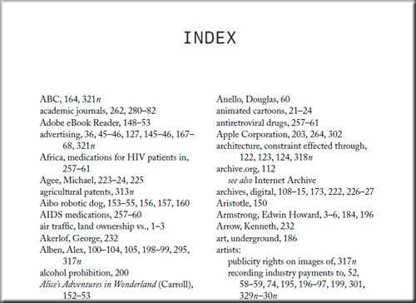
The collection of
What is Indexing ?
INDEXING is a data structure technique which allows you to quickly retrieve records from a database file.
Indexes are used to quickly locate data without having to search every record in multiple disk blocks
data that makes up a
computerized physically on medium.
database must be stored
some computer storage
The DBMS software can then retrieve,
update, and process this data as needed.
Similar to Indexing in Textbooks

Slide 3

Indexes as Access Paths
A single-level index is an auxiliary file that makes it more efficient to search for a record in the data file.
The index is usually specified on one field of the file (although it could be specified on several fields)
One form of an index is a file of entries <field value, pointer to record>, which is ordered by field value
The index is called an access path on the field.
3

Slide 4
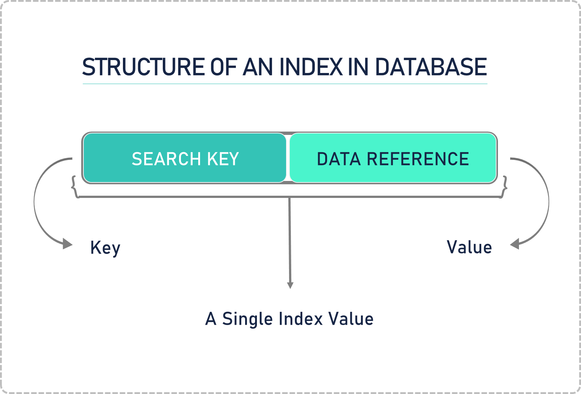
What is index in Database?
An Index is a small table having only two columns. The first column comprises a copy of the primary or candidate key of a table. Its second column contains a set of pointers for holding the address of the disk block where that specific key value stored.
An index -
Takes a search key as input
Efficiently returns a collection of matching records.

Slide 5
Types of Indexing
Indexing
Primary Indexing
Dense
Sparse
Clustered Indexing
Secondary Indexing
Multilevel Indexing

Slide 6
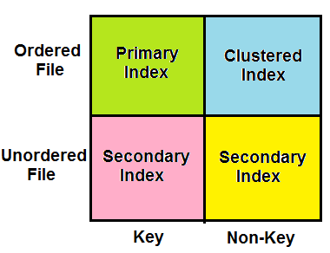
Which Indexing method is used ?
Types of Indexing

Slide 7
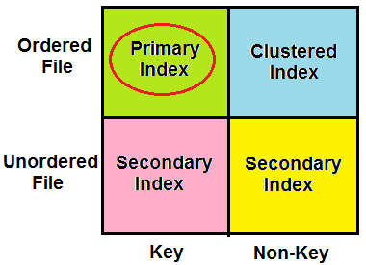
Primary Indexing
Primary Index is an ordered file which is of fixed length size with two fields.
The first field is the same a primary key and second field is a pointer that points to that specific data block.
The primary Indexing is further divided into two types.
Dense Index
Sparse Index

Slide 8
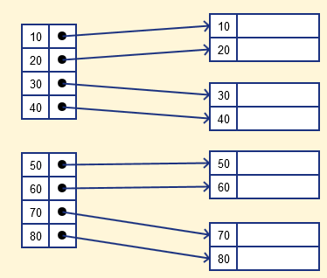
Dense Index
A record is created for each search key valued in the database.
Searching is faster
Requires more space to store index records
No. of records in IT = No. of records in HD

Slide 9
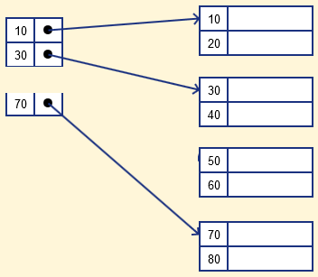
Sparse Index
Sparse Index
Sparse index contains only the anchor records
To locate a record, we find the index record with the largest search key value <= search key value we are looking for.
We start at that record pointed to by the index record, and proceed along with the pointers in the file (sequentially) until we find the desired record.
No. of records in IT = No. of blocks in HD
Time Complexity = log2N +1

Slide 10
Indexes as Access Paths
The index file usually occupies considerably less disk blocks than the data file because its entries are much smaller
A binary search on the index yields a pointer to the file record
Indexes can also be characterized as dense or sparse
A dense index has an index entry for every search key value (and hence every record) in the data file.
A sparse (or nondense) index, on the other hand, has index
entries for only some of the search values
10

Slide 11
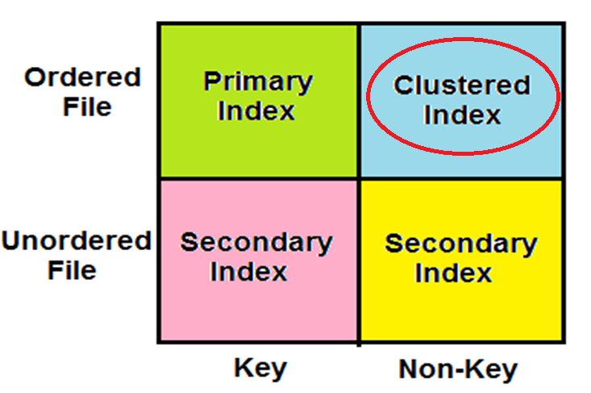
Clustered Index
Clustering index is defined on an ordered data file. The data file is ordered on a non-key field.
In some cases, the index is created on non-primary key columns which may not be unique for each record.
In such cases, in order to identify the records faster, we will group two or more columns together to get the unique values and create index out of them. This method is known as the clustering index.
Basically, records with similar characteristics are grouped together and indexes are created for these groups.

Slide 12
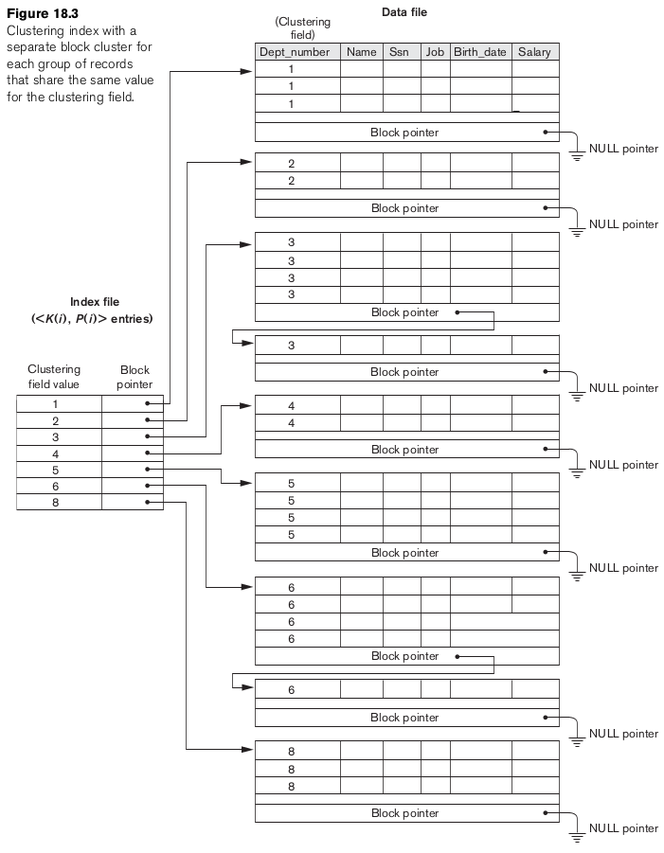
Indexes as Access Paths
Contains block pointer which points to the next block data with the same clustering field value.
Searching criteria is little bit increased. Uses Sparse index
Time Complexity = log2N + 1 + 1..

Slide 14
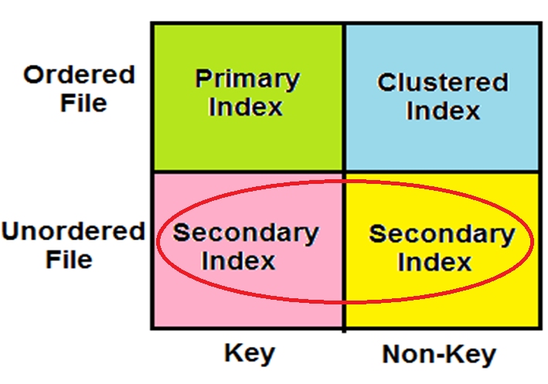
Secondary Indexing

Slide 15
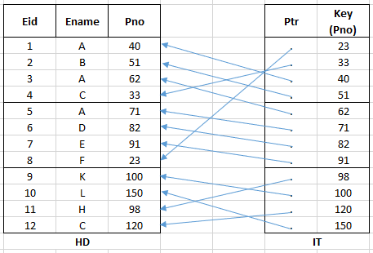
Unordered File With Secondary Key
Secondary Indexing
Secondary Index Example
File is ordered on Eid(Primary Key)
Search to be done using Pno
So, Index table will maintain Pno as a key and in ordered.
Time Complexity = log2N + 1

Slide 16
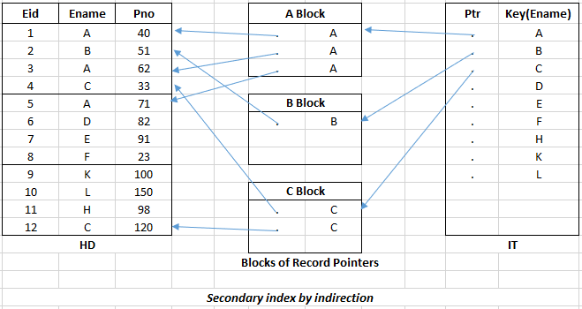
Unordered File with Non-key
Secondary Indexing
Secondary Index Example
Search done by Ename(Non-key)
Index file contains Ename as key and is ordered.
Maintains intermediate index layer which contains block of record pointers.
Pointer in IT points to a particular block and the record pointers in that block will point to the record in HD.
Time Complexity = log2N + 1 + 1

Slide 17
Types of Single-Level Indexes
Primary Index | Clustering Index | Secondary Index
ordered file | ordered file | ordered file a secondary means of accessing a file
Data file is ordered on a key field (distinct value for each record) | Data file is ordered on a non-key field (no distinct value for each record) | Data file is ordered may be on candidate key has a unique value or a non-key with duplicate values
file content <key field, pointer> one index entry for each disk block. key field value is the first record in the block, which is called the block anchor | file content <key field, pointer> one index entry for each distinct value of the field; the index entry points to the first data block that contains records with that field value | file content <key field, pointer> The index is an ordered file with two fields: field value. it is either a block pointer or a record pointer.
nondense (sparse) index | nondense (sparse) index | If key, dense. If non key, dense or sparse index

Slide 18
A Two-level Primary Index Dynamic Multilevel Indexes Using B-trees and B+-trees
Multi-Level Indexes

Slide 19
Multi-Level Indexes
Because a single-level index is an ordered file, we can create a primary index to the index itself;
In this case, the original index file is called the first-level index and the index to the index is called the second-level index.
We can repeat the process, creating a third, fourth, ..., top level until all entries of the top level fit in one disk block
A multi-level index can be created for any type of first-level index (primary, secondary, clustering) as long as the first- level index consists of more than one disk block

Slide 20
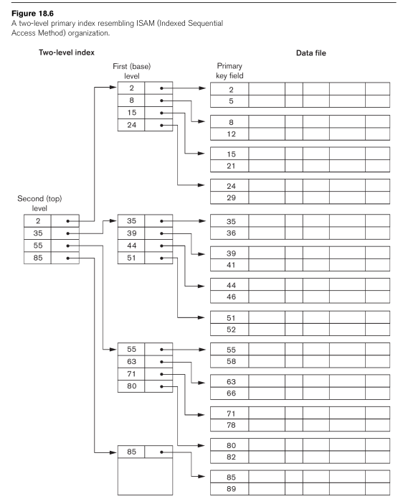
A Two-Level Primary Index

Slide 21
Multi-Level Indexes
Such a multi-level index is a form of search tree
However, insertion and deletion of new index entries is a severe problem because every level of the index is an ordered file.

Slide 22
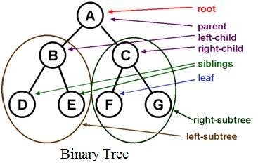
Multi-Level Indexes
Tree structure

Slide 23
Dynamic Multilevel Indexes Using B-Trees and B+- Trees
Most multi-level indexes use B-tree or B+-tree data
structures because of the insertion and deletion problem
This leaves space in each tree node (disk block) to allow for new index entries
These data structures are variations of search trees that
allow efficient insertion and deletion of new search values.
In B-Tree and B+-Tree data structures, each node corresponds to a disk block
Each node is kept between half-full and completely full

Slide 24
Dynamic Multilevel Indexes Using B-Trees and B+- Trees
An insertion into a node that is not full is quite efficient
 If a node is full the insertion causes a split into two nodes
Splitting may propagate to other tree levels
A deletion is quite efficient if a node does not become less than half full
If a deletion causes a node to become less than half full, it must be merged with neighboring nodes

Slide 25
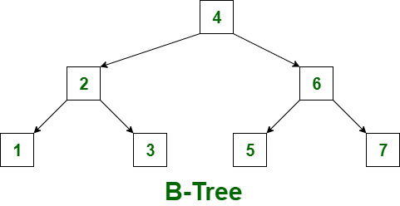
Dynamic Multilevel Indexes Using B-Trees and B+- Trees
Balanced Tree
In multilevel indexing, inserting and deleting a record is difficult, as the corresponding entries in index tables also need to be changed.
B-Trees makes these tasks simple.
Elements are in sorted order

Slide 26
The collection of
What is Hashing?
data that makes up a
computerized physically on medium.
database must be stored
In a huge database structure, it is very inefficient to search all the index values and reach the desired data.
Hashing technique is used to calculate the direct location of a data record on the disk without using index structure.
Data is stored at the data blocks whose address is generated by using the hashing function.
The memory location where these records are stored is known as data bucket or data blocks.
some computer storage
The DBMS software can then retrieve,
update, and process this data as needed.

Slide 27
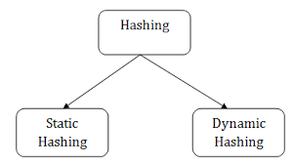
Types of Hashing

Slide 28
Static Hashing
A bucket is a unit of storage containing one or more records (a bucket is typically a disk block).
In a hash file organization we obtain the bucket of a record directly from its search-key value using a hash function.
Hash function h is a function from the set of all search-key values K to the set of all bucket addresses B.
Hash function is used to locate records for access, insertion as well as deletion.
Records with different search-key values may be mapped to the same bucket; thus entire bucket has to be searched sequentially to locate a record.

Slide 29
Example of Hash File Organization
Hash file organization of account file, using branch-name as key (See figure in next slide.)
There are 10 buckets,
The binary representation of the i th character is assumed to be the integer i.
The hash function returns the sum of the binary representations of the characters modulo 10
E.g. h(Perryridge) = 5 h(Round Hill) = 3 h(Brighton) = 3

Slide 30
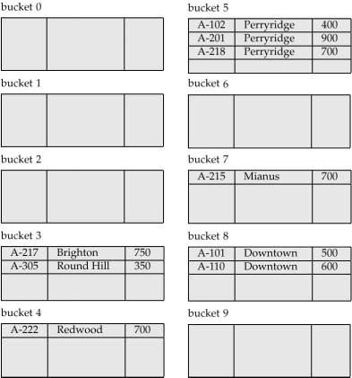
Example of Hash File Organization
Hash file organization of account file, using branch-name as key (see previous slide for details).

Slide 31
Hash Functions
Worst has function maps all search-key values to the same bucket; this makes access time proportional to the number of search-key values in the file.
An ideal hash function is uniform, i.e., each bucket is assigned the same number of search-key values from the set of all possible values.
Ideal hash function is random, so each bucket will have the same number of records assigned to it irrespective of the actual distribution of search-key values in the file.
Typical hash functions perform computation on the internal binary representation of the search-key.
For example, for a string search-key, the binary representations of all the characters in the string could be added and the sum modulo the number of buckets could be returned. .

Slide 32
Handling of Bucket Overflows
Bucket overflow can occur because of
Insufficient buckets
Skew in distribution of records. This can occur due to two reasons:
multiple records have same search-key value
chosen hash function produces non-uniform distribution of key values
Although the probability of bucket overflow can be reduced, it cannot be eliminated; it is handled by using overflow buckets.

Slide 33
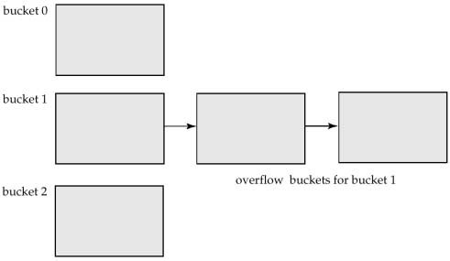
Handling of Bucket Overflows
Overflow chaining – the overflow buckets of a given bucket are chained together in a linked list.
Above scheme is called closed hashing.
An alternative, called open hashing, which does not use overflow buckets, is not suitable for database applications.

Slide 34
Hash Indices
Hashing can be used not only for file organization, but also for index-structure creation.
A hash index organizes the search keys, with their associated record pointers, into a hash file structure.
Strictly speaking, hash indices are always secondary indices
if the file itself is organized using hashing, a separate primary hash index on it using the same search-key is unnecessary.
However, we use the term hash index to refer to both secondary index structures and hash organized files.

Slide 35
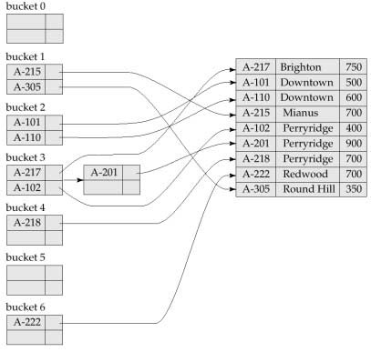
Example of Hash Index

Slide 36
Deficiencies of Static Hashing
In static hashing, function h maps search-key values to a fixed set of B of bucket addresses.
Databases grow with time. If initial number of buckets is too small, performance will degrade due to too much overflows.
If file size at some point in the future is anticipated and number of buckets allocated accordingly, significant amount of space will be wasted initially.
If database shrinks, again space will be wasted.
One option is periodic re-organization of the file with a new hash function, but it is very expensive.
These problems can be avoided by using techniques that allow the number of buckets to be modified dynamically.

Slide 37
Dynamic Hashing
Good for database that grows and shrinks in size
Allows the hash function to be modified dynamically
Extendable hashing – one form of dynamic hashing
Hash function generates values over a large range — typically b-bit integers, with b = 32.
At any time use only a prefix of the hash function to index into a table of bucket addresses.
Let the length of the prefix be i bits, 0  i  32.
Bucket address table size = 2^{i.} Initially i = 0
Value of i grows and shrinks as the size of the database grows and shrinks.
Multiple entries in the bucket address table may point to a bucket.
Thus, actual number of buckets is < 2^{i}
* The number of buckets also changes dynamically due to
coalescing and splitting of buckets.

Slide 38
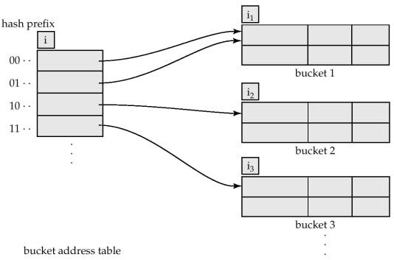
General Extendible Hash Structure
In this structure, i₂ = i₃ = i, whereas i₁ = i – 1 (see next slide for details)

Slide 39
Use of Extendible Hash Structure
Each bucket j stores a value i_{j}; all the entries that point to the same bucket have the same values on the first i_{j} bits.
To locate the bucket containing search-key K_{j}:
Compute h(K_{j}) = X
Use the first i high order bits of X as a displacement into bucket address table, and follow the pointer to appropriate bucket
To insert a record with search-key value K_{j}
follow same procedure as look-up and locate the bucket, say j.
If there is room in the bucket j insert record in the bucket.
Else the bucket must be split and insertion re-attempted (next slide.)
* Overflow buckets used instead in some cases (will see shortly)

Slide 40
Updates in Extendible Hash Structure
To split a bucket j when inserting record with search-key value K_{j}:
If i > i_{j} (more than one pointer to bucket j)
allocate a new bucket z, and set i_{j} and i_{z} to the old i_{j} -+ 1.
make the second half of the bucket address table entries pointing to j to point to z
remove and reinsert each record in bucket j.
recompute new bucket for K_{j} and insert record in the bucket (further splitting is required if the bucket is still full)
If i = i_{j} (only one pointer to bucket j)
increment i and double the size of the bucket address table.
replace each entry in the table by two entries that point to the same bucket.
recompute new bucket address table entry for K_{j} Now i > i_{j} so use the first case above.

Slide 41
Updates in Extendable Hash Structure
When inserting a value, if the bucket is full after
several splits (that is, i reaches some limit b) create an
overflow bucket instead of splitting bucket entry table further.
To delete a key value,
locate it in its bucket and remove it.
The bucket itself can be removed if it becomes
empty (with appropriate updates to the bucket
address table).
Coalescing of buckets can be done (can coalesce only with a “buddy” bucket having same value of i_{j} and same i_{j} –1 prefix, if it is present)
Decreasing bucket address table size is also possible
* Note: decreasing bucket address table size is an expensive operation and should be done only if number of buckets becomes much smaller than the size of the table

Slide 42
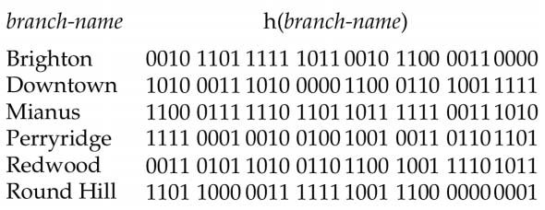
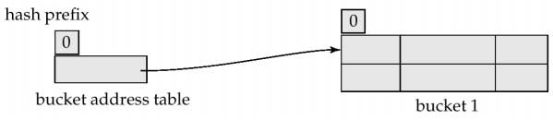
Example
Initial Hash structure, bucket size = 2

Slide 43
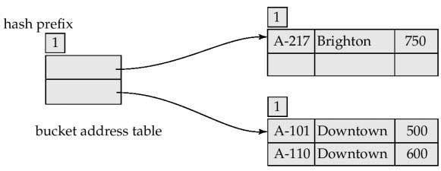
Example
Hash structure after insertion of one Brighton and two Downtown records

Slide 44
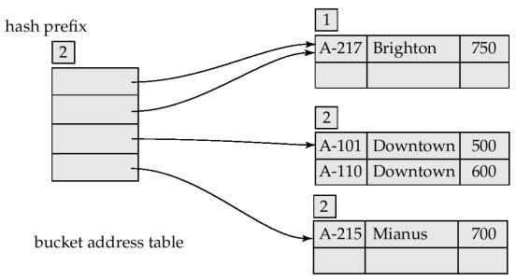
Example
Hash structure after insertion of Mianus record

Slide 45
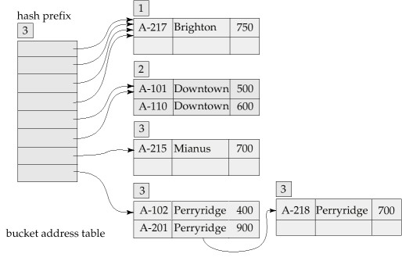
Example
Hash structure after insertion of three Perryridge records

Slide 46
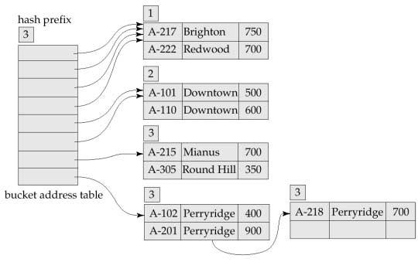
Example
Hash structure after insertion of Redwood and Round Hill records

Slide 47
Extendible Hashing vs. Other Schemes
Benefits of extendable hashing:
Hash performance does not degrade with growth of file
Minimal space overhead
Disadvantages of extendable hashing
Extra level of indirection to find desired record
Bucket address table may itself become very big (larger than memory)
* Need a tree structure to locate desired record in the structure!
Changing size of bucket address table is an expensive operation
Linear hashing is an alternative mechanism which avoids these disadvantages at the possible cost of more bucket overflows

Slide 48
Comparison of Ordered Indexing and Hashing
Cost of periodic re-organization
Relative frequency of insertions and deletions
Is it desirable to optimize average access time at the expense of worst-case access time?
Expected type of queries:
Hashing is generally better at retrieving records having a specified value of the key.
If range queries are common, ordered indices are to be preferred

Slide 49

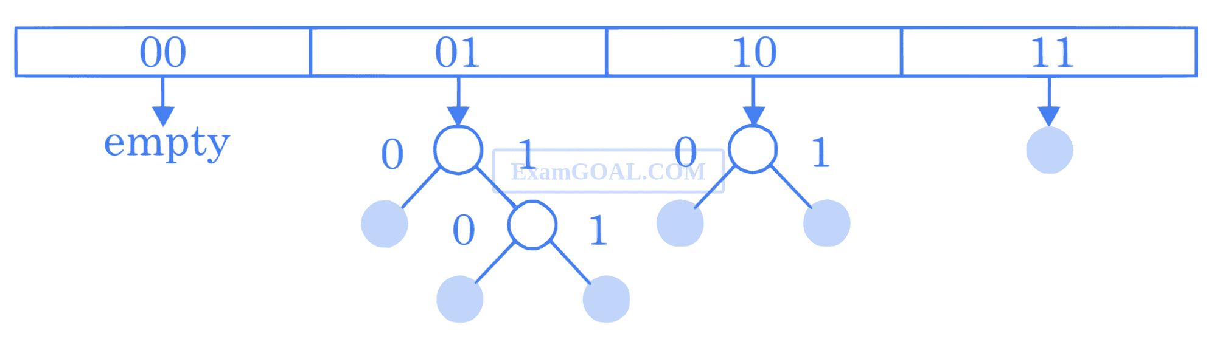
ACTIVITIES/ CASE STUDIES/ IMPORTANT FACTS RELATED TO THE SESSION
Consider a dynamic hashing approach for 4-bit integer keys:
1. There is a main hash table of size 4.
2. The 2 least significant bits of a key is used to index into the main hash table.
3. Initially, the main hash table entries are empty.
4. Thereafter, when more keys are hashed into it, to resolve collisions, the set of all keys corresponding to a main hash table entry is organized as a binary tree that grows on demand.
5. First, the 3rd least significant bit is used to divide the keys into left and right subtrees.
6. to resolve more collisions, each node of the binary tree is further sub-divided into left and right subtrees based on 4th least significant bit.
7. A split is done only if it is needed, i. e. only when there is a collision.
Consider the following state of the hash table.

Slide 50
SUMMARY
Hashing is a DBMS technique for searching for needed data on the disc without utilising an index structure. The hashing method is basically used to index items and retrieve them in a DB since searching for a specific item using a shorter hashed key rather than the original value is faster.

Slide 51
SELF-ASSESSMENT QUESTIONS
What is hashing?
A data structure for storing key-value pairs
b) A technique for converting data of arbitrary size to a fixed size
c) A process of compressing data to save space
d) A method for encrypting data
Which of the following is not a suitable use case for hashing?
a) Password storage
b) Data validation
c) Data encryption
d) Sorting large datasets

Slide 52
TERMINAL QUESTIONS
Can you explain the difference between static and dynamic hashing, and when each is appropriate?
What is collision handling, and how is it handled in hashing-based index structures?
How does the choice of hash function affect the performance of a hashing-based index?
What is a primary index, and how is it implemented using hashing in DBMS?
How does extendible hashing differ from linear and quadratic probing?

Slide 53
REFERENCES FOR FURTHER LEARNING OF THE SESSION
Reference Books:
"Database Management Systems" by Raghu Ramakrishnan and Johannes Gehrke - This book covers the basics of database management systems, including the concept of index structures.
"Database Systems: Design, Implementation, and Management" by Carlos Coronel, Steven Morris, and Peter Rob - This book provides a comprehensive introduction to database systems, including index structures and their importance in optimizing database performance.
"Database Indexing: A Practical Guide for Developers" by Will Iverson - This book focuses specifically on the concept of indexing in database management systems, providing practical advice and examples for developers.
Sites and Web links:
"Hash-Based Indexes" by Raghu Ramakrishnan and Johannes Gehrke - https://www-db.cs.wisc.edu/cidr/cidr2003/papers/cidr03p50.pdf
"Indexing and Hashing" by S. Sudarshan - http://www.cse.iitb.ac.in/~sudarsha/dbbook/dbchapter7.pdf
"Extendible Hashing" by Jerome Martin - http://pages.di.unipi.it/martin/Papers/ExtendibleHashing/ExtendibleHashing.pdf
"Concurrency Control in Hash-Based Database Systems" by Christoph G. Schuetz and Michael H. Böhlen - https://link.springer.com/chapter/10.1007/3-540-45481-7_2

Slide 54
THANK YOU
Team – DBMS

