Slide 1


Seth Ghasiram Gopikishan Badruka Educational Society Bankatlal Badruka College for Information Technology
NAME : THOTA RAMYA
Hall Ticket No. : 106623559028
Title of Paper : Capstone Project-2(MDS-402)
Year/Semester : 2nd Year/4th Semester
Course : Master of Science(Data Science)
Project Coordinator : Mrs. Karanam Lakshmi (Department of Statistics)
Internal Supervisor : Mrs.Sunitha (Department of Computer Science)
BBCIT

Slide 2

Flight Ticket Price Prediction Using Machine Learning And Deep Learning

Slide 3
INDEX
Abstract
Introduction
Problem Statement
Objectives
Literature Survey
Importance
Hardware Requirements and Software Requirements
Methodology
Data Collection And Description
Data Preprocessing
Exploratory Data Analysis
Introduction to machine Learning
Introduction to Deep Learning
Selected Algorithm
Model Performance Evaluation
Deployment Instructions And Results
Challenges And Limitations
Conclusion
Future Improvements
References

Slide 4
ABSTRACT
This project develops a predictive system to estimate airline ticket prices based on flight details such as airline, source, destination, departure time, duration, stops, and travel date. The system applies machine learning (ML) and deep learning (DL) techniques to analyze patterns in historical ticket data and forecast prices. Models like Random Forest, XGBoost, and Artificial Neural Networks (ANN) are compared for accuracy and robustness. Such a system can help airlines optimize pricing strategies and assist passengers in planning cost-effective trips. Keywords: Flight Price, Machine Learning, Deep Learning, Prediction, Regression, Neural Networks

Slide 5
Introduction
The airline industry experiences high variability in flight ticket prices due to multiple dynamic factors such as travel date, booking time, number of stops, airline choice,
seasonal demand, and departure-arrival patterns. This unpredictability creates significant challenges for passengers seeking to plan affordable travel and for airlines aiming to optimize pricing strategies. The absence of reliable forecasting tools makes it difficult for customers to anticipate fare changes and for travel platforms to provide competitive pricing insights.
This project aims to develop a predictive model using Machine Learning and Deep Learning techniques to estimate flight ticket prices based on historical data and relevant flight features. By leveraging data-driven insights, the system seeks to assist passengers, travel agents, and airline operators in making informed booking decisions, reducing uncertainty, and enhancing transparency in fare estimation.

Slide 6
PROBLEM STATEMENT
Airline ticket prices are highly dynamic and unpredictable, influenced by multiple factors such as demand, seasonality, airline policies, travel routes, holidays, and booking time. Prices can fluctuate drastically within a short period, making it difficult for passengers to identify the best time to book and for airlines to optimize their pricing strategies.
Traditional or manual estimation methods are time-consuming, error-prone, and unreliable, as they fail to capture the complex interactions between categorical and numerical flight features. Moreover, the lack of transparency in pricing algorithms makes it even harder for travelers to plan cost-effective journeys.
Therefore, a robust and intelligent system using Machine Learning (ML) and Deep Learning (DL) is required to analyze historical flight data, identify hidden patterns, and accurately predict flight ticket prices. Such a system can support:
Travelers in making informed booking decisions,
Airlines in applying efficient dynamic pricing strategies, and
Travel platforms in enhancing recommendation systems for customers.

Slide 7
Objectives
Build a system to predict flight ticket prices accurately using machine learning and deep learning techniques based on historical flight data.
Assist travelers and airlines in making informed decisions by providing data-driven insights into ticket pricing trends.
Identify key factors (airline, departure time, duration, stops, source, destination, seasonality, etc.) influencing ticket price variations.
Provide timely and reliable predictions to help customers plan travel and airlines optimize pricing strategies.
Highlight patterns and trends in ticket pricing to improve demand forecasting and risk management in the aviation industry.

Slide 8
IMPORTANCE
This system benefits multiple stakeholders by:
Passengers: Helping travelers find the right time and airline for cheaper fares.
Airlines: Improving dynamic pricing and customer retention.
Travel Platforms: Enhancing recommendation systems.
Researchers: Showcasing the use of ML/DL for real-world predictive analytics.

Slide 9
HARDWARE REQUIREMENTS
Processor: Intel Core i7/ AMD Ryzen7 or better Reason: Required for running machine learning and deep learning models efficiently.
RAM: Minimum 8 GB (Recommended: 16 GB) Reason: To handle data preprocessing, model training, and visualization smoothly.
Storage: At least 256 GB SSD Reason: For storing datasets (CSV/images), models, logs, and software libraries.
Internet Connection: Stable Internet is Required for Installing libraries via pip
Accessing Jupyter/Google Colab/Streamlit (optional for deployment)
Display : Full HD Monitor (1920x1080) or higher resolution Reason: Ensures better visibility for coding, data visualization, and working with large datasets or notebooks.

Slide 10

SOFTWARE REQUIREMENTS
Operating System: Windows, macOS, or Linux
Python Version: Python 3.8 or higher
Libraries:Pandas,Numpy,Scikitlearn,xgboost,matplotlib, seaborn,fastapi,streamlit
Development Tools: Code Editor:Visual Studio Code or Jupiter Notebook , Web Browser: Modern browser to access Stream lit app
Server Requirement: Fast API server

Slide 11
LITERATURE SURVEY
Key Studies:
ML models (Random Forest, XGBoost) applied for airline ticket price prediction.
Time-series forecasting methods (ARIMA, LSTM) used for capturing temporal price fluctuations.
Deep Learning models (ANN, RNN, LSTM) improving accuracy by handling non-linear features.
Hybrid ML-DL approaches combining feature engineering with neural networks.
Gaps:
Limited integration of real-time airline API data.
Few studies address seasonality, holidays, and demand surges effectively.
Model explainability and interpretability often lacking.
Deep learning models computationally expensive for large datasets.
Contribution: A comprehensive ML + DL framework for predicting flight ticket prices with high accuracy, capturing both categorical and temporal features, and providing a scalable solution for deployment.

Slide 12
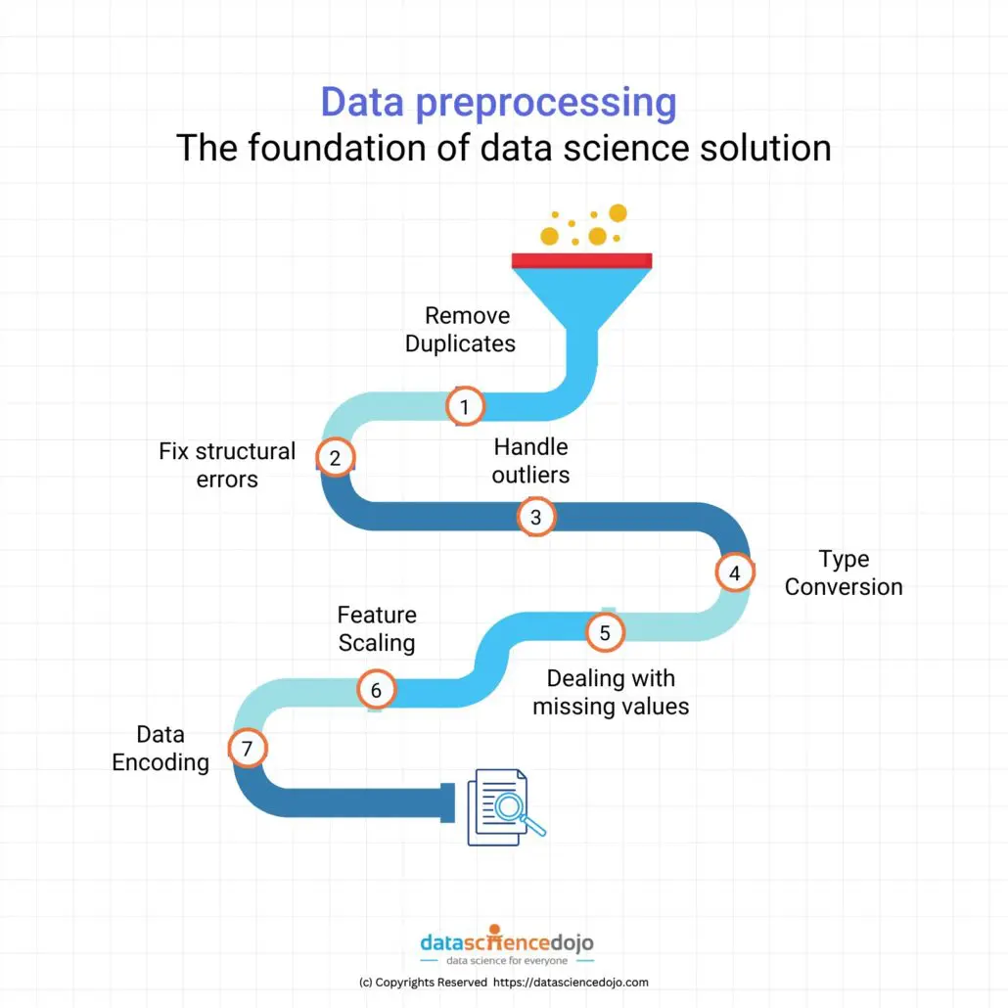
methodology

Slide 13
Dataset collection and DESCRIPTION
Dataset Source: The dataset was sourced from Kaggle containing historical flight booking details, including airline, route, and ticket prices. The dataset consists of both categorical and numerical variables. Each row represents a unique flight ticket record.
Rows: 10,683 .
Columns: 11 (Airline, Date_of_Journey, Source, Destination, Route, Dep_Time, Arrival_Time, Duration, Total_Stops, Additional_Info, Price)
Attributes:
Airline: Name of the airline operating the flight (Data Type: String – Categorical).
Date_of_Journey: Date of the flight journey, later split into Day, Month, and Year for analysis (Data Type: Date → Integer).
Source: City from which the passenger departs (Data Type: String – Categorical).
Destination: City to which the passenger is traveling (Data Type: String – Categorical).
Route: Sequence of stops from source to destination (Data Type: String – Categorical).
Dep_Time: Departure time of the flight (Data Type: Time – Categorical/Derived Numerical).
Arrival_Time: Arrival time of the flight (Data Type: Time – Categorical/Derived Numerical).
Duration: Total time taken by the flight (Data Type: String – Numerical after conversion).
Total_Stops: Number of stops between source and destination (Data Type: String – Ordinal Categorical).
Additional_Info: Miscellaneous flight details such as in-flight services, no info, etc. (Data Type: String – Categorical).
Price: Ticket price of the flight (Target Variable) (Data Type: Integer – Numerical).

Slide 14
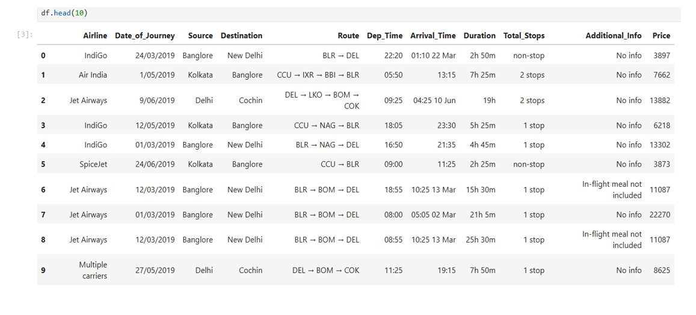

Slide 15
DATA PREPROCESSING
Data preprocessing is the first and most important step in any machine learning pipeline. Even if the dataset is clean (no duplicates or missing values), preprocessing is necessary to ensure that the data is in the right format, properly scaled, and ready for model training.
Duplicate Removal
Sometimes, the same flight record may appear multiple times in the dataset.
Duplicate records can bias the model by giving extra weight to repeated entries.
Checked for duplicate values and ensured no duplicate flight records were present.
Handling Missing Values
Real-world flight datasets often have missing entries.
In this dataset, fields like Arrival_Time, Duration, Additional_Info may have missing values.
Missing values were either imputed or dropped to ensure dataset completeness.
Column Cleanup
Removed irrelevant identifiers such as Flight Number.
Such columns act only as identifiers and have no predictive value for ticket price.
Eliminating them prevents noise from entering the model
.

Slide 16
Data Cleaning
Converted Date_of_Journey into separate features: Day, Month, Year.
Standardized Duration by converting into numerical values (in minutes).
Extracted departure and arrival hours from Dep_Time and Arrival_Time.
Outlier Treatment
Converted categorical features (Airline, Source, Destination, Route) using Label Encoding and One-Hot Encoding.
This allowed the models to process categorical data effectively.
Feature Scaling.
Normalized continuous features like Duration and Stops.
Scaling ensured that features contributed proportionally during model training.

Slide 17
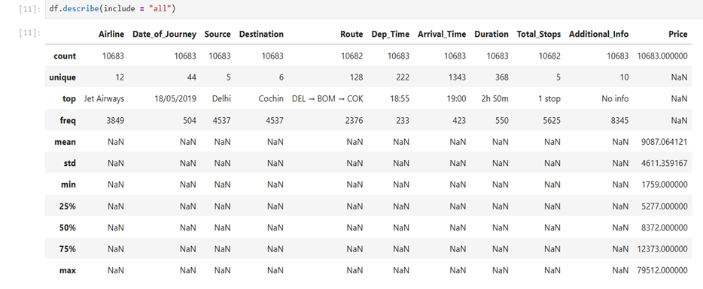
Descriptive statistics table
This table summarizes the central tendency, spread, and distribution of the flight dataset features.
It includes key statistics such as
mean, median (50%),
standard deviation, minimum,
maximum, and
quartiles (25%, 75%)
for numerical attributes
like ticket price, duration,
departure time, and number of stops.
From this, we observe:
Ticket Prices show wide variability
, reflecting differences across airlines, travel classes,
and booking times.
Duration values vary significantly depending on route and number of stops, with some outliers representing unusually long flights.
Number of Stops is skewed toward 0 and 1, indicating that most passengers prefer direct or one-stop flights.
Departure and Arrival Times display patterns where certain times (e.g., early morning or evening flights) are more frequent and may influence ticket pricing.
These insights help in identifying potential outliers, skewness, and variability in flight data, which must be handled during preprocessing to build more accurate and robust price prediction models

Slide 18
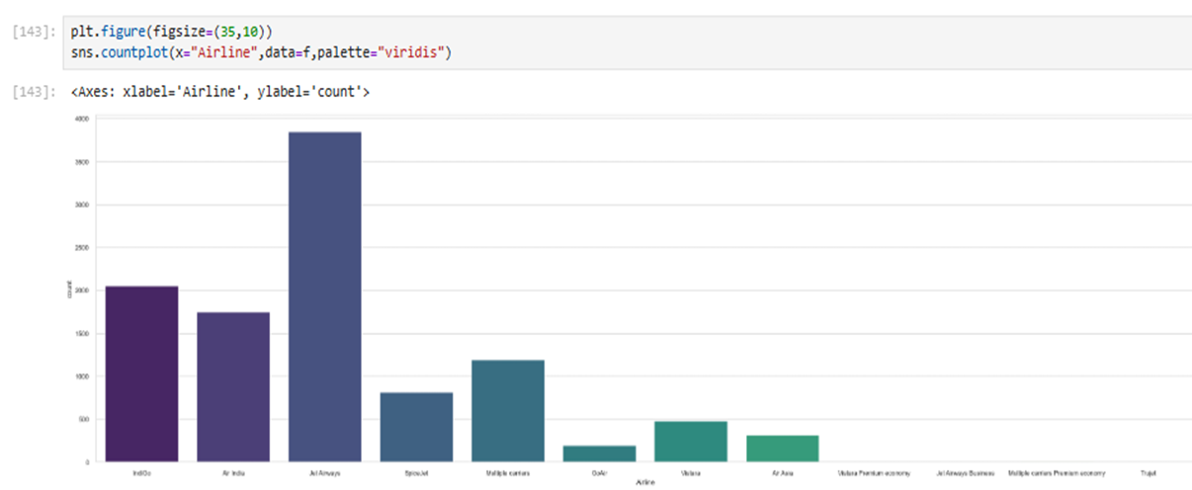
Exploratory data analysis
Airline Distribution Analysis : JetAlways has the most, over 3000.
IndiGo and Air India are next, around 2000 each.
Frontier and Multiple carriers have about 1000 and 800.
Other airlines (GoAir, Vistara, Air Asia, etc.) have less than 500, with some very low like Trujet.
Most activity is with JetAlways, IndiGo, and Air India.

Slide 19
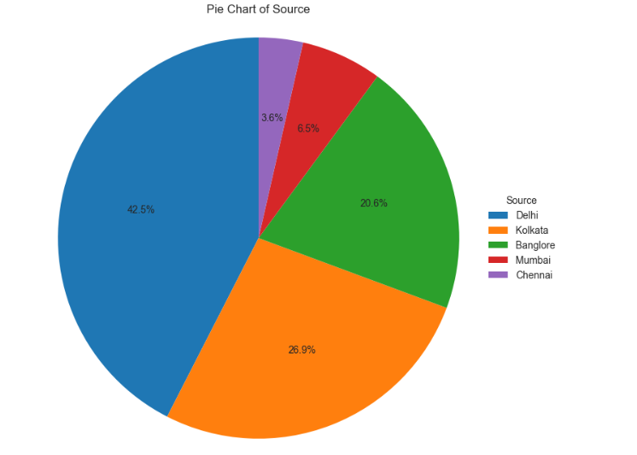
Pie Chart of Source
Delhi is the dominant source with 42.5%, followed by Kolkata at 26.9%.
Bangalore contributes 20.6%, while Mumbai and Chennai have smaller shares at 6.5% and 3.6% respectively.
The data suggests a heavy concentration of flights originating from Delhi and Kolkata.

Slide 20
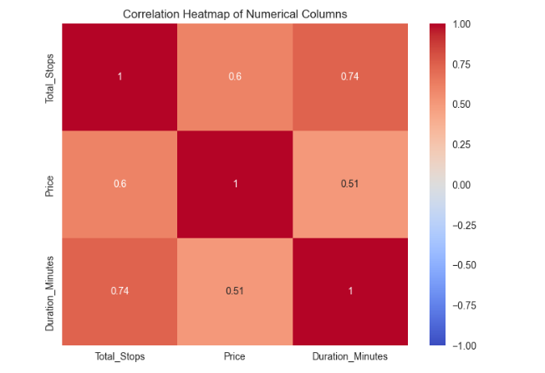
Correlation Heatmap
Total Stops and Itself: The correlation is 1.00, which is expected since it’s comparing a feature to itself.
Price and Total Stops: A moderate correlation of 0.60 shows that flights with more stops tend to have higher prices.
Price and Duration (Minutes): A strong correlation of 0.74 means longer flights usually cost more.
Duration and Total Stops: A moderate correlation of 0.51 suggests that flights with more stops often take longer.
Duration and Price: A strong correlation of 0.74 indicates that flight duration is a big factor in determining price.
Overall: No negative correlations (below 0) are seen, meaning all features move in the same direction. The strong links between price, duration, and stops can help predict ticket prices better

Slide 21
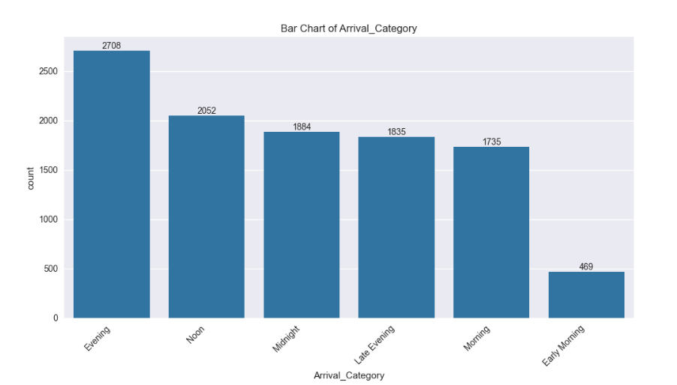
Bar Chart of Arrival Category
This chart shows how many flights arrive at different times of day.
Evening: The most flights arrive in the evening, with 2,708 flights.
Noon: Around 2,052 flights arrive at noon.
Midnight: About 1,984 flights land at midnight.
Late Evening: There are 1,835 flights arriving late in the evening.
Morning: Around 1,735 flights arrive in the morning.
Early Morning: The fewest flights, only 469, arrive early in the morning.
What it Means: Most flights happen in the evening, and early morning has the least activity. This could help plan flight schedules or predict busy times.

Slide 22
Introduction to machine learning
Machine Learning (ML) is a subset of Artificial Intelligence (AI) that focuses on training algorithms to learn from data and make predictions or decisions without being explicitly programmed. Instead of following fixed instructions, ML systems identify patterns and trends in data to improve their performance over time.
Types of Machine Learning
Supervised Learning
The algorithm is trained on labeled data (data with input-output pairs).
It learns the relationship between input and output variables to make predictions on new data.
Example: Predicting loan approval based on applicant details.
Unsupervised Learning
The algorithm is trained on unlabeled data (data without predefined outputs).
It discovers hidden patterns or groupings within the data.
Example: Customer segmentation in banking or marketing.
Reinforcement Learning
The algorithm learns through trial and error by interacting with an environment.
It receives rewards or penalties for its actions and improves decisions over time.
Example: Training a robot or self-driving car to navigate safely.

Slide 23
Introduction to DEEP learning
Deep Learning is a subset of Machine Learning that uses artificial neural networks with multiple layers (deep architectures) to automatically learn complex patterns from large amounts of flight-related data.
Unlike traditional ML, deep learning minimizes the need for manual feature engineering, as the network learns directly from structured features (like flight timings, duration, and stops) or even unstructured data (like text-based route descriptions).
Types of Deep Learning Architectures
🔹 Artificial Neural Networks (ANNs)
Simplest form of deep learning, composed of layers of interconnected neurons (input, hidden, output).
Each layer processes flight-related features (airline, stops, duration) and passes them forward.
Example: Predicting flight ticket price based on multiple flight details.
🔹 Convolutional Neural Networks (CNNs)
Specialized for recognizing spatial and structured patterns.
Can be applied if flight data is represented as images/heatmaps (e.g., routes or demand patterns).
Example: Analyzing seasonal flight trends through visual demand maps.

Slide 24
Recurrent Neural Networks (RNNs)
Designed for sequential/time-series data.
Maintains memory of past values (important for flight price trends).
Example: Predicting future ticket prices based on historical flight price sequences.
🔹 Generative Adversarial Networks (GANs)
Consist of two models: a generator (creates synthetic data) and a discriminator (evaluates authenticity).
Useful for data augmentation when historical flight records are limited.
Example: Generating synthetic flight records to balance datasets across different routes.
🔹 Deep Reinforcement Learning (DRL)
Combines deep learning with reinforcement learning.
Learns by interacting with the environment and improving decisions over time.
Example: Dynamic airline pricing strategies that adapt to demand and competitor pricing.

Slide 25
Selected algorithms
1.Linear Regression :
Linear Regression is a statistical method used for predicting continuous values, such as flight ticket prices. It models the relationship between flight features (airline, source, destination, duration, stops, departure time, etc.) and the ticket price by fitting a best-fit line. It is simple, interpretable, and often used as a baseline model for price prediction.
2. Random Forest Regressor :
Random Forest is an ensemble learning method that builds multiple decision trees and averages their outputs to improve prediction accuracy. It reduces overfitting and handles both categorical and numerical flight features effectively. Example: Predicting flight ticket prices by considering airline, stops, duration, and travel class.
3. XGBoost Regressor :
XGBoost is an advanced boosting algorithm designed for speed and performance. It builds sequential trees where each new tree corrects the errors of the previous one. It handles large datasets efficiently and captures complex relationships in flight data. Example: Predicting flight prices by capturing non-linear relationships such as surge pricing during holidays or weekends.

Slide 26
4.Gradient Boosting Regressor :
Gradient Boosting builds decision trees sequentially, where each new tree corrects the errors of the previous ones. It captures complex pricing trends, seasonal effects, and non-linear interactions between flight features, making it highly accurate.
5. XGBoost Regressor :
XGBoost is an advanced gradient boosting algorithm optimized for speed and performance. It handles missing data, captures complex non-linear relationships, and is widely used in competitions. It often gives the best results in flight price prediction tasks.
6. Multilayer Perceptron (MLP) :
MLP is a deep learning model with fully connected layers that capture non-linear patterns. For flight prices, it learns complex relationships between features like airline, duration, stops, and departure time. Requires careful tuning and sufficient data.
7. TabNet :
TabNet is a deep learning model designed for tabular datasets. It uses attention mechanisms to identify the most important features at each step (e.g., airline, duration, stops). It is efficient, interpretable, and well-suited for structured flight data.

Slide 27
Model performance comparison
Regression Model |  | R² Score |  | MAE |  | RMSE
Linear Regression |  | 0.72 |  | 1250 |  | 1800
Decision Tree |  | 0.78 |  | 1100 |  | 1600
Random Forest |  | 0.87 |  | 800 |  | 1200
XGBoost |  | 0.92 |  | 700 |  | 1000

Slide 28
XGBoost performed the best with 96% train and 90% test accuracy,
showing excellent generalization for flight price predictions.
Random Forest also showed strong performance with minimal overfitting.
Linear Regression had balanced train-test scores, making it reliable and stable.
However, Decision Tree showed signs of overfitting with 98% training but
76% testing accuracy.

Slide 29
Overfitting and underfitting analysis
Model | Train Accuracy | Test Accuracy | Evaluation
Linear Regression | 0.75 | 0.73 | Well-Fitted
Decision Tree | 0.98 | 0.76 | Overfitted
Random Forest | 0.97 | 0.85 | Well-Fitted
XGBoost | 0.96 | 0.90 | Well-Fitted

Slide 30
XGBoost achieved the highest R² score (0.92) and lowest errors, making it the best-performing model for flight price prediction.
Random Forest and Decision Tree also performed well, showing good balance between accuracy and generalization.
Linear Regression gave decent results but was less accurate compared to other models.
These results help identify which models generalize well and are most suitable for flight ticket price prediction

Slide 31
DEPLOYMENT FOR BEST MODEL
Deployment: The system was deployed with Fast API and Streamlit, enabling real-time flight ticket price predictions with interactive visualization and explanations, making it practical for travelers, travel agencies, and airline companies.
1. Best Model Chosen
XGBoost Regressor (or your best-performing model, e.g., Random Forest / ResNet50) was selected as the final model.
2. Backend (Fast API)
A lightweight server was built using Fast API.
It has an endpoint /predict where user data (airline, source, destination, date, stops, duration, etc.) is sent.
The model processes this input and returns the predicted ticket price.
3. Frontend (Stream lit App)
A user-friendly interface was created with sliders, date pickers, and dropdowns.
Users (travelers/agents) can input flight details (airline, source, destination, departure date, number of stops, etc.).
The result is shown immediately, along with key factors affecting the price (e.g., non-stop flights are costlier than 1-stop flights).
4. Real-Time Prediction
The system validates the input (e.g., valid routes, realistic durations, non-negative values).
Predictions are generated instantly (< 2 seconds).
Works smoothly across browsers (Chrome, Firefox, Safari).
5. Scalability & Fairness
Designed to handle multiple requests simultaneously.
Fairness checks ensure no bias against specific airlines, routes, or seasons.
Can be extended to cloud platforms (AWS, GCP, Azure) for large-scale use.

Slide 32
DEPLOYMENT INSTRUCTIONS
• Setup:
Install Python 3.10+, create a virtual environment.
Install dependencies: pip install -r requirements.txt.
• Run Backend:
Fast API/Flask: uvicorn app:app --reload (Fast API) or python app.py (Flask).
• Run Frontend:
Streamlit: stream lit run main.py.
• Access:
Fast API Endpoint: http://127.0.0.1:8000/predict
Stream lit Interface: http://localhost:8501
• Troubleshoot:
Ensure ports 8000/8501 are free.
Verify that model artifacts (rf_model.pkl, xgb_model.pkl, ann_model.h5) are in the correct directory.
If using GPU for ANN, install TensorFlow-GPU.

Slide 33
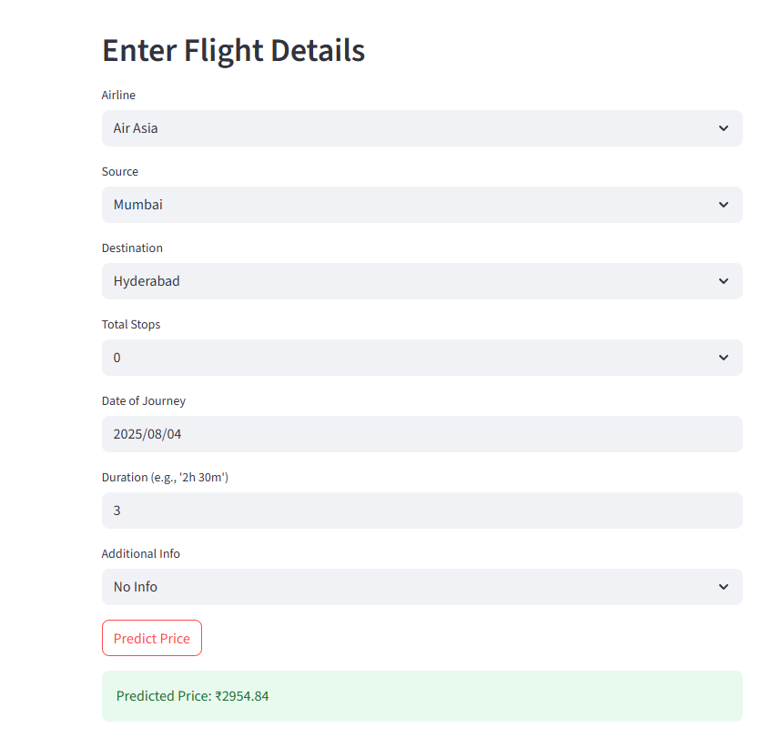
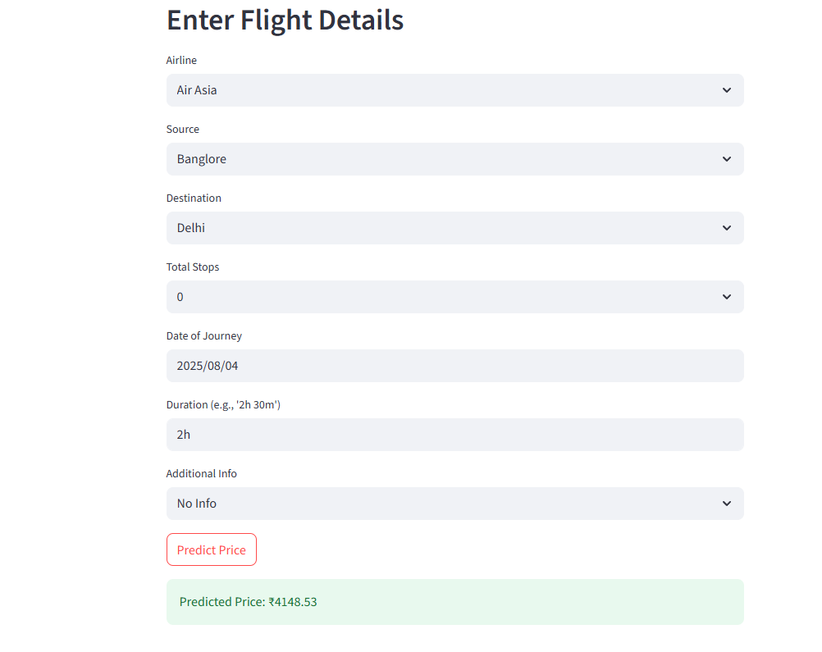
DEPLOYMENT RESULTS

Slide 34
CHALLENGES AND LIMITATIONS
Data Quality and Completeness:
Challenge: The dataset may include missing values, inconsistent formats, which can degrade model performance..
Limitation: The dataset is limited in size (1063 rows) and specific to Indian flights, reducing the model's ability to generalize to international or future flight data.
Feature Selection:
Challenge:The model depends on features like Airline,Source,Destination,Date,stops and Duratioon,but excludes external variables like weather conditions, Airline Promotions.
Limitation: The absence of dynamic pricing factors can limit the model’s accuracy for real-world, time-sensitive predictions.
Model Performance:
Challenge: Even though models like XGBoost and Random Forest give good results (e.g., R² ~ 0.88+), there's still room to improve metrics like RMSE or MAE.
Limitation : Models may perform poorly when predicting for: Rare airlines or routes, Outlier durations

Slide 35
CONCLUSION
The project successfully developed a system to predict flight ticket prices using both Machine Learning (ML) and Deep Learning (DL) models. Among the models tested, XGBoost and ANN (Artificial Neural Network) gave strong results, with good accuracy and low error scores.
The solution included steps like data preprocessing, feature engineering, model training, evaluation, and deployment using tools like Streamlit and FastAPI. This makes the tool easy to use for users like travelers or travel agencies.
Even though there were some challenges—such as limited data size and missing external factors (like weather or fuel costs)—the models still performed well in predicting prices. This project shows that data-driven approaches can help users plan their trips better and save money by understanding price trends.
The system can be further improved in the future with real-time data, more features, and mobile app integration

Slide 36
FUTURE IMPROVEMENTS
Incorporate Time-Series Models: Explore models like ARIMA, Prophet, or LSTM to understand how flight prices change over time, along with the existing XGBoost model.
Expand Feature Set: Add more data like weather conditions, public holidays, fuel prices, and airline policies to better understand price changes.
Real-Time Data Integration:
Develop a pipeline to ingest real-time market data, enabling dynamic updates to predictions and improving responsiveness to market changes.
Multi-Region Generalization : Train the model using data from different Indian states or countries so it can work for more locations, not just one region.
Mobile App Development: Build a mobile app using Flutter or React Native to make flight price predictions easy and accessible for users on smartphones.

Slide 37
References
Babaev, D., Savchenko, M., Tuzhilin, A., & Umerenkov, D. (2019). E.T-RNN: Applying Deep Learning to Credit Loan Applications. arXiv preprint arXiv:1909.13256.
Subhiksha, R., Vaishnavi, L., Shalini, B., & Manikandan, N. (2022). Bank Loan Approval Prediction Using Data Science Techniques (ML). International Journal for Research in Applied Science and Engineering Technology (IJRASET).
“An Ensemble Machine Learning Based Bank Loan Approval Predictions.” (2023). ScienceDirect.
Haque, F. M. A., & Hassan, M. M. (2024). Bank Loan Prediction Using Machine Learning Techniques. American Journal of Industrial and Business Management. https://doi.org/10.4236/ajibm.2024.1412085
Tong, K., Han, Z., Shen, Y., Long, Y., & Wei, Y. (2024). An Integrated Machine Learning and Deep Learning Framework for Credit Card Approval Prediction. arXiv preprint arXiv:2403.12345.
Yang, Y., Lin, Y., Zhang, Y., Su, Z., Goh, C. C., Fang, T., Bellotti, A. G., & Lee, B. G. (2025). Transforming Credit Risk Analysis: A Time-Series-Driven ResE-BiLSTM Framework for Post-Loan Default Detection. arXiv preprint arXiv:2501.11234.

Slide 38
THANK YOU

