Slide 1
Hotel Management Application
Sruthi Thota

Slide 2
Technologies used
Python3
Django Framework
PostgreSQL
HTML, CSS, JavaScript
Visual studio code
Mac terminal

Slide 3
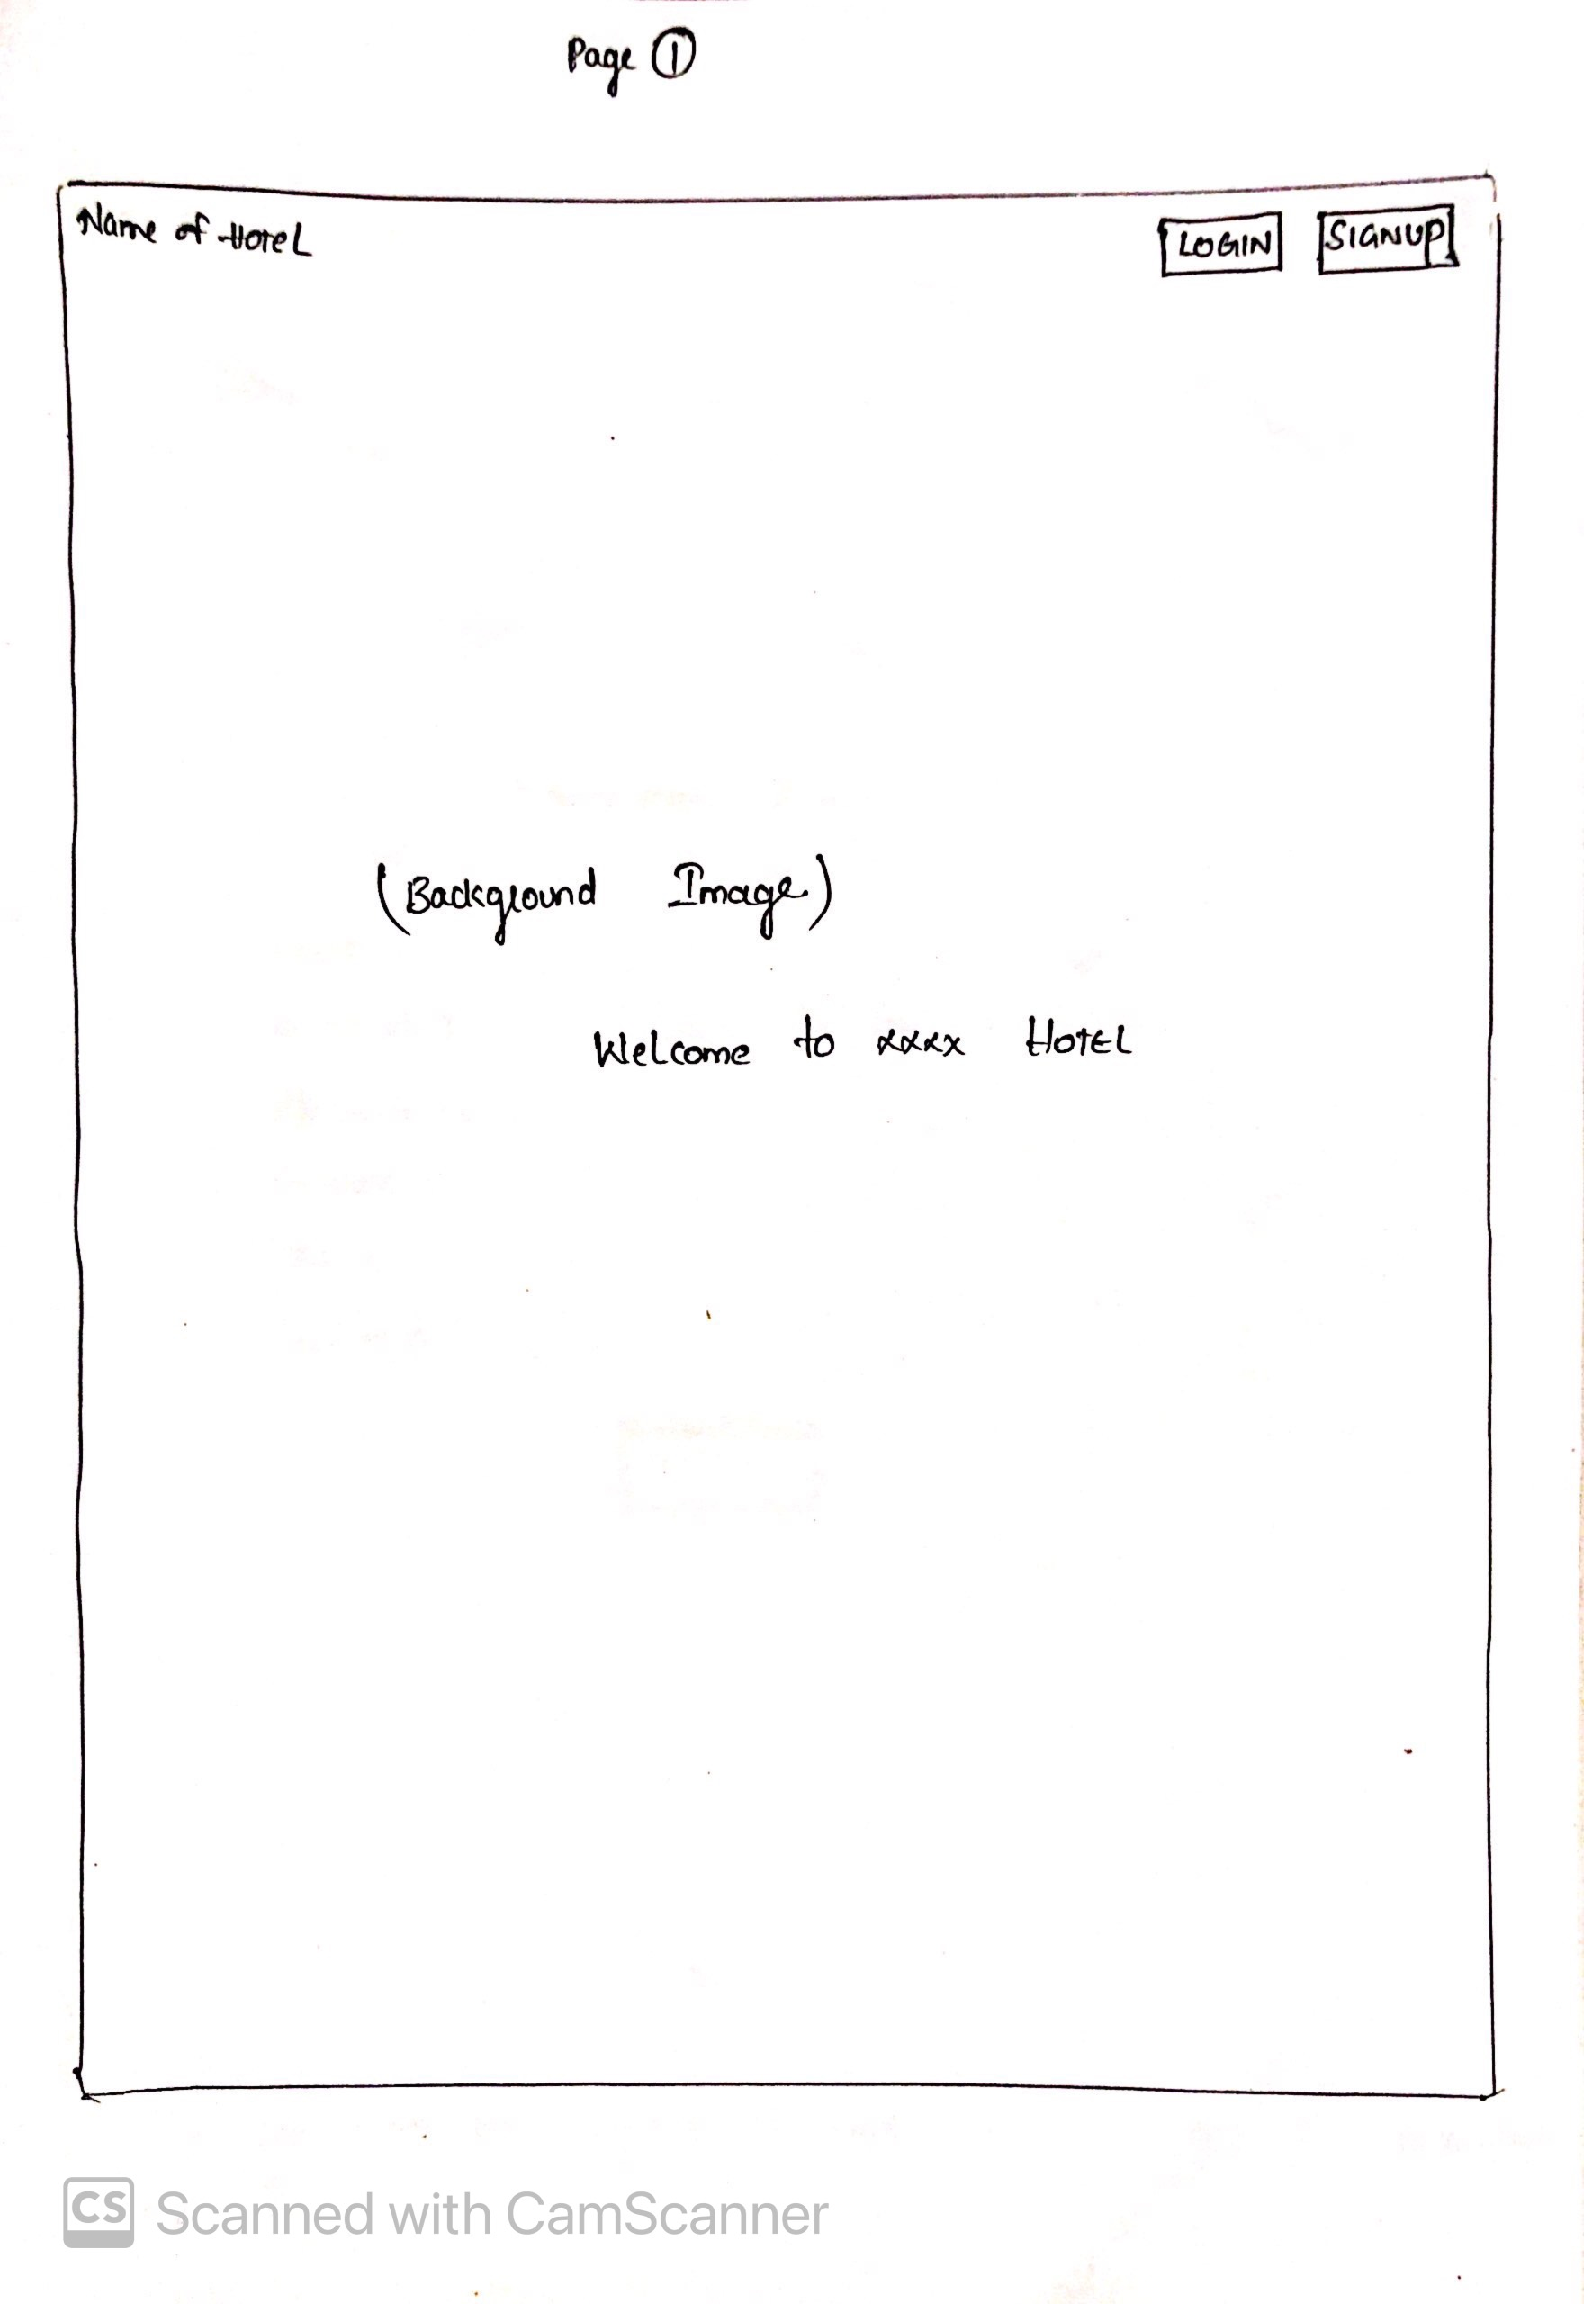
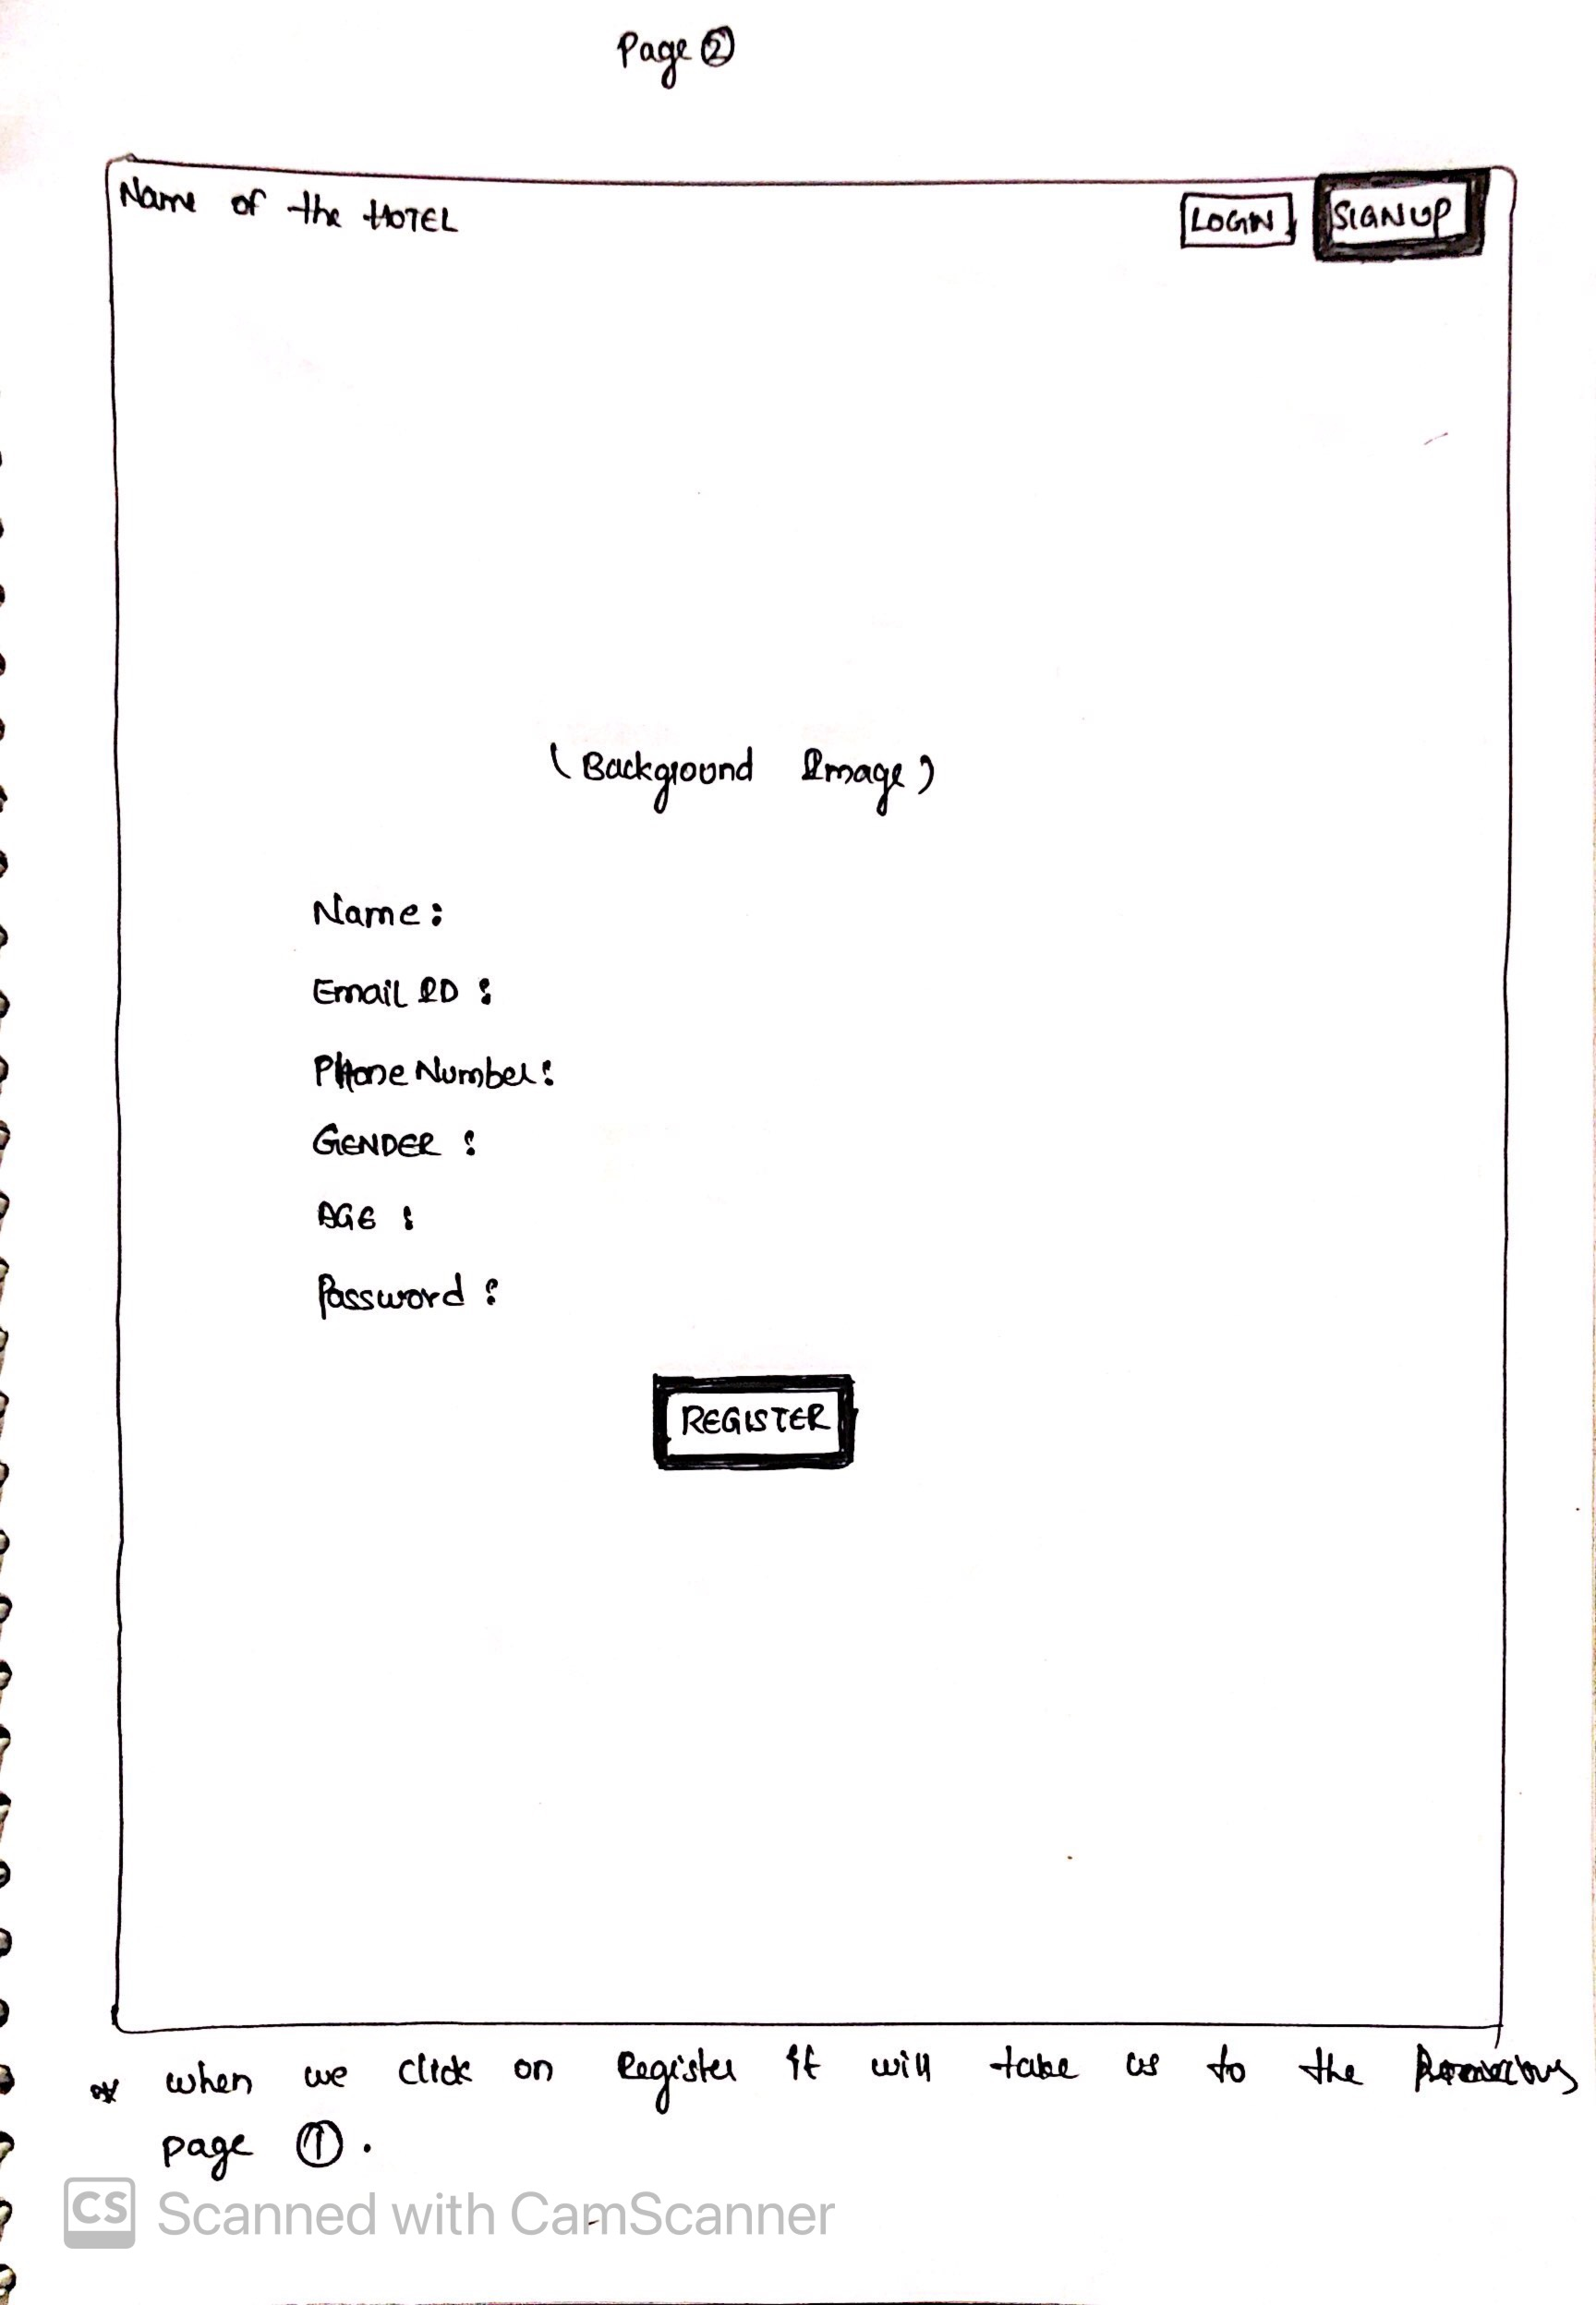
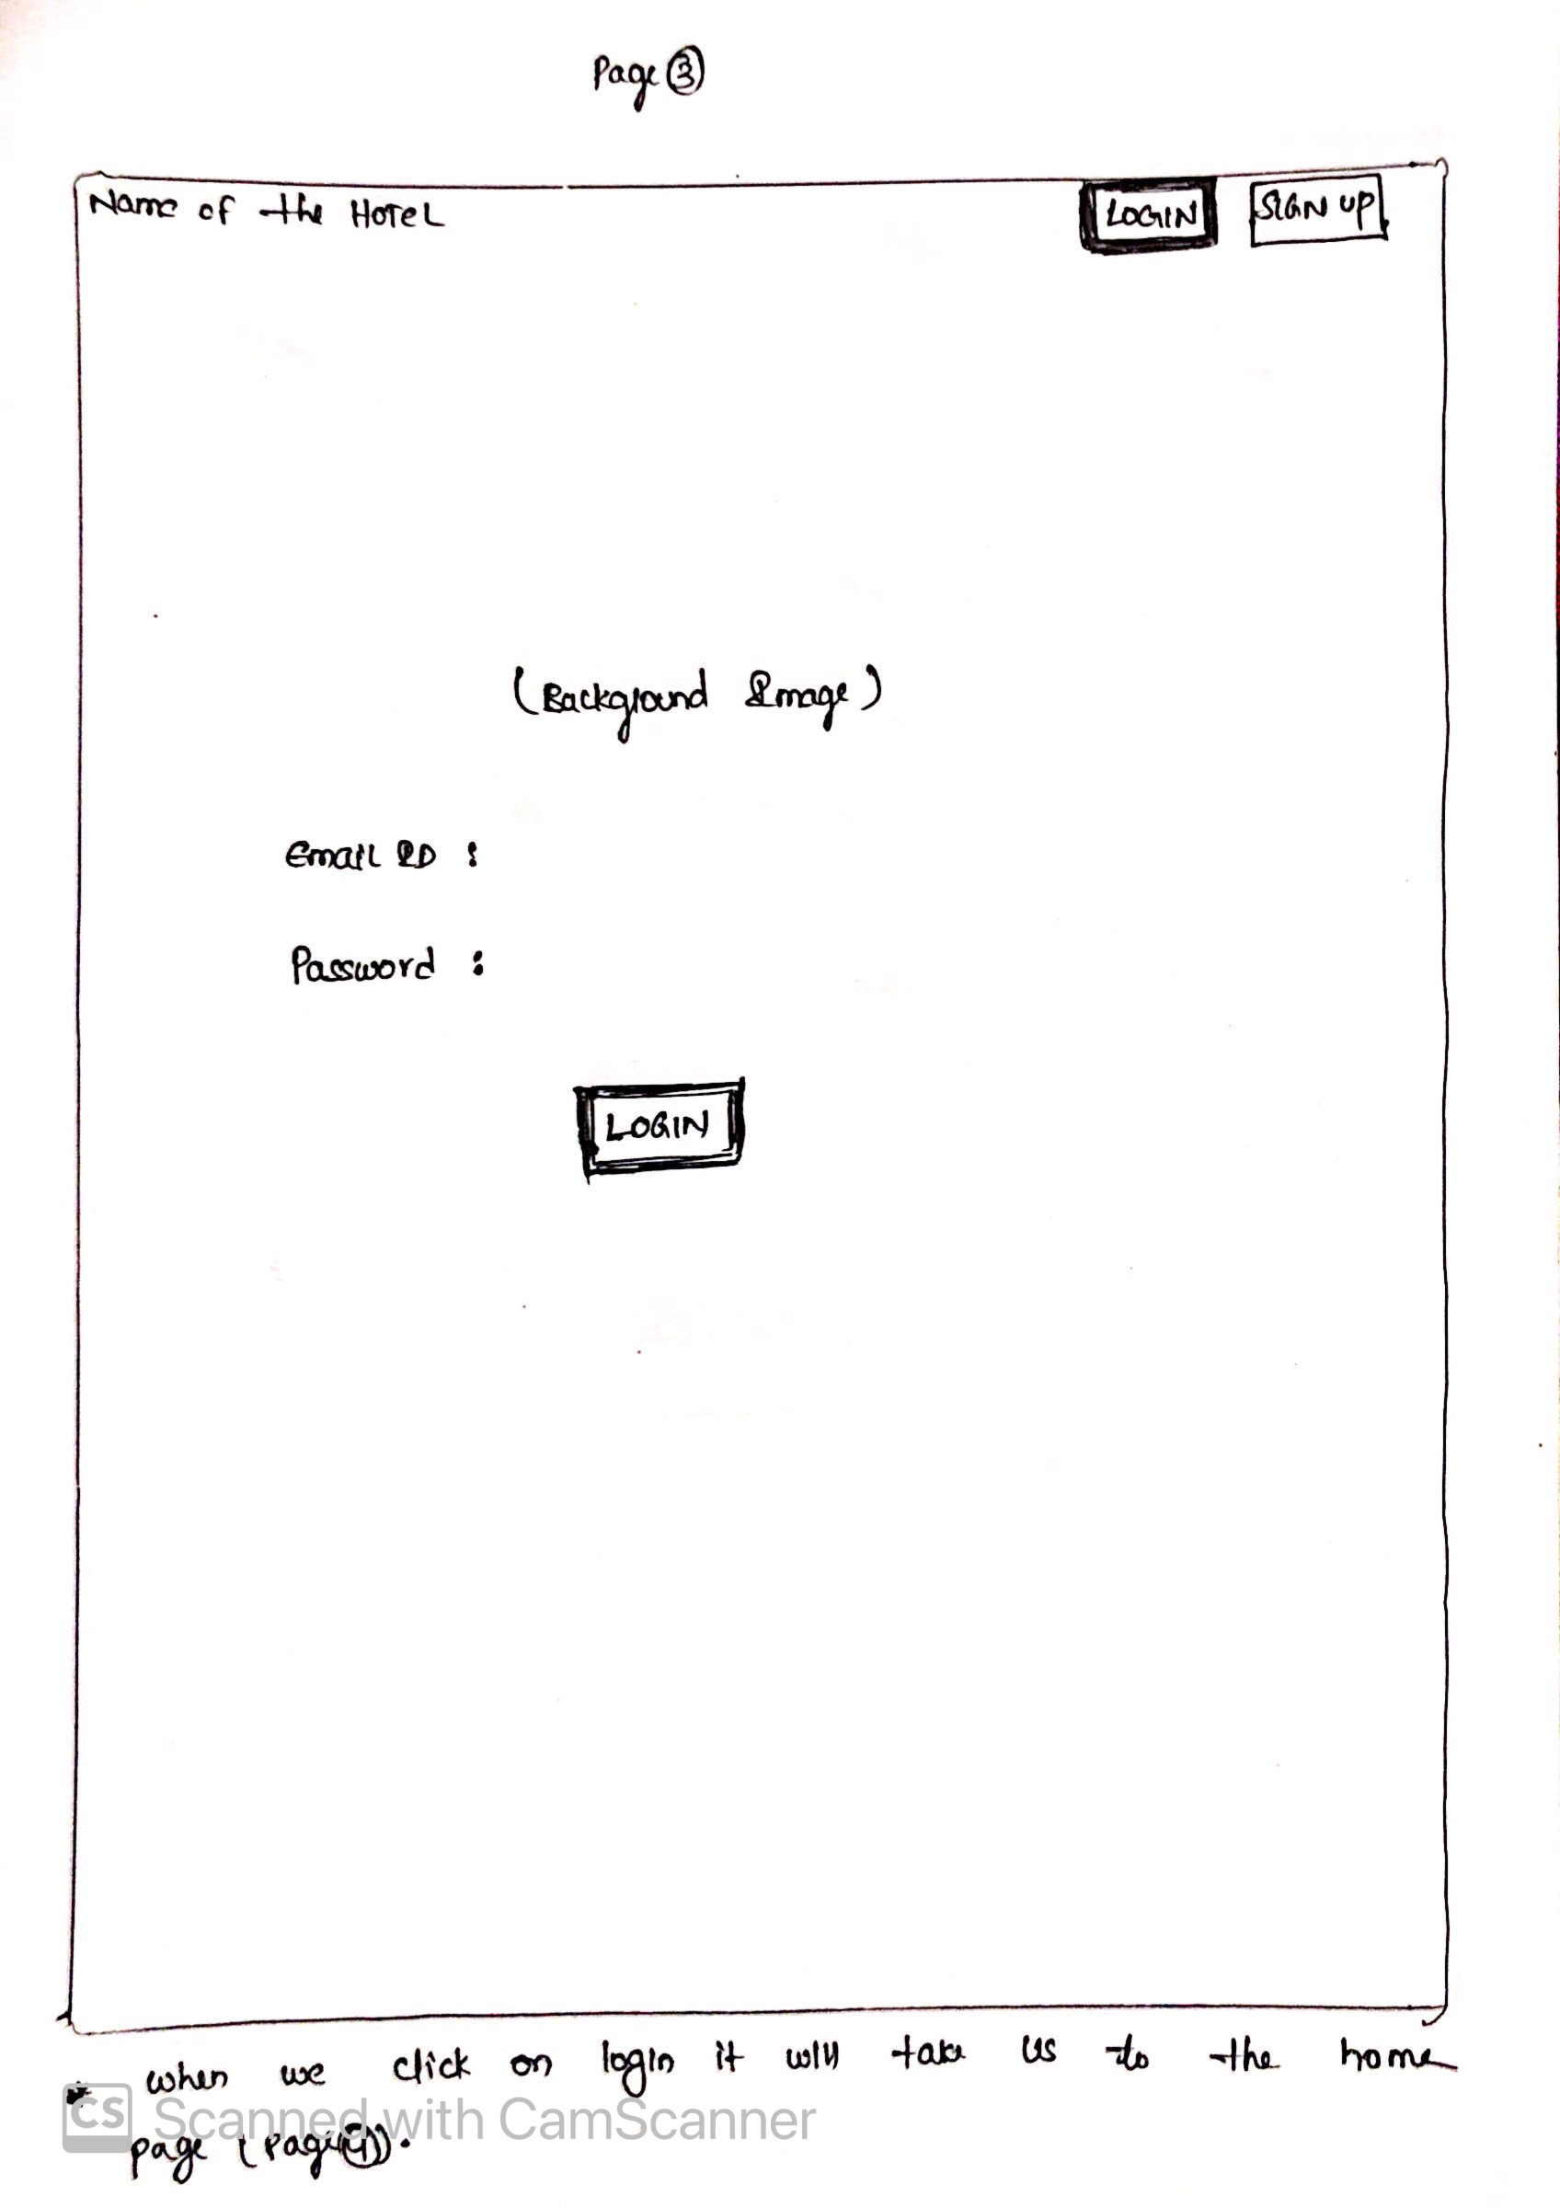
Paper Prototype

Slide 4
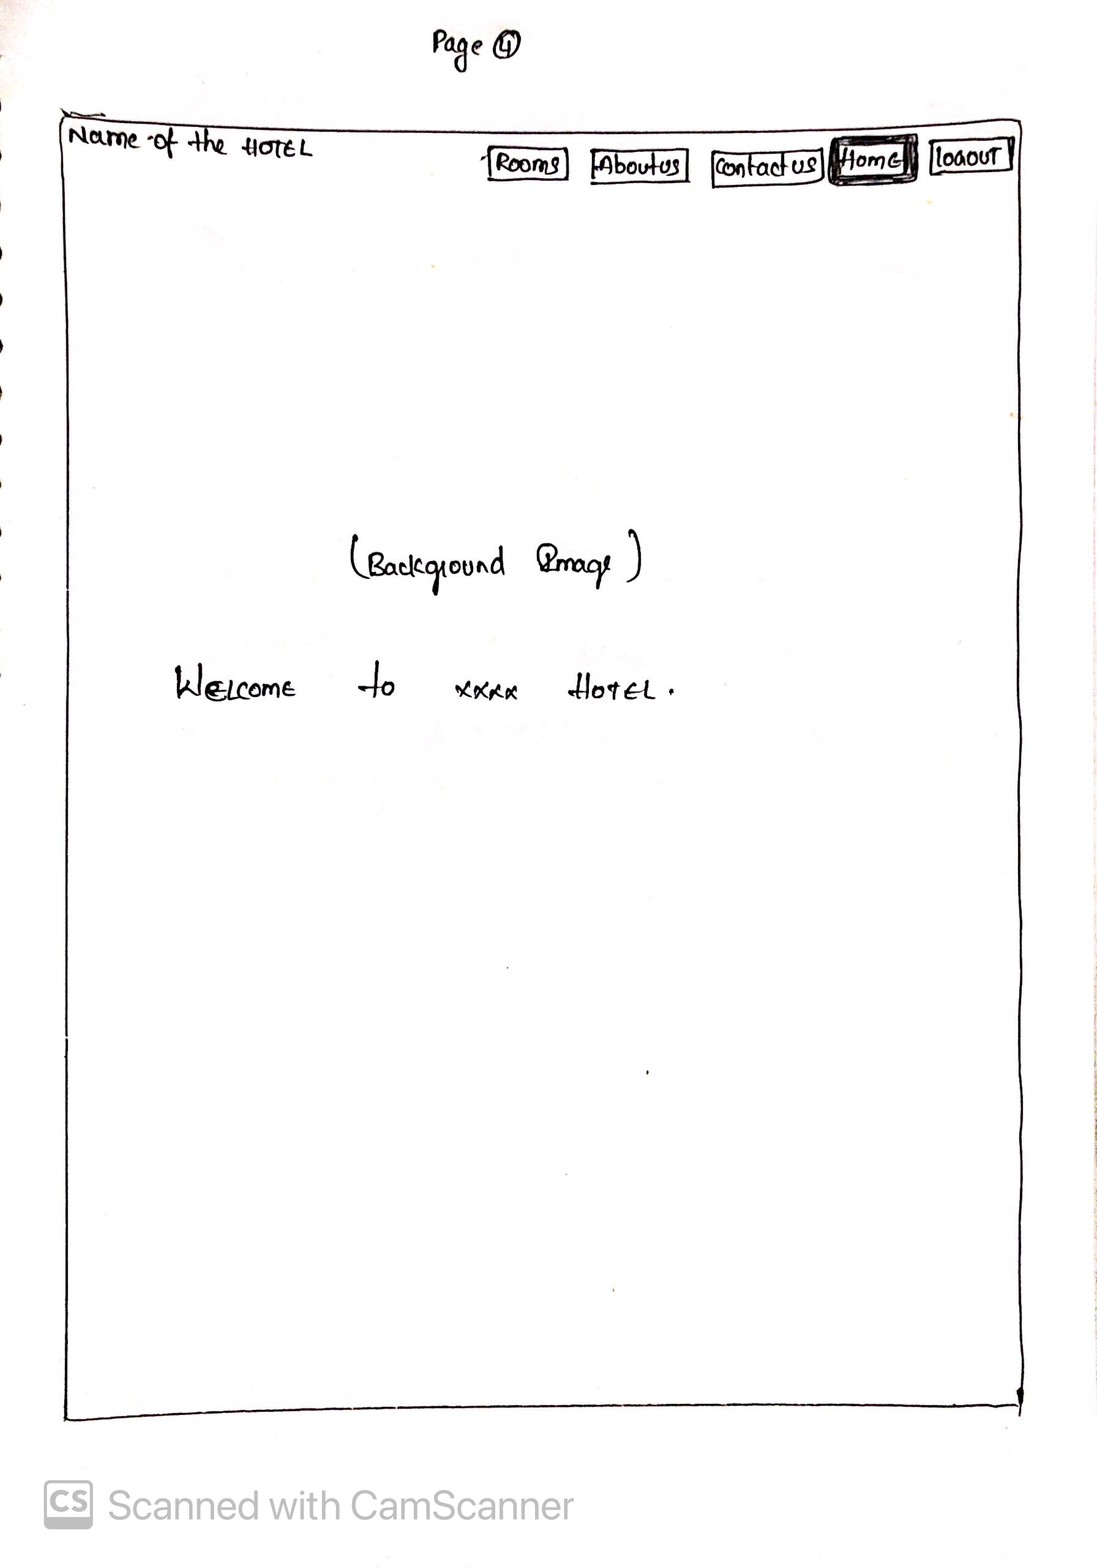
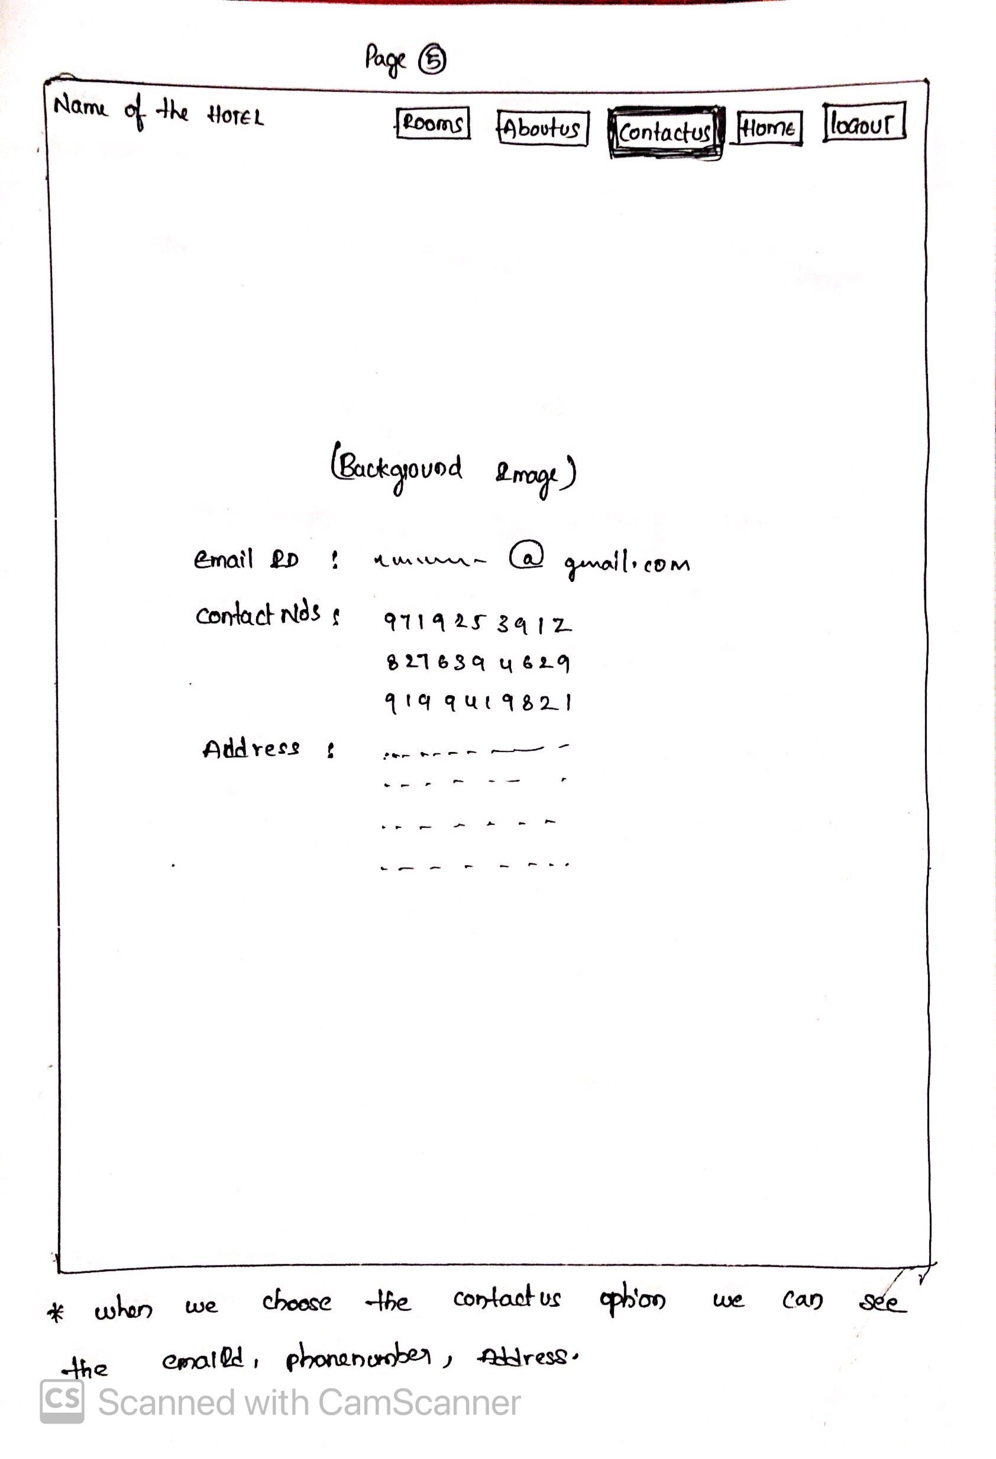
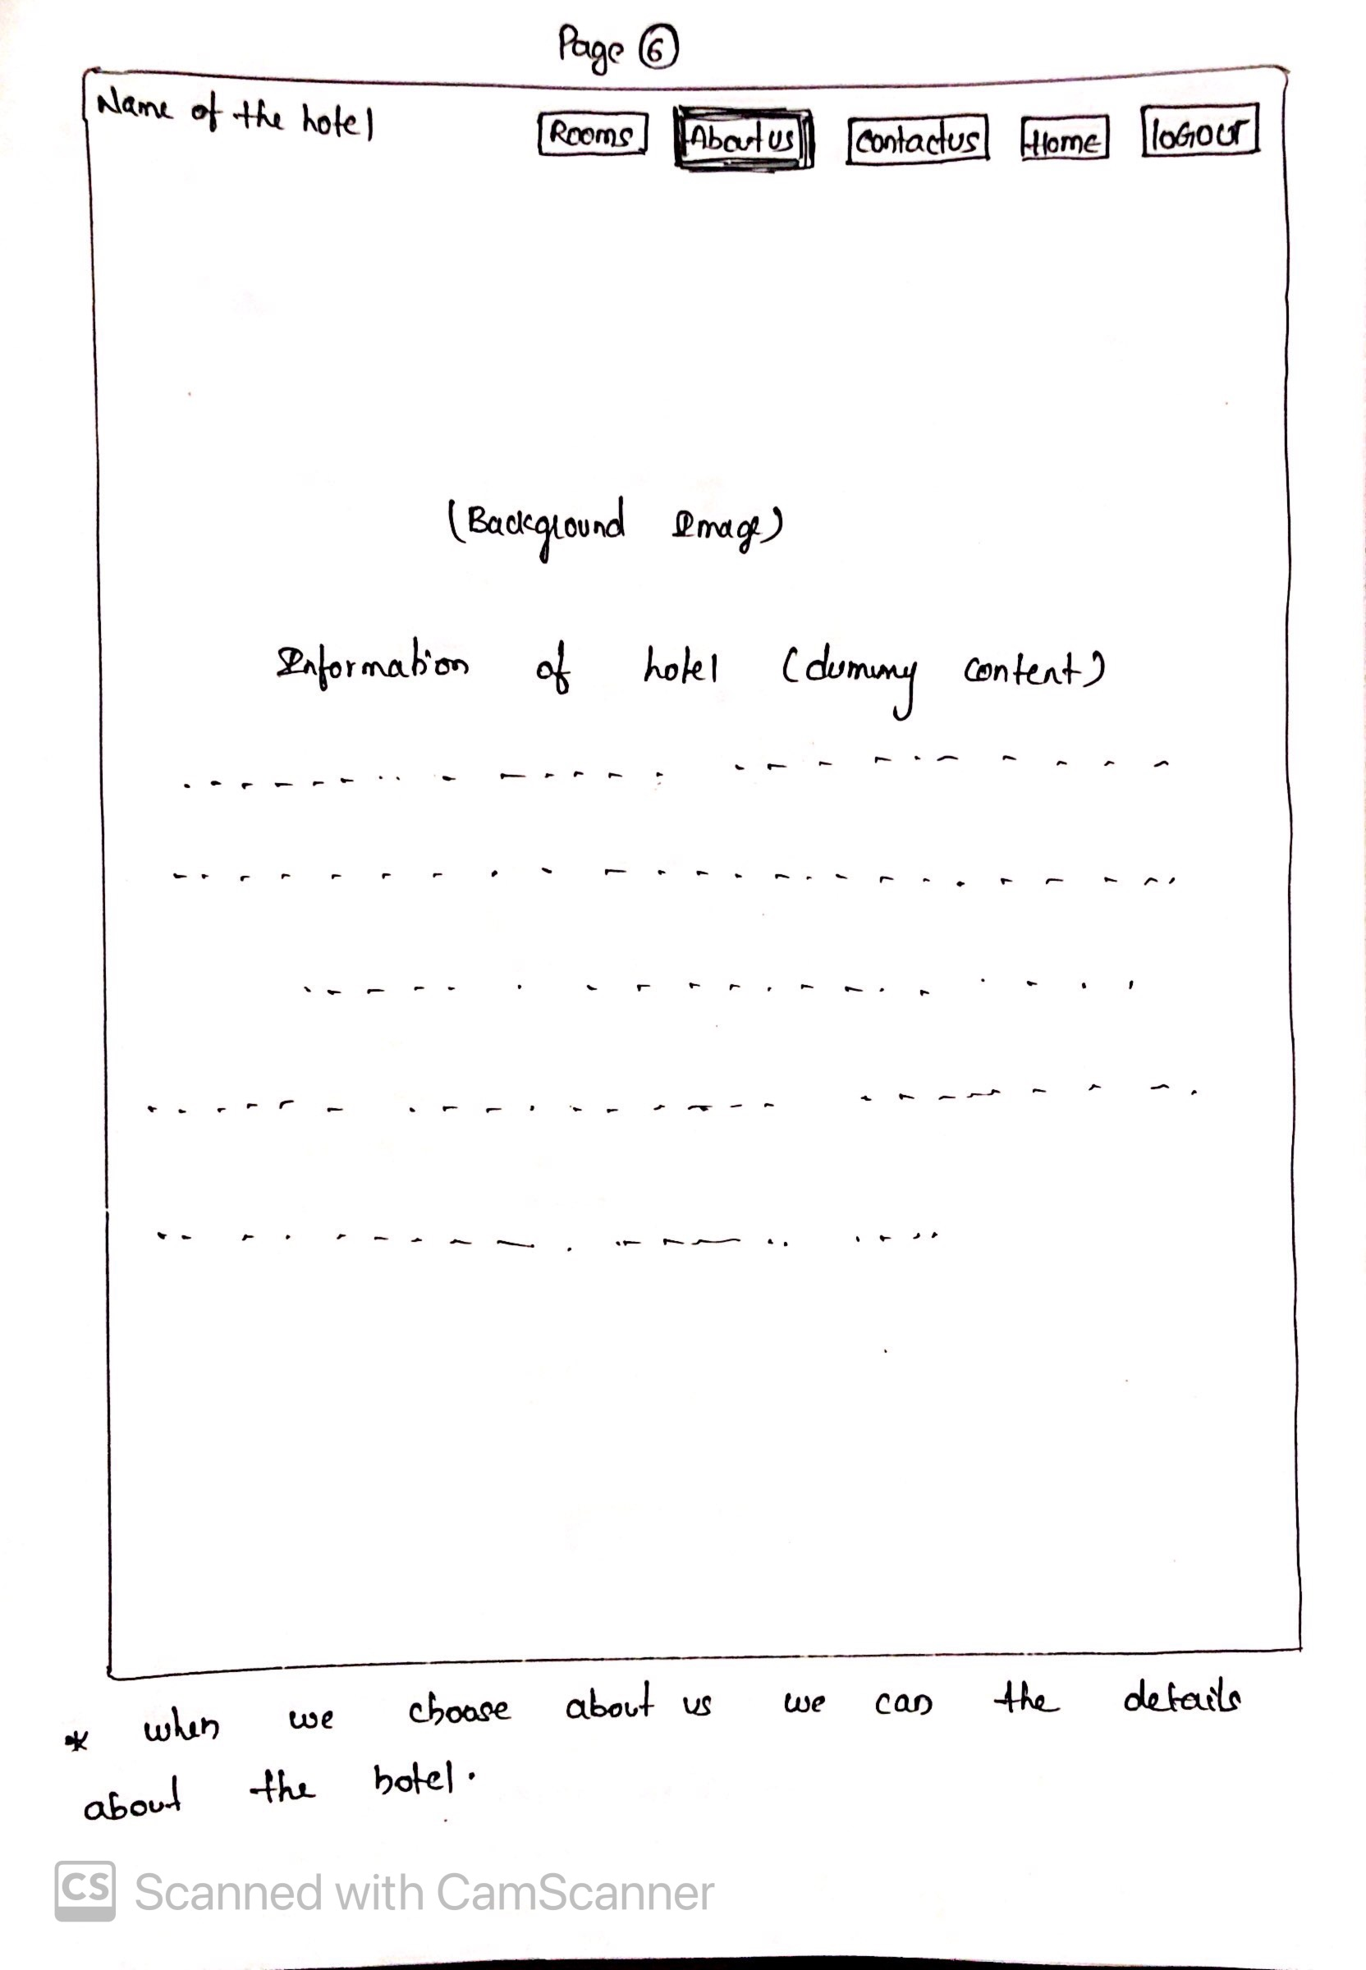
Paper Prototype

Slide 5
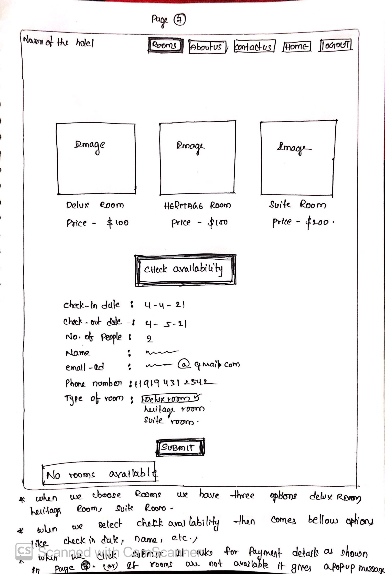
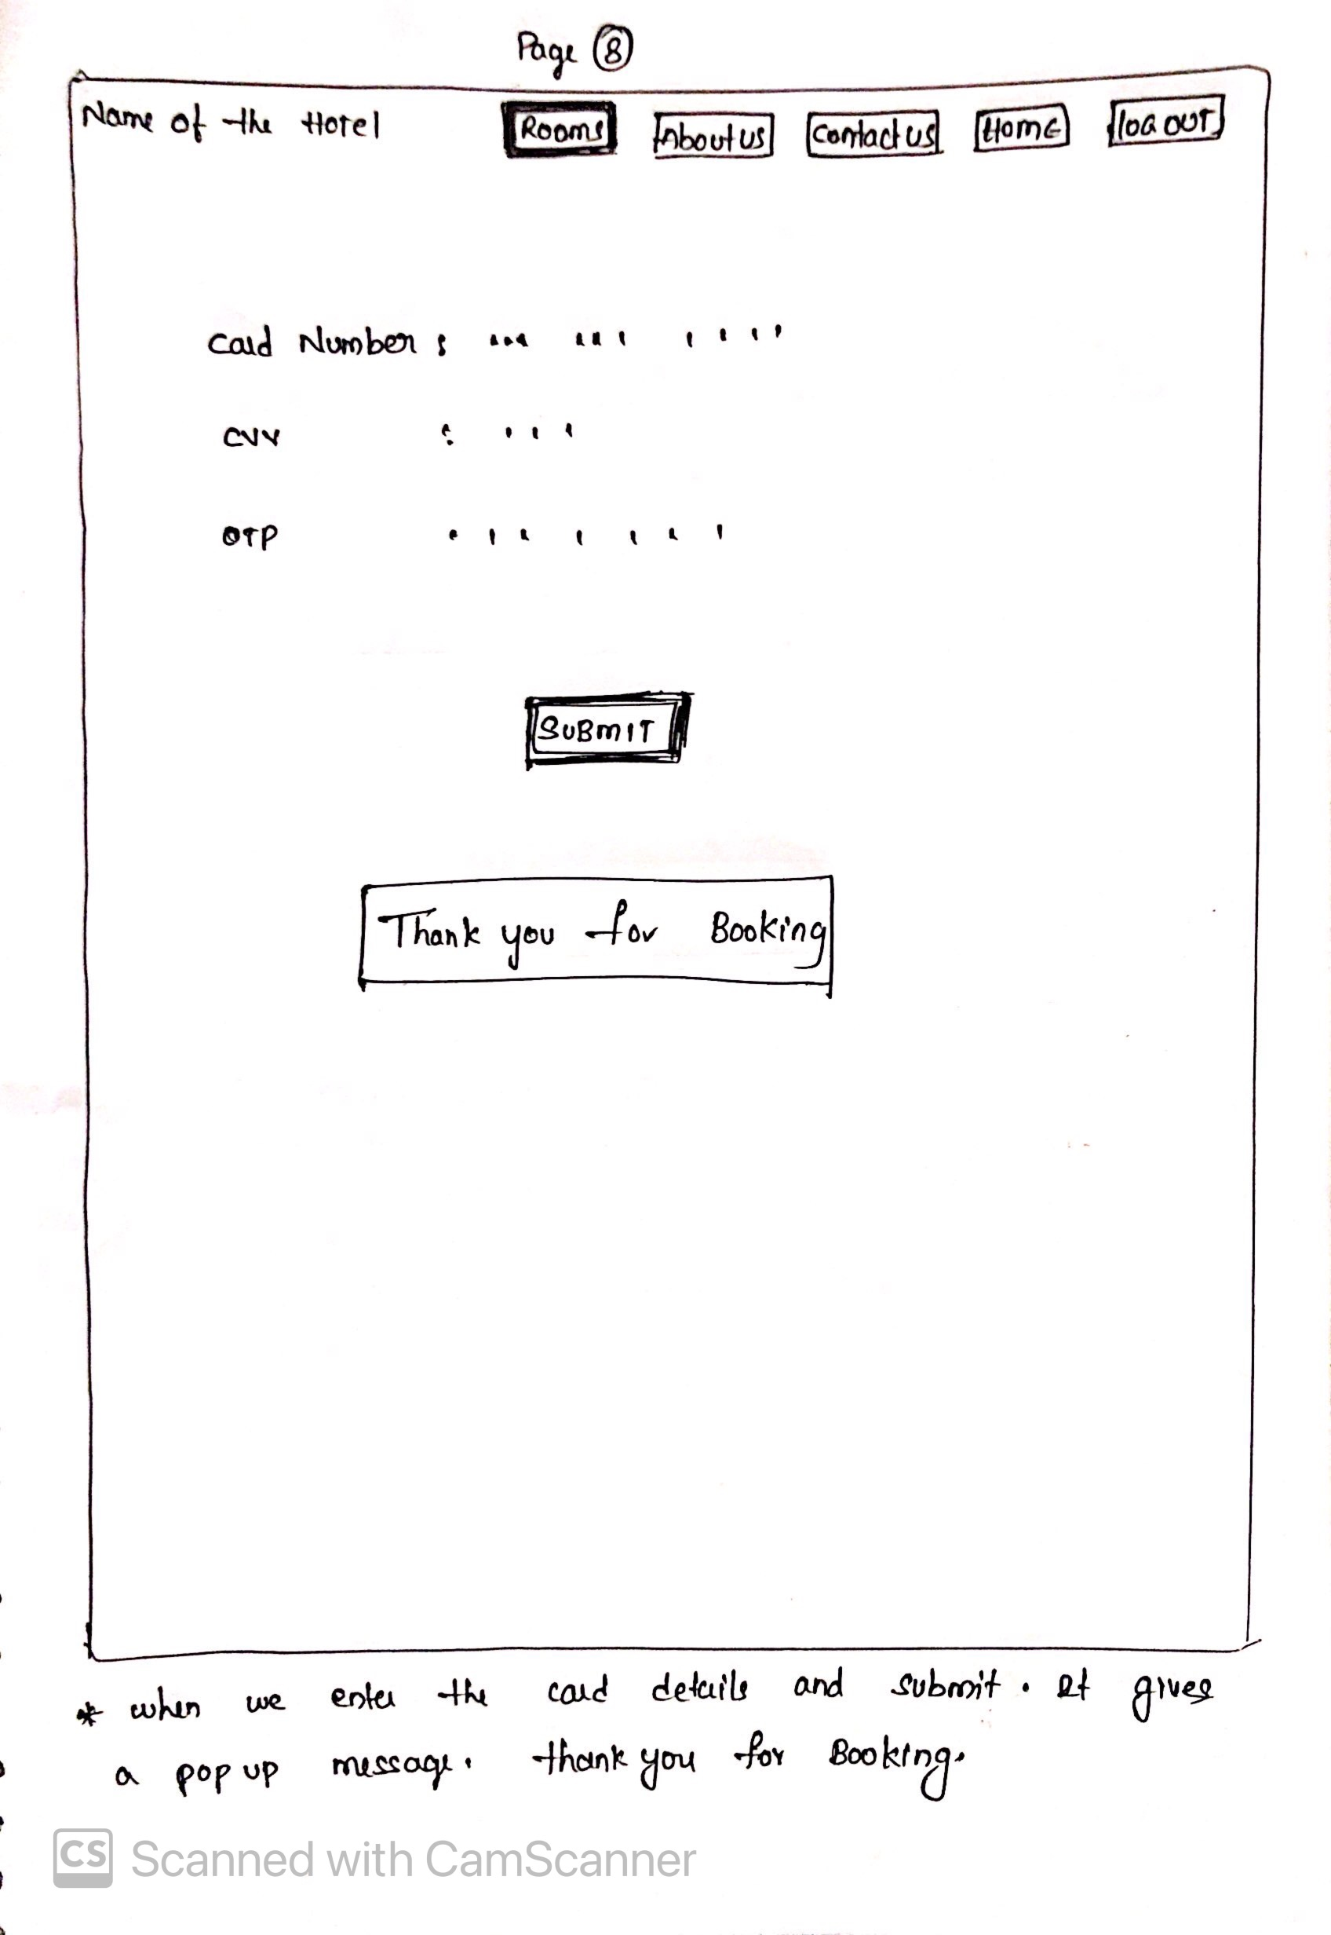
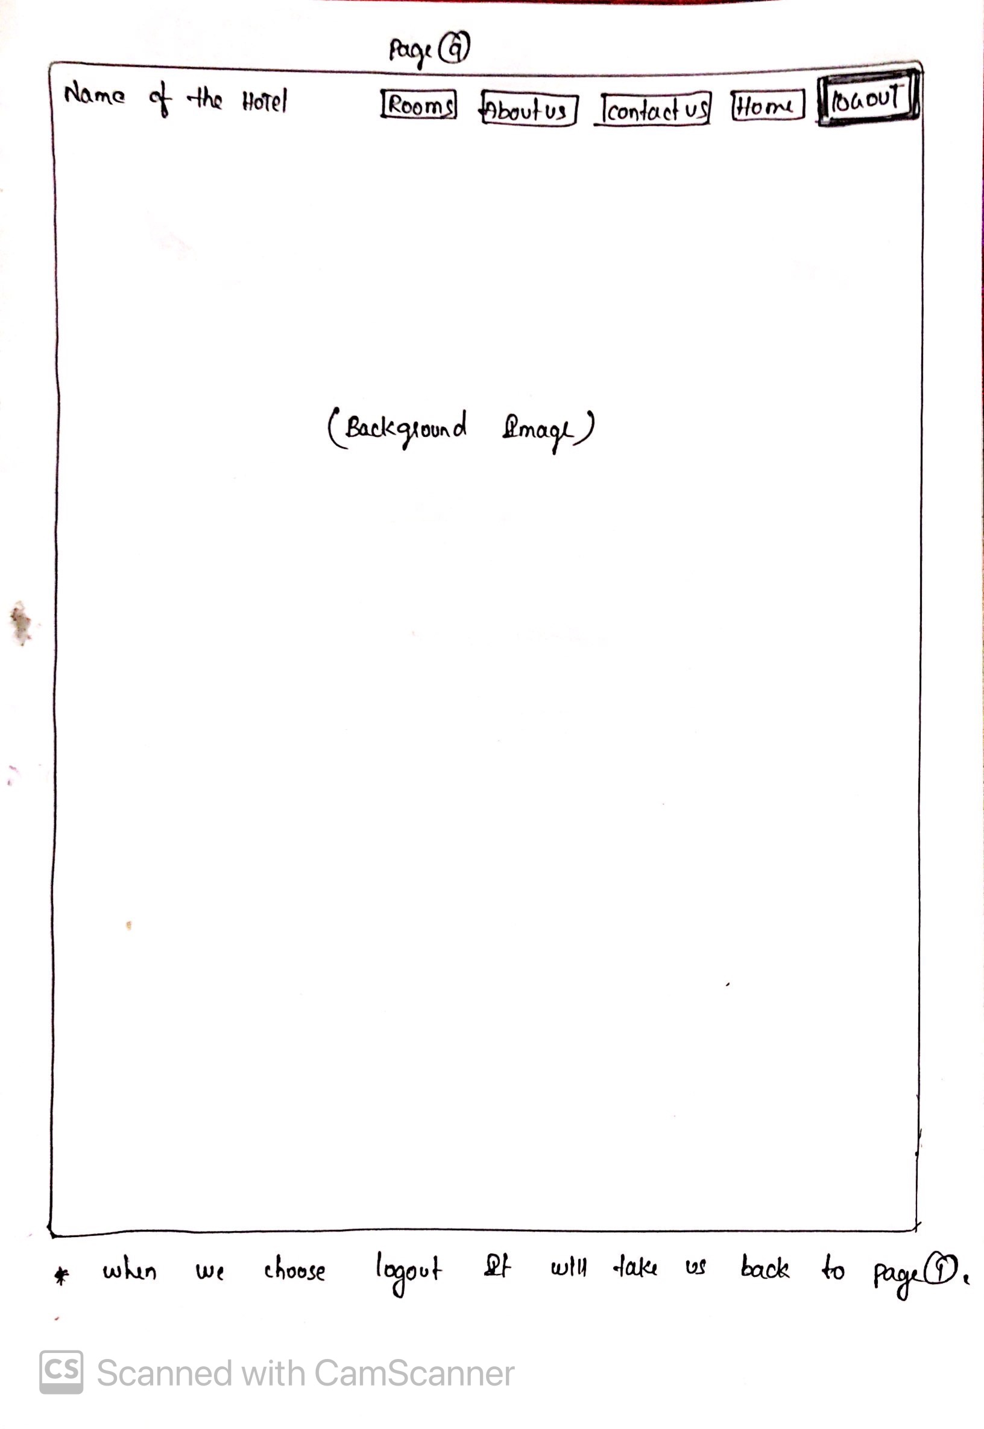
Paper Prototype

Slide 6
Installation steps
Install Python
brew install python3
Install pip (if it is not already installed)
sudo easy_install pip
Download and Install PostgreSQL from its ORG site.
The PostgreSQL should be downloaded based on the type of OS (Mac), and version (10).
Note down the password given while installing PostgreSQL.
Link: https://www.enterprisedb.com/downloads/postgres-postgresql-downloads

Slide 7
Installation steps
Install Django in terminal
sudo pip install Django==3.0.1
Install Psycopg2
pip install psycopg2
Download Visual studio code
We can use just terminal instead of using visual studio code also.

Slide 8
Links
https://medium.com/@diwassharma/starting-a-python-django-project-on-mac-os-x-c089165cf010
http://hisabimbola.com/steps-to-setup-postgres-with-django-on-mac/
https://realpython.com/get-started-with-django-1/
https://www.youtube.com/watch?v=cCTZpJu3Gk4
https://www.youtube.com/watch?v=TqWZup5vySs

Slide 9
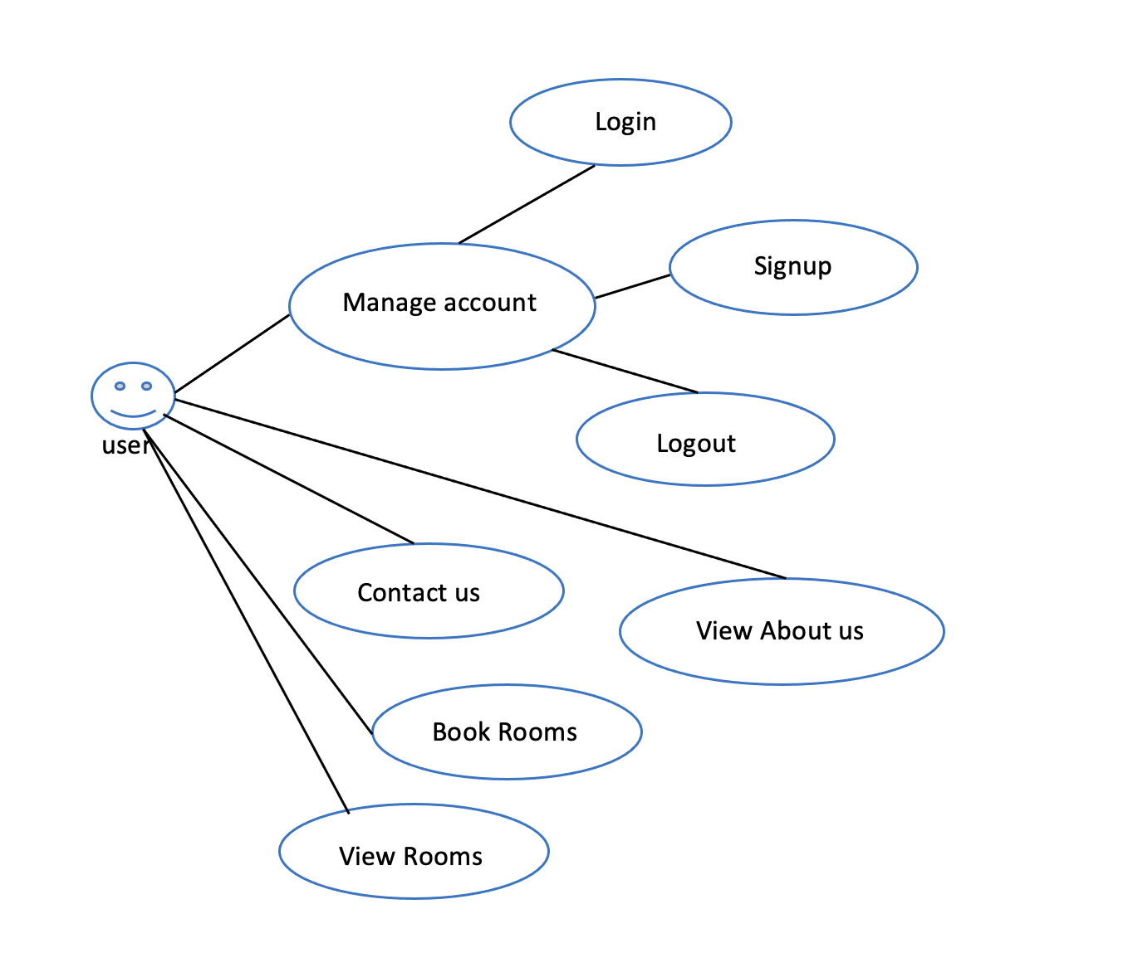
Use cases:

Slide 10
Demo

