Slide 1
Sport Activity Recognition
YOLOv11n · Sony IMX500 AI Camera · Raspberry Pi 5
4 Sport Classes
916 Images
95.7% mAP50
25 FPS On-Device
AISD · Prof. Dr. Thomas Ewender · THD Deggendorf
Tagore Thotakura
Charuphala Balasubramanian
Varsha Palampalli
Notes:
Good morning everyone.
Today, I will present our project titled Sport Activity Recognition using YOLOv11n deployed on the Sony IMX500 AI Camera with Raspberry Pi 5.
The objective of this project was to develop a complete edge AI system capable of recognizing different sports activities in real time.
The project covers the complete pipeline, starting from dataset preparation and model training to deployment on the Sony IMX500 AI camera running with a Raspberry Pi 5.

Slide 2
01
Motivation & Overview
Why edge AI for sport detection?
SECTION 1
Notes:
I'll begin by explaining the motivation behind this project and the problem we wanted to solve.

Slide 3
Project Overview
Real-time sport activity detection on a Sony IMX500 AI camera
The Problem
Key Benefit
▪ Manual sport coaching is time-consuming
▪ No cloud — fully private
▪ Cameras need cloud connectivity for AI
▪ <3 ms per frame on-chip
Our Solution
▪ Latency is too high for real-time feedback
▪ Runs on Raspberry Pi 5
▪ Train a compact YOLOv11n detector
▪ Export to Sony IMX500 edge AI chip
▪ Run inference directly in the camera
Notes:
Traditional sports analysis often depends on manual observation or cloud-based AI systems.
These approaches introduce latency and require continuous internet connectivity, making them unsuitable for real-time applications.
Our solution was to develop an edge AI system where the inference runs directly on the Sony IMX500 camera.
We trained a lightweight YOLOv11n model and deployed it onto the camera, enabling real-time sport activity recognition with low latency while preserving user privacy.
In this architecture, the Raspberry Pi acts as the host device while the Sony IMX500 performs the AI inference directly on the camera.

Slide 4
02
Dataset
Sports AISD — Custom annotated dataset
SECTION 2

Slide 5
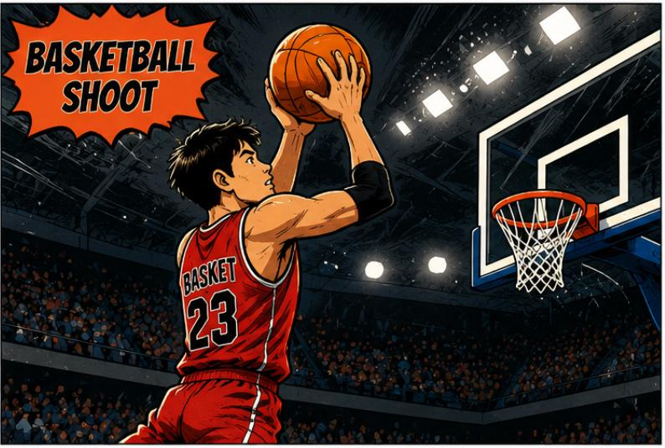
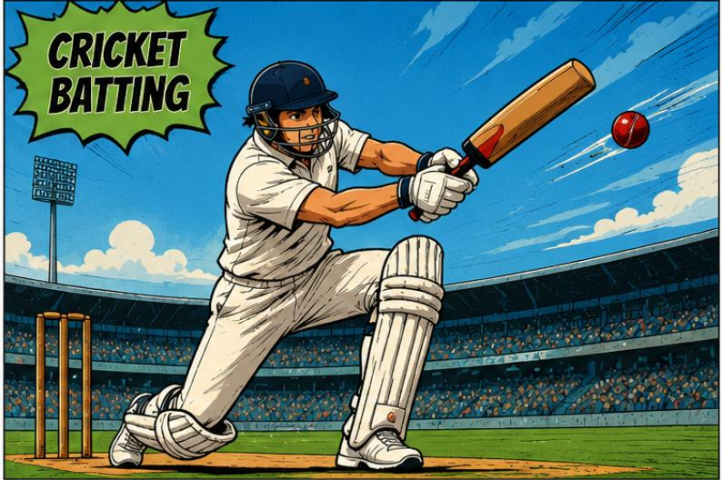
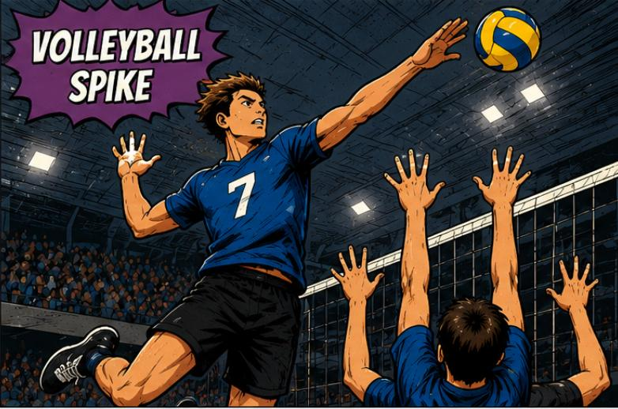
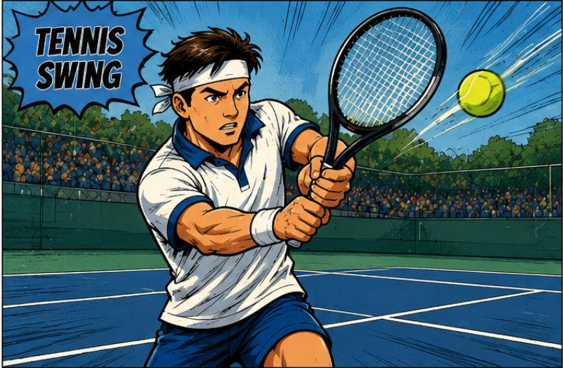
Dataset — Sports AISD
916 images · YOLO format · 4 sport classes · 80/10/10 split
916
4
YOLO
80/10/10
Total Images
Classes
Label Format
Train/Val/Test
Class
Images
Training
Val
Test
Basketball Shoot
182
Train: 145
Val: 18
Test: 19
Cricket Batting
268
Train: 214
Val: 27
Test: 27
Tennis Swing
182
Train: 145
Val: 18
Test: 19
Volleyball Spike
284
Train: 227
Val: 28
Test: 29
Annotation: Bounding boxes per player · Input resolution: 640 × 640 px · Collected from publicly available sport images
Notes:
Our final dataset consists of 916 annotated images across four sport activities.
Every image was annotated using LabelImg in YOLO bounding-box format.
The dataset was divided into 80% training, 10% validation, and 10% testing.
All images were resized to 640 by 640 pixels, which is the standard input size for YOLOv11n.
This dataset was then used to train and evaluate our model.

Slide 6
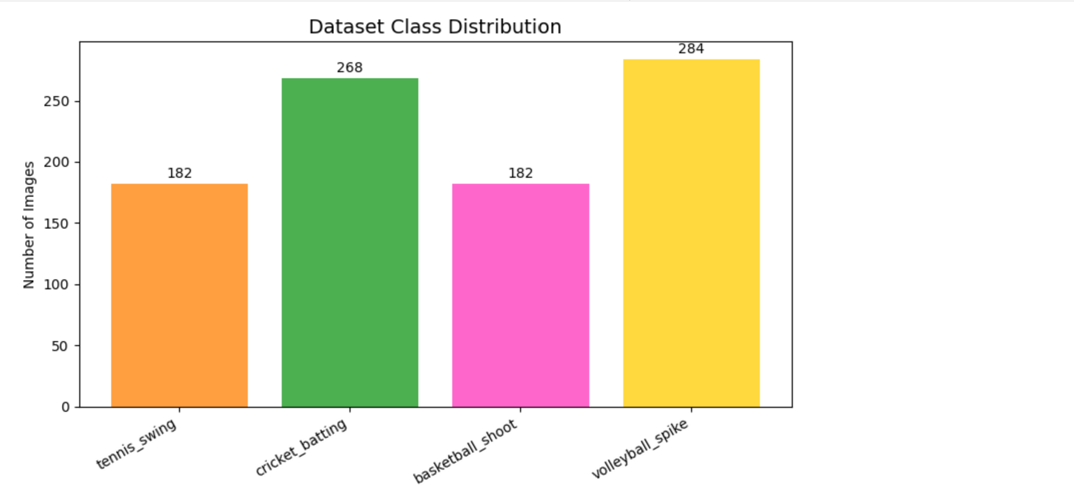
Dataset Class Distribution
Visual breakdown of images per sport class
Largest Class
Volleyball Spike
284 images
Smallest Classes
Basketball & Tennis
182 images each
Label Format
YOLO TXT
class x_c y_c w h
Critical Fix: Original labels used class IDs 0–5 (6-class scheme). Remapped to IDs 0–3 before training — this fixed mAP from 0% to 95.7%.
Notes:
This slide shows how the dataset is distributed among the four sport classes.
Volleyball Spike contains the highest number of images, while Basketball Shoot and Tennis Swing contain the fewest.
During dataset verification, we discovered that the annotation files still contained the original class IDs from the previous dataset configuration.
Before training, we corrected these class IDs so that they matched the final four-class dataset.
This correction was essential because incorrect labels initially resulted in poor training performance.

Slide 7
Dataset Collection, Cleaning & Preparation
From raw videos to a training-ready YOLO dataset
01
UCF101 Videos +
Self-recorded Cricket
Dataset Collection
↓
Basketball, Tennis & Volleyball: frame extraction from UCF101 action videos. Cricket Batting: UCF101 frames + self-recorded batting video. Diverse player poses across all classes.
02
Frame Extraction
↓
03
Image Collection
Frame Extraction & Annotation
↓
▪ Videos converted to image frames at multiple timestamps
04
Manual Annotation
(LabelImg)
▪ Redundant and blurred frames removed manually
▪ Images annotated with LabelImg in YOLO bounding-box format
↓
▪ One .txt annotation file generated per image
05
YOLO Label
Generation
Dataset Cleaning & Verification
↓
06
Dataset Cleaning
▪ Removed duplicates, blurred and irrelevant images
▪ Deleted unused annotation files to maintain pairing
↓
▪ Verified every image had a matching YOLO label file
07
Class ID Correction
▪ Corrected incorrect class IDs before training
↓
Dataset Organization
08
Train / Val / Test
Split
80% Train · 10% Validation · 10% Test — Ready for YOLOv11n training
Careful dataset preparation improves annotation quality, training consistency, and model reliability.
Notes:
Before training the model, we first created the dataset from both publicly available videos and our own recorded data.
For Basketball Shoot, Tennis Swing, and Volleyball Spike, we extracted image frames from videos in the UCF101 action recognition dataset.
For Cricket Batting, we additionally recorded our own batting video and extracted frames to capture more realistic batting poses.
After extracting the frames, we organized the images into their respective sport categories.
Each image was manually annotated using LabelImg, generating one YOLO annotation file for every image.
We then manually reviewed the dataset and removed duplicate, blurred, and irrelevant images.
Whenever an image was removed, its corresponding annotation file was also deleted to maintain consistency.
Next, we verified that every image had a matching annotation file and corrected the annotation class IDs before training.
Finally, the cleaned dataset was organized into training, validation, and testing folders, making it ready for YOLOv11n training.

Slide 8
03
Technical Pipeline
End-to-end workflow from data to live detection
SECTION 3
Notes:
After preparing the dataset, the next step was building the complete technical pipeline.

Slide 9
Technical Pipeline
Seven-stage workflow from raw images to on-chip live detection
01
02
03
04
05
06
07
Data
Collection
Label
Remap
Train
YOLOv11n
IMX
Export
RPK
Convert
Deploy
to Pi
Live
Detection
›
›
›
›
›
›
916 sport
images
Fix IDs
0→3
Colab T4
79 epochs
INT8 quant
.zip
imx500-pkg
.rpk
Raspberry
Pi 5
25 FPS
on-chip
Training & IMX Export run in Google Colab (T4 GPU) · RPK conversion & live demo run on Raspberry Pi 5
Key constraint: Only YOLOv11n (nano) fits within the Sony IMX500 chip's on-board memory. Larger variants are rejected at RPK conversion.
Notes:
Our workflow begins with collecting and preparing the dataset.
After verifying the labels and correcting the class IDs, we trained the YOLOv11n model using Google Colab with a Tesla T4 GPU.
Once training was complete, the model was exported into Sony's IMX format using INT8 quantization.
The exported package was converted into an RPK file on the Raspberry Pi.
Finally, the RPK model was deployed onto the Sony IMX500 camera, enabling real-time sport activity detection at approximately 25 frames per second.
One important hardware constraint is that only the YOLOv11 Nano model fits within the memory limits of the Sony IMX500.

Slide 10
04
Model Architecture
YOLOv11n — chosen for IMX500 compatibility
SECTION 4
Notes:
Next, I'll explain why we selected YOLOv11n for this project.

Slide 11
YOLOv11n — Model Specifications
Nano variant is the only YOLO size supported by the Sony IMX500 chip
Model Specifications
Why YOLOv11n?
Architecture
YOLOv11n (nano)
▪ IMX500 chip memory only fits nano variant
▪ Larger models fail at RPK conversion
Layers
101 (fused)
Parameters
2.58 M
▪ 2.58 M params — ideal for edge deployment
▪ Single-pass detector — no region proposals
GFLOPs
6.3
Input Size
640 × 640 px
How YOLO Works
Output Format
INT8 quantized
▪ Divides image into grid cells
Model Size
5.2 MB
▪ Each cell predicts box + class in one pass
Classes
4 sport actions
▪ No two-stage region proposal needed
▪ NMS filters overlapping detections
Notes:
We selected YOLOv11n because it is lightweight and fully compatible with the Sony IMX500 hardware.
The model contains approximately 2.58 million parameters and occupies only 5.2 megabytes after export.
Larger YOLO models exceed the available memory of the IMX500 and therefore cannot be deployed.
YOLO is a single-stage detector that predicts both object locations and class labels in a single forward pass, making it highly suitable for real-time edge AI applications.

Slide 12
05
Training Setup
Google Colab T4 GPU · 100 epochs · Early stopping
SECTION 5
Notes:
After selecting the model, we configured the training process.

Slide 13
Training Configuration
YOLOv11n trained on Google Colab with T4 GPU
G
Platform
E
Epochs
B
Batch Size
Google Colab
100 max / 79
16
T4 GPU · Python 3.12
Early stop at epoch 59
640×640 px input
P
Patience
O
Optimizer
S
Image Size
20 epochs
Auto (SGD)
640 × 640
Best model at epoch 59
lr0=0.01 momentum=0.937
Standard YOLO input
Notes:
Training was performed using Google Colab with a Tesla T4 GPU.
The maximum number of epochs was set to 100.
The best-performing model was obtained around epoch 59, and training stopped automatically at epoch 79 because early stopping was enabled with a patience value of 20.
We used a batch size of 16 and an input resolution of 640 by 640 pixels.
The optimizer configuration provided by Ultralytics was used throughout training.

Slide 14
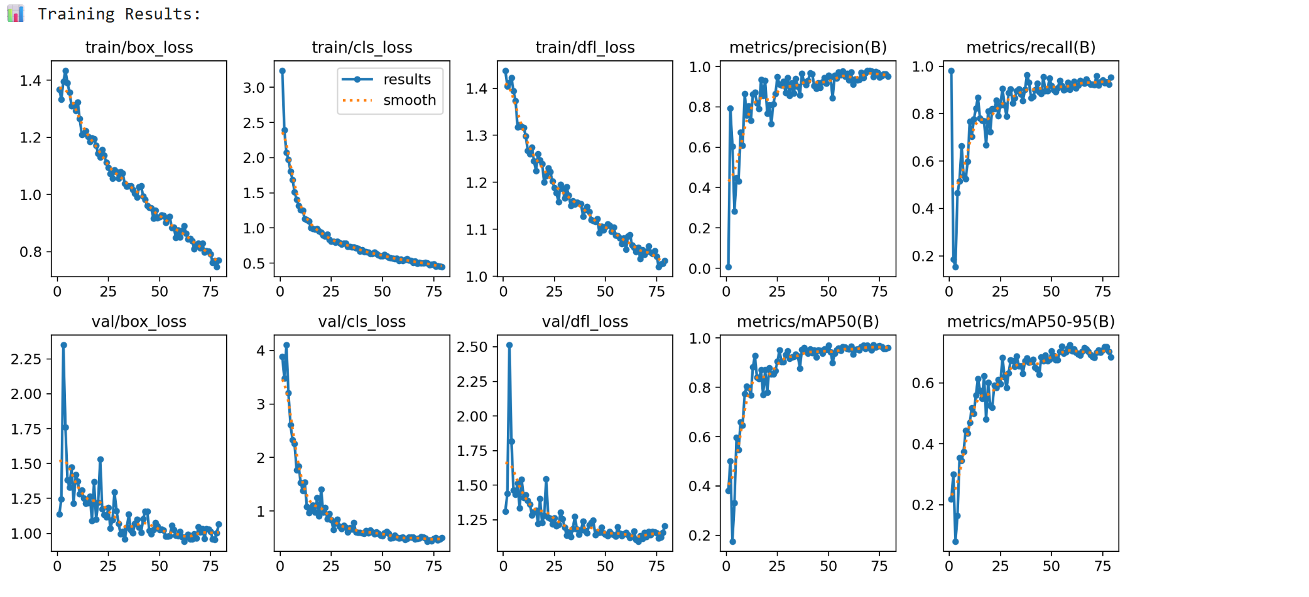
Training Curves
Loss decreasing steadily · mAP50 converging to 97% · No overfitting observed
Loss Trend
All 3 losses (box, cls, dfl)
decreasing smoothly
Best Epoch
Epoch 59 — highest mAP50
Early stop at epoch 79
No Overfitting
Train and val losses track
closely throughout
Notes:
These graphs illustrate the learning behavior during training.
The box loss, classification loss, and distribution focal loss decrease steadily, showing that the model learned effectively.
The validation performance improved consistently before stabilizing.
Since both training and validation losses followed similar trends, there is no clear evidence of overfitting.
Early stopping automatically selected the best-performing model.

Slide 15
06
Evaluation & Results
Metrics, confusion matrix, and per-class analysis
SECTION 6
Notes:
Next, I'll present the evaluation results of our trained model.

Slide 16
Model Performance — Overall Metrics
YOLOv11n · Validation set · confidence threshold 0.25
95.7%
96.6%
90.2%
93.3%
mAP50
Precision
Recall
F1 Score
Per-Class Breakdown
Sport Class
Precision
Recall
mAP50
Status
Basketball Shoot
98.1%
75.3%
92.0%
✔ Good
Cricket Batting
98.7%
100%
99.5%
✔ Excellent
Tennis Swing
97.1%
100%
99.5%
✔ Excellent
Volleyball Spike
90.4%
85.7%
91.9%
✔ Good
Notes:
Our model achieved an overall mAP50 of 95.7%.
The precision is 96.6%, recall is 90.2%, and the F1-score is 93.3%.
Cricket Batting and Tennis Swing achieved the highest performance with nearly perfect mAP values.
Basketball Shoot and Volleyball Spike also achieved strong performance, demonstrating that the detector performs reliably across all four sport activities.

Slide 17
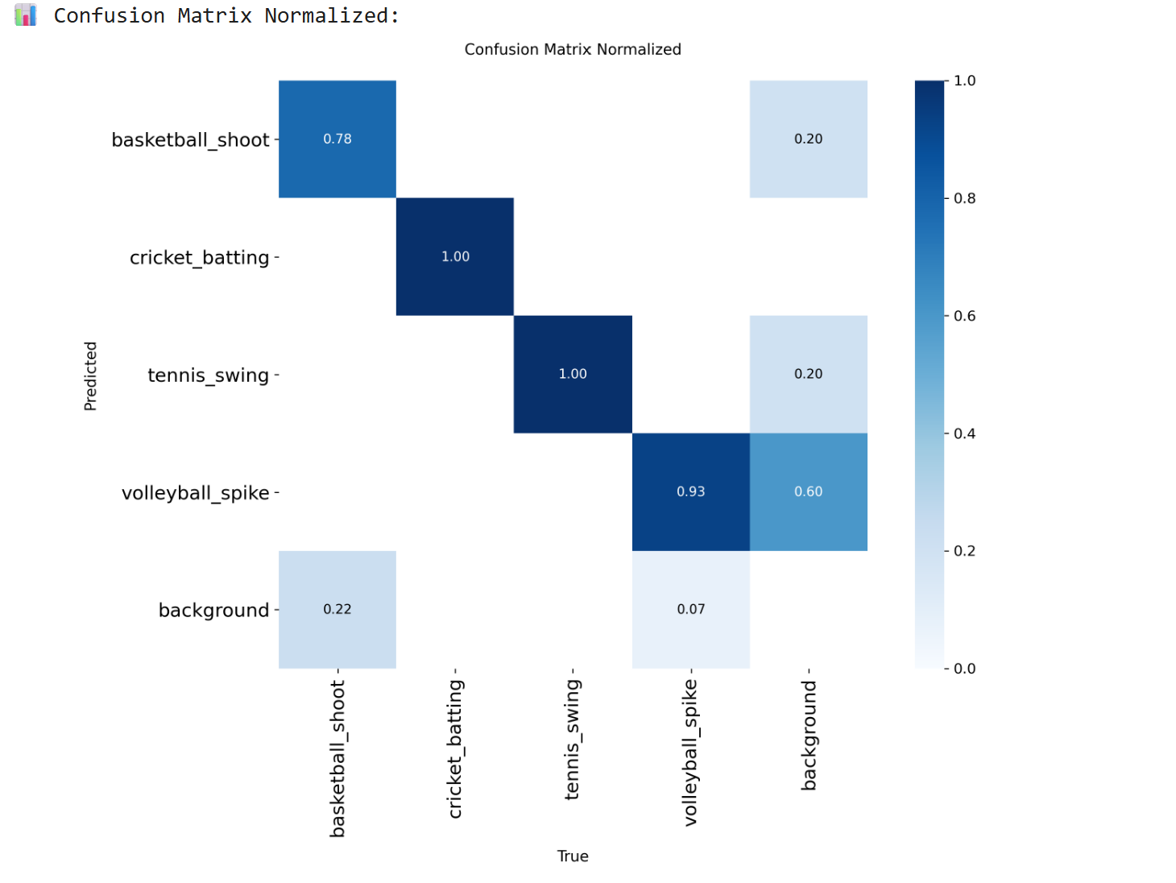
Confusion Matrix
Strong diagonal — cricket batting and tennis swing at 100% recall
1.00
Cricket Batting
Perfect recall
1.00
Tennis Swing
Perfect recall
0.78
Basketball Shoot
20% as background
0.93
Volleyball Spike
7% missed in crowd
Notes:
The confusion matrix shows how accurately the model classified each sport activity.
Cricket Batting and Tennis Swing achieved perfect recall.
Basketball Shoot has a few missed detections, mainly when the athlete appears small in the image.
Volleyball Spike also has a few missed detections in crowded scenes where players overlap.
Overall, the strong diagonal indicates excellent classification performance.

Slide 18
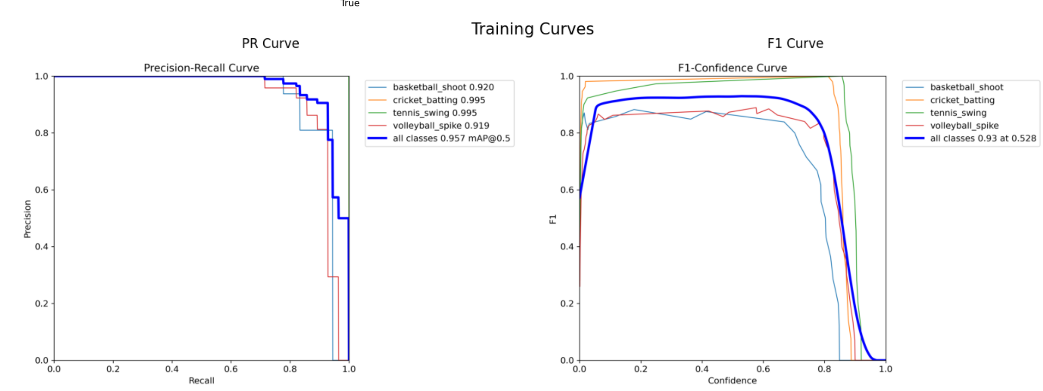
Precision–Recall & F1 Curves
All classes maintain high precision · F1 peaks at 0.93 @ conf 0.528
Notes:
This graph illustrates the relationship between precision and recall across different confidence thresholds.
All four sport classes maintain high precision throughout most of the operating range.
The highest F1-score occurs at a confidence threshold of approximately 0.53, representing a good balance between precision and recall.

Slide 19
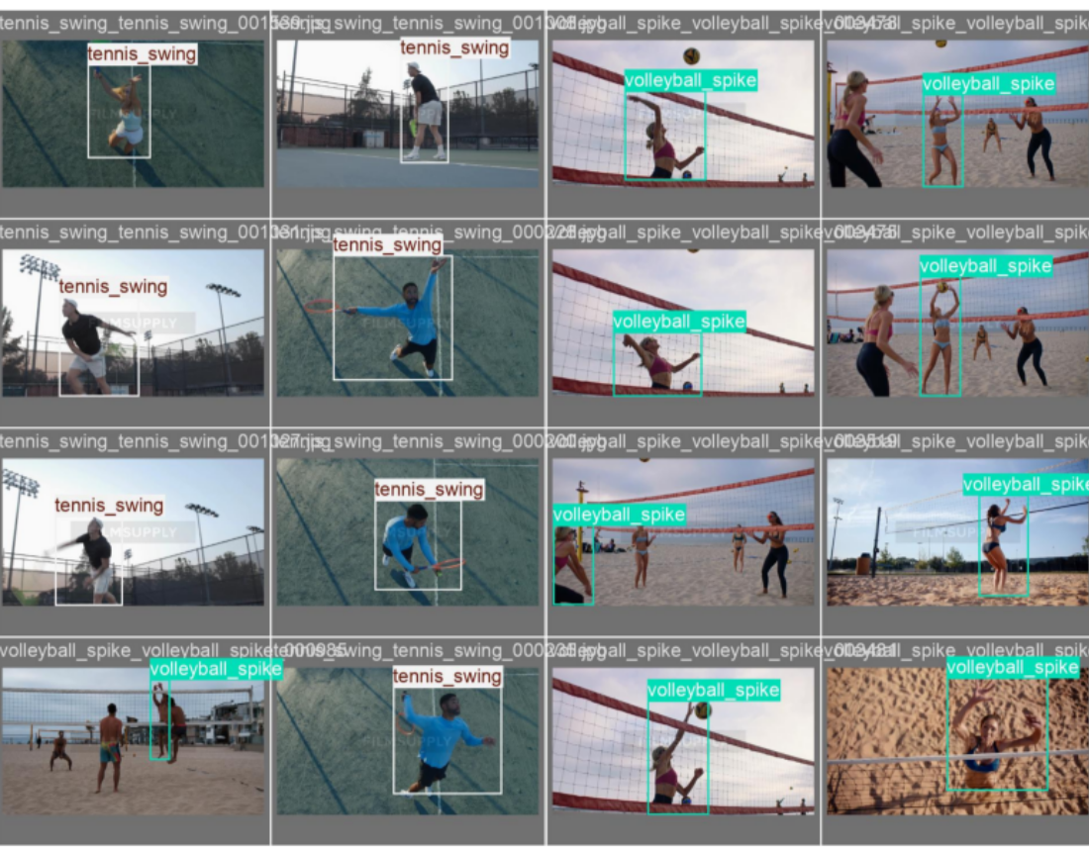
Sample Predictions — Validation Set
Model correctly identifies sport poses with tight bounding boxes
Notes:
These examples show predictions generated on the validation dataset.
The model correctly identifies the different sport activities and produces accurate bounding boxes around the athletes.
These results demonstrate that the detector generalizes well to unseen images.

Slide 20
07
Deployment
From packerOut.zip to live IMX500 detection on Raspberry Pi 5
SECTION 7
Notes:
I'll now explain how the trained model was deployed onto the Sony IMX500 AI camera.

Slide 21
Deployment Pipeline — Raspberry Pi 5 + IMX500
Three steps on-device after training completes in Colab
01
02
03
Export to IMX
Convert to RPK
Run Live Demo
model.export(
format='imx',
int8=True)
imx500-package
-i packerOut.zip
-o rpk_output/
python3 sport_detect.py
--model network.rpk
--labels labels.txt
--fps 25
→
→
Output: packerOut.zip
+ labels.txt
Output: network.rpk
Output: Live detection
@ 25 FPS
Colab: model.export() · Raspberry Pi: imx500-package + picamera2 demo script
Notes:
After training, the model was exported into Sony's IMX format.
This generated the packerOut.zip package along with the label file.
On the Raspberry Pi, Sony's packaging tool converted this package into an RPK model.
Finally, the RPK model was deployed to the Sony IMX500 camera, where inference runs directly on the embedded neural processor.
The Raspberry Pi manages the application, while the camera performs the AI inference

Slide 22
08
Constraints & Future Work
Known limitations and paths to improvement
SECTION 8
Notes:
Like any engineering project, this work has certain limitations and opportunities for future improvement.

Slide 23
Constraints & Limitations
Challenges encountered during the project
!
Dataset Size
!
INT8 Calibration
916 images is sufficient for proof of concept. Production systems typically need 5000+ images per class.
Export calibration used only 4 generic COCO images. Sony recommends 300+ domain-specific images for best quantization accuracy.
!
IMX Export Dependencies
!
Single-Person Detection
protobuf, numpy, and edge-mdt-cl version conflicts on Python 3.12 required careful pinning. Resolved by running export in Colab.
The model places one box per active player. Crowded scenes with multiple players visible simultaneously reduce accuracy.
Notes:
One limitation is the dataset size.
Although it is sufficient to demonstrate the concept, a larger dataset would improve the model's robustness.
Another limitation is the calibration process used during INT8 quantization.
Using more sport-specific calibration images would likely improve deployment accuracy.
We also encountered software dependency conflicts during model export, which were resolved by using a compatible Google Colab environment.
Finally, crowded scenes remain challenging because the current implementation focuses on detecting individual players.

Slide 24
Future Work & Improvements
Paths to a stronger, more capable system
01
Domain Calibration
02
Larger Dataset
03
Pose Keypoints
Use 300+ sport-specific images during INT8 export calibration to close the quantization accuracy gap.
Collect 500+ images per class with diverse angles, lighting conditions, and backgrounds.
Add skeleton keypoint estimation to better disambiguate visually similar sport poses.
04
Multi-Person Tracking
05
FPS Benchmarking
Implement ByteTrack or SORT to handle team scenarios with multiple players simultaneously.
Systematically measure on-device latency, FPS, and power consumption using IMX500 performance counters.
Notes:
There are several possible directions for future work.
Increasing the dataset size would improve generalization.
Better calibration images could improve quantized model accuracy.
Pose estimation could further distinguish visually similar sport activities.
Multi-person tracking would enable the system to analyze team sports more effectively.
Finally, benchmarking latency, FPS, and power consumption would provide a more comprehensive evaluation of the deployed system.

Slide 25
09
Conclusion
Project summary and key achievements
SECTION 9
Notes:
Finally, I'll summarize the project and its key outcomes.

Slide 26
Project Summary
Complete end-to-end sport activity recognition on IMX500 edge AI camera
D
✓
M
✓
T
✓
Dataset
Model
Training
916 images
YOLOv11n
95.7% mAP50
4 classes · YOLO format
2.58M params · 5.2MB
79 epochs · T4 GPU
E
✓
X
✓
L
✓
Evaluation
IMX Export
Live Detection
F1: 93.3%
INT8 Quant
25 FPS
P: 96.6% R: 90.2%
packerOut.zip → RPK
On-chip · Raspberry Pi 5
YOLOv11n on Sony IMX500 achieves 95.7% mAP50 at 25 FPS — proving that compact, on-chip sport activity recognition is viable for real-time edge AI applications.
Notes:
In this project, we developed a complete edge AI solution for sport activity recognition.
We prepared a custom dataset, trained a YOLOv11n model, achieved a validation mAP50 of 95.7%, exported the model to Sony's IMX format, and successfully deployed it on the Sony IMX500 AI camera with Raspberry Pi 5.
This project demonstrates that lightweight deep learning models can provide accurate, real-time sport activity recognition directly on embedded hardware without requiring cloud-based processing.

Slide 27
Thank You
Questions & Discussion
mAP50: 95.7% · Precision: 96.6% · Recall: 90.2% · F1: 93.3%
YOLOv11n · Sony IMX500 · Raspberry Pi 5 · 25 FPS On-Device
AISD · Prof. Dr. Thomas Ewender · THD Deggendorf · Tagore Thotakura · Charuphala Balasubramanian · Varsha Palampalii
Notes:
Thank you for your attention.
I would be happy to answer any questions regarding the dataset preparation, model training, deployment process, or implementation details.

