Slide 1
Digi -XXX
Objective: create and maintain an updated repository of key regulatory information for product compliance
Key benefits: reduce the risk of human error of missing a key information that is critical for product compliance, keep an updated repository with a consistent view across markets, able to make risk assessment about the likelihood of a given country adopting a certain regulation based on the situation of a similar country within the same region

Slide 2
Architecture
Regulatory sources
Web application
Web scrapping / NLP
Data Analytics
Focus on key topics:
Packaging (plastic)
Electrical parts (battery, cable)
XYZ

Slide 3
User interface
filter | topics
Region | Plastic
country | X
Region | Country | Topic | Issue | Regulation | Ref. reg.
Europe | Switzerland | Plastic | max limit | X % | A
Europe | Switzerland | Device | temperature | Y deg | B
Country overview
Topic overview
Stats on maps

Slide 4
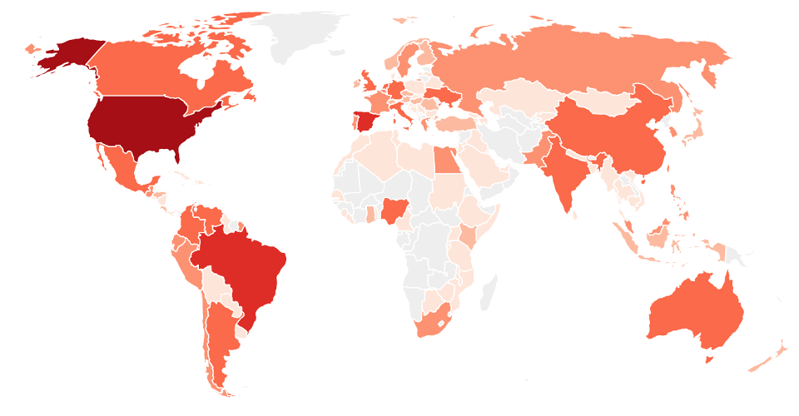
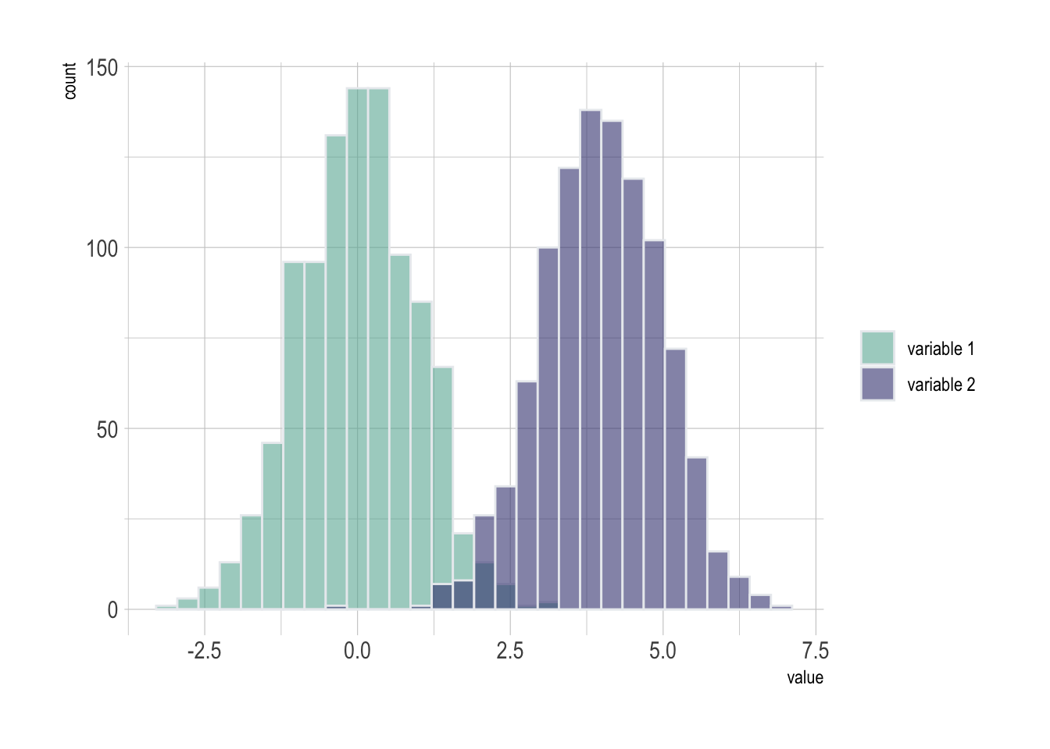
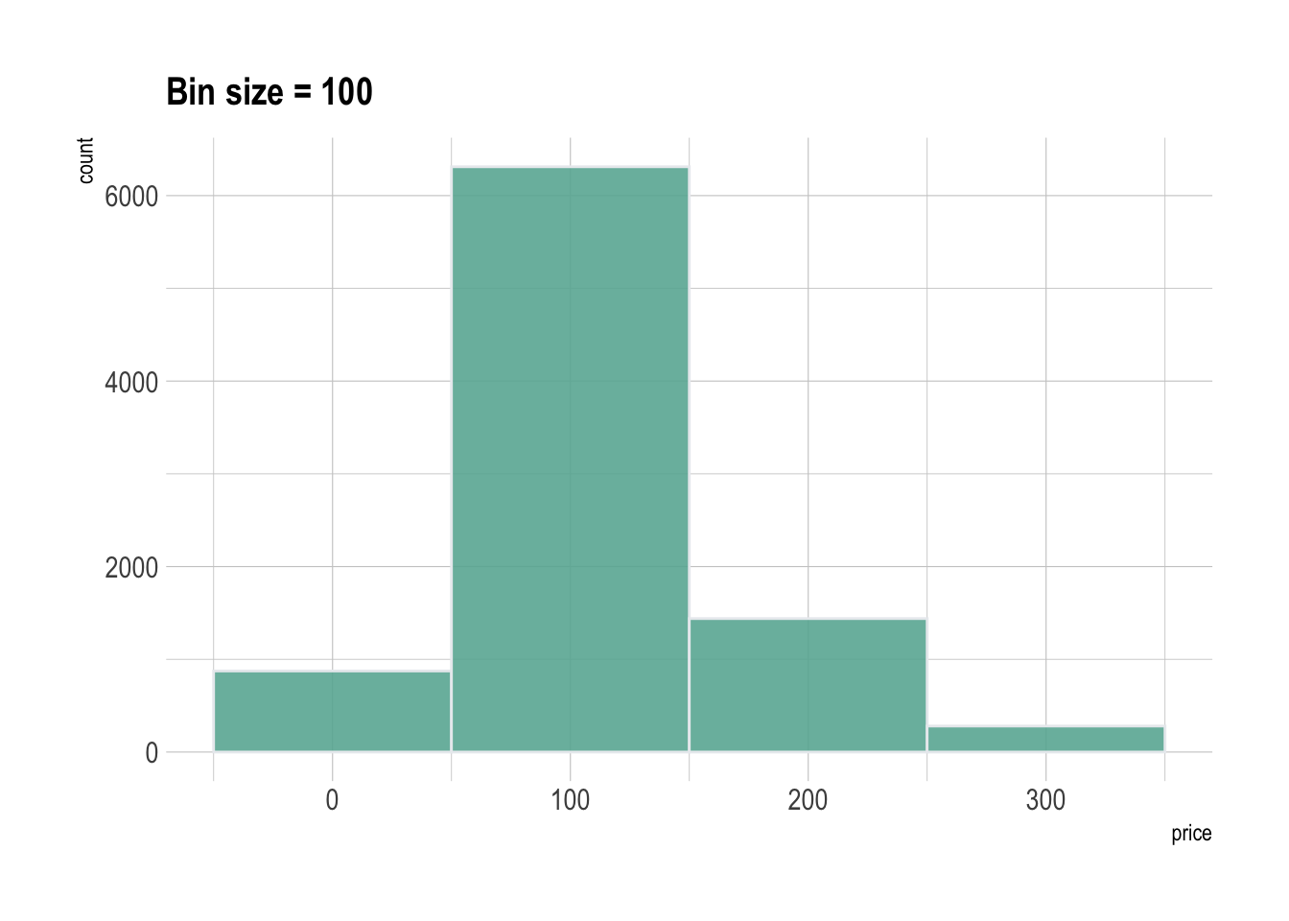
Analytics

