Slide 1
Tab Criticality
Selections
Risk owner Project ….
Probability
Impact

Slide 2
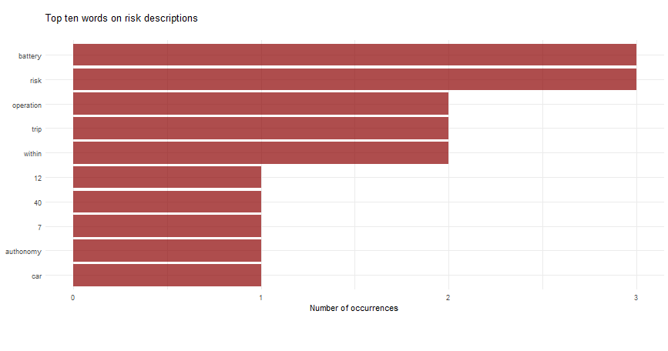
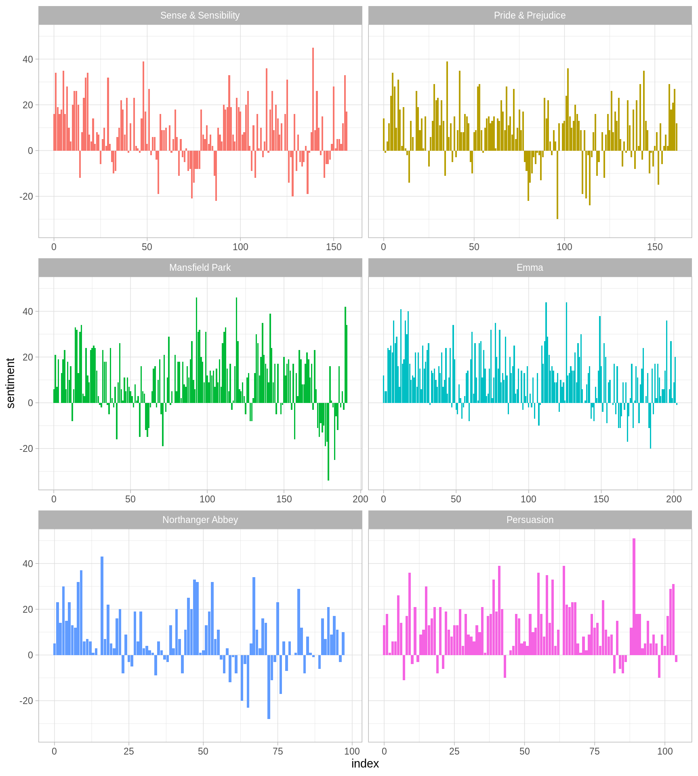
Tab Text analysis
Selections
Risk owner Project ….
Word count
Sentiment analysis

Slide 3
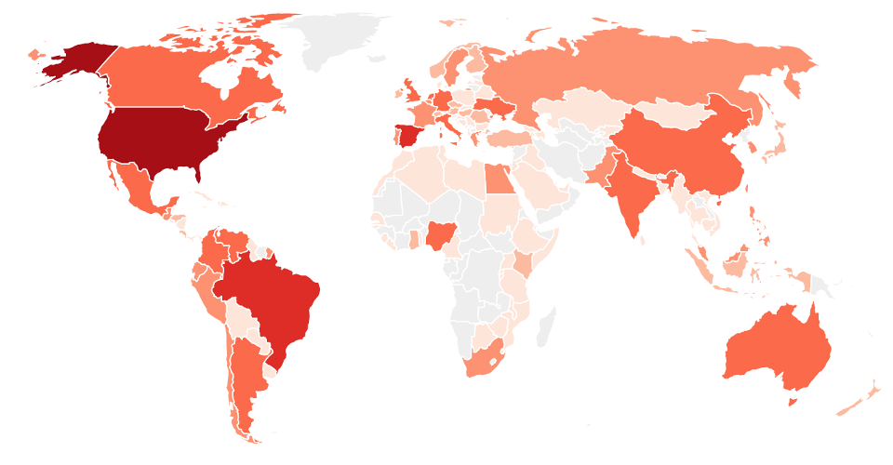
Tab Geographical analysis
Countries with higher risk

Slide 4
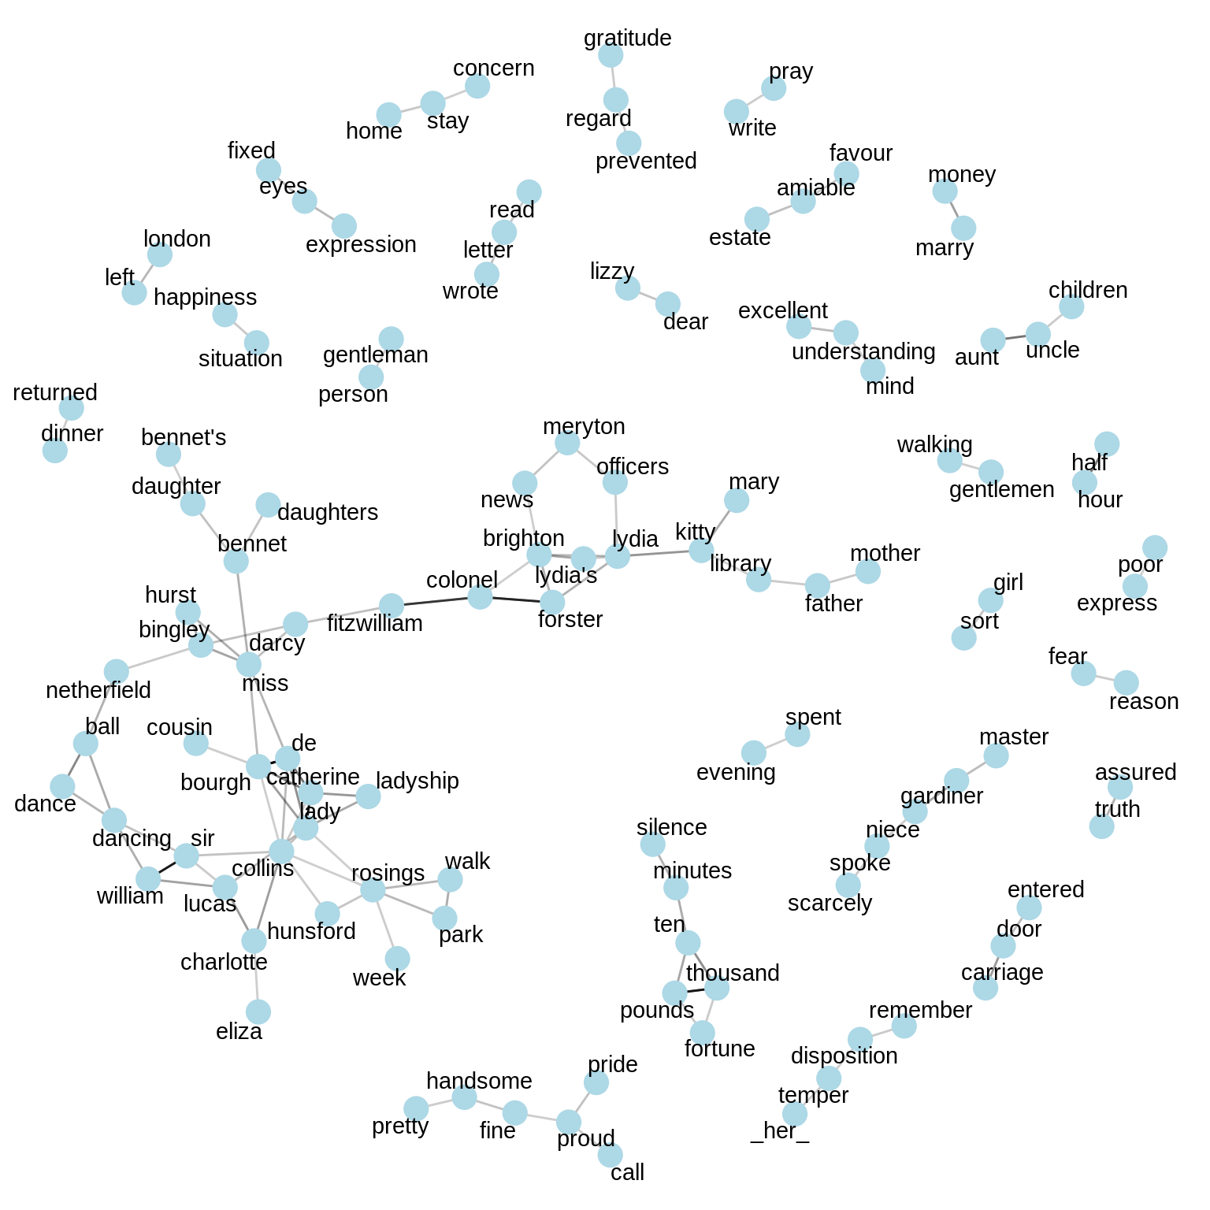
Tab Network analysis
Components proximity

Slide 5
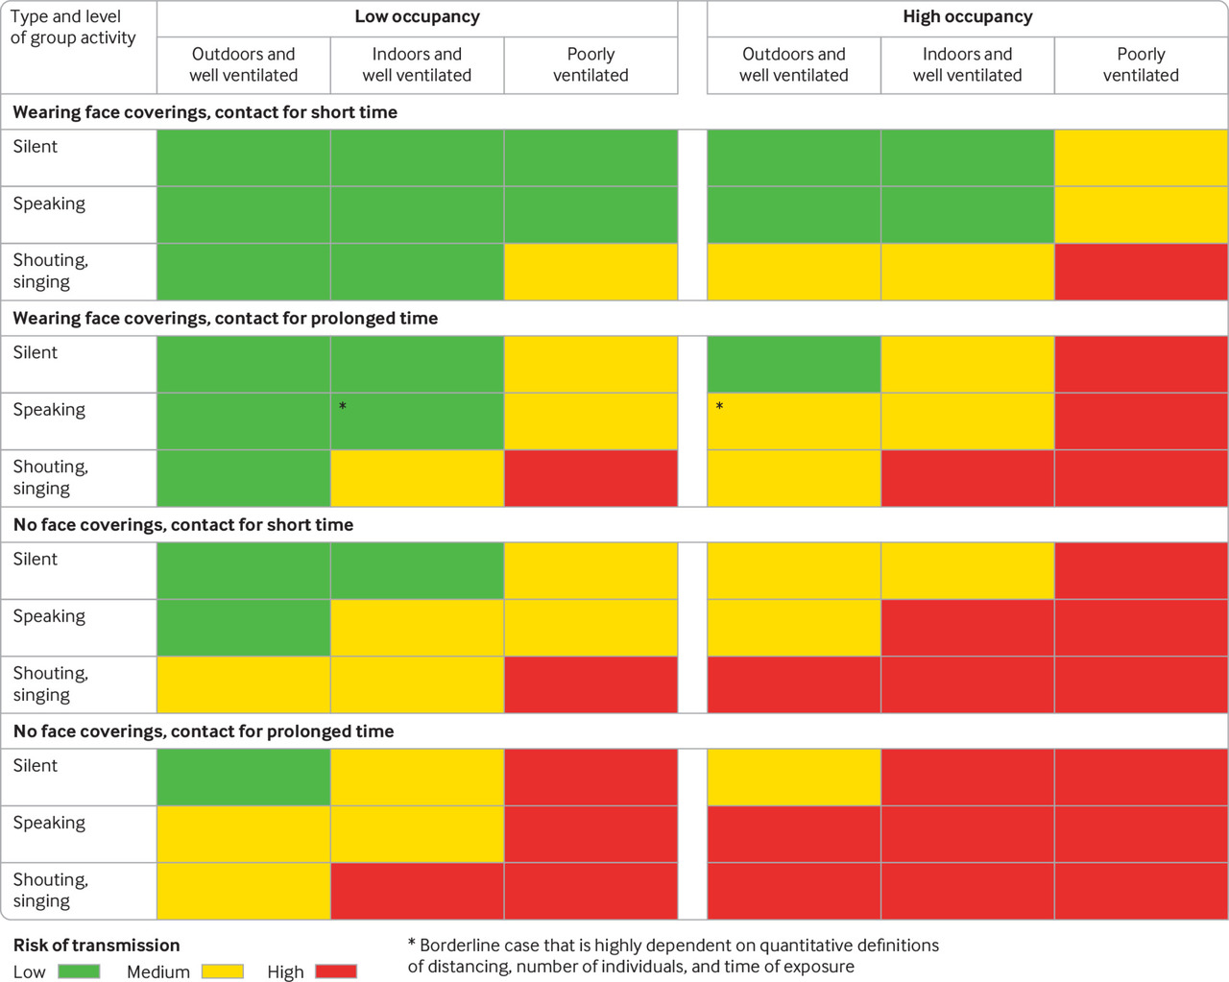
Example: Covid transmission risk level by activity and location
Source: British Medical Journal
https://www.bmj.com/content/370/bmj.m3223

Slide 6
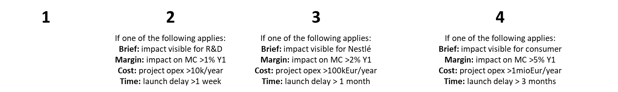
Tab Manage Risk
 |  |  |  | A | Probability
 |  | X |  | B
 |  |  |  | C
 |  |  |  | D
1 | 2 | 3 | 4
Project | Risk n. | Area
Risk Owner | Last updated
Risk name
Impact
Risk Description (CAUSES?)
Impact Description
Data, Charts, Images
Key Action
Responsible | Deadline | Status

Slide 7
Tab Criticality
​ | ​ | ​ | ​
​ | ​ | ​ | ​
​ | ​ | ​ | ​
​ | ​ | ​ | ​
Selections
Risk owner Project ….
Probability
Impact

