Slide 1

Login
Password
Cancel
Log in

Slide 2
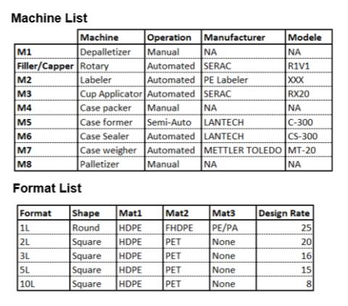
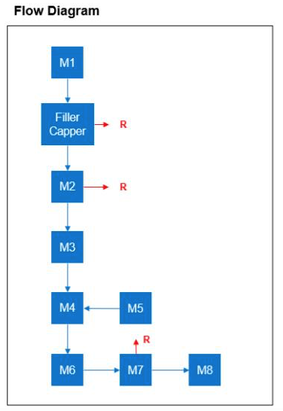
Pages :
open
MD
Site :
MD
PACKAGING LINE ID
Production Line :
MD
Product :
MD
Formulation Type :
MD
OLE Reporting :
OLE Tool :

Slide 3
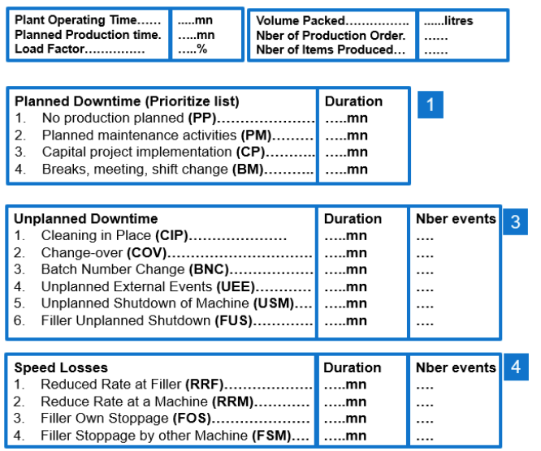
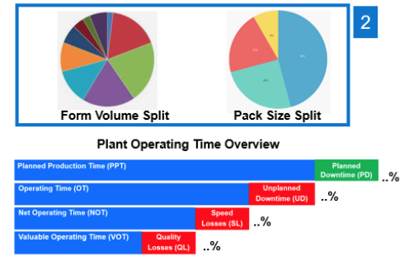
Pages :
open
MD
Site :
MD
Production Window
Production Line :
From
To
MD
MD
MD
72
64
98
78
Availability
Performance
Quality
OLE

Slide 4
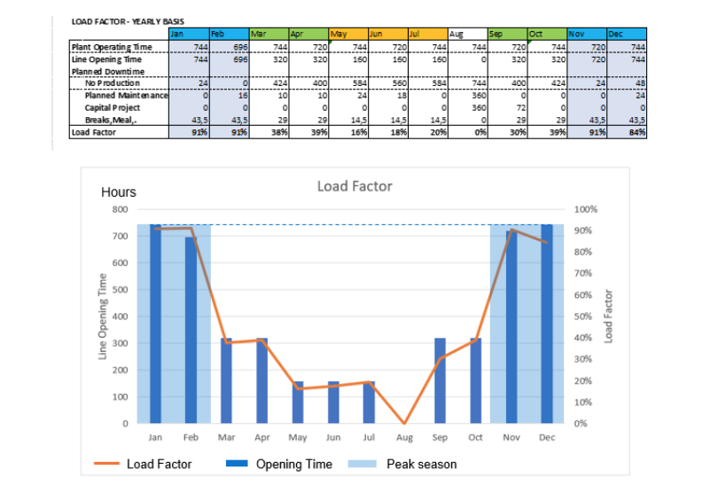
Pages :
open
MD
Monthly Load Factor –
One year overview
1

Slide 5
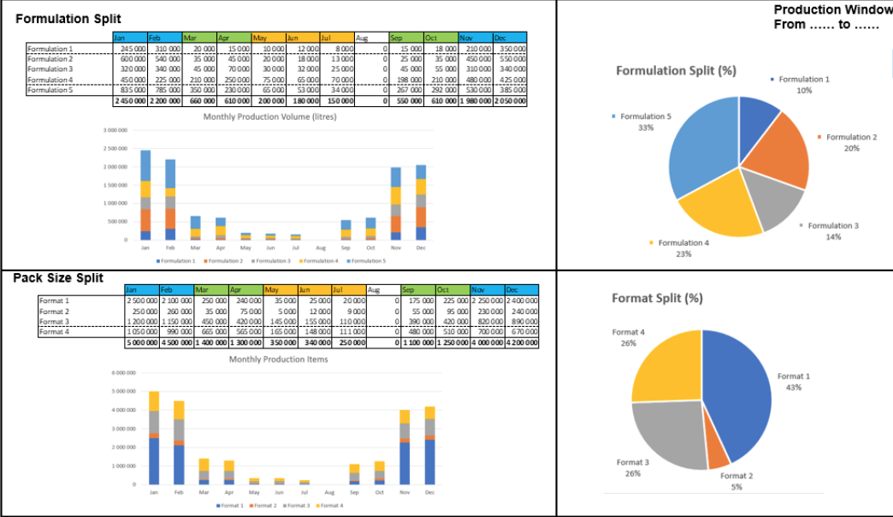
Pages :
open
MD
Production Dashboard
Production Window
From
To
MD
MD
Year window
2

Slide 6
Pages :
open
MD
Production Dashboard
Production Window
Of
MD
Month window
2

Slide 7
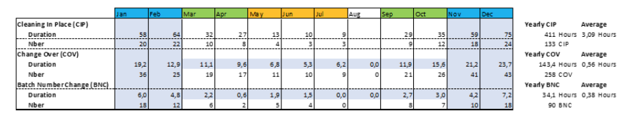
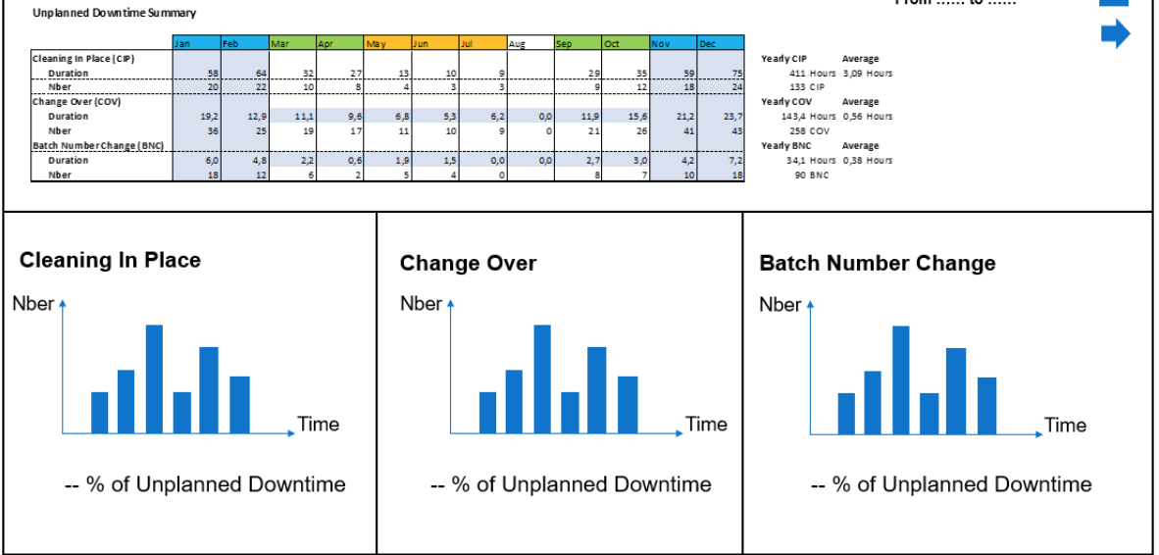
Pages :
open
MD
Unplanned Downtime Dashboard
Site :
Production Window
MD
Production Line :
From
To
MD
MD
MD
3

Slide 8
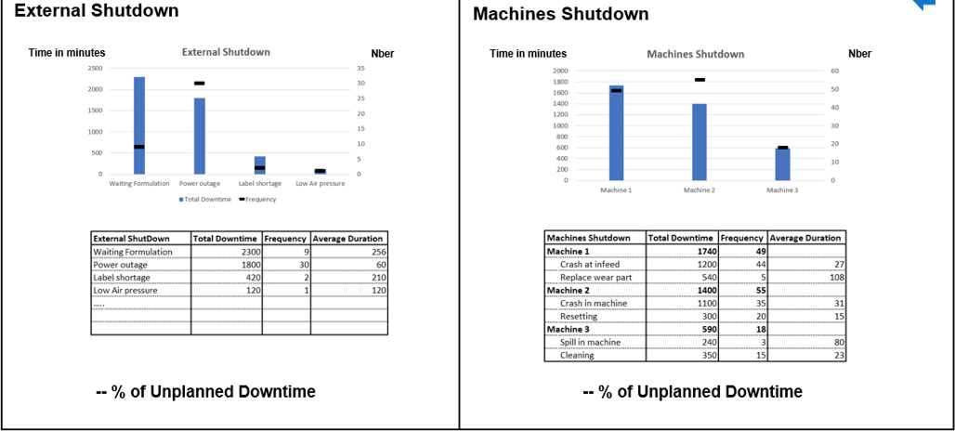
Pages :
open
MD
Unplanned Downtime
Production Window
From
To
MD
MD
3

Slide 9
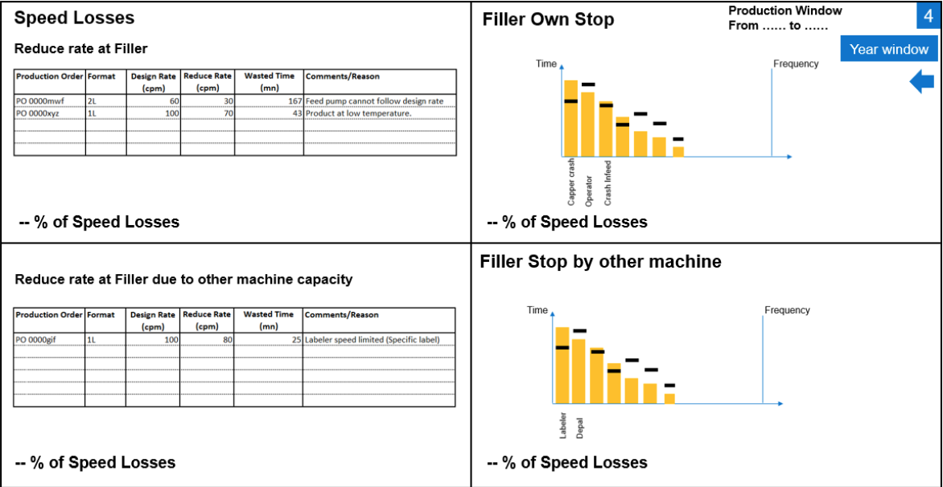
Pages :
open
MD
Unplanned Downtime Dashboard
Production Window
From
To
MD
MD
Year window
Year window
Year window
4

Slide 10
Pages :
open
MD
Unplanned Downtime Dashboard
Production Window
Of
MD
Month window
Year window
Year window
4
Notes:
Filler own stop – filler own stoppage et reduce rate at filler

Slide 11
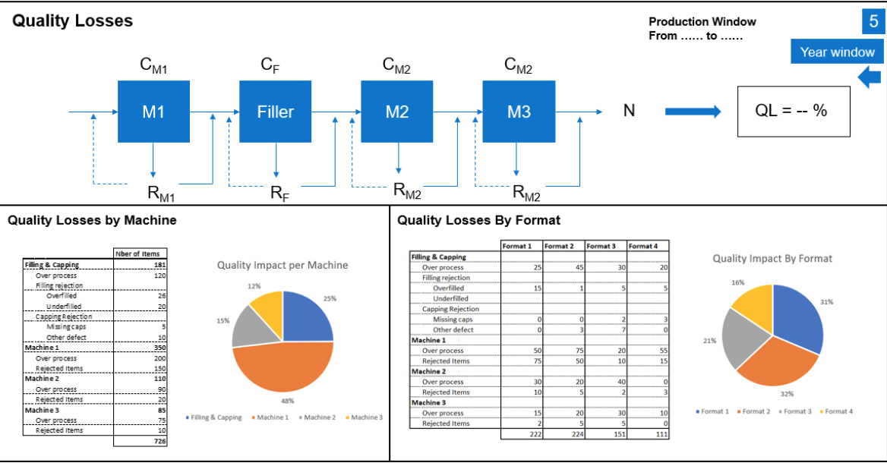
Pages :
open
CORTEVA OLE TOOL
MD
Quality Losses Dashboard
Production Window
From
To
MD
MD
Year window
Year window
5

Slide 12
Pages :
open
CORTEVA OLE TOOL
MD
Quality Losses Dashboard
Production Window
Of
MD
Month window
Year window
5

Slide 13
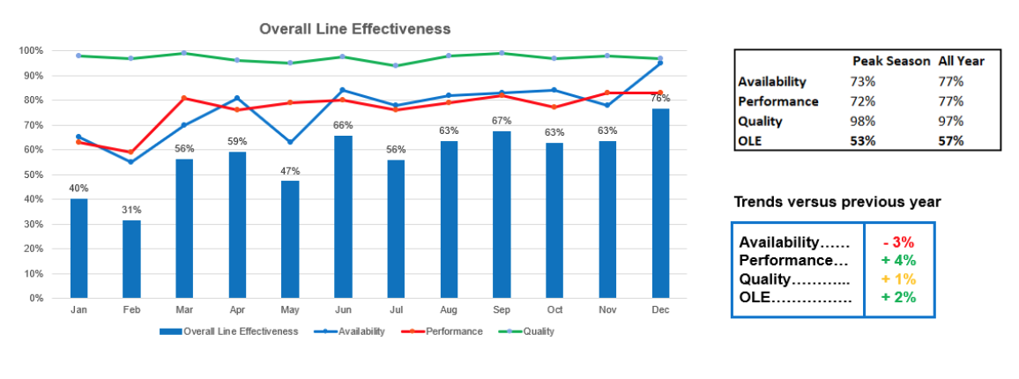
Pages :
open
CORTEVA OLE TOOL
MD
Overall Line Effectiveness
6

