Slide 1
Cache memory
Direct Cache Memory
Associate Cache Memory
Set Associative Cache Memory

Slide 2
How can one get fast memory with less expense?
It is possible to build a computer which uses only static RAM (large capacity of fast memory)
  This would be a very fast computer
  But, this would be very costly
It also can be built using a small fast memory for present reads and writes.
  Add a Cache memory

Slide 3
Locality of Reference Principle
During the course of the execution of a program, memory references tend to cluster
- e.g. programs - loops, nesting, …
data – strings, lists, arrays, …
This can be exploited with a Cache memory

Slide 4

Cache Memory Organization
Cache - Small amount of fast memory
  Sits between normal main memory and CPU
  May be located on CPU chip or in system
  Objective is to make slower memory system look like fast memory.
There may be more levels of cache (L1, L2,..)

Slide 5
Cache Operation – Overview
CPU requests contents of memory location
Cache is checked for this data
If present, get from cache (fast)
If not present, read required block from main memory to cache
Then deliver from cache to CPU
Cache includes tags to identify which block(s) of main memory are in the cache

Slide 6
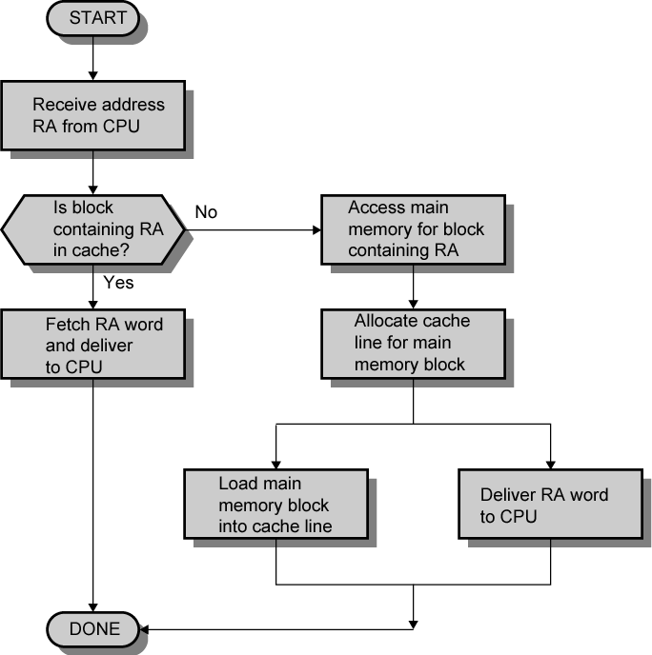
Cache Read Operation - Flowchart

Slide 7
Cache Design Parameters
Size of Cache
Size of Blocks in Cache
Mapping Function – how to assign blocks
Write Policy - Replacement Algorithm when blocks need to be replaced

Slide 8
Size Does Matter
Cost
  More cache is expensive
Speed
  More cache is faster (up to a point)
  Checking cache for data takes time

Slide 9

Typical Cache Organization

Slide 10
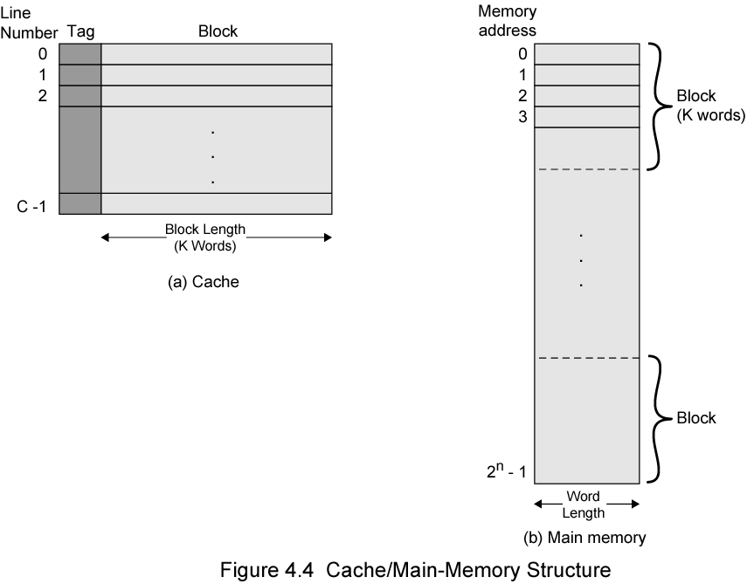
Cache/Main Direct Caching Memory Structure

Slide 11
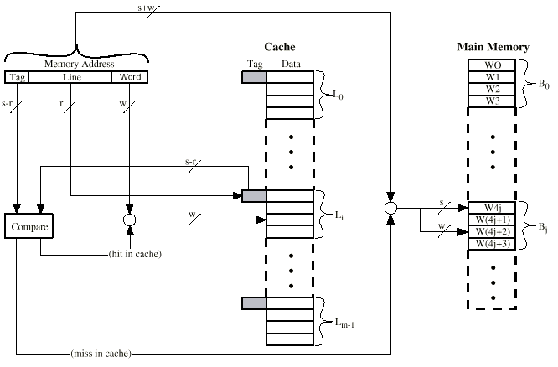
Direct Mapping Cache Organization

Slide 12
Direct Mapping Summary
Each block of main memory maps to only one cache line
  i.e. if a block is in cache, it must be in one specific place
Address is in two parts
- Least Significant w bits identify unique word
- Most Significant s bits specify which one memory block
All but the LSBs are split into
  a cache line field r and
  a tag of s-r (most significant)

Slide 13
Example Direct Mapping Function
16MBytes main memory
  i.e. memory address is 24 bits
  - (2²⁴=16M) bytes of memory
Cache of 64k bytes
  i.e. cache is 16k
  - (2¹⁴) lines of 4 bytes each
Cache block of 4 bytes
  i.e. block is 4 bytes
  - (2²) bytes of data per block

Slide 14
Example Direct Mapping Address Structure
Tag s-r
Line or Slot r
Word w
8
14
2
24 bit address
2 bit word identifier (4 byte block)
– likely it would be wider
22 bit block identifier
  8 bit tag (=22-14)
  14 bit slot or line
No two blocks sharing the same line have the same Tag field
Check contents of cache by finding line and checking Tag

Slide 15
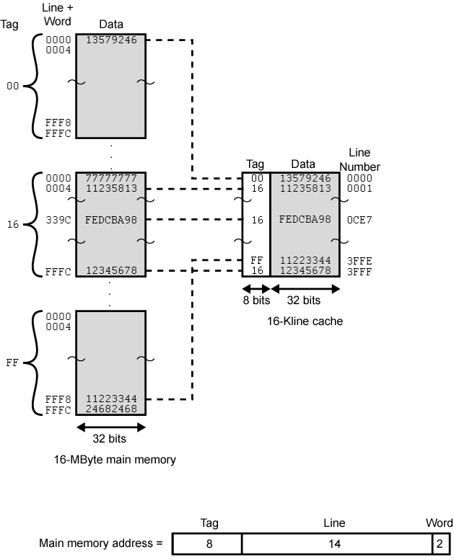
Illustration of Example

Slide 16
Direct Mapping pros & cons
Pros:
  Simple
  Inexpensive
  ?
Cons:
  One fixed location for given block
  If a program accesses 2 blocks that map to
  the same line repeatedly, cache misses are
  very high – thrashing & counterproductivity
  ?

Slide 17
Associative Cache Mapping
A main memory block can load into any line of cache
The Memory Address is interpreted as tag and word
The Tag uniquely identifies block of memory
Every line’s tag is examined for a match
Cache searching gets expensive/complex or slow

Slide 18

Fully Associative Cache Organization

Slide 19
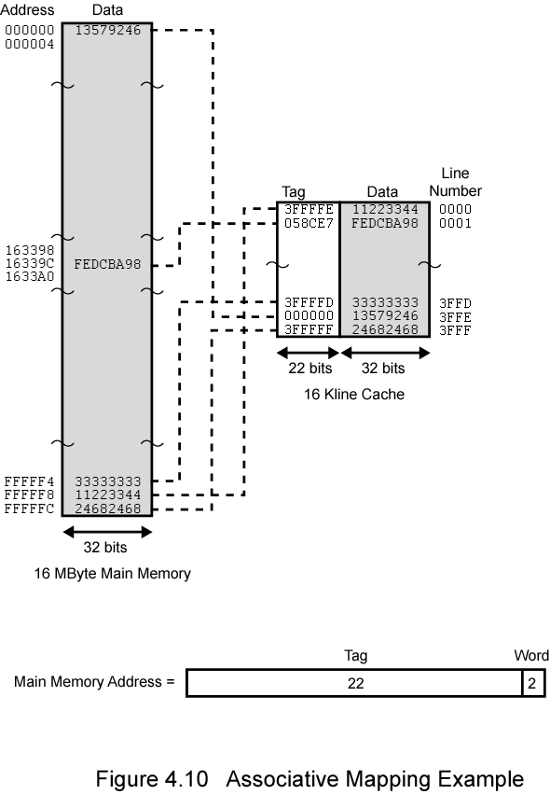
Associative Caching Example

Slide 20
Comparison of Associate to Direct Caching
Direct Cache Example:
8 bit tag
14 bit Line
2 bit word
Associate Cache Example:
22 bit tag
2 bit word

Slide 21
Set Associative Mapping
Cache is divided into a number of sets
Each set contains a number of lines
A given block maps to any line in a given set
  e.g. Block B can be in any line of set i
e.g. with 2 lines per set
  We have 2 way associative mapping
  A given block can be in one of 2 lines in only
  one set

Slide 22
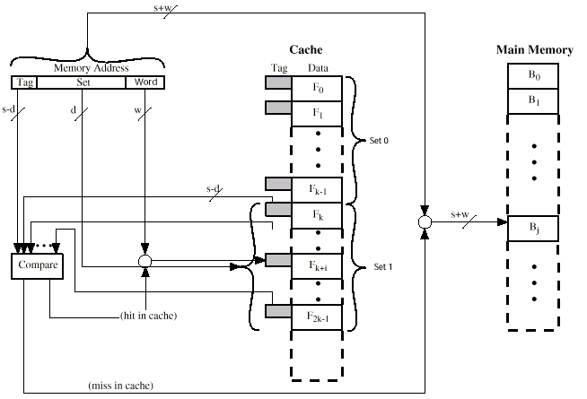
Two Way Set Associative Cache Organization

Slide 23
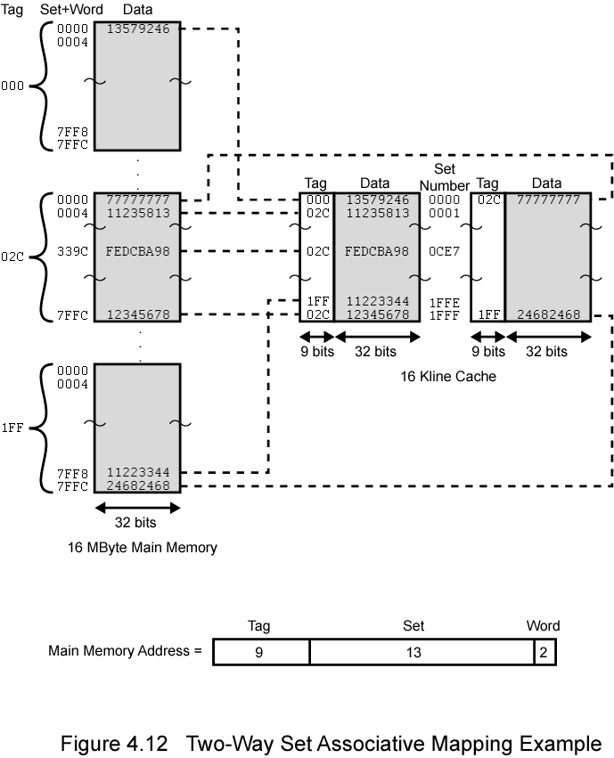
2 Way Set Assoc Example

Slide 24
Comparison of Direct, Assoc, Set Assoc Caching
Direct Cache Example (16K Lines):
8 bit tag
14 bit line
2 bit word
Associate Cache Example (16K Lines):
22 bit tag
2 bit word
Set Associate Cache Example (16K Lines):
9 bit tag
13 bit line
2 bit word

Slide 25
Replacement Algorithms (1)
Direct mapping
No choice
Each block only maps to one line
Replace that line

Slide 26
Replacement Algorithms (2)
Associative & Set Associative
Likely Hardware implemented algorithm (for speed)
First in first out (FIFO) ?
  replace block that has been in cache longest
Least frequently used (LFU) ?
  replace block which has had fewest hits
Random ?

Slide 27
Write Policy Challenges
Must not overwrite a cache block unless main memory is correct
Multiple CPUs/Processes may have the block cached
I/O may address main memory directly ?
(may not allow I/O buffers to be cached)

Slide 28
Write through
All writes go to main memory as well as cache
(Typically 15% or less of memory references are
writes)
Challenges:
Multiple CPUs MUST monitor main memory traffic to keep local (to CPU) cache up to date
Lots of traffic – may cause bottlenecks
Potentially slows down writes

Slide 29
Write back
Updates initially made in cache only
(Update bit for cache slot is set when update occurs – Other caches must be updated)
If block is to be replaced, memory overwritten only if update bit is set
( 15% or less of memory references are writes )
I/O must access main memory through cache or update cache

Slide 30
Coherency with Multiple Caches
Bus Watching with write through
1) mark a block as invalid when another
cache writes back that block, or
2) update cache block in parallel with
memory write
Hardware transparency
(all caches are updated simultaneously)
I/O must access main memory through cache or update cache(s)
Multiple Processors & I/O only access non-cacheable memory blocks

Slide 31
Choosing Line (block) size
8 to 64 bytes is typically an optimal block
(obviously depends upon the program)
Larger blocks decrease number of blocks in a given cache size, while including words that are more or less likely to be accessed soon.
Alternative is to sometimes replace lines with adjacent blocks when a line is loaded into cache.
Alternative could be to have program loader decide the cache strategy for a particular program.

Slide 32
Multi-level Cache Systems
As logic density increases, it has become advantages and practical to create multi-level caches:
1) on chip
2) off chip
L2 cache may not use system bus to make caching faster
If L2 can potentially be moved into the chip, even if it doesn’t use the system bus
Contemporary designs are now incorporating an on chip(s) L3 cache . . . .

Slide 33
Split Cache Systems
Split cache into:
1) Data cache
2) Program cache
Advantage:
Likely increased hit rates
- data and program accesses display different behavior
Disadvantage:
Complexity

Slide 34
Intel Caches
80386 – no on chip cache
80486 – 8k using 16 byte lines and four way set associative organization
Pentium (all versions) – two on chip L1 caches
  Data & instructions
Pentium 3 – L3 cache added off chip
Pentium 4
  L1 caches
    8k bytes
    64 byte lines
    four way set associative
  L2 cache
    Feeding both L1 caches
    256k
    128 byte lines
    8 way set associative
  L3 cache on chip

Slide 35
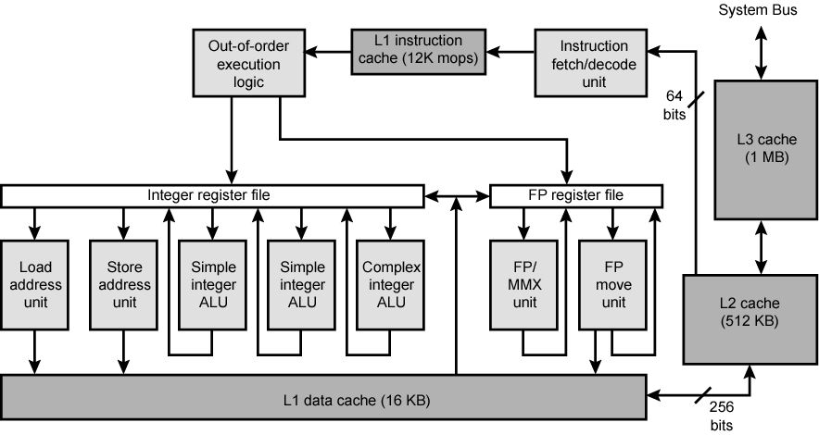
Pentium 4 Block Diagram

Slide 36
Intel Cache Evolution
Problem
Solution
Processor on which feature first appears
External memory slower than the system bus.
Add external cache using faster memory technology.
386
Increased processor speed results in external bus becoming a bottleneck for cache access.
Move external cache on-chip, operating at the same speed as the processor.
486
Internal cache is rather small, due to limited space on chip
Add external L2 cache using faster technology than main memory
486
Contention occurs when both the Instruction Prefetcher and the Execution Unit simultaneously require access to the cache. In that case, the Prefetcher is stalled while the Execution Unit’s data access takes place.
Create separate data and instruction caches.
Pentium
Increased processor speed results in external bus becoming a bottleneck for L2 cache access.
Create separate back-side bus that runs at higher speed than the main (front-side) external bus. The BSB is dedicated to the L2 cache.
Pentium Pro
Move L2 cache on to the processor chip.
Pentium II
Some applications deal with massive databases and must have rapid access to large amounts of data. The on-chip caches are too small.
Add external L3 cache.
Pentium III
Move L3 cache on-chip.
Pentium 4

Slide 37
PowerPC Cache Organization (Apple-IBM-Motorola)
601 – single 32kb 8 way set associative
603 – 16kb (2 x 8kb) two way set associative
604 – 32kb
620 – 64kb
G3 & G4
  64kb L1 cache
    8 way set associative
  256k, 512k or 1M L2 cache
    two way set associative
G5
  32kB instruction cache
  64kB data cache

Slide 38
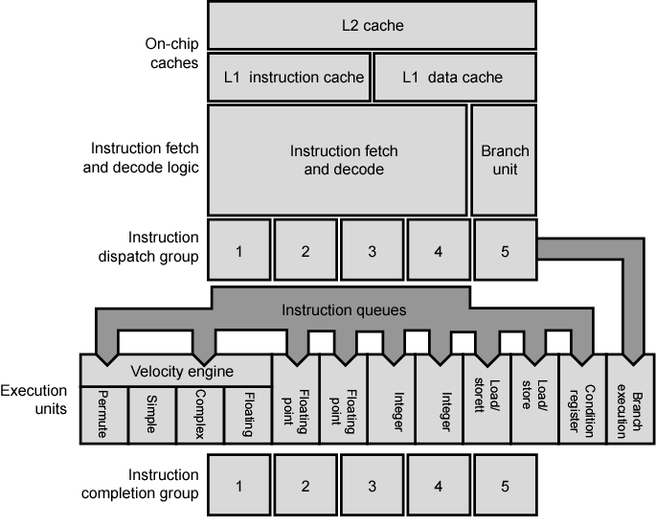
PowerPC G5 Block Diagram

Slide 39
Comparison of Cache Sizes
Processor
Type
Year of Introduction
Primary cache (L1)
2nd level Cache (L2)
3rd level Cache (L3)
IBM 360/85
Mainframe
1968
16 to 32 KB
—
—
PDP-11/70
Minicomputer
1975
1 KB
—
—
VAX 11/780
Minicomputer
1978
16 KB
—
—
IBM 3033
Mainframe
1978
64 KB
—
—
IBM 3090
Mainframe
1985
128 to 256 KB
—
—
Intel 80486
PC
1989
8 KB
—
—
Pentium
PC
1993
8 KB/8 KB
256 to 512 KB
—
PowerPC 601
PC
1993
32 KB
—
—
PowerPC 620
PC
1996
32 KB/32 KB
—
—
PowerPC G4
PC/server
1999
32 KB/32 KB
256 KB to 1 MB
2 MB
IBM S/390 G4
Mainframe
1997
32 KB
256 KB
2 MB
IBM S/390 G6
Mainframe
1999
256 KB
8 MB
—
Pentium 4
PC/server
2000
8 KB/8 KB
256 KB
—
IBM SP
High-end server/ supercomputer
2000
64 KB/32 KB
8 MB
—
CRAY MTAb
Supercomputer
2000
8 KB
2 MB
—
Itanium
PC/server
2001
16 KB/16 KB
96 KB
4 MB
SGI Origin 2001
High-end server
2001
32 KB/32 KB
4 MB
—
Itanium 2
PC/server
2002
32 KB
256 KB
6 MB
IBM POWER5
High-end server
2003
64 KB
1.9 MB
36 MB
CRAY XD-1
Supercomputer
2004
64 KB/64 KB
1MB
—
a Two values seperated by a slash refer to instruction and data caches
b Both caches are instruction only; no data caches

