Slide 1
Intro to Data Management with Python
Course Description: “Data Management with Python, a Primer” is for users who are brand new to using Python and want to get exposure to Python OR existing Python users who want to check out the coursework’s data management methods. This class will cover; introductory Python concepts/methods, basic module usage, debugging tips, Juypter notebooks, Pandas data fames, and more.
June 25th, 2020
Instructors/Teaching Assistants
Nathan Zimpher nathan_zimpfer@fws.gov, MB,
Erin Butts erin_butts@fws.gov, SA/Fisheries, Portland, OR
Brent Frakes brent_frakes@fws.gov – Refuges I&M – Fort Collins, CO
Matt Heller matthew_heller@fws.gov – SA - Bozeman, MT
Notes:
Before get started, not the Yes/No icons
How many have code with Python before? How many have code with Python in the last 2 years?
Doesn’t really matter where start, most all programming concepts relate to each other. Sure syntax differences and some methodology but there’s usually techniques and methods cross over between languages. Where I do fell like your starting from scratch is… programming whithout code (i.e. Modelbuilder, etc.)
In a way, coding itself documents work, less need for notes than creating some procedural document
Difference between programming/scripting/coding
not much
-In general, Why programming/scripting is useful
-Valuable to you and “The Service”

Slide 2
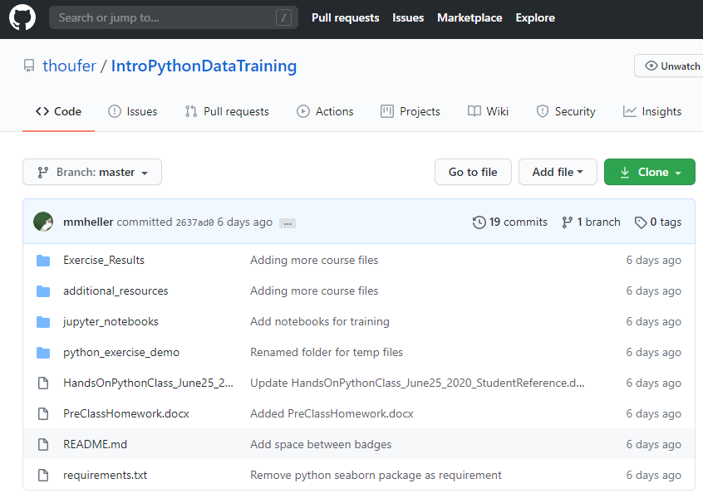
Class Format and Materials
Attendees, please use the chat box early and often. Instructors will do their best to answer questions.
The class will consist of instruction, 5 short hands on exercises and a final challenge
Materials https://github.com/thoufer/IntroPythonDataTraining
Sections 1 and 2 attendee reference: HandsOnPythonClass_June25_2020_StudentReference.docx
Exercise Results for Sections 1 and 2: Exercise_Results/(various files)
Exercise Section 2 files: python_exercise_demo/(various files)
Jupyter notebook files
jupyter_notebooks/PANDAS TRAINING SOLUTIONS.ipynb
jupyter_notebooks/PANDAS TRAINING.ipynb
Powerpoint file: additional_resources/HandsOnPythonClass_June25_2020.pptx
Additional Python resources: additional_resources/Addtional Resources.docx
Pandas cheat sheet: additional_resources/Pandas_Cheat_Sheet.pdf
Jupyter cheat sheet: additional_resources/weidadeyue_jupyter-notebook.bw.pdf
Notes:
Extremely fast pace class, Primer is in the title
Slide content….
The Materails have many links to help resources that expand on topics

Slide 3
Class Outline
Intro to Python (15 min)
Exercises 1A, 1B
Python Topics for Data Management using IDLE (35 min)
Exercise 2A, 2B, 2D Extra Credit
Python Topics for Data Management using Jupyter (40 min)
Final Challenge Exercise

Slide 4
Intro to Python – Course Section
15 Minutes
Matt Heller

Slide 5
What & Why
What is Python - python.org definition
“Python is an easy to learn, powerful language... (with) high-level data structures and a simple but effective approach to object-oriented programming. Python’s elegant syntax and dynamic typing...make it an ideal language for scripting...in many areas and on most platforms.”
ESRI
What is Python & Why use it
Free, cross-platform, easy to learn,
Widely useful, great community ESRI
Personal Reason Why…
Interoperable
USFWS and DOI allow using it
Allows me (shareable to ) to do powerful processing
A ton of help resources
Personal Why not…
GUI development (however there are companion frameworks that can be added e.g. Tkinter, Django)
Code with multiple modules (especially ArcPY) can at times be difficult to transfer to other systems

Slide 6
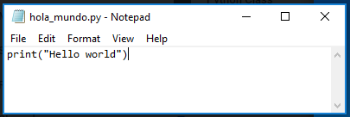
Creating a Python script from scratch & the Print Statement
Creating from scratch easy,
Python file is a text file with a .py extension
Can also copy/paste old python files
Print Statement
Python statement to enter text in the shell (command line window to execute python)
Useful for providing information while the script runs

Slide 7
IDE
An integrated development environment (IDE) is a software application that provides comprehensive facilities to computer programmers for software development. An IDE normally consists of at least a source code editor, build automation tools and a debugger…
The boundary between an IDE and other parts of the broader software development environment is not well-defined; sometimes a version control system or various tools to simplify the construction of a graphical user interface (GUI) are integrated… https://en.wikipedia.org/wiki/Integrated_development_environment
Why use IDE’s
Easier code editing (longer scripts, expanding/contracting code, code navigation, editing tools, text colors, etc.,)
Debugging (various tools)
Common Python IDE’s
IDLE - bundled with the default install of Python, Shell window, Editor Window, Debug Control Window
MS Visual Studio – my favorite!!!!
PyScripter
PyCharm
Many many more…
Jupyter Notebooks (discussed in depth later in this)
Non-traditional IDE
Visualization capabilities (graphs, tables, etc.)
Sharing
Notes:
Jupyter notebooks is not an IDE
Vs editing in ArcPro, Arc Desktop,
Python window in ArcGIS

Slide 8
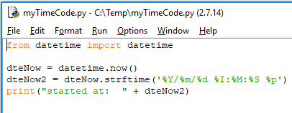
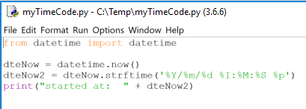
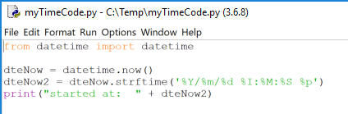
python Versions
2x vs 3x
Syntax
ArcGIS Desktop vs ArcGIS Pro
IDLE startup .bat file path examples
2x
C:\Python27\ArcGIS10.6\Lib\idlelib\idle.bat
C:\Program Files\MySQL\MySQL Shell 8.0\lib\Python2.7\Lib\idlelib\idle.bat
3x
C:\Users\#username#\Anaconda3\Lib\idlelib\idle.bat
C:\Program Files\ArcGIS\Pro\bin\Python\envs\arcgispro-py3\Lib\idlelib\idle.bat
IDE considerations – make sure the IDE is configured with the Python version you want
Feel free to find the idle.bat file on your system during this presentation!!!!
Notes:
The path to you idle.bat file will depend on what installation you went with. Check out the #### document for help finding your .bat file

Slide 9
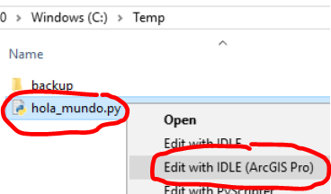
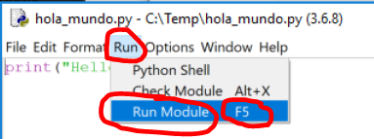
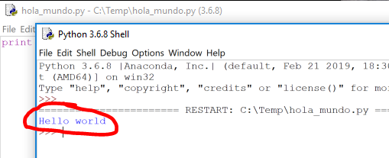

Introductory Python concepts/ methods
Exercise 1: Hello World!
Open a text editor (e.g. MS Notepad)
Enter print(“Hello world”) → save as filename hola_mundo.py on C:\temp
In a file browser, right click → hola_mundo.py → select “Edit with IDLE…”
Note: explore intellisense functionality. Enter the text “pr” → ctrl-spacebar → tab
Under the Run menu, click Run Module OR click the F5 shortcut key
Rerun from step 3 however select “Edit with IDLE”, do you notice a difference?
What is Python & Why use Python
Creating a Python Script from Scratch
The Print Statement
Notes:
Hint: look at the Python editing window header

Slide 10
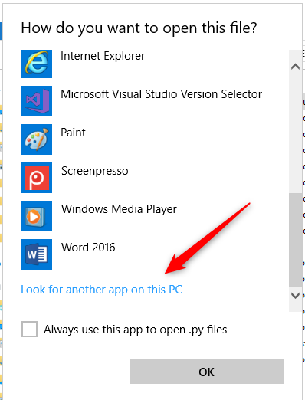
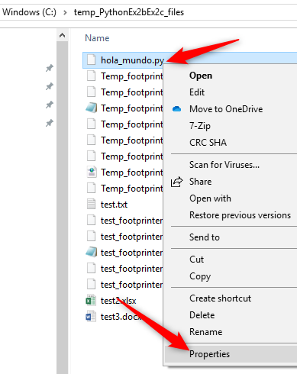

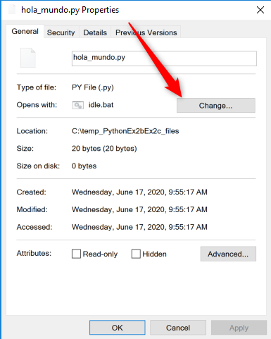
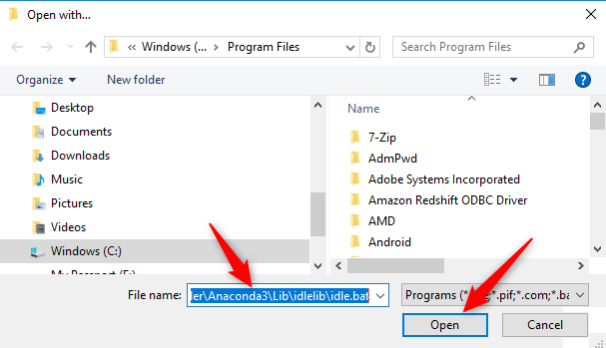
If not “Edit with IDLE” option
C:\Users\#username#\Anaconda3\Lib\idlelib\idle.bat

Slide 11
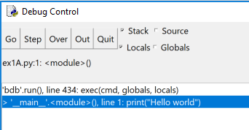
Debugging
What – run the code while giving details on most all portions of the code
Why – gives much more ability to get python code to run properly
How
Control speed of execution
Break points
Inspect variables
Step into, over out
What is the Python IDLE Shell: Python interpreter in interactive mode is commonly known as Python Shell.
https://overiq.com/

Slide 12
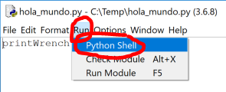
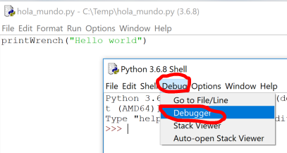
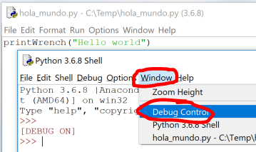
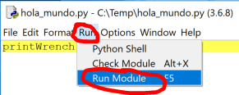
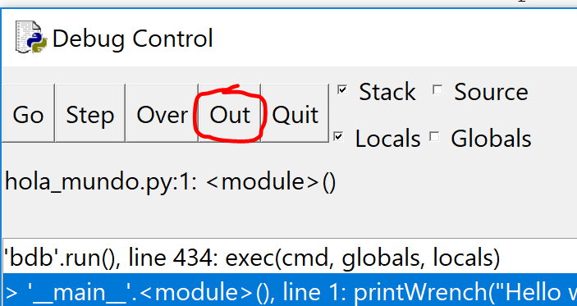
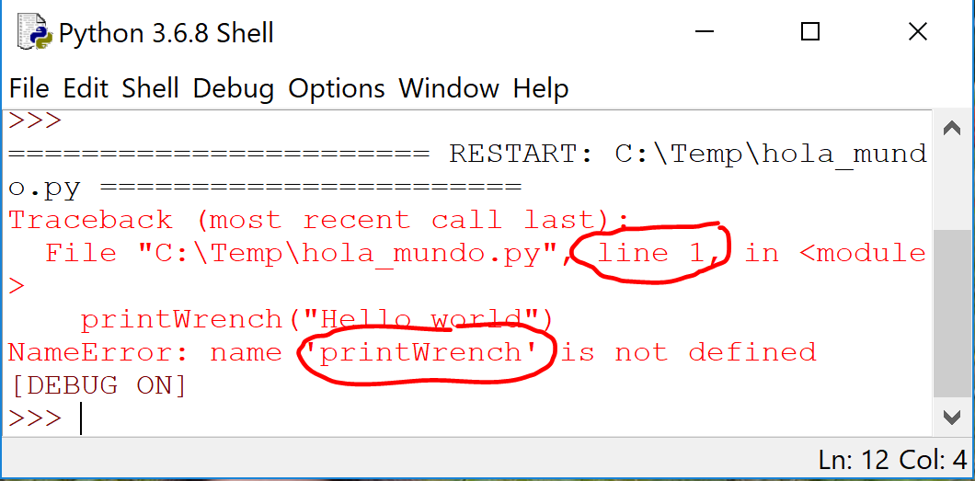
Introductory Python concepts/ methods
Exercise 1b: Hello World Debugging
Change print command to printWrench → save. Note: this intentionally produces an error
From IDLE, click Run →Python Shell
From Shell, click Debug → Debugger
Click Window → Debug Control
From IDLE, click Run → Run Module & from the Debug Control, click Out
Observe the line number and error message
Change printWrench back to print → save → Run
Note: “Run module” would have shown the same error. Ex 1B was to begin using debugging.
IDE
Python Versions
Debugging

Slide 13
Python Topics for Data Management using IDLE – Course Section
35 Minutes
Matt Heller

Slide 14
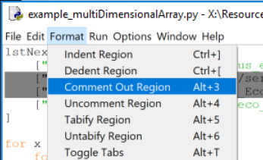
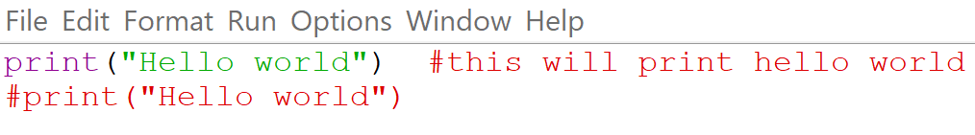
Commenting
What is it: Indicate text in a file that is not to be executed when running a script
When to use it:
Script header
#title :hola_mundo.py
#description :This is a simple hello world script
#author,org :Your name, Your org name
#date :1/22/2020
#version :0.1
#usage :python hola_mundo.py
#notes :
#python_version :3.6.8
#======================================
Describe what’s going on in parts of the script
Save code that you don’t want to execute
Note: most IDE’s will display commented text in a different color

Slide 15
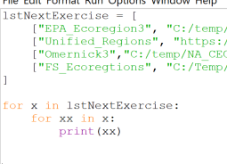
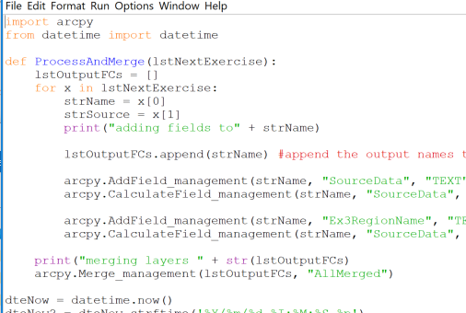
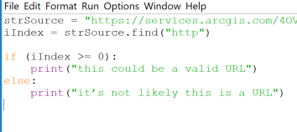
Indenting
What is it: Indenting text in a document using tabs or blank spaces
Why: Python requires consistent indenting for blocks of code (functions, conditional statements, loops, etc.)

Slide 16
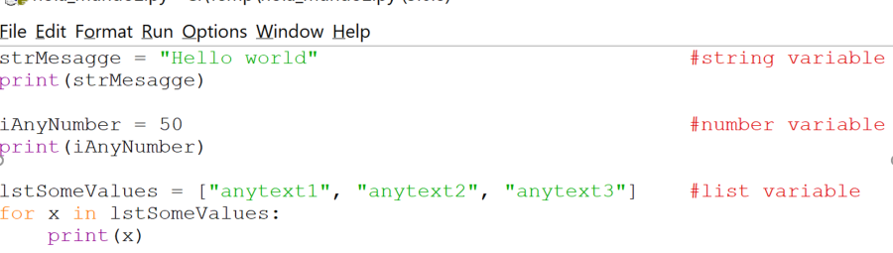
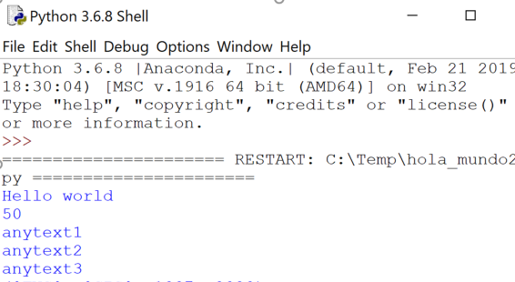
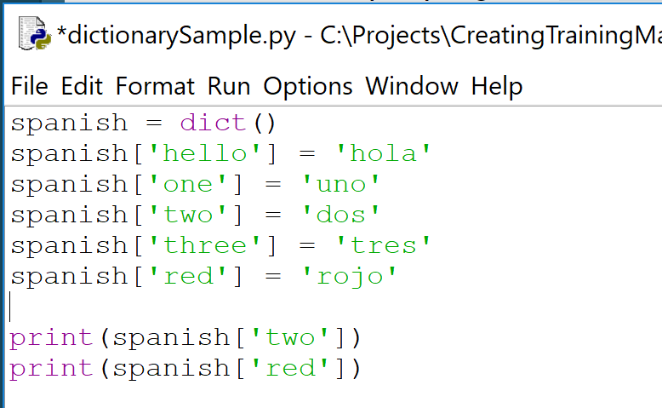
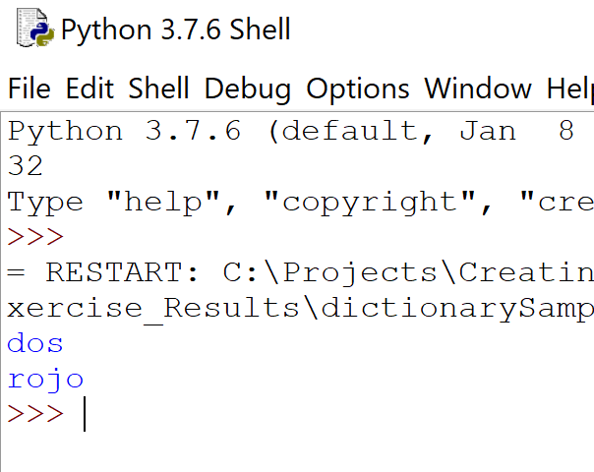
Variables
What is it: A name that stores a value; assign using = ESRI
Variable types - variables have data types
String - Strings are defined either with a single quote or a double quotes.
Number - Python supports two types of numbers - integers and floating point numbers. (It also supports complex numbers, which will not be explained in this tutorial).
List – Lists are very similar to arrays. They can contain any type of variable, and they can contain as many variables as you wish. Lists can also be iterated over in a very simple manner.
https://www.learnpython.org/
Dictionary - a collection of words matched with their definitions. Given a word, you can look up its definition.
http://anh.cs.luc.edu/

Slide 17
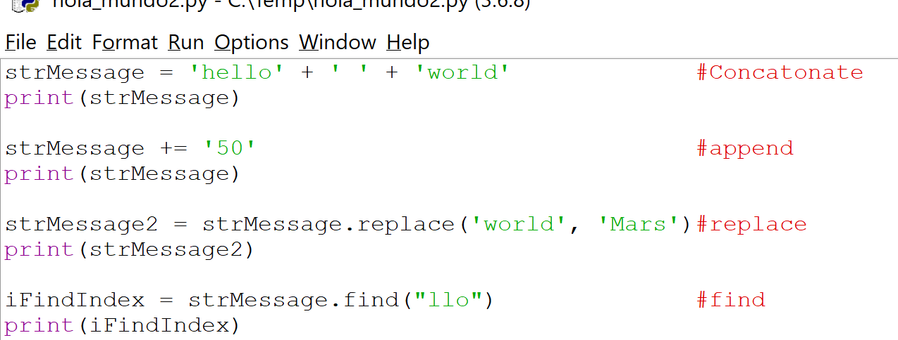
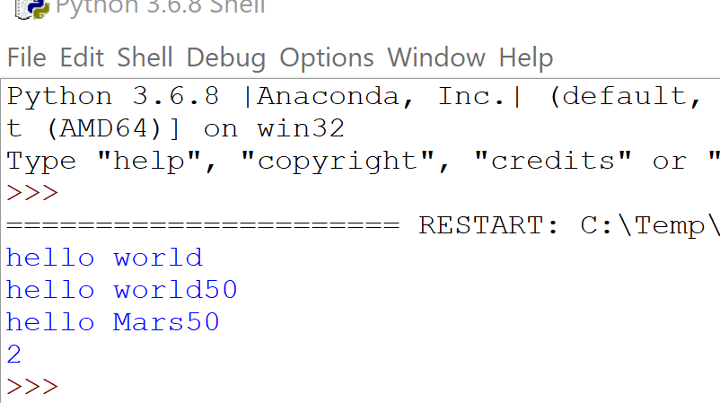
More on String Variables
Valid use of paths in Python
strPath = “c:/temp/roads.shp”
strPath = “c:\\temp\\roads.shp”
strPath = r“c:\temp\roads.shp”
Not Valid use of paths in Python
strPath = “c:\temp\roads.shp”
Manipulating string – useful when bulk processing of data
Concatenate
Append
Replace
Find

Slide 18
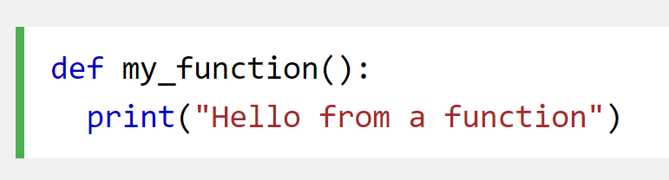
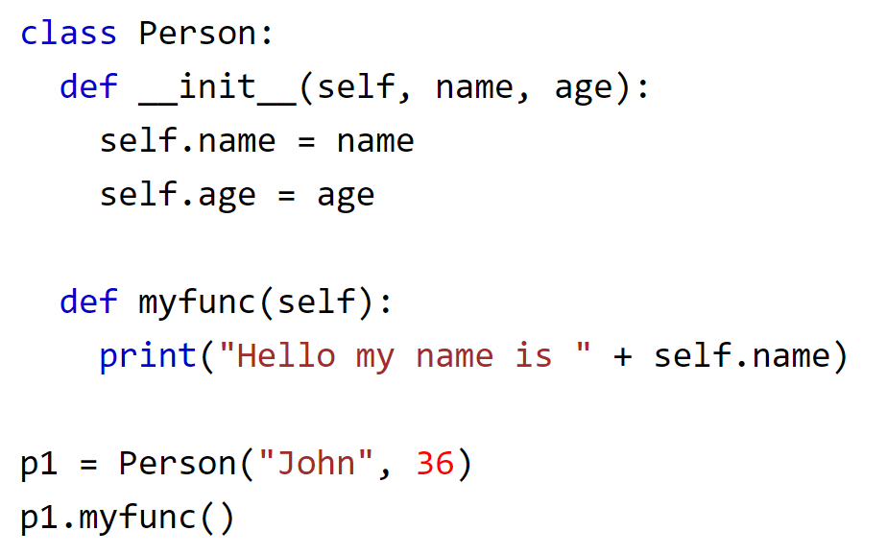
Functions, methods, properties
Python Function:
A function is a block of code which only runs when it is called.
You can pass data, known as parameters, into a function.
A function can return data/variables as a result
https://www.w3schools.com/
Python Method:
Objects can contain methods. Methods in objects are functions that belong to the object..
https://www.w3schools.com/
Python Properties (and attributes):
Objects can contain attributes. Attributes are described by data variables for example like name, age, height etc. Properties are special kind of attributes which have getter, setter and delete methods
https://www.tutorialspoint.com/

Slide 19
Python Classes
What is a it: Python is an object oriented programming language. Almost everything in Python is an object, with its properties and methods. A Class is like an object constructor, or a "blueprint" for creating object.
https://www.w3schools.com/
Why: Classes provide a means of bundling data and functionality together. Creating a new class creates a new type of object, allowing new instances of that type to be made. Each class instance can have attributes attached to it for maintaining its state. Class instances can also have methods (defined by its class) for modifying its state.
https://docs.python.org/

Slide 20
Python Modules
What is a it: File consisting of Python code of statements, functions, classes, variables, and/or other modules.
How it is used:
Line of code added: import #module name#
First python (interpreter) searches for a built-in module (i.e. dir, os, sys) then in a list of system directories, by the environment variable sys.path (folder containing the input script, PYTHONPATH shell variable PATH, install-dependent default)
Python can cache complied versions of .py files, as .pyc files, for speed of loading
Python comes with library of standard modules (e.g. sys)
Why use it:
Simplicity (bite size), Maintainability (updates when needed), Reusability (no copies needed), Scoping (avoid overlap with other areas of coding)
Benefit from the development of additional modules in numerous niches of Python by Data Manager and GIS professionals and programmers from many different disciplines.
https://knowpapa.com/
Notes:
statements are intended to initialize the module
It’s the norm but not required to place all import statements at the beginning of a module (or script, for that matter)

Slide 21
Python packages and Libraries
Python Package: a collection of Python modules
Python Library: the term library does not have any specific contextual meaning in Python. When used in Python, a library is used loosely to describe a collection of the core modules. “Additional libraries” refer to those optional components that are commonly included in Python distributions.
https://knowpapa.com/
Notes:
statements are intended to initialize the module
It’s the norm but not required to place all import statements at the beginning of a module (or script, for that matter)

Slide 22
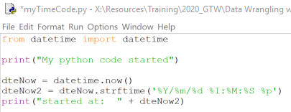
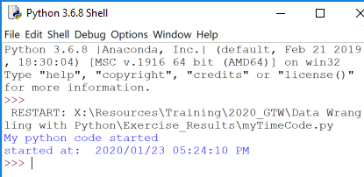
Introductory Python Concepts/Methods
Exercise 2A: Time, Time, tell me what time!
Make a python file that “print’s” the text “My python code started” → save as “myTimeCode.py”
Before the print statement, import the datetime module with the date time classes, enter “import datetime”
After the import, enter
dteNow = datetime.now()
dteNow2 = dteNow.strftime('%Y/%m/%d %I:%M:%S %p')
print("started at: " + dteNow2)
Save → Run
Commenting
Variables
More on String Variables
Python Classes, Modules, Packages
Methods
Notes:
The datetime module supplies classes for manipulating dates and times.
Now() is a method to get local time
strFtime is a method and converts the format

Slide 23
For Loops, IteratinG
What is it: A for loop is used for iterating over a sequence (that is either a list, a tuple, a dictionary, a set, or a string).
Python supports different kinds of loops:
While - execute a block of statements repeatedly until a given a condition is satisfied.
For in - For loops are used for sequential traversal (list, string, dictionaries, etc.)
Iterating by index of sequences (Range) - We can also use the index of elements in the sequence to iterate
else statement with for loops - Combine else statement with for loop like in while loop
Nested - one loop inside another loop
Loop Control Statements
Continue Statement - returns the control to the beginning of the loop
Break Statement - brings control out of the loop
Pass Statement - pass statement to write empty loops
https://www.geeksforgeeks.org/
Why: Handle repetitive tasks
What is a multi-dimensional list: Multi-dimensional lists are the lists within lists
https://www.geeksforgeeks.org/

Slide 24
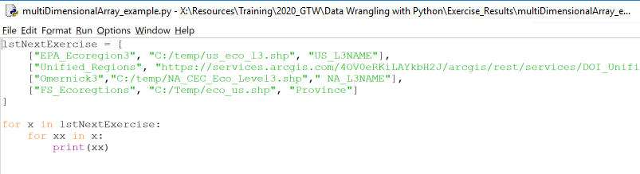
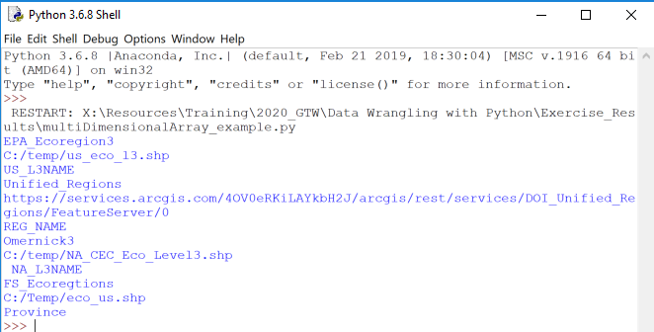
For Loops, Iterating through a list Examples
Example of looping through a 2 dimensional list
Notes:
File → folder → draw → cabinent → row → room

Slide 25
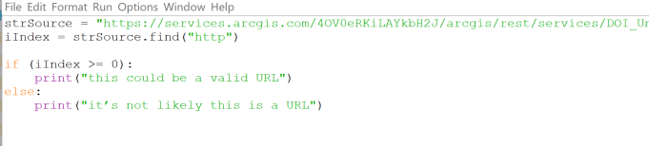
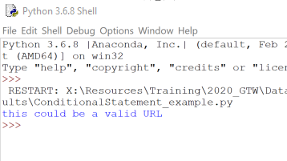
Conditional Statements
What is it: The “If” statement
Why: In programming, very often we want to check the conditions and change the behavior of the program.
https://www.pythonforbeginners.com/
Example of simple conditional statement:

Slide 26
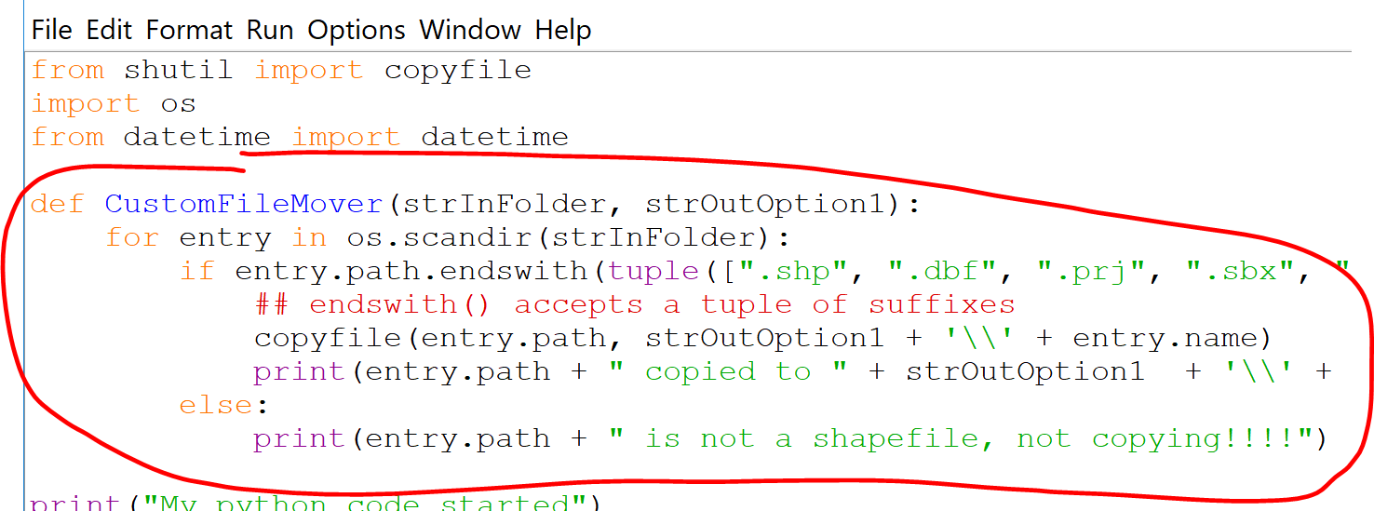
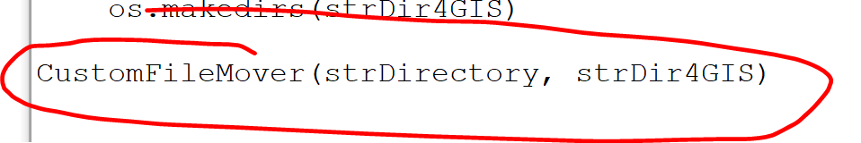
User-Defined functions
What it is: Python includes many built-in functions, users can also define functions. A function is a reusable block of programming statements designed to perform a certain task.
https://www.tutorialsteacher.com/
Why:
Organize code for readability and reusability
Helps with DRY
Don't repeat yourself (DRY, or sometimes do not repeat yourself) is a principle of software development aimed at reducing repetition of software patterns, replacing it with abstractions or using data normalization to avoid redundancy.
https://en.wikipedia.org/
How: To define a function, Python provides the def keyword, add colon, proper indentation, call the function

Slide 27
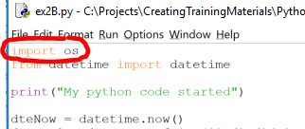
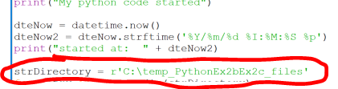
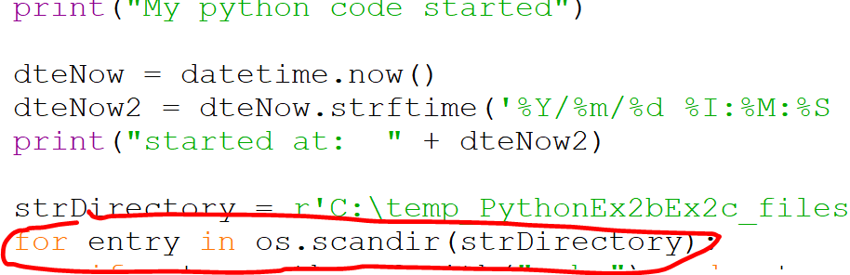
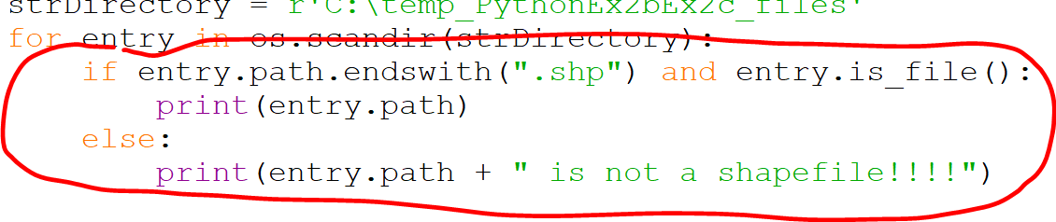
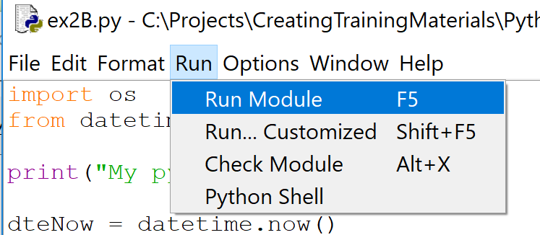
Exercise 2B: Manage them files
Introductory Python concepts/ methods
Copy the Exercise 2A resulting Python file and rename ex2B.py
Insert a new line at the top of the .py file and add “import os” to import the os module
After the last print statement, Declare a string variable named strDirectory and set it to equal… r'C:\temp_PythonEx2bEx2c_files‘ Note: these are the temporary exercise files
Enter the first line of the loop by copy/pasting … for entry in os.scandir(strDirectory):
Create a conditional statement that checks the file extension for .shp and that the it is indeed a file (vs. a folder) by copy/pasting …
if entry.path.endswith(".shp") and entry.is_file():
print(entry.path)
else:
print(entry.path + " is not a shapefile!!!!")
Save → Run → view the PythonEx3A.gdb contents
For Loops, Iterating through a dictionary
Conditional Statements
Python os module usage
https://www.newbedev.com/python/howto/how-to-iterate-over-files-in-a-given-directory/
Notes:
NOTE: must copy file from report to local!!!!
The os module provides a portable way of using operating system dependent functionality
The scandir() function returns directory entries along with file attribute information, giving better performance for many common use cases.

Slide 28
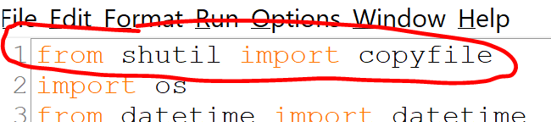
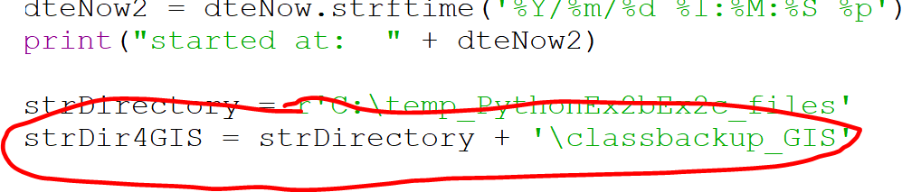
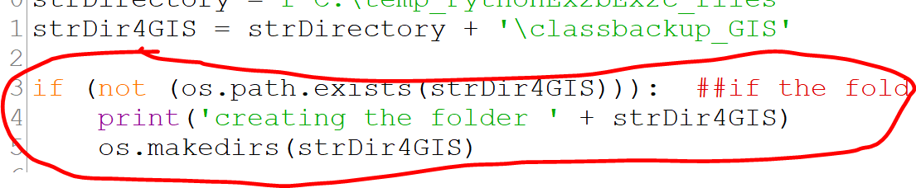
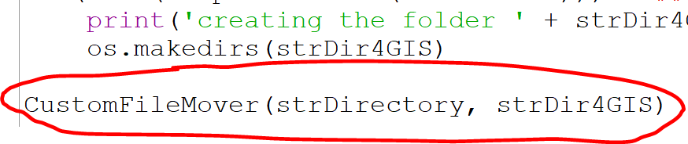
Exercise 2C: Extra Credit, Keeping it DRy
Introductory Python concepts/ methods
Copy the Exercise 2B resulting Python file and rename ex3C.py
Insert a new line at the top of the .py file and add “from shutil import copyfile” to specify importingthe copyfile method from the module
After the string variable add a new variable strDir4GIS and set it to equal…
strDirectory + '\classbackup_GIS‘
Add the following 3 lines of code to create a new folder if does not exist
if (not (os.path.exists(strDir4GIS))): ##if the folder does not exist
print('creating the folder ' + strDir4GIS)
os.makedirs(strDir4GIS)
Add a line of code, to call the user defined function that you will create next, and pass the 2 variables with folder pathing…
CustomFileMover(strDirectory, strDir4GIS)
More methods
User defined function
Notes:
Don’t repeat yourself
The shutil module offers a number of high-level operations on files and collections of files
Copyfile is a method

Slide 29
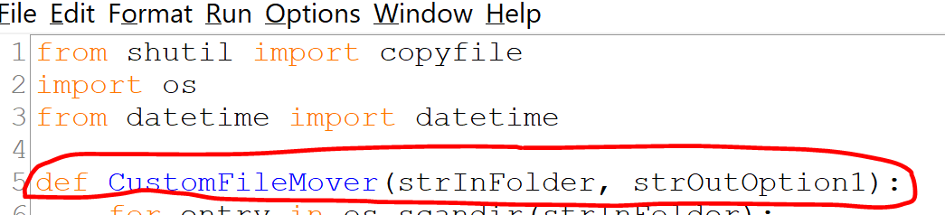


Exercise 2C: Extra Credit, Keeping it DRy
Create the first line of the user defined function, under the From datetime import datetime line…
def CustomFileMover(strInFolder, strOutOption1):
Cut/paste the for loop content and nest (using the tab key) under the user defined function’s 1st line
Swap out the for loop’s content with the following…
if entry.path.endswith(tuple([".shp", ".dbf", ".prj", ".sbx", ".shx"])) and entry.is_file(): ## endswith() accepts a tuple of suffixes
copyfile(entry.path, strOutOption1 + '\\' + entry.name)
print(entry.path + " copied to " + strOutOption1 + '\\' + entry.name)
else:
print(entry.path + " is not a shapefile, not copying!!!!")
Save → Run → view the changes in the C:\temp_PythonEx2bEx2c_files folder
Notes:
Don’t repeat yourself
The shutil module offers a number of high-level operations on files and collections of files
Copyfile is a method
If dst already exists, it will be replaced.
A tuple is a collection of objects which ordered and immutable. Tuples are sequences, just like lists. The differences between tuples and lists are, the tuples cannot be changed unlike lists and tuples use parentheses, whereas lists use square brackets

Slide 30
Topics to explore on your own
Error Trapping
Python Arguments
Packaging into tools for ArcGIS Pro/ArcMap
Module installation, installing Python modules & packages with pip

Slide 31
Python Topics for Data Management using Jupyter – Course Section
40 Minutes
Brent Frakes
Notes:
Before get started, not the Yes/No icons
How many have code with Python before? How many have code with Python in the last 2 years?
Doesn’t really matter where start, most all programming concepts relate to each other. Sure syntax differences and some methodology but there’s usually techniques and methods cross over between languages. Where I do fell like your starting from scratch is programming whithout code (i.e. Modelbuilder, etc.)
In a way, coding itself documents work, less need for notes than creating some procedural document
Difference between programming/scripting/coding
not much
-In general, Why programming/scripting is useful
-Valuable to you and “The Service”

