Slide 1
Intro to Data Management with Python
Course Description: “Data Management with Python, a Primer” is for users who are brand new to using Python and want to get exposure to Python OR existing Python users who want to check out the coursework’s data management methods. This class will cover; introductory Python concepts/methods, basic module usage, debugging tips, Juypter notebooks, Pandas data fames, and more.
June 25th, 2020
Instructors/Teaching Assistants
Nathan Zimpher nathan_zimpfer@fws.gov, MB,
Erin Butts erin_butts@fws.gov, SA/Fisheries, Portland, OR
Brent Frakes brent_frakes@fws.gov – Refuges I&M – Fort Collins, CO
Matt Heller matthew_heller@fws.gov – SA - Bozeman, MT
Setup: Create a C:\TEMP folder
Notes:
Before get started, not the Yes/No icons
How many have code with Python before? How many have code with Python in the last 2 years?
Doesn’t really matter where start, most all programming concepts relate to each other. Sure syntax differences and some methodology but there’s usually techniques and methods cross over between languages. Where I do fell like your starting from scratch is programming whithout code (i.e. Modelbuilder, etc.)
In a way, coding itself documents work, less need for notes than creating some procedural document
Difference between programming/scripting/coding
not much
-In general, Why programming/scripting is useful
-Valuable to you and “The Service”

Slide 2
Class Format and Materials
Attendees, please use the chat box early and often. Instructors will do their best to answer questions.
The class will consist of instruction, 5 short hands on exercises and a final challenge
Materials
Powerpoint file
Attendee Coursework, helpful links, exercises word document
Jupyter notebook file
Sample files in .zip file
Notes:
Extremely fast pace class, Primer is in the title
Slide content….
The Materails have many links to help resources that expand on topics

Slide 3
Class Outline
Intro to Python (15 min)
Exercises 1A, 1B
Python Topics for Data Management using IDLE (35 min)
Exercise 2A, 2B, 2D Extra Credit
Python Topics for Data Management using Jupyter (40 min)
Final Challenge Exercise

Slide 4
Intro to Python – Course Section
15 Minutes
Matt Heller

Slide 5
What & Why
What is Python - python.org definition
“Python is an easy to learn, powerful language... (with) high-level data structures and a simple but effective approach to object-oriented programming. Python’s elegant syntax and dynamic typing...make it an ideal language for scripting...in many areas and on most platforms.”
ESRI
What is Python & Why use it
Free, cross-platform, easy to learn,
Widely useful, great community ESRI
Personal Reason Why…
Interoperable
USFWS and DOI allow using it
Allows me (shareable to ) to do powerful processing
A ton of help resources
Personal Why not…
GUI development (however there are companion frameworks that can be added e.g. Tkinter, Django)
Code with multiple modules (especially ArcPY) can at times be difficult to transfer to other systems

Slide 6
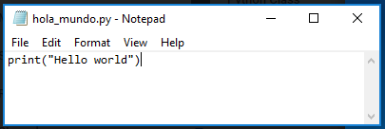
Creating a Python script from scratch & the Print Statement
Creating from scratch easy,
Python file is a text file with a .py extension
Can also copy/paste old python files
Print Statement
Python statement to enter text in the shell (command line window to execute python)
Useful for providing information while the script runs

Slide 7
IDE
An integrated development environment (IDE) is a software application that provides comprehensive facilities to computer programmers for software development. An IDE normally consists of at least a source code editor, build automation tools and a debugger…
The boundary between an IDE and other parts of the broader software development environment is not well-defined; sometimes a version control system or various tools to simplify the construction of a graphical user interface (GUI) are integrated… https://en.wikipedia.org/wiki/Integrated_development_environment
Why use IDE’s
Easier code editing (longer scripts, expanding/contracting code, code navigation, editing tools, text colors, etc.,)
Debugging (various tools)
Common Python IDE’s
IDLE - bundled with the default install of Python, Shell window, Editor Window, Debug Control Window
MS Visual Studio – my favorite!!!!
PyScripter
PyCharm
Many many more…
Jupyter Notebooks (discussed in depth later in this)
Non-traditional IDE
Visualization capabilities (graphs, tables, etc.)
Sharing
Notes:
Jupyter notebooks is not an IDE
Vs editing in ArcPro, Arc Desktop,
Python window in ArcGIS

Slide 8
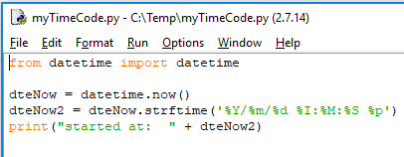
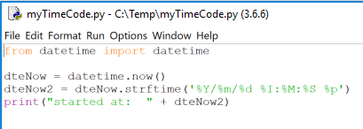
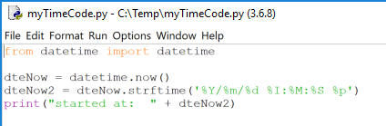
python Versions
2x vs 3x
Syntax
ArcGIS Desktop vs ArcGIS Pro
IDLE startup .bat file path examples
2x
C:\Python27\ArcGIS10.6\Lib\idlelib\idle.bat
C:\Python27\ArcGIS10.6\Lib\idlelib\idle.bat
C:\Program Files\MySQL\MySQL Shell 8.0\lib\Python2.7\Lib\idlelib\idle.bat
C:\Microsoft\AndroidNDK\android-ndk-r16b\prebuilt\windows\lib\python2.7\idlelib\idle.bat
C:\Program Files\MySQL\MySQL Shell 8.0\lib\Python2.7\Lib\idlelib\idle.bat
C:\Microsoft\AndroidNDK64\android-ndk-r16b\prebuilt\windows-x86_64\lib\python2.7\idlelib\idle.bat
3x
C:\Program Files (x86)\Microsoft Visual Studio\Shared\Python36_64\Lib\idlelib\idle.bat
C:\Program Files (x86)\Microsoft Visual Studio\2019\Community\Common7\IDE\Extensions\Microsoft\Python\Miniconda\Miniconda3-x64\Lib\idlelib\idle.bat
C:\Program Files\ArcGIS\Pro\bin\Python\envs\arcgispro-py3\Lib\idlelib\idle.bat
C:\Users\fwsManaged\AppData\Local\Programs\Python\Python37\Lib\idlelib\idle.bat
IDE considerations – make sure the IDE is configured with the Python version you want
Feel free to find the idle.bat file on your system during this presentation!!!!
Notes:
The path to you idle.bat file will depend on what installation you went with. Check out the #### document for help finding your .bat file

Slide 9
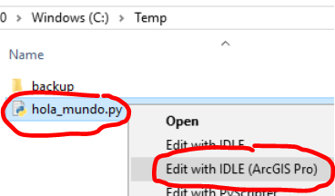
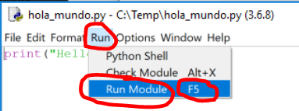
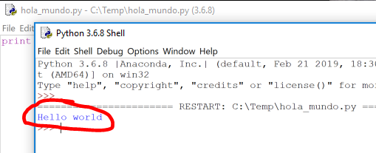

Introductory Python concepts/ methods
Exercise 1: Hello World!
Open a text editor (e.g. MS Notepad)
Enter print(“Hello world”) → save as filename hola_mundo.py on C:\temp
In a file browser, right click → hola_mundo.py → select “Edit with IDLE…”
Note: explore intellisense functionality. Enter the text “pr” → ctrl-spacebar → tab
Under the Run menu, click Run Module OR click the F5 shortcut key
Rerun from step 3 however select “Edit with IDLE”, do you notice a difference?
What is Python & Why use Python
Creating a Python Script from Scratch
The Print Statement
Notes:
Hint: look at the Python editing window header

Slide 10
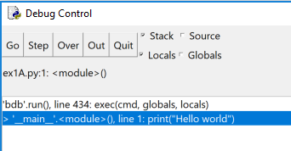
Debugging
What – run the code while giving details on most all portions of the code
Why – gives much more ability to get python code to run properly
How
Control speed of execution
Break points
Inspect variables
Step into, over out
What is the Python IDLE Shell: Python interpreter in interactive mode is commonly known as Python Shell.
https://overiq.com/

Slide 11
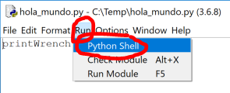
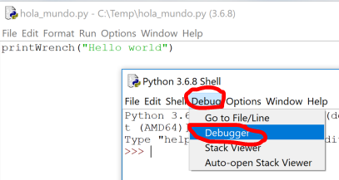
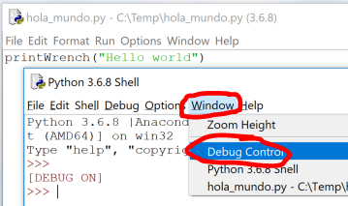
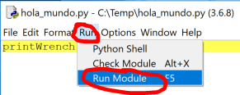
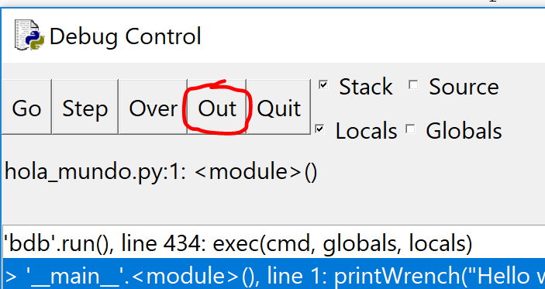
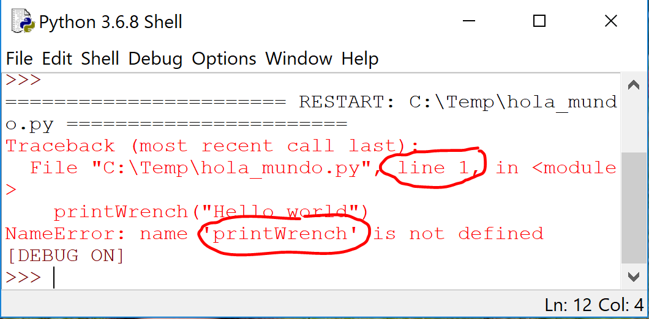
Introductory Python concepts/ methods
Exercise 1b: Hello World Debugging
Change print command to printWrench → save. Note: this intentionally produces an error
From IDLE, click Run →Python Shell
From Shell, click Debug → Debugger
Click Window → Debug Control
From IDLE, click Run → Run Module & from the Debug Control, click Out
Observe the line number and error message
Change printWrench back to print → save → Run
Note: “Run module” would have shown the same error. Ex 1B was to begin using debugging.
IDE
Python Versions
Debugging

Slide 12
Python Topics for Data Management using IDLE – Course Section
35 Minutes
Matt Heller
Notes:
Before get started, not the Yes/No icons
How many have code with Python before? How many have code with Python in the last 2 years?
Doesn’t really matter where start, most all programming concepts relate to each other. Sure syntax differences and some methodology but there’s usually techniques and methods cross over between languages. Where I do fell like your starting from scratch is programming whithout code (i.e. Modelbuilder, etc.)
In a way, coding itself documents work, less need for notes than creating some procedural document
Difference between programming/scripting/coding
not much
-In general, Why programming/scripting is useful
-Valuable to you and “The Service”

Slide 13
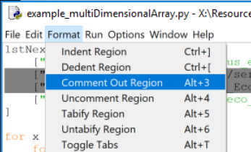
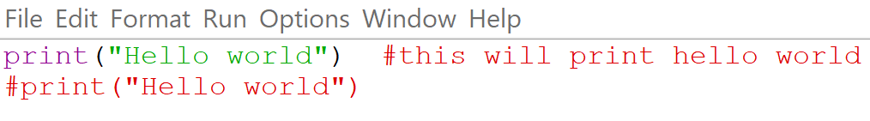
Commenting
What is it: Indicate text in a file that is not to be executed when running a script
When to use it:
Script header
#title :hola_mundo.py
#description :This is a simple hello world script
#author,org :Your name, Your org name
#date :1/22/2020
#version :0.1
#usage :python hola_mundo.py
#notes :
#python_version :3.6.8
#======================================
Describe what’s going on in parts of the script
Save code that you don’t want to execute
Note: most IDE’s will display commented text in a different color

Slide 14
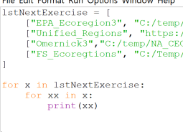
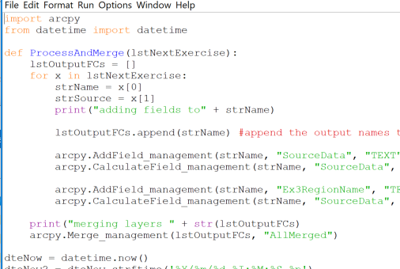
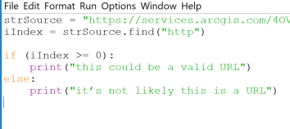
Indenting
What is it: Indenting text in a document using tabs or blank spaces
Why: Python requires consistent indenting for blocks of code (functions, conditional statements, loops, etc.)

Slide 15
Functions, methods, properties
Empty
empty

Slide 16
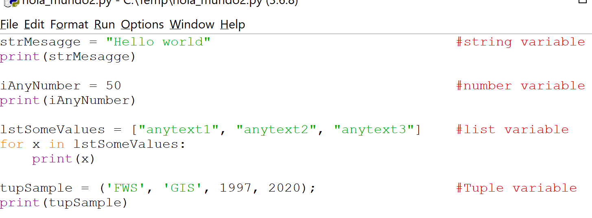
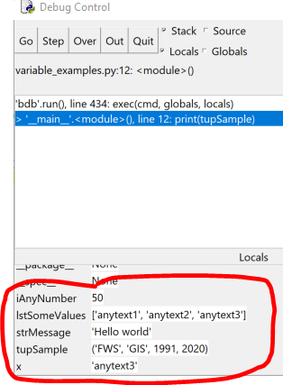
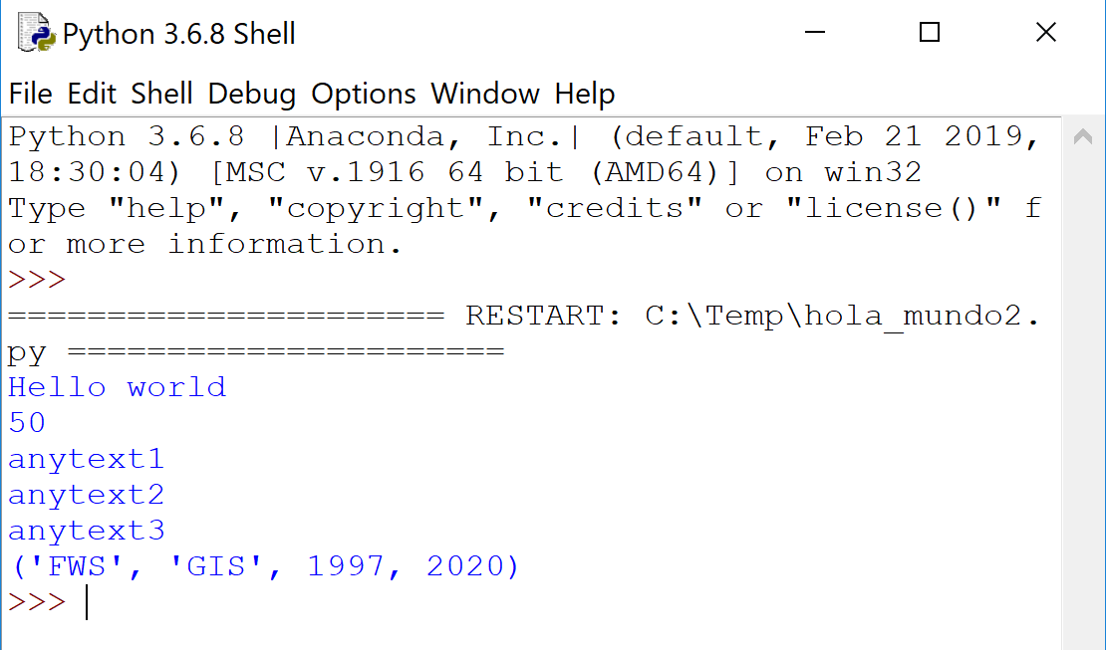
Variables
What is it: A name that stores a value; assign using = ESRI
Variable types - just like field data types, variables have data types
String - Strings are defined either with a single quote or a double quotes.
Number - Python supports two types of numbers - integers and floating point numbers. (It also supports complex numbers, which will not be explained in this tutorial).
List – Lists are very similar to arrays. They can contain any type of variable, and they can contain as many variables as you wish. Lists can also be iterated over in a very simple manner.
https://www.learnpython.org/
Tuple - Tuples are sequences, just like lists. The differences between tuples and lists are, the tuples cannot be changed unlike lists and tuples use parentheses, whereas lists use square brackets.
https://www.tutorialspoint.com/
Tuples often used to pass arguments to Arcpy ESRI functions
Explore other variables for further reading
Date
Dictionary

Slide 17
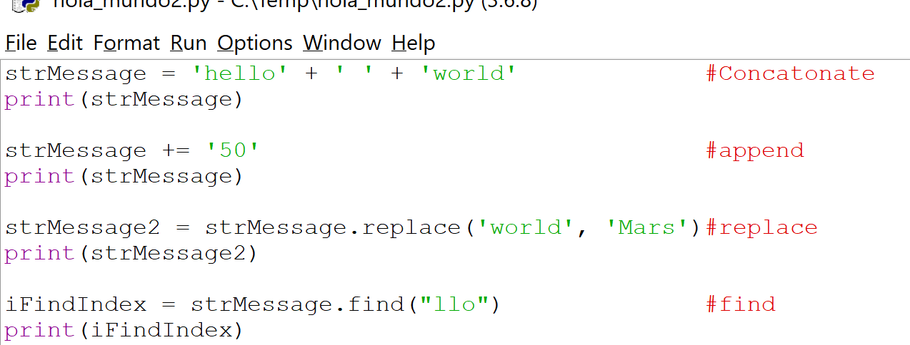
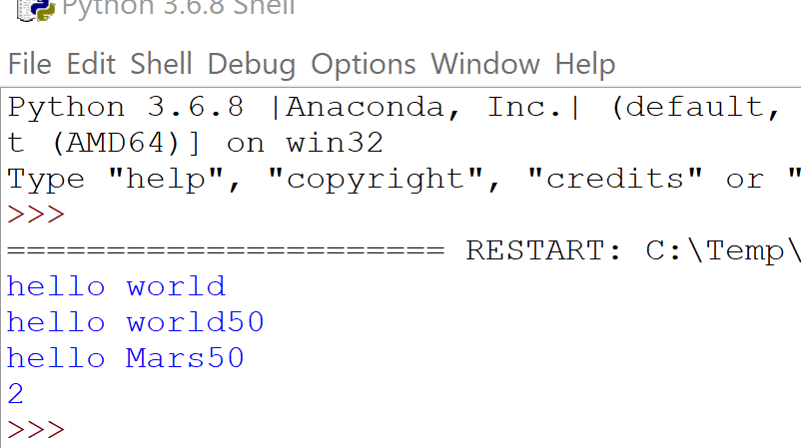
More on String Variables
Valid use of paths in Python
strPath = “c:/temp/roads.shp”
strPath = “c:\\temp\\roads.shp”
strPath = r“c:\temp\roads.shp”
Not Valid use of paths in Python
strPath = “c:\temp\roads.shp”
Manipulating string – useful when bulk processing of data
Concatenate
Append
Replace
Find

Slide 18
Python Classes
What is a it: A class is a blueprint for the object. Object is simply a collection of data (variables) and methods (functions) that act on those data.
https://www.programiz.com/
Why: Classes provide a means of bundling data and functionality together. Creating a new class creates a new type of object, allowing new instances of that type to be made. Each class instance can have attributes attached to it for maintaining its state. Class instances can also have methods (defined by its class) for modifying its state.
https://docs.python.org/
Notes:
statements are intended to initialize the module
It’s the norm but not required to place all import statements at the beginning of a module (or script, for that matter)

Slide 19
Python Modules
What is a it: File consisting of Python code of statements, functions, classes, variables, and/or other modules.
How it is used:
Line of code added: import #module name#
First python (interpreter) searches for a built-in module (i.e. dir, os, sys) then in a list of system directories, by the environment variable sys.path (folder containing the input script, PYTHONPATH shell variable PATH, install-dependent default)
Python can cache complied versions of .py files, as .pyc files, for speed of loading
Python comes with library of standard modules (e.g. sys)
Why use it:
Simplicity (bite size), Maintainability (updates when needed), Reusability (no copies needed), Scoping (avoid overlap with other areas of coding)
Benefit from the development of additional modules in numerous niches of Python by GIS professionals and programmers from many different disciplines.
https://knowpapa.com/
Notes:
statements are intended to initialize the module
It’s the norm but not required to place all import statements at the beginning of a module (or script, for that matter)

Slide 20
Python packages and Libraries
Python Package: a collection of Python modules
Python Library: the term library does not have any specific contextual meaning in Python. When used in Python, a library is used loosely to describe a collection of the core modules. “Additional libraries” refer to those optional components that are commonly included in Python distributions.
https://knowpapa.com/
Notes:
statements are intended to initialize the module
It’s the norm but not required to place all import statements at the beginning of a module (or script, for that matter)

Slide 21
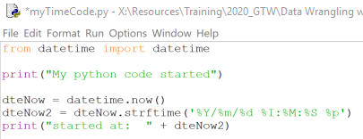
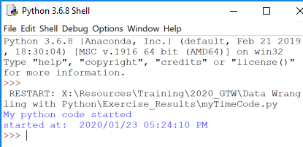
Introductory Python Concepts/Methods
Exercise 2A: Time, Time, tell me what time!
Make a python file that “print’s” the text “My python code started” → save as “myTimeCode.py”
Before the print statement, import the datetime module with the date time classes, enter “import datetime”
After the import, enter
dteNow = datetime.now()
dteNow2 = dteNow.strftime('%Y/%m/%d %I:%M:%S %p')
print("started at: " + dteNow2)
Save → Run
Commenting
Indenting
Variables
More on String Variables
Python Classes, Modules, Packages
Methods
Notes:
Now() function to get the current date time!
strFtime, converts the format
!!!!!!!!!!!!!!!!!!!!!!!!!!!!!!!!!!!!!!!!!!!!!!!!!!!!!!!!!!!!!!
!!!!!!!!!!!!!!!!!!!!!!!!!!!!!!!!!!!!!!!!!!!!!!!!!!!!!!!!!!!!!!
!!!!!!!!!!!!!!!!!!!!!!!!!!!!!!!!!!!!!!!!!!!!!!!!!!!!!!!!!!!!!!
Explain what is the method, class, package variable

Slide 22
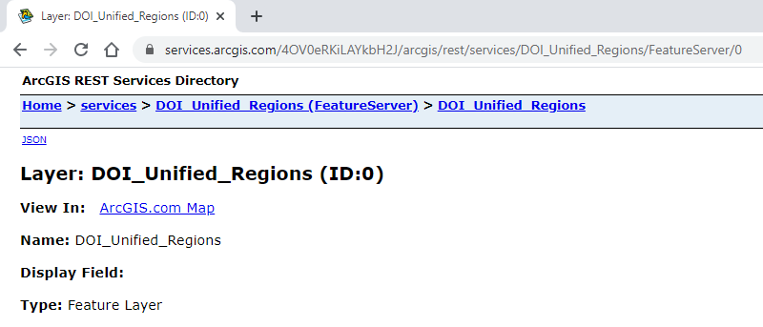

Accessing AGOL hosted feature layers
Maybe replace with Excel Exampel
The arcpy Featurset: FeatureSet objects are a lightweight representation of a feature class… The FeatureSet object is also how feature data is sent and received from the server.
ESRI
Featureset object can be used with a feature service

Slide 23
For Loops, Iterating through a list
What is it: A for loop is used for iterating over a sequence (that is either a list, a tuple, a dictionary, a set, or a string).
Python supports different kinds of loops:
While - execute a block of statements repeatedly until a given a condition is satisfied.
For in - For loops are used for sequential traversal (list, string, array, etc.)
Iterating by index of sequences (Range) - We can also use the index of elements in the sequence to iterate
else statement with for loops - Combine else statement with for loop like in while loop
Nested - one loop inside another loop
Loop Control Statements
Continue Statement - returns the control to the beginning of the loop
Break Statement - brings control out of the loop
Pass Statement - pass statement to write empty loops
https://www.geeksforgeeks.org/
Why: Handle repetitive tasks
What is a multi-dimensional list: Multi-dimensional lists are the lists within lists
https://www.geeksforgeeks.org/

Slide 24
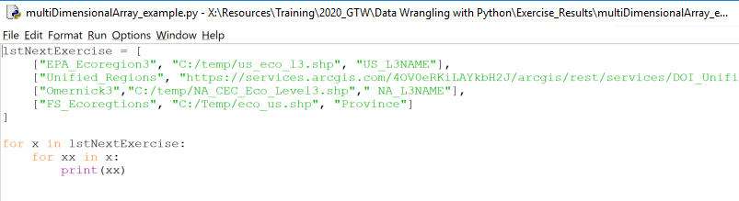
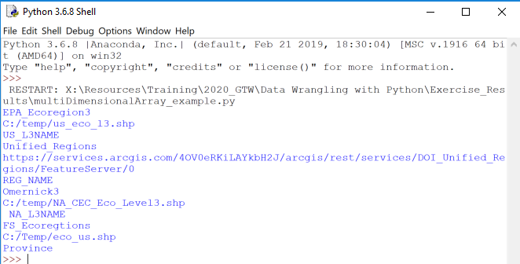
For Loops, Iterating through a list Examples
Example of looping through a 2 dimensional list
Notes:
File → folder → draw → cabinent → row → room

Slide 25
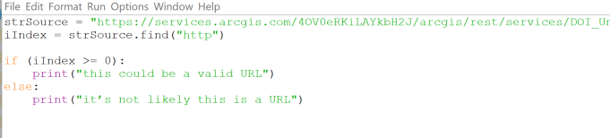
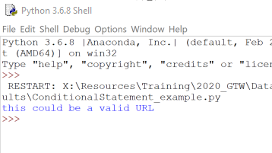
Conditional Statements
What is it: The “If” statement
Why: In programming, very often we want to check the conditions and change the behavior of the program.
https://www.pythonforbeginners.com/
Example of simple conditional statement:

Slide 26
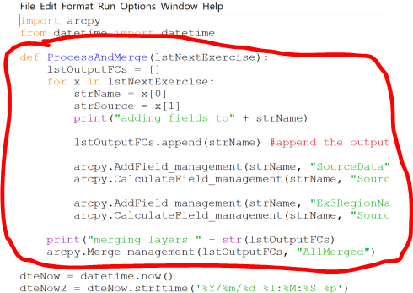
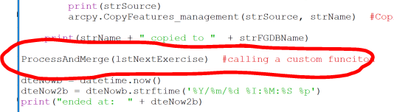
User-Defined functions
What it is: Python includes many built-in functions, users can also define funcitons. A function is a reusable block of programming statements designed to perform a certain task.
https://www.tutorialsteacher.com/
Why:
Organize code for readability and reusability
Helps with DRY
Don't repeat yourself (DRY, or sometimes do not repeat yourself) is a principle of software development aimed at reducing repetition of software patterns, replacing it with abstractions or using data normalization to avoid redundancy.
https://en.wikipedia.org/
How: To define a function, Python provides the def keyword, add colon, proper indentation, call the function

Slide 27
Wrangling Up them Data
Exercise 2B: Manage them files
Copy the Exercise 2A resulting Python file and rename Exercise2B.py
From the file example_multiDimensionalArray.py, copy/paste the lines declaring the lstNextExercise list variable under the first print statement
Delete the line declaring the strHFL_URL variable
For Loops, Iterating through a list
Conditional Statements
https://www.newbedev.com/python/howto/how-to-iterate-over-files-in-a-given-directory/
Notes:
Do not repeat

Slide 28
Wrangling Up them Data
Exercise 2C: Extra Credit, Keeping it DRy
For Loops, Iterating through a list
Conditional Statements
Copy the Exercise 2C resulting Python file and rename Exercise3A.py
From the file example_multiDimensionalArray.py, copy/paste the lines declaring the lstNextExercise list variable under the first print statement
Delete the line declaring the strHFL_URL variable
Notes:
Do not repeat

Slide 29
Topics to explore on your own
Error Trapping
Python Arguments
Packaging into tools for ArcGIS Pro/ArcMap
Module installation
Installing Python modules & packages with pip

Slide 30
Python Topics for Data Management using Jupyter – Course Section
40 Minutes
Brent Frakes
Notes:
Before get started, not the Yes/No icons
How many have code with Python before? How many have code with Python in the last 2 years?
Doesn’t really matter where start, most all programming concepts relate to each other. Sure syntax differences and some methodology but there’s usually techniques and methods cross over between languages. Where I do fell like your starting from scratch is programming whithout code (i.e. Modelbuilder, etc.)
In a way, coding itself documents work, less need for notes than creating some procedural document
Difference between programming/scripting/coding
not much
-In general, Why programming/scripting is useful
-Valuable to you and “The Service”

Slide 31
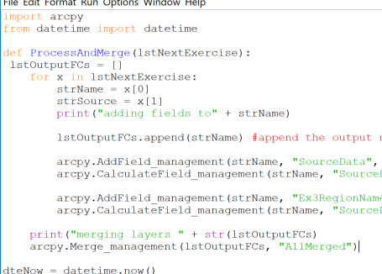
Wrangling Up them DatA
Exercise 3b: (continued)
In the ProcessAndMerge function…
Declare a blank list variable named lstOutputFCs
lstOutputFCs = []
Copy/paste the for loop used below, along with the lines setting the strName and strSource variables, and add a print statement noting the strName
for x in lstNextExercise:
strName = x[0]
strSource = x[1]
print("adding fields to" + strName)
Append the strName variable to the list variable
lstOutputFCs.append(strName)
Use the following code to add 2 fields and calculate the 2 fields
arcpy.AddField_management(strName, "SourceData", "TEXT", 255, "", "", "#", "NULLABLE", "REQUIRED")
arcpy.CalculateField_management(strName, "SourceData", "'" + strSource+ "'","PYTHON_9.3","#")
arcpy.AddField_management(strName, "Ex3RegionName", "TEXT", 255, "", "", "#", "NULLABLE", "REQUIRED") arcpy.CalculateField_management(strName, "SourceData", "'" + strSource+ "'","PYTHON_9.3","#")
Add the merge tool to finish wrangling up the data and change the print statement, noting the merge, to include the list of FC’s to merge
print("merging layers " + str(lstOutputFCs)
arcpy.Merge_management(lstOutputFCs, "AllMerged")
Save → Run → view the PythonEx3A.gdb contents
User-Defined Functions
Help
Notes:
Note: there was an error in the copied code, can you fix it?

Slide 32
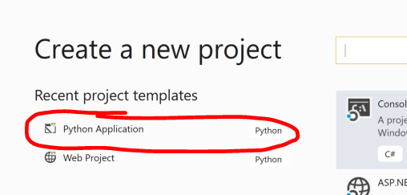
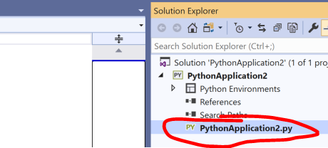
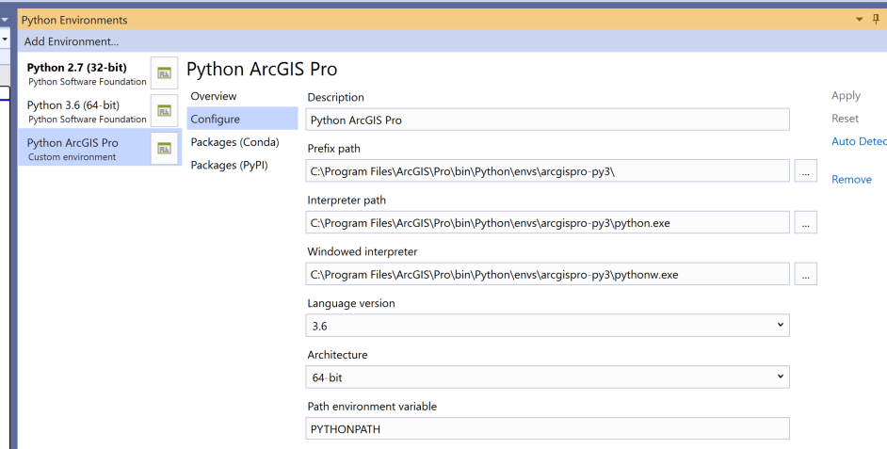
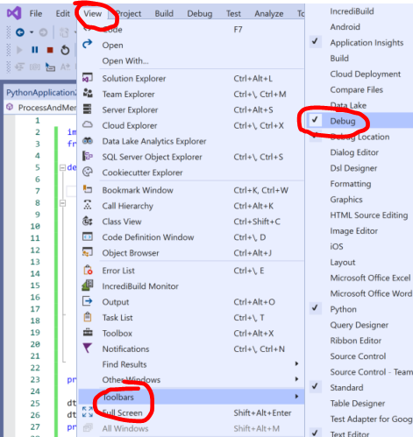
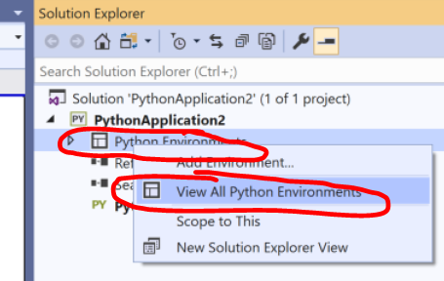
Extra Credit: Configuring The Visual Studio IDE
Create a new project using the Python App template
From the Solution Explorer edit the .py file with previous code or import an existing .py file
Verify python versioning
Note: Custom Environment can help and can be a one-time setup
Debug using the debug toolbar

Slide 33
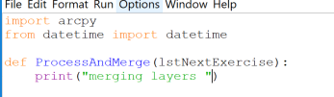
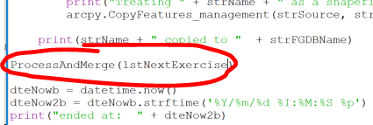
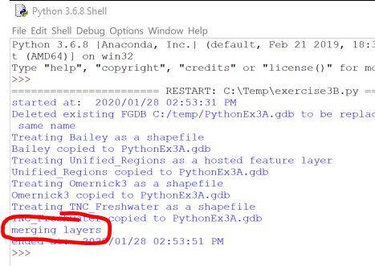
Wrangling Up them DatA
Exercise 3b: Merge it Up
Copy the Exercise 3A resulting Python file and rename Exercise3B.py
Under the datatime import line, add the user-defined function, that accepts the list variable, and add a print statement with the following code.
def ProcessAndMerge(lstNextExercise):
print("merging layers “)
Above that last date variable declarations, call the user-defined function that accepts the list variable
ProcessAndMerge(lstNextExercise)
Save → Run → verify the print statement executes
User-Defined Functions
Help
Notes:
Note: there was an error in the copied code, can you fix it?

