Slide 1
The day the carnival came to town
David Hood, @thoughtfulnz
github.com/thoughtfulbloke/kiwicon2038

Slide 2
Dataset
From targetted searches & capturing at time
2018-07-25 13:03:40 to 2018-08-06 23:45:21 UTC
115218 tweets, 3065709 mentions
373693 accounts loosely involved
40798 accounts tightly involved
53900649 friends relationships
21366303 likes

Slide 3
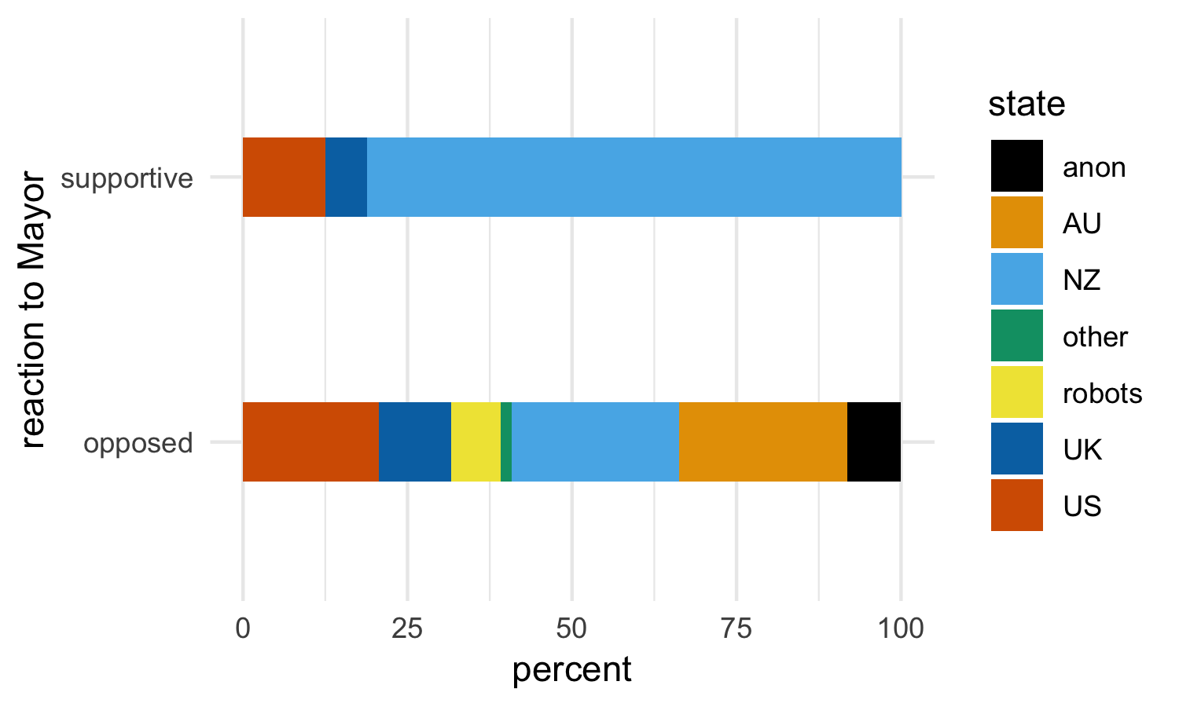
Backstory

Slide 4
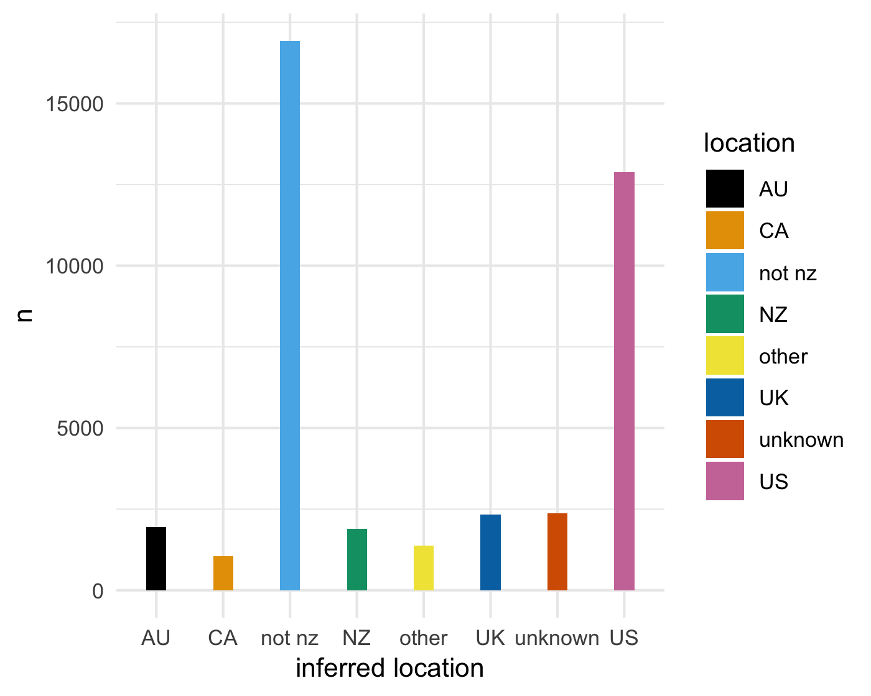
Composition

Slide 5
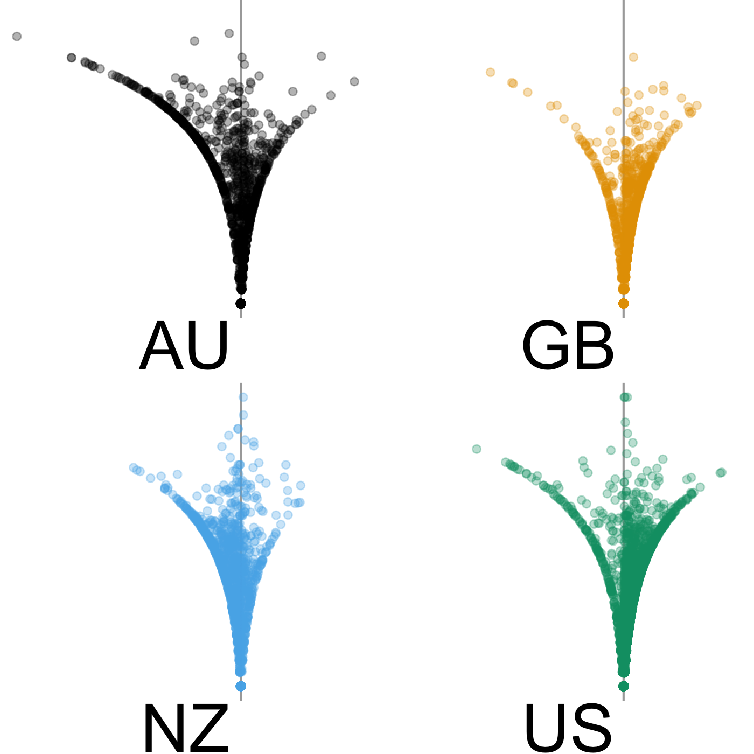
Politics - notifiers

Slide 6
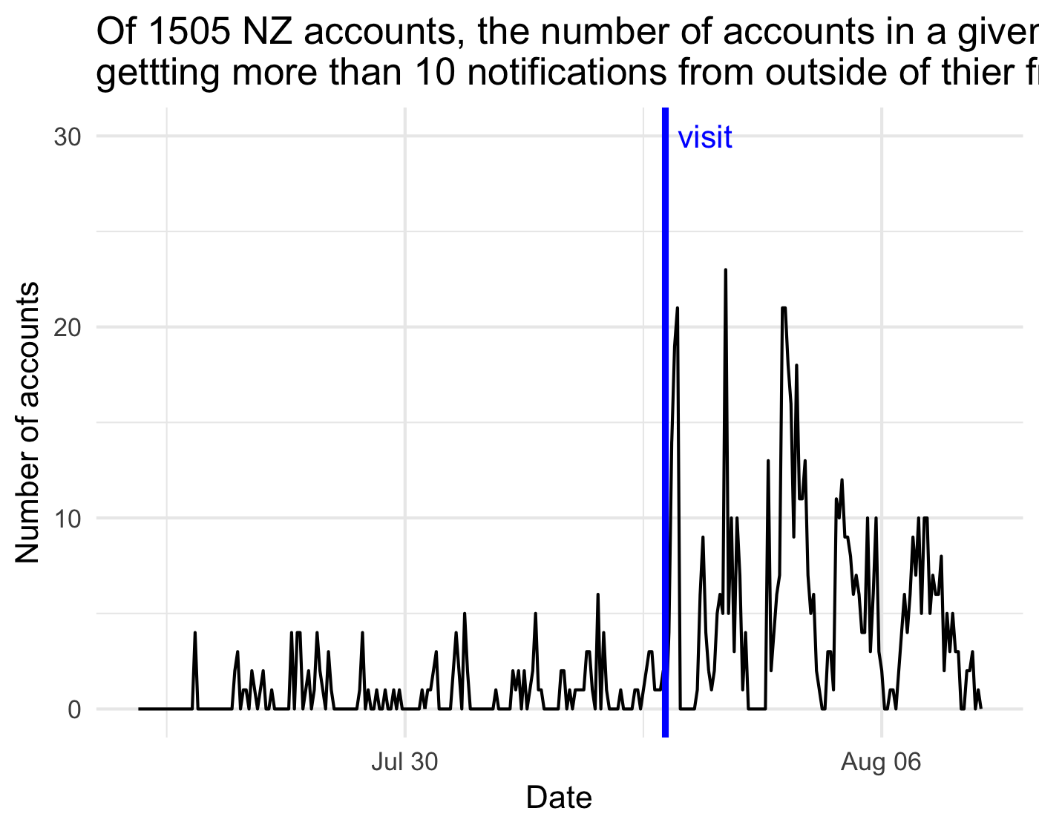
Community

Slide 7
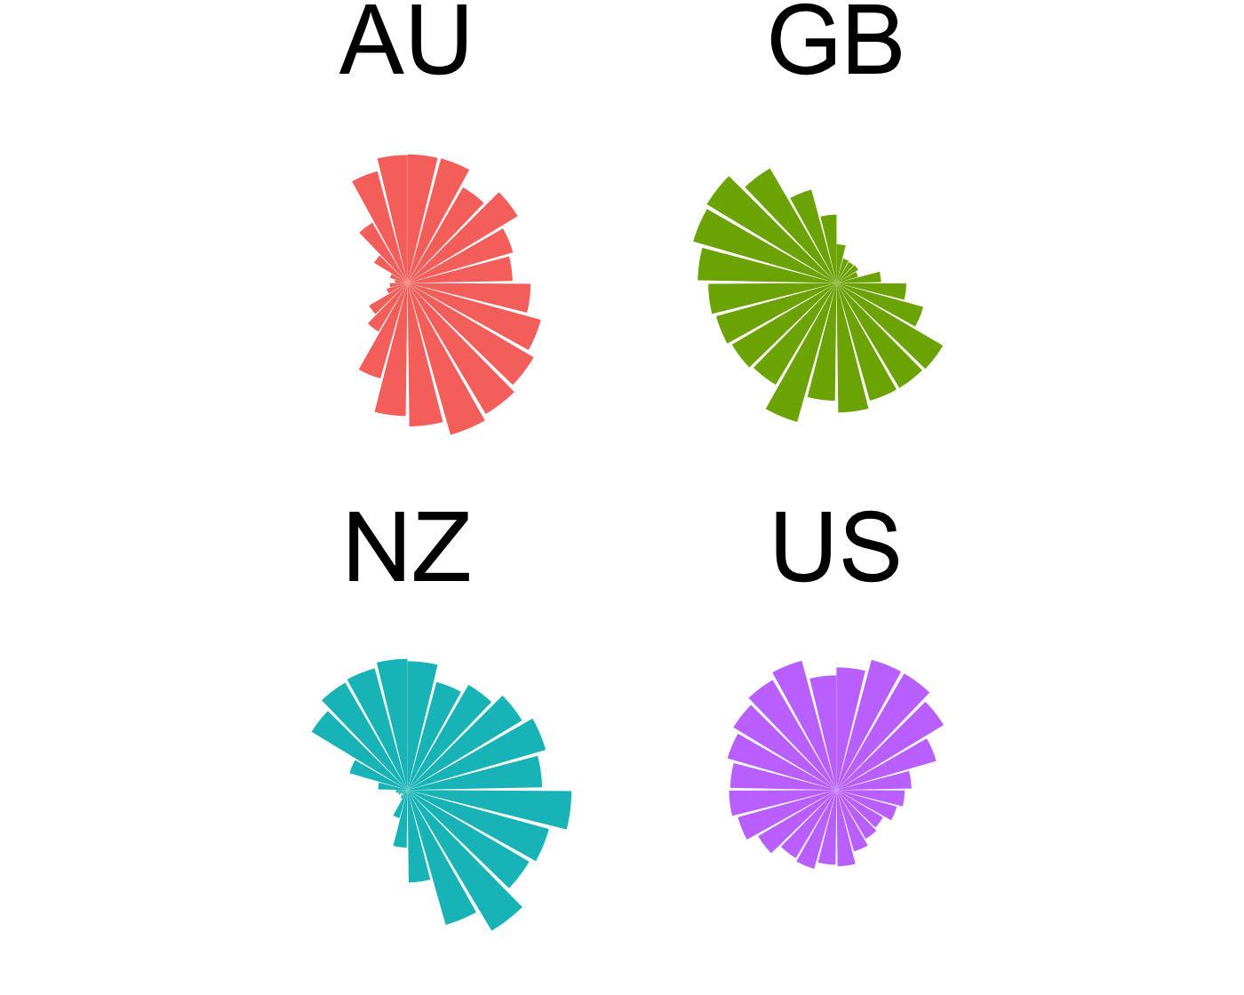
Time

Slide 8
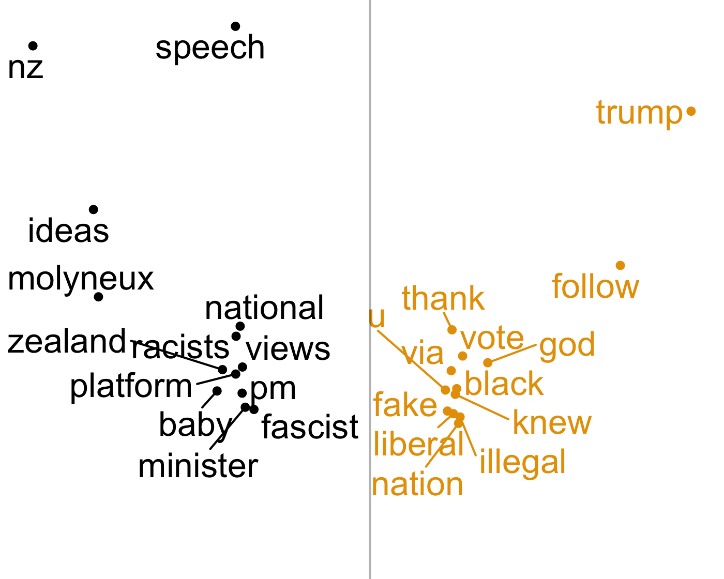
Language (1) Rate difference

Slide 9
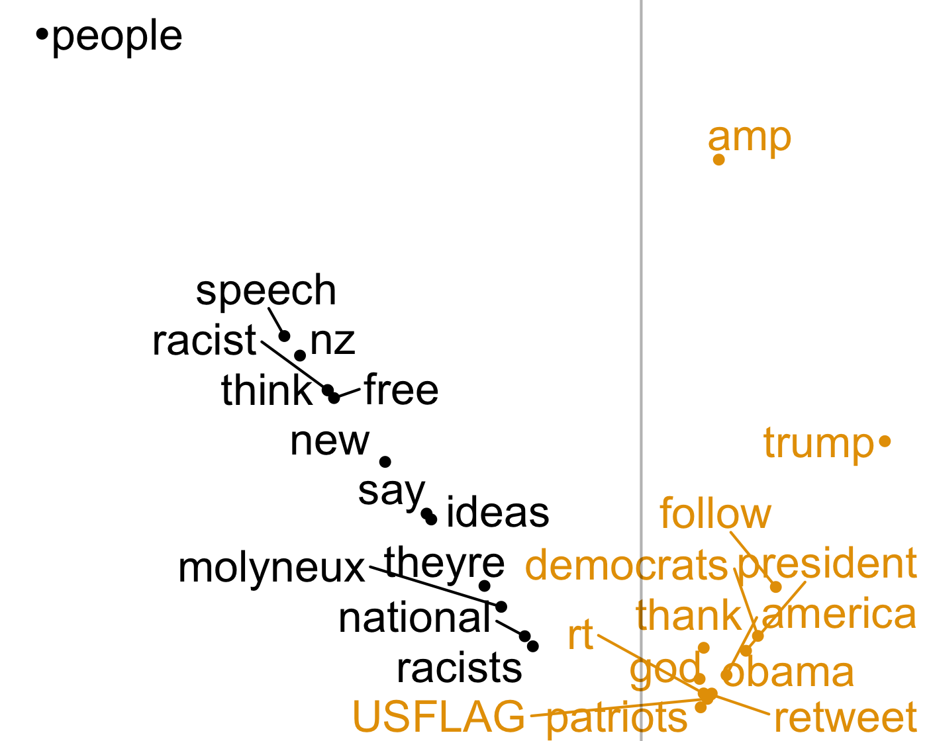
Language (2) Absolute difference

Slide 10
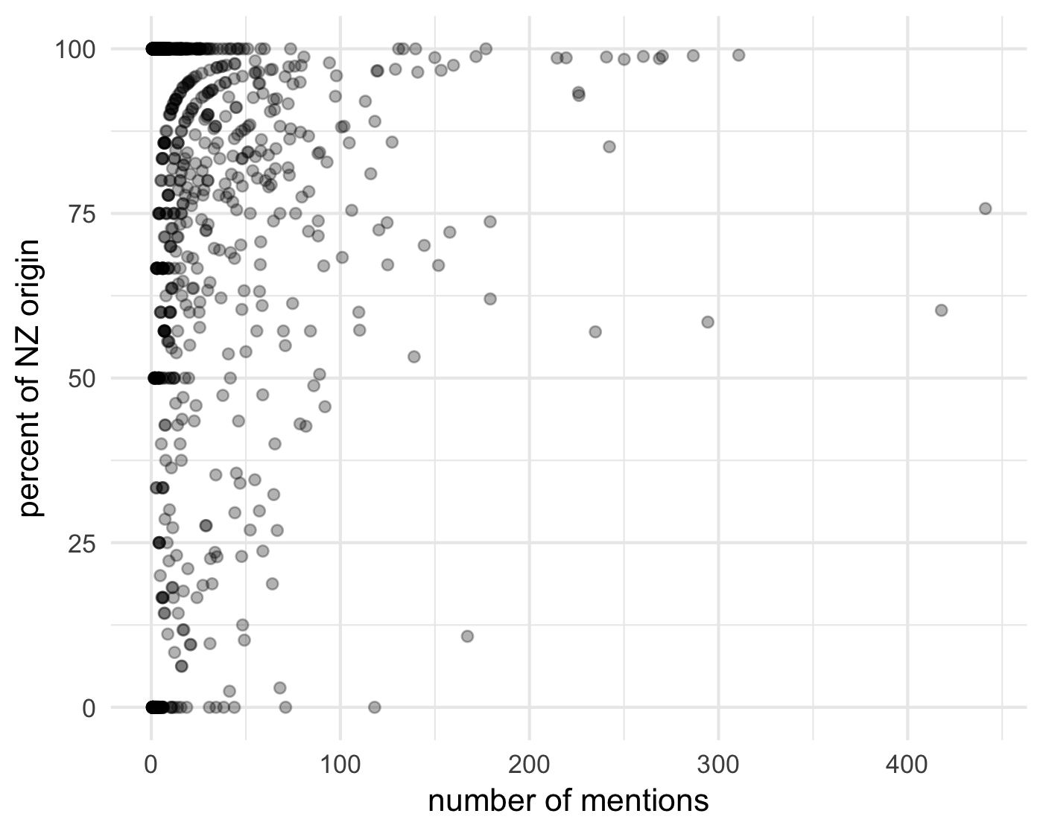
Uneven

Slide 11
Possible Responses
all along the watchtower
pick on someone your own size
burn it all down

