Slide 1



Better Background Tasks
Using Serverless Functions
and SignalR
thoughtpost.com
@thoughtpost

Slide 2

Thoughtpost
thoughtpost.com
Been doing this a long time
Coder, author, speaker, former MVP
@anotherchrisdix
CHRIS DIX
Chief Developer
@Thoughtpost

Slide 3
https://github.com/thoughtpost/background-worker-functions

Slide 4
Save
Import
Run

Slide 5
408

Slide 6
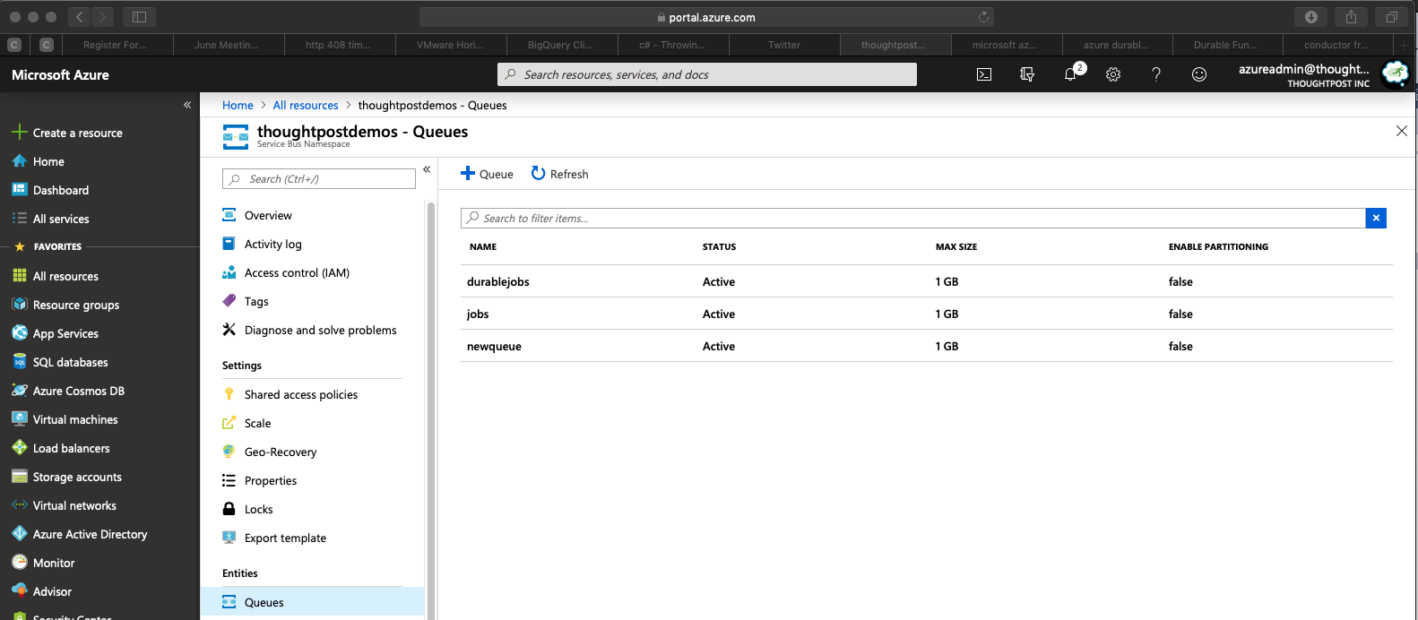



Slide 7

Platform Choices
.NET Core 2.1
ASP.NET Core
Azure

Slide 8
Design Choices
Multi-client, multi-trigger
Need a cache
Detailed response, flexible jobs
Filter by job id

Slide 9



BACKGROUND
CLIENT
COMMUNICATION

Slide 10
BACKGROUND
PROCESSING
Windows Service
WebJobs
App Service

Slide 11
Azure
Functions
Write single functions to solve a problem
Serverless
C#, F#, Node.js, Java, PHP

Slide 12
Azure
Functions
Pay-per-use (Consumption) or App Service Plan
Code is triggered by something (HTTP, queue)
C#, F#, Node.js, Java, PHP

Slide 13



Azure
Functions

Slide 14
namespace JobsFunctionApp
{
public static class DemoFunction
{
[FunctionName("DemoFunction")]
public static async Task<IActionResult> Run(
[HttpTrigger(AuthorizationLevel.Function, "get", "post", Route = null)]
HttpRequest req, ILogger log)
{
log.LogInformation("C# HTTP trigger function processed a request.");
string name = req.Query["name"];
string requestBody = await new StreamReader(req.Body).ReadToEndAsync();
dynamic data = JsonConvert.DeserializeObject(requestBody);
name = name ?? data?.name;
return name != null
? (ActionResult)new OkObjectResult($"Hello, {name}")
: new BadRequestObjectResult("Please pass a name on the query string or in the request body");
}
}
}

Slide 15
Azure Functions
Client
COMMUNICATION

Slide 16
Communications
WebSockets
Polling
Build it yourself??

Slide 17
SignalR
Library for real-time communication between applications (good enough for games)
Been around since 2013!
Typical example has been built around web

Slide 18

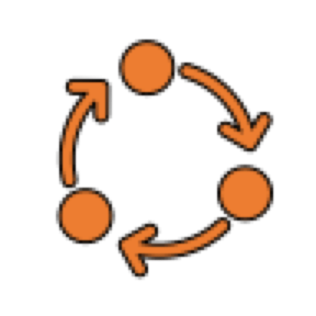


SignalR
Client
Hub
Client
Client

Slide 19
SignalR
Can use client library from .NET or JavaScript
Can host the hub in ASP.NET web application
Communication is bi-directional

Slide 20
SignalR
Communication can filter by groups inside hub
await Groups.AddToGroupAsync(Context.ConnectionId, id);

Slide 21
SignalR
Client
Hub
Client
Background
Process
Client

Slide 22
Azure SignalR
Service
New managed offering with tons of potential
Lots of advantages to hosting the hub in Azure

Slide 23
Azure SignalR
Service
Familiar model but there are differences (ex. groups, client calls)
TODO: Support both in this example

Slide 24
Azure Functions
Client
SignalR

Slide 25

Azure Functions
Client
SignalR
Process
Service Bus Queue

Slide 26
JobsWeb
JobsFunctionApp
Thoughtpost.AspNetCore.Mvc
Job Implementations
Thoughtpost.Background
Thoughtpost.Background
Thoughtpost.Azure
Thoughtpost.Azure

Slide 27
JobsWeb
JobsFunctionApp
Client
Process
Service Bus Queue

Slide 28
Demo
Time

Slide 29
Timeout Limitations
Consumption Plan = 10 minutes max, 2 minute default
App service Plan = No maximum, 30 minute default
Triggers can timeout though ex. queues

Slide 30
Durable Functions
Extension of Azure Functions
Stateful functions
Orchestration

Slide 31
Durable Functions
ASP.NET Core 2.x
C#, F#, or JavaScript
Orchestration

Slide 32
Durable Functions
Durability requires Storage
Blob, Queues, Tables
So you don’t have to ☺
{
"IsEncrypted": false,
"Values": {
"AzureWebJobsStorage": "DefaultEndpointsProtocol=https;AccountName=XXX;AccountKey=YYY;EndpointSuffix=core.windows.net"
}

Slide 33

Orchestration
Chaining

Slide 34

Orchestration
Fan out / Fan in

Slide 35

Orchestration
Events

Slide 36

Bonus
Code!

Slide 37

View
Components

Slide 38
thoughtpost.com
View Components
Way to reuse visual components
Single project OR in a separate assembly
Notes:
We have a solution. Our software automates messaging to deliver app-like features to your customers, using chatbots. CHATBOTS = BAD

Slide 39
thoughtpost.com
View Components
Mark the view as an embedded resource
Be aware that you don’t have support for sections
Rebuild the project that references it if you change
Notes:
We have a solution. Our software automates messaging to deliver app-like features to your customers, using chatbots. CHATBOTS = BAD

Slide 40
thoughtpost.com
View Components
[ViewComponent(Name = “MyWidget")]
public class MyWidgetViewComponent : ViewComponent
{
public MyWidgetViewComponent() { }
public IViewComponentResult Invoke(string value)
{
MyModel model = new MyModel()
{
Value = parameter
};
return View(model);
}
}
Notes:
We have a solution. Our software automates messaging to deliver app-like features to your customers, using chatbots. CHATBOTS = BAD

Slide 41
Using View Components – Startup.cs
thoughtpost.com
public void ConfigureServices(IServiceCollection services)
{
var assembly =
typeof(MyWidget).GetTypeInfo().Assembly;
var provider = new
EmbeddedFileProvider( assembly,
”MyNamespace” );
// Add the file provider to the Razor view engine
services.Configure<RazorViewEngineOptions>(
options => {
options.FileProviders.Add(provider);
});
}
Notes:
We have a solution. Our software automates messaging to deliver app-like features to your customers, using chatbots. CHATBOTS = BAD

Slide 42

StorageHelper<T>
BlobAsyncDistributedCache
DynamicTableEntity
ImportCsvJob
ImportImageSearchJob

Slide 43


Next Steps
Identify
More Jobs
Try Out More
Patterns
Solve Problems

Slide 44
Thanks!
Chris Dix
chris@thoughtpost.com
https://github.com/thoughtpost/background-worker-functions
thoughtpost.com
@thoughtpost

