Slide 1
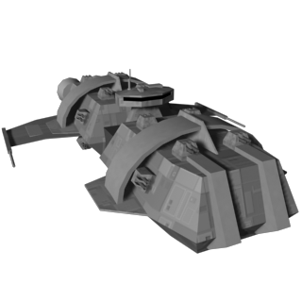
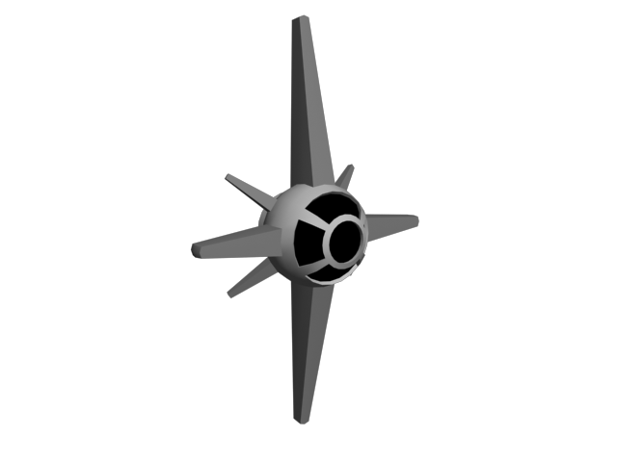

Taking over the
Universe!

Slide 3

Thousand Parsec
http://www.thousandparsec.net/

Slide 4
Thousand Parsec www.thousandparsec.net
Framework
Playable Games

Slide 5
Thousand Parsec
http://www.thousandparsec.net/
Any client <-> Any Server
Star Wars, Star Trek, Your own ideas!
Web of 4x games

Slide 6
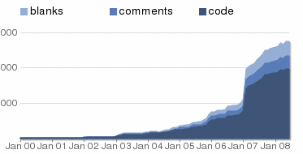
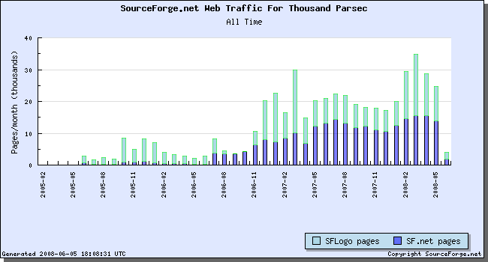
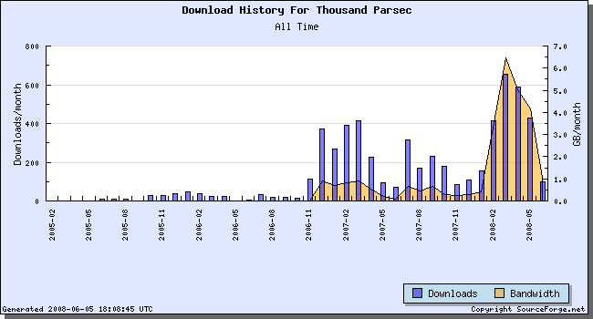
Growing
~150k LOC

Slide 7
Helping Grow
Google
Summer of Code
Students!

Slide 8
GSoC
2008
  8 students, 130k LOC
2007
  20,000 LOC from one student

Slide 9
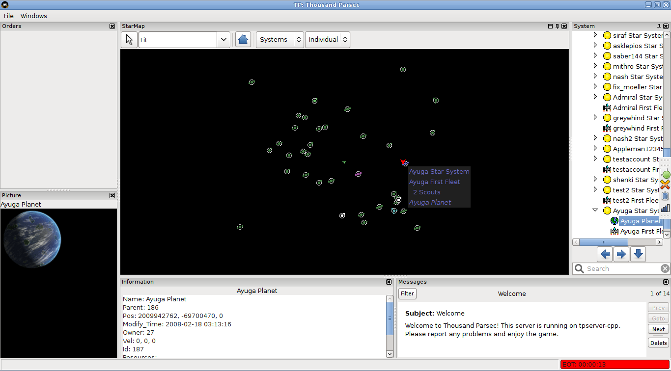
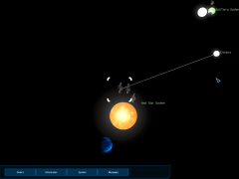
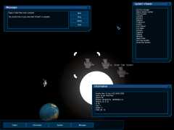
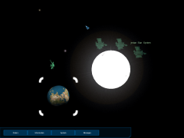
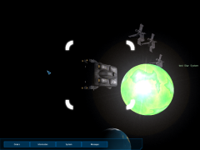
Eye Candy Woo!

Slide 10
Thousand Parsec http://www.thousandparsec.net/
  http://www.thousandparsec.net/
          tp/gettingstarted.php
  Help us play!
  (Windows, Mac, Linux)

