Slide 1
REST + Spring + AngularJS

Slide 2
Introduction
Trey Howard
Senior Consultant
Pinnacle Solutions Group
http://www.pinnsg.com/
@thoward333
https://github.com/thoward333

Slide 3
Service-Oriented Architecture
Growing popularity of SOA: “Digital Glue”
(forbes.com)
Mobile apps
SPA Apps: AngularJS, Ember, etc.—especially as browsers add more support for HTML5
SOA allows for re-use of a single API across all
Think of your website as a consumer of an API
It's OK for services to consume other services

Slide 4
External
System 1
AngularJS
External
System 2
DB1
Spring REST Service
DB2

Slide 5
Why RESTful?
Clean, meaningful URLs
Language agnostic: Java, .NET, JavaScript, etc.
Built on HTTP, so we get some things for free Caching rules, etc.
Don't have to use XML. JSON is less verbose, so less bandwidth usage, a mobile consideration. Native support in JavaScript
Java EE 7 is embracing JSON (oracle.com)

Slide 6
Why Spring?
Dependency Injection (DI) and
Inversion of Control (IoC) Container
MVC architecture promotes clean separation of tiers, which promotes testability
The spring-test module provides a full MVC lifecycle for unit tests
Jackson offers seamless JSON support
Mature, popular, well-documented

Slide 7
Why AngularJS?
MVC on the front end
Good support from Google and community
Declarative user interface
Bookmarkable URLs
Dependency Injection, promotes unit tests
Can be used as SPA or as components in an existing (traditional) site

Slide 8
Look Ma, No XML!
Java EE 6 Servlet 3.0 spec
Pluggability, ease of development, etc.
Allows WAR without web.xml
Spring 3.0 introduced annotation-driven, but still relied on web.xml for bootstrap
Spring 3.1 introduced WebApplicationInitializer, allowing Java bootstrap

Slide 9
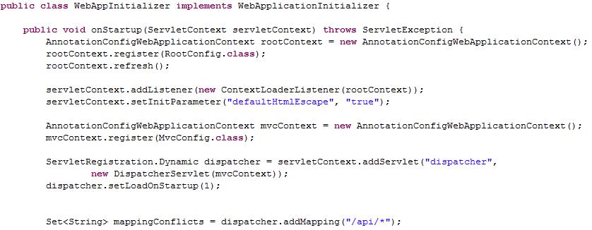
Java Bootstrap

Slide 10
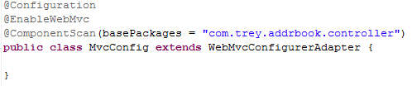
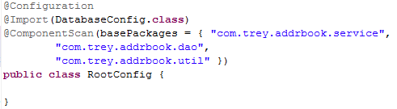
Spring @Configuration

Slide 11
@Controller @Service @Repository
@Component is generic stereotype
Special stereotypes allow better support for tools and aspects:
  @Controller: Web tier
  @Service: Business tier
  @Repository: Database tier (DAO)
  Provides automatic exception translation

Slide 12
@Controller (Web Tier)
Binds URLs to Java methods
@RequestMethod
Binds params/path variables to method params
@RequestParam / @PathVariable
Binds request body and request response
@RequestBody / @ResponseBody
HTTP Status: 200, 404, etc.
@ExceptionHandler / @ResponseStatus
Use DTOs to sculpt the request/response—do NOT use domain entities in request/response signatures

Slide 13
@Service (Business Tier)
Encapsulates all business logic
@Transactional – Transaction advice
At this layer the tx will wrap multiple operations to create a single “user transaction”

Slide 14
@Repository (Data Access Tier)
Spring's JdbcTemplate simplifies JDBC code
RowMapper, named parameters, etc.
@Transactional – Transaction advice

Slide 15
Show Me the Code!

Slide 16
Spring's Test Module (spring-test)
Run tests in full Spring MVC environment
@RunWith SpringJUnit4ClassRunner
@ContextConfiguration
org.springframework.test.web.servlet package
MockMvcBuilders, ResultActions, ResultMatchers—similar to Mockito
Supports XPath-like queries for JSON
Use custom @Configuration classes to provide mocked beans or use real ones for end-to-end integration tests

Slide 17
Show Me the Code!

Slide 18
AngularJS (Presentation Tier)
<html ng-app>
<div ng-view>
Popular convention is to organize code into separate files: app.js, controller.js, etc.
partials/ sub-directory contains templates
These are compiled into JavaScript during init
Consumes the Spring REST service using $http.get and $http.post

Slide 19
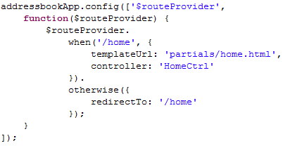
MVC

Slide 20
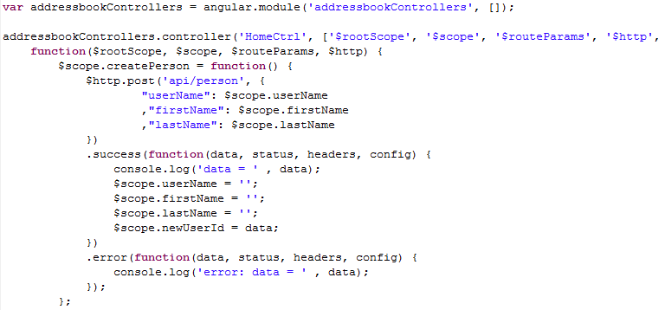
Dependency Injection

Slide 21
Data Binding with Directives
controller.js: $scope.userName
home.html: <input ng-model="userName" />
controller.js: $scope.createPerson = function() { ... }
home.html: <form ng-submit="createPerson()">
Can build custom directives, too

Slide 22
Filters
<div class="searchOutput">
{{person | json}}
</div>
Out of box filters also include orderBy, lowercase, limitTo, currency, date, etc.
Can define custom filters, too

Slide 23
Spring as a Proxy Service
Tight coupling of front end and REST service
Sometimes called a Microservice
What if our app needs to interact with many heterogeneous systems
The front end communicates solely with the REST service so we can fully control the request/response signatures and DTOs
This is especially important for mobile clients

Slide 24
Spring as a Proxy Service, cont'd
Leveraging Java tools/libraries for interfacing with the remote system: SOAP stubs, JMS, JUnit, etc.
Additionally, can mock/stub data in the service to support parallel development across teams
For example: developing a front end for a SOAP service still being developed by another team

Slide 25
Resources
Source Code: https://github.com/thoward333/addrbook
Forrester: Top Technology Trends for 2014 And Beyond
10 Reasons Why You Should Use AngularJS
Spring test mvc with Spring 3.2RC1
Unit Testing of Spring MVC Controllers: “Normal Controllers”
JUnit Testing Spring Service and DAO (with In-Memory Database)

