Slide 1
WebSockets
(HTML5, JSR 356, EE7)

Slide 2
Introduction
Trey Howard
Principal Consultant
Pinnacle Solutions Group
http://www.pinnsg.com/
@thoward333
https://github.com/thoward333
http://www.linkedin.com/in/treyhoward/

Slide 3
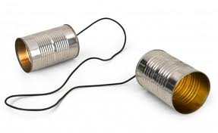
Before WebSockets
http://www.alamoareabsa.org/News/CommunicationNewsOct2012

Slide 4
Before WebSockets
Poll or Long poll (HTTP 1.0 or 1.1)
  AJAX (socket.io) call per message
  Had to deal with timeouts
  HTTP header overhead, latency hit
HTTP Streaming
HTTP 2.0

Slide 5
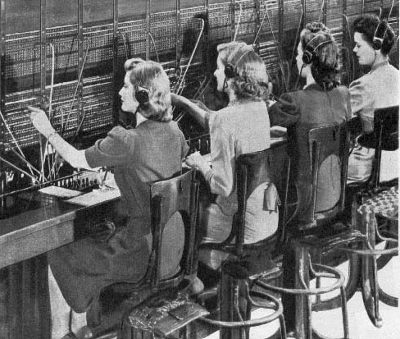
After WebSockets
http://ourwebhome.com/TENP/TENproject.html

Slide 6
HTML5 WebSockets
HTTP Upgrade – handshake
Full-duplex communication
Message-based transport layer
Single HTTP connection for all messages
Support: Modern browsers (IE10+), EE7
Not single request per response
Not HTTP 1.0 or HTTP 1.1 (ws:/wss: protocol)

Slide 7
Java WebSockets
JSR 356, EE7
Java EE7 added support for WebSockets
Annotation-based or Interface driven
Stateful WebSocket (unlike Servlet)

Slide 8
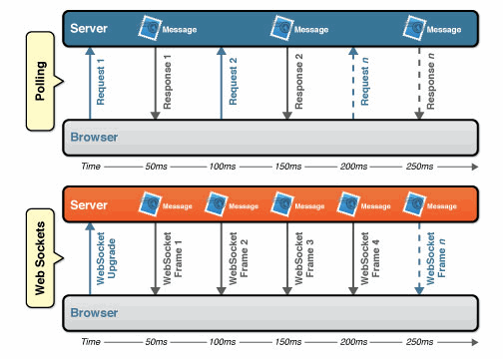
WebSocket Lifecycle
Reduced network traffic
http://www.websocket.org/quantum.html

Slide 9
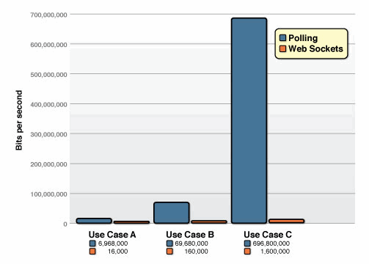
WebSocket Performance
A=1K clients, B=10K, C=100K
http://www.websocket.org/quantum.html

Slide 10
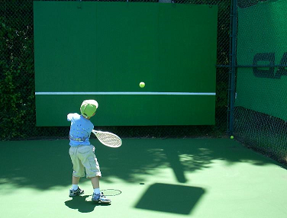
SMTC!
Demo 1 – MySocket
Client sends message
Server echos it back
Stateful: Created timestamp to distinguish
Error: message 'error'
http://www.optimumtennis.net/tennis-warm-up-drills.htm

Slide 11

SMTC!
Demo 2 – ChatSocket
Client authenticates (login@user)
Client sends message
Stateful: User to distinguish
Server sends user@message to all clients
javax.websocket.Session.getOpenSessions()
Real app could use JMS or similar
http://www.dailyelessons.com/Daily_E_Lessons/Chat_room.html

Slide 12

SMTC!
Demo 3 - ChatClient
Desktop app with J2SE + 2 libraries:
  javax.websocket-api-1.0.jar
  tyrus-standalone-client-1.7.jar
http://www.iconshock.com/icon-sets/stroke-networking-icons.html

Slide 13
Questions?

Slide 14
Resources
http://en.wikipedia.org/wiki/WebSocket
http://caniuse.com/websockets
http://www.oracle.com/technetwork/articles/java/jsr356-1937161.html
https://www.youtube.com/watch?v=_Fi4vz6oUio
http://www.websocket.org/demos.html
http://architects.dzone.com/articles/sample-java-web-socket-client

