Slide 1


ModuleViewer
A standalone Java GUI for visualizing gene modules and expression data.
Lunch meeting 25/10/2011
Thomas Van Parys

Slide 2
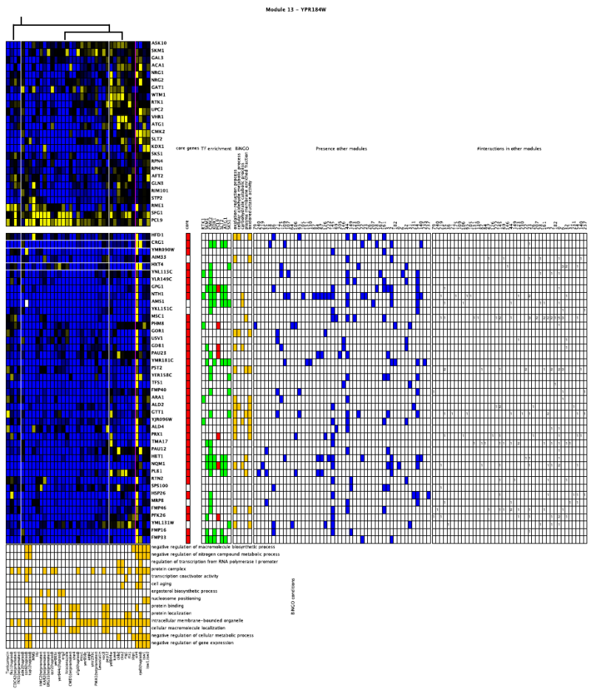



ModuleViewer

Slide 3
ModuleGraphics
Generic Elements
Canvas: layout of Elements
Rendering of graphics
Managing MouseEvents
iText
Pdf library
Eps library
epsgraphics
ModuleViewer
Parsing of input files
Model of ModuleNetwork
Application specific Elements
GUI for rendering the graphics and browsing the data.

Slide 4


ModuleGraphics
Graphical library for Java developers
Elements
  Data agnostic
  Generic
  Extensible
Canvas
  Contains Elements
  Grid layouting: add(), newRow()
  Nested structures
Rendering on JLabel or figure (eps, pdf, ...)
matrix
tree
label

Slide 5
ModuleViewer
Standalone Java GUI, desktop application
Depends on ModuleGraphics
Specific for LeMoNe/Enigma style figures
Loads files locally or over http
Parses input data
Renders figures in navigable GUI

Slide 6
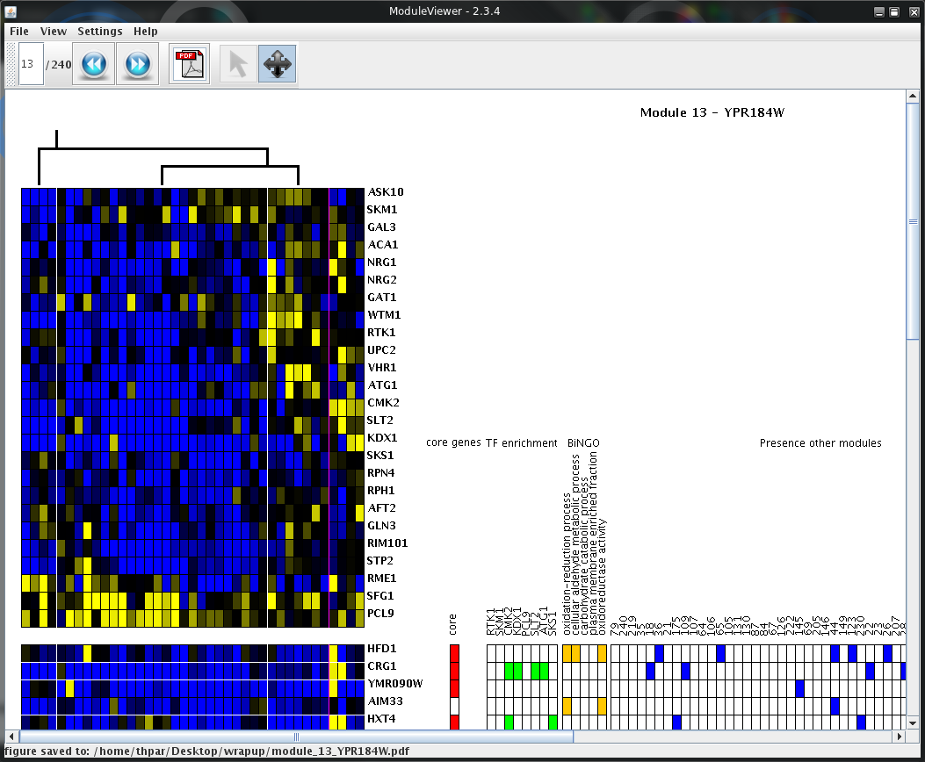

Slide 7
File types
Regulator Tree(s)
XML
Expression data
Tab delimited file with
conditions, genes and values
Annotations
MVF
Gene tree
XML
Condition tree
XML
Annotations
MVF

Slide 8
ModuleViewer Format (MVF)
Format to describe extra data around an expression matrix.
Module# | list of genes [| label]
Block tags
  NAME, OBJECT, TYPE, COLOR, ...
::TYPE=bingo
::TITLE=BiNGO
::COLOR=orange
::OBJECT=GENES
#MODULENUMBER OBJECT LABEL
0 HOM2|STR2|STR3|VHR1|SAM4|BIO3|BIO4|MET13|MET22|ISA1 sulfur compound biosynthetic process
0 LEU1|AAP1|TEA1|ERG5|STB4|PIP2|HIS1|ADH5|PYC2|ARO1|RIM101|ZTA1|BUD16|STP2|ISU1|LYS12|LYS5|ADE
0 LEU1|ACO2|ISU1|CFD1|DRE2|ISA1|ILV3 iron-sulfur cluster binding
0 AAP1|ERG4|ERG5|ADH5|PDX3|PYC2|ARO1|ERG1|ZTA1|LYS1|AAD10|LYS12|ALD5|ARG5,6|LYS2|NQM1|AAD16|ER
0 PHO89|SSU1|ATR1|OAC1 inorganic anion transmembrane transporter activity
0 PHO89|VHT1|MCH4|ESBP6 symporter activity
0 VHR1|BIO3|BIO4|ISA1 cellular amide metabolic process
0 HOM3|LYS2|ARG3 amine binding

Slide 9
Usage
Used as visualization at end of Arctix Galaxy pipeline
Standalone, Java Webstart:
http://bioinformatics.psb.ugent.be/webtools/moduleviewer/launch.jnlp
Documentation, demo data, downloads, feature requests and bug reports:
https://psbsvn01.psb.ugent.be/trac/modnet

