Slide 1
Specialized Project 2
Building an iot system in aquaculture
Nguyễn Thành Quốc – 21CE109

Slide 2
Content
Overview
Cơ sở lý thuyết
Theoretical basis
Conclude

Slide 3
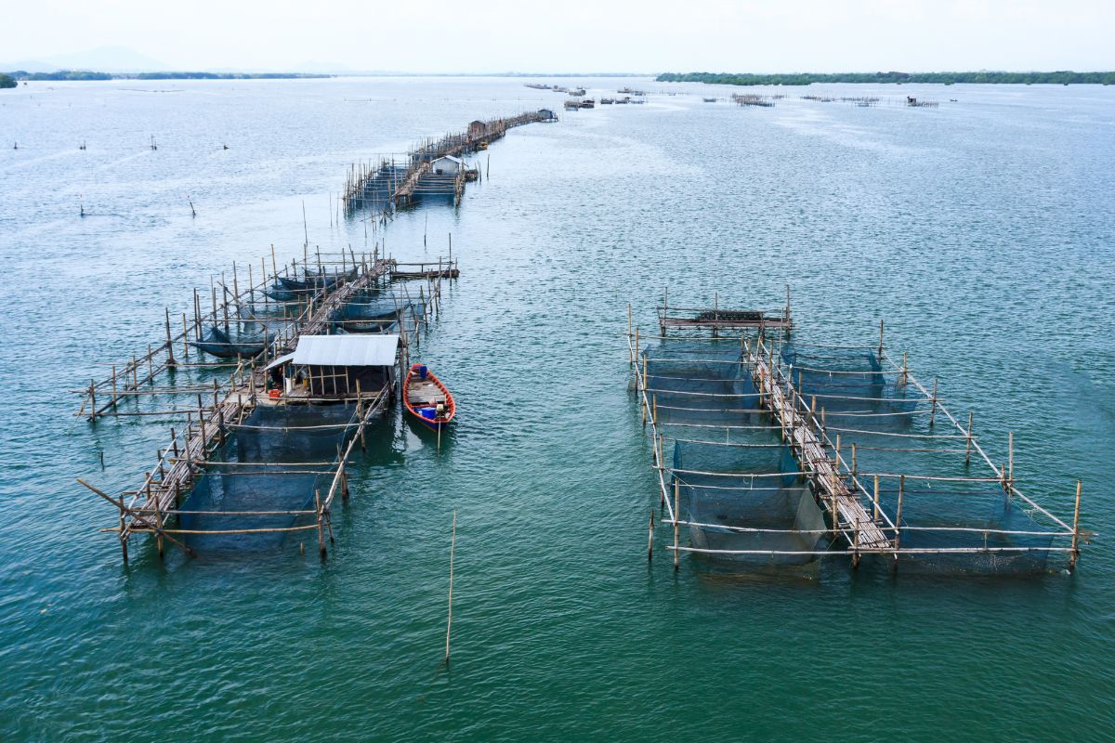
Overview
IoT systems in aquaculture use IoT technology to automatically monitor and control factors such as temperature, turbidity of water, pH, oxygen solubility, ultrasonic sensors. The data will be stored in firebase.

Slide 4
Overview
Objectives of the project:
- Automate the aquaculture process, saving time and effort.
- Control environmental factors such as water turbidity, oxygen solubility, etc.
- Control the risk of diseases in aquatic products through environmental factors.
Reasons for choosing the topic:
- Farmers face many difficulties in controlling diseases caused by environmental factors.
- Minimizing labor for farmers.

Slide 5
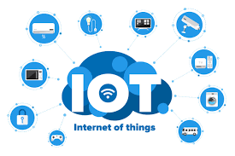
Theoretical basis
IoT concept: IoT is a network of devices connected via the internet, allowing data to be exchanged and collected remotely.
Applications in fisheries: IoT helps monitor environmental conditions, automatically control systems, and analyze data to improve production.

Slide 6
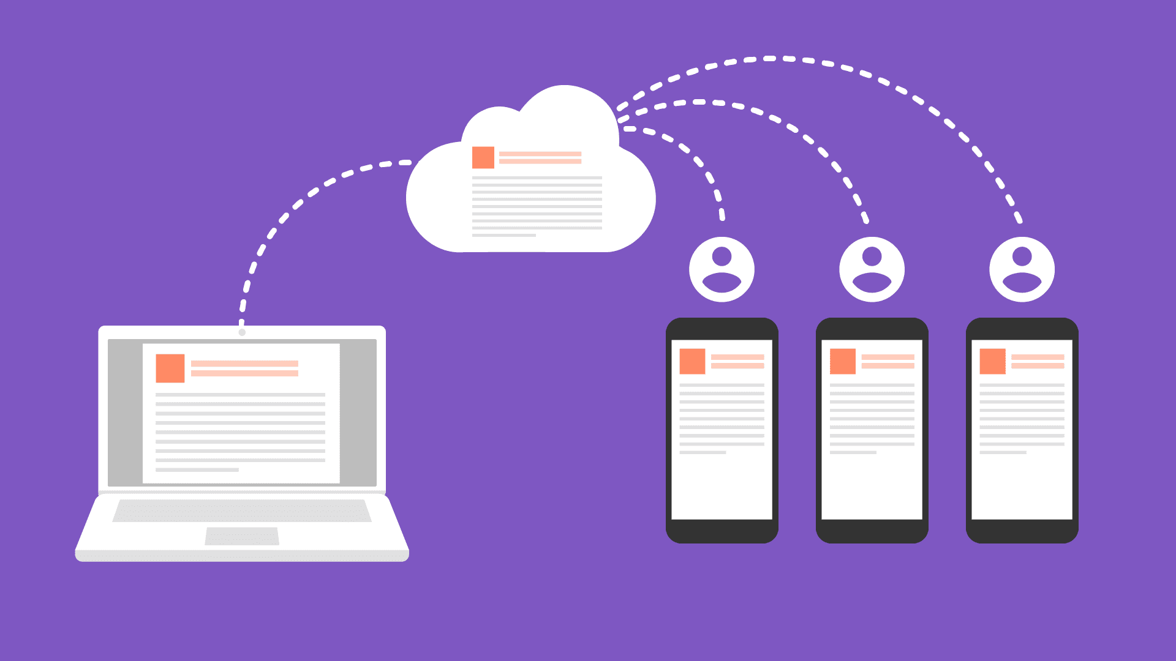
Theoretical basis
Firebase
Firebase is a database service that operates on a cloud platform and is used on Google's server system, which is the platform for fast, easy mobile application and website development.

Slide 7
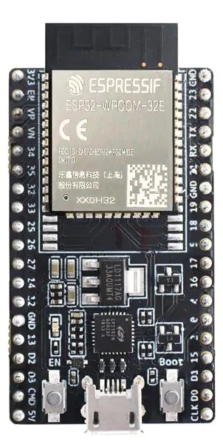
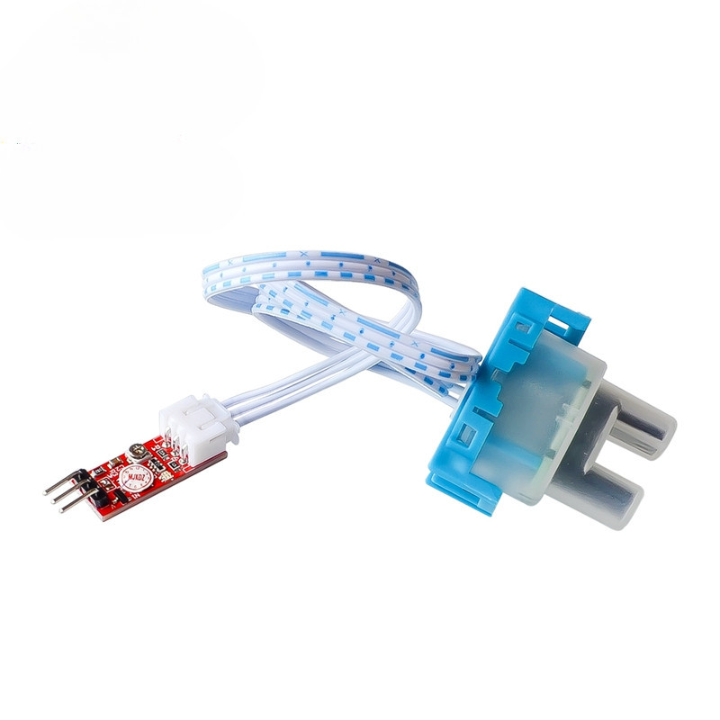
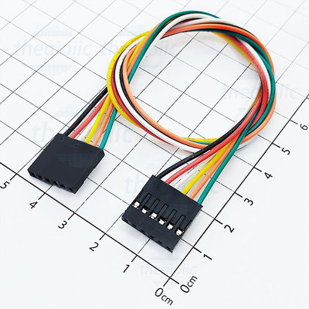
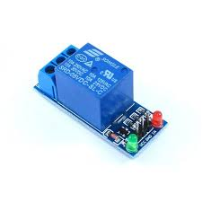
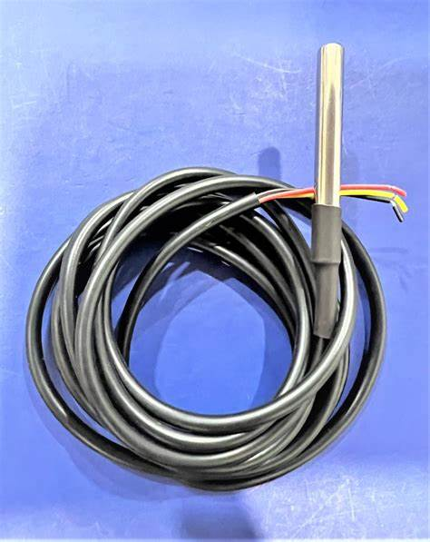
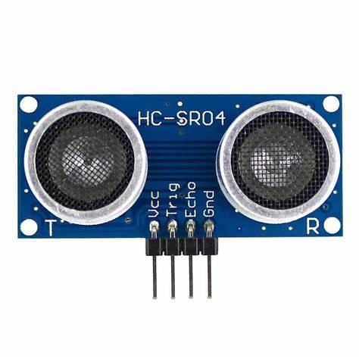
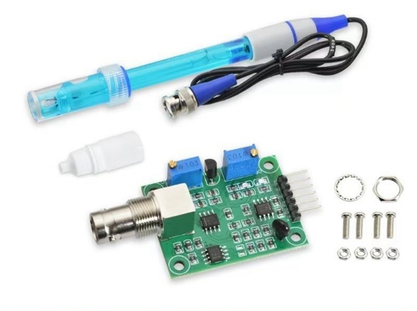
System design and implementation

Slide 8
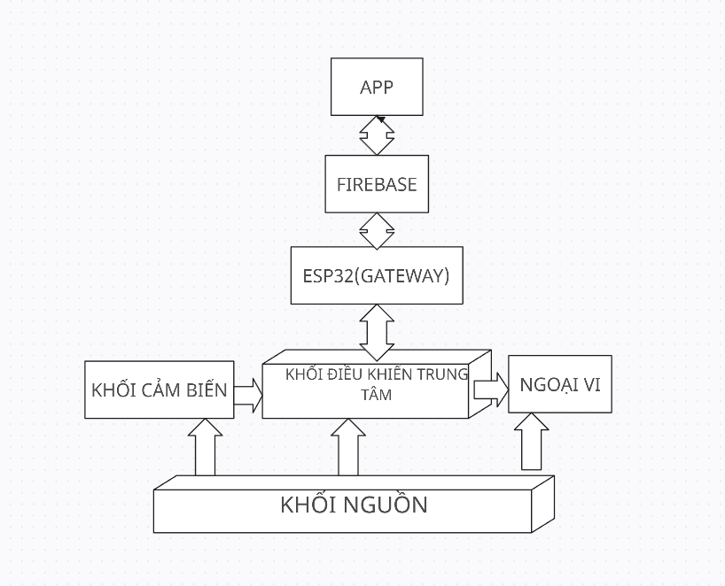
System design and implementation
System Diagram

Slide 9
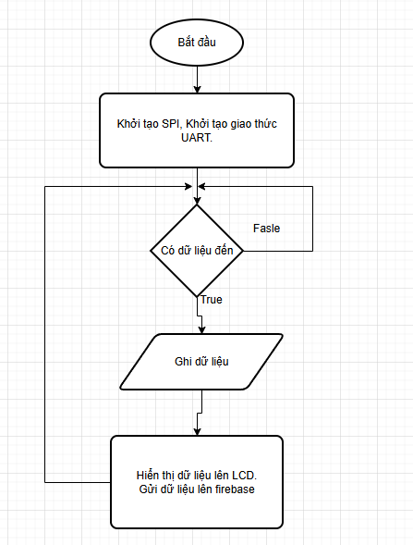
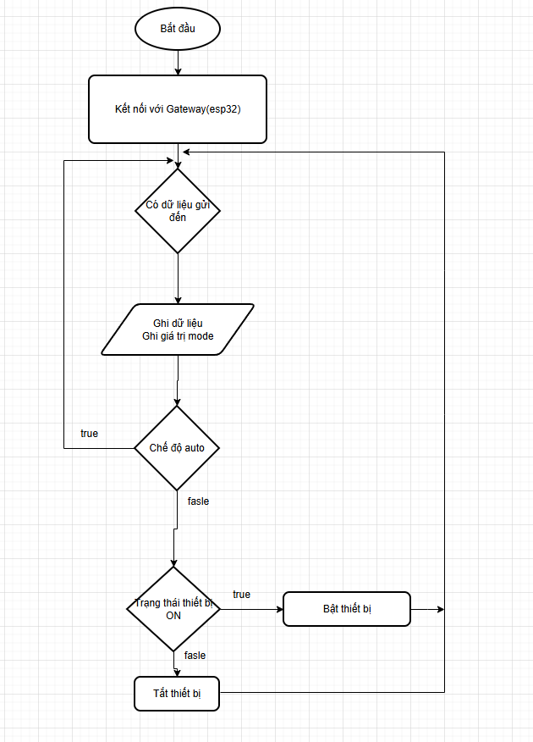
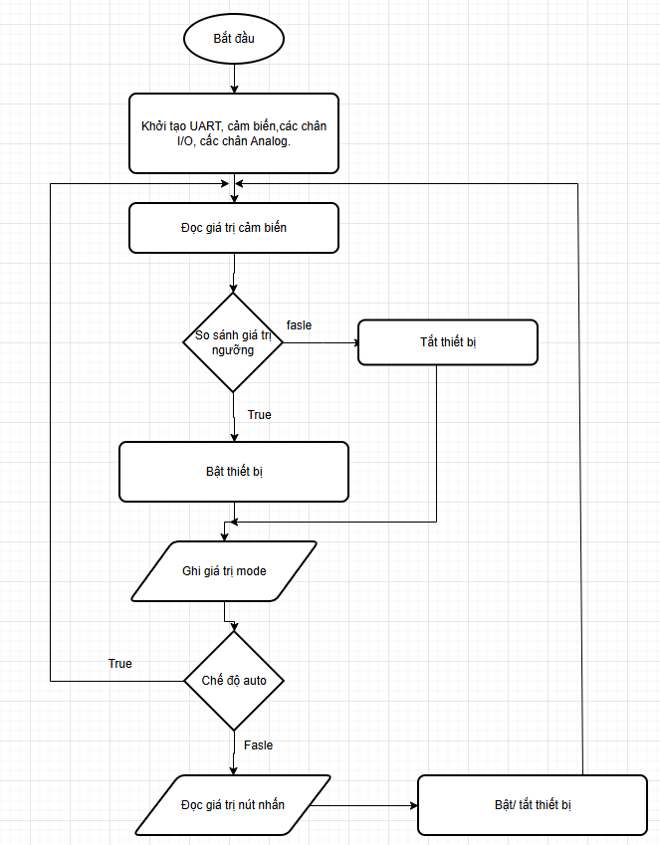
System design and implementation
Lưu đồ gải thuật của arduino, cảm biến và khối ngoại vi
Lưu đồ giải thuật gateway(esp32) với arduino uno.
Lưu đồ giải thuật điều khiển thiết bị bằng app thông qua gateway
Lưu đồ thuật toán

Slide 10
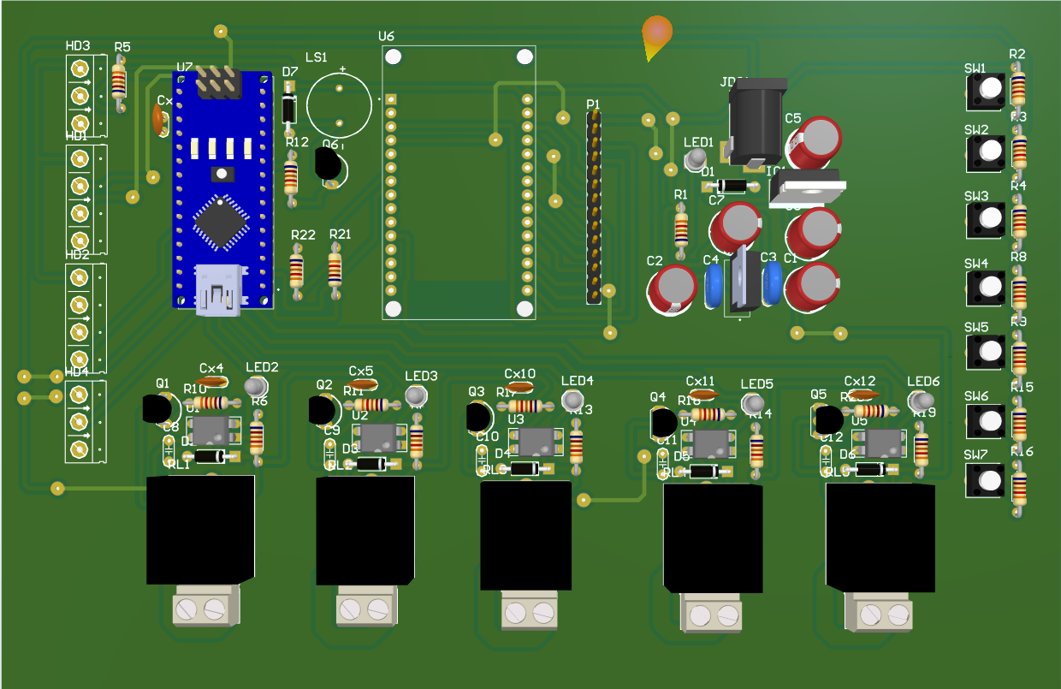
System design and implementation
Results Achieved

Slide 11
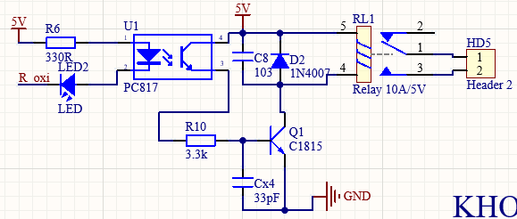

Relay Block Principle Diagram
$\text{"}\text{The} \text{manufacturer}\text{'}\text{s} \text{recommended} \text{line} \text{for} \text{pc}\text{817 }\text{internal} \text{infrared} \text{led} \text{is}\text{ 5}\text{mA} \text{to}\text{ 20}\text{mA}\text{.}“$
The manufacturer's recommended voltage is between 1.2V and 1.4V. Then the current resistance of the pc817 will be : $R_{6}=\frac{Vcc−V_{led}−V_{sat}}{I_{led}}=\frac{5−1.3−0.2}{0.01}=350R$

Slide 12
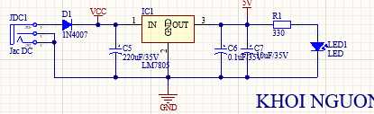

Power Block Principle Diagram
In the circuit we use leds to recognize the status of the source. The red LED uses a current of 10mA to 20mA and the voltage drop is about 1.8V to 2.2V
$R_{1}= \frac{Vcc−V_{led}−0.2}{I_{led}}= \frac{5−1.8−0.2}{0.01}=300Ω.$

Slide 13
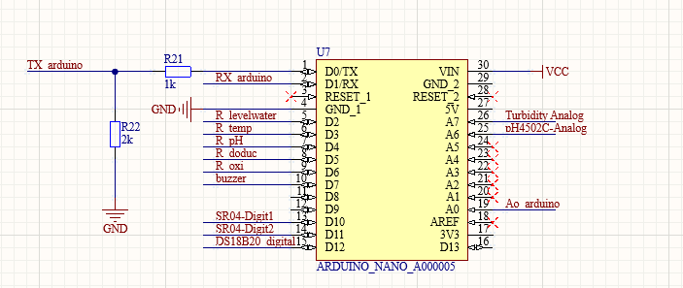
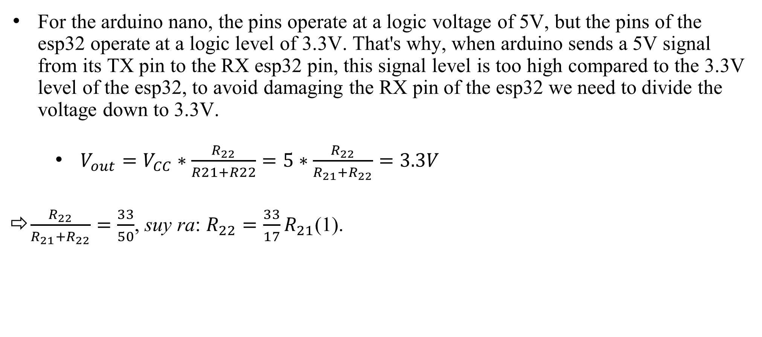
Central Control Block Principle Diagram
For the arduino nano, the pins operate at a logic voltage of 5V, but the pins of the esp32 operate at a logic level of 3.3V. That's why, when arduino sends a 5V signal from its TX pin to the RX esp32 pin, this signal level is too high compared to the 3.3V level of the esp32, to avoid damaging the RX pin of the esp32 we need to divide the voltage down to 3.3V.
$V_{out}=V_{CC}∗\frac{R_{22}}{R21+R22}=5∗\frac{R_{22}}{R_{21}+R_{22}}=3.3V$
$\frac{R_{22}}{R_{21}+R_{22}}=\frac{33}{50}$, suy ra: $R_{22}=\frac{33}{17}R_{21}$(1).

Slide 14
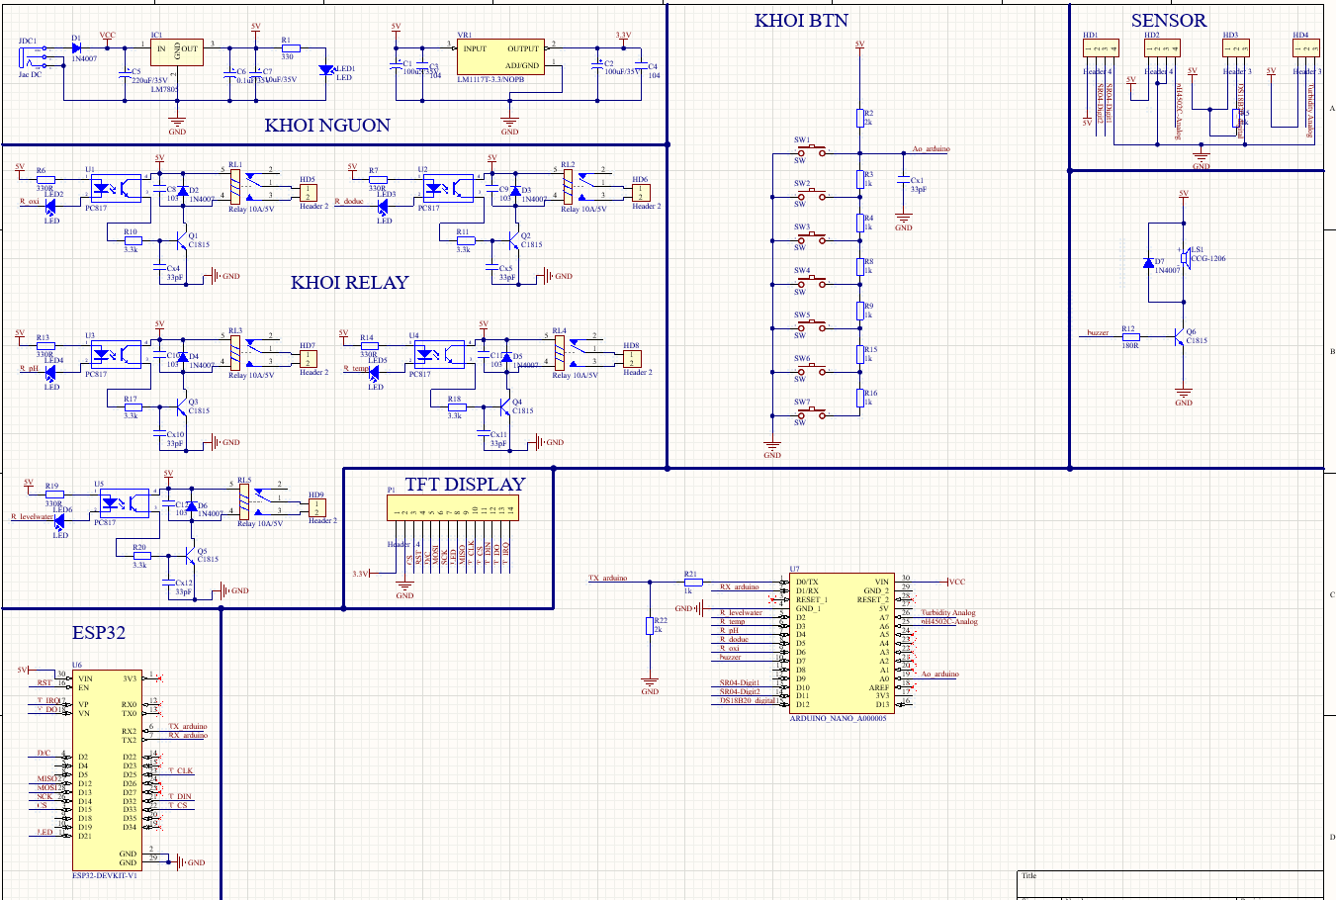
Whole Circuit Principle Diagram

Slide 15
Conclude
The project "Building an IoT system in aquaculture" has completed the goal of designing and deploying an automatic monitoring and control system. The system makes it easy for farmers to monitor important environmental parameters such as temperature, pH, dissolved oxygen concentration, etc. in real-time through the mobile app. At the same time, the automatic control function of equipment such as aerators, pumps and lighting systems makes it more convenient for users to manage ponds remotely.

Slide 16

CẢM ƠN
số 8

