Slide 1

Introductory Penetration Testing
A Hands-on Approach to Learning
By: Ethan Page
Notes:
Hello, my name is Ethan Page and I’m here to talk about my presentation entitled: Introductory Penetration Testing: A Hands-On approach to learning

Slide 2
Penetration Testing Skills Gap
This survey discovered:
Globally, 60% of leaders admit their organizations struggle with cybersecurity recruitment as candidates lacked necessary skills.
Which roles are these organizations looking for?
27% of organizations were actively looking for penetration testers
Which roles are hardest to fill?
34% said Security Assessment and Testing roles were amongst the hardest to fill.
The Cybersecurity Skills Gap Report was conducted by Fortinet in 2022
The report was conducted by surveying 1223 IT and cybersecurity decision-makers located in over 25 countries
Notes:
The cybersecurity job market is currently facing a concerning challenge. The challenge is the current skill gap between candidates, and the roles they seek to fill

Slide 3

The Numbers
Cyberseek estimates over 750,000 cybersecurity jobs currently unfilled.
According to Cyberseek:
Penetration & Vulnerability Tester is one of the most challenging roles for employers to fill
Figure 1

Slide 4
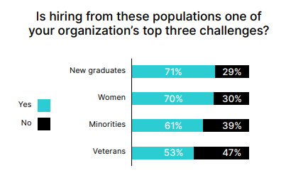
Graduate Hiring Challenges
Despite an increase in computer science graduates, Cybersecurity Skills Gap Report shows 71% of those surveyed stated that hiring new graduates was a challenge for their organization.
This ranked new graduates as the most difficult demographic to hire from.
Figure 2

Slide 5
Problems Presented
The cybersecurity industry is facing an increasingly wide skills gap, resulting in an alarming number of unfilled positions
Penetration Tester and Security Assessment roles are one of the hardest cybersecurity positions for employers to fill.
Despite relevant degrees, college graduates often enter the job market without the skills required to fill aforementioned roles.

Slide 6
What is Responsible for This Gap?

Slide 7
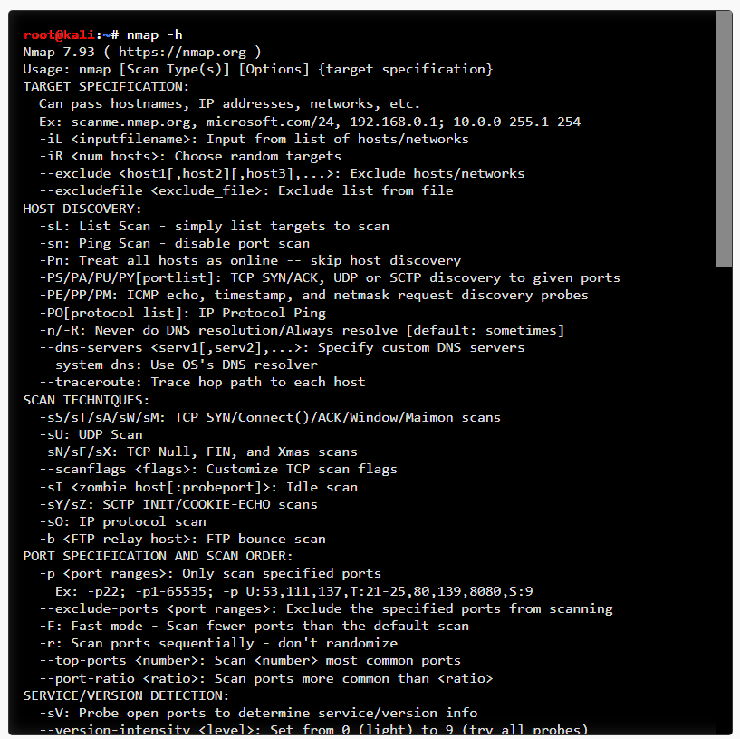
Steep Learning Curve
Nmap “help” output in Kali Linux command line interface
Notes:
One of the challenges that faces individuals getting started with penetration testing topics, is that penetration testing has a very steep learning curve. This image shows output from a program called Nmap. Nmap is a commonly used tool in penetration testing due to it’s network mapping capabilities. It is listed in the NICE framework as a tool that Vulnerability Assessment analysts should be familiar with using. It’s listed by Infosec Institute as the number one most useful pentesting tool. This is the “help” output for Nmap. If you’re just getting started with pentesting, this can be a little intimidating. To learn how to get to this output, you must know how to install and use Linux. You must be familiar with the Linux package manager and how to install Linux, and you’d need to understand how to navigate Linux. Then, to use Nmap, you must have some knowledge of networking to understand the functions of domain names, ports, IP addresses and so on. Attempting to use some of the most simple, common penetration testing processes and tools, can certainly give beginners some challenges to overcome.

Slide 8
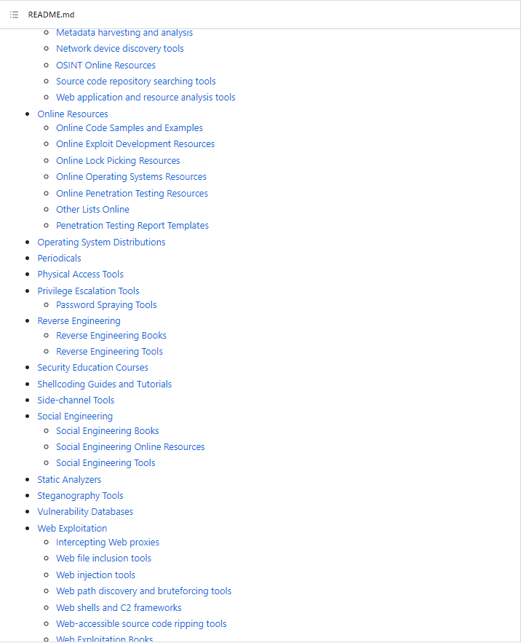
Lack of Direction and Information Overload
“Awesome Pentest”
Github.com
Notes:
Say you’ve made it far enough to get to the image in the last slide, and you’re determined to learn Nmap, so you navigate to github and search “pentesting”. You see a page called “Awesome Pentesting” with over 17,000 stars and you think “great, I’m sure I’ll find a guide here”. You open the page and encounter 20+ pages like the one shown in the image. Where do you start? There are many great resources online for pentesting, but these resources do a poor job with providing direction. For a beginner, the sheer amount of information can be way too overwhelming.

Slide 9
Computer Science and Cybersecurity Curriculum Design
“Preparing Cybersecurity Professionals to Make an Impact Today and in the Future” NIST & ISACA (2017)
“The fundamentals of security, networking, business, governance and risk are all being taught. The problem is that each of these is its own discipline…students are getting more of a “jack of all trades” education than a deep dive into each specialty.”
“They (students) receive very little hands-on training; thus, the skill sets need to be developed on the job. If people do not supplement their training and education with on-the-job experience…they will not be prepared to face the challenges that enterprises are encountering”

Slide 10
How do educators prepare students for these roles?

Slide 11
This is a Major Challenge Facing Educators
Computer Science programs
As seen, typically not enough to prepare students for penetration testing roles.
Often requires additional education beyond four-year programs
Cybersecurity Programs
Very new and inconsistent across universities, leading to holes in knowledge
This leads to the requirement of additional education beyond 4-year programs
Certifications Route
Can be effective, but very pricey
Comptia Security+: $360
Certified Ethical Hacker: $950-$1199
Offensive Security Certified Professional: $850
Inherently requires additional education

Slide 12
Is it possible to alter existing computer science and cybersecurity programs to better prepare students for unfilled roles?

Slide 13
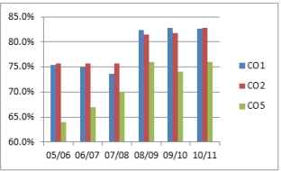
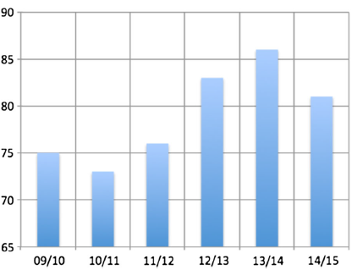
Course Outcomes Before and After the Implementation of Labs
Figure 3
Figure 4
Scores for DDos attack related tests in
SEC455: Intrusion Detection and Response,
United Arab Emirates University
Implementation of labs began year 08/09
Scores for Android app security tests
in SECB358: Network Border Control,
United Arab Emirates University
Implementation of labs began year 12/13
Notes:
Thes are graphs of test scores for classes Intrusion Detection and Response, and Network Border Control and United Arab Emirates University. In the first, students participated in labs that took them through the process of carrying out a Distributed Denial of Service attack to better understand security measures to prevent those types of attacks. In the second, students participated in packet analysis labs, to better understand firewall filtering rules

Slide 14
Experimenting With Labs in College Cybersecurity Classes
Higher test scores by students in every class.
The vast majority of students reported:
Increased understanding of topics presented.
Increased ability to apply security principles & tools in practice.
Authors concluded hands-on labs lead to better overall learning outcomes.
Studies conducted by Zouheir Trabelsi & Walid Ibrahim (United Arab Emirates University) implemented labs in cybersecurity classes and found:
Notes:
A theory of this research is that educators can add methods to established Computer Science and Cybersecurity programs to adequately prepare students for cybersecurity positions without the need of additional education

Slide 15
This Research Seeks To:
Take input from cybersecurity professionals like those quoted in the NIST & ISACA document
Recreate & Demonstrate the efficacy of a hands-on, lab focused learning process for the execution of penetration testing tasks.
Give students a clear, comprehensible progression path for developing penetration testing knowledge and skills.
Begin to bridge the gap between the skills of college graduates, and the skills required for penetration testing roles.

Slide 16
Project Overview
Penetration testing lab
A “pilot” virtual machine for students
An intentionally vulnerable “target” machine
A comprehensive penetration testing methodology
Commonly used penetration testing tools
Clear starting point and learning path for students
Notes:
This project is made up of a full penetration testing lab environment. A “pilot” virtual machine, which will serve as the operator for which students participate in the lab. Twi intentionally vulnerable target machines, that serve as demonstrations of real world vulnerabilites. This lab will be accompanied by a comprehensive penetration testing methodology that will serve as a guide for students during the ab. It will cover a multitude of commonly used penetration testing tools. And it will provide students with a clear process for starting and progressing when learning the topic of penetration testing-avoiding some of the challenges presented by both the sharp learning curve, and the overwhelming amount of information.

Slide 17
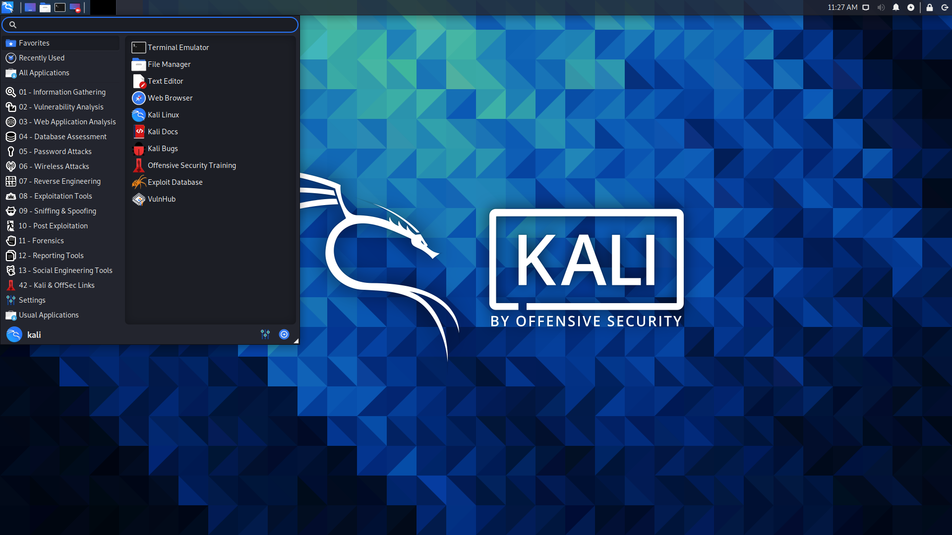
Pilot Machine: Kali Linux
Kali Linux Operating System
Created by Offensive Security
“Pilot” Virtual Machine
Open-source, Debian-based Linux distribution.
Designed for penetration testing.
Notes:
For the pilot machine, students will use the Kali linux operating system. Kali Linux was…

Slide 18
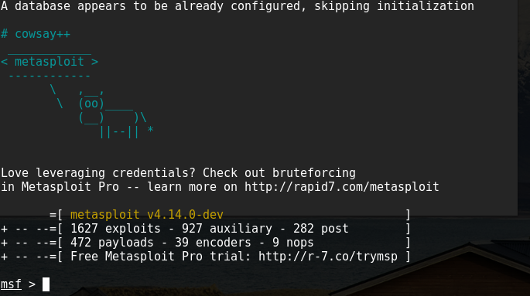
Metasploitable2
Metasploitable2
Created by Rapid7
“Target” Virtual Machine
An intentionally vulnerable virtual machine.
Created to serve as a target for practicing penetration testing tasks.
Notes:
The first target machine will be metasploitable two

Slide 19
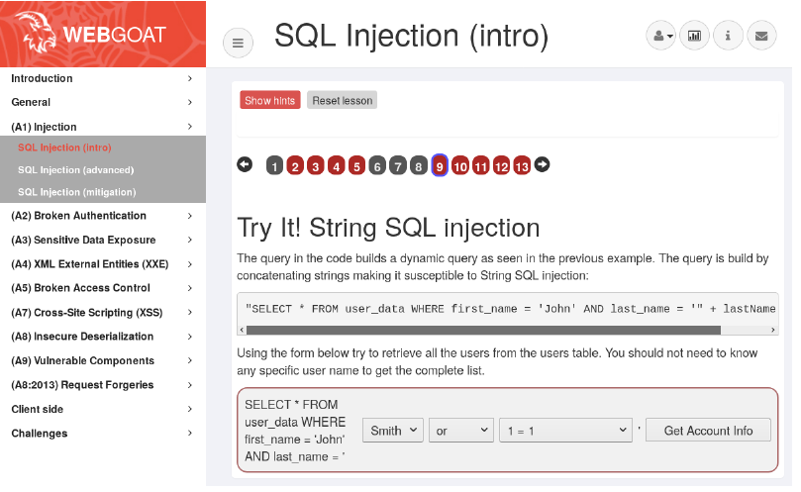
OWASP WebGoat
WebGoat
“Target” Virtual Machine
Deliberately vulnerable, Java-based web application.
Created as an aid for security students and professionals to practice their skills in a legal environment
Notes:
The second target machine is OWASP WebGoat. Owasp Webgoat is…

Slide 20
Lab Creation Steps:
Download virtual machine file from source
Upload file to virtualization cluster
Boot up machine
Ensure connection of machines
Lab is initialized

Slide 21
Basis for Framework
NIST: Technical Guide to Information Security Testing and Assessment
SANS: Conducting a Penetration Test on an Organization
EC Council: Five Phases of the Penetration Testing Process
ISECOM: Open-Source Security Testing Methodology Manual
PTES Technical Guidelines: Pentest Standard Technical Guidelines
OWASP: Testing Guide
Notes:
The basis for the methodology creation was the multitude of methods and guides that have been made available by many of the highly respected cybersecurity organizations that guide us as students and professionals.

Slide 22
Methodology Framework
Reconnaissance
Sometimes called information gathering, this step entails accumulating all possible information on a target.
Enumeration
This step entails taking information from the reconnaissance process and using it to determine potential weak points in the target.
Exploitation
Exploitation refers to all phases of testing where the discovered weaknesses are capitalized on.
Post-Exploitation
This step can include covering tracks and/or maintaining control, but for purposes of this lab, it will focus on reporting.
Notes:
While all of the guides mentioned in the previous slide provide excellent information, they each have their own ways of conducting a penetration test. While some, of those resources, like the PTES may go into every possible detail of a pentest, some of the others have more broad descriptions of the process. Another issue beginners may face when reading those documents, is their variability. THe the terminology used for a concept in one document, may vary in another. For example, Reconnaissance. Sometime this is referred to as Information Gathering, sometimes it’s reconnaissance. In one document, scanning may be done in the Reconnaissance Step, in another it is done in the enumeration step. So upon review of those resources, and taking the audience of this project into consideration, this study has taken the core themes among all the documents, tailored them down to fit the purposes of this lab, and distilled them into these four overarching steps.

Slide 23
Basis for Tool Selection
All tools were selected for a specific purpose.
Selections were based on suggestions from respected cybersecurity organizations.
Sources for Tool Selection
CISA Free Cybersecurity Services and Tools
OWASP Testing Tools
InfoSec Institute
Official Kali Tools Website
Notes:
When tools were being considered for this project, a certain criteria was applied to the selection. Is the tool referenced in any of the aforementioned methodology resources?
Is the tool referenced by a respectable cybersecurity education or job framework like NICE? Is it referenced in other respectable documents?

Slide 24
Methodology Break Down
Reconnaissance
OSINT
Web-based tools
Desktop/CLI tools
Reconnaissance Scanning
Netdiscover
Nmap
dnsrecon
Amass
theHarvester
Enumeration
Nikto
Dirb
Wfuzz
Wpscan
Exploitation
Metasploit
Target exfiltration files
Reverse shell techniques
Post-Exploitation
Report Writing
Faraday
Notes:
Tools and processes were then decided upon and added to the overarching step that their purpose corresponds with

Slide 25
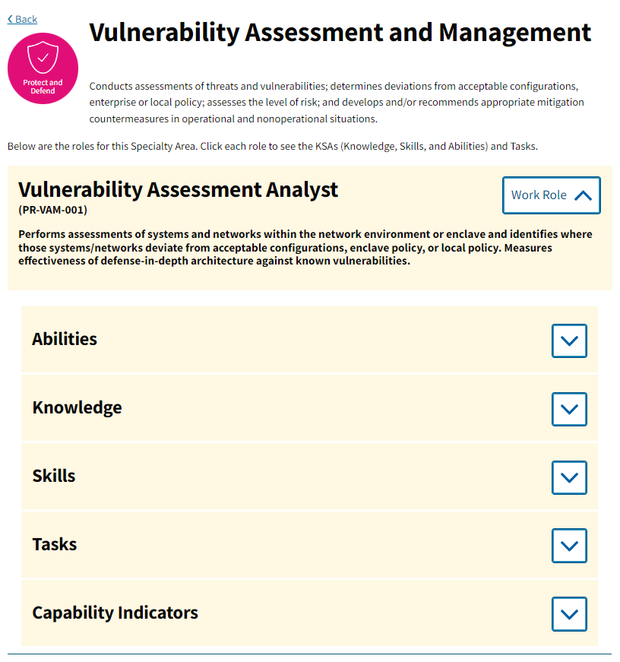
Intended Outcomes: NICE Framework
NATIONAL INITIATIVE FOR CYBERSECURITY EDUCATION (NICE)
Online Resource for cybersecurity training, education and career information
Primary Role Examined:
Vulnerability Assessment Analyst
Figure 5
Notes:
That brings us to the intended outcomes for this project. The project was created with very specific outcomes in mind. Those were the ability, knowledge, skill, and task requirements put forth by the NICE Framework by NICCS. This research focused on the defined Vulnerability Assessment and Management Role Requirements. The NICE Framework lays out exactly what is expected from candidates who apply for these roles, and even break it down by entry/mid/senior level expectations

Slide 26
Intended Outcomes: Knowledge, Skills & Tasks
KNOWLEDGE
K0206: Knowledge of ethical hacking principles and techniques.
K0177: Knowledge of cyber attack stages (e.g., reconnaissance, scanning, enumeration, gaining access, escalation of privileges, maintaining access, network exploitation, covering tracks).
SKILLS
S0051: Skill in the use of penetration testing tools and techniques.
S0081: Skill in using network analysis tools to identify vulnerabilities. (e.g., fuzzing, nmap, etc.).
S0137: Skill in conducting application vulnerability assessments.
TASKS
T0549: Perform technical (evaluation of technology) and nontechnical (evaluation of people and operations) risk and vulnerability assessments of relevant technology focus areas (e.g., local computing environment, network and infrastructure, enclave boundary, supporting infrastructure, and applications).
T0550: Make recommendations regarding the selection of cost-effective security controls to mitigate risk (e.g., protection of information, systems and processes).
Notes:
These are the core requirements referenced by NICE that this project intends to help students develop and meet. The hope is that upon completion of this lab, students will be more prepared to meet the demands of the current job market for Penetration Testers

Slide 27
Challenges Faced
Limited data on teaching methods for penetration testing
Limited information to draw from for lab development
Time and resource constraints for lab setup
Limited data and statistics available regarding cybersecurity education
Obstacles and responsibilities outside of research
Notes:
To close, I wanted to mention some of the challenges faced during this research.

Slide 28
Citations
Cyberseek. (2023). Cybersecurity Supply and Demand Heat Map. Cybersecurity Supply And Demand Heat Map. Retrieved April 27, 2023, from https://www.cyberseek.org/heatmap.html
EC-Council. (2023, April 19). Understanding the five phases of the penetration testing process . Cybersecurity Exchange. Retrieved April 19, 2023, from https://www.eccouncil.org/cybersecurity-exchange/penetration-testing/penetration-testing-phases/#:~:text=There are five penetration testing,assessment%2C exploitation%2C and reporting.
Kali tools: Kali linux tools. Kali Linux. (2022, July 14). Retrieved March 15, 2023, from https://www.kali.org/tools/
Metasploitable 2 exploitability guide. Metasploitable 2 Exploitability Guide | Metasploit Documentation. (n.d.). Retrieved March 15, 2023, from https://docs.rapid7.com/metasploit/metasploitable-2-exploitability-guide
National Initiative for Cybersecurity Careers and Studies. (n.d.). Vulnerability assessment analyst. NICCS. Retrieved April 27, 2023, from https://niccs.cisa.gov/workforce-development/nice-framework/work-roles/vulnerability-assessment-analyst
NIST. (2017, August 1). Preparing Cybersecurity Professionals to Make an Impact Today and in the Future. NIST. Retrieved April 27, 2023, from https://www.nist.gov/system/files/documents/2017/08/01/nice_rfi_final_isaca.pdf
OWASP Foundation. (n.d.). Free for open source application security tools. Free for Open Source Application Security Tools | OWASP Foundation. Retrieved April 27, 2023, from https://owasp.org/www-community/Free_for_Open_Source_Application_Security_Tools
OWASP Foundation. (n.d.). Owasp WebGoat. OWASP WebGoat | OWASP Foundation. Retrieved April 27, 2023, from https://owasp.org/www-project-webgoat/
Penetration testing guidance - PCI security standards council. (n.d.). Retrieved April 20, 2023, from https://listings.pcisecuritystandards.org/documents/Penetration-Testing-Guidance-v1_1.pdf
PTES Technical Guidelines. PTES Technical Guidelines - The Penetration Testing Execution Standard. (n.d.). Retrieved April 19, 2023, from http://www.pentest-standard.org/index.php/PTES_Technical_Guidelines
SANS Top 25 Most Dangerous Security Vulnerabilities. SANS Institute. (n.d.). Retrieved April 19, 2023, from https://www.sans.org/top25-software-errors/
The Open Source Security Testing Methodology Manual. ISECOM. (n.d.). Retrieved April 19, 2023, from https://www.isecom.org/research.html
Trabelsi, Z. (2020). Teaching network covert channels using a hands-on approach. 2020 IEEE Global Engineering Education Conference (EDUCON). https://doi.org/10.1109/educon45650.2020.9125094
Trabelsi, Zouheir & Ibrahim, Walid. (2013). A Hands-on Approach for Teaching Denial of Service Attacks: A Case Study. Journal of Information Technology Education: Innovations in Practice. 12. 299-319. 10.28945/1920.
Trabelsi, Zouheir & Matrooshi, Mohammed & Bairaq, Saeed & Ibrahim, Walid & Masud, Mehedy. (2017). Android based mobile apps for information security hands-on education. Education and Information Technologies. 22. 10.1007/s10639-015-9439-8.
Trabelsi, Zouheir & Ibrahim, Walid. (2013). Teaching ethical hacking in information security curriculum: A case study. 130-137. 10.1109/EduCon.2013.6530097.

Slide 29

Thank You!

Slide 30
Introduction
Education
Cybersecurity Major graduating Spring 2023
University of Southern Maine
Work Experience
Application Support
Penetration Tester Internship
Inspiration for Research
Challenges faced with internship
Challenges faced learning penetration testing topics

