Slide 1

PRE-IDEATHON TEMPLATE
GENESIS
IDEATHON
TEAM & DOMAIN
Introduce your team and the domain you have chosen
Team Name – BRAIN BYTES
Team Members – Tharunima M [CB.EN.U4AEE26060 ], Jagat S R [CB.EN.U4AEE26020 ], Sanjay Krishnan V [CB.EN.U4AEE26045 ], Vishwaja S [CB.EN.U4AEE26065]
Selected Domain – 8 [Space, Aerospace, Mobility & Next-Gen Infrastructure]
Problem Statement – To develop an autonomous deployable surface tower network that overcomes lunar terrain blockages and ensures continuous, high-rate rover data transfer to orbital relays.

Slide 2

DOMAIN PROBLEM IN OUR OWN WORDS
TEAM
BRAIN BYTES
L U N A R R O V A R C O M M U N I C A T I O N S Y S T E M
The Challenge & Our Solution
EXPLORE / COLLECT / SEND
Clear Signals. Farther Reach
1
2
3
4
What is a lunar rover?
The challenge
The problem is not simply that the rover needs communication.
Instead, it needs an autonomous surface tower to make lunar communication and data transfer seamless.
Our goal
A robotic vehicle that moves across the moon’s surface.
Explores areas that are difficult or unsafe for humans to reach.
Collects scientific data, captures images, and send information back to Earth or nearby base.
When the rover explores the moon, it may travel through craters, behind ridges, or across uneven terrain where its direct communication signal with Earth or a base can become weak or completely blocked.
The problem
Our goal is to develop a network of autonomous, deployable lunar communication towers that overcome terrain-induced signal blockages by connecting rovers to orbital relay satellites, ensuring reliable data transmission even in cratered and shadowed regions of the moon.
5
6
7
Future lunar rovers will involve more rovers, long distances, and more challenging terrain.
Rovers will need to keep sending data, receiving instructions, and staying connected while far from a base.
Why it matters
The need
Future need / perspective
Even a temporary communication failure could interrupt scientific work.
It could delay important data.
It could affect control of the rover.
A scalable, low-mass surface tower network with optional micro-relays to ensure uninterrupted connectivity across complex terrain.
S M A R T E R C O M M U N I C A T I O N . S T R O N G E R M I S S I O N S

Slide 3
WHO IS AFFECTED?
TEAM
BRAIN BYTES
PRIMARY USERS
SECONDARY STAKEHOLDERS
IMPACT
Rover operators
Maintain reliable command and data links.
Mission control
Monitor rover health, commands and scientific data.
Scientists/researchers
Stay connected while exploring difficult terrain.
Space agencies
More flexible support for lunar missions.
Scientists
More reliable transmission of exploration data.
Future surface crews
Local connectivity for multiple mobile assets.
More exploration
Rovers can operate beyond favourable communication locations.
Resilient links
Weak or failed relay paths can be bypassed.
Scalable network
The concept can support multiple lunar assets.
KEY VALUE: Not just better signal — a communication layer that adapts with the rover as the lunar environment changes.

Slide 4
CURRENT SITUATION & CONTEXT
TEAM
BRAIN BYTES
Lunar terrain can disrupt communication as rovers move through difficult regions.
EXISTING SCENARIO
KEY CHALLENGE
WHY IT MATTERS
Rovers depend on direct Earth links, relay satellites, or nearby surface infrastructure. Craters and ridges can obstruct the communication path.
The lunar South Pole has rugged terrain and limited or obstructed communication visibility.
Future missions will involve more rovers and surface operations, increasing the need for reliable connectivity.
CURRENT WORKFLOW
GAP → OUR IDEA
Explore
Transmit
Route
Terrain
Local lunar terrain (craters and ridges) to maintain continuous line of sight between surface rovers and existing satellites or Earth.
1
Rover collects data
2
3
Earth / relay / surface infrastructure
4
Movement changes link quality
Uses an available link
Block
Recover
Resume
We propose a network of autonomous deployable lunar tower that overcome terrain blockages by connecting rovers to orbital satellites , ensuring reliable data transmission in shadowed regions.
5
Terrain may weaken or block signal
6
7
Data & commands continue
Another path or relay is used

Slide 5
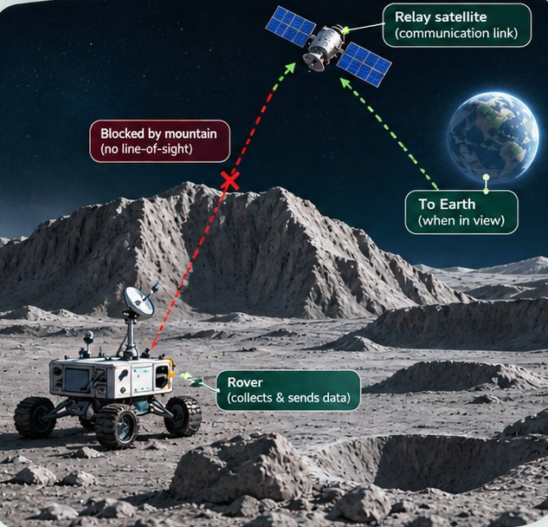
KEY CHALLENGES
TEAM
BRAIN BYTES
Why lunar terrain and limited relay coverage disrupt surface missions
01 Terrain obstruction
Crater walls, mountains and ridges block line-of-sight radio links.
02 Limited coverage
Earth-based and orbital links cannot provide continuous access everywhere.
03 Communication blackouts
Deep craters, valleys and far-side areas may lose direct contact.
04 Orbital dependence
Relay visibility and orbital geometry create periods without access.
05 Operational delays
Lost links delay rover commands, monitoring and science-data transfer.
06 Restricted exploration
Coverage limits how far rovers can safely travel into key regions.
07 Expensive expansion
Wider reliable coverage requires added relays and mission resources.
08 Greater mission risk
Blackouts delay fault detection, emergency response and recovery.
ROOT CAUSE Uneven terrain + line-of-sight dependence + limited relay reach.
IMPACT Interrupted science, restricted exploration and higher mission risk.

Slide 6
EXISTING SOLUTIONS / APPROACHES
TEAM
BRAIN BYTES
LIMITATIONS
Traditional Radio Waves
Radio-frequency (RF)
Signal strength decreases with distance
RF Communication
communication
Long-Distance
Communication
Laser Beams
Optical or laser
Requires precise pointing and clear line of
Optical
communication
sight
Communication
High Bandwidth
Orbiters
Relay
Relay communication
Depends on orbiter position and coverage
Communication
through orbiters
Communication Relay
Direct Signal
Direct-to-Earth
Transmission
Direct-to-Earth
Requires usable path between spacecraft
Communication
communication
and ground station
Relay Satellites
Space
Earth Stations
Space-Based Relay
Communication
Space-based relay
Require relay satellites and deployment
Network Coverage
Networks
Technologies
networks
planning
High-Gain Antennas
Antennas
High-gain and low-
Trade-off between pointing accuracy and
Data Storage
Low-Gain Antennas
gain antennas
coverage
Store-and-Forward
Delayed Transmission
Communication
Store-and-forward
Data stored until communication
Regenerative
Signal Regeneration
communication
opportunity
Relaying
Signal Repeating
Regenerative relaying
Amplifies noise along with signal
Spacecraft
Inter-Spacecraft
Networking
Communication
and signal repeating
Network Connectivity
Inter-spacecraft
Spacecraft communicate with each other
networking

Slide 7
PROBLEM INSIGHTS & OPPORTUNITY AREAS
TEAM
BRAIN BYTES
Lunar Relay Network Deployment Sequence
Micro-Relay
Decision Software
Lander Arrives
Self-Anchoring
RF Module Activates
Directional Antenna
Sensors Activate
Evaluates
Autonomous lunar
Mechanism Engages
Transmits
Solar Panels Deploy
Sensors monitor
Micro-relay
lander touches
Self-anchoring
Local RF
Directional antenna
Solar panels
tilt, leg loads,
deployment
down at selected
mechanism
communication
and RF backhaul
deploy to generate
temperature, and
decision software
location
secures lander
module connects
module transmit
electrical power for
structural
determines need
against movement
rover and tower
data to orbit
tower
condition
for additional
relays
Three-Legged
Rollable Mast
LTE/3GPP Hardware
Control Electronics
Power Management
Mast Unrolls and
Thermal and Dust
Structure Deploys
Unrolls
Online
Activate
Unit Regulates
Deploys
Components Protect
Three-legged
Rollable composite
LTE/3GPP-
Onboard computer
Rechargeable
Mast deployment
Thermal protection
landing structure
mast extends to
compatible
and control
batteries and
mechanism unrolls
and dust-resistant
extends for stable
raise
networking
electronics
power-
and deploys the
components
support
communication
hardware supports
manage
management unit
composite mast
safeguard
antenna
surface
deployment and
store and regulate
electronics
communication
operations
power

Slide 8
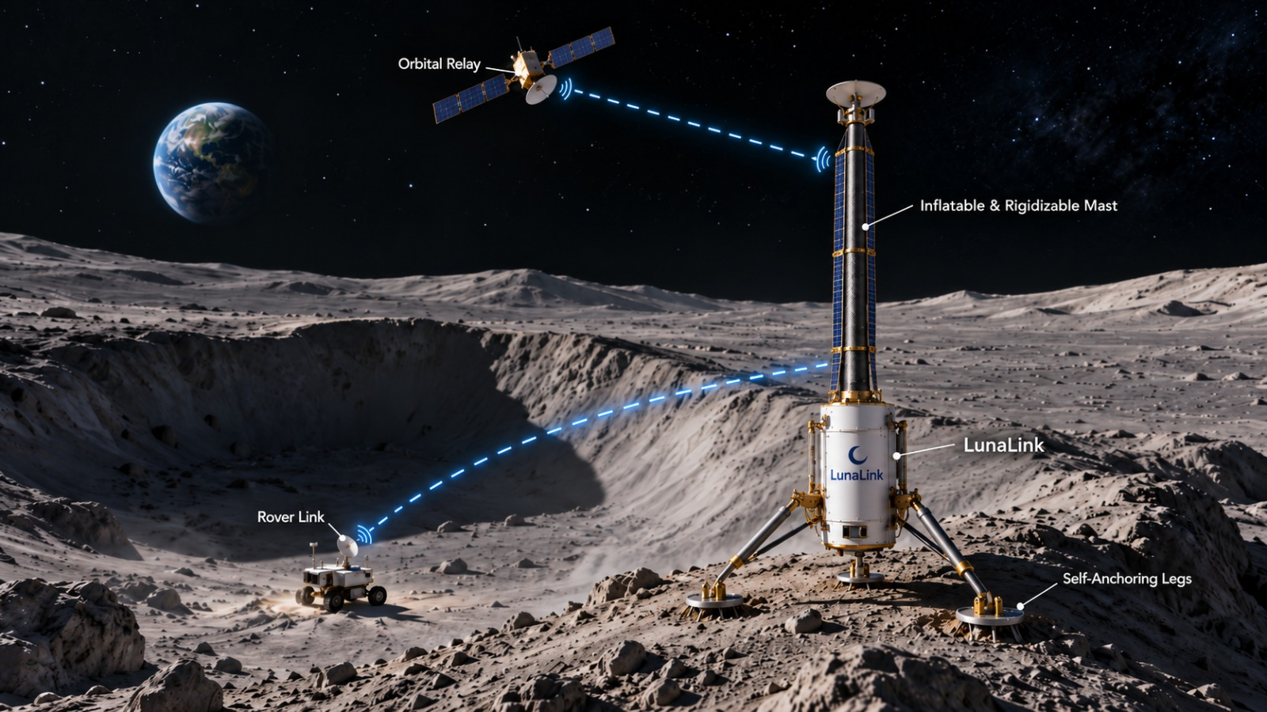
INITIAL DIRECTION & EXPECTED OUTCOME
TEAM
BRAIN BYTES
Enhancing Lunar Communication with Autonomous Towers
Data flow
Software integration
enhancement
Future growth
and refinement
Enable continuous
planning
Network design and
Use terrain-aware
or more consistent
Establish a
prototyping
software to select
transmission of
scalable lunar
Develop a network
suitable tower
scientific data,
communication
of autonomous,
locations and
images, telemetry,
network that can
deployable lunar
deploy additional
and commands,
expand as
communication
relay nodes when
subject to network
exploration
towers
necessary
availability
activities grow
Initial deployment
Continuous
Coverage
and testing
communication
expansion
Connect rovers in
achieved
Reduce
craters and terrain-
Maintain more
communication
shadowed regions to
reliable
dead zones through
orbital relay
communication
strategically placed
satellites and Earth
between lunar
towers and optional
rovers and Earth,
micro-relays
even in challenging
terrain

