Slide 1
Phylogenetics methods part 2
Marielle
Jitender

Slide 2
STUDY MATERIAL
This PowerPoint and the word document will be at:
https://git.nbi.ac.uk/jic-scientific-computing-training/phylogenetics_course/tree/master/Presentation/Tree-Making
https://github.com/threadmapper/phylo-course/

Slide 3
Take Home Message: Why ?
Study Evolutionary relationships among genes (or taxa)
ASKING QUESTION LIKE:
• What are the evolutionary relationships among genes of interest?
How do sequences evolve?

Slide 4
How to Build a Phylogenetic Tree
Start with a Good alignment
Else : GIGO

Slide 5
Typical look and Feel
Species A TGACTGAC
Species B TGCCTGTC
Species C TGGCTGTC
Species D TGGCAGTC
CLADOGRAM:
branch order
PHENOGRAM (branch lengths means something)
Image cited from http://guava.physics.uiuc.edu/~nigel/courses/598BIO/498BIOonline-essays/hw2/files/hw2_li.pdf [Yan Li]

Slide 6
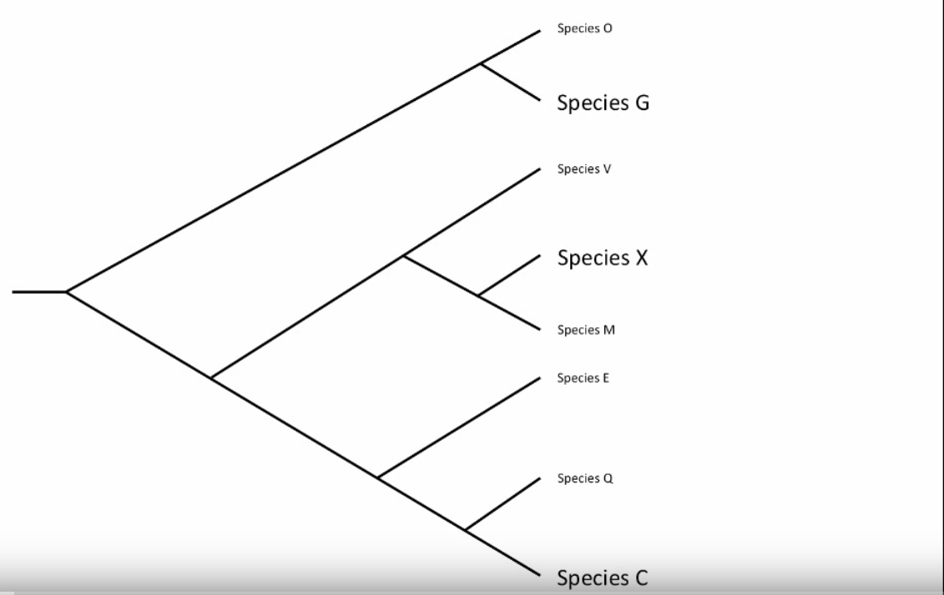
Quiz: How to Read a Tree ?
Which is more Closely related to Wheat ?
Barley or maize
Which comparison method is correct ?
distance between branch tips
Number of nodes between species
Time to common ancestor
Number of shared monophyletic (clade) groups
Time
Barley
Wheat
Maize
Citing: Matthew Taylor Wheat close to Maize than Barley

Slide 7
Two approaches
Most popular and frequently used methods of tree building
Phenetic methods based on distances: distance/dissimilarity between two genes
Cladistic methods based on characters:
All possible trees and seek for the one that
optimizes the evolution

Slide 8
Choosing a method
Once we have aligned our sequences, we need to choose a method of phylogenetic analysis.
The most widely-used methods are
a) distance
b) parsimony methods
c) maximum likelihood (ML),
The choice of method will depend on the type of dataset you are analysing, the size of the dataset (and your computing power) and the purpose of your analysis.
Courtesy Jo Dicks IFR

Slide 9
DISTANCE BASED
NJ
Character based
ML , Bayesian based “INFORMATION” rich
There is a hypothesis for every column
TRACE evolution to a site(catalytic site)
Maximum Parsimony(MP)
FAST and EASY
But WE CAN’T TRUST: Little Information other than a Tree
Maximum Likelihood(ML)
BOOTSRAPPING

Slide 10
Distance-based methods
For each pair of sequences in our alignment, we calculate a distance between them.
The result is a distance matrix.
Seq1 ATCGAAGAG..
Seq2 ATCCGAGAG..
Seq3 ATTTTTCGAG..
Seq4 ATTTTTCGAG…
Seq1 Seq2 Seq3 Seq4
Sequence1 * 0.83 0.62 0.55
Sequence2 0.83 * 0.48 0.79
Sequence3 0.62 0.48 * 0.81
Sequence4 0.55 0.79 0.81 *

Slide 11
Tree-building from distance matrices
Once we have a distance matrix, how do we build a tree? There are several strategies including goodness-of-fit (e.g. least-squares fit) and minimum evolution.
The most widely-used methods are neighbor-joining (NJ), UPGMA (evolutionary clock), fitch and kitsch (evolutionary clock).
Distance methods are straightforward – a single statistic , the distance (roughly, the percent sequence difference), is calculated for all pairwise combinations of species, and then the distances are assembled into a tree.

Slide 12
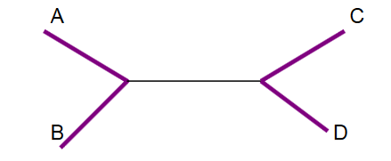
neighbour Joining(NJ)Saitou and Nei, 1987 Which pairs are neighbour ?
A – B : YES
A – C : NO
New node added
Gene 1 and 2 are nearest we call them neighbours

Slide 13
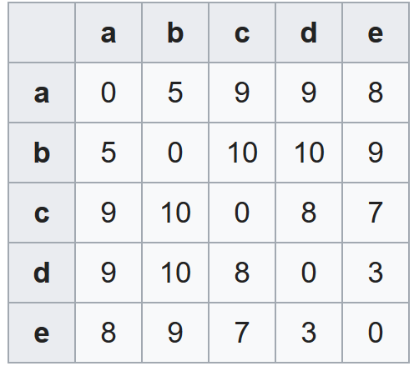
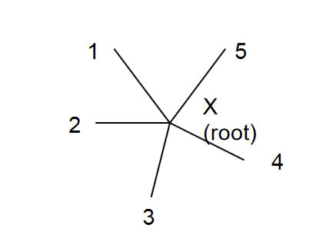
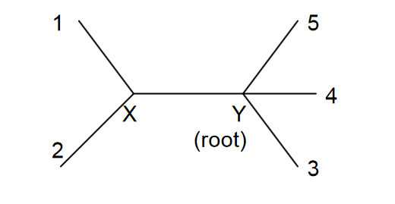
NJ: Intuitive Steps
1. We start with a Star tree
Any distance matrix
2. Assume, 1 and 2 are nearest : hence neighbours
3. We added a new node X
4. Define distance between node X and the rest of the nodes; Enter into matrix.
5. Remove 1 and 2; Compute the branch lengths for the branches that have been joined 1-X and 2-X
6. We Repeat
Courtesy: https://www.stat.berkeley.edu/~terry/Classes/s246.2006/Week6/2neighbourJoining.pdf

Slide 14
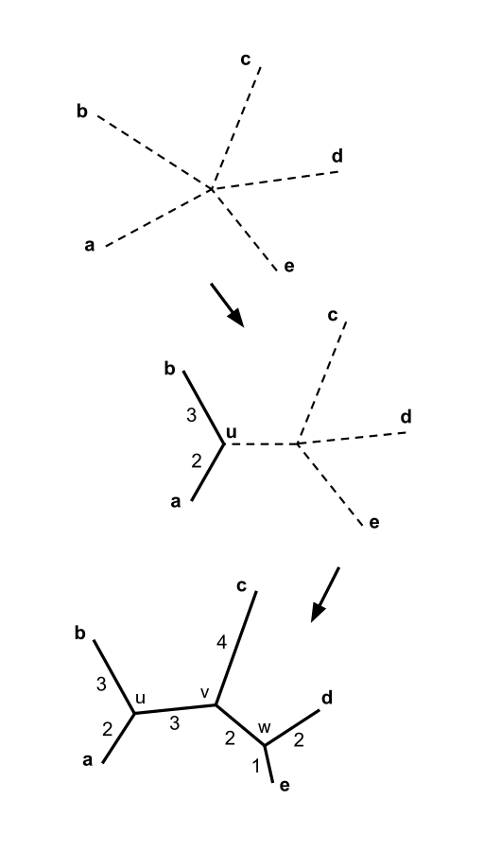
neighbor-joining(NJ)
Saitou and Nei, 1987
From: https://en.wikipedia.org/wiki/Neighbor_joining

Slide 15
Tools to make a NJ tree
RapidNJ
NINJA
Its very FAST
But assume distances are additive
Shorter distances are relatively better known than the longer distances : Weigbour and BIONJ

Slide 17
Distance Based Tree: Exercise 1
[MEGA 6 on window machines are already installed by default there are also others ]
We are going to use FastTree today

Slide 18
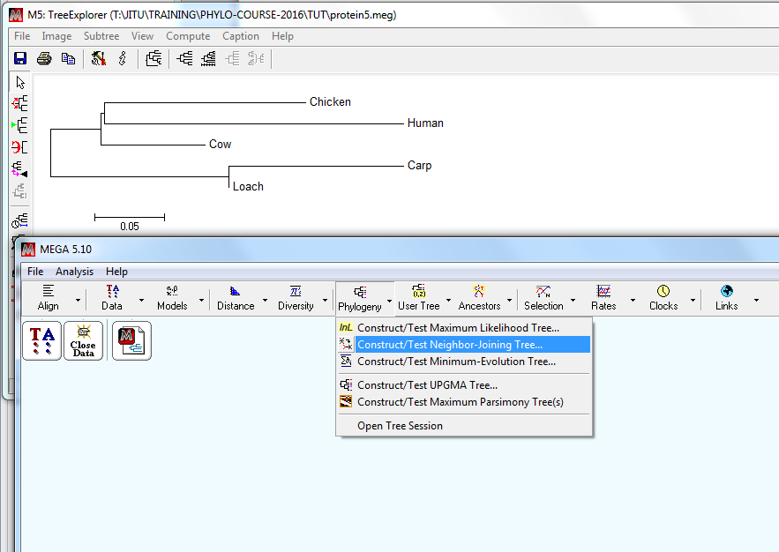
Select Neighbour Joining Tree from “Phylogeny”
Select protein sequences
And try: NJ
File.. Export Current Tree as..
protein5-NJ.nwk

Slide 19
Advanced and blazingly fast on big datasets
We can use FastTree to Make a Distance based Tree for big data set
fasttree -fastest < protein5.phy > protein5-fastNJ.nwk
Where input file is: protein5.phy
And output tree saved as newick formatted Tree as : protein5-fastNJ.nwk
Some of the virtues and fact about FastTree is discussed at http://www.davelunt.net/evophylo/tag/fasttree/

Slide 20



Workbook
1. Please go the Terminal and click
An type cd Desktop/Notebook
and press ENTER
3. Type jupyter notebook course-blank.ipynb
and press ENTER:

Slide 21
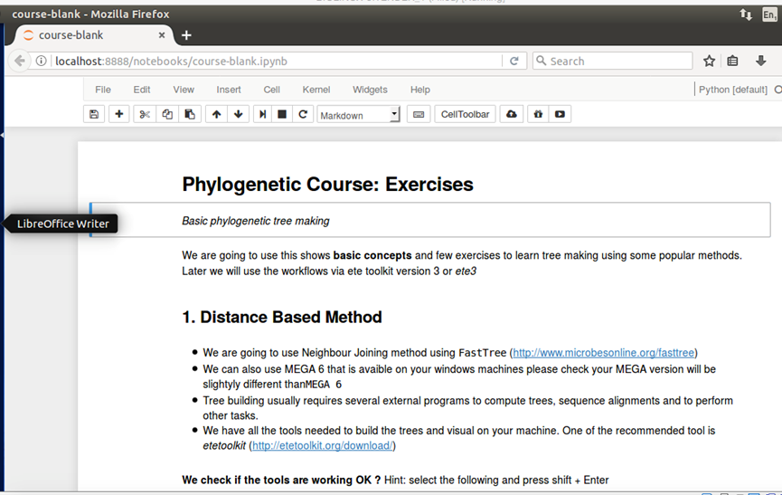
Wait for this page to load..

Slide 22
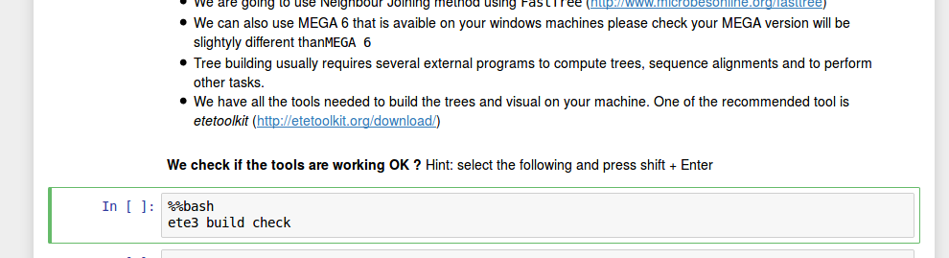

Really Simple ☺
Instructions
Commands
Output
In order to run the selected Cell,
press Shift + Enter
This will turn the In [ ] to the following:
In Progress

Slide 23
How to pick the Best tree: PARSIMONY
Parsimomy(minimal) tells us to choose the simplest explanation that fits the evidence
All the other things being equal, the best hypothesis is the one tat requires the fewest evolutionary changes(mutations)
Maximum Parsimony Trees

Slide 24
Traditional parsimony
The data are binary characters (0 or 1).
This method says that the best tree is the one which displays the minimum amount of evolution.

Slide 25
Maximum parsimony
New methods exist for molecular data that minimise the number of substitutions.
Five changes, over this tree topology, is the minimum for this dataset.
ATTTT
GCCGT
*
*
ATCGT
GCCGT
*
*
*
ATCGT
GCAGT

Slide 26
Why parsimony works..
The tree with the fewest evolutionary events is the most likely one, as the evolution events are rare..
So when we try reconstruct the past, thee reconstructed tree with fewest events are more likely to be accurate.
Same as Occam’s razor principle out of given possible explanations the simplest is the most likely
Carterlabcsulb Courtesy

Slide 27
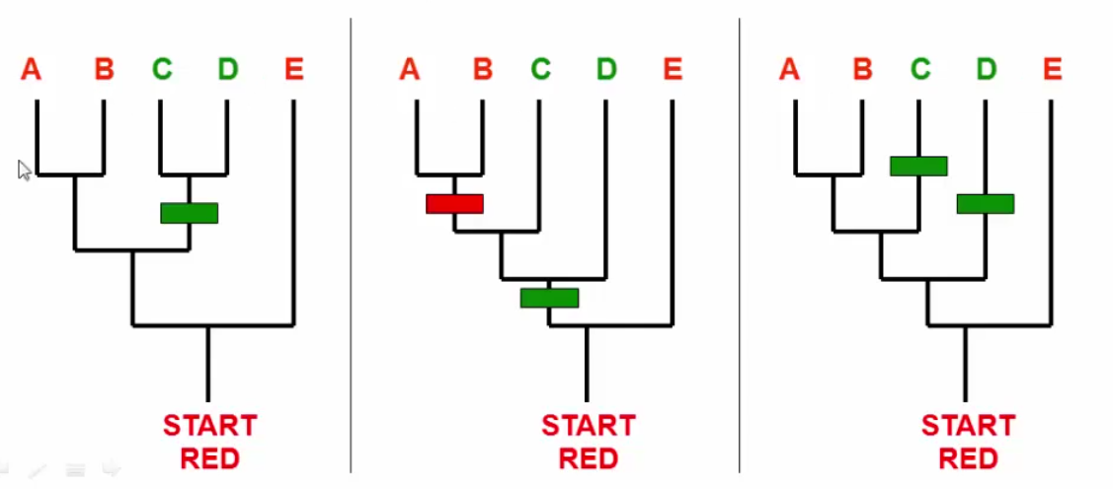
Number of Events (mutations)
Citing: https://plus.google.com/111130913785157301054 [ carterlabcsulb]

Slide 28
From 3 taxa to 4 taxa:
1
2
1
2
1
2
4
4
3
3
3
n=4
T=3
1
2
n=3
T=1
4
3
#Unrooted trees: (2n – 5)! / ((n-3)!2n-3), n > 2

Slide 29
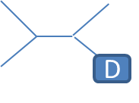
Problem with Real data
A
A
B
A
B
C
B
C
D
C
D
D
Combinations are enormous even with relatively small number of genes(taxa)
 | Taxa | #unrooted Tree
 | 4 | 3
 | 5 | 15
 | 6 | 105
 | 7 8 | 945 10,395
 | 20 | 2 X 10^20
Modern day: 30 species
Exhaustive search
We need Heuristics
To search for optimal Tree

Slide 30
Parsimony Tree any one..
Exercise
Making a maximum parsimony tree with RAxML (Randomized Axelerated Maximum Likelihood)
It is very quick

Slide 31
RAxML to rescue…
Parsimony tree building with RAxML
raxml -y -s protein5.phy
-m PROTGAMMAAUTO
-n protein5-parsim.nwk
-p 1234
-N 1

Slide 32
COFFEE BREAK

Slide 33
Maximum likelihood
Maximum likelihood is a statistical method that finds the most likely tree under a particular model of evolution.
This is the gold standard approach and should be used if at all possible. However, a maximum likelihood tree can be slow to estimate. Furthermore, it is not a practical method for very large datasets.
To find the best model for a particular dataset, we can compare nested models using likelihood ratio tests.

Slide 34
MLE trees
For moderate to large size you will need HPC
We recommend that you attend the HPC and linux course
You should give a try on your computer for small size data set via ete3 toolkit

Slide 35
Bootstrapping
A way of assessing the reliability of a tree estimate.
We make new datasets from our original dataset by sampling columns from our alignment and putting the columns together to make new alignments.
For each of our new dataset, we estimate the tree (with the same method) and find out how many splits in our tree are supported in our sampled datasets.

Slide 36
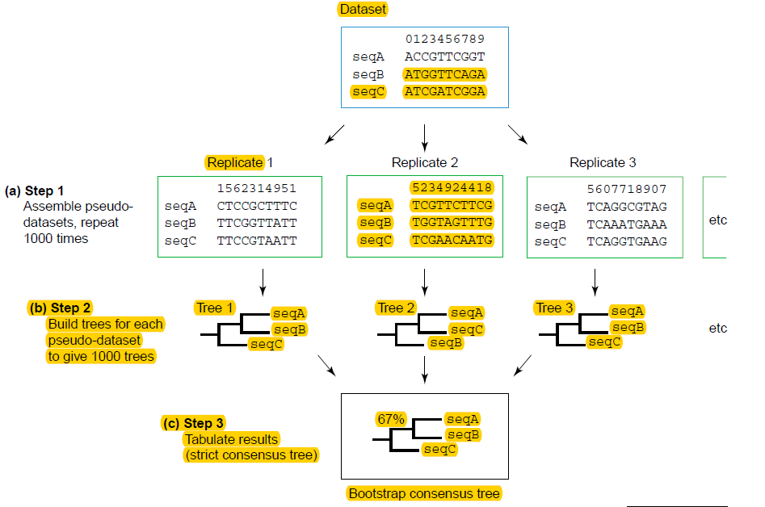
Baldouf, 2003

Slide 37
Bootstrap values on trees
97
85
74
91
Typically, make 1,000 bootstrapped datasets and estimate a tree for each.
It is then possible to see parts of the tree that are better supported than others (i.e. higher percentage values).

Slide 38
Exercises ML with RaxML
Using Raxml
Making A Max Likelihood Tree and then overlay bootstrap information on the TOP
Create a Maximum parsimony a starting TREE
Generate ML tree based on above
Boot 1
Boot2
Boot3
…
Boot100
Boostrapped ML tree

Slide 39
All in one Go..
We will use ete3 toolkit via Python notebook: http://etetoolkit.org/documentation/ete-build/

Slide 40
Using RAxML from Commandline
raxml -f a -m PROTGAMMAAUTO -p 12345 -x 12345 -# 100 -s protein5.phy -n T20
RAxML will do 100 rapid Bootstrap searches
20 ML searches and return the best ML tree with support values to you via one single program call.
And then:
cp RAxML_bestTree.T20 prot5-RAxML_bestTree.T20.nwk

Slide 41
ete3 build -w standard_raxml -a NUP62.aa.fa -o NUP62_tree
ete3 build -w standard_raxml -a protein5.fasta -o PROT5_tree

Slide 42

Through Python notebook..
Install python on your computer
pip install jupyter jupyter notebook ~
This will open safari and type in one cell:

Slide 43
Please try a workflow.. As they highly powerful features
http://etetoolkit.org/cookbook/ete_build_workflows.ipynb

Slide 44
Acknowledgements
Jo Dicks IFR
David Waters
Thanks for attending and if you need further help we are the CSB building.

