Slide 1


| Tech Management, SRI-B
CLAWS
CLASH OF THE
M S Ramaiah Institute of Technology_Low Cortisol Coders
Clawrity
AI Business Intelligence Agent
Powered by OpenClaw
Manoj H V – 1MS24CS094@msrit.edu
Mohammed Farhan – 1MS24CS100@msrit.edu
K S Tanish – 1MS24CS074@msrit.edu
<Members Names>

Slide 2
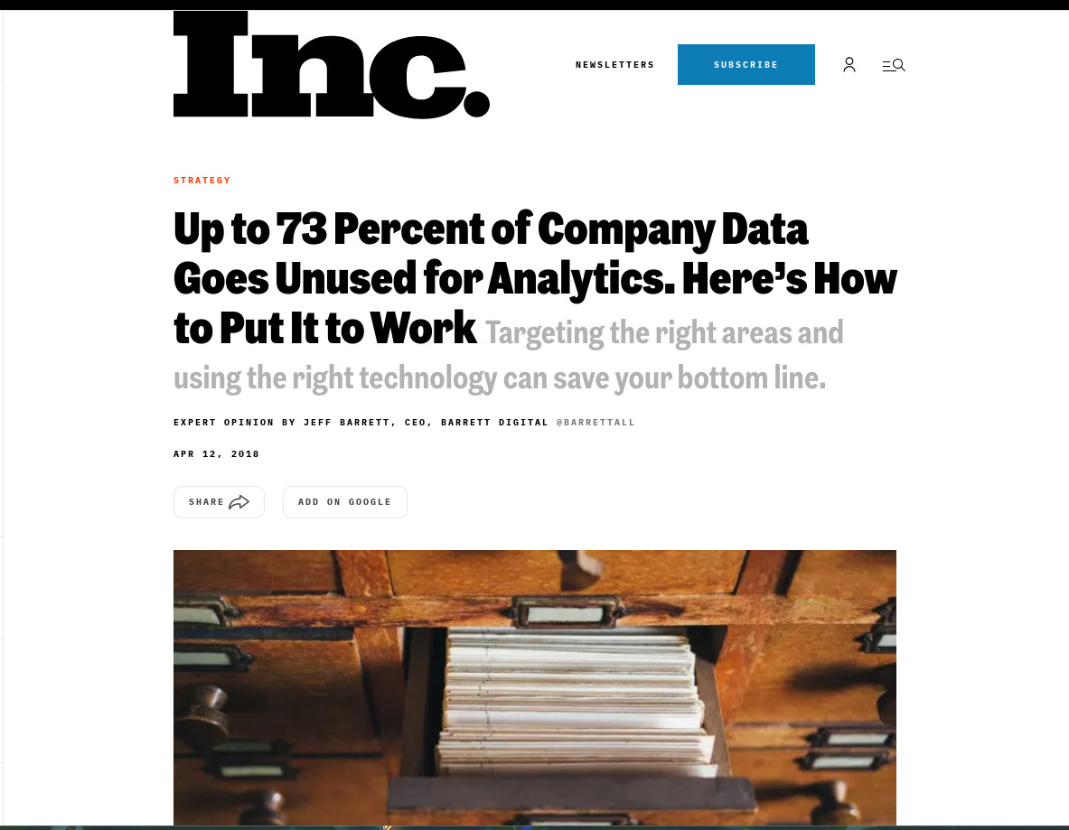
Idea
Problem Statement
Theme: Productivity × GenAI
73% of enterprise data goes unused.
The problem isn’t data availability. It’s data accessibility.
Business Teams: Waste 3-5 hrs/week chasing analysts.
Analysts: Lose 40% of their time on repetitive ad-hoc queries.
Executives: Delayed decisions based on stale, 40-page weekly reports.
WHY IT MATTERS
• 73% of enterprise data goes unused for analytics (Forrester)
• The gap isn't data availability — it's data ACCESSIBILITY
Organizations are drowning in data but starving for answers; because data is inaccessible to non-technical users, analysts waste 40% of their time acting as human query engines while business leaders are forced to make delayed decisions on stale reports.
Theme: Productivity × GenAI

Slide 3
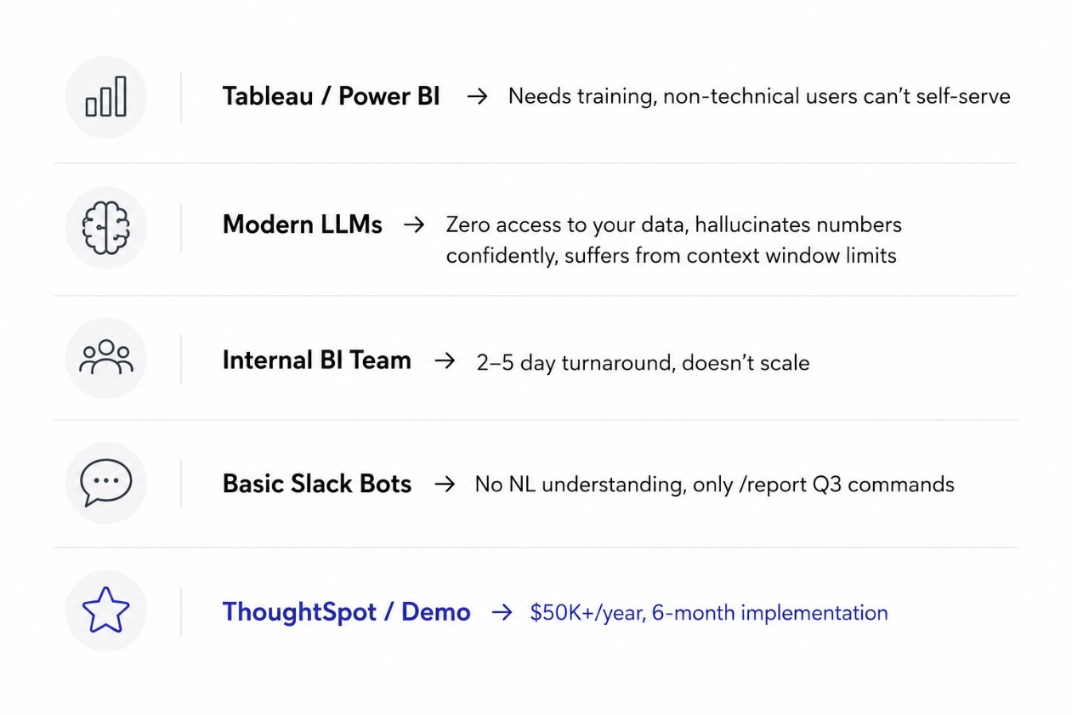
Idea
Current Solutions & Gaps
EXISTING SOLUTIONS & WHAT'S BROKEN
THE GAP
No solution that lives in Slack, connects to your actual database,
understands natural language, AND fact-checks its own answers.
Clawrity — built on OpenClaw — fills this exact gap.

Slide 4
Idea
Your Solution
Headline: Meet Clawrity — The Autonomous BI Agent
What it is: A multi-channel, AI-driven intelligence layer that instantly translates plain-English questions into data-grounded insights directly within Slack or Teams.
How it solves the problem:
Talk to Your Data (Zero Friction): No more chasing analysts or waiting for dashboards. Anyone can ask complex business questions in plain English and receive real-time, actionable answers in seconds.
Proactive Intelligence (Zero Delay): Executives don't have to hunt for stale weekly reports. Clawrity pushes automated, highly localized daily digests and performance alerts straight to their chat every morning.
Fact-Checked Accuracy (Zero Hallucinations): We eliminate "AI trust issues." Our proprietary adversarial QA loop mathematically audits every single number and claim against your live database before it ever reaches the user. add this in 'your solution' remove everyhting before how open claw makes this work
HOW OPENCLAW MAKES THIS WORK
• SOUL.md — identity, tone, business rules & routing logic.
Routes: business query → /chat, competitor → /scout, chat → direct
• HEARTBEAT.md — automated schedules (8 AM digest + retry config)
• Protocol Adapter — normalizes Slack/Teams/API → unified message

Slide 5
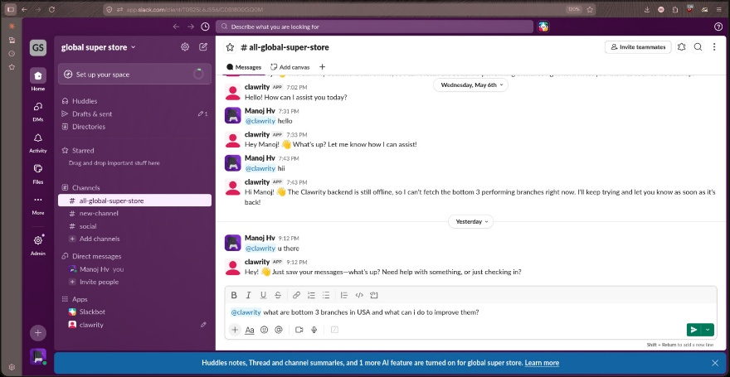
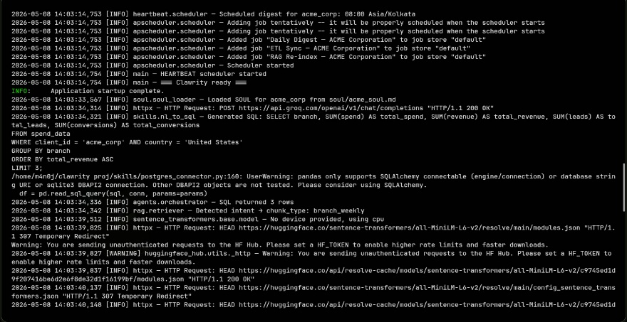
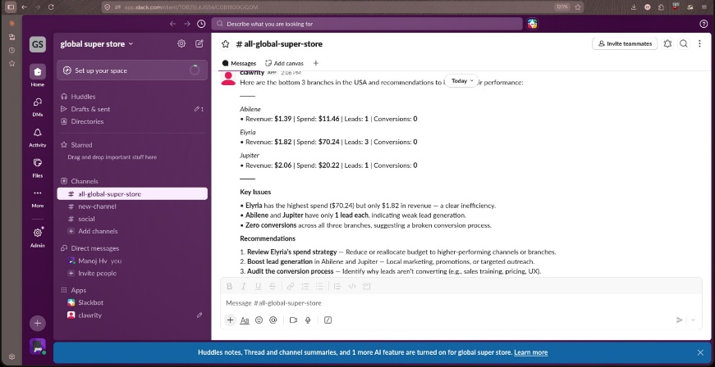
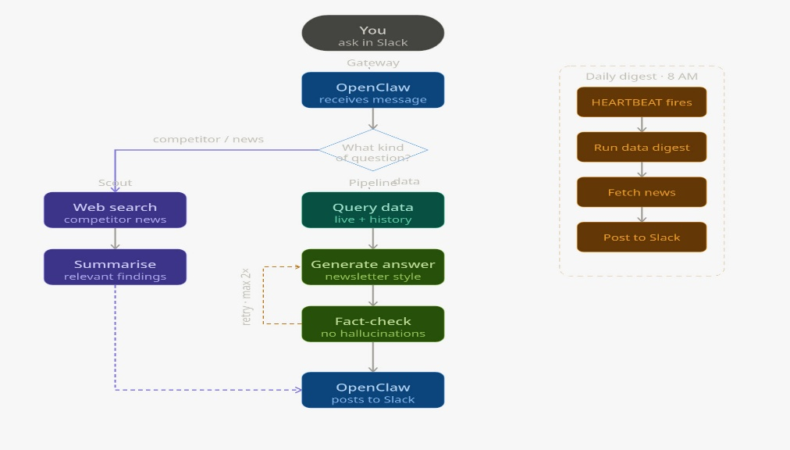
Idea
Demo / Product Walkthrough
User asks complex business questions in plain English directly on slack workspace
The clawrity backend translates NL to SQL and retrieves semantic RAG context
The open claw agent delivers an instant, data-grounded analysis complete with suggestions based on live data metrics
SYSTEM FLOW

Slide 6
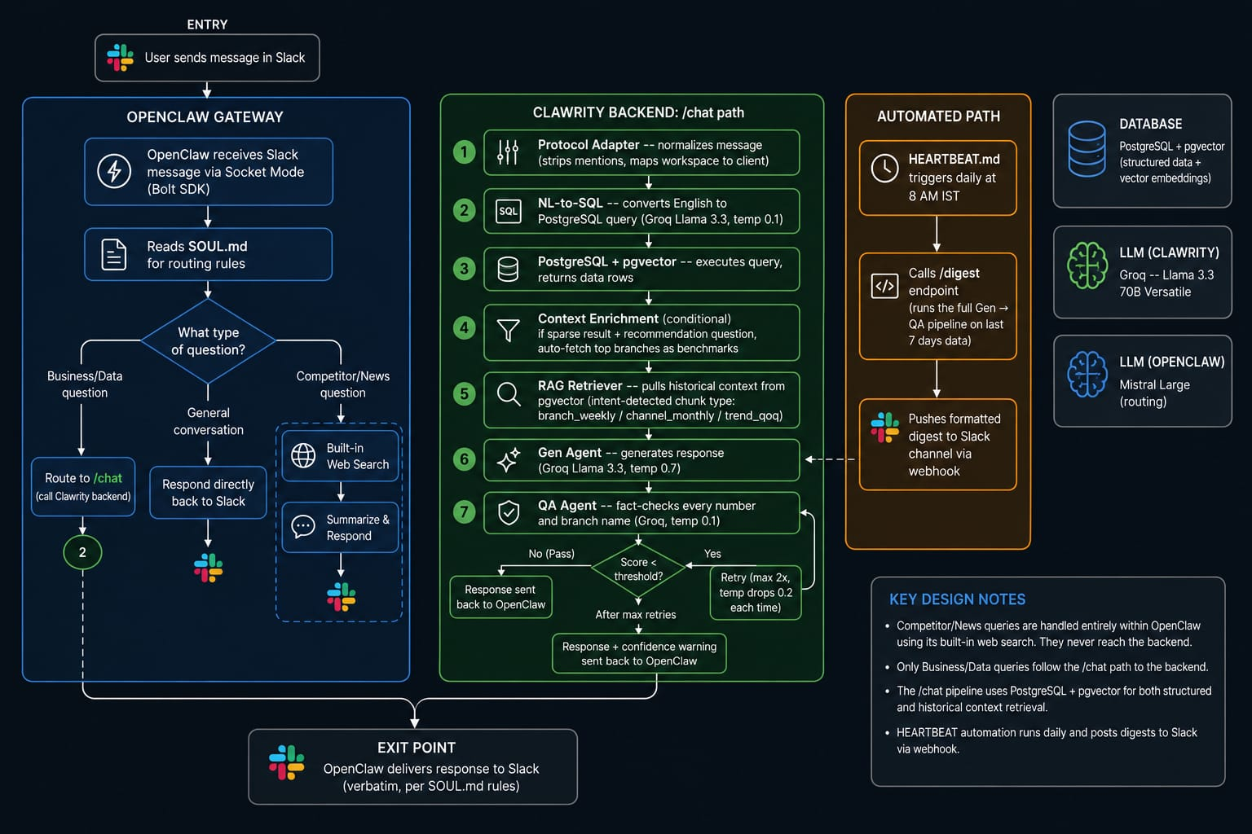
Idea
Tech & Architecture
TECH STACK
Slack Gateway: OpenClaw (Mistral Large, routing via SOUL.md)
LLM Backend: Groq — Llama 3.3 70B Versatile
API Server: FastAPI + Uvicorn
Database: PostgreSQL + pgvector (data + vectors in 1 DB)
Embeddings: all-MiniLM-L6-v2 (CPU, 384 dims)
Web Search: Tavily (primary) + DuckDuckGo (fallback)
Forecasting: Facebook Prophet (6-month horizon)
Scheduler: APScheduler (cron from HEARTBEAT.md)
Deploy: Docker Compose (2 services)
OPENCLAW PATTERN
• SOUL.md = personality + routing (what to route where)
• HEARTBEAT.md = automation (when to trigger + retry config)
• Protocol Adapter = channel normalization (Slack/Teams/API)
• Per-client YAML = data source, thresholds, scout config

Slide 7
Idea
Impact & Use Cases
USE CASE 1 — Regional Manager
"Bottom 3 branches by revenue this month?"
Before: Tableau → email BI team → wait 2 days → parse CSV
With Clawrity: 8 seconds. Table + recommendations. 3 hrs/week saved.
USE CASE 2 — Marketing Lead
"Channel ROI breakdown for last 30 days?"
Before: Wait for monthly report. $15K wasted on bad channel.
With Clawrity: "Shift budget from Instagram (0.87) to Email (2.29)"
USE CASE 3 — Executive (Zero-Effort Morning Brief)
Automated 8 AM digest via HEARTBEAT.md. Zero human effort.
1.5 hrs analyst time freed daily. Executive reads in 2 min.
USE CASE 4 — Competitor Intel
"@clawrity what is IKEA doing?" → Scout Agent via Tavily
Half-day of research done in 10 seconds.
SCALE POTENTIAL
• Multi-tenant: 1 instance, ∞ clients (1 YAML each)
• Multi-channel: Slack live, Teams ready, API ready
• LLM-agnostic: 5 providers — swap with 1 env var
• Any industry: retail, fintech, healthcare — if PostgreSQL, it works

Slide 8
Idea
Differentiation
MOAT 1: The Trust Monopoly (Zero-Hallucination Engine)
The Advantage: Competitors lose enterprise clients the moment an AI hallucinates a financial metric. We guarantee absolute data integrity.
The Barrier: Competitors would have to rebuild their entire architecture to match our proprietary "Gen vs. QA" mathematical audit loop.
The Profitability:100% data trust equals near-100% client retention, permanently locking out competitors suffering from "AI trust issues."
MOAT 2: Infinite Scalability (Zero-Code Architecture)
The Advantage: Traditional B2B AI demands expensive engineering teams and months of setup per client, crushing profit margins.
The Barrier: Our OpenClaw pattern allows non-technical teams to deploy custom enterprise agents instantly using just three simple text files.
The Profitability: With integration costs near $0, we onboard clients 100x faster than competitors while maintaining massive, pure-SaaS profit margins.
Non-technical people customize behavior by editing markdown.
Restart. Done. SaaS-ready from day one.

Slide 9
Idea
Demo Link
GITHUB REPO
https://github.com/threadsync/clawrity
DEMO LINK
https://github.com/threadsync/clawrity/blob/main/clawrity-demo.mp4
https://www.youtube.com/watch?v=sXboHHSg4_k
DOCUMENT SUBMITTED
AI Disclosure Form, PPT, Demo Video, GitHub Repo Link

Slide 10
Idea
Brownie Points
Hallucination Shield (Gen → QA Loop)
No other Slack BI bot fact-checks itself.
• Gen Agent generates at temp 0.7
• QA Agent evaluates at temp 0.1 — checks every number,
branch name, and claim against actual SQL results
• Deducts 0.3/hallucinated branch, 0.2/wrong number
• Fail? Retry with lower temp. Max 2 retries.
• Still failing? User gets confidence warning with score.
• Pipeline stage with caching, scoring & SQL-aware validation
Zero-Code Onboarding (OpenClaw Pattern)
New client = 3 files, 0 lines of code:
• client_newcorp.yaml — data source, thresholds, scout config
• newcorp_soul.md — personality, business rules, routing
• newcorp_heartbeat.md — digest schedule, report format

