Slide 1
What are Russia’s strategic ambitions towards Europe and how Russia uses information measures to achieve its goals
Jakub M. Godzimirski
Threat-Defuser Meeting
12 May 2021

Slide 2
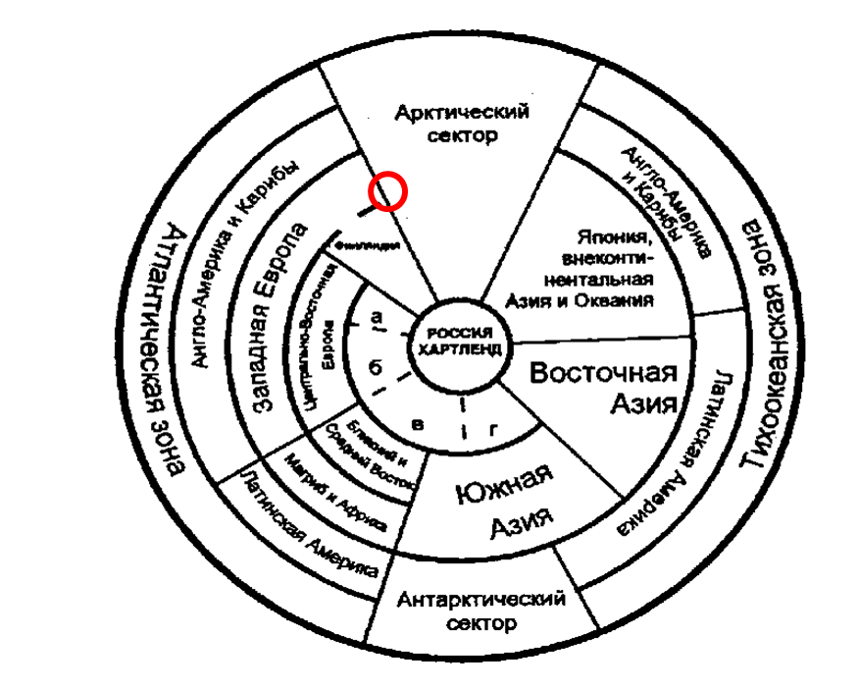
Russia and Europe Goals, means and measures
What Does Russia Want?
What Does Russia See?
How Do They Do It?
Information/communication measures
Three cases
2016 Brexit
2016 Warsaw NATO Summit
2017 US deployment to Norway

Slide 3
What Does Russia Want? Genealogy of Russian strategic objectives: from long-lines to 2021
Black 1962 Long-term pattern | Rand 2017 Post-Ukraine | Liik 2017 Post-Ukraine
Stabilization of frontiers | Defense of the country and the regime Influence in the near abroad Non-interference in domestic affairs | Establishment of a sphere of control in its neighbourhood to prevent the expansion of Western organisations
Assurance of favourable conditions for economic growth | Political and economic cooperation as a partner equal to other great powers
Unification of Russian territories |  | Russia does not want the restoration of the Soviet Union or even the gathering of Russian territories – or the territories populated by ethnic Russians
Participation in alliance systems and international institutions | Political and economic cooperation as a partner equal to other great powers A vision of Russia as a great power | To establish a new international order, and new rules of the international game No longer a rule-taker but a rule-maker and implementer To be a great power among great powers

Slide 4
What Does Russia Want? 2015 National Security Concept on strategic objectives
strengthening the country's defence, ensuring the constitutional order, sovereignty, independence, and national and territorial integrity and inviolability of the Russian Federation;
strengthening national accord, political and social stability, developing democratic institutions, and refining the mechanisms for cooperation between the state and civil society;
raising living standards, improving the population's health, and ensuring stable demographic development;
preserving and developing culture and traditional Russian spiritual and moral values;
making the national economy more competitive;
consolidating the status of the Russian Federation as a leading world power, whose actions are aimed at maintaining strategic stability and mutually advantageous partnerships in a polycentric world.

Slide 5
What Does Russia Want? Operational and tactical objectives 2021
To challenge the Western definition power in global media
To weaken trust among members of the Western community
To undermine trust between people and political elite in Western societies

Slide 6
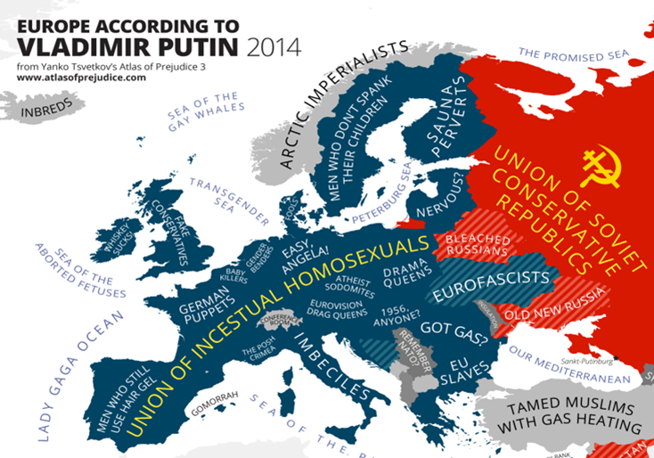
What Does Russia See? Strategic Perceptions of Europe

Slide 7
What Does Russia See? Strategic Perceptions of Norway
Small neighbour → disparity of potentials → vulnerability
West / NATO member, US ally → possible source of threat to Russia’s strategic assets in the Northern Bastion
Active in the High North → common and contradicting Arctic interests
Oil and gas producer → energy competitor on the European energy market
Russian community → strategic asset receptive for Russian communication?

Slide 8
How Do They Do It? Russian Objectives and Means
OBJECTIVES | INSTRUMENTS
 | Legal | Economic | Communicative | Infrastructural
Defense of the country and the regime |  |  | x
Influence in the near abroad |  |  | x
Non-interference in domestic affairs |  |  | x
Political and economic cooperation as a partner equal to other great powers |  |  | x
A vision of Russia as a great power |  |  | x

Slide 9
Russian understandings of information warfare 2016 Doctrine for Information Security
1. providing the Russian and international community with reliable information on the State policy of the Russian Federation and its official position on socially significant events in Russia and in the world, and applying information technologies to ensure the national security of the Russian Federation in the sphere of culture;
2. facilitating the development of an international information security system aimed at countering threats of the use of information technologies to compromise the strategic stability, at strengthening equal strategic partnership in the sphere of information security, as well as protecting the information sovereignty of the Russian Federation.

Slide 10
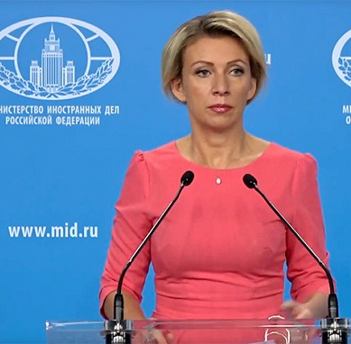
Information measures in foreign policy 2016 Foreign Policy Concept of the Russian Federation
the State’s foreign policy activities shall be aimed at … bolster[ing] the standing of Russian mass media and communication tools in the global information space and convey[ing] Russia’s perspectives on international process to a wider international community

Slide 11
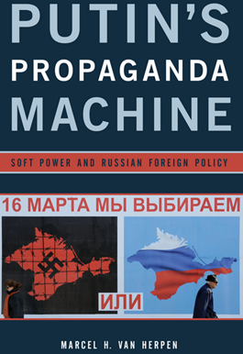
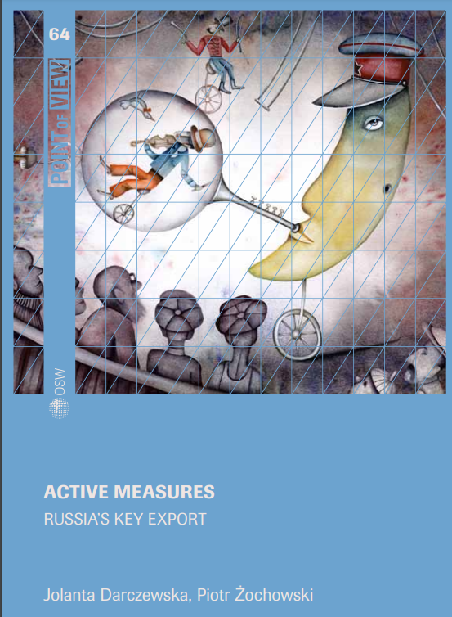
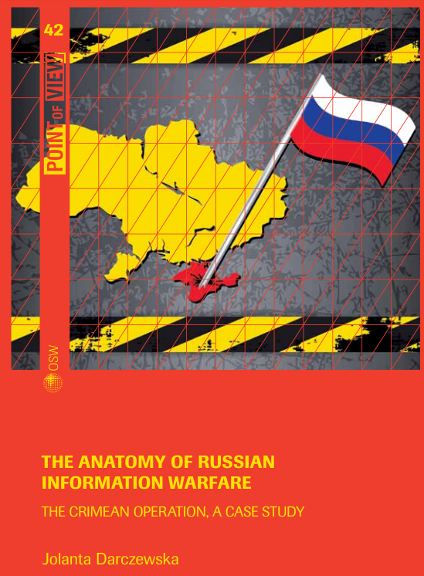
How Do They Do It? Communicative instruments
Transfer of knowledge for the purpose of informing, persuading, convincing or tempting.
The main goal is to create social support or opposition, increase awareness or distort perceptions to weaken the enemy, to undermine its institutions, and damage its system of national governance.

Slide 12
How Do They Do IT? Strategic narratives
Narrative |  | Event 1: NATO Summit in Warsaw 8 July 2016 |  |  | Event 2: Decision to station US troops in Norway announced |  |  | Event 3: Brexit referendum
 |  | RT | Sputnik News | RG | RT | Sputnik News | RG | RT | Sputnik News | RG
1 | The West is irresponsible and aggressive | x | x | x | x | x | x
2 | Historical break | x | x |  | x | x | x |  |  | x
3 | NATO and EU are not united |  | x | x |  |  |  | x
4 | Domestic political discord within NATO countries | x | x |  | x | x | x
5 | The USA is dictating European countries | x | x | x | x | x | x
6 | Brexit is a part of a transnational people’s uprising against elites |  |  |  |  |  |  | x | x | x
7 | The UK is in political turmoil |  |  |  |  |  |  | x | x | x
8 | The UK is losing its power and position in international affairs |  |  |  |  |  |  | x | x
9 | Brexit is a danger to the global economy |  |  |  |  |  |  |  |  | x

Slide 13
Narratives/Interests |  | Black 1962 |  |  |  | Light 2015 |  |  |  |  |  | Radin and Reach 2017
 |  | Stabilization of frontiers | Assurance of favourable conditions for economic growth | Unification of Russian territories | Participation in alliance systems and international institutions | Priority for relations with the CIS as a buffer zone | Opposition to NATO eastward expansion | Defence of sovereignty, territorial integrity | No to Western deployment of ballistic missile defence | Support for a multipolar international system | Russia recognized as a great power | Defence of the nation and the regime | Influence in the near abroad | Non-interference in domestic affairs | Vision of Russia as a great power | Political and economic cooperation as a partner equal to other great powers
1 | The West is irresponsible and aggressive | xx | x |  | xxx | xxx | xxx | xxx | xxx | xxx | xxx | xxx | xx | xxx | xxx | xxx
2 | Historical break | xx | x |  | xxx | xx | xx | xxx | xxx | xxx | xxx | xxx | xx | xxx | xxx | xxx
3 | NATO and EU are not united | xxx | xxx |  | xxx | xx | xxx | xxx | xxx | xxx | xxx | xxx | xxx | xxx | xxx | xxx
4 | Domestic political discord within NATO countries | xxx | xxx |  | xxx | xx | xxx | xxx | xxx | xxx | xxx | xxx | xxx | xxx | xxx | xxx
5 | The USA is dictating European countries | x | x |  | x |  | x | x | xxx | x | xx | x | xx | x | xx | x
6 | Brexit is a part of a transnational people’s uprising against elites |  | xx |  | xx |  | xx | xx |  | xxx | xx | xx |  | xx | xxx | xxx
7 | The UK is in political turmoil |  | x |  | xxx |  | xxx | xx |  | xxx | xxx | xx | xx | xx | xxx | xxx
8 | The UK is losing its power and position in international affairs |  | xxx |  | xxx |  | xxx |  |  | xxx | xxx | xx | xx | xx | xxx | xxx
9 | Brexit is a danger to the global economy |  | xxx |  |  |  |  |  |  | xxx |  | xx |  | xx | xxx | xx

Slide 14
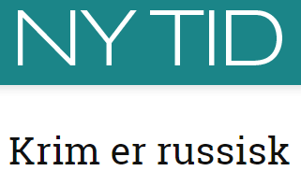
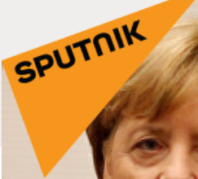
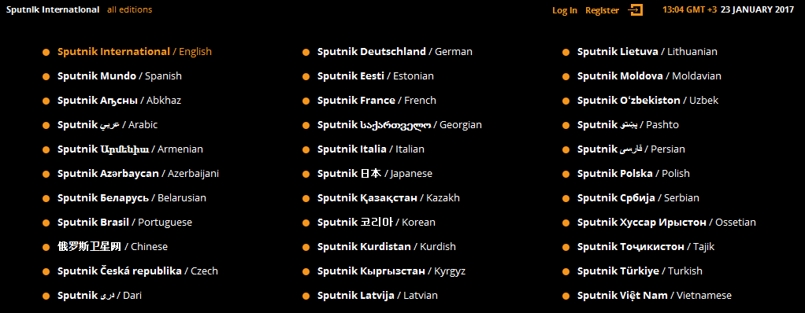
How Do They Do It? Key channels in Russian communicative strategy towards Norway
Norwegian channels
Russian channels

Slide 15
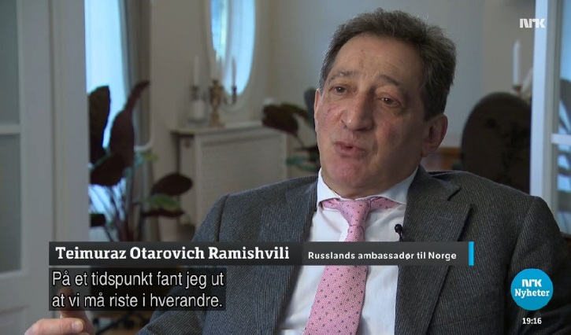
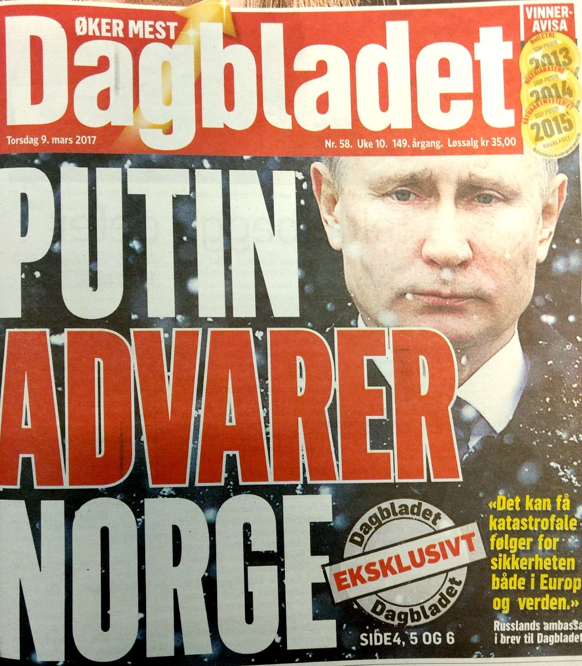
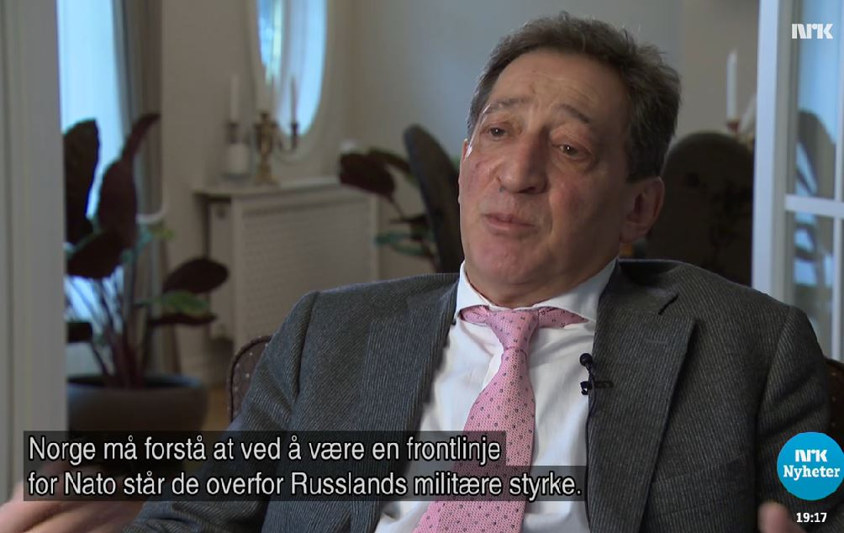
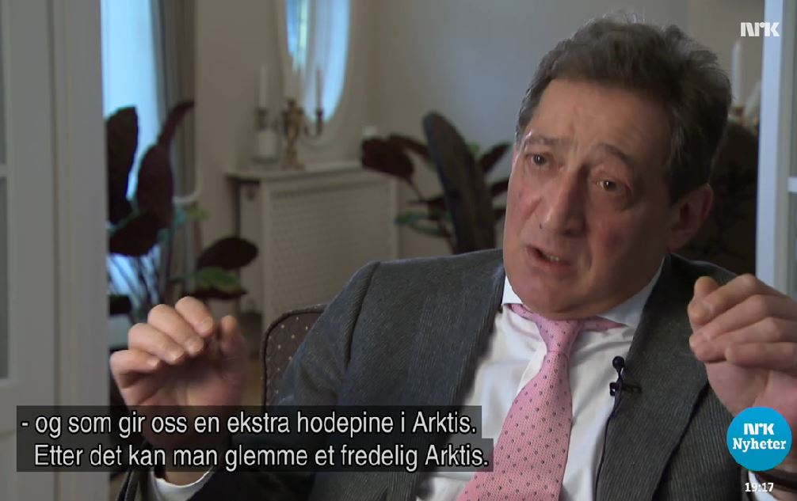
How Do They Do It? 2017 Infocampaign against Norway

Slide 16
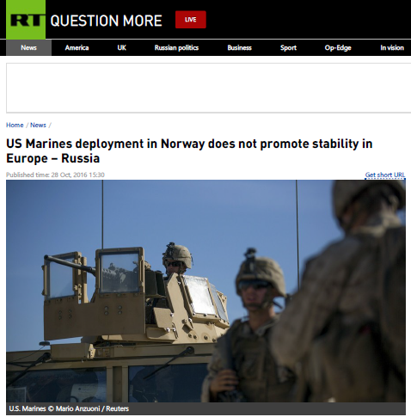
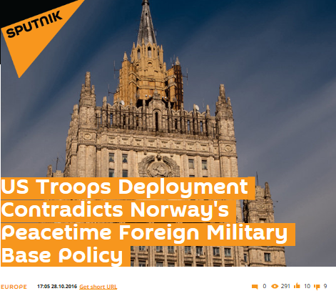
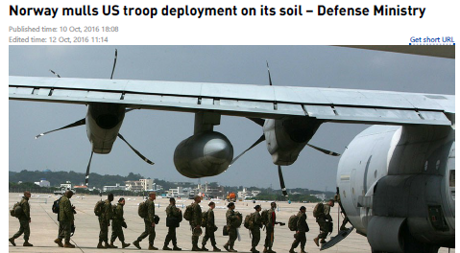
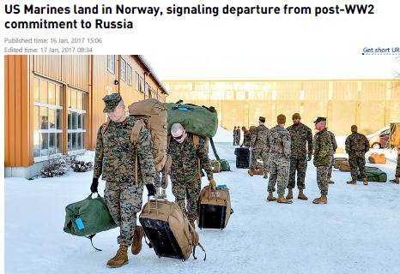
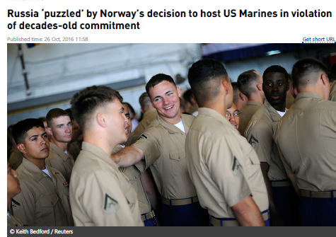
How Do They Do It? 2017 Infocampaign against US Deployment

Slide 17
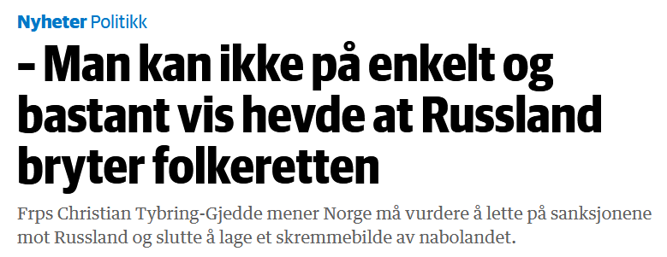
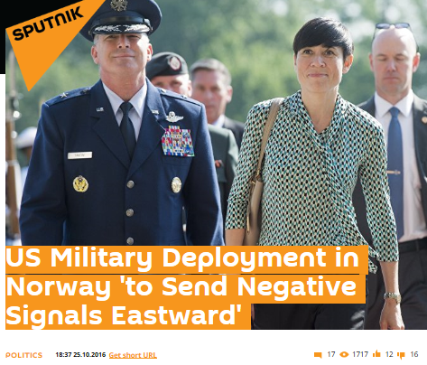
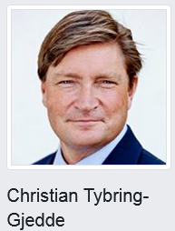
Who is Christian Tybring-Pike?

Slide 18
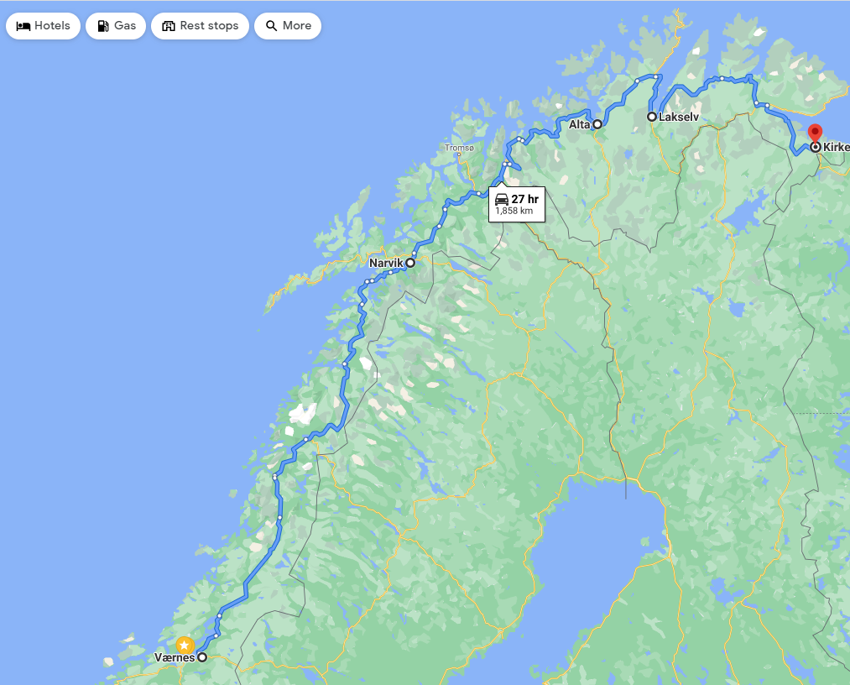
How Do they Do it? RT’s half-truths and complete lies
On 10 October 2016 RT indicated that the base was located at Værnes which was according to RT located 970 km from the Russian border
On 19 October 2016 RT reported that the base was only 100 km from Russian borders
In fact, Værnes is located some 1800 km from the Norwegian–Russian border

Slide 19
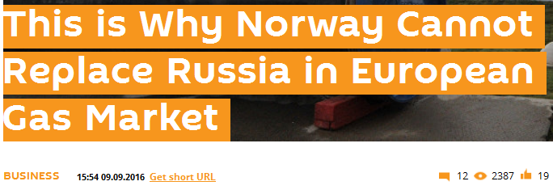
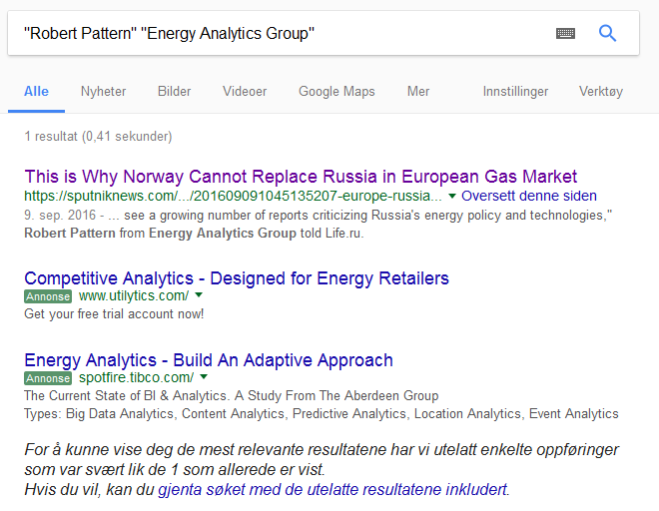
How Do they Do it? Who is Robert Pattern?

Slide 20
Logic of unintended communicative consequences?
Has the use of Russian communicative towards Europe helped Russia to… | Yes | No
… set the global and regional media agenda? | ✓
… increase support or understanding for its policy in Europe? | ✓ | ✓
… weaken the trust among key allies? |  | ✓
… weaken Europe’s resilience, defence or deterrence potential? |  | ✓
… change perception of Russia as a great power in Europe and in the world? | ✓
… change the rules of cooperation among allies? |  | ✓
… undermine trust between people and political elite in Europe? | ✓ | ✓
... undermine the cohesion of Western institutions? |  | ✓
… improve conditions for economic cooperation between Russia and Europe? |  | ✓
… improve conditions for political cooperation between Russia and Europe? |  | ✓

Slide 21
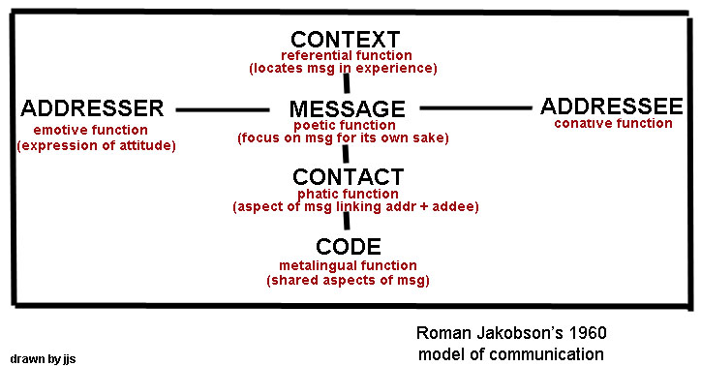
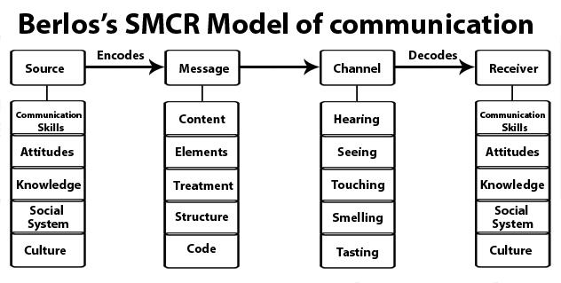
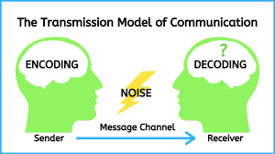
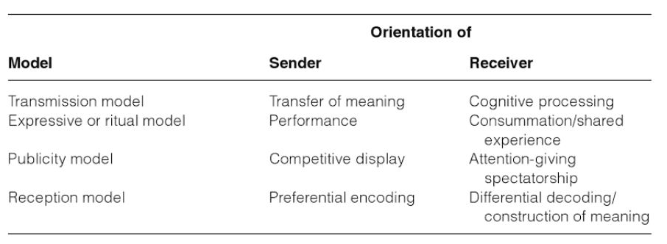
Various models of communication
Notes:
https://www.communicationtheory.org/berlos-smcr-model-of-communication/ Mc Quail p.74 on various communication models
Published in 2000
McQuail's Mass Communication TheoryD. McQuail

